Slide 2
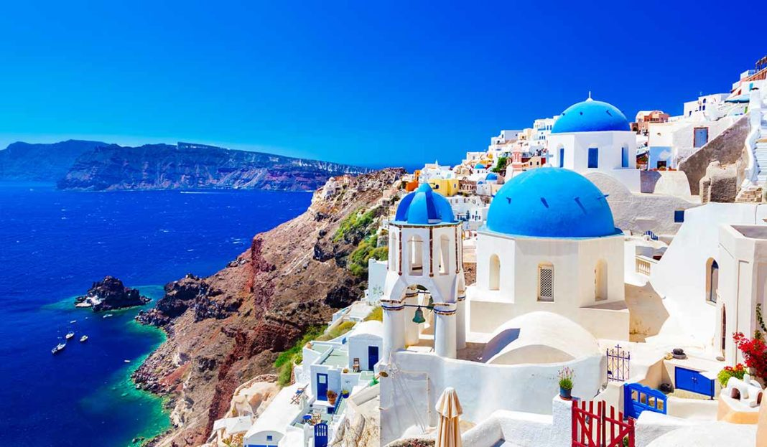
Celebrations in Greece
Notes:
And now we will show you how we celebrate different occasions

Slide 3
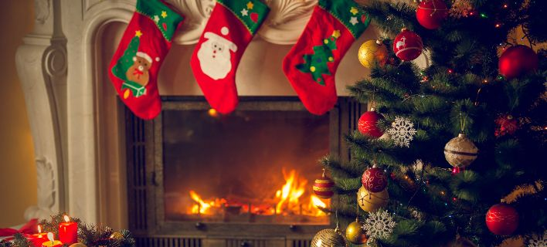
CHRISTMAS IN GREECE
Notes:
Christmas is one of most important ones.

Slide 4
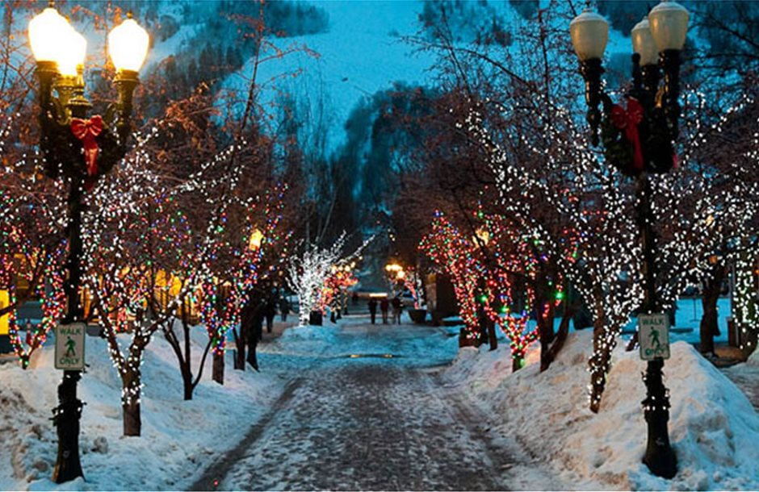
Christmas
Streets are packed with people buying Christmas gifts for their loved ones, as well as Christmas carolers singing Christmas songs,(gifts are traditionally given on New Year's Eve)
In Greece there are three "official" caroling days. The custom is that children go from house to house singing the carol, with the accompaniment of a triangle, and residents of the houses give them a small amount of money. Greek Christmas carols (calanda) are sung on the mornings of Christmas Eve, New Year's Eve and January 5, the Eve of the Epiphany.
Notes:
People buy gifts and sing carols.
In Greece it is not Santa Claus (Saint Nikolaos) who brings the gifts but Saint Vassilios from Cappadocia who brings them on New Year’s Eve.
There are special carols for Christmas, New Year and the Epiphany (sung on the eves)

Slide 5
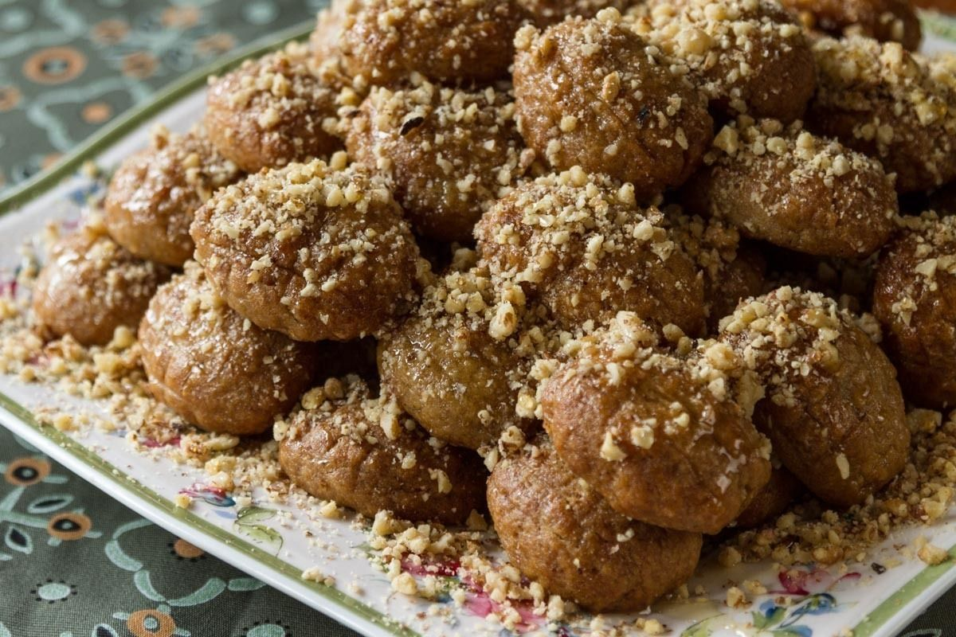
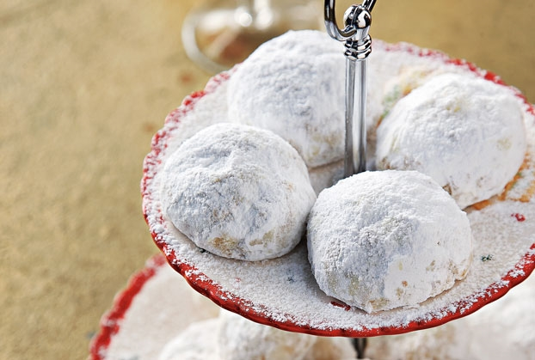
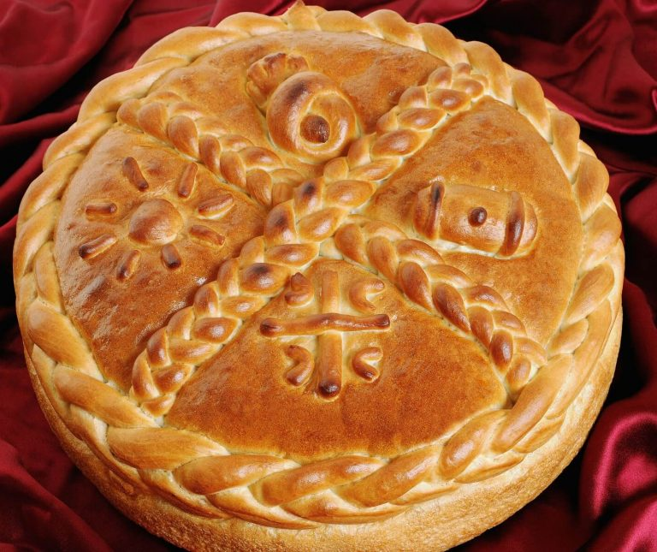
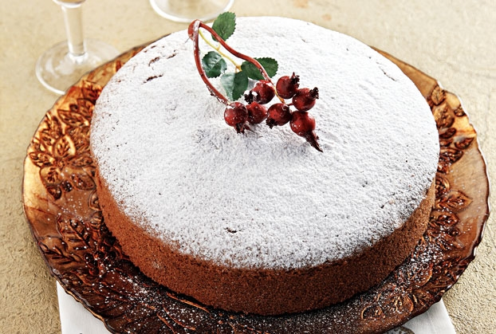
Christmas food in Greece
Melomakarona and kourabiedes are the two varieties of Christmas and New Year's cookies in Greece.
Christopsomo is the bread that is made on Christmas Eve, which has a cross carved into the top crust before it is baked.
Vasilopita is a cake that is eaten on New Year's Day. Before the cake is baked, a coin covered in foil is placed in it.
Notes:
Vassilopita is a tradition of Saint Vassilios. When he was a bishop in Cappadocia, the Roman officer took away all the jewellery from the people. Saint Vassilios - who was an excellent orator - persuaded the officer to return the jewellery. When the Saint wanted to give everyone their own pieces, everyone claimed that it was all theirs. So the Saint asked for a huge pie to be prepared and put all the jewellery in it. Everyone got a piece of the pie with a piece of jewellery in it. Legend says that everyone got back their own jewellery.

Slide 6
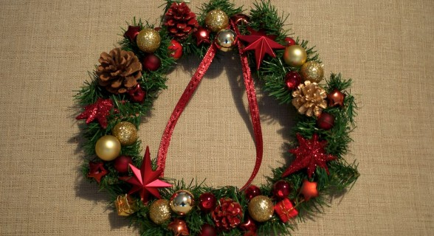
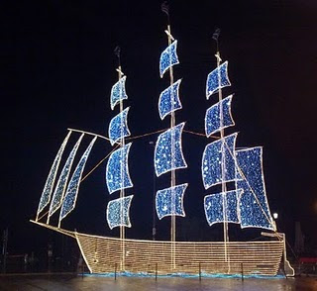
Christmas traditions in Greece
On the front door of the houses is also decorated a fir tree wreath, decorated with Christmas decorations. According to tradition, the wreath brings luck to the occupants of the house
A custom that has tended to disappear in recent years, and its place has taken the foreign custom of the Christmas tree.The boat symbolizes the new man's journey to life after the birth of Christ.Also symbolized the expectation of children to rejoin their relatives, but also their love for the sea.

Slide 7
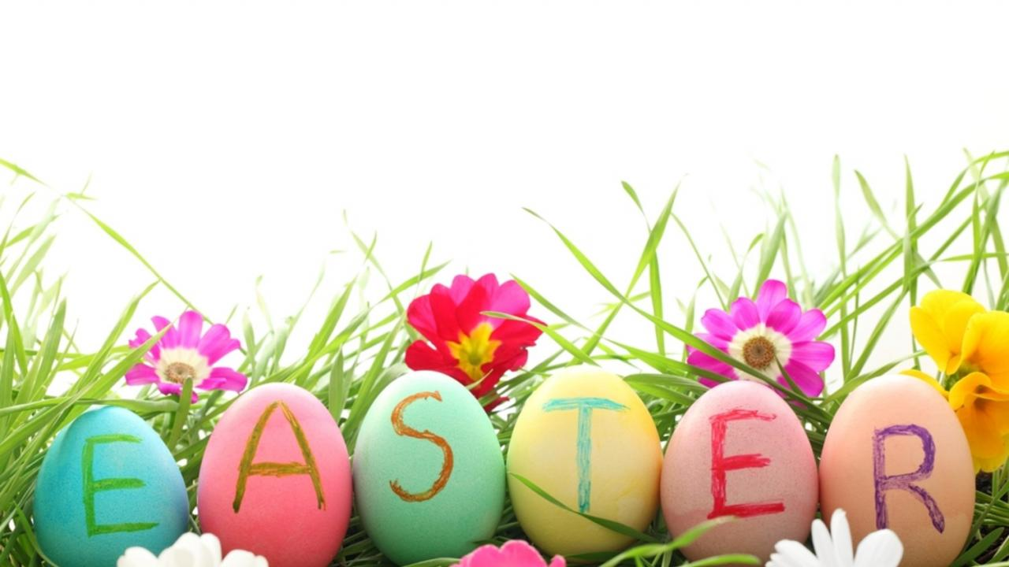
EASTER IN GREECE

Slide 8
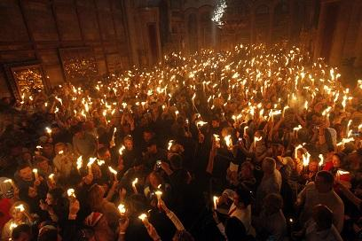
Easter
On Good Friday, there is a sombre atmosphere and the church bells ring and flags fly half mast, and in some villages a shrine representing the tomb of Jesus is carried in the streets. This sad mood is soon broken in true Greek style, with lots of eating and singling and loud noise.
Late on Saturday night, before midnight all the people go to all the churches. Then follows a festival of light. At midnight the church goes dark and the bells ring out to proclaim the resurrection, and people start cheering and letting off fireworks and crackers! The Greeks young and old buy or make their own Easter candles which they take to the church on this night. Εveryone lights their candle from this one. People carefully carry their candle home and make a black cross on their house with the flame to bless themselves.

Slide 9
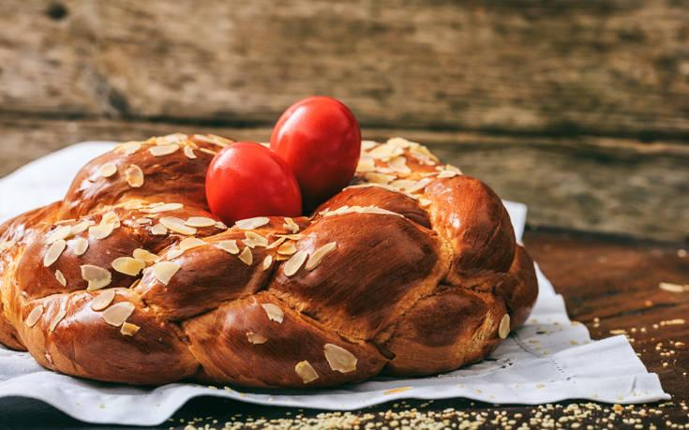
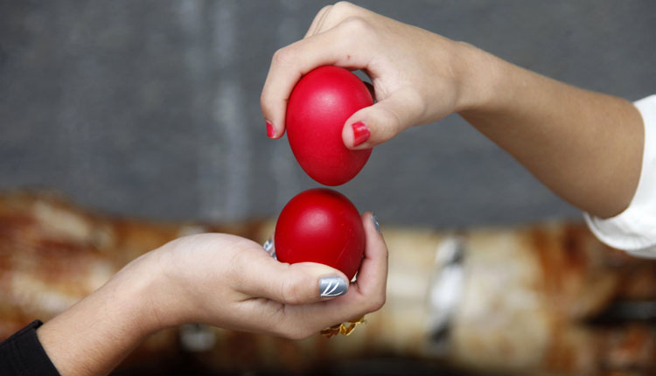
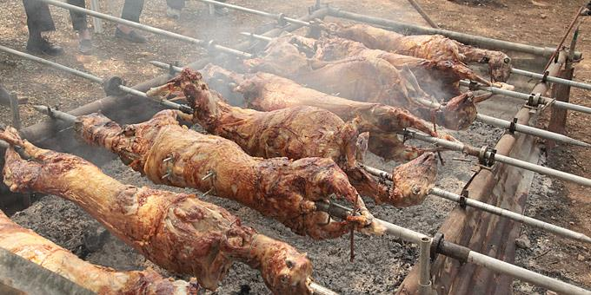
Baking Tsoureki & Dying Red Eggs
Afterwards, we return to our homes and the families sit together at the table to have the festive dinner! We always start with cracking the red eggs with each other. Everyone selects one egg, carefully choosing the one that seems the strongest. Then the egg cracking begins! One cracks their chosen egg on top of another’s chosen eggs. Each time there is a winner and loser. Loser is obviously the one with the cracked egg. The egg cracking keeps on going, until there is only one winner- the chosen one with the un-cracked egg! The one with the strongest egg is said the have good luck for the whole year.
The Easter Sunday is another day to celebrate. Families gather again before noon to roast the lamb on a spit and then enjoy a long lunch with lots of meat, potatoes, salads and drinks.

Slide 10
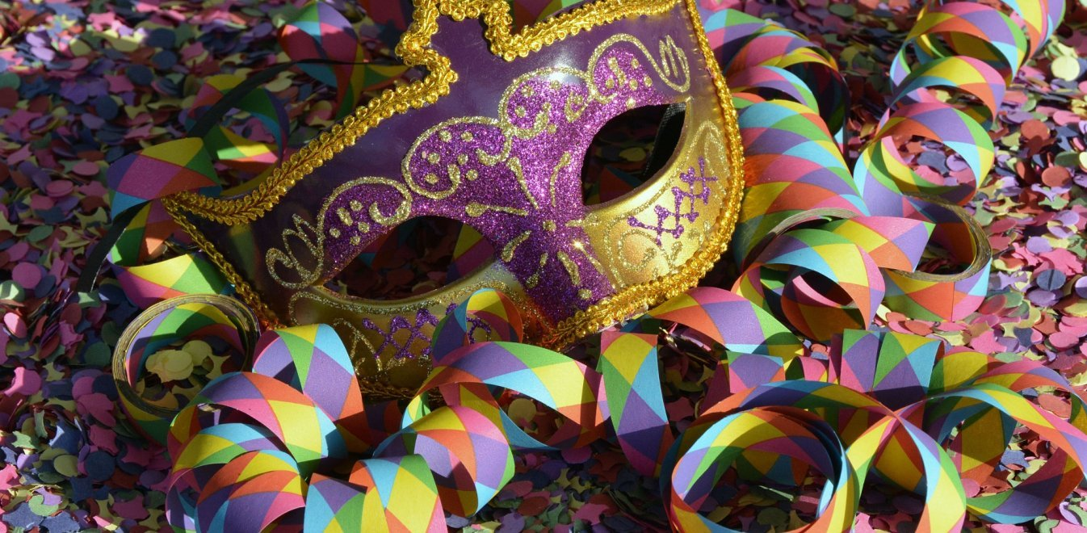
CARNIVAL IN GREECE

Slide 11
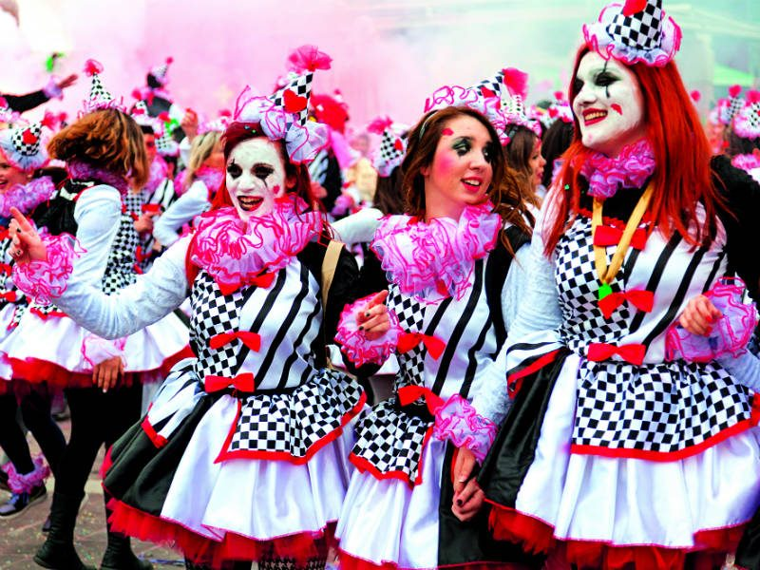
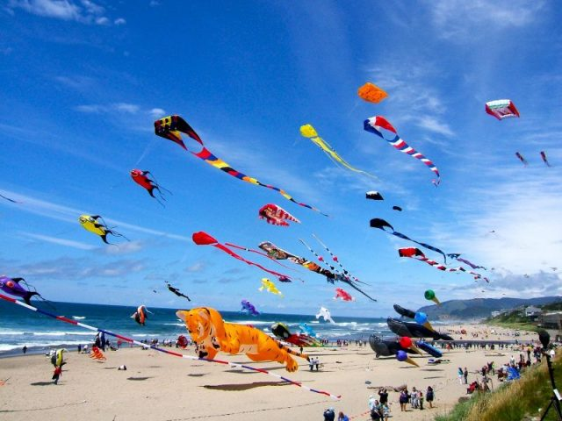
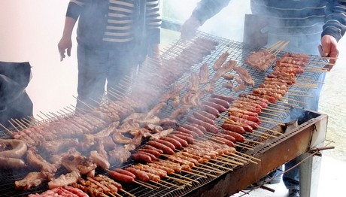
Carnival (Apokries)
The Carnival season in Greece, known as «Apokries,» is a period which traditionally begins ten weeks before Greek Orthodox Easter, and ends with “Clean Monday”, the first day of Lent.
During those three carnival weeks there are many private parties and masquerades, as well as parades and public events organized by municipalities and schools all over Greece.
On the Thursday of the second week of Carnivale, Greeks celebrate the so called “Tsiknopempti”. On this particular Thursday everyone grills and eats meat.
When the carnival festive season is over, the period of fasting begins, until Easter Sunday. But on the first day of fasting, do not forget to participate in the “Clean Monday” celebration – a day of joy and excitement in Greece and a day to fly your kite!

Slide 12
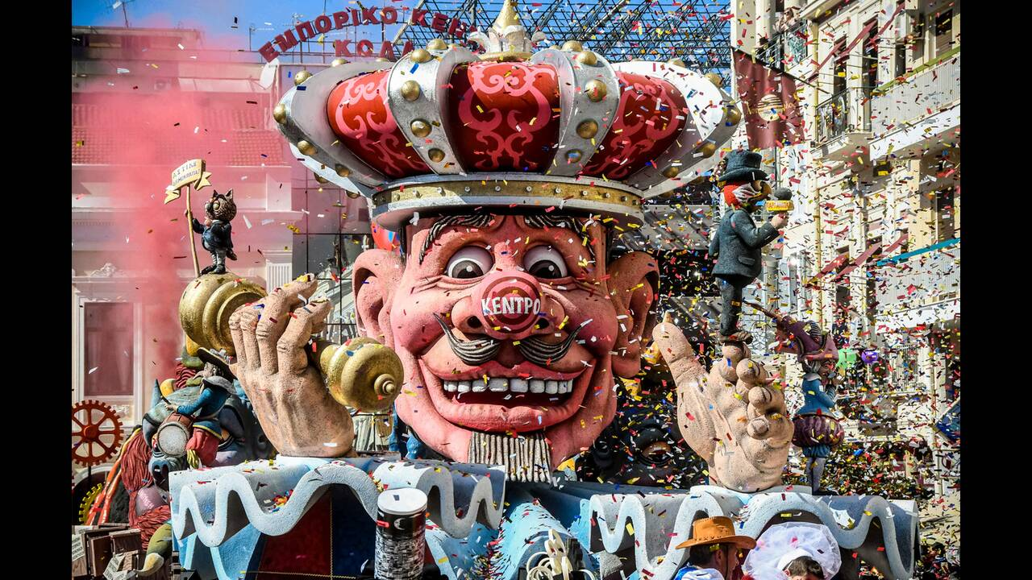
Patras Carnival
Patras is the largest carnival in Greece with a duration of two months, and on the last Sunday of the carnival, parade is headed by the carnival goddess of the carnival and the following of other smart masks with the participation of 40,000 carnivals and a host of visitors.

Slide 13
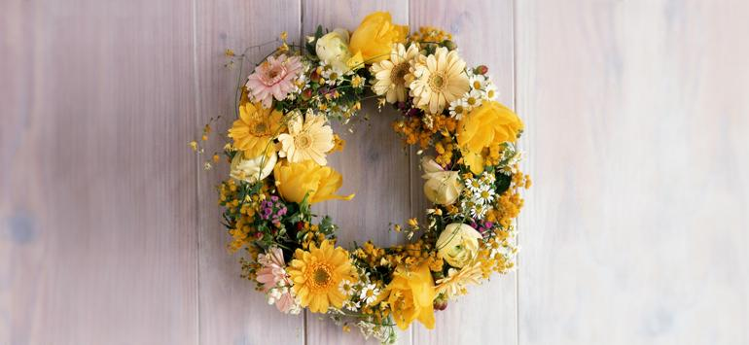
MAY IN GREECE

Slide 14
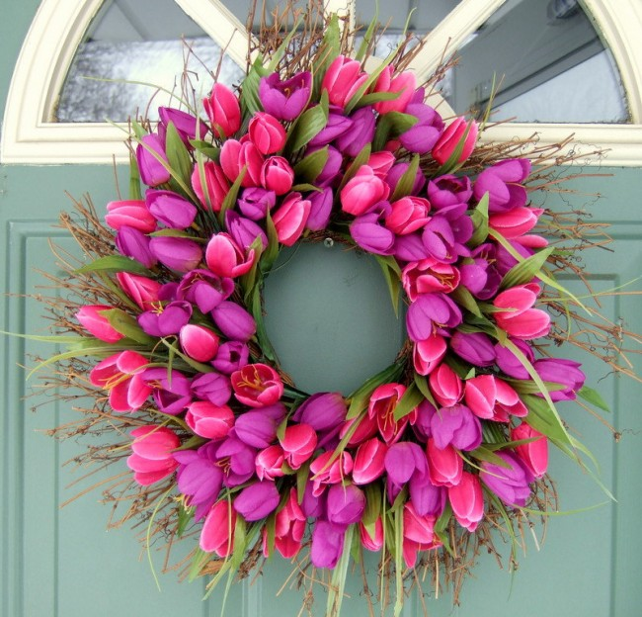
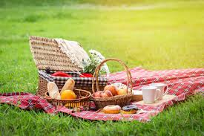
First of May(Protomagia)
People traditionally go to the countryside for picnics and gather wild flowers.
is considered a celebration of the arrival of Spring. According to tradition, the month of May was named after the Roman goddess Maia, which is the Greek word for midwife, nurse and mother.
It is a national holiday either,which means that everything is closed with the exception of cafeterias and food venues.
We also name that day as ‘’International Worker’s Day’’.

Slide 15
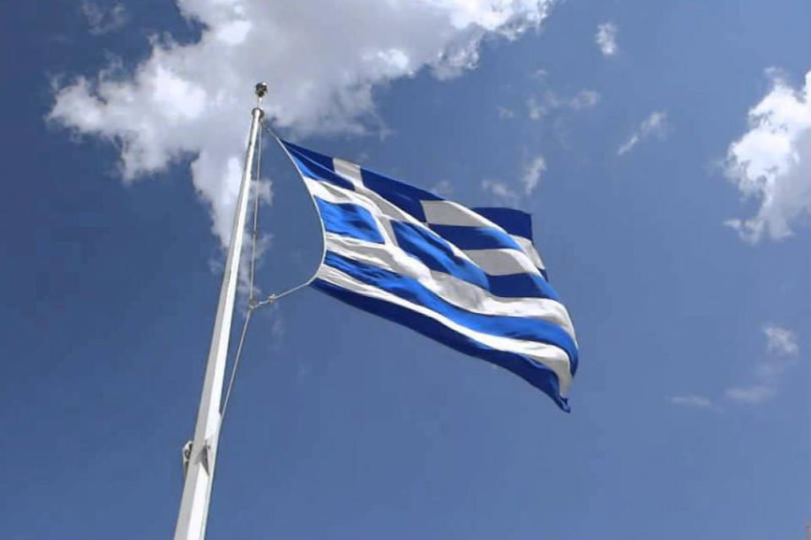
ANNIVERSARIES OF GREECE
Notes:
And three national celebrations

Slide 16
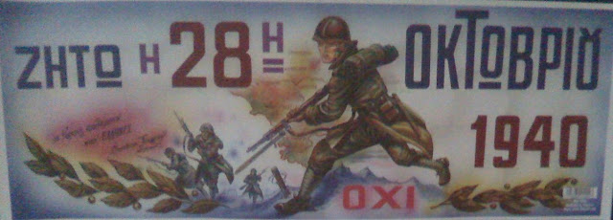
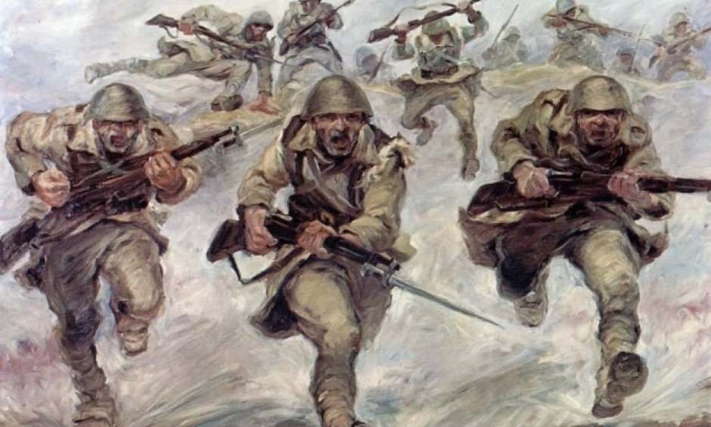
Anniversary of No(ohi)
The Anniversary of ohi is celebrated on the 28th of October(1940).
It is the day that commemorates the rejection by Greek dictator Ioannis Metaxas of the ultimatum made by Italian dictator Benito Mussolini.
On this day in Greece, most public buildings and residences are decorated with Greek flags. You will see parades and other festivities throughout the country.
Notes:
on October 28, 1940 war was declared by Mussolini to Greece. Greece was given an ultimatum to surrender. The Greek leader responded with the famous OXI which means NO

Slide 17
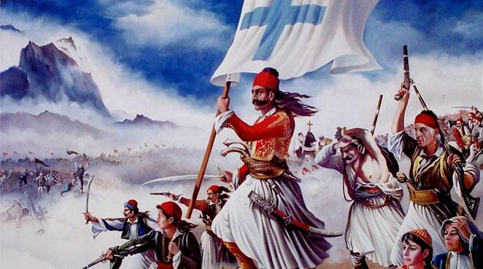
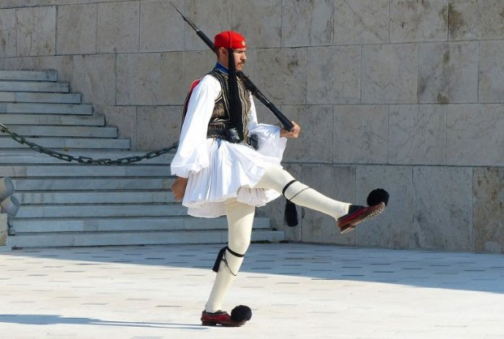
The Greek Revolution
The anniversary of the ‘’Greek Revolution’’ is celebrated on the 25th of March(1821).
Greeks celebrate the War of Independence against the Ottoman Empire. The “Greek Revolution” was a successful war of independence waged by the Greek revolutionaries between 1821 and 1830.
A custom across the country on this day is to eat crispy, fried Cod fish with garlic sauce (Bakaliaros skordalia) !
Notes:
On 25 March, 1821 the Greeks started the Revolution against the Ottoman Occupation which lasted 400 years.

Slide 18
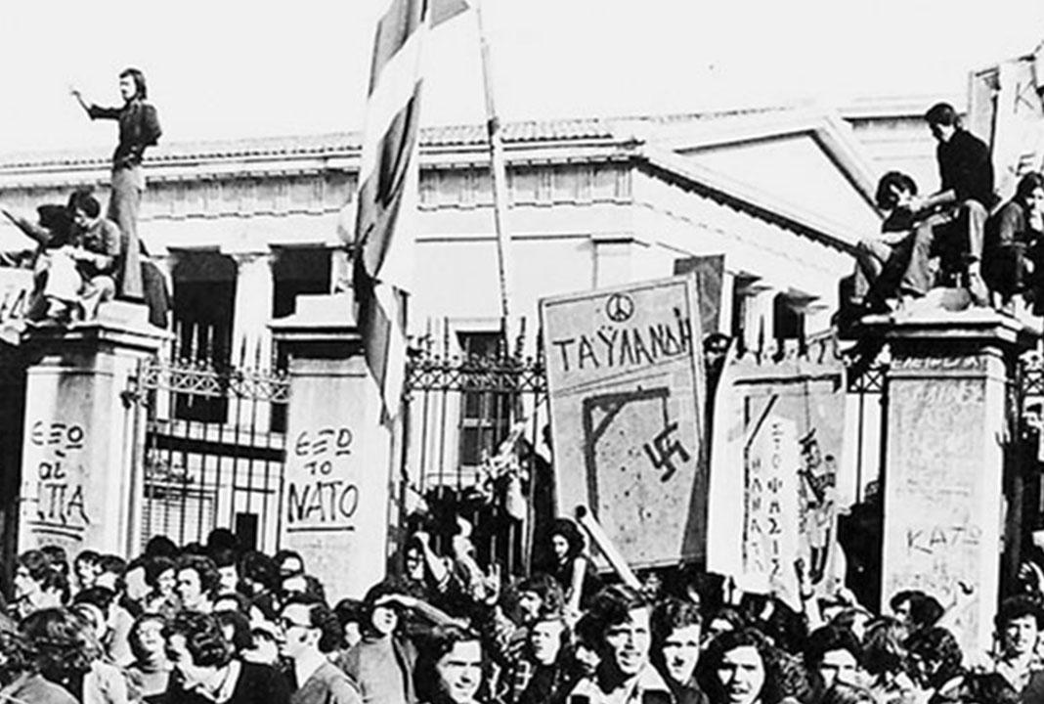
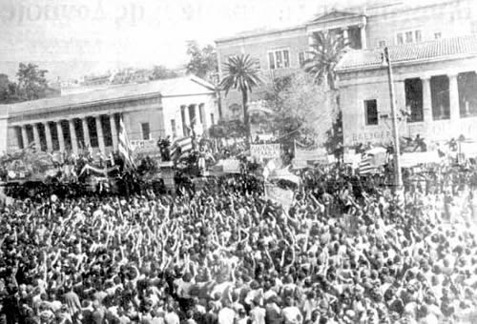
Athens Polytechnic uprising
The Anniversary of the uprising is celebrated on the 17th of November(1974)
occurred as a massive student demonstration of popular rejection of the Greek military junta of 1967–1974.
The uprising began on 14 November 1973, escalated to an open anti-junta revolt, and ended in bloodshed in the early morning of 17 November after a series of events starting with a tank crashing through the gates of the Polytechnic.
Notes:
On November 17, 1974 the Students at the Polytechnic University of Athens started a Revolution against the Junta, military dictatorship that had lasted 7 years

