Slide 1
Migration Stories and the Cultural Influences they Create
A common presentation made at Erasmus+ Meeting in Athens held from 6th to 10th of may 2019

Slide 2
The Main Questions
Who migrated where?
Why do people migrate from one region to another?
Which cultural influences have emerged from these migration movements ?

Slide 3
Migration from Greece
Greek people εmigrate to countries for these main reasons:
    High quality of life
    In order to make a living
    Better opportunities and situations
    Because the unemployment rate has expanded
    To study abroad and graduate

Slide 4
Where Greeks immigrate to?
Czech Republic
According to the available data, about 1100 Greek students are studying in Czech Republic and about 150-200 Greeks working in multinational companies are also registered.
Germany
The number of Greeks that immigrated to Germany from 2010 to 2014 is about 30.000 and according the statistics the highest rate of people are the young people.

Slide 5
Greek colonization in ancient time
From the 11th century BC the Greeks migrated to the coast of Αsia Minor, the other side of Aegean sea.There, they got to know the civilisation of the East.
They spread across the Βlack Sea and all over the Mediterranean Sea
(Spain - in Emporion (Empúries, south France- in Massalia, and in south Italy)
In South Italy and Sicily, the Greeks were so many, that the area was called Magna Graecia. The greeks settled even in Milazzo!

Slide 6
Greek influences to the other countries
Science and Mathematics
from Eratosthenes and Archimedes the mathematicians and Aristarchus Hipparchus the astronomers.
Democracy
The ancient Greeks created the world’s first democracy and today the majority of the countries all around the word use the democratic system.
The theater
The first western theater originated in Athens, and was, like many other ancient Greek theaters, a semi-circular structure cut into a hillside that was capable of seating 10,000 to 20,000 people.
Architecture
One of the most common examples of Greek architecture in the modern world is the column or pillar.The most famous example of Greek architecture is the Parthenon, a grand building with pillars located in Athens.

Slide 7
Migration from Italy
In ancient times the Romans started an expansion aiming at the mineral richness of several countries such as Spain or strategic military outposts such as in Czech Republic.
The Republics of Venice and Genoa did the same and Venice in particular at the height of its expansion, 12th-16th century, included Peloponnese, Crete and Cyprus.
In 20th a migration flow towards Germany started for economic reasons and it is estimated that from 1956 to 1976 over 4 million Italians entered West Germany.
A special group of migrants was the one represented by the Italian- Levantines who settled in Turkey since the Crusades as descendants of Genoese and Venetian settlers.

Slide 8
Which cultural traces did they leave and do they still create in the countries they have migrated to?
The Romans left a lot of buildings and sites behind them which are still standing in Europe. For example in
Spain : the cities of Cartagena and Terragona;
Germany: the city of Treviri;
Greece: the city of Nicopoli;
Turkey: the city of Ephesus;
Czech Republic: the military settlement of Musov.
The Italian-Levantines kept their Catholic faith in a Muslim country and they still speak Italian among themselves
Italians in Germany have had a substancial influence on the development of Fine Arts, contemporaryFashion and Design.

Slide 9
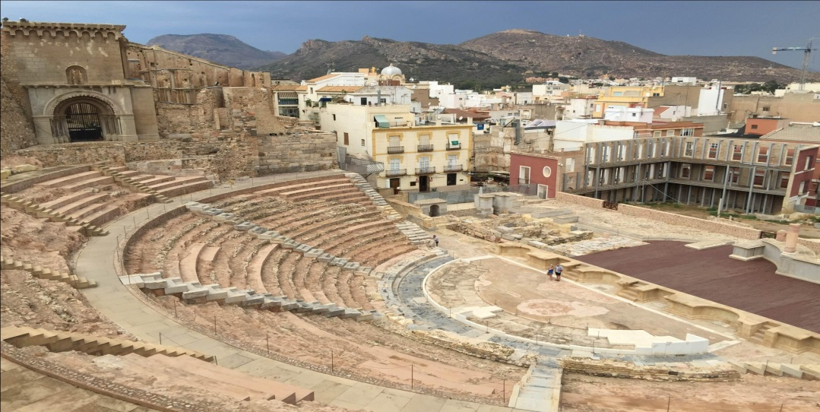
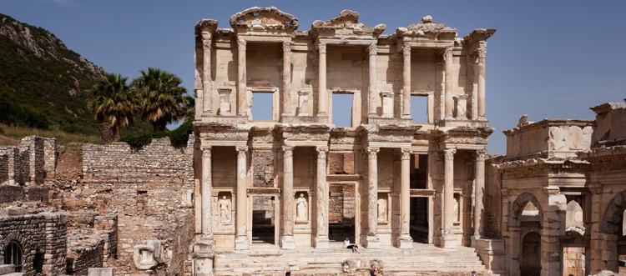
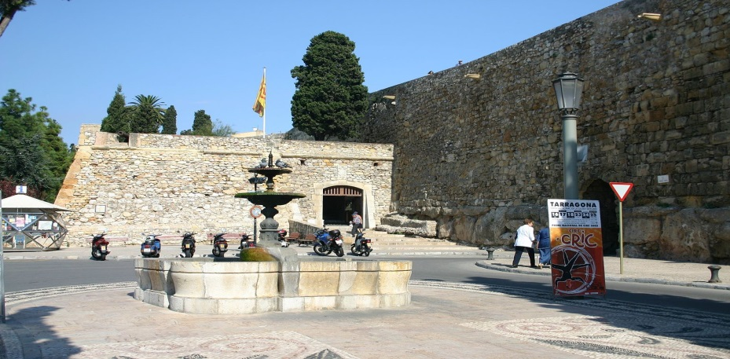
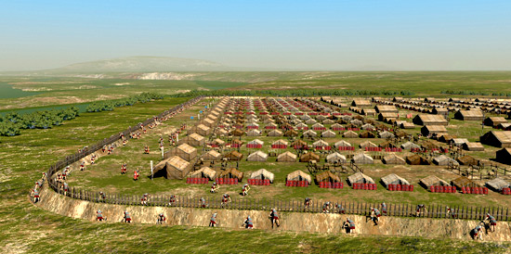
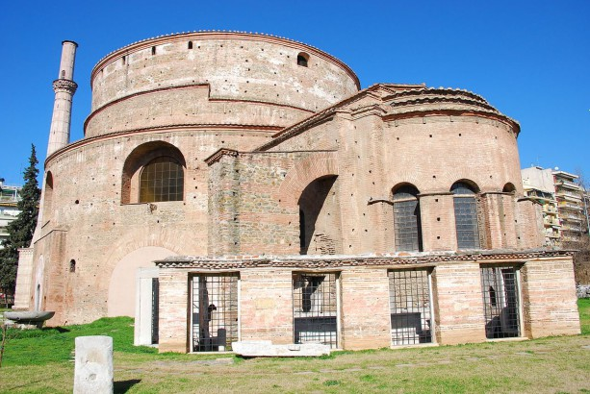
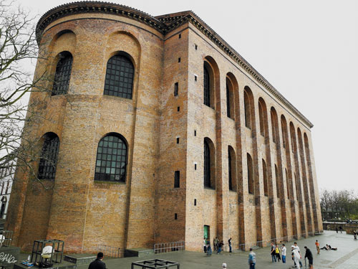

Slide 10
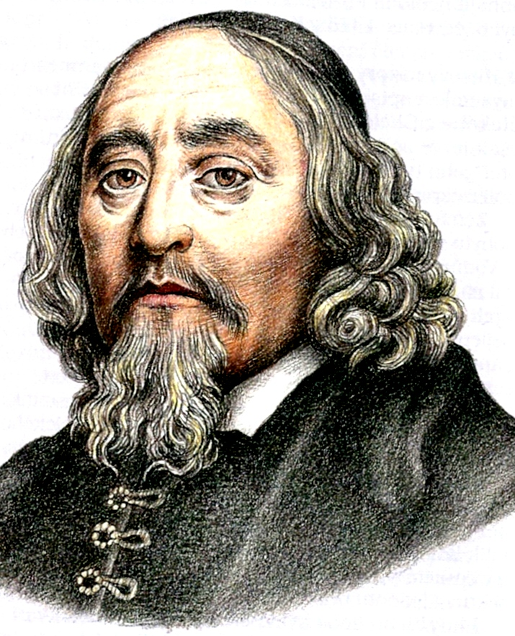
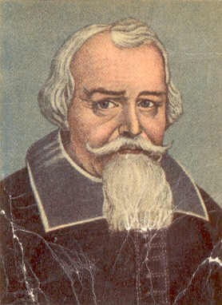
Migrations from Czech lands
Most people living on the Lands of the Czech crown were protestants.
After the battle of Bílá Hora – Habsburgs wanted to change the religion on the Czech lands to catholicism
Teachers and educated people were supposed to change their religion, but most of them emigrated to Germany or Netherlands not to.
Jan Ámos Komenský (Johann Amos Comenius), Pavel Stránský were among those people.
Many of those people became headmasters at grammar schools or universities and they assimilated very well new models and life style.

Slide 11
Migrations of Czech Germans
Germans also lived in Czech territories (Germans numbered out Slovaks in Czechoslovakia).
Over 2,4 milons of Germans were displaced as a revenge for atricities which were comitted on Czech nation during the German occupation.
Under President Edvard Beneš Germans and Hungarians had their citizenship revoked and they became foreigners on Czechoslovakian territories.
When they arrived in Bavaria and Upper Palatine, no one wanted them there. Nevertheless they soon asimelted well with the local population as usual.

Slide 12
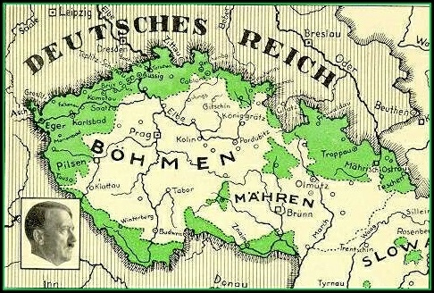

Slide 13
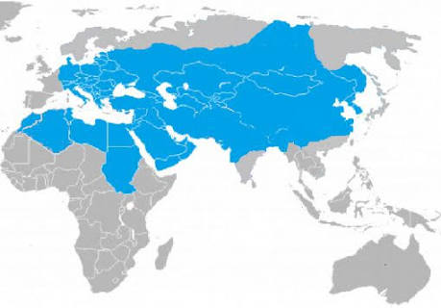
Turks migrated to the following regions for various reasons and lived in these regions.

Slide 14
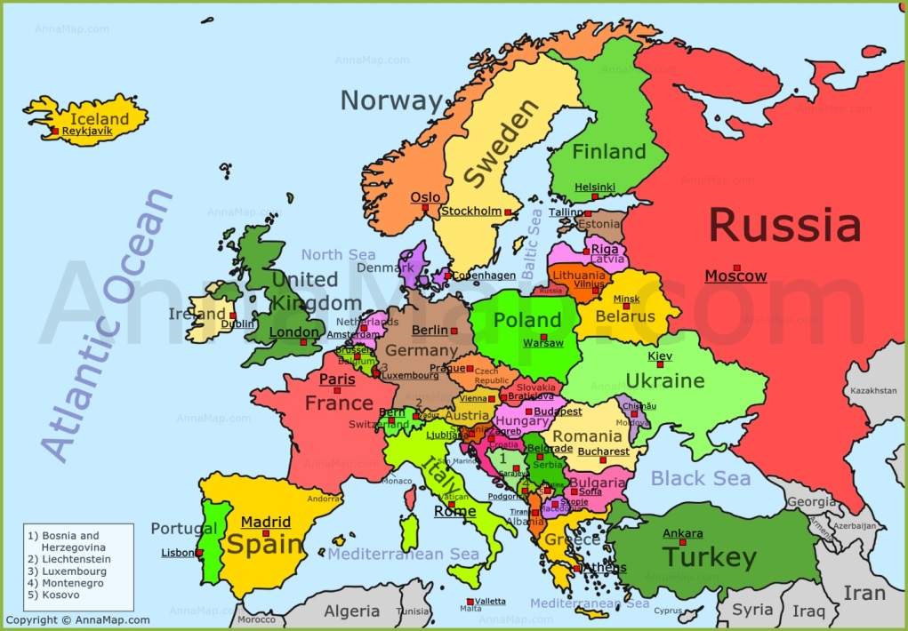
In the European context huge number of Turks migrated to Germany and Greece which are our project partners.

Slide 15
Migration from Turkey to Greece
WHY?
Greece was under domination of Ottoman Empire for 400 years. According to Ottoman policy some people who lives in Anatolia was forced to migrate to Greece. Because Ottoman chose the way establish to the Turkish culture in order strengthen their sovereignty in the conquered places.
WHICH CULTUREL TRACES?
It is important that the traditions and customs of the exchange, dress, music, dance, culinary cultures, languages and dialects, in short the common memory, cultural heritage and identity of the exchange are kept alive in Greece.

Slide 16
Migration from Turkey to Germany
WHY?
An agreement between the government of the Republic of Turkey and the government of the Federal Republic of Germany was signed on October 30, 1961.
After World War II, the need for workers emerged in Germany. With this agreement, many people from Turkey migrated to Germany as workers.
WHICH CULTUREL TRACES?
Turkish workers started to establish joint works with Germans. After 1980 very fast progress occured and after 1999 the number of Turkish businesses considerably increased.
Turkish workers changed German’s taste of palate. In a lot of places of Germany there are Turkish restaurants serving kebab, doner etc...

Slide 17
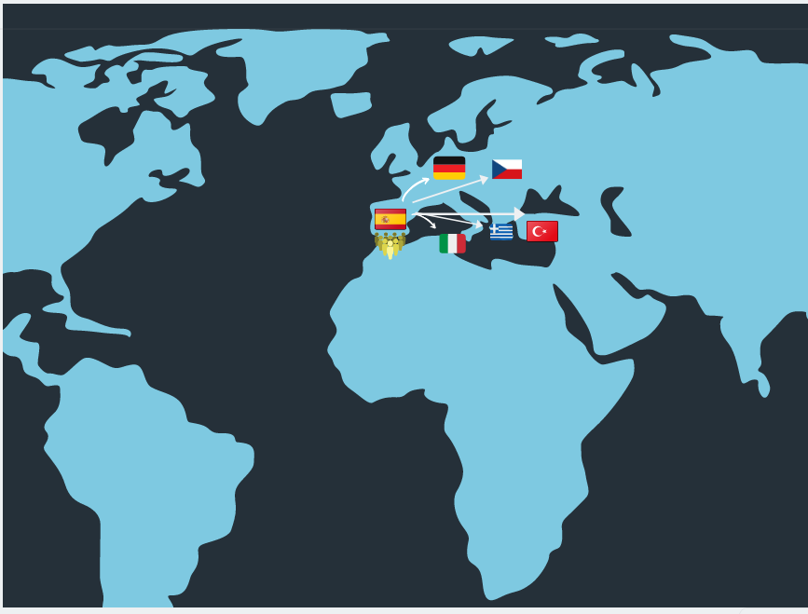
Migration from Spain
Spain to Italy: Spanish civil war exiled people.
Spain to Germany: Spanish non-qualified workers.
Spain to Greece: Jews expelled because of Christian rulers.
Spain to Czech republic: exiled politicians.
Spain to Turkey: we didn’t found evidences.

Slide 18

Why have people migrated from Spain to …?
During the Spanish Civil War (1936-1939) and the post-war period.
Between 1963 and 1970, up to 600.000 Spanish workers emigrated to Germany.

Slide 19


Sephardic Jews inmigrated to Thessaloniki following their expulsion from Spain by Christian rulers under de Alhambra Decree in 1492.
People of the Communist Party of Spain during the Spanish Civil War had to exile into Czechoslovakia after the war.

Slide 20
Which culture traces do they leave?
Many students choose to learn Spanish as a second language in Germany.
Culture Spanish trace in Greece: Sephardi is the language spoken by the Jewish communities descendants of Hebrews, who lived in the Iberian Peninsula until 1492 , when they were expelled from the Kingdom of Spain for the Catholic Kings.

Slide 21
Migration into Germany in the 20th century until today

Slide 22
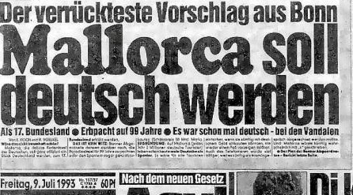
Germans immigrated into other countries
In the peoples migration the Germanics peoples went into the roman empire
Apart from this, the Germans didn’t immigrated to other of the participating countries
Lots of Germans immigrated into Majorca temporarily
Crazy suggestion from Bonn (former German
Capital) Majorca should become German as a
17th federal country (1993)
Studying abroad because of economic reasons

Slide 23
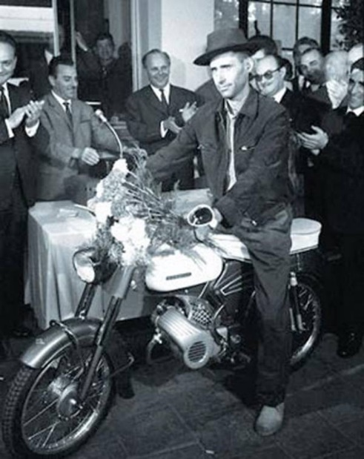
Migration of guest-workers into Germany
In the 1960s a lot of lowly qualified people from Turkey, Italy, Spain and Greece were encouraged by the German government to come to Germany and work there for a limited period of time. These people were called guest-workers and they were expected to return to their country of origin.
But most of them stayed permanently.
Reasons for the guest-workers to come
to Germany:
better living situation
better salary
safe job
high quotient of unemployed persons in their home country

Slide 24


German cultural influences on other countries
As the Germanic peoples immigrated to the Roman Empire they didn’t have any cultural influences on it
German/Austrian culinary and architectural influence on Czechia
German cars (BMW, Mercedes, Porsche, Audi) as status symbols
German beer
Quality seal: Made in Germany
German is an official language within the EU

Slide 25
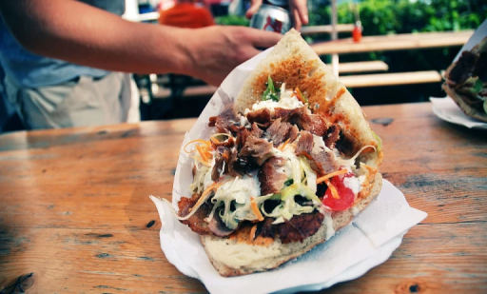
Cultural influences of other countries to Germany
Italian food is the most popular food at our school in Germany
Lots of Italian and Greek restaurants and Turkish Kebap stands opened
Doener Kebap was invented by Turkish guest-workers in Berlin and is now also one of the most popular dishes in Germany
Italian pop-music was partly popular
The wanderlust (the desire to get to know the countries of the guest-workers) began with travelling to Italy
The Italian Fiat and Spanish Seat car companies are common in Germany

