Slide 2
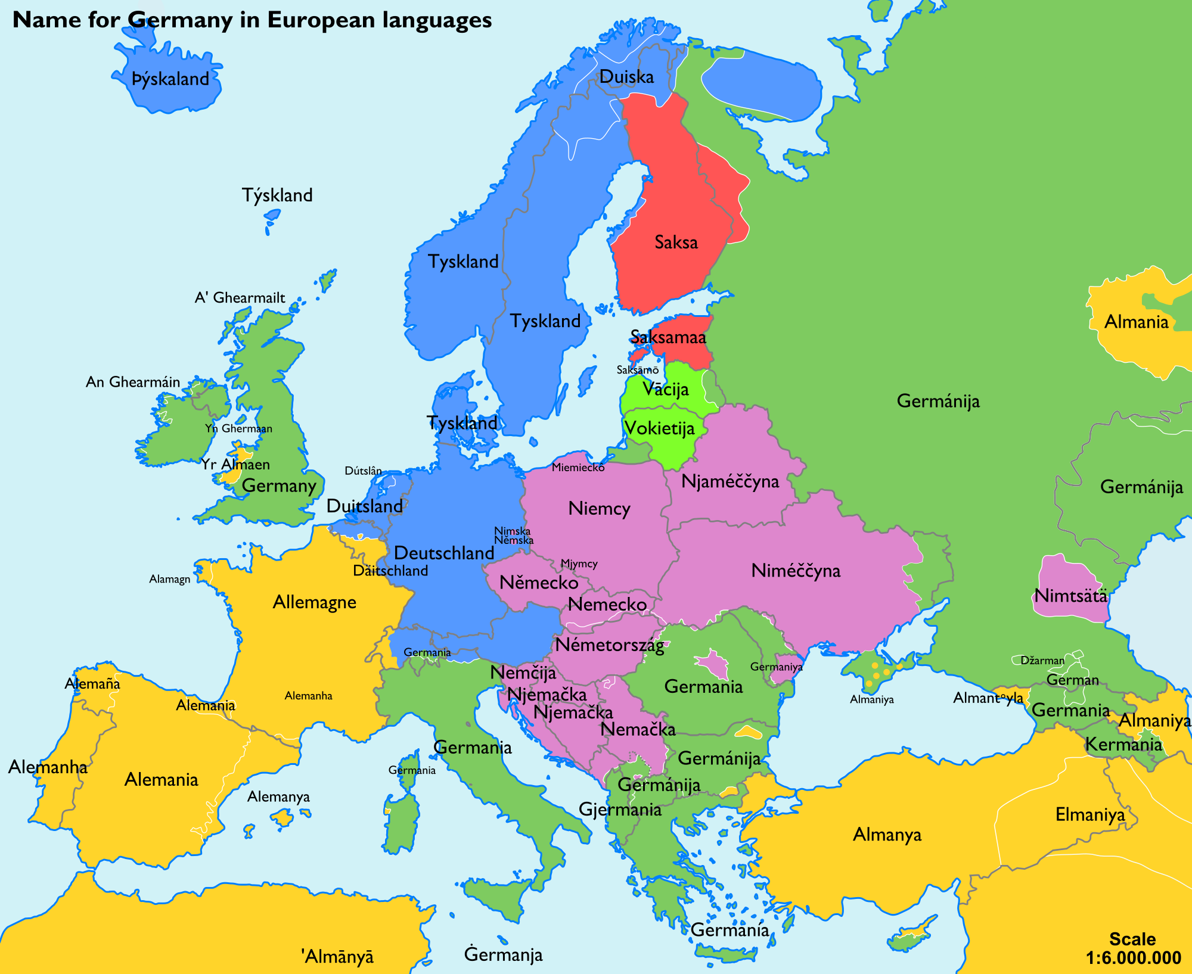
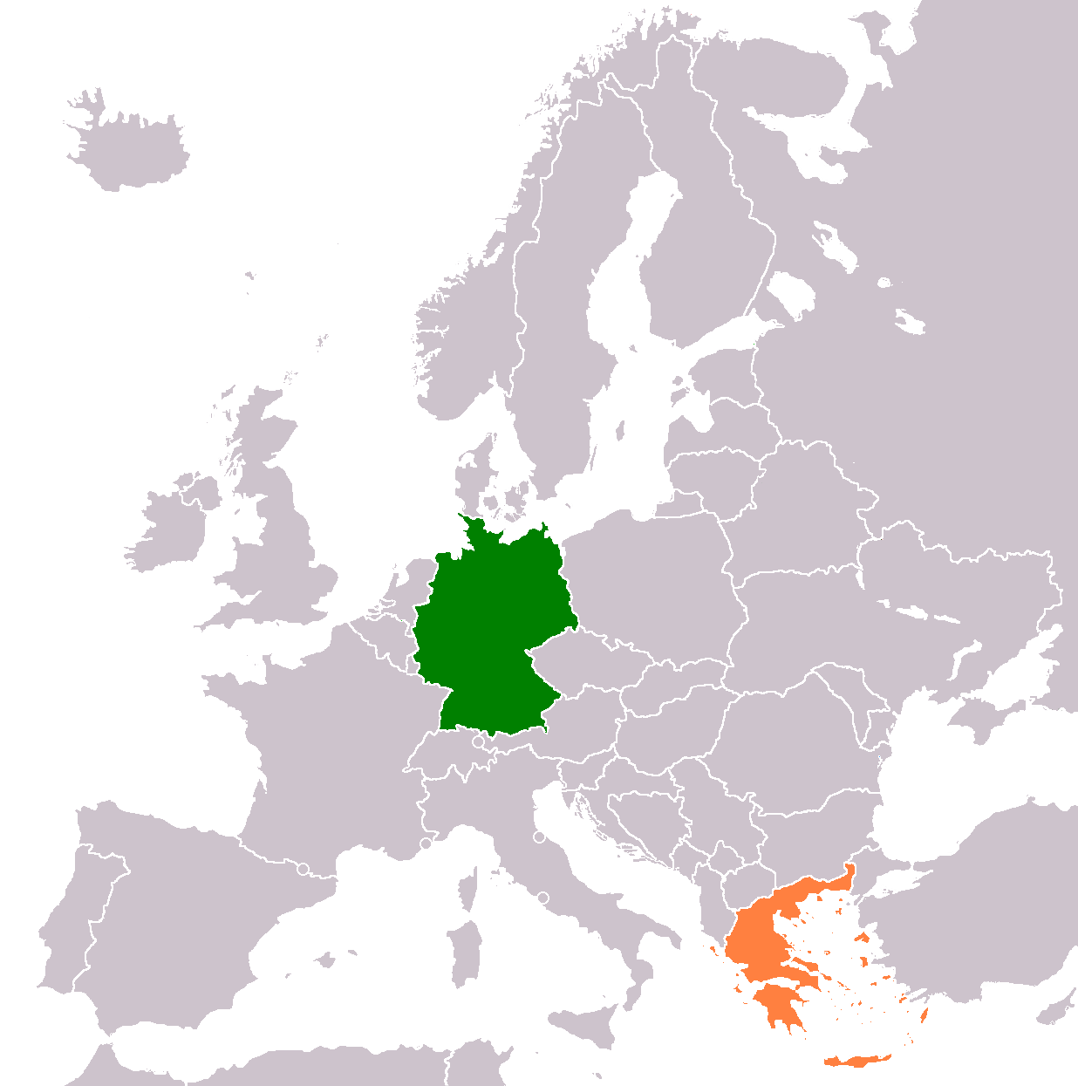
FROM GREECE
TO GERMANY

Slide 3
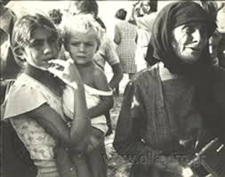
From 1700 till 1945
From 1453 to the 1800s, Greece was occupied by the Ottoman Empire.
When the Empire’s borders opened for merchants at the end of the 17th century, many Greeks decided to leave.
Leipzig became the center of Greek immigration.

Slide 4
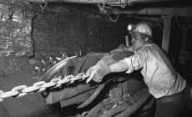
From 1945 till 1970
During the Greek Civil War,many communists sent their children to East Germany that was under the Communist regime.
During that time, West Germany also began to call for workforce from abroad, many of whom were Greeks

Slide 5
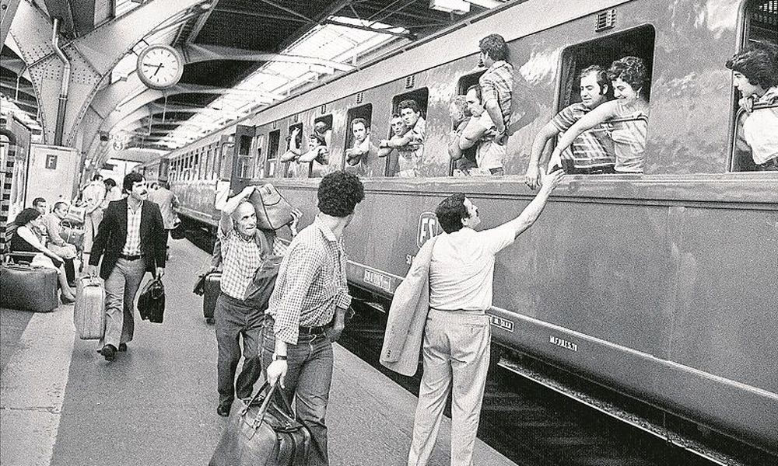
From 1967 till 1990
Military dictatorship in Greece led to a new Greek immigration wave to both German states.
After Greece became a member of the EEC (EU) there was a slight increase in Greek immigration to Germany for work as Gastarbeiter.

Slide 6
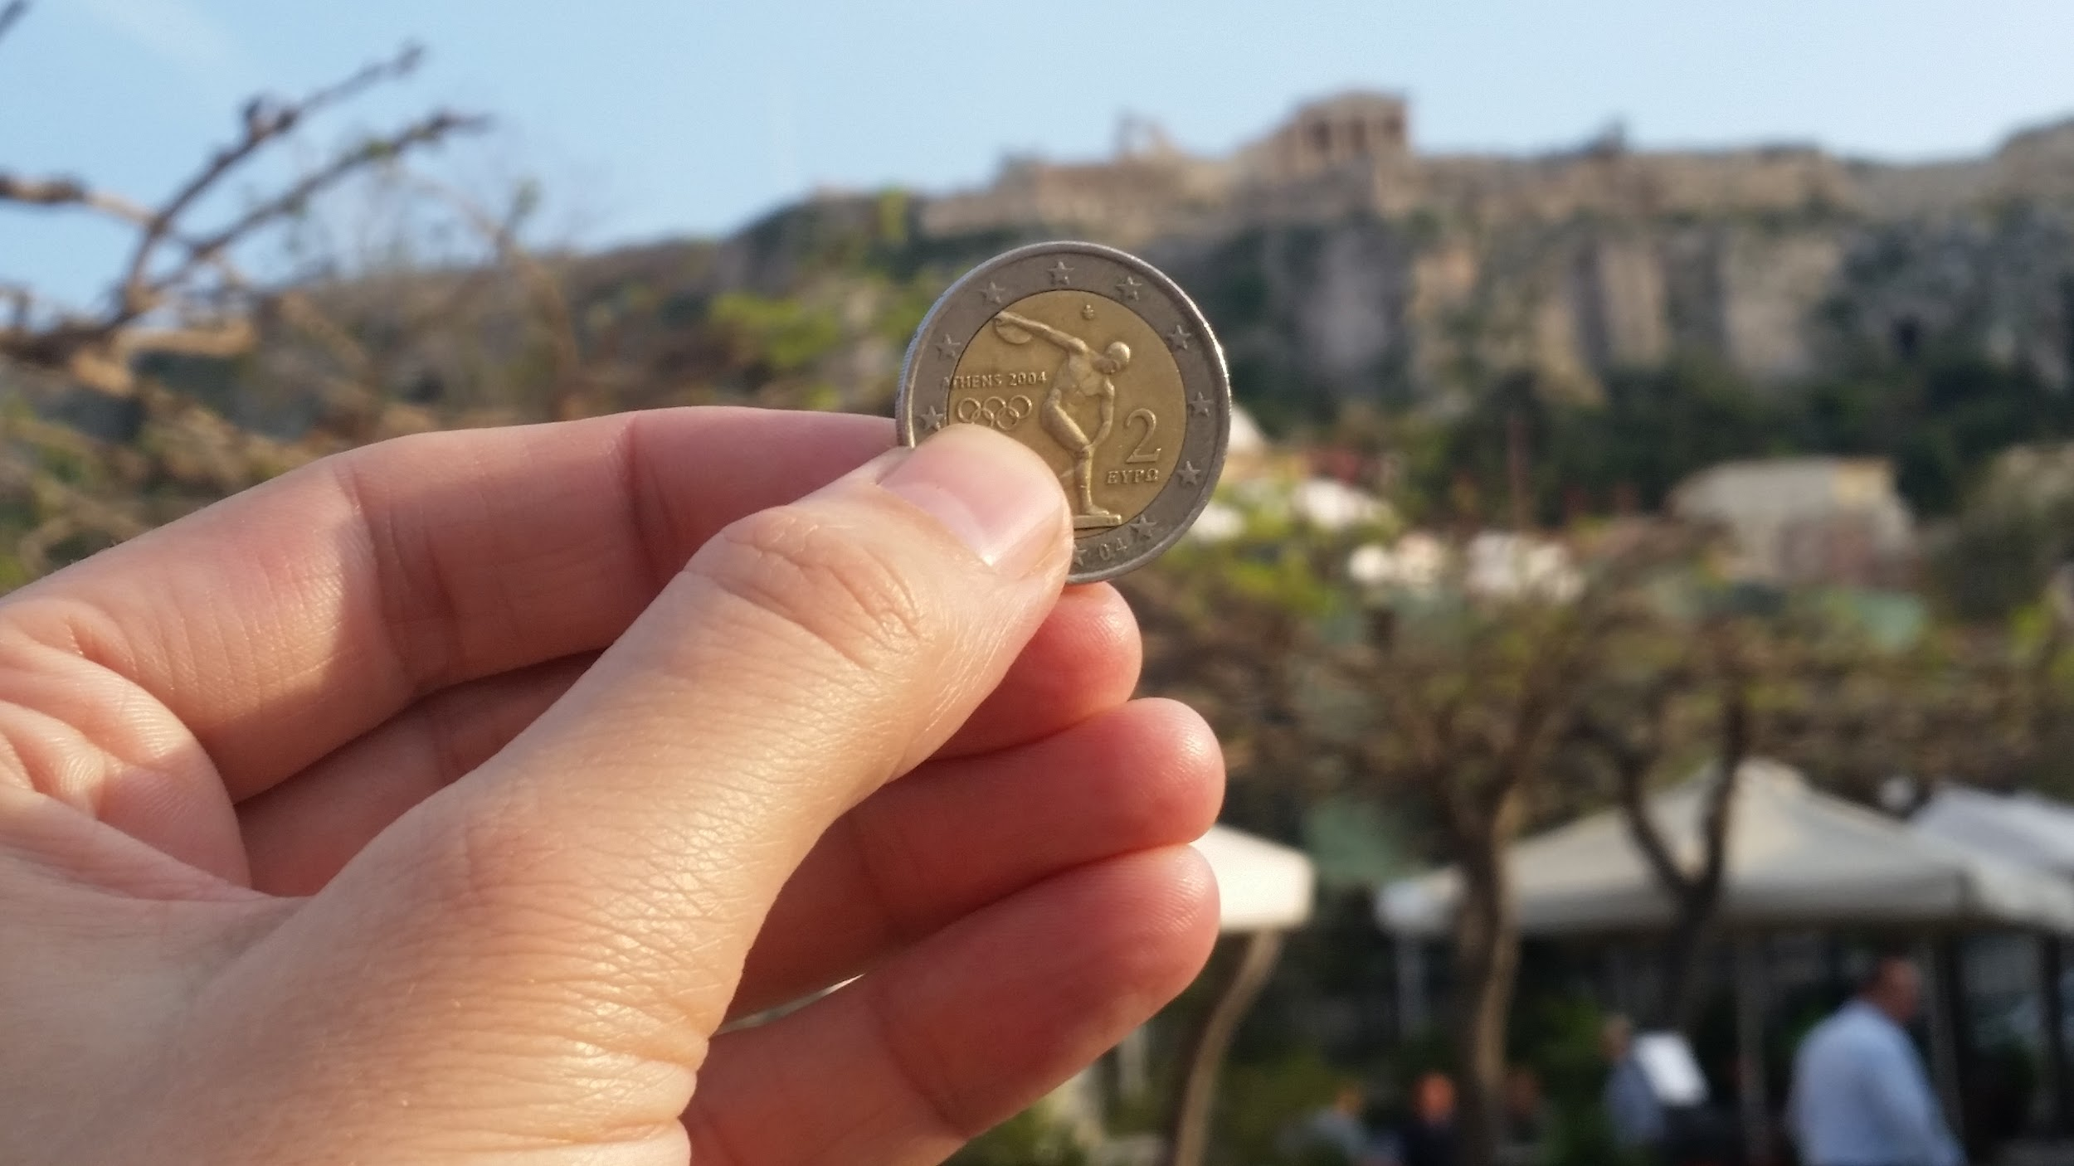
From 1990 till today
Although the improved Greek Economy from 1990 to 2010 led many Gastarbeiter to return to Greece,
during the debt crisis in Greece from 2010 till today, the percentage of greek immigrants in Germany grew again with many being doctors

Slide 7
Work Migration
New Home
Emigration to Germany

Slide 8
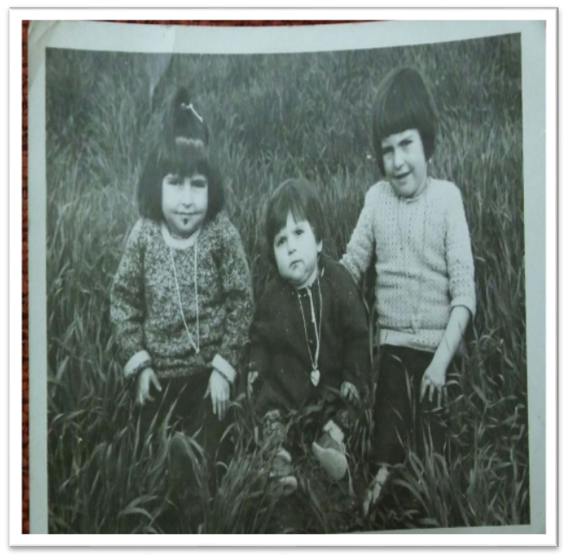
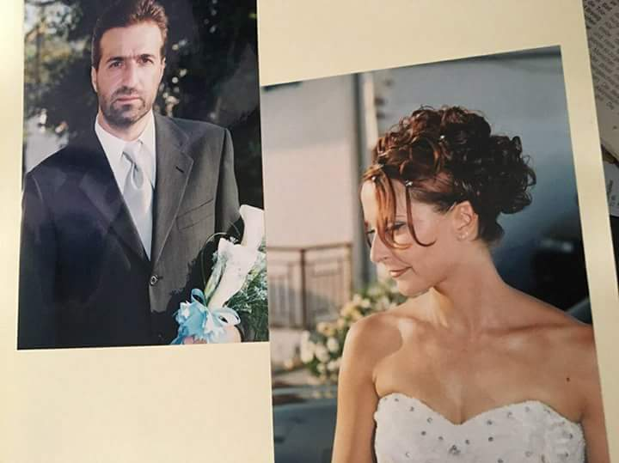
When did our parents arrive in Germany?

Slide 9
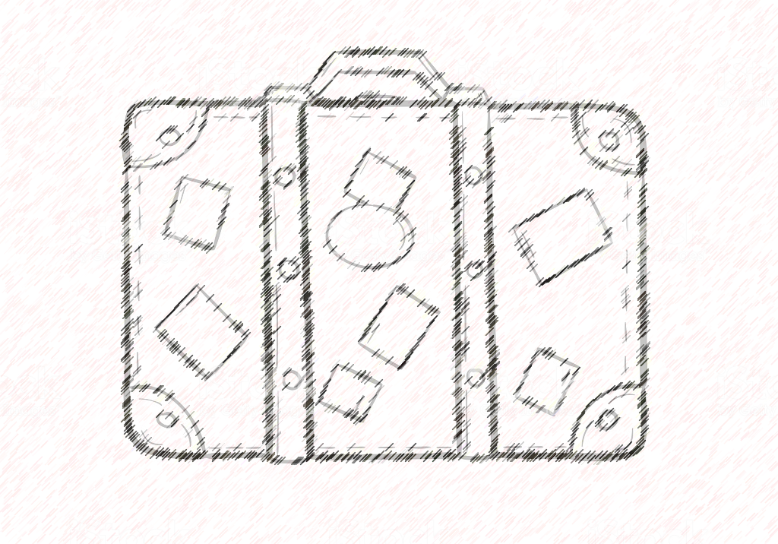
Why our parents had to move?
Main aim: Work
Better possibilities for education
Political situations
Bad life-conditions in their home country
Bad or none Social support from their homeland

Slide 10
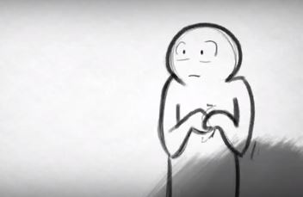
What kind of feelings/fears did they have before their trip ?
Couldn‘t realize it Happiness , Luck, Excitement New adventures New friends, new school Completely different environment | Had to leave their family, friends in their home country How can I reorient myself in this country? Anger towards everybody even the parents → in childhood

Slide 11
What kind of difficulties did they face?
Cultural difficulties
New way of life→ Customs
New language
Hide their sense of shame → not being able to be themselves
Food

Slide 12
Before and after , what‘s changed ?
Before | After
-Poverty -strict household-rules -strict nurture -stress -children had to work on fields -children had to raise their siblings -no freedom for the young -youth depended on their parents | -no strict household rules -more jobs → access to money -neglect their own culture -new generations aren‘t as comfortable with their culture -forgotten origins -new way of life -

Slide 13
What are our parents craving?
Warm-hearted humans ( from their home country)
The typical scent of home
The climate
Feeling free showing their beliefs
Ease of mind
The food and the beach
Family time

Slide 14
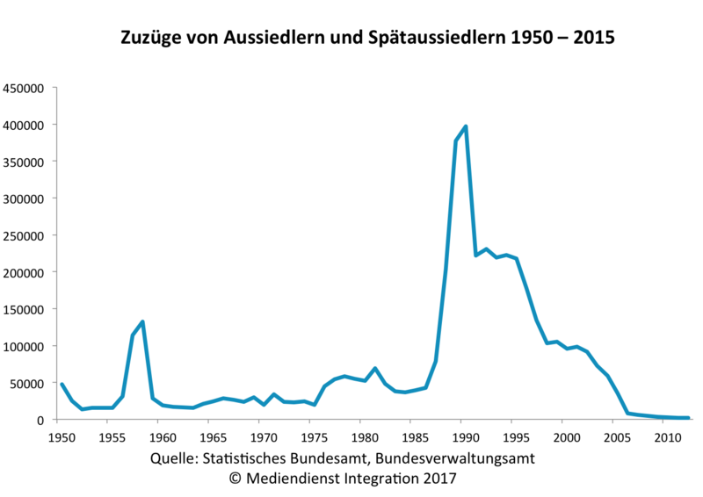
Immigration to Germany 1950 - 2015

