Slide 1
In Germany

Slide 3
Definition of sustainable tourism
Care about the nature
Includes a balanced lifestyle
Local experiences
Climate protection
Get to know cultural and local traditions and people
Saves the natural and cultural heritage

Slide 4
Tips
Take public transports
Cycling
Hitch hiking
Take a hostel or hotel nearby the place you are going to visit
Do your holidays in your own country
Host communities

Slide 5
In Germany

Slide 6
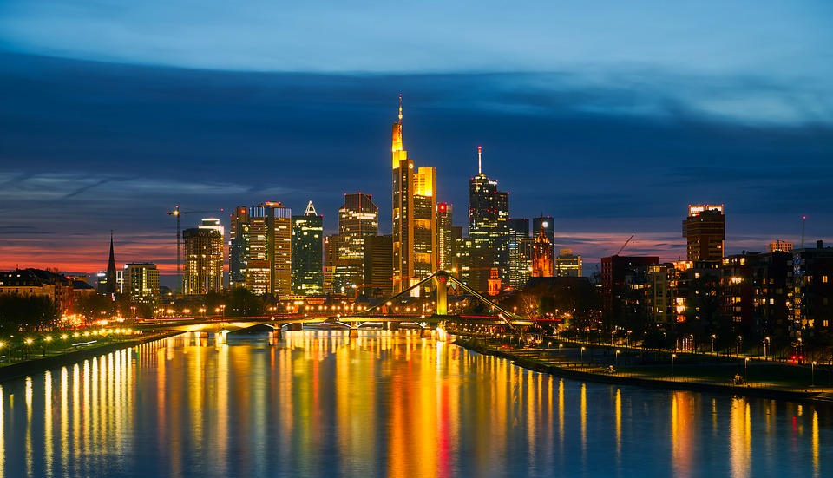
Big Cities
So many tourists want to visit big cities,
Like Cologne, Berlin, Munich, Hamburg and of course Frankfurt,
because they are famous and landmarks of Germany.
But the overwhelmed cities are not healthy for the climate protection and the people, who live there.
Find new beatiful places for yourself and connect more with the nature and get local experiences.

Slide 7
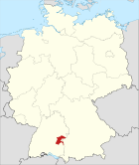
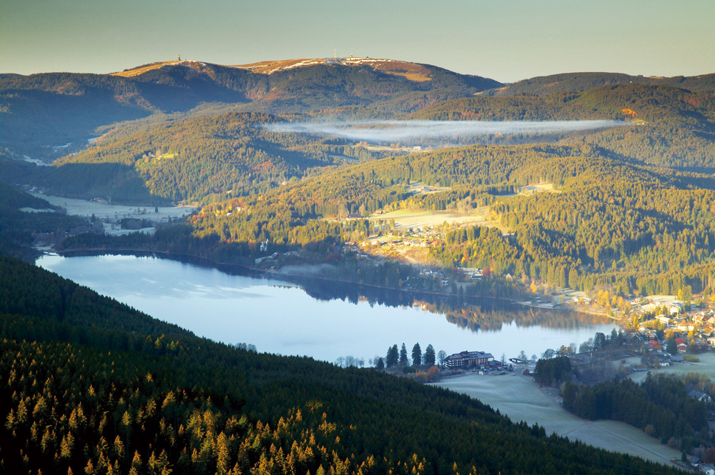
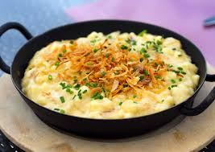
Schwäbische Alb
Winner of the „sustainable tourism in Germany“-competition
-> the most sustainable holiday place in Germany
A lot of Nationalparks, which are great attractions
Black Forest (Schwarzwald)
-> good for hiking in summer and
skiing in winter
Traditional food,
for example: Kässpätzle (kind of pasta with cheese

Slide 8
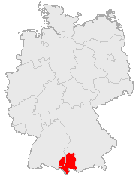
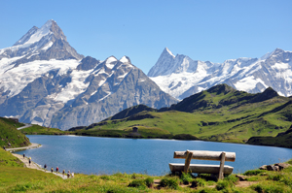
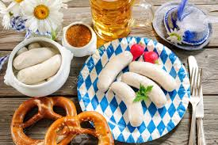
Alps
Allgäu
Great place for skiing
Environmental benefits
Great for hiking
Enjoy traditional food in a familiar area
-> Weisswurst with sweet mustard and Brezeln
Sleeping in huts, than in big hotels
Stunning view
Enjoy the silence

Slide 9
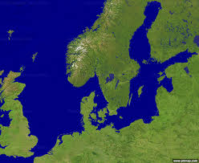
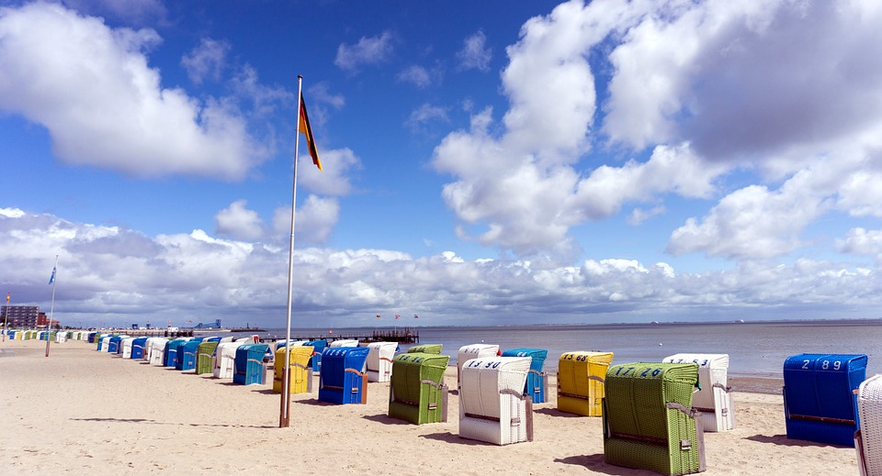
North Sea and Baltic Sea
North Sea
Baltic sea
Small islands to visit
Do cycling tours
Even some islands do not have cars
Walk near the sea on the beach
Explore and eat cultural fish
Do a mudflat hiking tour
Watch the tides
Germany

Slide 10
Beautiful Hidden Nature Places

Slide 11
Rakotz Bridge, Saxony

Slide 12
Wiblingen Abbey, Baden-Württemberg

Slide 13
Lake Königssee, Bavaria

Slide 14
Wilhelmshöhe, Hessen

