Slide 2
ANCIENT GREEK RECIPES
Still used today

Slide 3
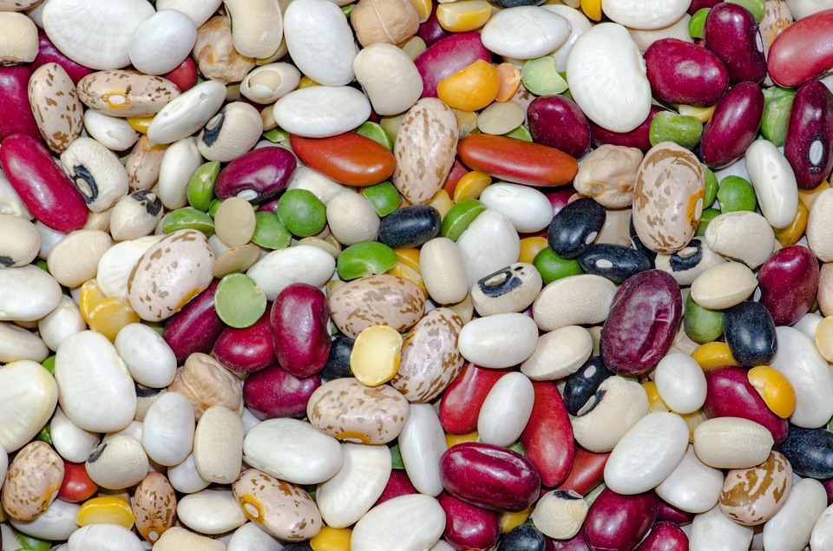
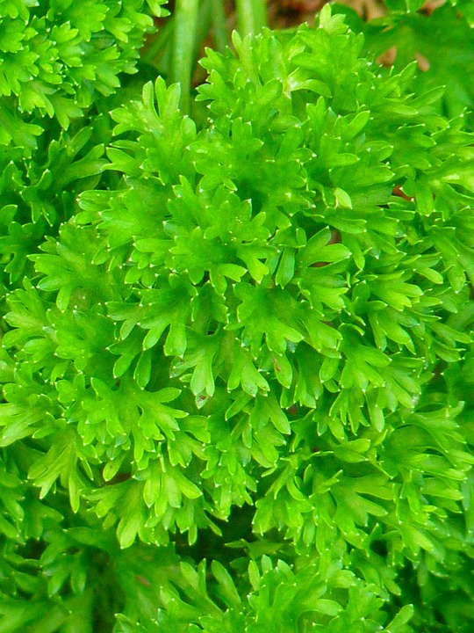
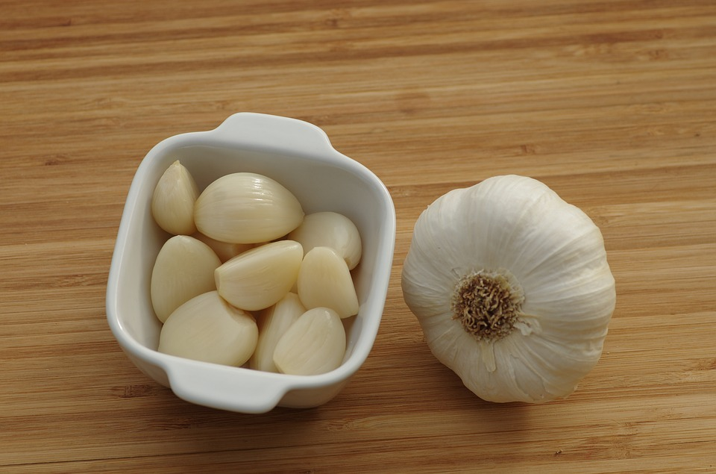
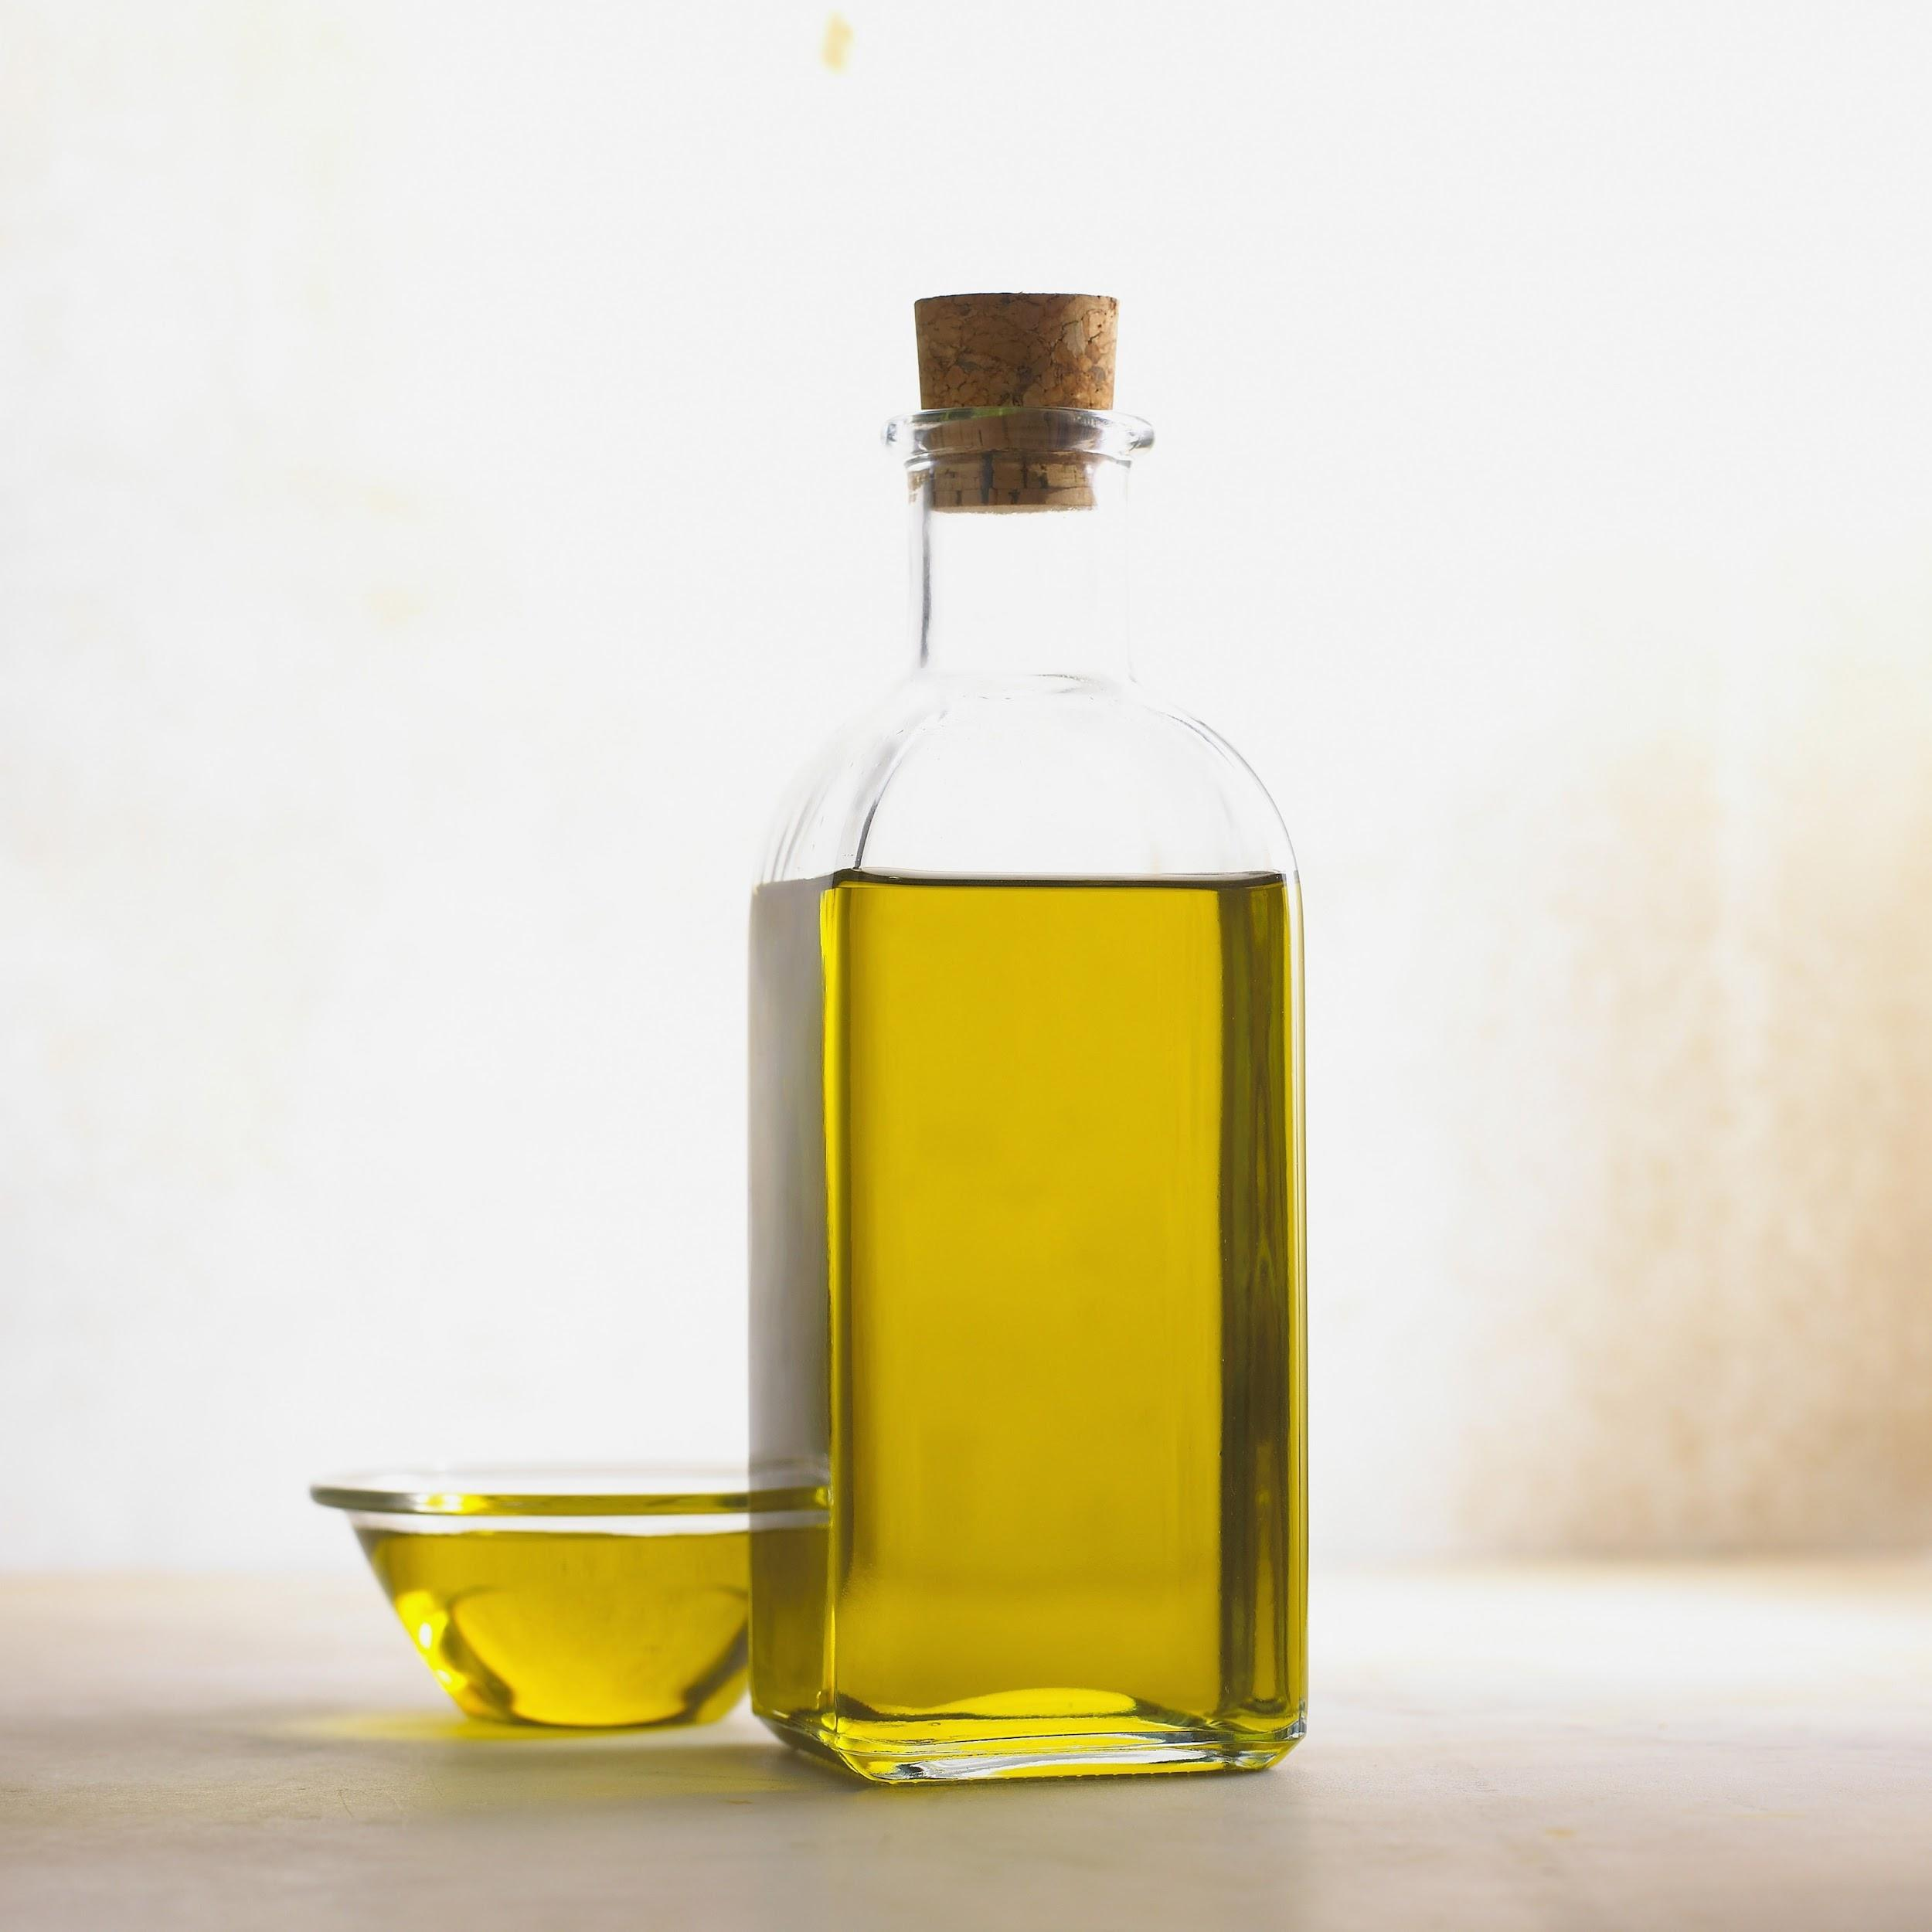
ANCIENT BEAN SOUP
Ingredients
● Parsley, 1 bunch
● Honey, 1 tablespoon
● Coriander, ½ teaspoon
● White beans, 2 cups
● Onions, 3 (finely-chopped)
● Salt and pepper to taste
● Water, 2 cups
● Olive oil, 2 tablespoons
● Beef broth, 2 cups
● Lard, 7 oz.
● Garlic cloves, 2

Slide 4
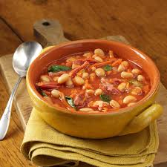
PREPARATION
● soak the beans in water the previous day and let it soak overnight
boil them for approximately 5 to 7 minutes
● let it remain that way for about an hour
● put the bay leaf and beans into the beef broth and let it boil slowly for about 2 hours
●sauté the onion in the lard
mix the coriander, the parsley, the salt and pepper
● add this to the beans
● add honey and allow it to boil slowly again
add the cloves and garlic
garnish with parsley or coriander
Tada! The soup is ready
to be eaten.

Slide 5
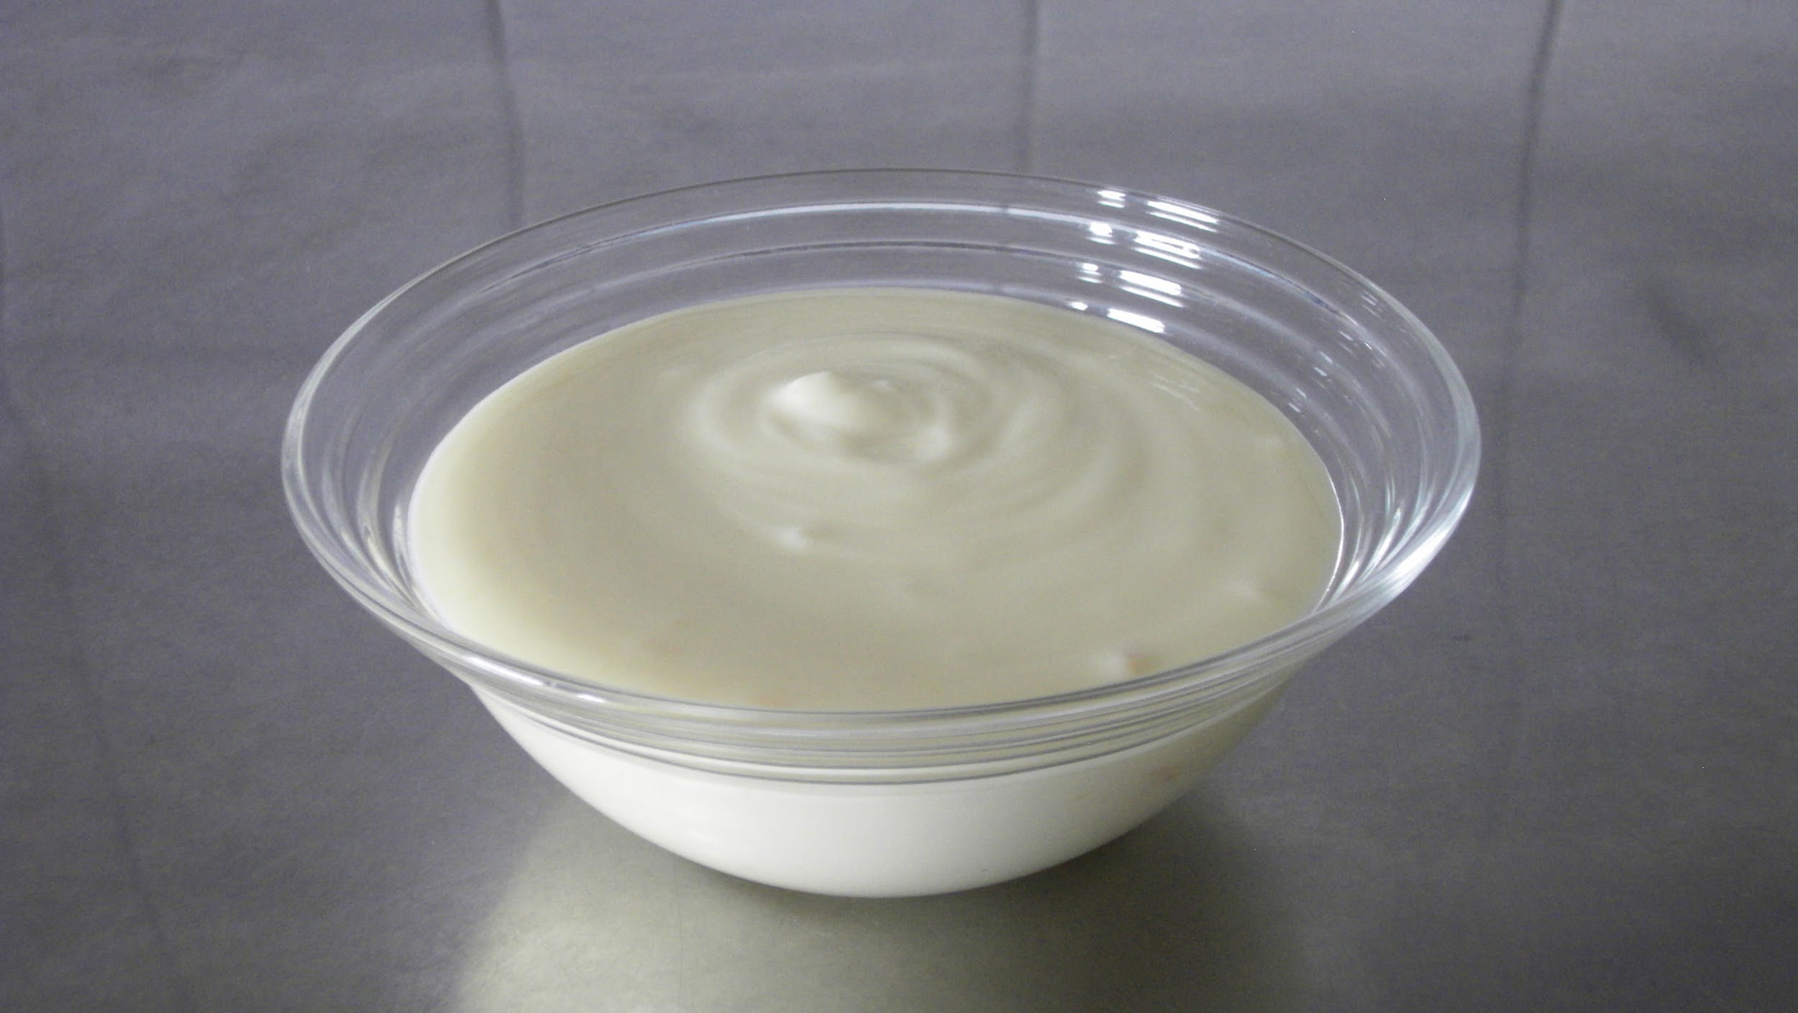
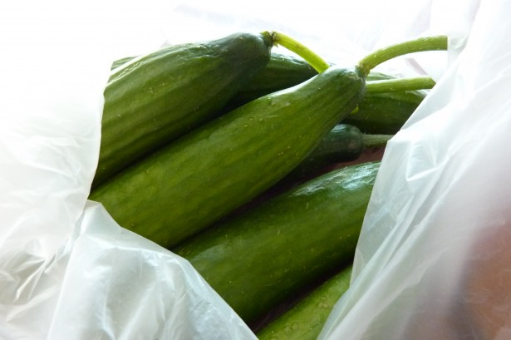
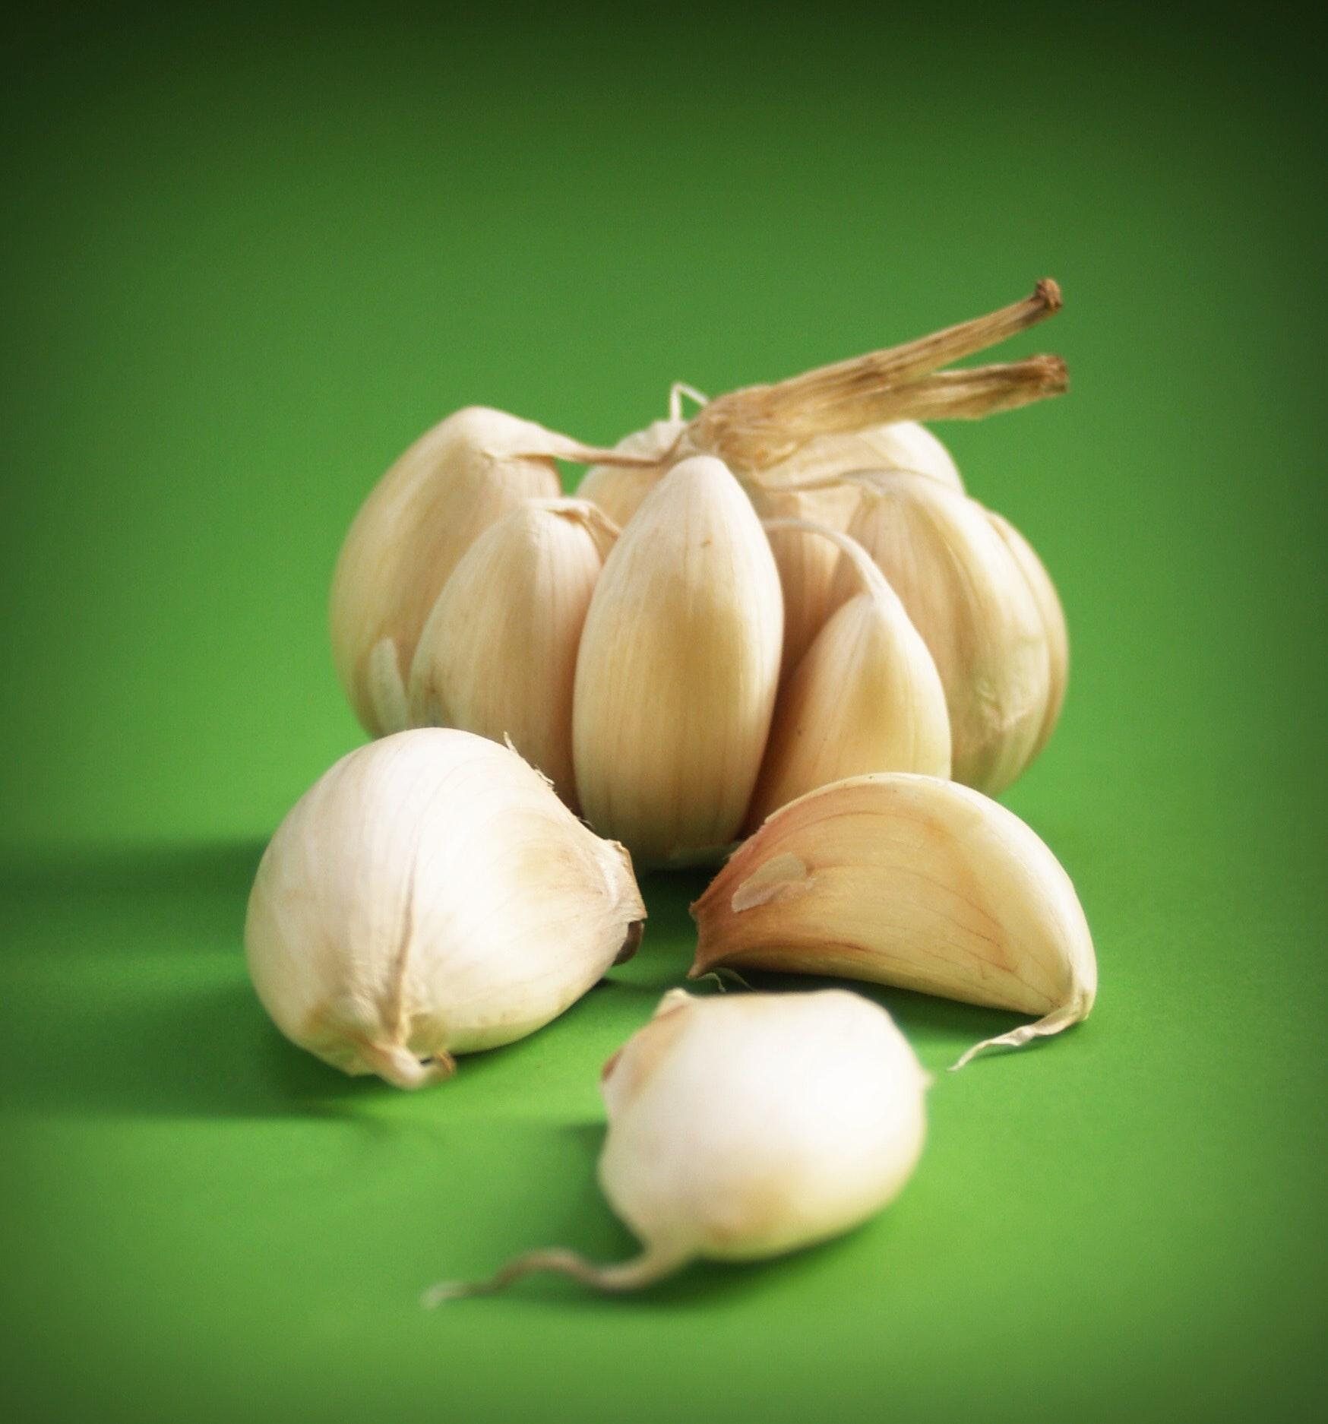
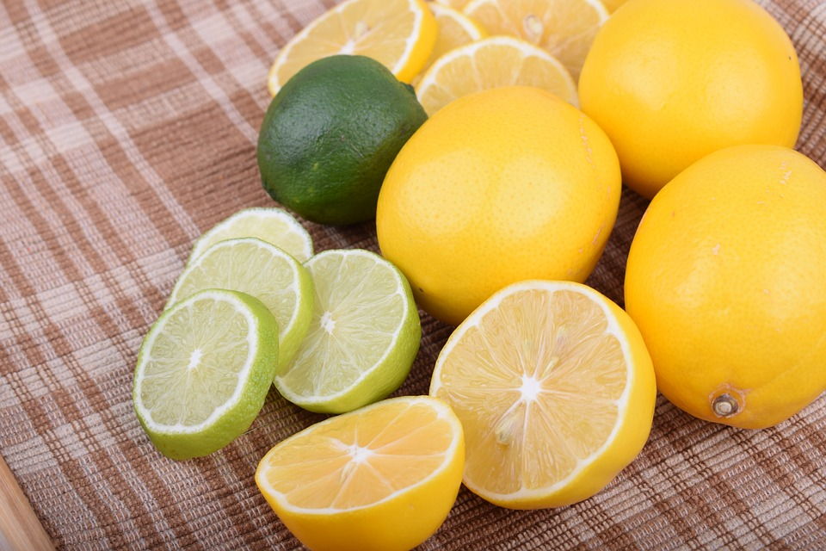
TZATZIKI
Ingredients
● Greek yogurt, 16 oz. (strained)
● Lemon juice, 2 teaspoons
● Cucumber, ½ cup (diced or grated)
● Garlic cloves, 5 - 10 (finely-chopped)
● Olive oil, 1 tablespoon

Slide 6
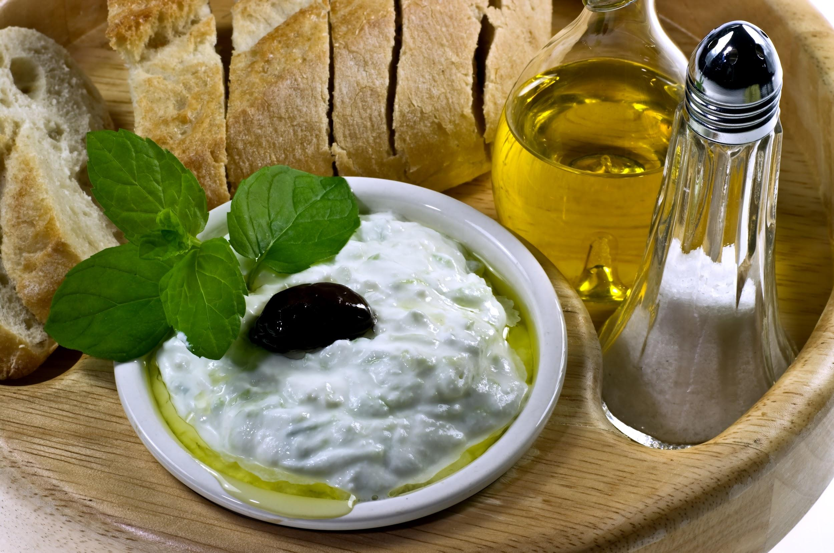
PREPARATION
● grate the cucumber
● mix oil and lemon juice in a mixing bowl
● add garlic, according to taste, and cucumber
Keep stirring until the garlic and the cucumber are evenly distributed
● garnish it with a bit of green
serve well chilled
Notes:
green for example spearmint, basil, parsley

Slide 7
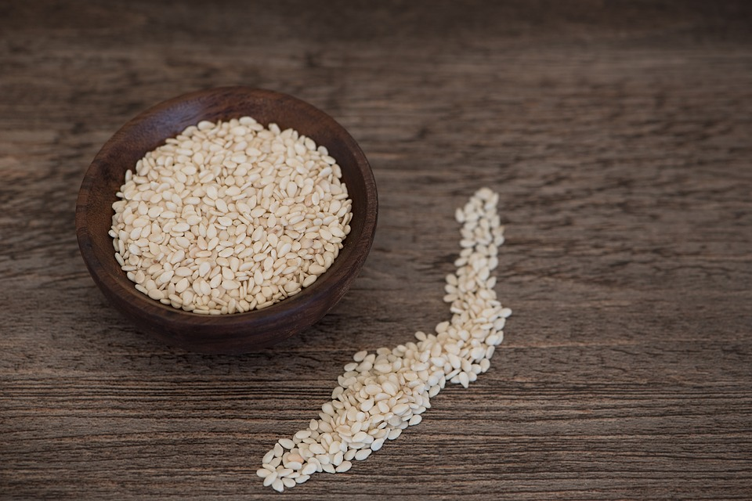
sesame honey candy(pasteli)
Ingredients
11/3 cups honey
3 cups white sesame seeds(hulled)
Optional:1 strip lemon peel

Slide 8
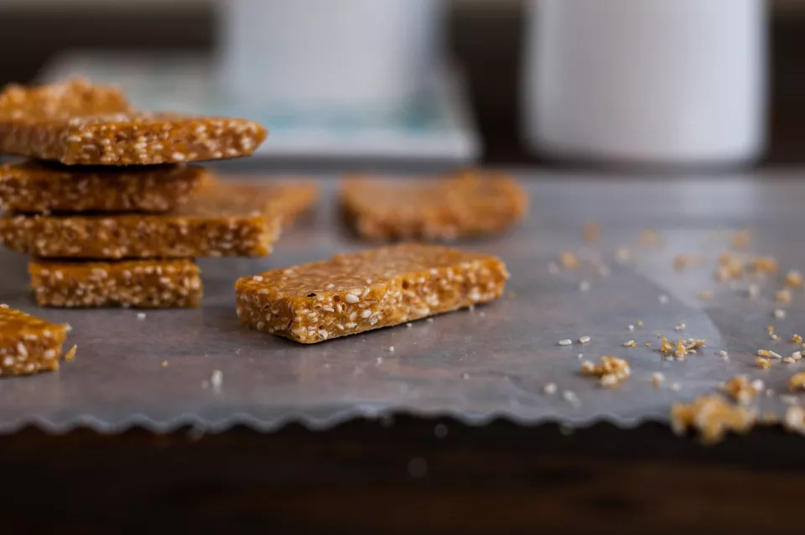
Preparation
Βring the honey & the lemon peel to a boil.
Add the sesame seeds.
Place a piece of baking parchment on a cool work surface and spread out the mix thinly and evenly.
When the pasteli cools to room temperature, refrigerate it on the parchment paper.
Chill for at least 2 to 3 hours

Slide 9
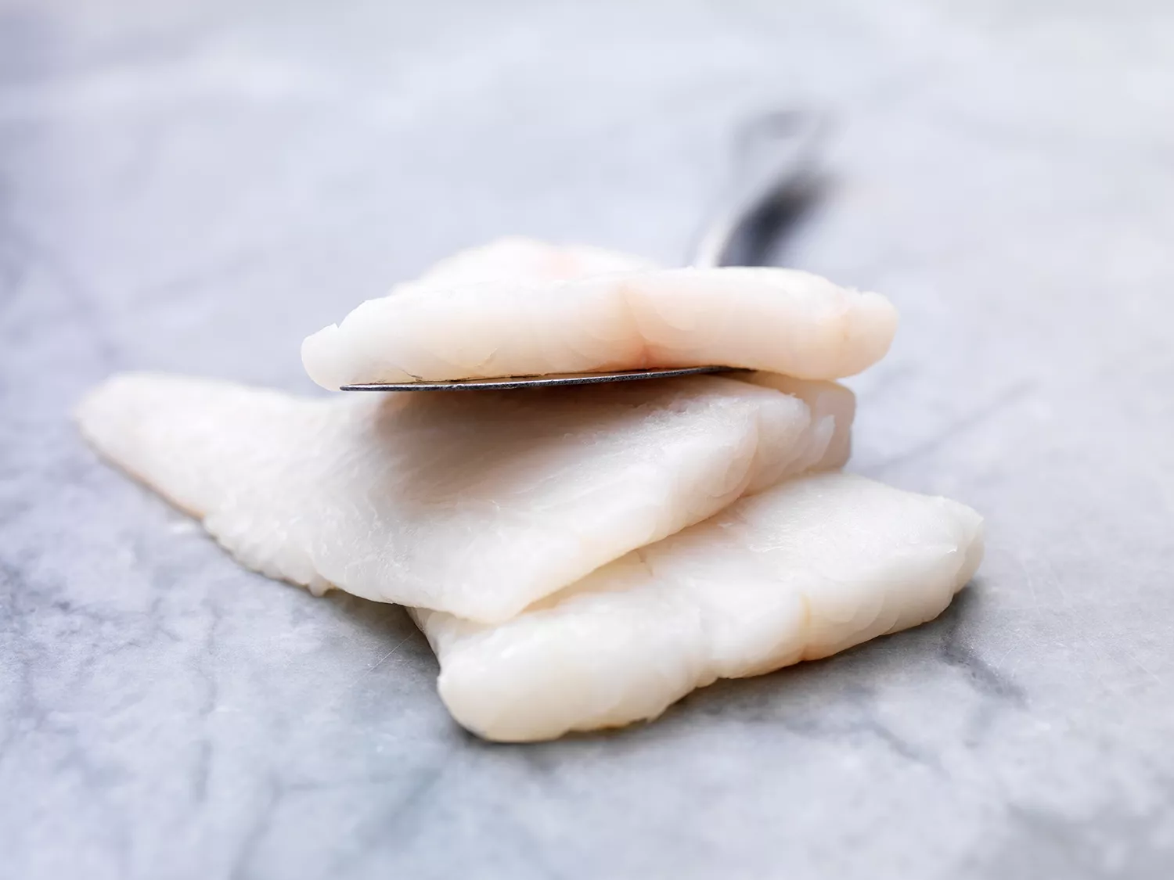
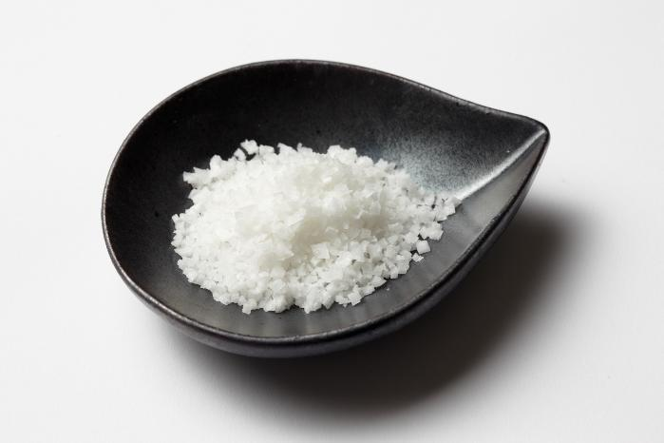
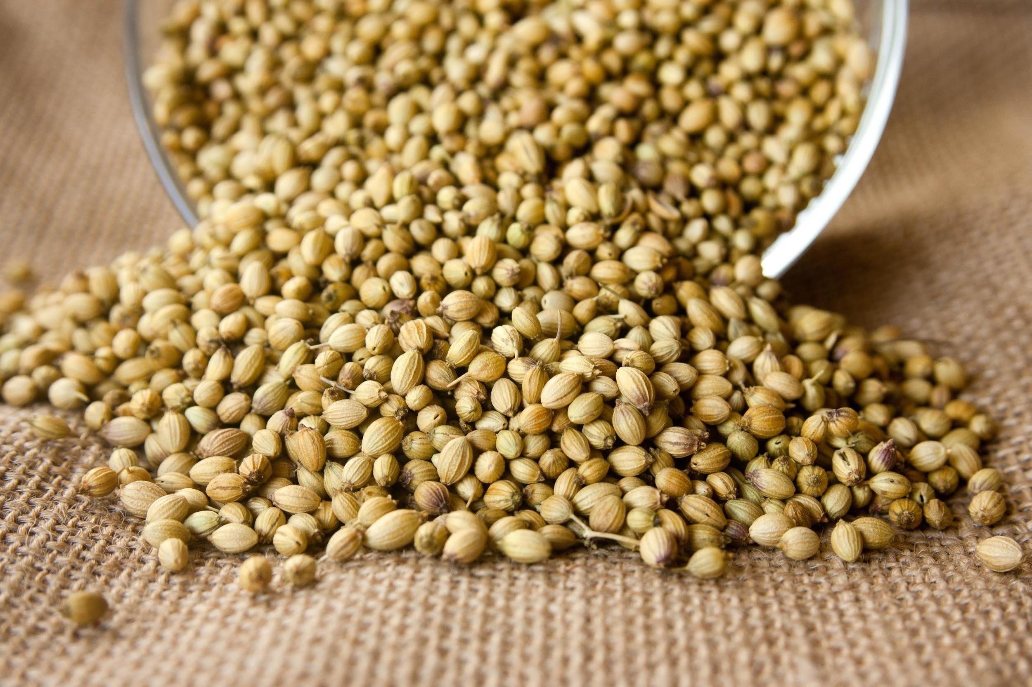
cod with coriander
Ingredients
2 spoons of coriander seeds
1 teaspoon salt
2 steaks cod
vinegar,made of white wine

Slide 10
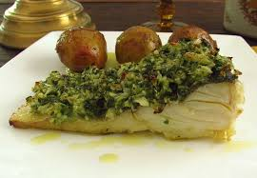
preparation
preheat the oven at 190C.
Place the coriander seeds in a baking pan and bake them for 10 min.Let them cool for some minutes.
Mash them with a mortar with salt.
Drain the fish steaks and remove any tiny bones you can find.
Sift them with the coriander mixture
Bake the fish for 20-25 minutes

Slide 11
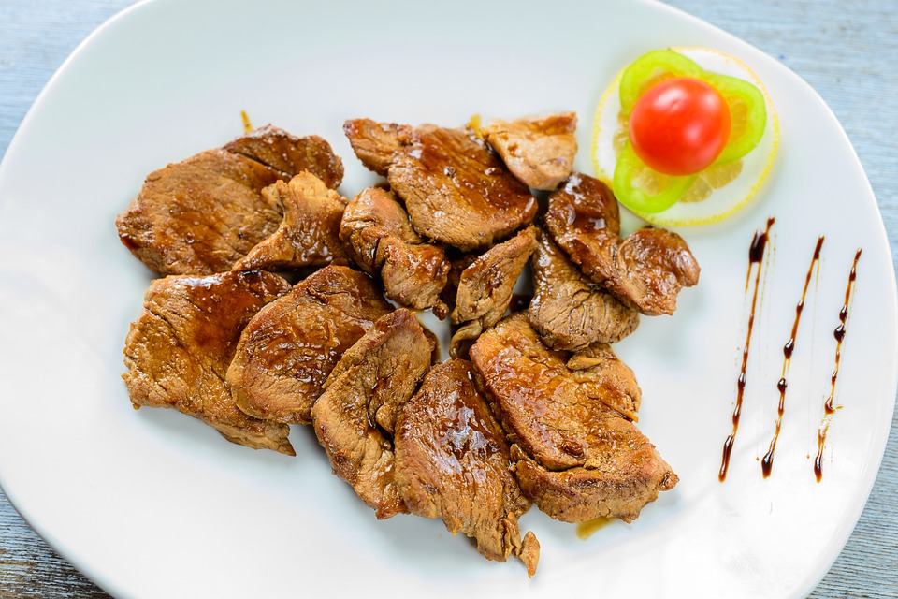
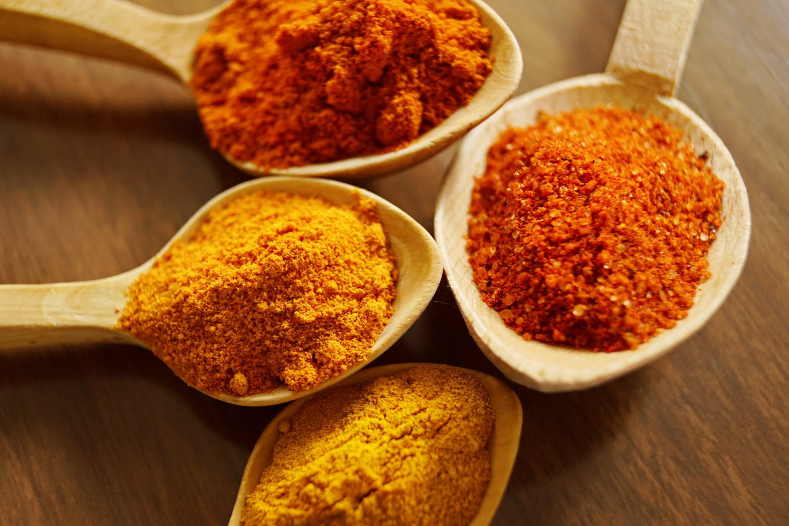
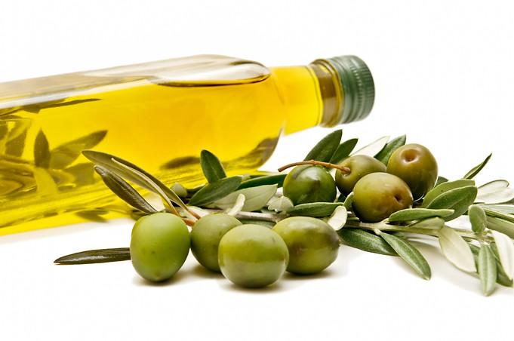
pork bites
Ingredients
800g pork tenderloin
100g fine salt
2 tbsp cumin
120ml olive oil

Slide 12
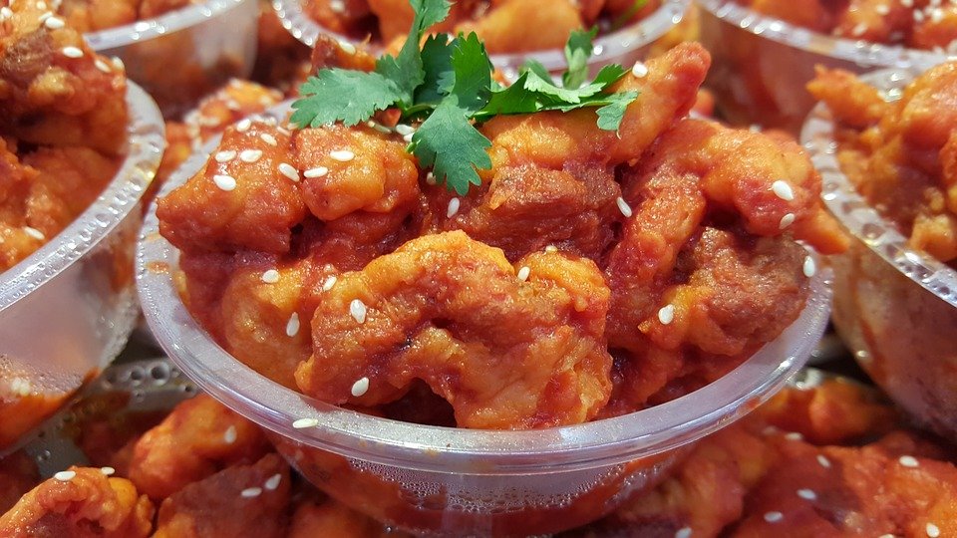
preparation
Add The salt and the cumin in a bowl.
pour over the broth of water,salt and cumin.
Cover and leave it in the fridge for 1 hour.
simmer for about 35mins until golden brown

Slide 13
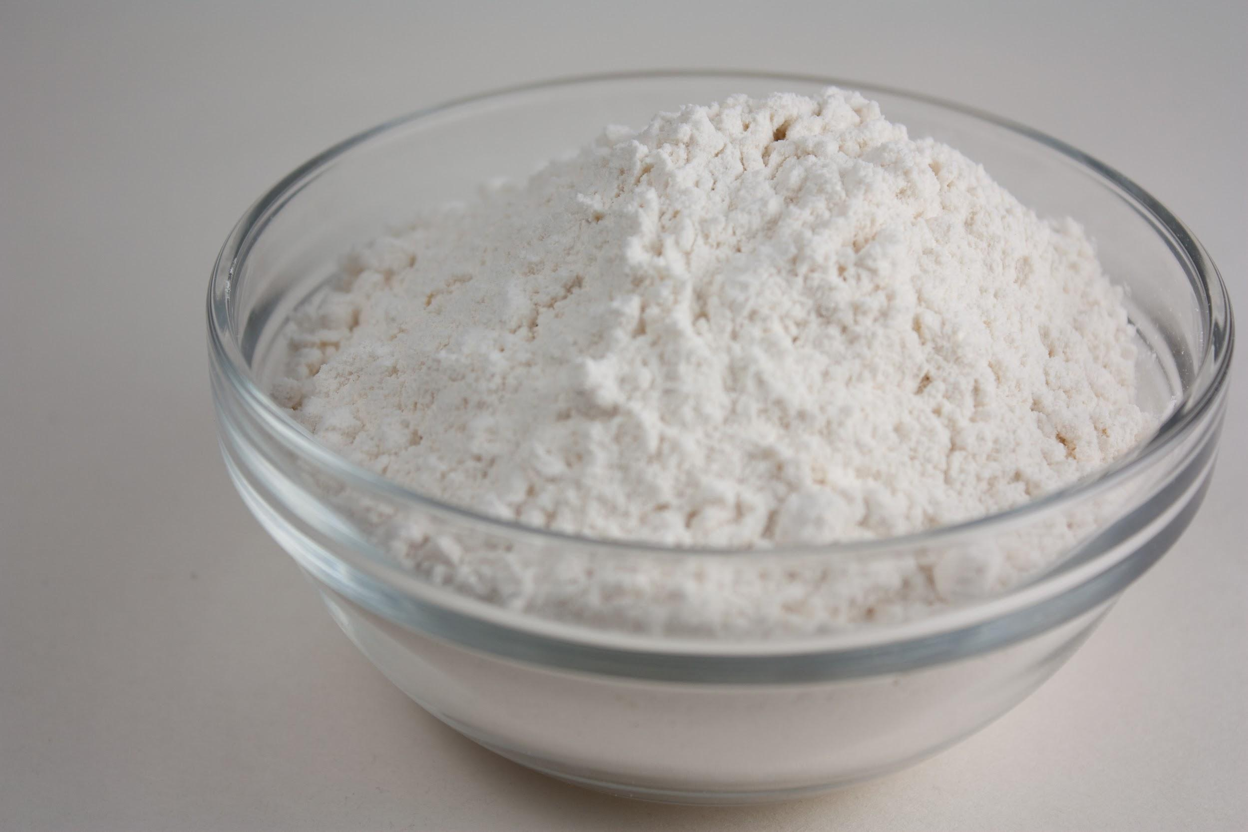
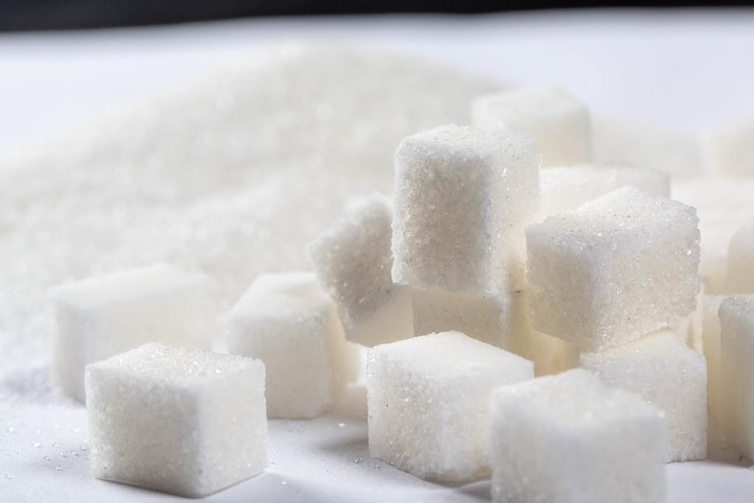
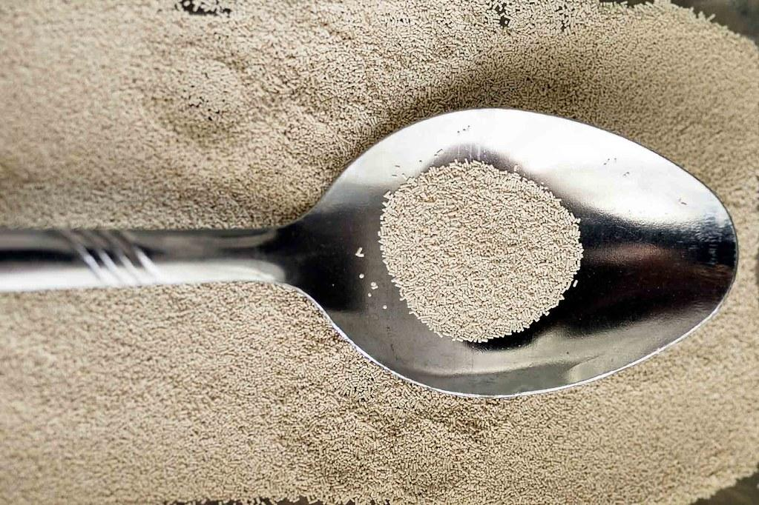
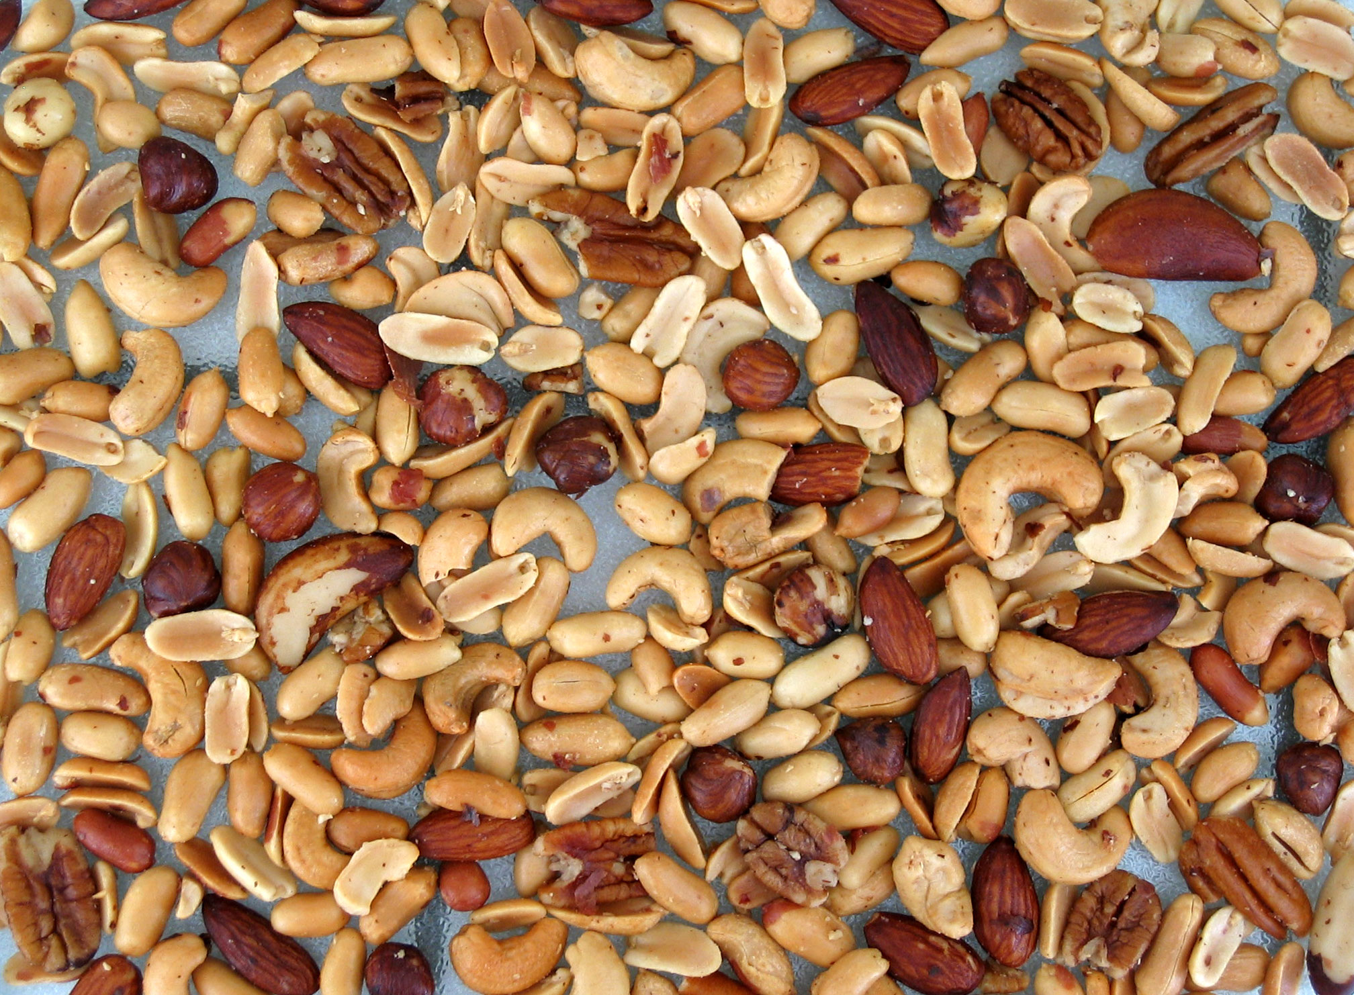
tiganites(greek pancakes)
Ingredients
500ml water
400g flour
100ml olive oil
1 tsp salt
2 tbsp sugar
1 tsp dry yeast
honey and nuts of your choice

Slide 14
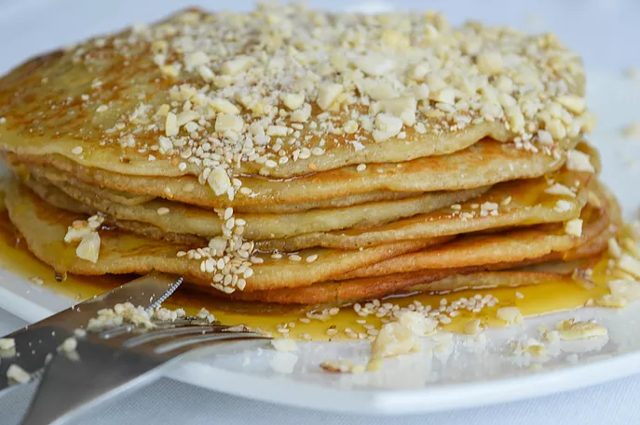
preparation
Dissolve the yeast in the water.Add the olive oil,the salt and the sugar
Add the flour to the ready liquid.Whisk the mixture into a smooth batter and leave it for 20-30 min.
Set a medium pan,grease it with olive oil.
Cook until the down side is gold.Flip and cook the other side.
Pour honey on the top until the tiganites are still hot.Add crushed nuts of your choice.

