Slide 2
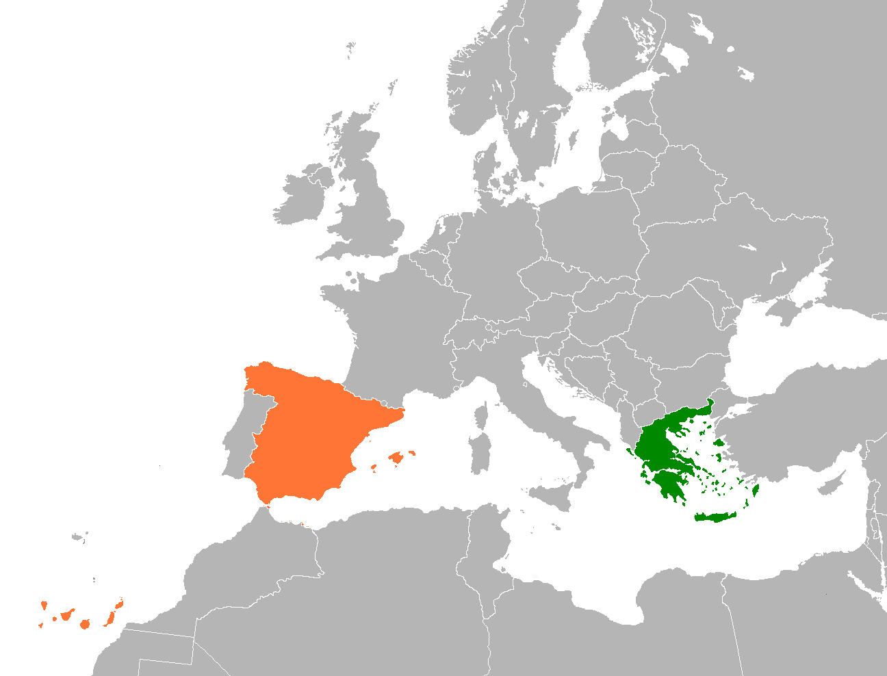
From greece to spain

Slide 3
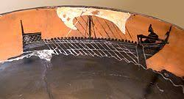
In ancient times
Parts of the Mediterranean coast of Spain were colonized by Greeks(Emporion and Rhodes,Girona,in Catalonia and possibly Zacantha and Dianion near Valencia).

Slide 4
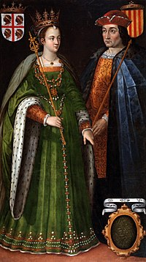
In the late middle ages
Part of Greece came under the Aragonese rule(the Duchy of Athens and the Duchy of Neopatras).

Slide 5
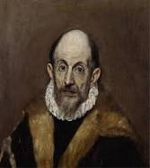
Cultural links
Painter Dominikos Theotokopoulos (better known as El Greco) was of Greek descent,as Queen Sophia of Spain.
the Sephardi Jewish community of Greece,particularly the Jews of Thessaloniki,who traditionally spoke Judaeo Spanish

Slide 6
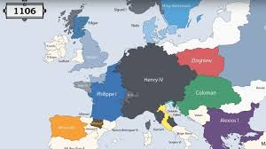
Both countries
Are the doors to Southern Europe and have shaped the Greco-Latin and Mediterranean culture,together with Italy and Portugal.

Slide 7
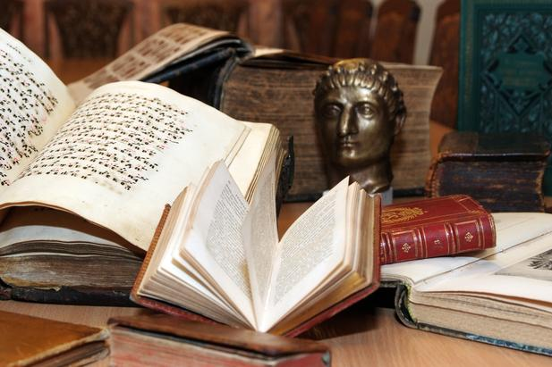
Mutual Interest in each other’s literature
Federico Garcia Lorca
Nikolaos Kazantzakis

Slide 8
Major immigration
Origin | 2007 | 2006
Greece | 3.567 | 3.027
Greece comes 11th in the chart of foreign nationals in Spain after 2001.

