Slide 2
Our Agriculture
The common Agricultural heritage across our countries

Slide 3
Medicinal Plants common among
Italy
Greece
Spain
Turkey

Slide 4
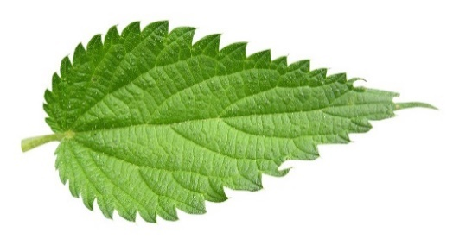
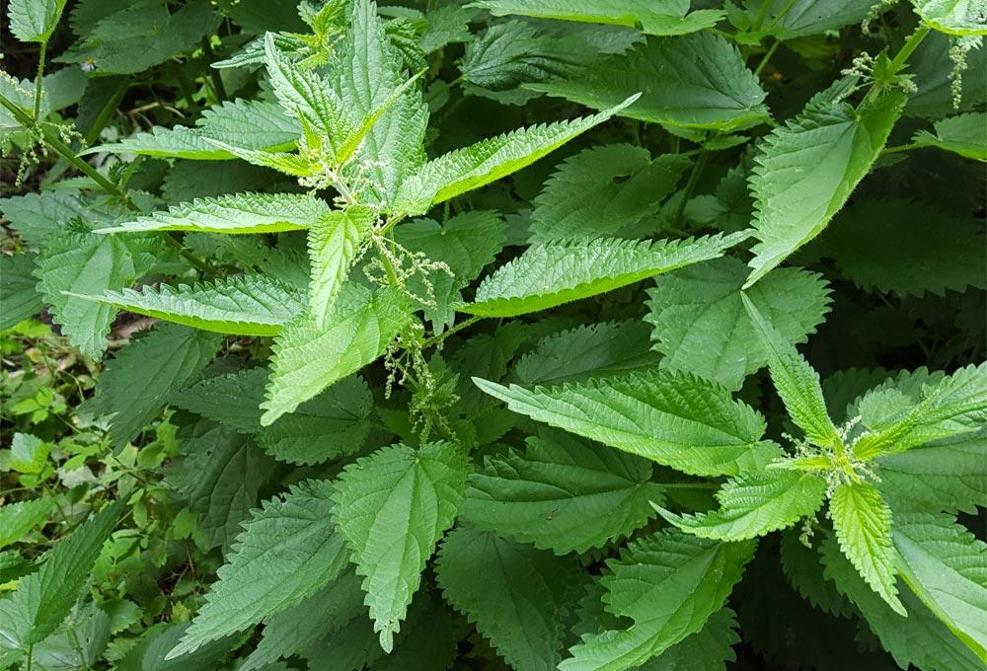
Stinging-nettle (τσουκνίδα)
Latin name : Urtica Dioica German name : Brennnessel Family: Nettle plants facts: -30-150 centimeters high -70 centimeters deep -3-5 centimeters diameter -the flowering time is from July to October - the nettles are also used for tea -Mostly the nettle leaves are used for tea. -The occurrence is almost everywhere in the world. The healing use of the nettles: The leaves, the roots and the herbs are used for the healing. The ingredients of the leaves are slightly anti-inflammatory and diuretic.
That is why they are often used in urinary tract diseases. Drugs with nettle extract are also used to treat rheumatism.

Slide 5
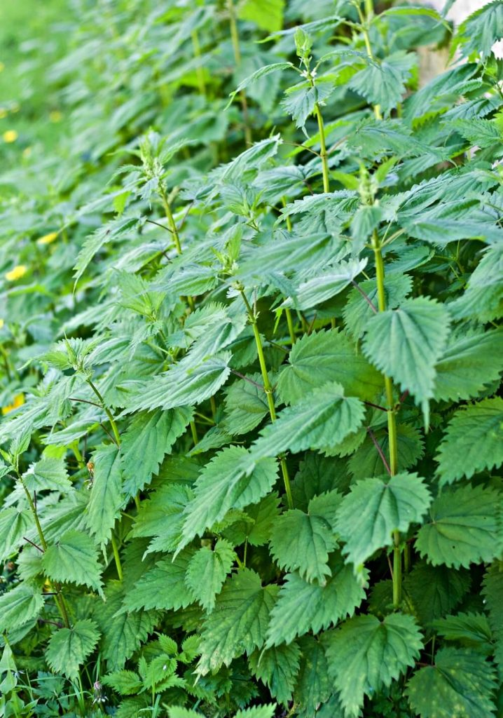
Nettle (Urtica dioica)
A herbaceous plant with quadrangular stems that can reach a meter and a half tall is the membranous nettle (Urtica membranacea).
This species generally grows in nitrate-rich soils.
The plant is covered with stinging hairs containing formic acid and, if touched, releases a stinging liquid.
The tenderest leaves are suitable for preparing soups and even hair-strengthening and anti-dandruff decoctions. For this purpose, half a kilogram of leaves is left to macerate in a liter of water.
There are several varieties of nettle present in the territory of Matera, an example is the common nettle (Urtica dioica) which is quite widespread, lives in ruderal environments in the shade and is also used as the previous one.

Slide 6
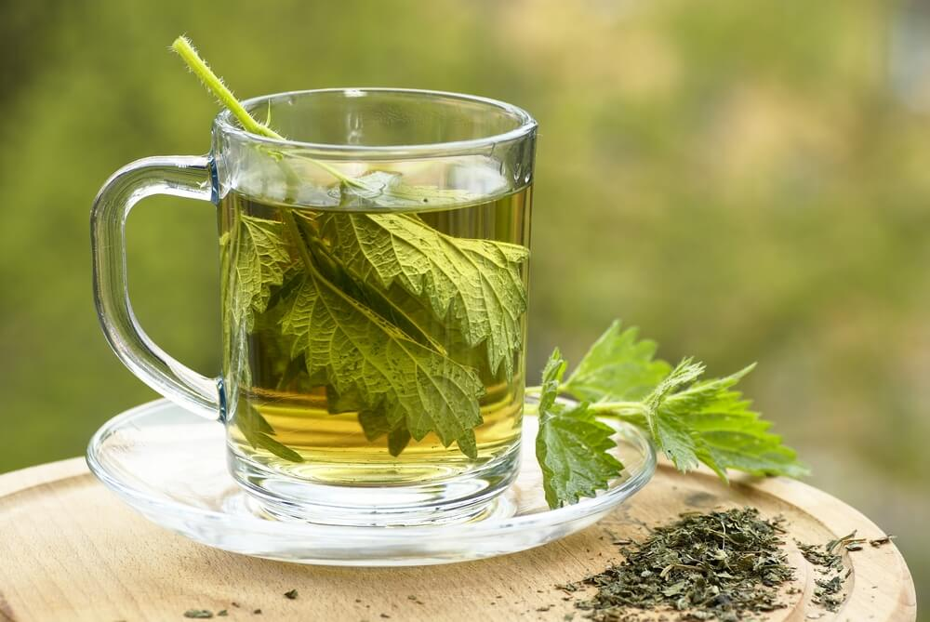
ISIRGAN ÇAYI – NETTLE TEA
Cleanses the liver and kidneys.
Strengthens the immune system.
Is diuretic
Reduces cellulite.

Slide 7
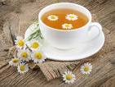
Chamomile Tea
A concentrate of nutrients
Slows down the digestive organs -
(stomach and bowel)
relieving from pain at digestion
is also a mild laxative
with anti-inflammatory and bactericidal properties
from the Greek χαμαίμηλον (chamaimēlon)
meaning "earth-apple"

Slide 8
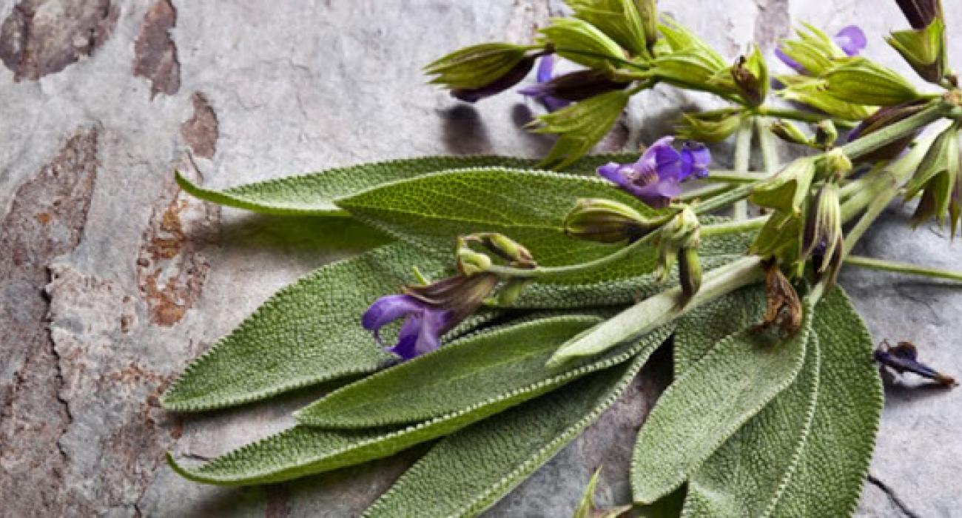
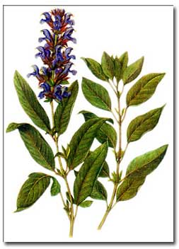
Sage
φασκόμηλο
Dioscorides, (now known as the father of pharmacology), reported that sage can help stop wounds from bleeding, help disinfect sores and promote healing of ulcers. He also used sage juice to treat coughs and hoarseness.
Helps relieve Alzheimer’s disease symptoms
Helps boost memory in young and healthy adults.
Assists in lowering cholesterol and blood glucose

Slide 9
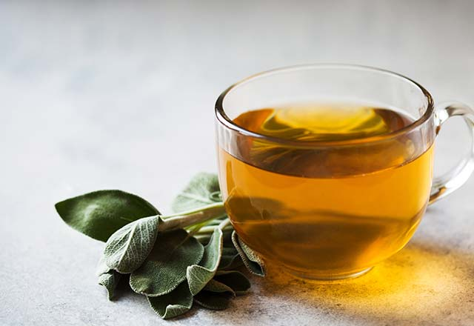
ADAÇAYI - SAGE
Heals wounds and urinary tract infections
Cleanses the liver
Slows down the whitening of the hair
Reduces stress
Lowers blood sugar.

Slide 10
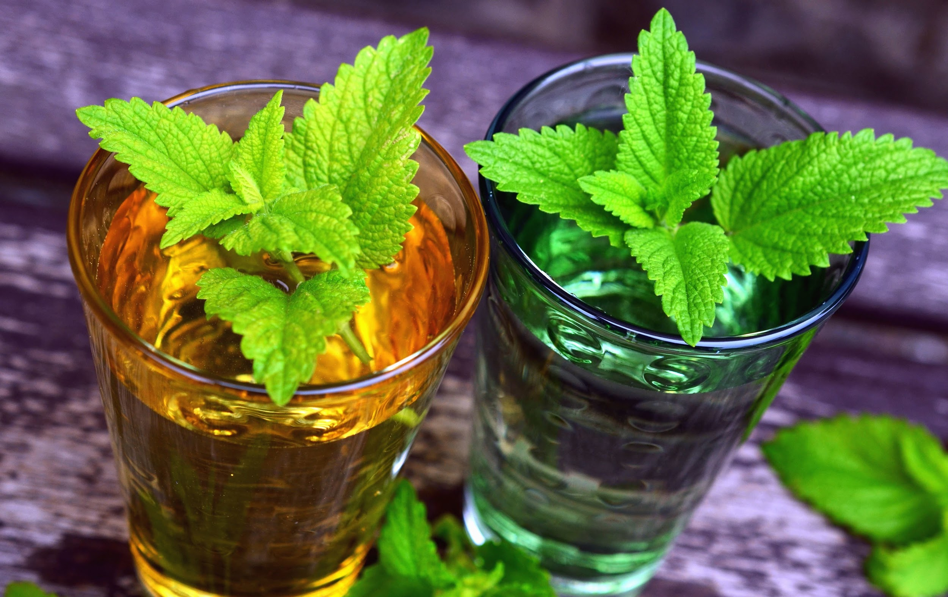
MINT and Spearmint - μέντα και δυόσμος
Help relieve from irritable bowel syndrome and indigestion
Decrease cold symptoms
Stop bad breath
Boost brain function

Slide 11
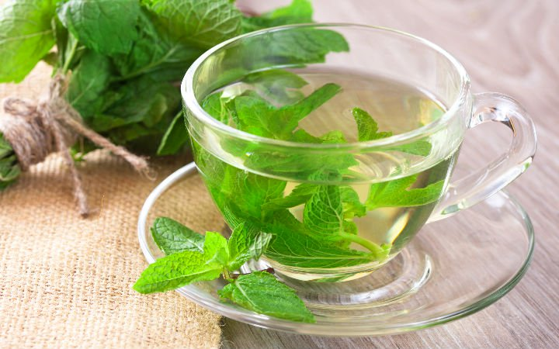
NANE ÇAYI – MINT TEA
Reduces nausea
Accelerates digestion
Lowers cholesterol
Helps calm down
Removes smells
Rich in omega 3

Slide 12
Gramigna (Cynodon Dactylon) - αγριάδα
The gramigna is a very widespread plant in the period that goes from May until December. We can find it either in small tufts or in large carpets. It has a stem from which sprout many leaves from 3 to 7 that remind a helix these are green or purple.
This plant has the roots that go very deep is that branch out in all directions, in fact the peasants to eradicate it used a particular hoe that came very deep to eradicate. This plant is very common in agricultural areas. From this plant they obtained excellent refreshing and depurative even for inflammation was also an excellent nutrition for horse and donkeys.

Slide 13
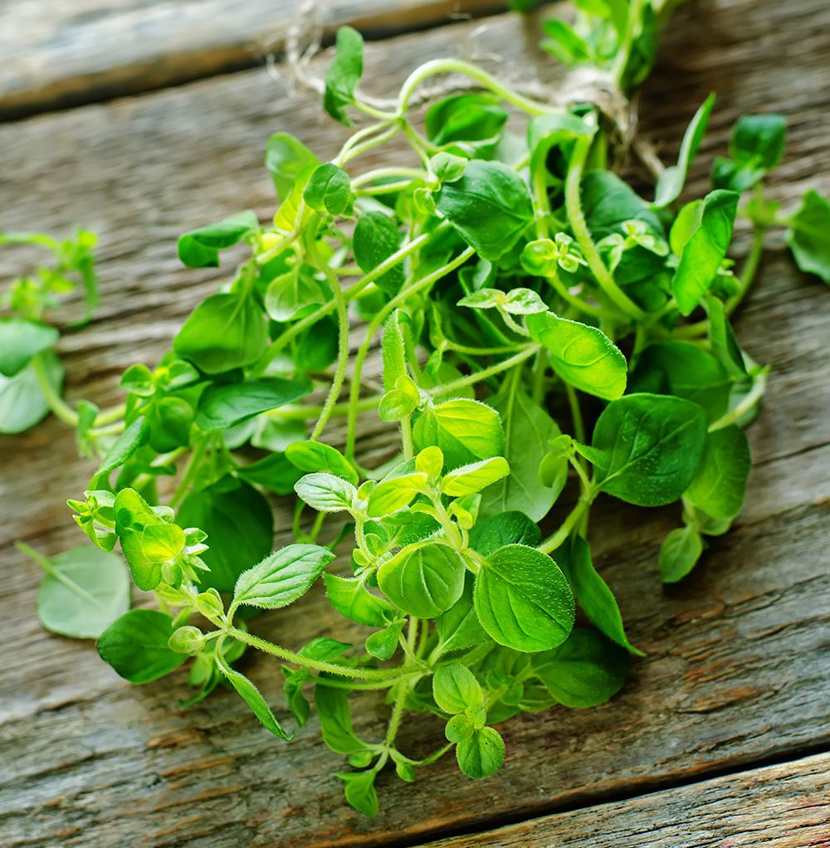
Oregano (Origanum vulgare)
It's a cultivable plant, but it's born everywhere naturally between June and July.
To receive the aroma the flowered ends are joined in bunches and they are left to dry under the sun for a week. Then the bunches are rubbed in the hands and the fragments are collected. These will be sieved to collect the aromatic component that will be placed in glass beaker.
Southern oregano was the spice of the poor and it was one of the basic ingredients of the people's diet.
Even today it is the most typical ingredient of
Mediterranean foods, like our slice of toasted bread, flavoured with garlic and oregano and seasoned with oil, salt and tomatoes.

Slide 14
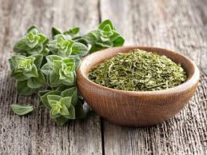
Oregano
Oregano is a culinary herb,
used for the flavor of its leaves,
which can be more flavorful
when dried than fresh
It has an aromatic, warm,
and slightly bitter taste,
which can vary in intensity

Slide 15
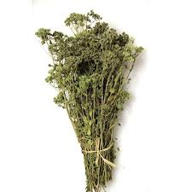
spice and medicine
native to temperate Eurasia and the Mediterranean region
The herb is widely used in cuisines of the Mediterranean Basin, the Philippines, and Latin America, especially in Argentinian cuisine
used in Greece to add flavor to Greek salad, and is usually added to the lemon-olive oil sauce that accompanies fish or meat grills and casseroles
Kills germs when drunk hot!

Slide 16
Rosemary (Rosmarinus officinalis) δενδρολίβανο
Rosemary is a plant that can be found in the
form of large bushes that can exceed a meter
in height. It has characteristic pale blue or
lilac or white or pink flowers; these are very
attractive to bees and allow them to produce a
lot of nectar.
The plant, originally from the Mediterranean,
since ancient times was used for:
- cover scent and aromatize;
- favour the digestion;
In more ancient times, intertwined to form
funeral crowns and bee grazing;
The branches used for decoctions to remedy
the colds.
Owns various properties, such as:
Tonic, stimulating and strengthening for the
body;
Pain reliever, antiseptic, antiparasitic,
antibacterial and anti-inflammatory.

Slide 17
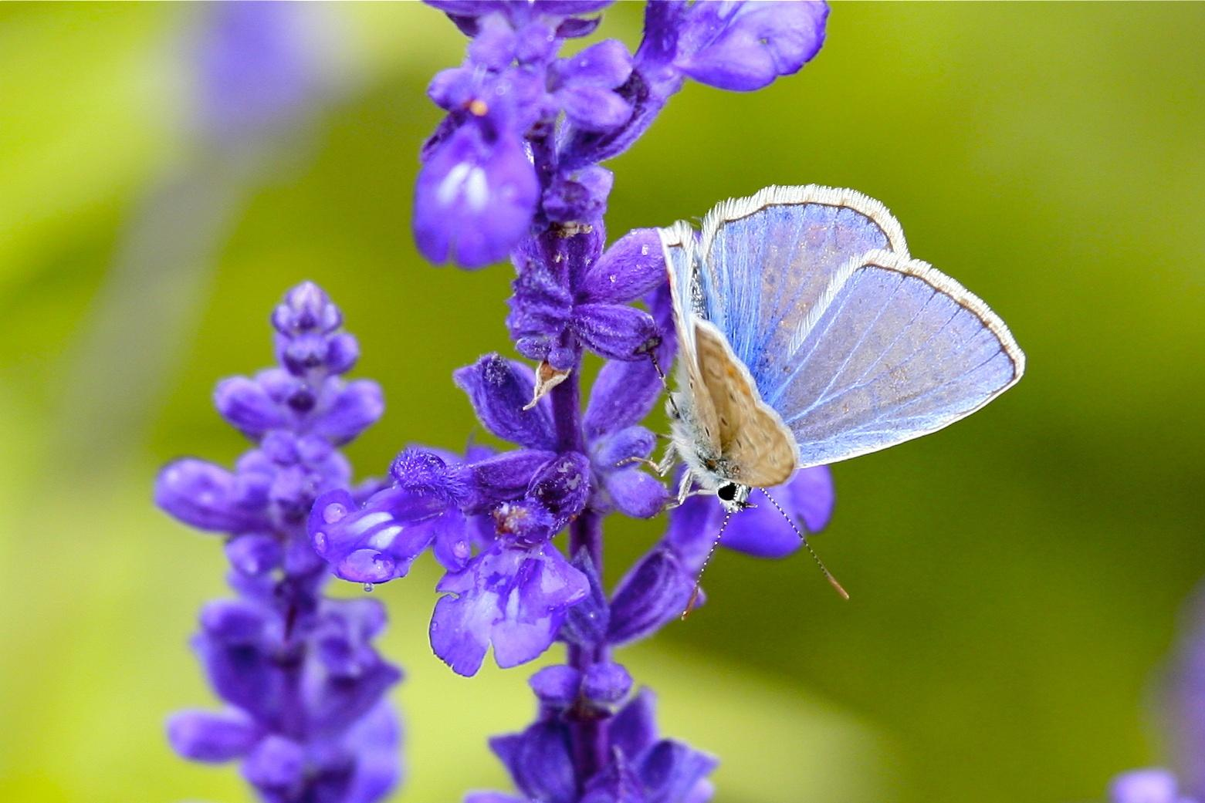
Lavender - λεβάντα
Treats anxiety and depression
Heals wounds and eczema
Stops nausea, hair loss and fungal infections
Repels insects

Slide 18
Thyme (Thymus capitata) - θυμάρι
Thyme is an aromatic perennial evergreen herb with culinary, medicinal, and or
It is an evergreen shrub, in flower from July to September. It is pollinated by Bees, flies, Lepidoptera and it is noted for attracting wildlife.
Together with oregano is one of the most used aromatic plants in the local traditional cuisine
The leaves, and especially the essential oil contained in them, are strongly antiseptic, deodorant and disinfectant. The plant can be used fresh at any time of the year, or it can be harvested as it comes into flower and either be distilled for the oil or dried for later use.

Slide 19
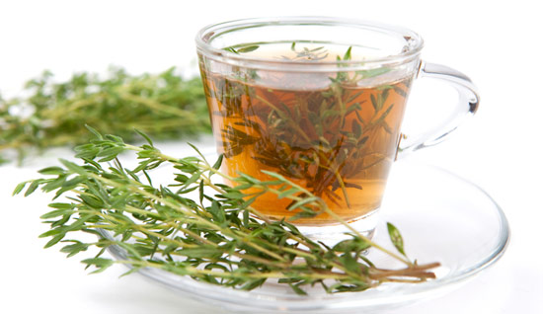
THYME TEA
Relieves sore throat
Reduces cough
Soothes headaches
Antioxidant
Antiseptic

Slide 20
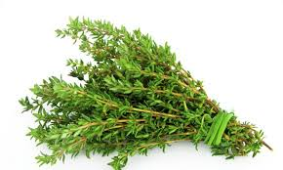
Thyme
has antibacterial, insecticidal, and antifungal properties
fresh and dried herbs
essential oil

Slide 21
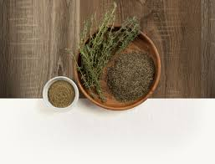
Uses as traditional medicine
Thyme contains Thymol,
one of the biocides
that can destroy infectious bacteria

Slide 22
Laurel (Laurus nobilis) - δάφνη
The laurel is an aromatic plant used in the
kitchen, officinal as a natural remedy and ornamental to
realize gardens, hedges and flower beds.
It comes in the form of shrub but it is a real tall tree up to 10 meters.
The ovals leaves are dark green, shiny at the top and opaque in the lower part, they are very fragrant.
The leaves thanks to their essential oils can be used for various uses:
-in the kitchen to flavor meats, fish and legumes;
-in the wardrobes to remove moths;
-to make decoctions from digestive, antiseptic and antioxidants qualities;
-treated with the alcohol is obtained an aromatic liqueur.
From the pounded berries is obtained the laurel oil used to massage the back, the chest in case of cold and cough.

Slide 23
Fennel (Foeniculum vulgare) - μάραθος
Fennel is a Mediterranean herbaceous plant known since ancient times for its aromatic properties.
Wild fennel is a spontaneous, perennial plant with a ramified stem up to 2 m high. It has leaves that remind the hay of green color and produces umbrellas of small yellow flowers in summer. The fruits follow, first green and then greyish.
The main use is the carminative one, that is, it helps to eliminate intestinal gases and prevents its formation. It is used for those with digestive difficulties. It is particularly indicated for breastfeeding because it increases milk production. Fennel has a quality of emmenagogue, diuretic, antiemetic, aromatic, antispasmodic, anti-inflammatory, liver tonic. Normally the dried fruits are used in infused, but it is also possible to find the freeze-dried sachets or the essential oil on the market.

Slide 24
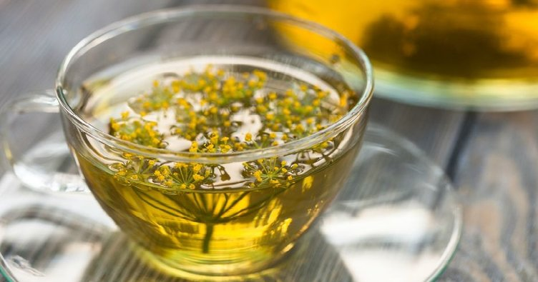
REZENE ÇAYI – FENNEL TEA
Increases milk in breast-feeding women.
Relieves stomach pain
Helps digest

Slide 25
Chicory (Cichorium intybus) - σταμναγκάθι
The common chicory is a herbaceous plant, perennial with bright celestial flowers, belonging to the Asteraceae family.
The biological cycle is perennial, but sometimes even annual; in the first year a basal rosette of leaves appears, while the flower stem appears only at the second year of life of the plant.
The leaves are born during the autumn, they last during the winter, but they dry up immediately at the next flowering, so it is easy to find plants with branches with only flowers.
Active principles: in the roots there are bitter substances, but also sugars, choline, inulin, potassium, calcium and iron.
The flower, the leaves and the roots all have curative effects. Chicory tea can be used as a remedy for rheumatics, gout, and arthritis. It purifies the liver, kidney and spleen, excretes urine, enhances the appetite and has positive effects against jaundice. Chicory decreases the level of triglyceride and cholesterol in blood.
-In the kitchen the most frequent use is that of leaves in salads (fresh or cooked). If the fresh leaves are used constantly, the medicinal benefits described above are also obtained.

Slide 26
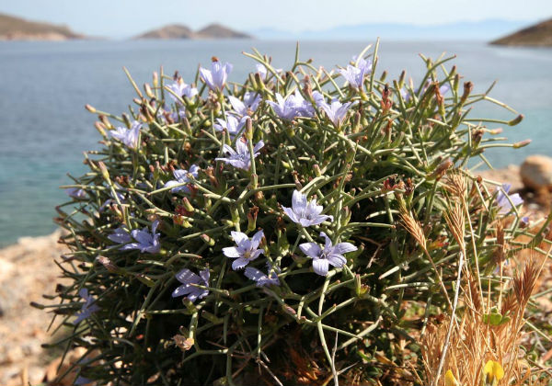
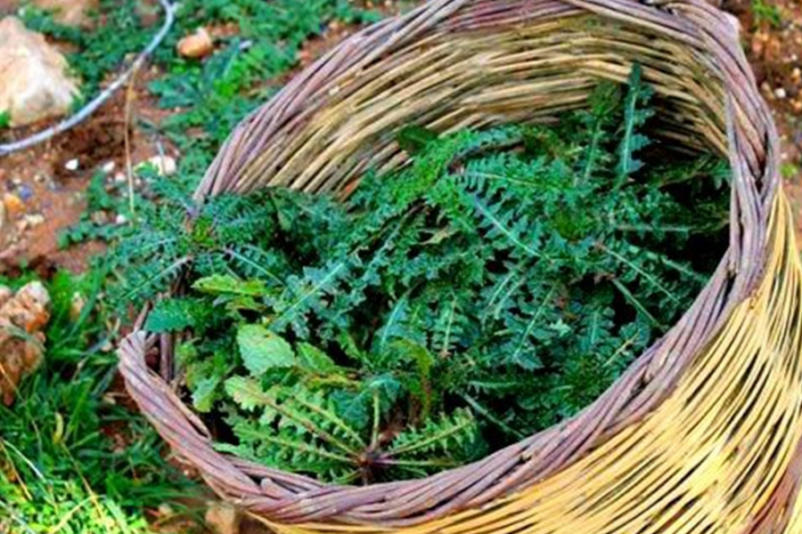
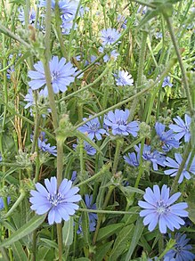
Cichorium
three species of Cichorium found only in Greece:
Cichorium hybridum Halácsy
Cichorium pumilum Jacq.
Cichorium spinosum L.

Slide 27
Winter savory (Satureja montana) - αρτεμισία
The Winter savory is an aromatic plant
belonging to the Lamiaceae family.
It grows in the warm and sunny Mediterranean countries (also the area of ​​the Murgia). It is also native to the Alps and the calcareous mountains of Dalmatia and Croatia.
The savory is a small, broad-leaved perennial shrub and reaches
a height of 20 - 50 cm.
It is an aromatic plant that emanates a fragrance that competes with that of the thyme it is associated with.
Uses:
antiseptic function (used by farmers to treat vines against downy mildew);
digestive function (helps food digestion);
in phytotherapy for diabetes;
in the kitchen it is used to flavor many dishes and to obtain herbal teas from the leaves.

Slide 28
Dog Rose (Rosa canina) - σκυλάκι
Rosa canina, is a variable climbing, wild rose species native to Europe, northwest Africa, and western Asia.
It is a deciduous shrub normally ranging in height from 1–5 metres, though sometimes it can scramble higher into the crowns of taller trees. Its stems are covered with small, sharp, hooked prickles, which aid it in climbing.
The plant is high in certain antioxidants. The fruit is noted for its high level of vitamin C, and is used to make syrup, tea, and marmalade
Orally, dog rose is also used for stomach disorders. It is also used for diarrhea, constipation, lower urinary tract and kidney disorders, fluid retention, gout, diabetes, high cholesterol, weight loss, high blood pressure, chest ailments, fever, increasing immune function during exhaustion, increasing blood flow in the limbs, increasing urine flow and quenching thirst.

Slide 29
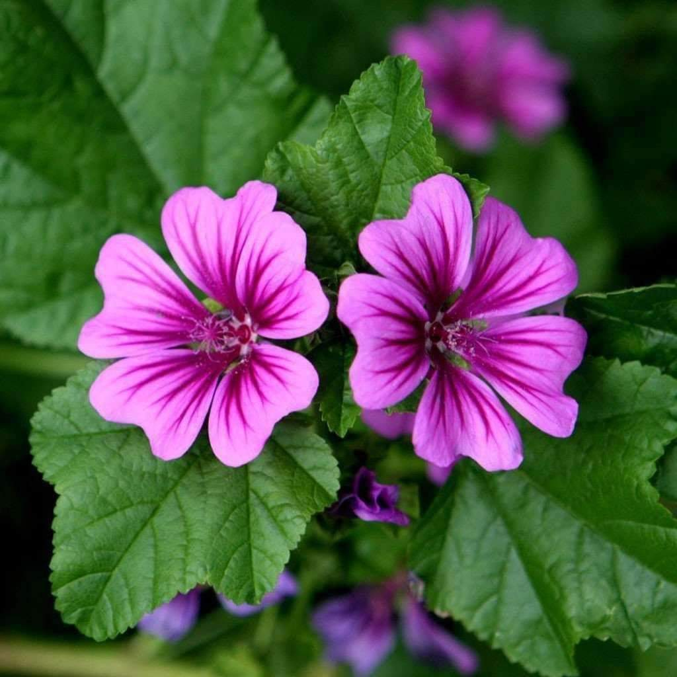
Mallow (Malva sylvestris) - μολόχα
The mallow is a collection of plants from the Malvaceae family. Widespread along the paths, between the margins of the roads, it has the characteristic of having pinkish-colored flowers with purple stripes to indicate to the insects the ways of the nectar, with an erect stem that can grow up to 60-80cm.
Due to its high content of mucilage, it has an intense emollient, anti-inflammatory action of the mucous membranes of the oral cavity, of the intestinal and respiratory gastro. the dried flowers of the mallow in decoction were used to calm the cough. Mallow flowers and nettle branches, boiled in water, were applied to sunburn. The mallow, which grows on the high ridges of the Gravina, was widely used in the past in Matera, for medicinal use.

Slide 30
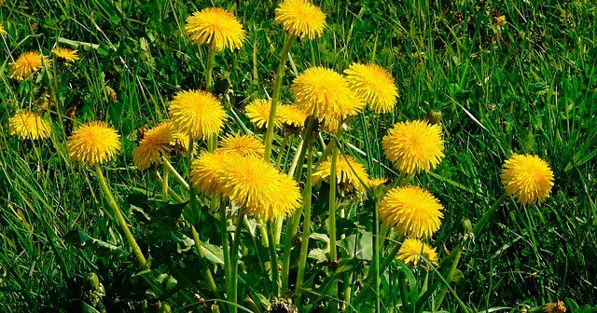
Karahindiba - Dandelion - πικραλίδα /ταραξακο
Dandelion with a high nutritive value gives the body power and fitness.
Soothes sore throat
Reduces cough
Is diuretic
Helps reduce kidney
and gallstones

Slide 31
Asparagus (Asparagus acutifolius)
Asparagus is a spring vegetable. It can grow from 100 to 150 cm. The leaves are needle like, they are 6-32 mm long and 1 mm broad and clustered four to 15 together . The flowers are bell-shaped, greenish-white to yellowish. The fruit is a small red berry 6–10 mm diameter, which is poisonous to humans. Only young asparagus shoots are commonly eaten: once the buds start to open the shoots quickly turn woody. Asparagus stalks are commonly consumed as a vegetable.
It can be used for its diuretic, hypoglycemic, antihypertensive, hypocholesterolemic and antioxidant effects.

Slide 32
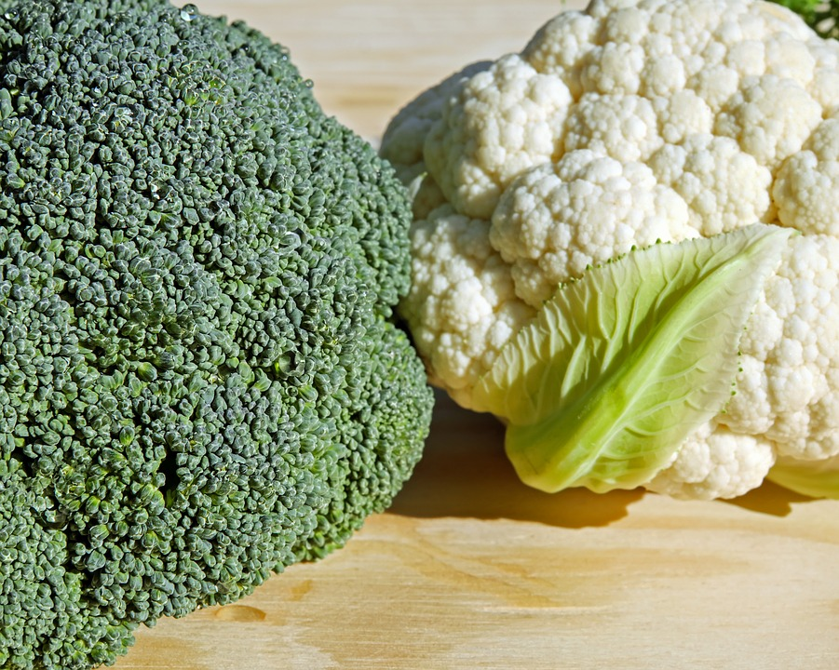
Cauliflower and broccoli
Lower the risk of cancer
Rich in Vitamin C - necessary to fight viruses
Rich in Vitamin K - necessary for bones and blood clots

Slide 33
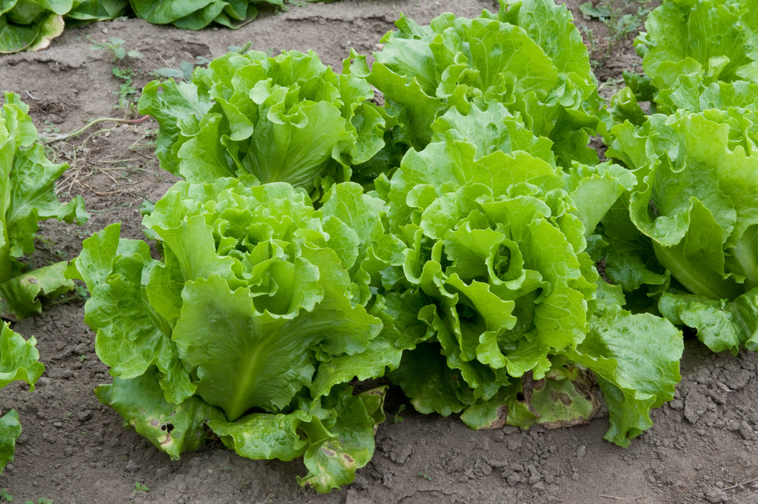
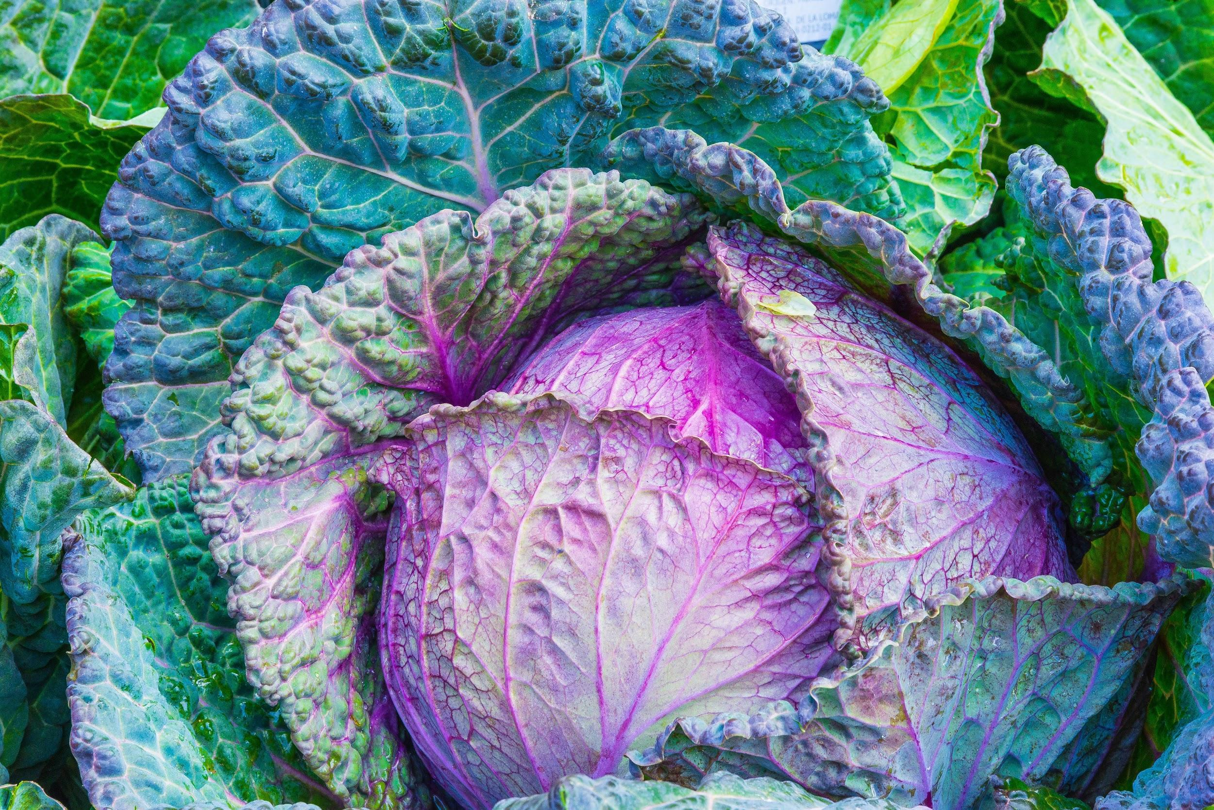
Lettuce and Cabbage
Anti-flammatory, anti-oxidant, anti-cancer
a low-calorie vegetable that is rich in vitamins, minerals and antioxidants

Slide 34
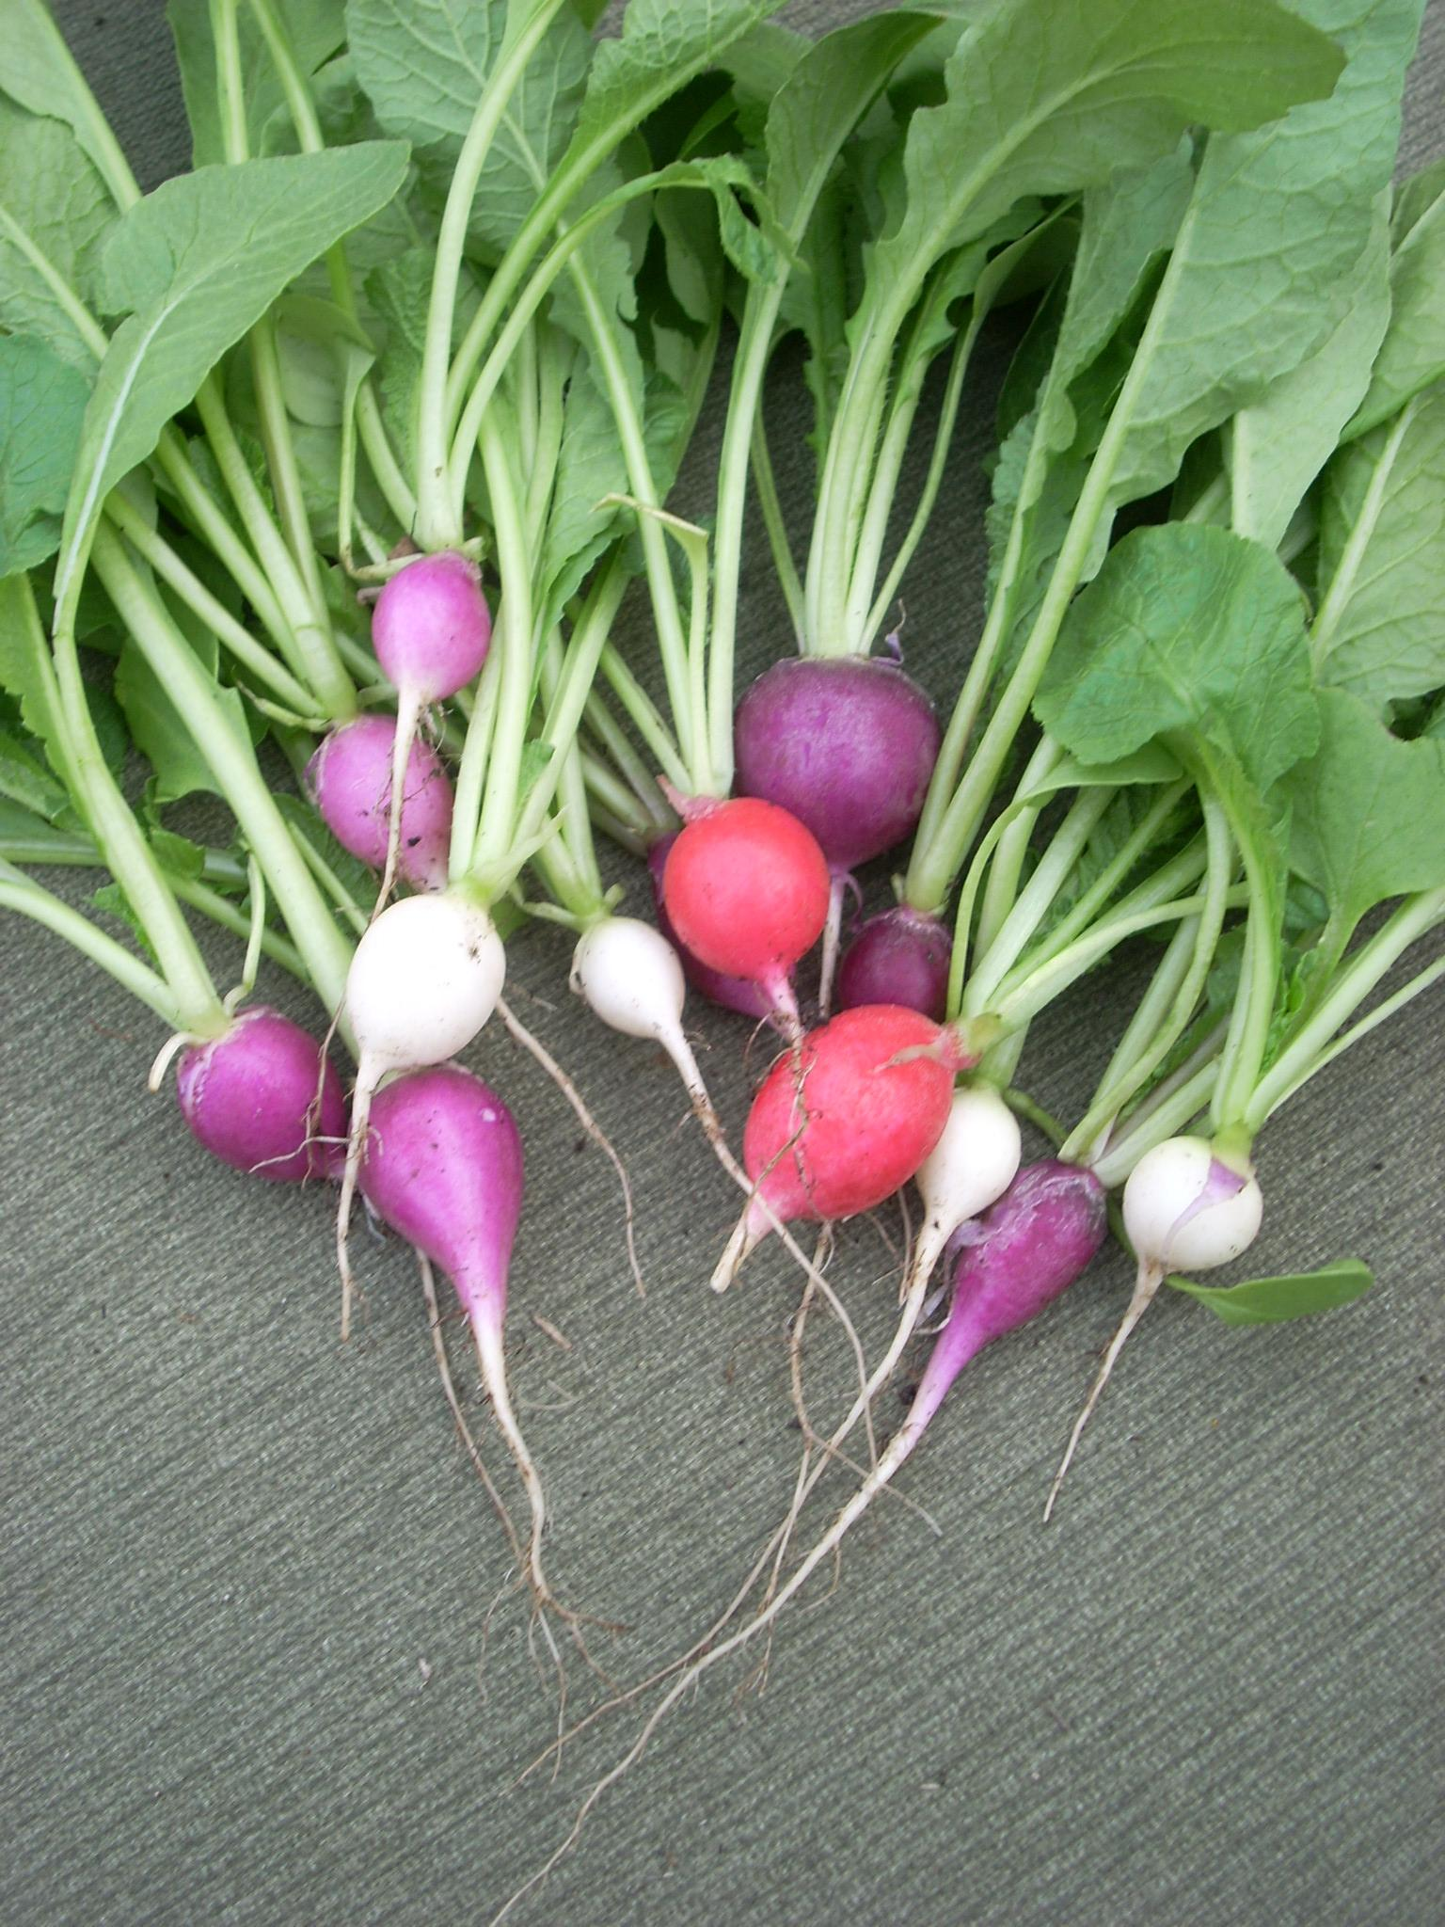
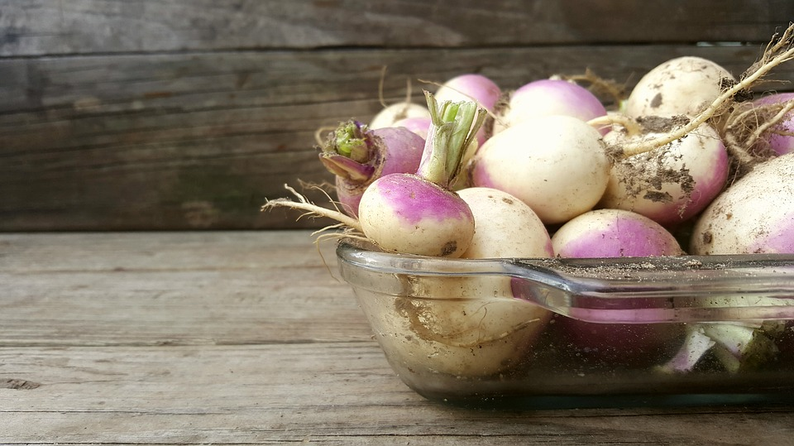
Radish and turnip
Nutritious, anti-cancer, lowers blood-pressure,
aids weight loss
Potassium, Vitamin C, fibre

Slide 35
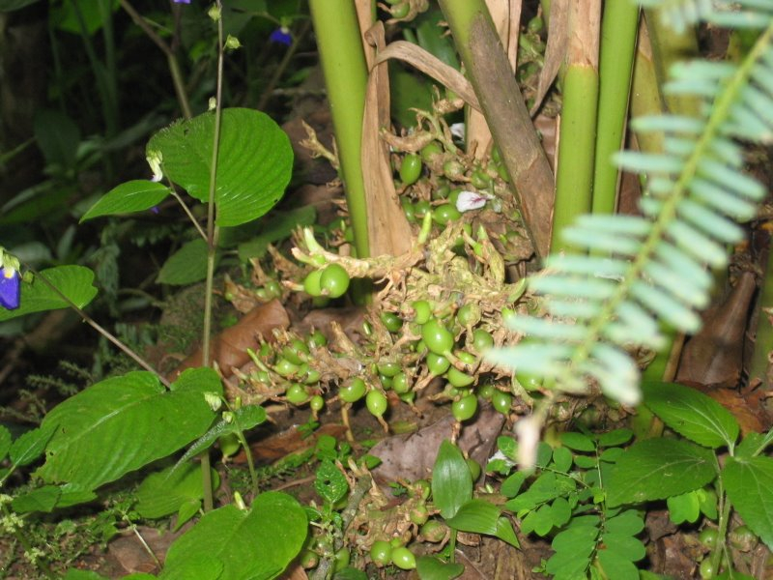
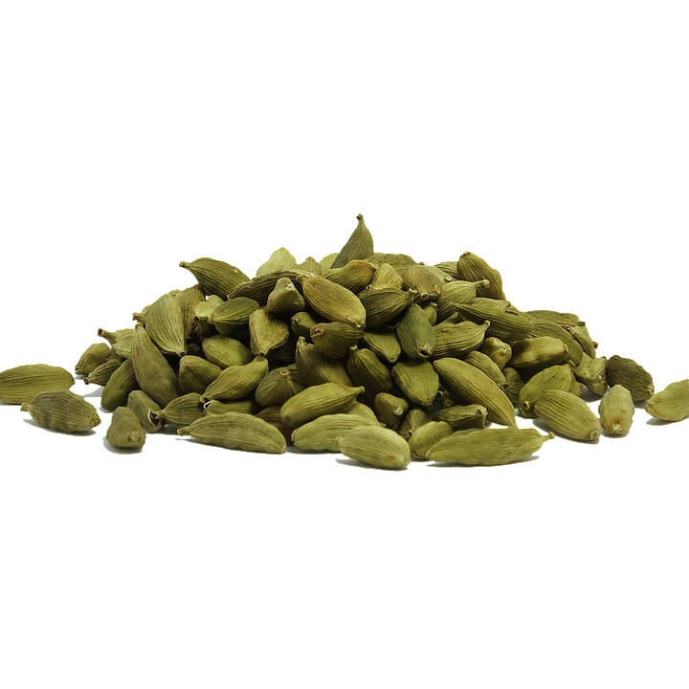
cardamom
Anti-cancer,
anti-diabetic,
anti-ulcer,
anti-obesity,
anti-anxiety

Slide 36
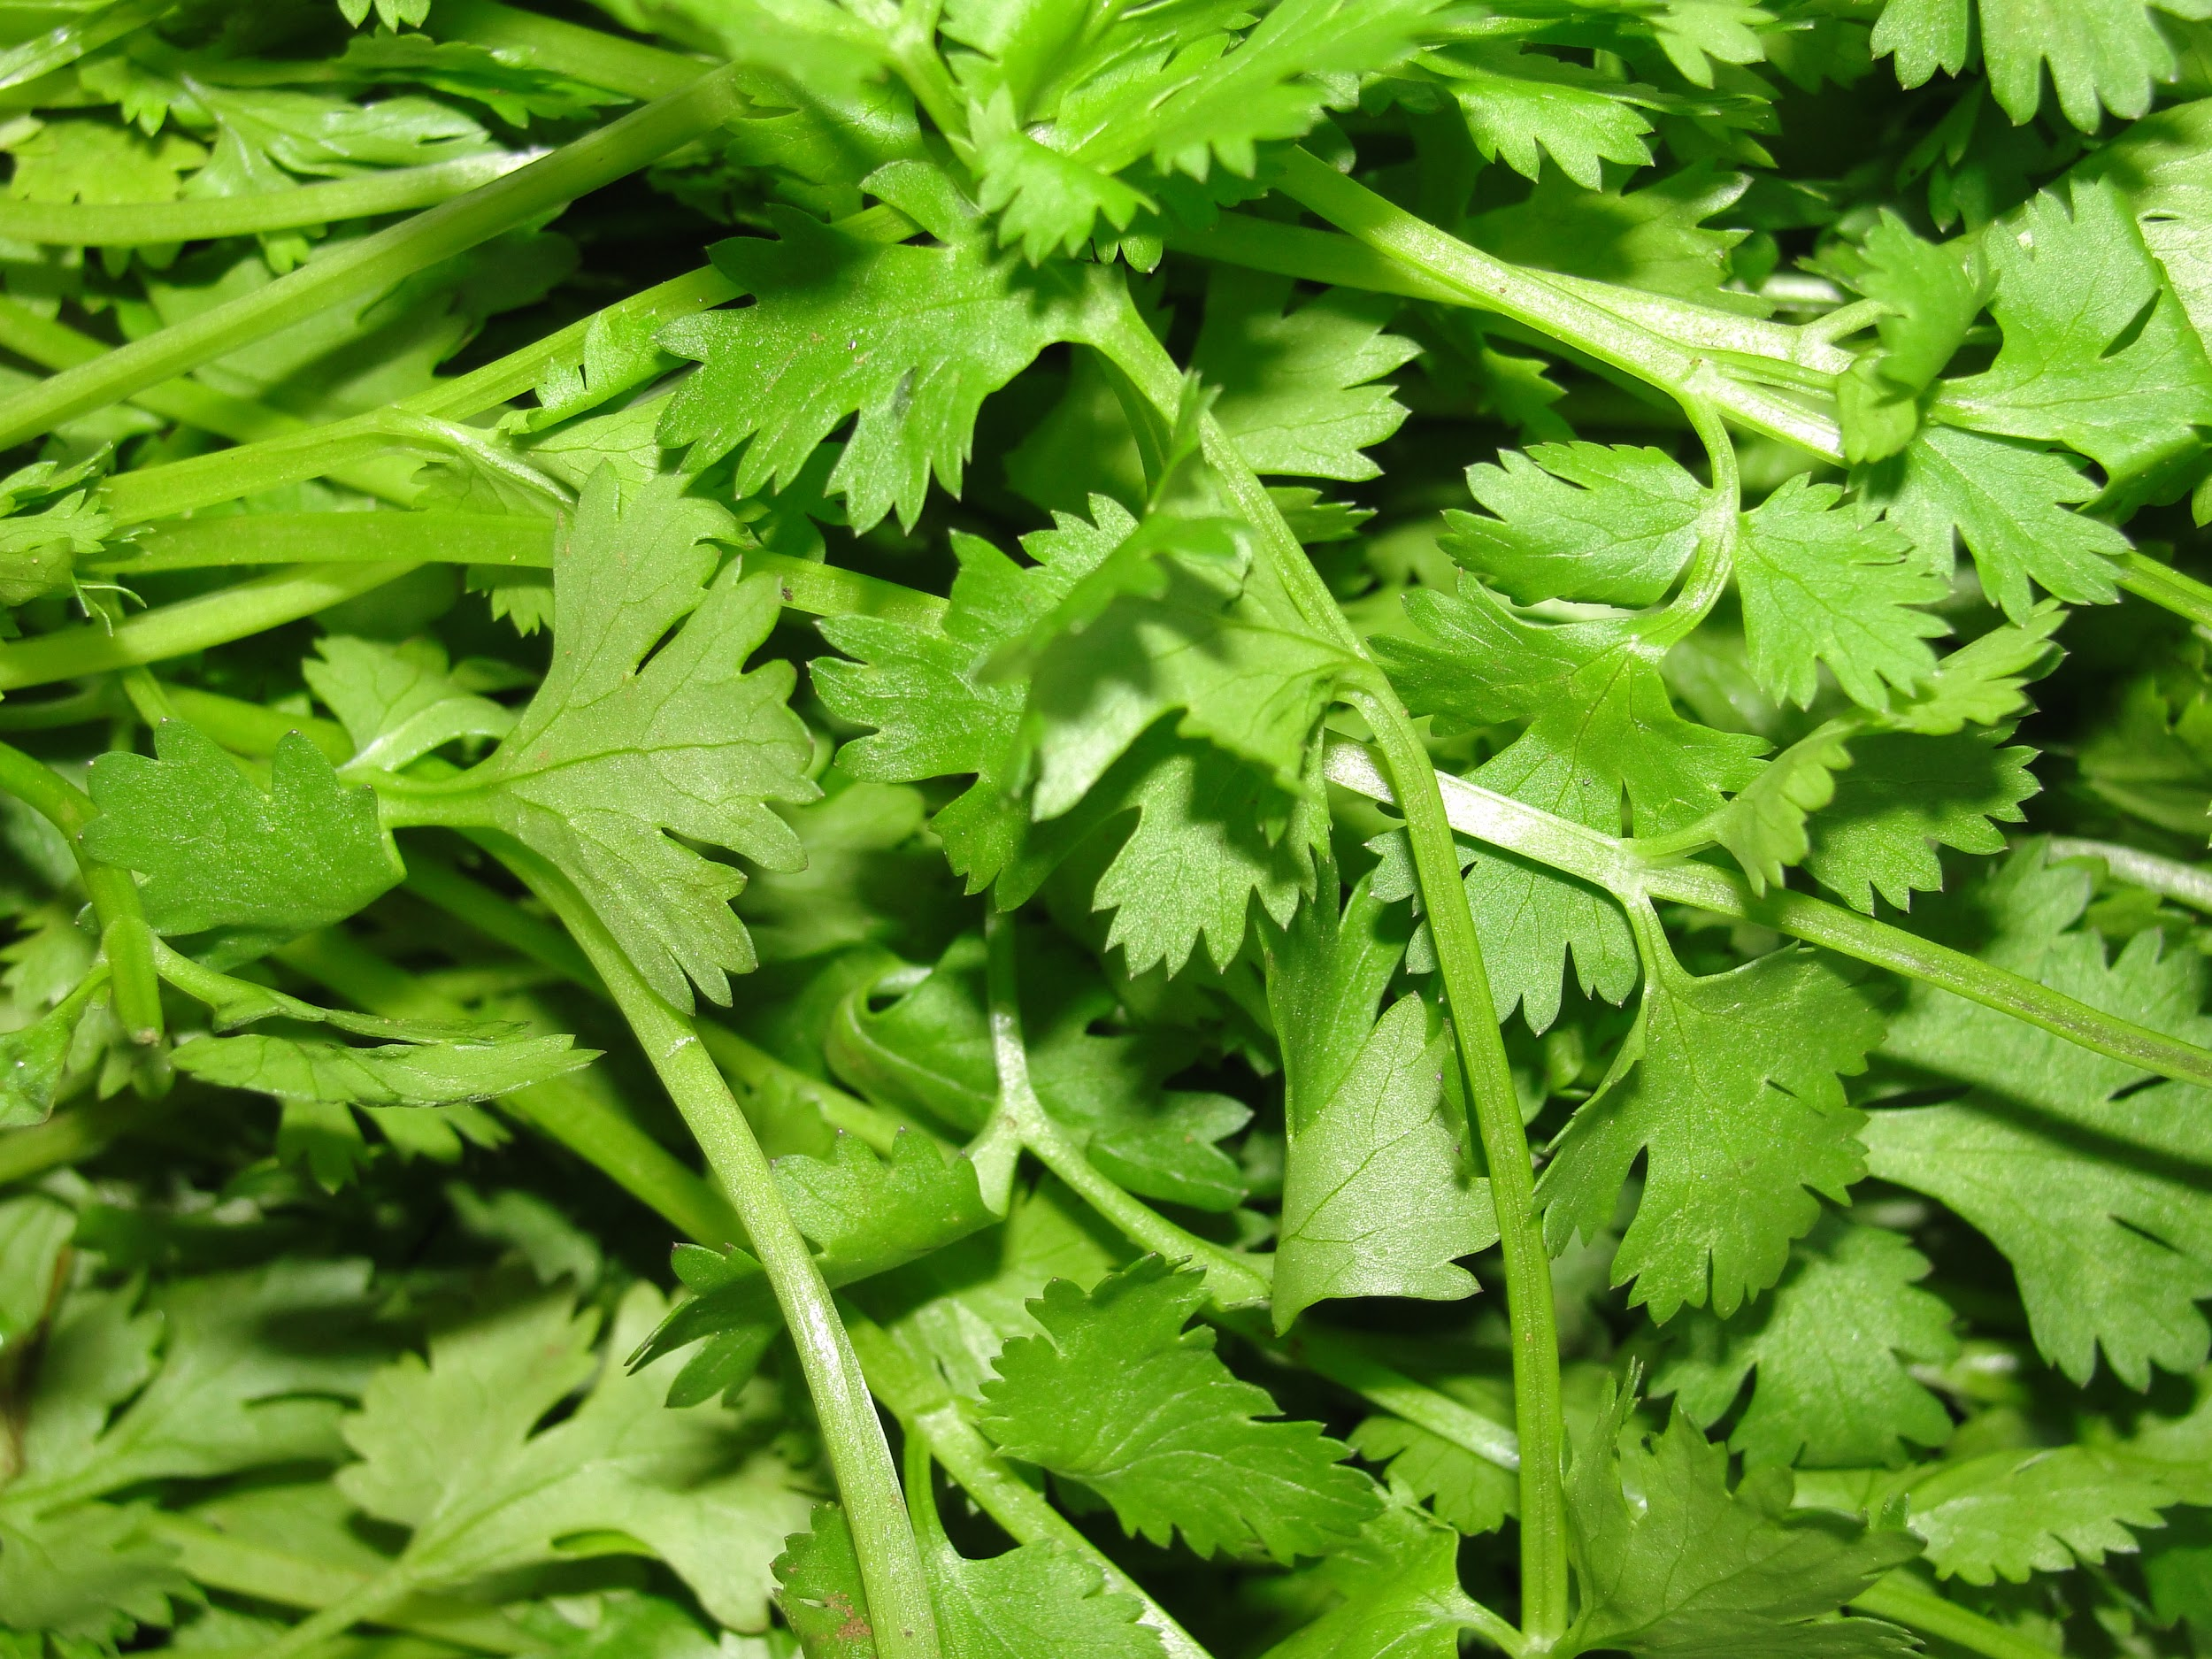
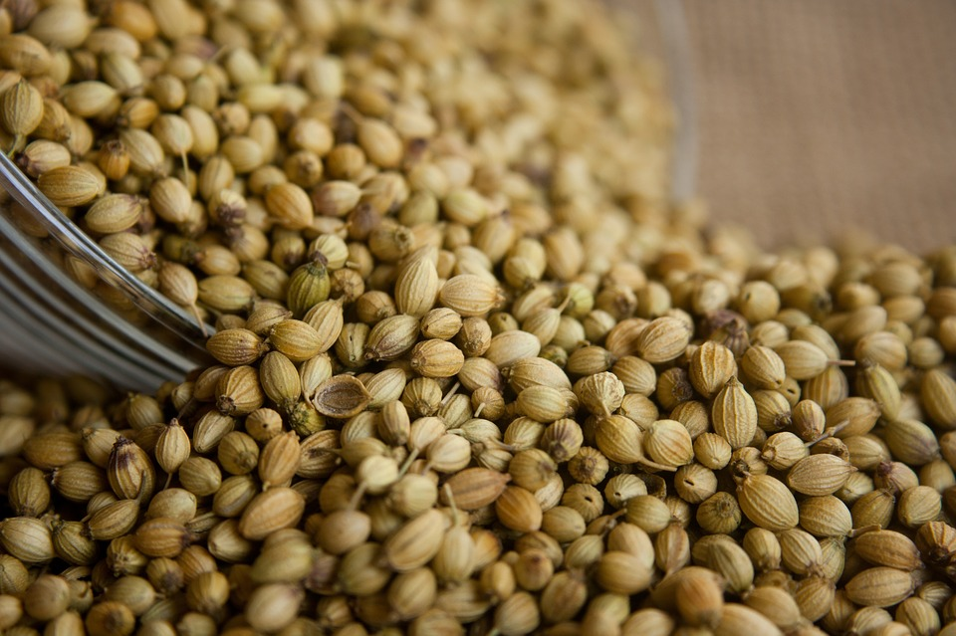
Coriander - κόλιαντρο
Anti- inflammatory
Anti- diabetes
Anti-cholesterol
Anti-cancer
Anti-oxidant

Slide 37
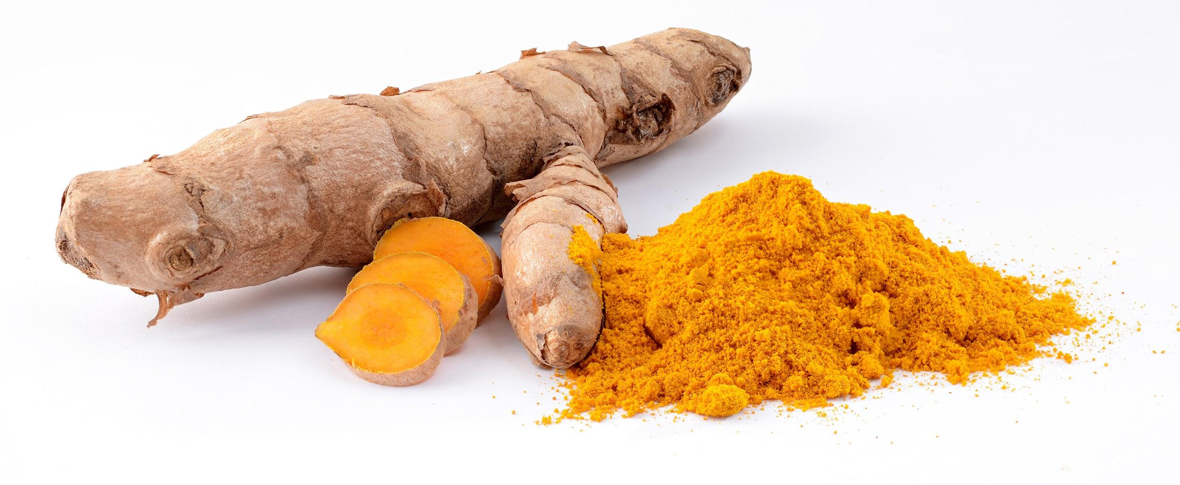
Turmeric - κουρκουμάς
All that there is to coriander, plus
Improved brain function and low risk of brain diseases

Slide 38
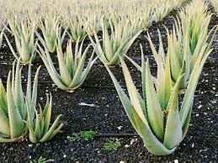
Aloe vera
originates from the Arabian Peninsula
medicinal uses
soothing,
moisturizing,
healing

Slide 39
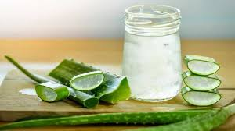
Aloe vera gel
yogurts, beverages, and some desserts
helps cure body from the inside!

Slide 40
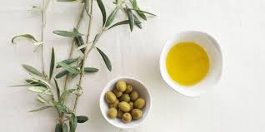
Olive
found in the Mediterranean Basin from Portugal to the Levant,
the Arabian Peninsula,
southern Asia as far east as China,
the Canary Islands and Réunion.
cultivated in many other places:
Argentina, Saudi Arabia, Java, Norfolk Island, California, and Bermuda

Slide 41
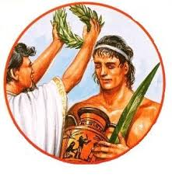
Olives in ancient Greece
The ancient Greeks smeared olive oil on their bodies and hair as a matter of grooming and good health.
Olive oil was used to anoint kings and athletes in ancient Greece. It was burnt in the sacred lamps of temples and was the "eternal flame" of the original Olympic games. Victors in these games were crowned with its leaves.

Slide 42
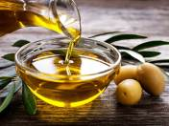
Olive oil
Why Extra Virgin Olive Oil is The Healthiest Fat on Earth

Slide 43
11 Proven Benefits of Olive Oil
is over 70% monounsaturated fats, which are the “good fats”, ω3 and oleic acid
prevents obesity
prevents heart disease
prevents strokes
prevents cancer
prevents Alzheimer’s disease
prevents rheumatoid arthritis
prevents diabetes II
is anti-oxidant
is anti-bacterial
is anti-inflammatory

Slide 44
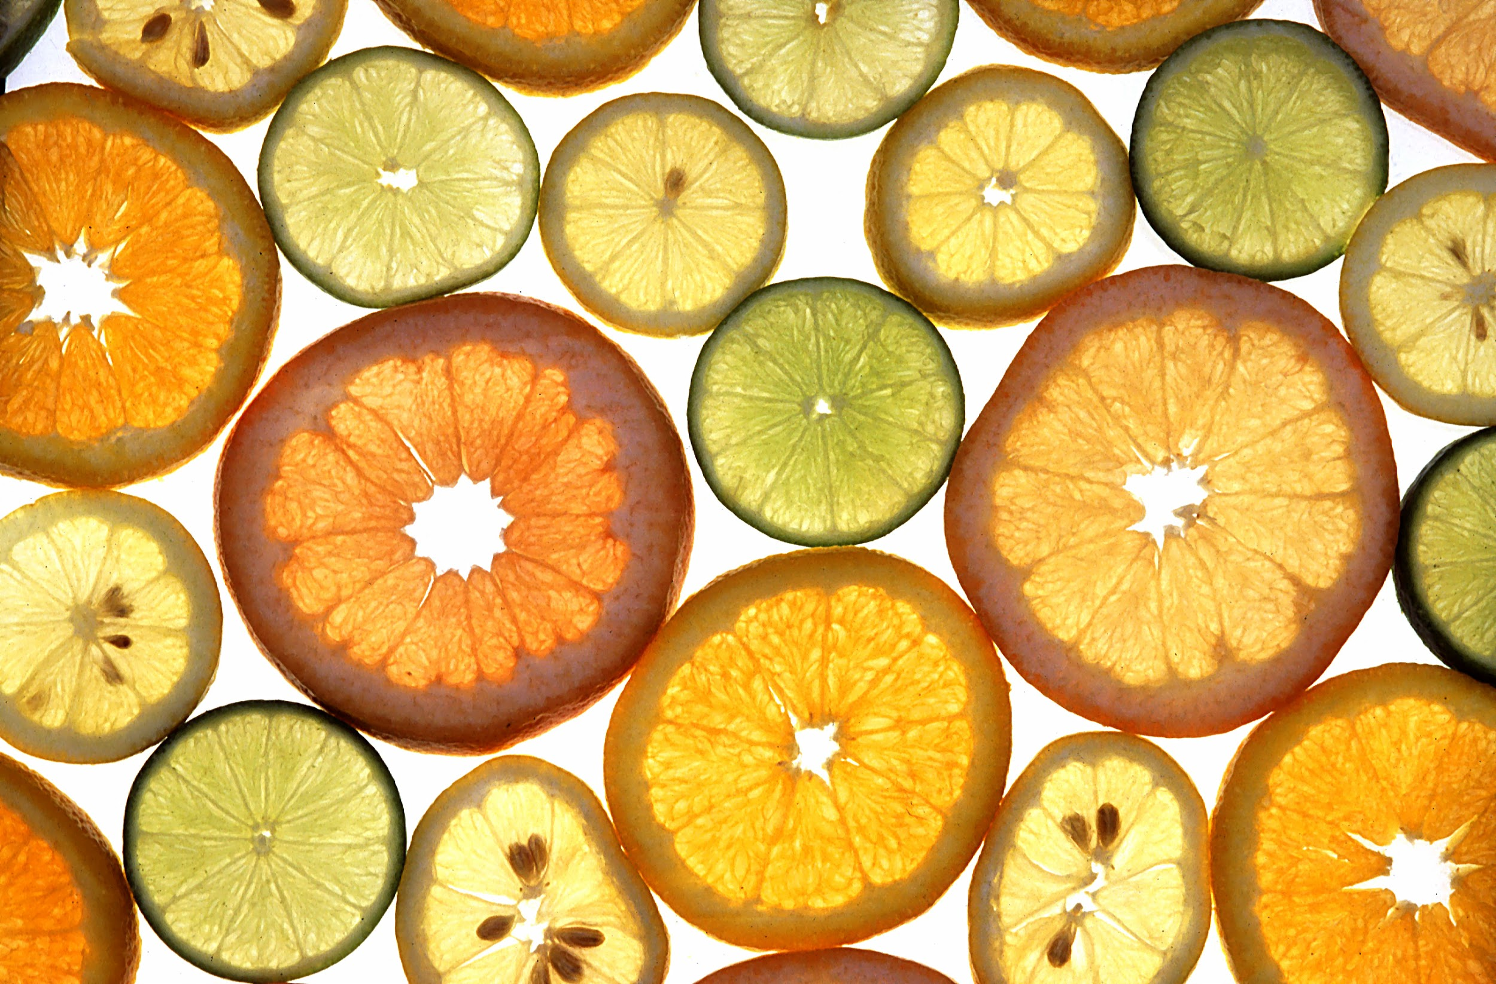
Citrus fruit
oranges
lemons
tangerines
bergamot oranges
kumquats

Slide 45
Health, nutrition, aroma and pastry!
vitamin C
helps absorb iron
prevents scurvy
prevents cancer and cardiovascular diseases.
citric acid
major food and drink preservative
Aroma
principle ingredient of soaps and detergents
Pastry
orange cake: great Christmas treat
Tsitsibira: citrus beer
kumquat liqueur

Slide 46
Citrus etymology and mythology
citrus= hesperioidea
Hesperia (Greek): the West
‘espera”: evening
portokalia (Greek): oranges
probably from Portugal
Hera had an orchard in Hesperia, known as the Garden of Hesperides, since it was under the care of these mythical figures
The fruits grown there were the famous “golden apples”— oranges, granting immortality to the ones savouring them.
Yet, this very orchard and its fruit brought about the widely-known Trojan War

