Slide 2
Art
across our countries

Slide 3
The Venus Figurine
Dating 40.000 years ago
Found in 2008
in the Hohle Fels in the Czech Republic
Germanic Art
Made of mammoth ivory

Slide 4
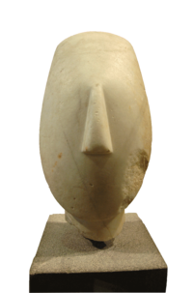
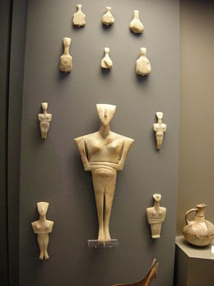
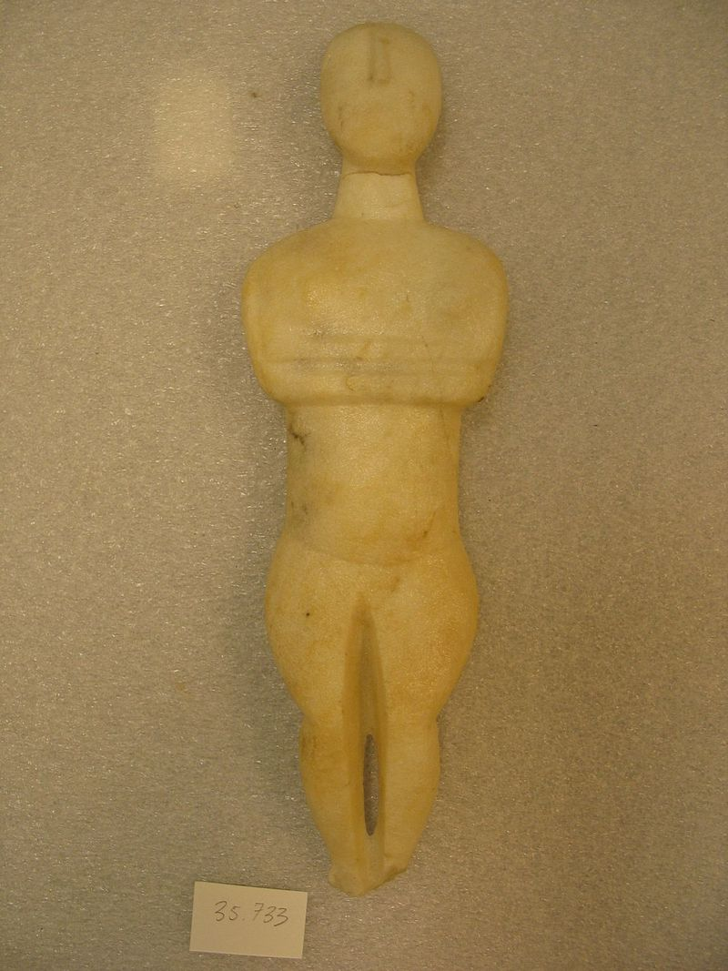
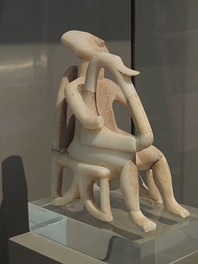
Aegean and Cycladic Art - 2.800 BC

Slide 5
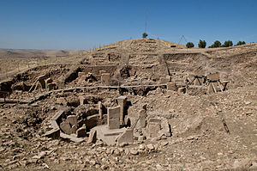
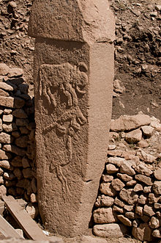
Göbekli Tepe
in Anatolia, Turkey
dating back to the 10th–8th millennium BC
circles of massive T-shaped stone pillars

Slide 6
Prehistoric art in Europe
between 50.000 and 10.000 years ago
shell with geometric incisions
claimed as the first known work of art

Slide 7
Roca dels Moros
a rock shelter containing paintings of prehistoric Levantine rock art
in Catalonia, Spain

Slide 8
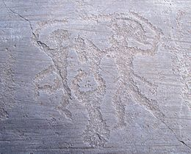
stone carvings of Val Camonica
in the Province of Brescia, Italy
the largest collections of prehistoric petroglyphs
in the world

Slide 9
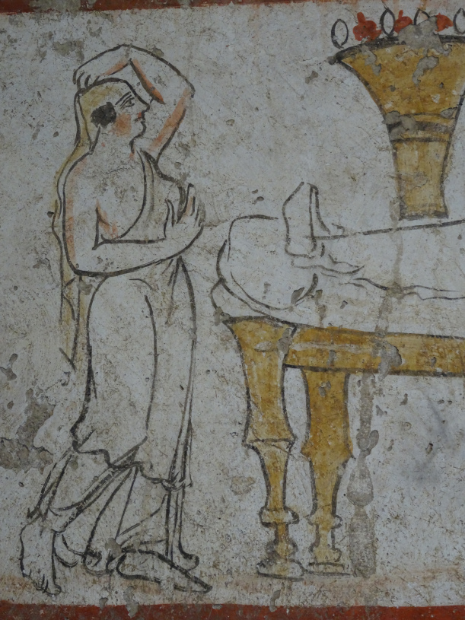
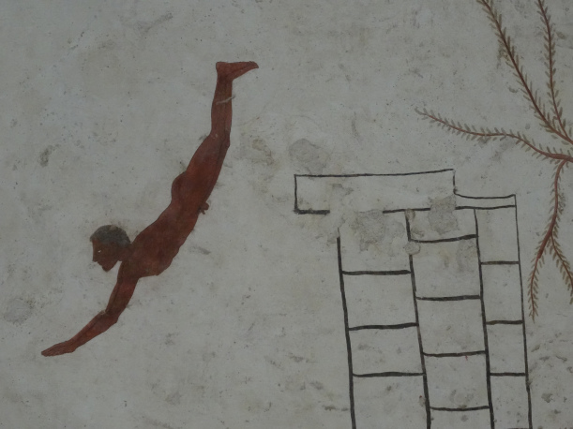
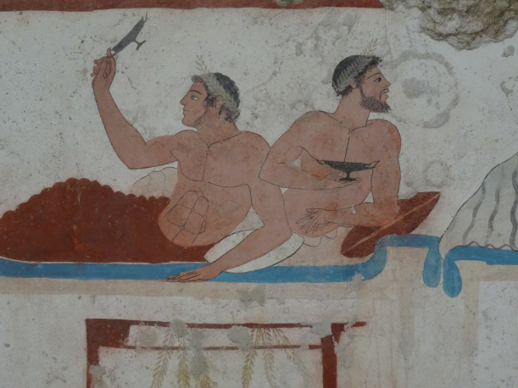
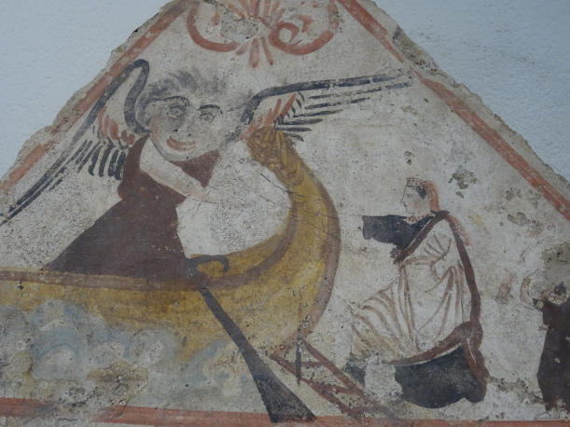
In Basilicata

Slide 10
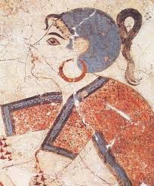
Minoan Art - Crete dating back to 2.900 BC

Slide 11
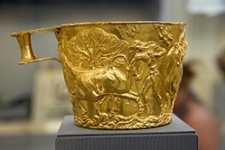
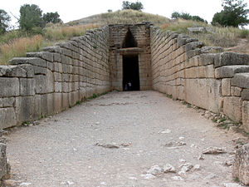
Mycenaean Art - 1.600 BC

