Slide 2
Giving a new life to what has been thrown away….

Slide 3
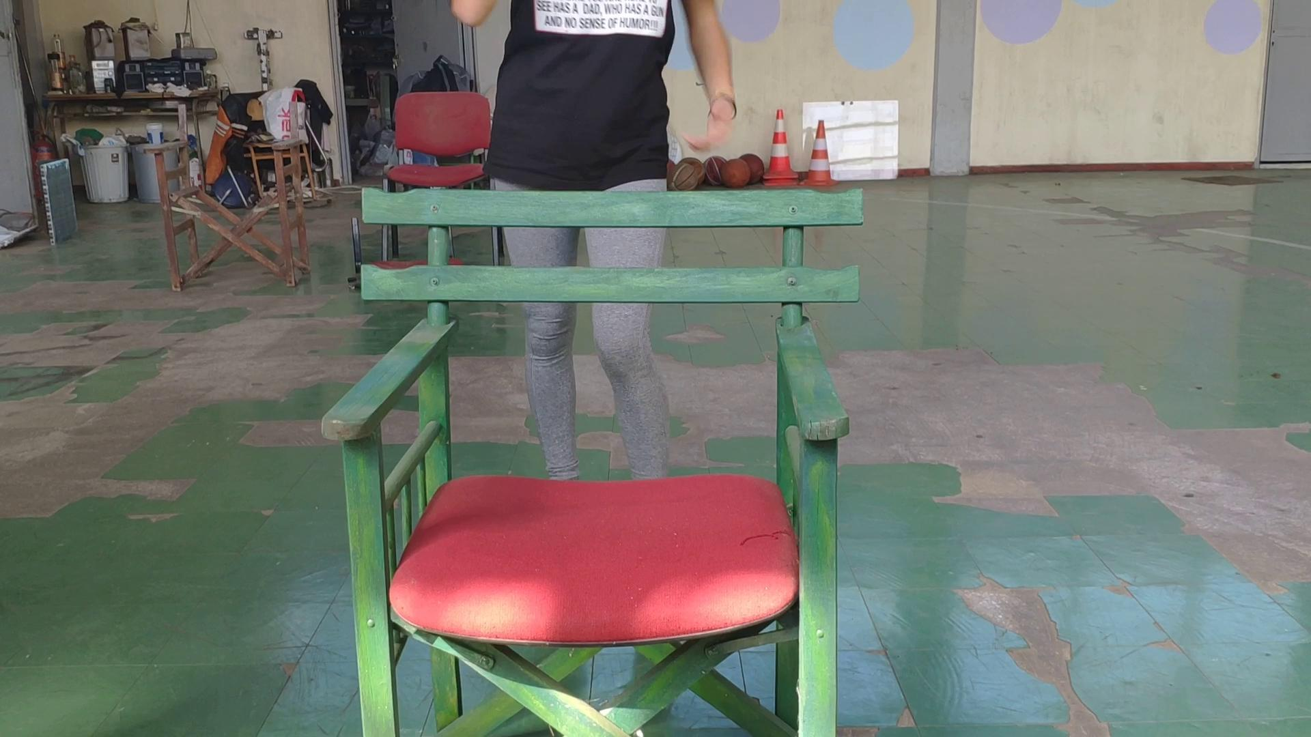
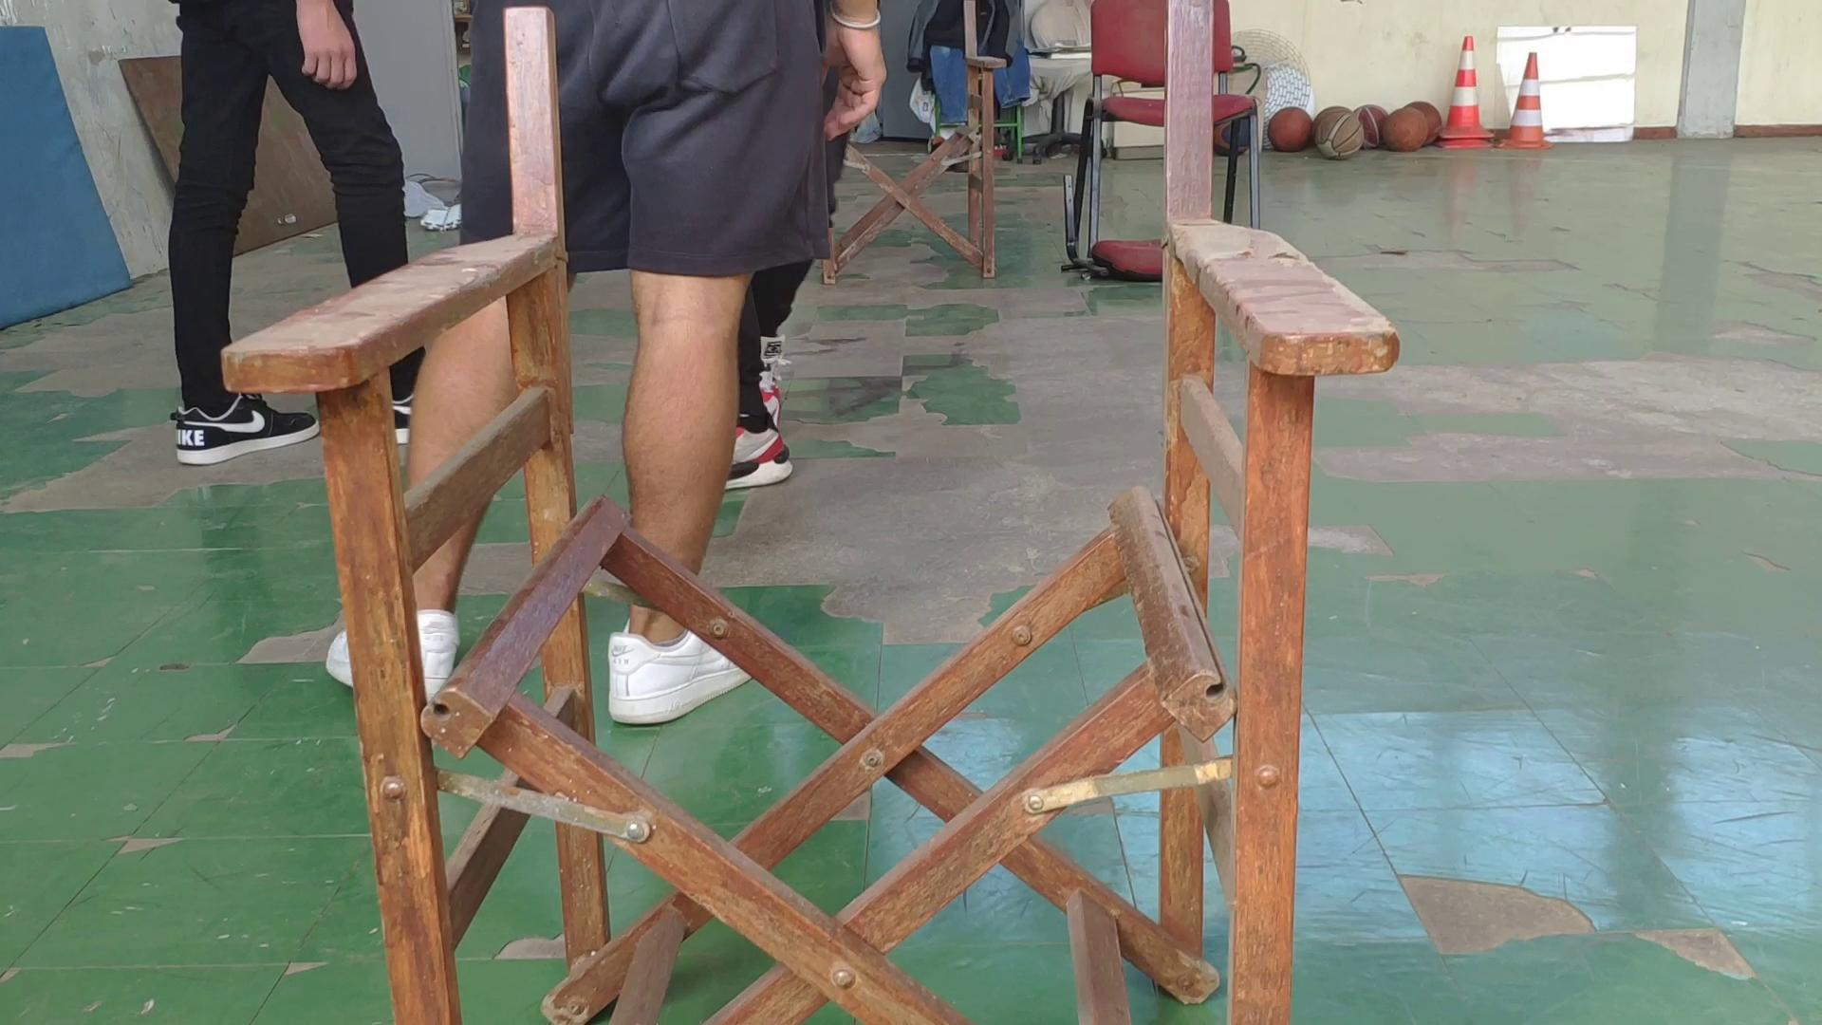
Remaking a director’s chair

Slide 4
Remaking a chair.mp4 (1)
remaking a chair.mp4 (2)

Slide 5
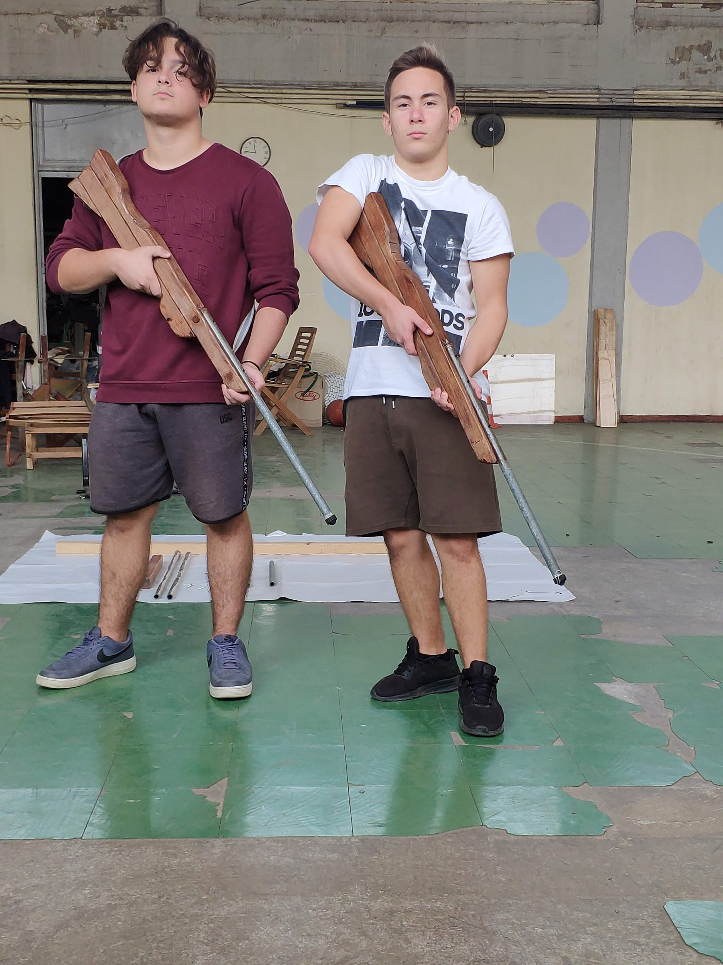
Constructing props for school performances
Toy-rifles from pieces of an old bed

Slide 6
Constructing toy rifles from bed parts.mp4

Slide 7
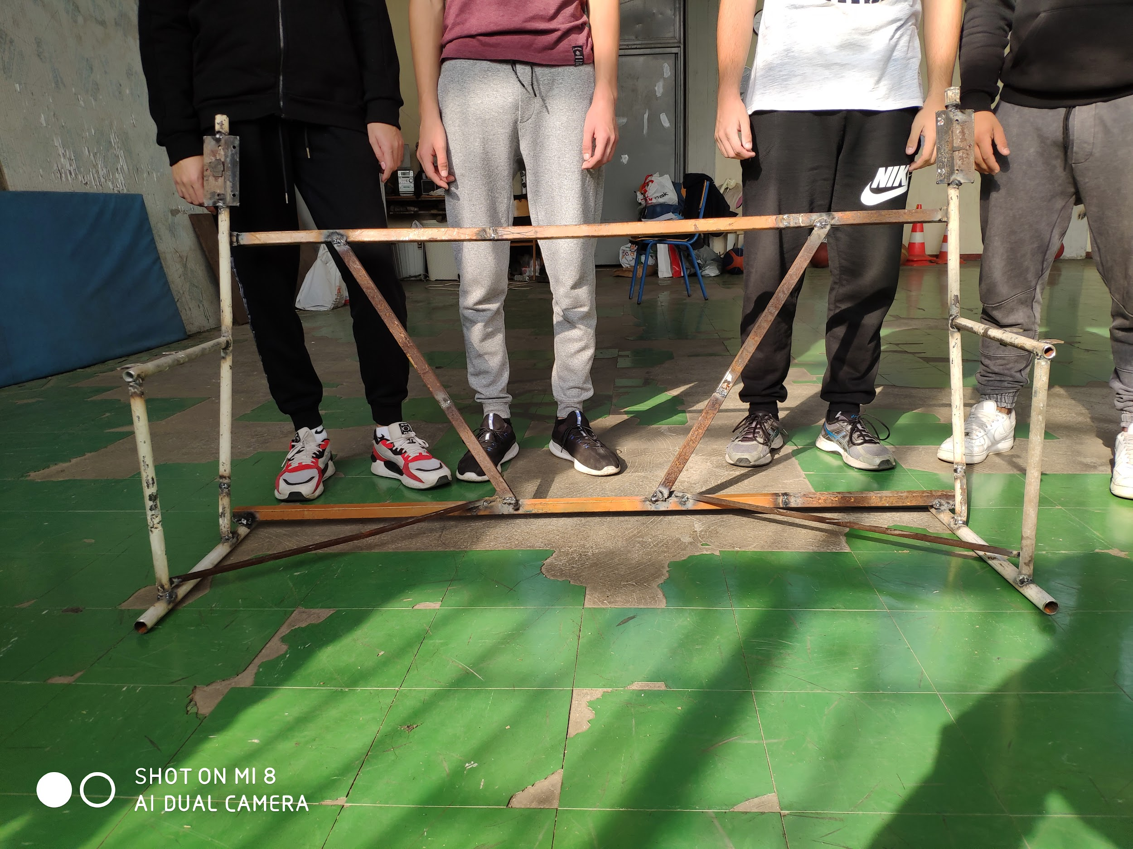
Constructing
a bench
for our playground

Slide 8
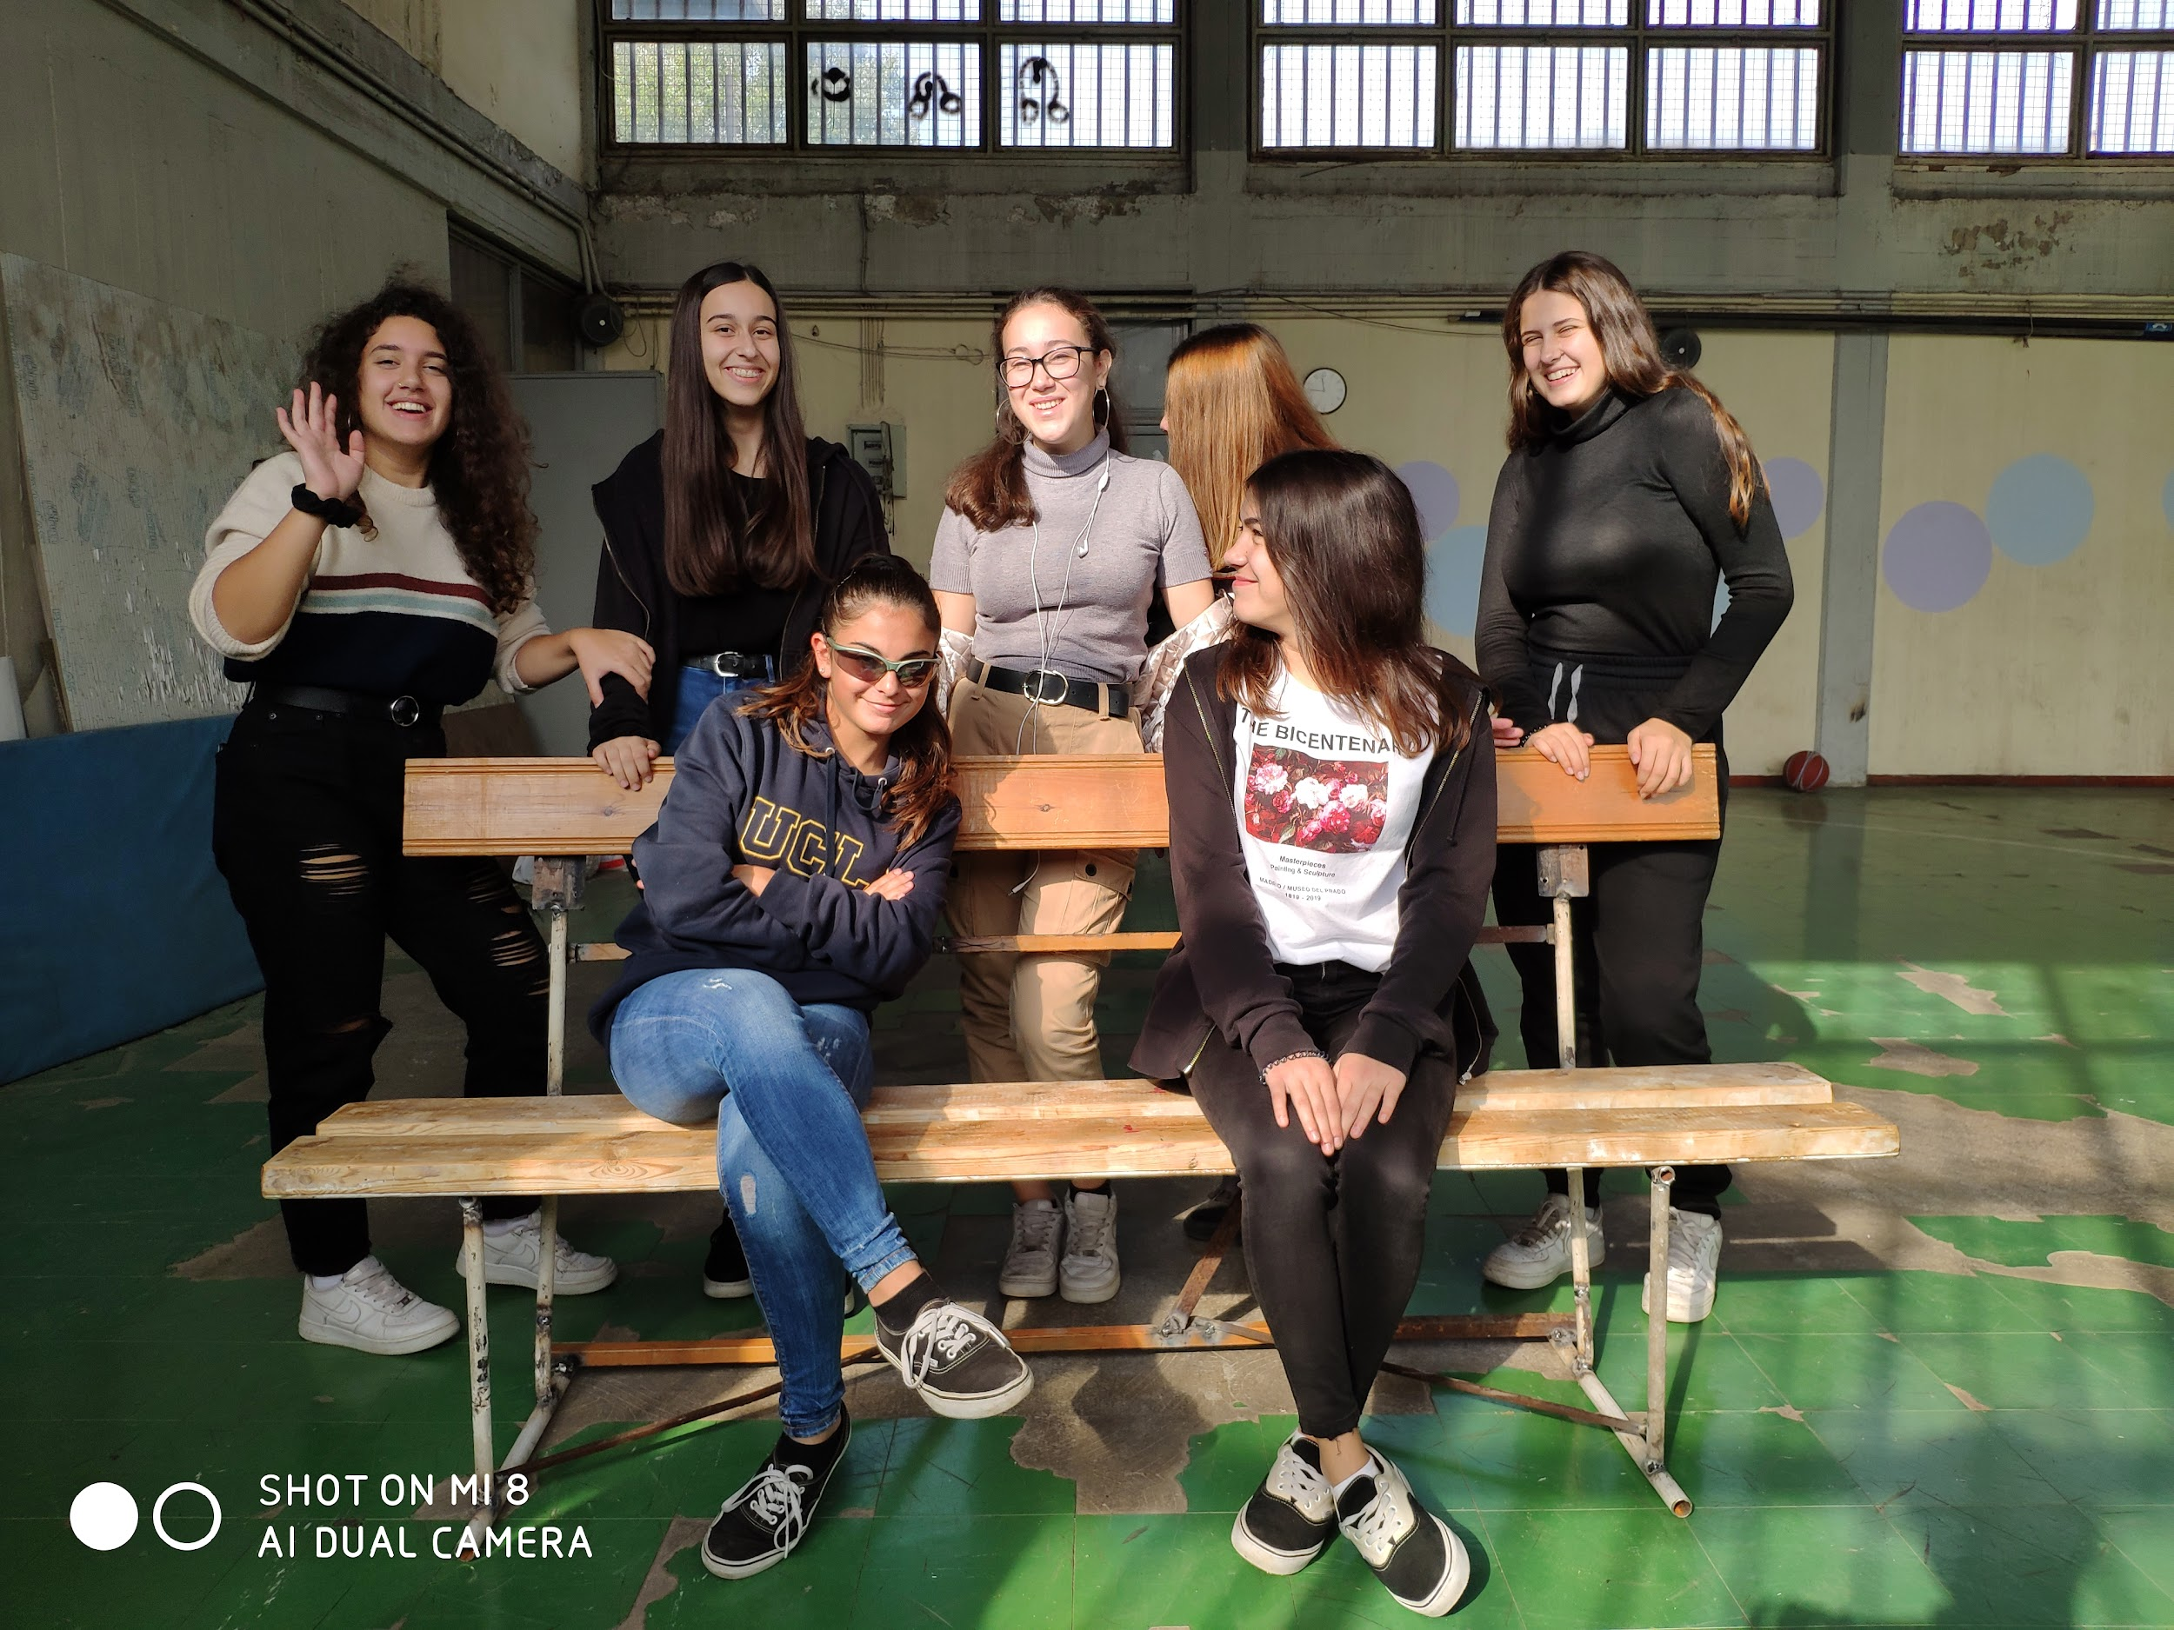
School project 2019-2020

