Slide 2
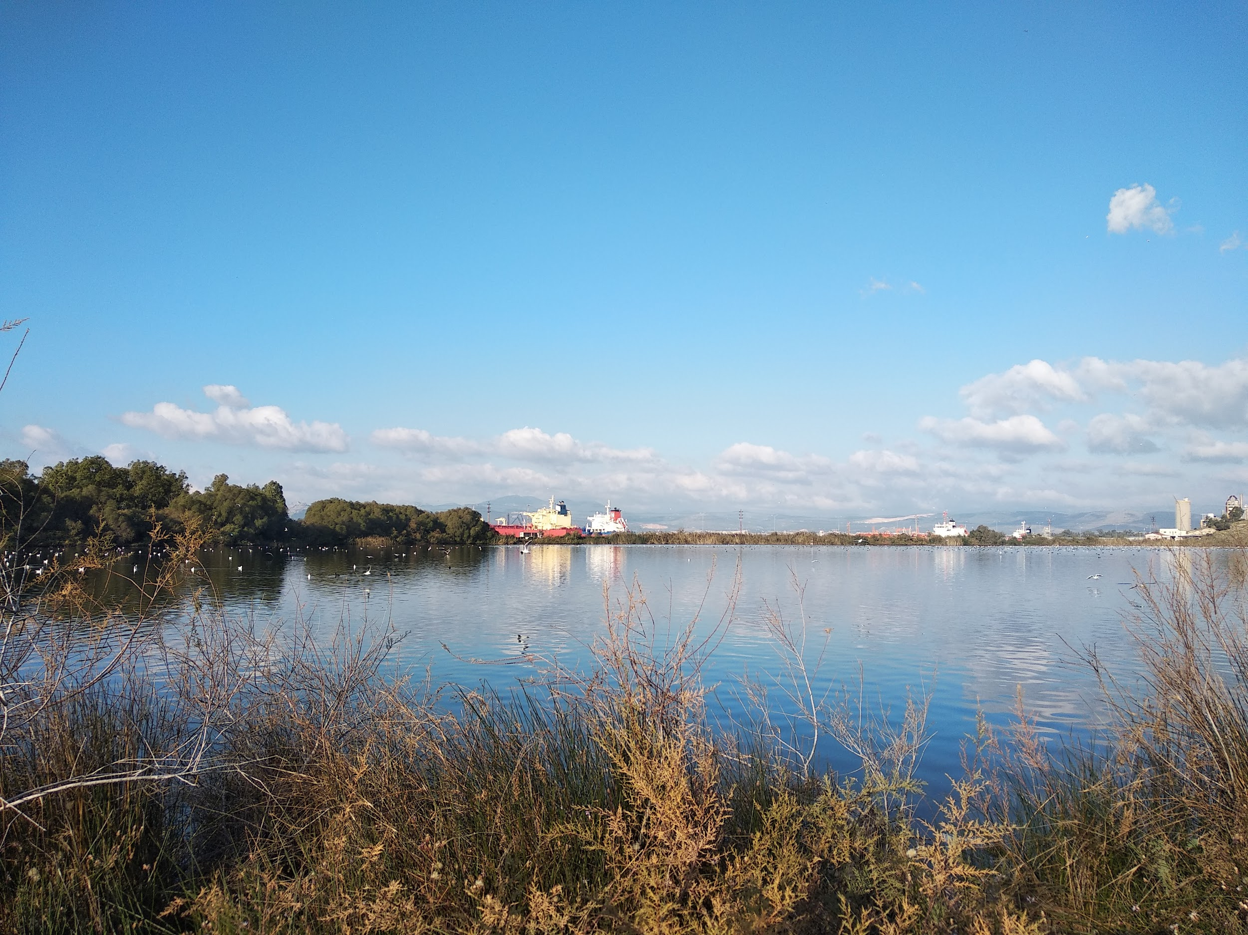
Students from all local schools
visited lake Koumoundourou
for an environmental project
7/12/2018

Slide 3
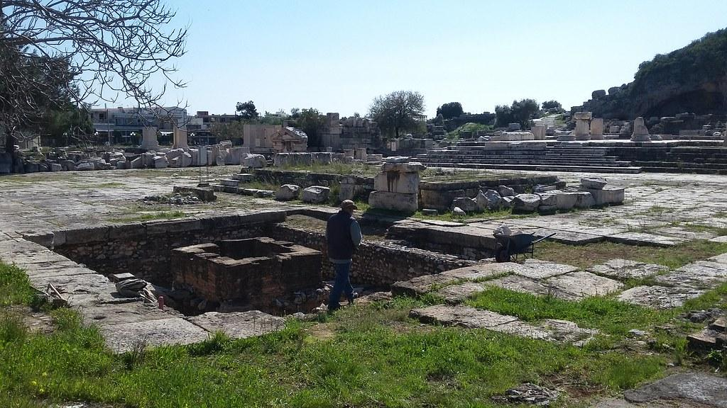
The region is
Elefsina
one of Ancient Greece’s most sacred towns, about 20 km
NW of Athens

Slide 4
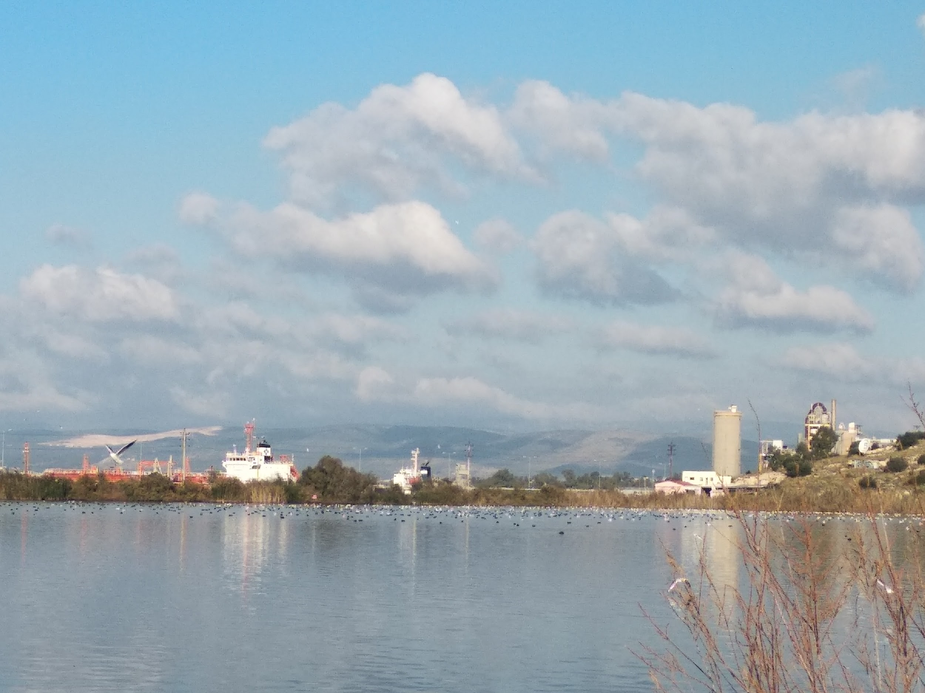
The lake is
badly polluted
by the ships
and the nearby shipyard
a neighbouring landfill
and several factories
and an OIL REFINERY

Slide 5
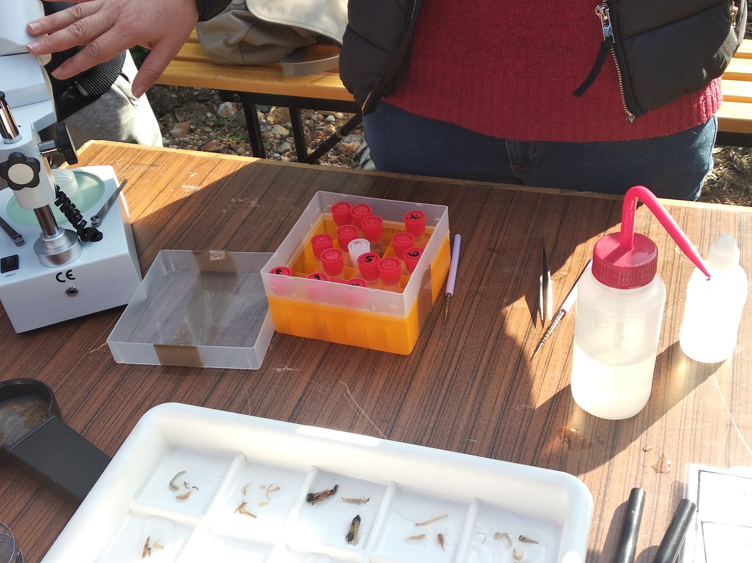
We took on-site measurements
in order to assess
the quality of the lake

Slide 6
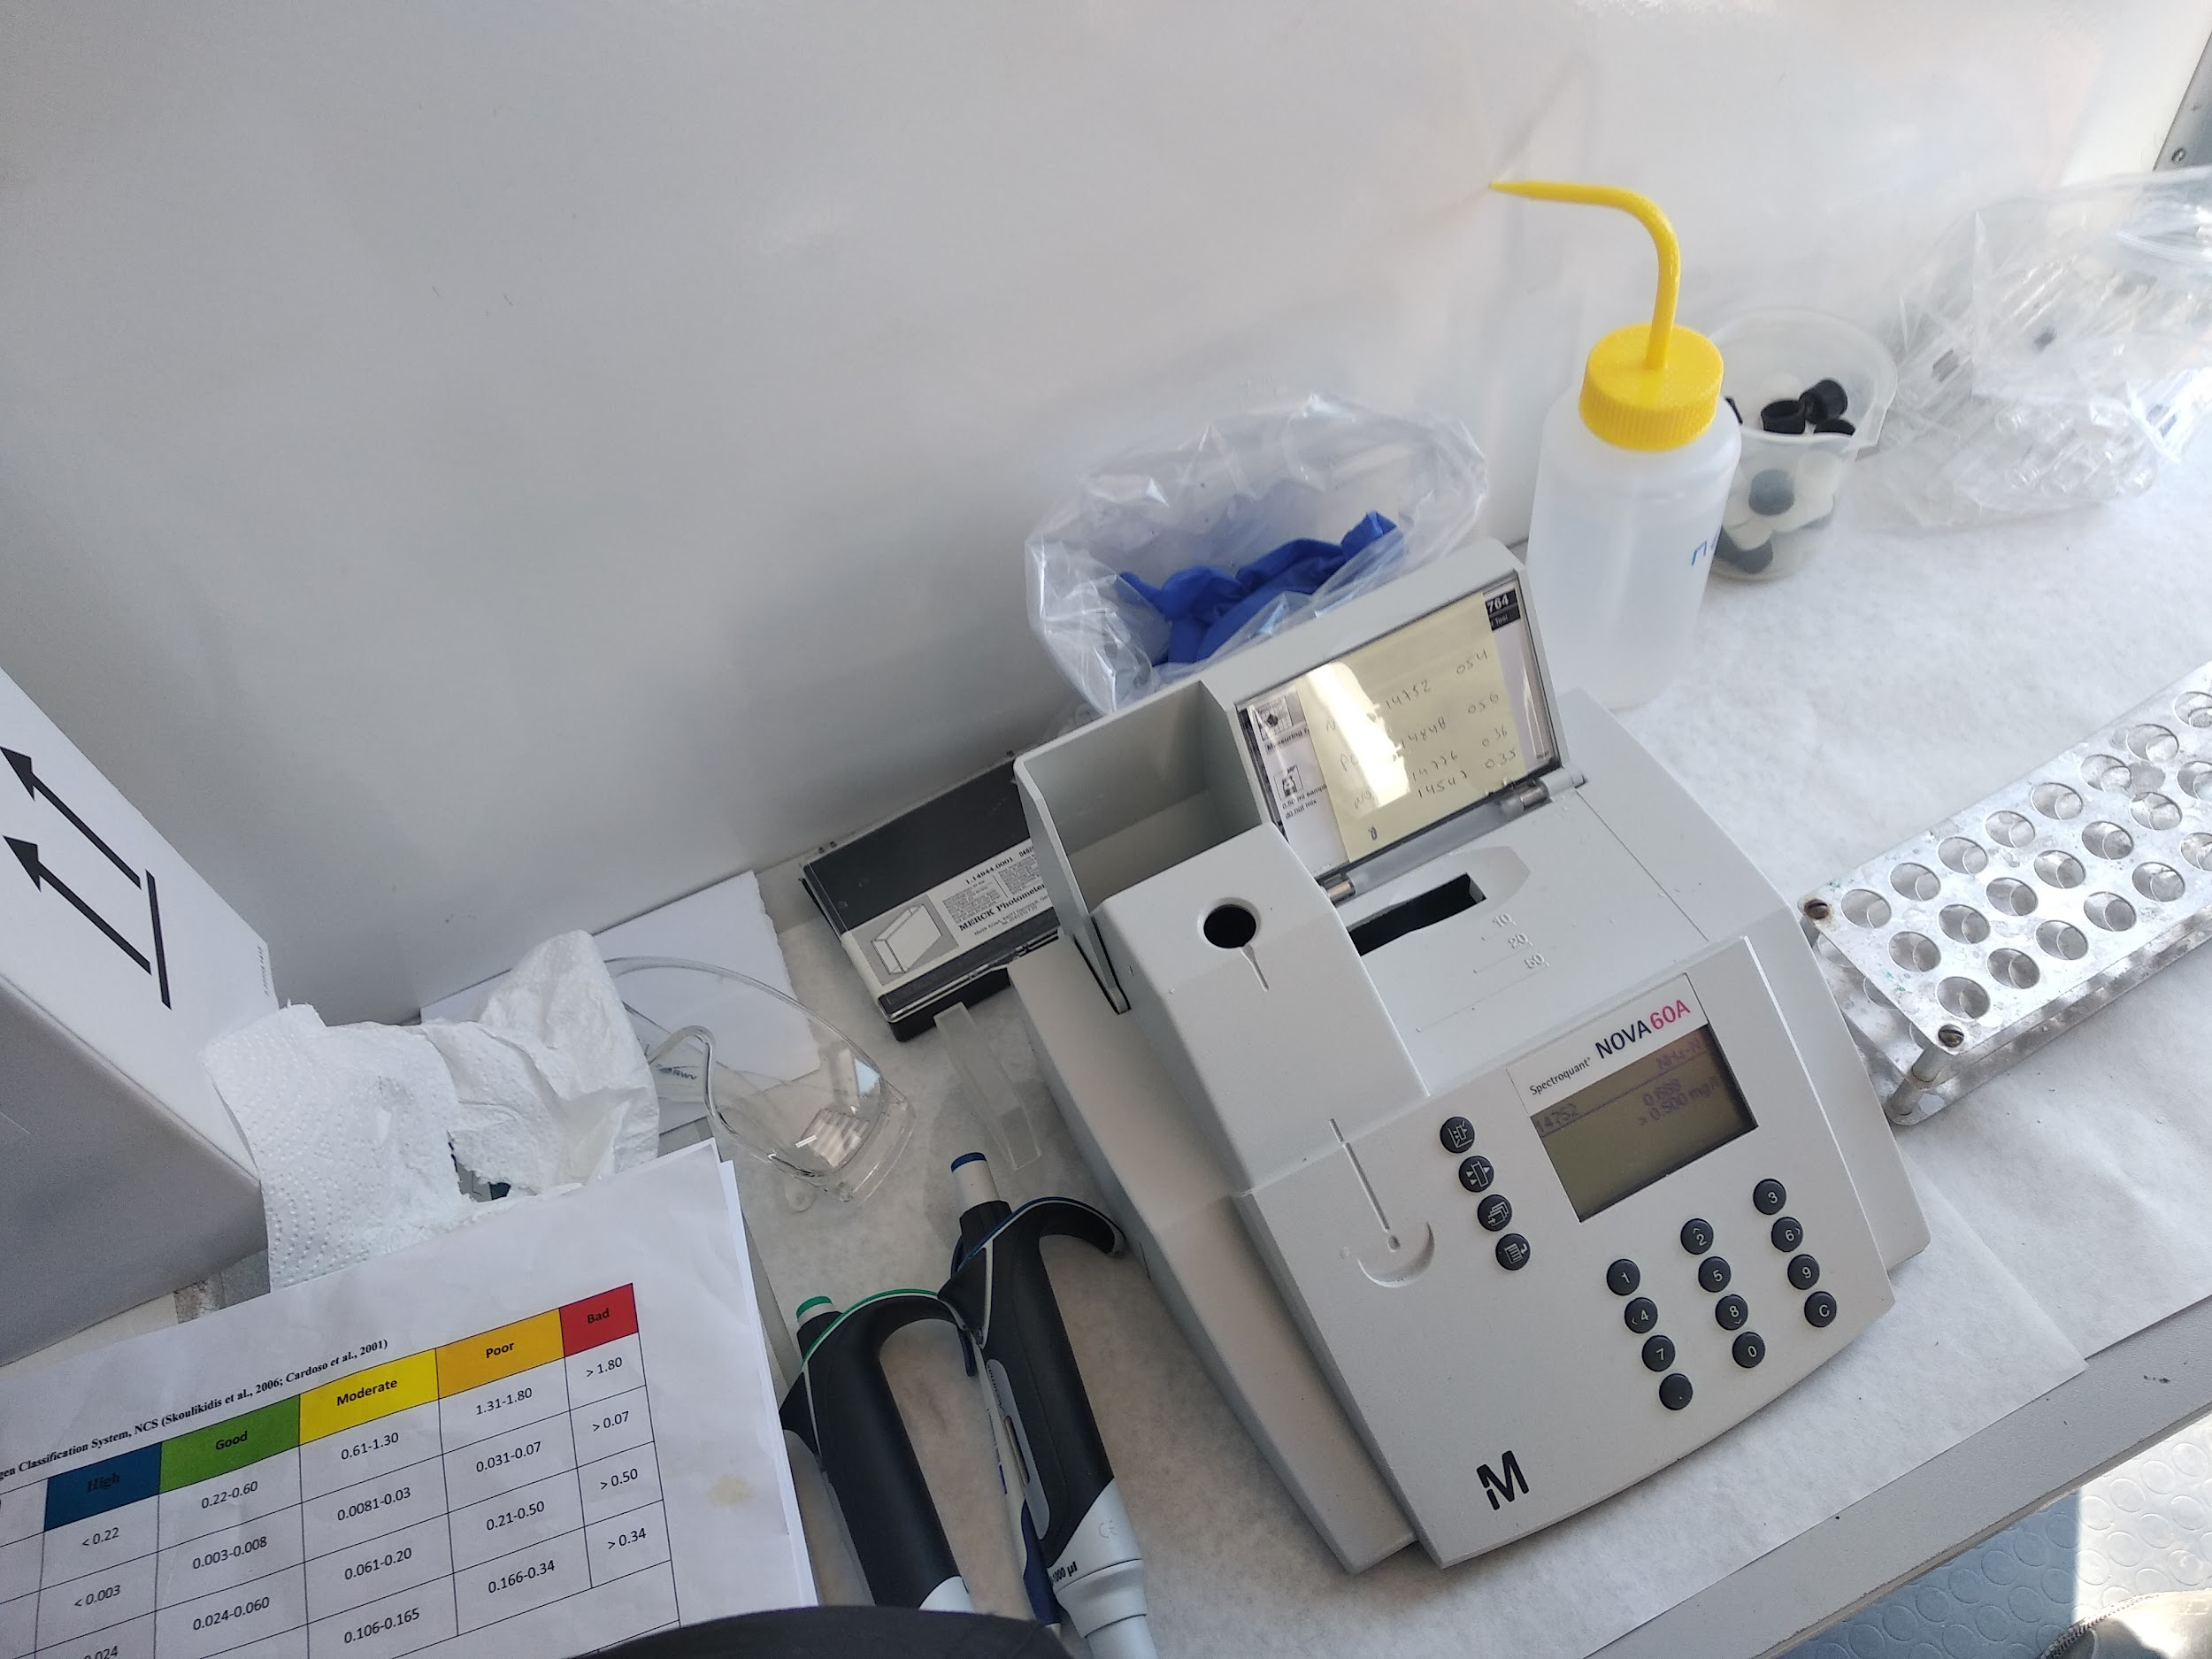
We used
a monitoring station
of physicochemical measures

Slide 7
Water Quality Monitoring
investigate aquatic insects
analyse the lake water chemically
take physicochemical measurements
We made 3 groups and took turns to:

Slide 8
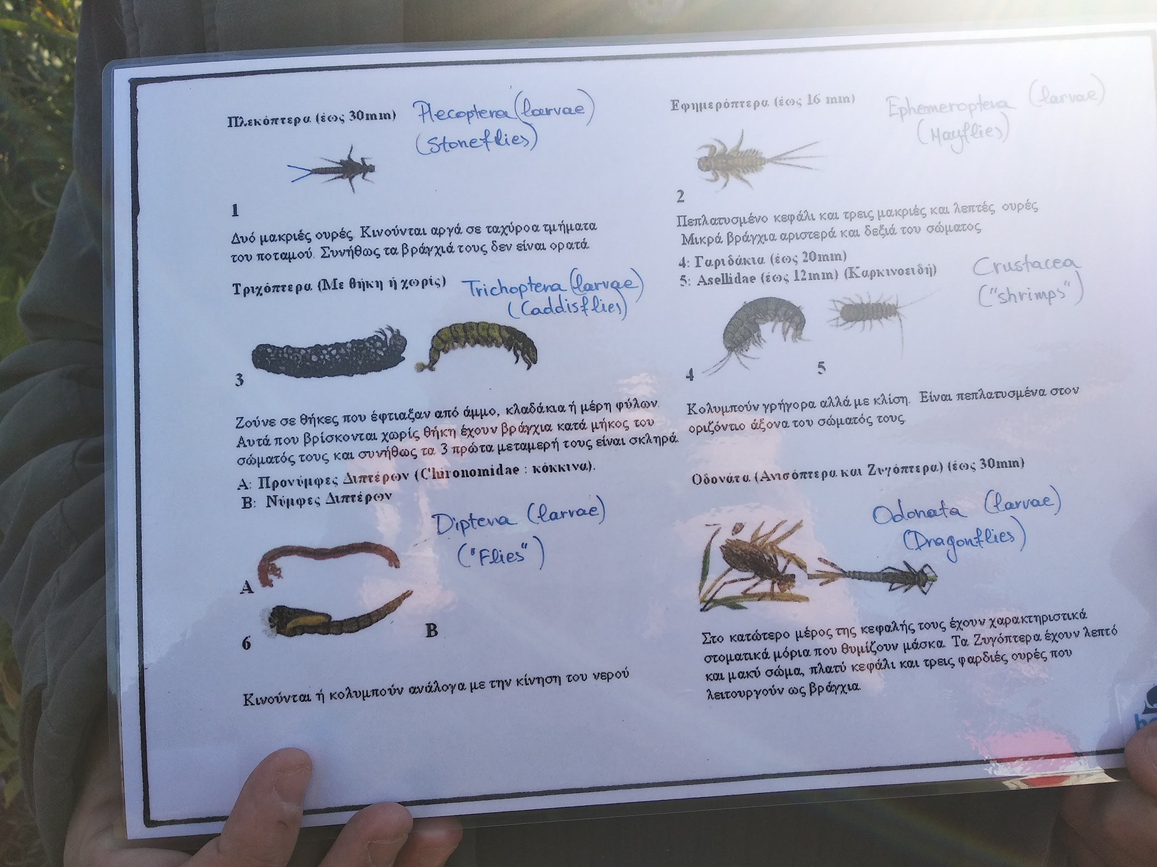
Investigating macro-
invertebrates with the help
of stereoscopes

Slide 9
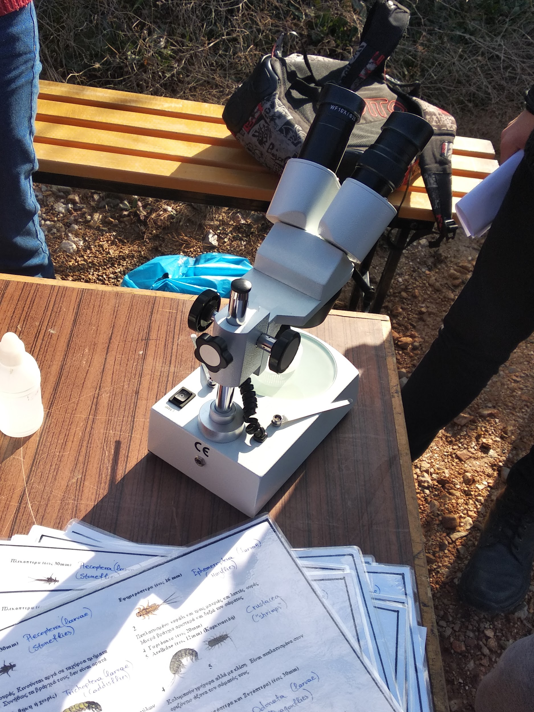
with the help of stereoscopes
helps assess
the quality of the lake water

Slide 10
We carried out chemical analysis of the lake water
nitrate ΝΟ₃⁻
nitrogen dioxide ΝΟ₂⁻
ammoniac ion ΝΗ₄⁺
phosphoric ion PO₄³⁻
to detect nutritious minerals

Slide 11
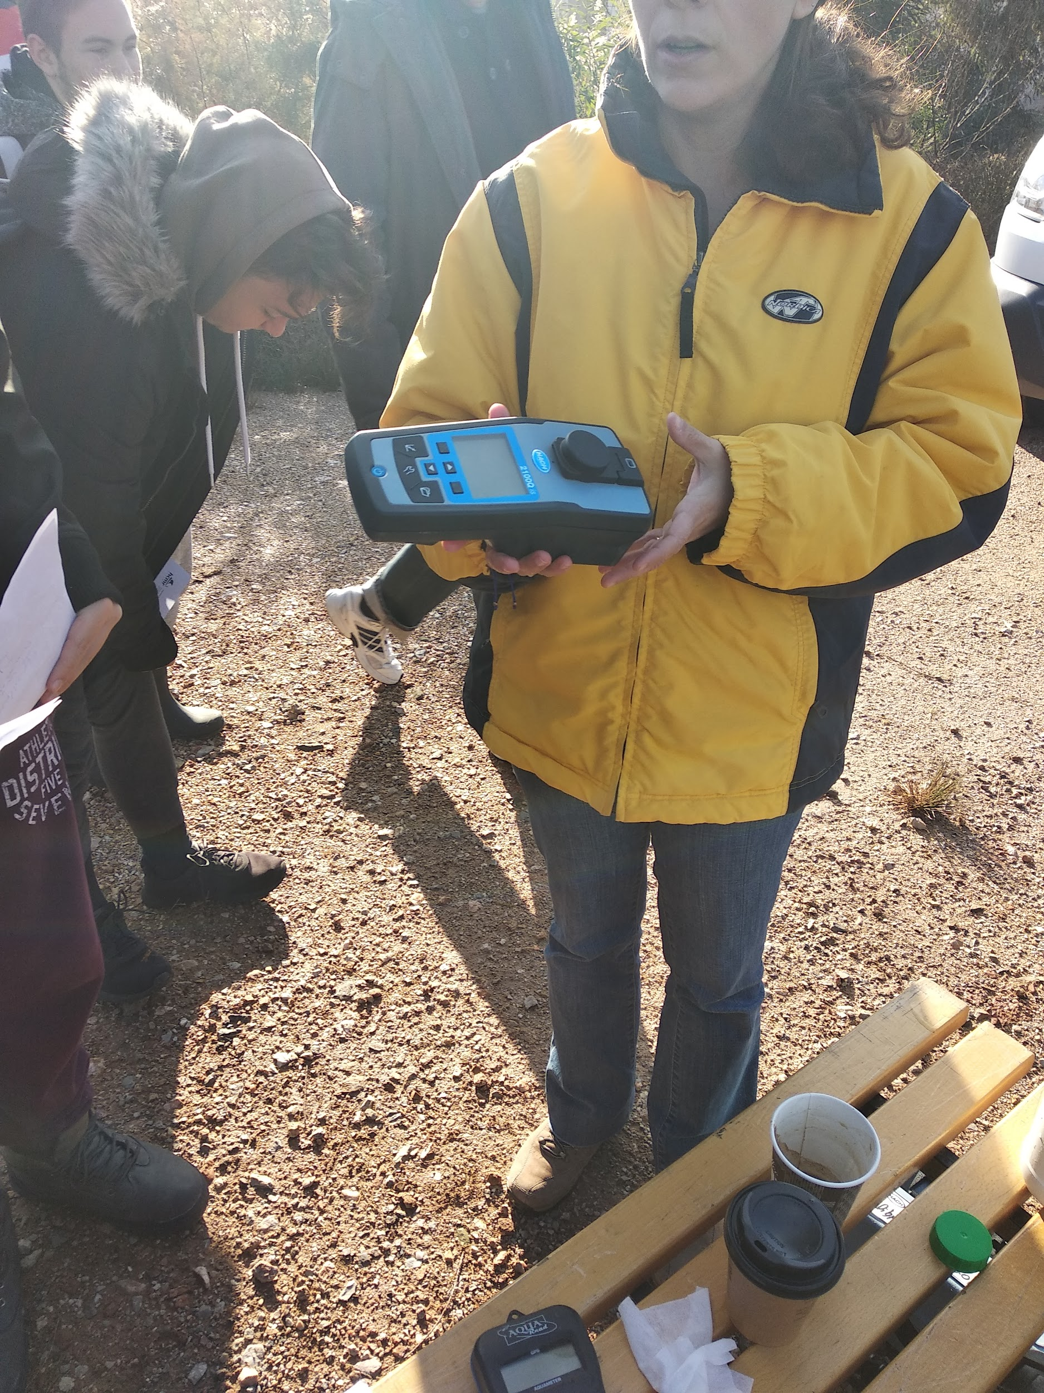
with the aid
of a mobile spectrophotometer

Slide 12
The physicochemical
measurements
PH
temperature
electric conductivity
dissolved oxygen
water turbidity

Slide 13
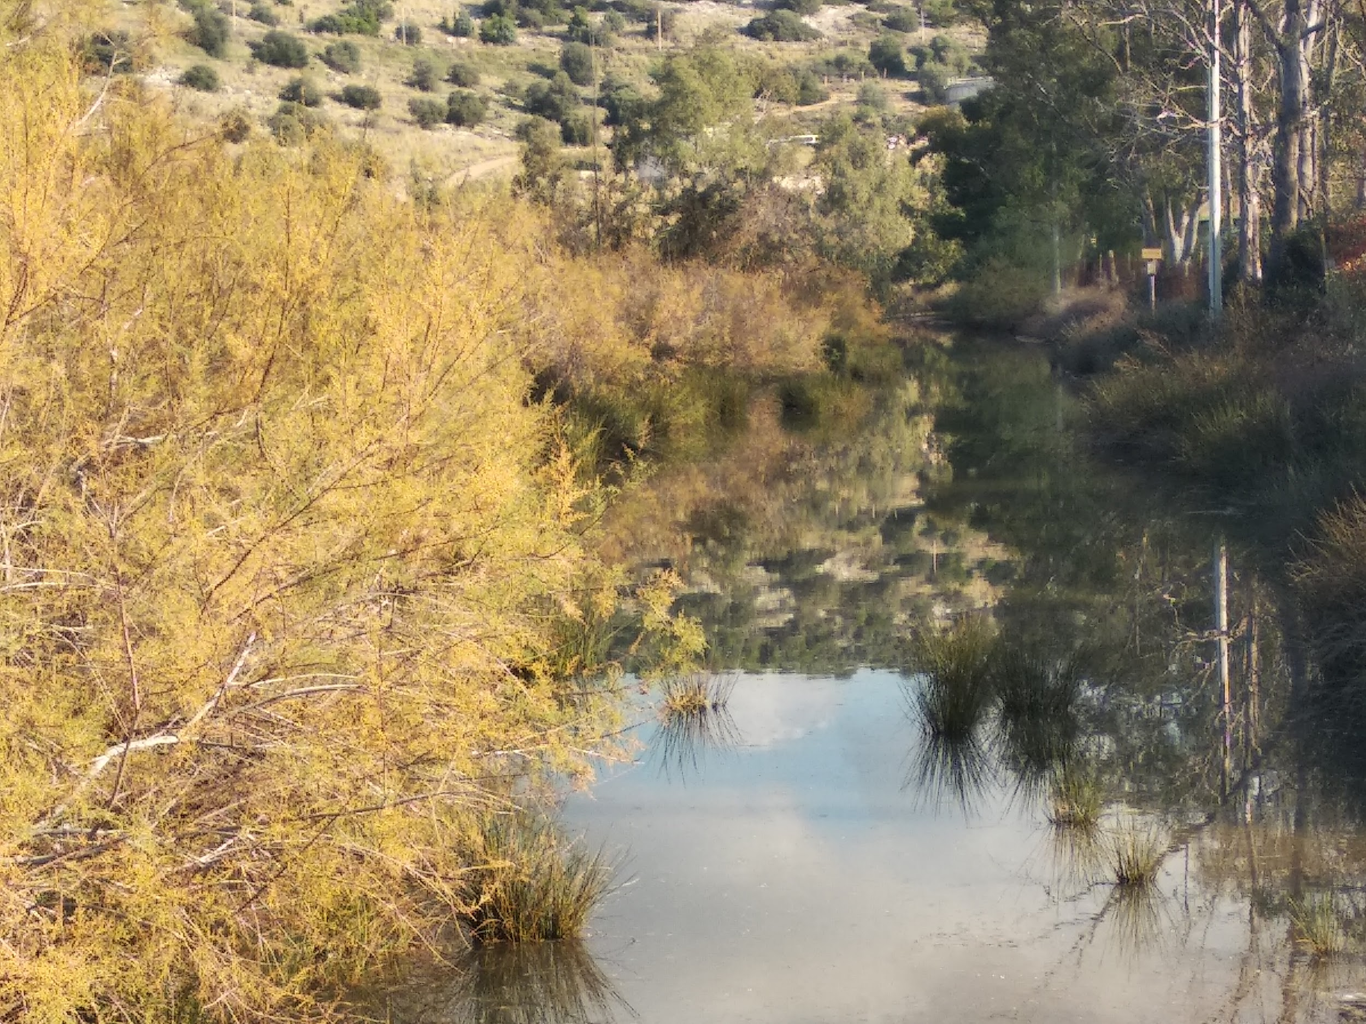
confirmed the bad quality of the water
and the need for interventions

Slide 14
Lake_Koumoundourou.mp4
a short video of our field trip

Slide 15
Conclusions
Also, underground pollution from the neighbouring waste disposal center further pollutes the Lake.
Underwater pollution from highly dangerous industrial pollutants is also significant.
Elefsina is the city with
the highest ever officially recorded temperature
in Europe of 48.0 °C
Lake Koumoundourou
has been polluted by
toxic chemical substances,
which are by 10 times greater
than maximum safety levels.

