Slide 2
Migration across the Aegean Sea
Since the antiquity...

Slide 3
11th century BC
Greek peoples, the
Ionians
Aeolians
Dories
came to the coasts of Asia Minor and established major cultural centres
Asia Minor has always been a crossway of civilizations

Slide 4
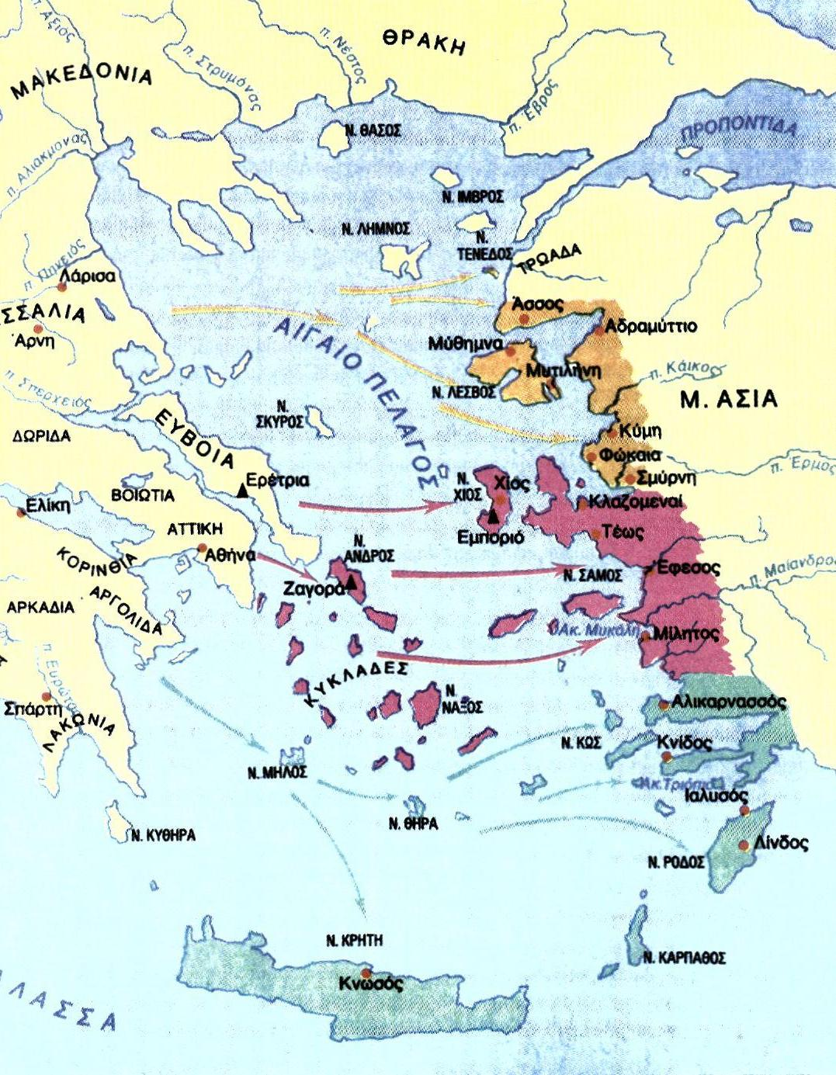
The antique civilizations
In Asia Minor

Slide 5
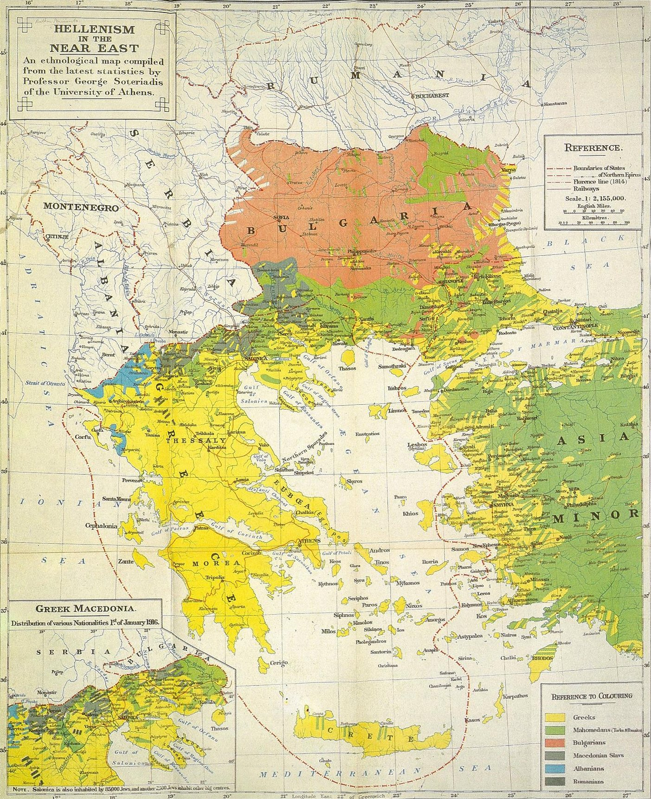
In the Middle Ages
Asia Minor thrives both culturally and economically

Slide 6
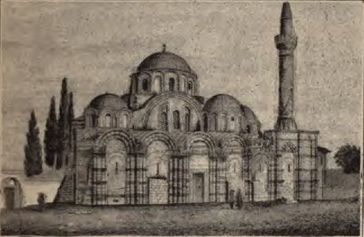
1453 AD The Fall of the Byzantine Empire
The Byzantine capital Konstantinoupolis
(city of the Byzantine Emperor, Konstantine)
or simply “Polis” (the City)
changes its name into Istanbul
(to the City “is tin Poli)
and becomes the capital city
of the Ottoman Empire

Slide 7
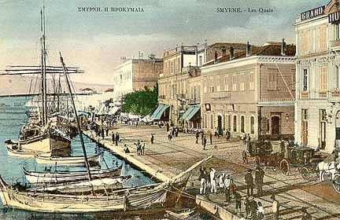
Meanwhile
Many Greek settlements in Pontus and Asia Minor still exist and thrive with Greek and Turkish people coexisting peacefully
At the beginning of the 20th century, there were 94 greek schools in Smyrna with 14.000 students

Slide 8
In the early 1900s
Fall of the Ottoman Empire and Rise of Nationalism on both sides

Slide 9
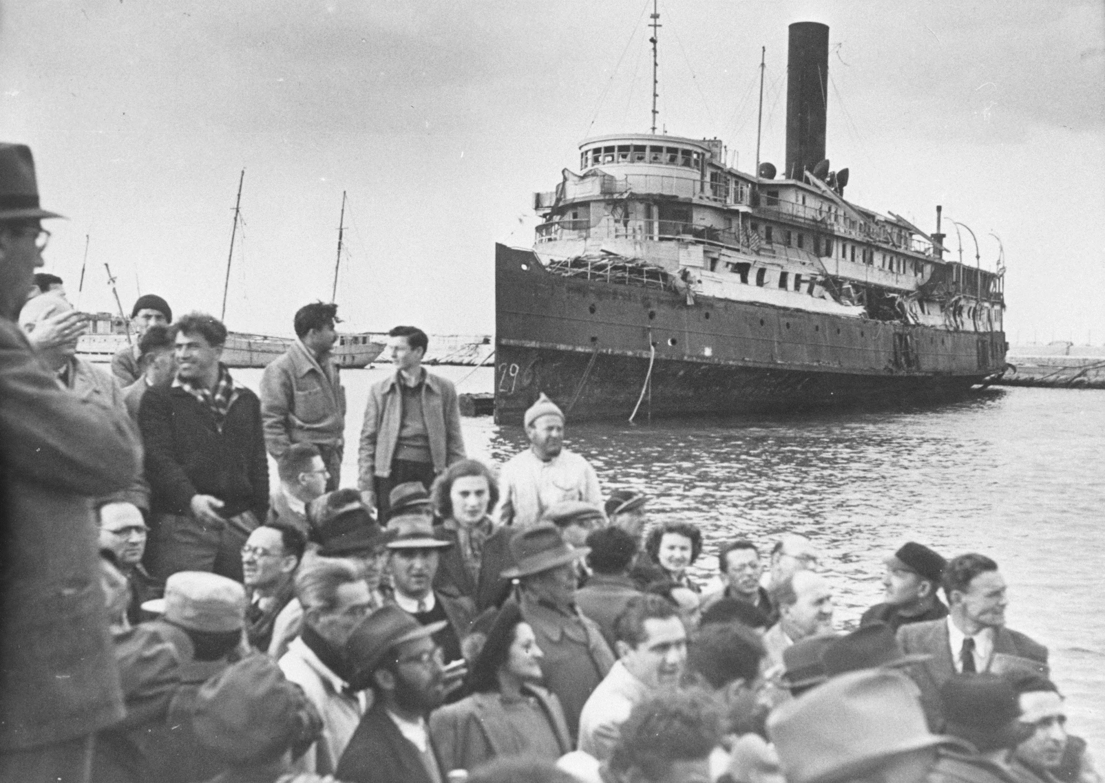
May, 1919
Greek troops disembark at Smyrna as a consequence of WORLD WAR I -
by order of
the League of Nations

Slide 10
1920
Smyrna is declared an autonomous state (Autonomous Ionian State)
The administration of Smyrna is handed to the Greek State for 5 years
1925: a referendum among the citizens of Smyrna was supposed to determine its future but never actually happened...
The Cerves Convention is signed

Slide 11
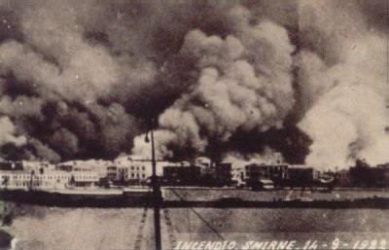
August 31st, 1922
Smyrna is on fire

Slide 12
1923
The POPULATION EXCHANGE
1.220.000 Christians are forced to leave Asia Minor (of which 190.000 came from Smyrna) and settle in Greece
350.000 Greek Muslims are forced to leave Greece and settle in Turkey
BOTH PARTIES WERE TREATED AS REFUGEES by the host communities at first
The Lausagne Convention is signed

Slide 13
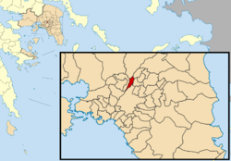
νNννν
ΝΕΑ ΦΙΛΑΦΕΛΦΕΙΑ
Afterwards
The Greeks of Asia Minor
established towns
in Greece
and named them after their hometowns in Asia Minor
Nea Philadelphia
Nea Chalkidona
Nea Ionia
Nea Smyrni

Slide 14
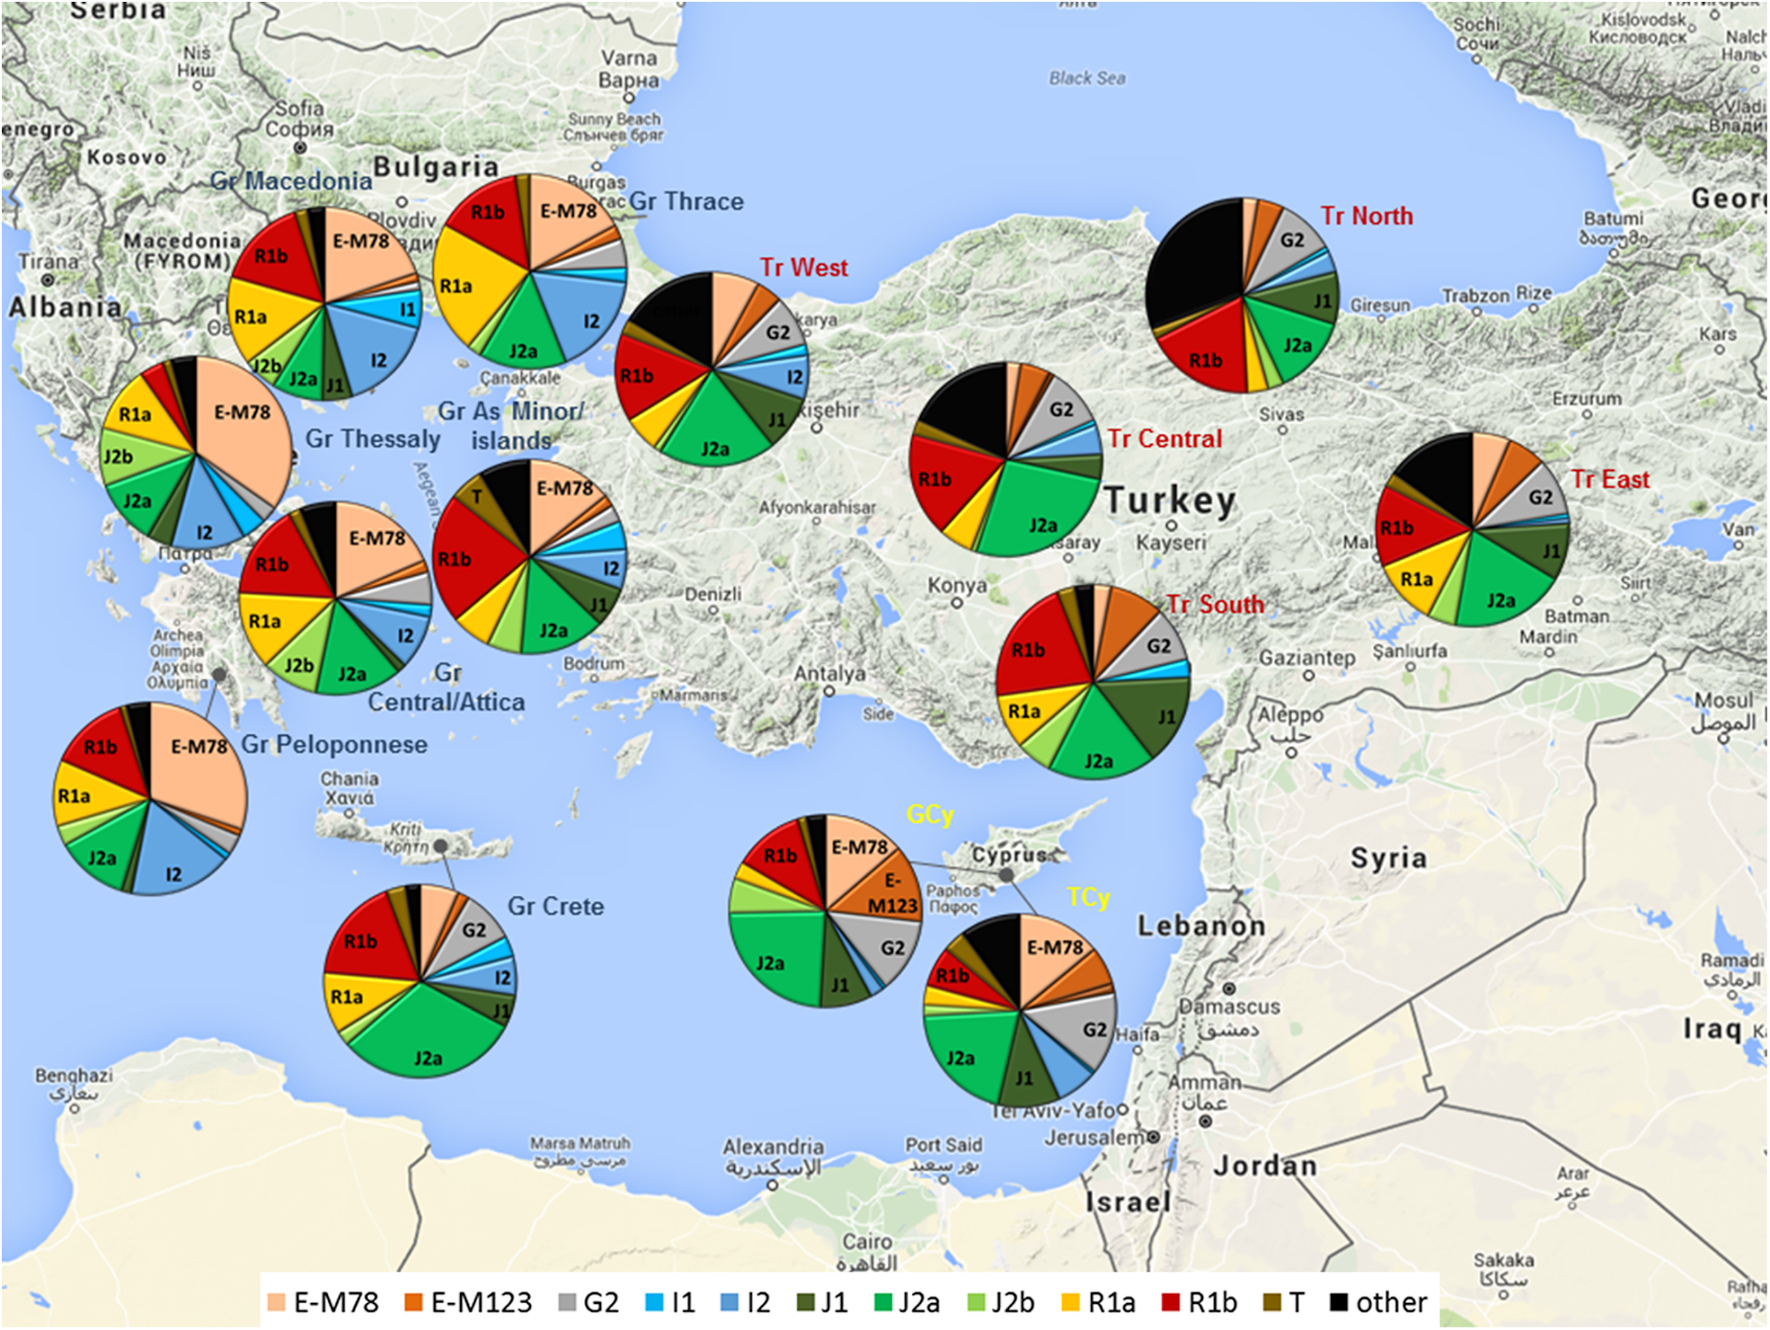
All in all,
Greeks and Turks have a lot
in common
after their 30-century- long coexistence
in Asia Minor!!!

