Slide 2
A full Greek traditional menu

Slide 3
Starters Main Dish
Tzatziki (cucumber and garlic dip)
Keftedakia (small meatballs)
Side Dish
Greek Salad
Moussaka
(vegetables and minced meat in red tomato sauce and bechamel top)
Dessert
spoon sweets

Slide 4
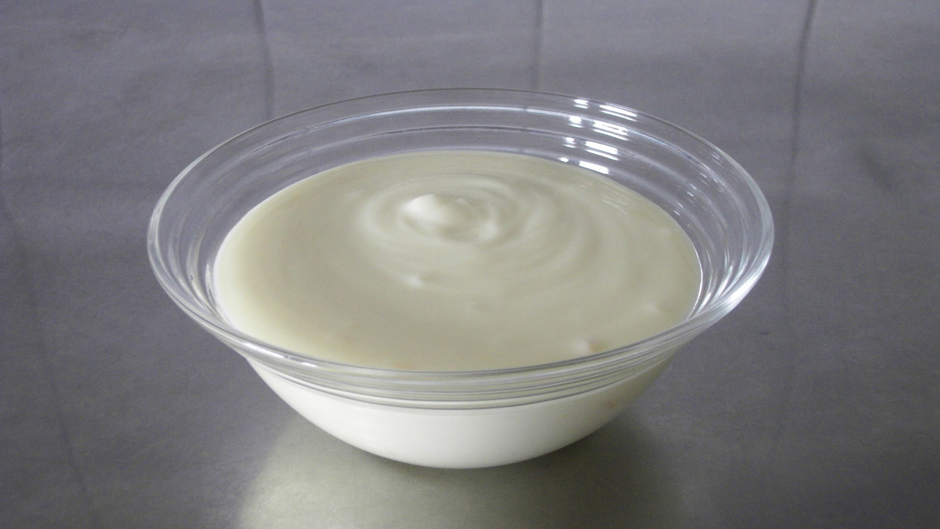
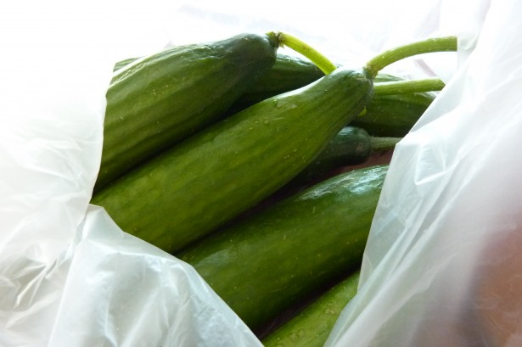
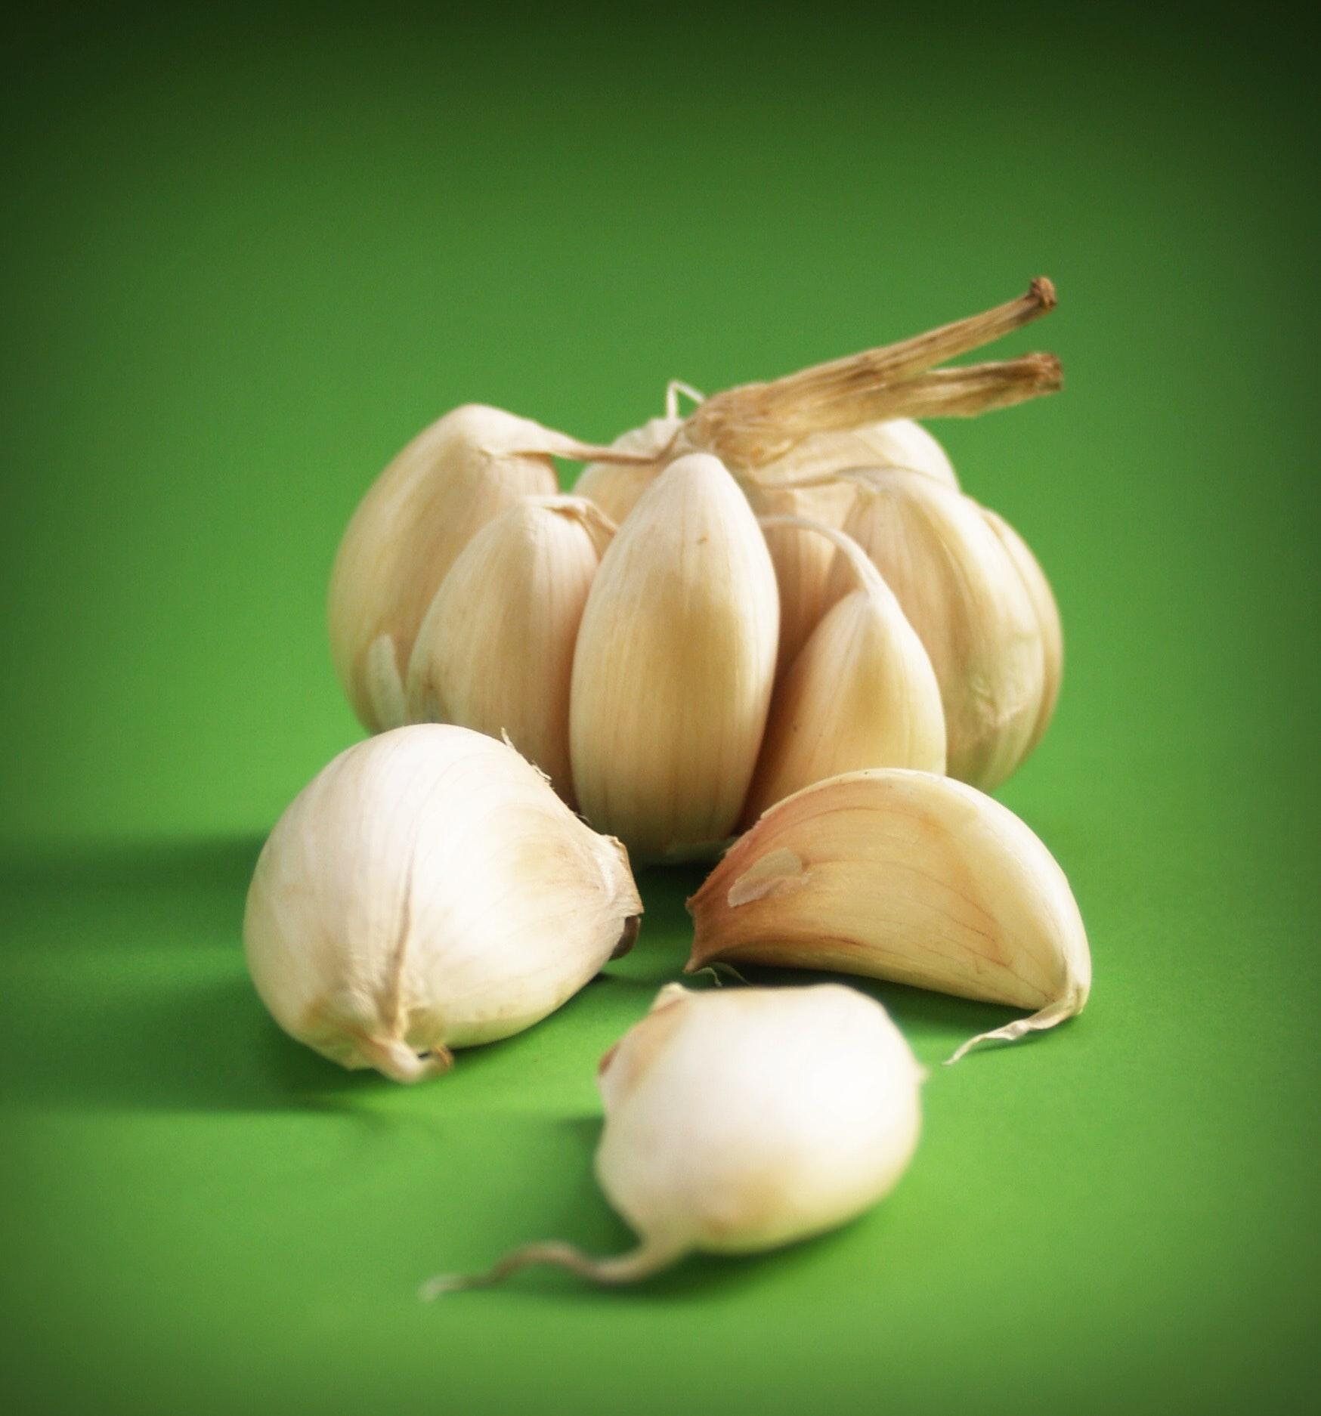
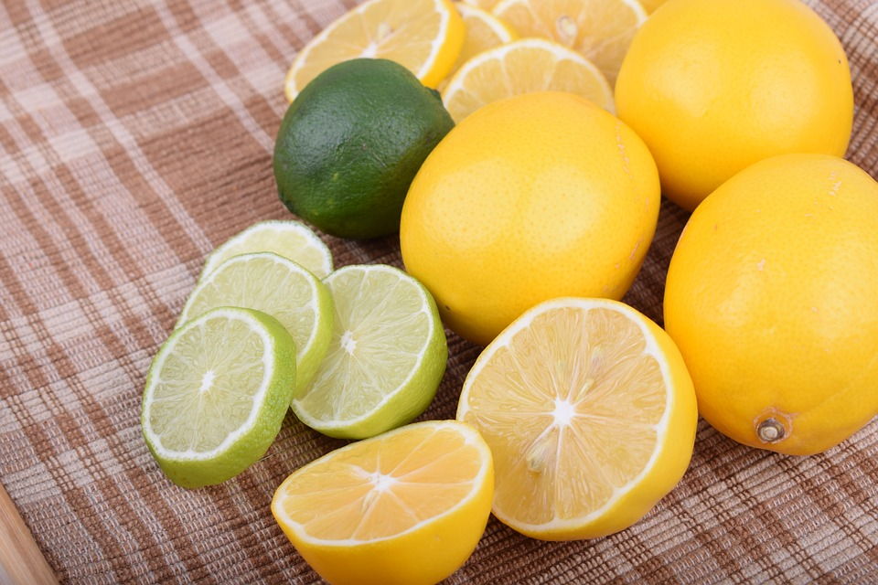
TZATZIKI
Ingredients
● Greek yogurt, 16 oz. (strained)
● Lemon juice, 2 teaspoons
● Cucumber, ½ cup (diced or grated)
● Garlic cloves, 5 - 10 (finely-chopped)
● Olive oil, 1 tablespoon

Slide 5
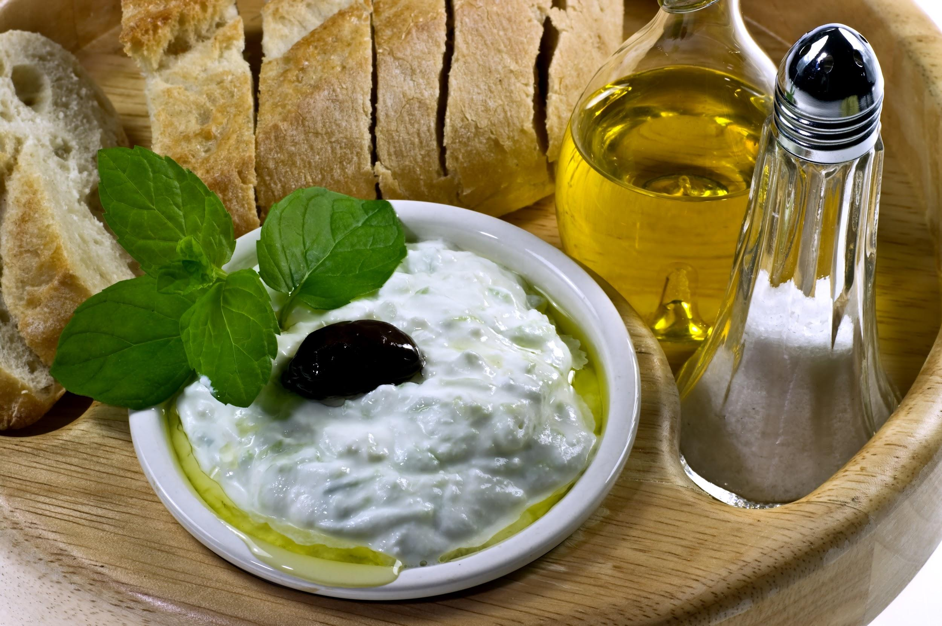
PREPARATION
● grate the cucumber
● mix oil and lemon juice in a mixing bowl
● add garlic, according to taste, and cucumber
keep stirring until the garlic and the cucumber are evenly distributed
● garnish it with a bit of green and an olive
serve well chilled
Notes:
green for example spearmint, basil, parsley

Slide 6
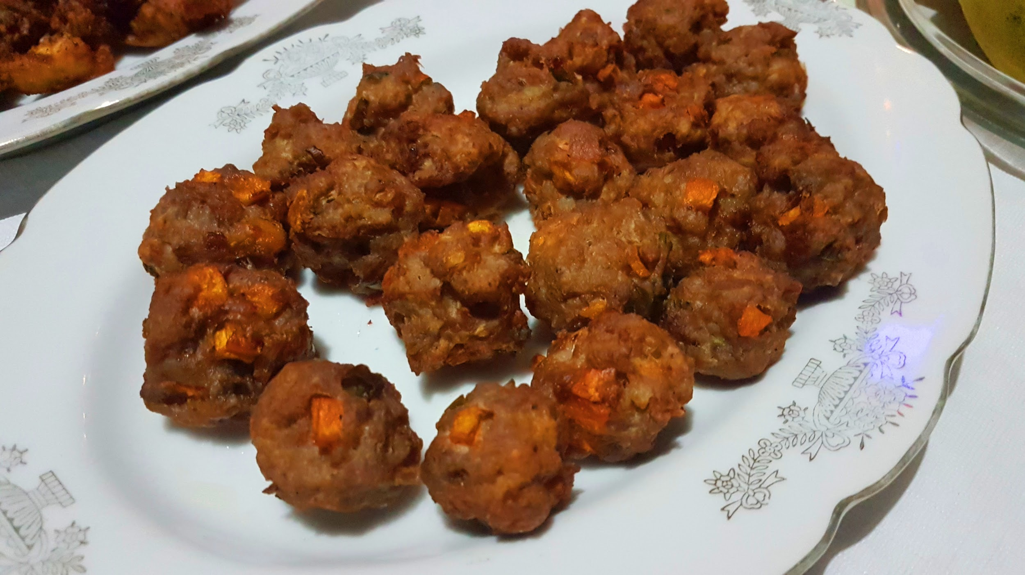
Keftedakia (ingredients)
3 lb beef minced
3 onions
fresh mint and parsley
3 cloves garlic
1 teaspoon cumin
5 large tomatoes peeled
2 teaspoons tomato paste
1 small branch thyme
1 tablespoon white vinegar
2 eggs
breadcrumbs
Olive oil
½ cup water
Salt and pepper
some ouzo (spirit)

Slide 7
Keftedakia (instructions)
In a large container, place the minced beef.
Add the mint, parsley, bread crumbs, vinegar, garlic, cumin and onion.
Add the eggs. Season with salt and pepper.
Mix and knead vigorously for 10 minutes.
Form small balls.
In a deep frying pan, pour the olive oil (about 1 inch of oil).
Fry the meatballs until golden brown.
Remove the meatballs from the pan with a skimmer and place on paper towels

Slide 8
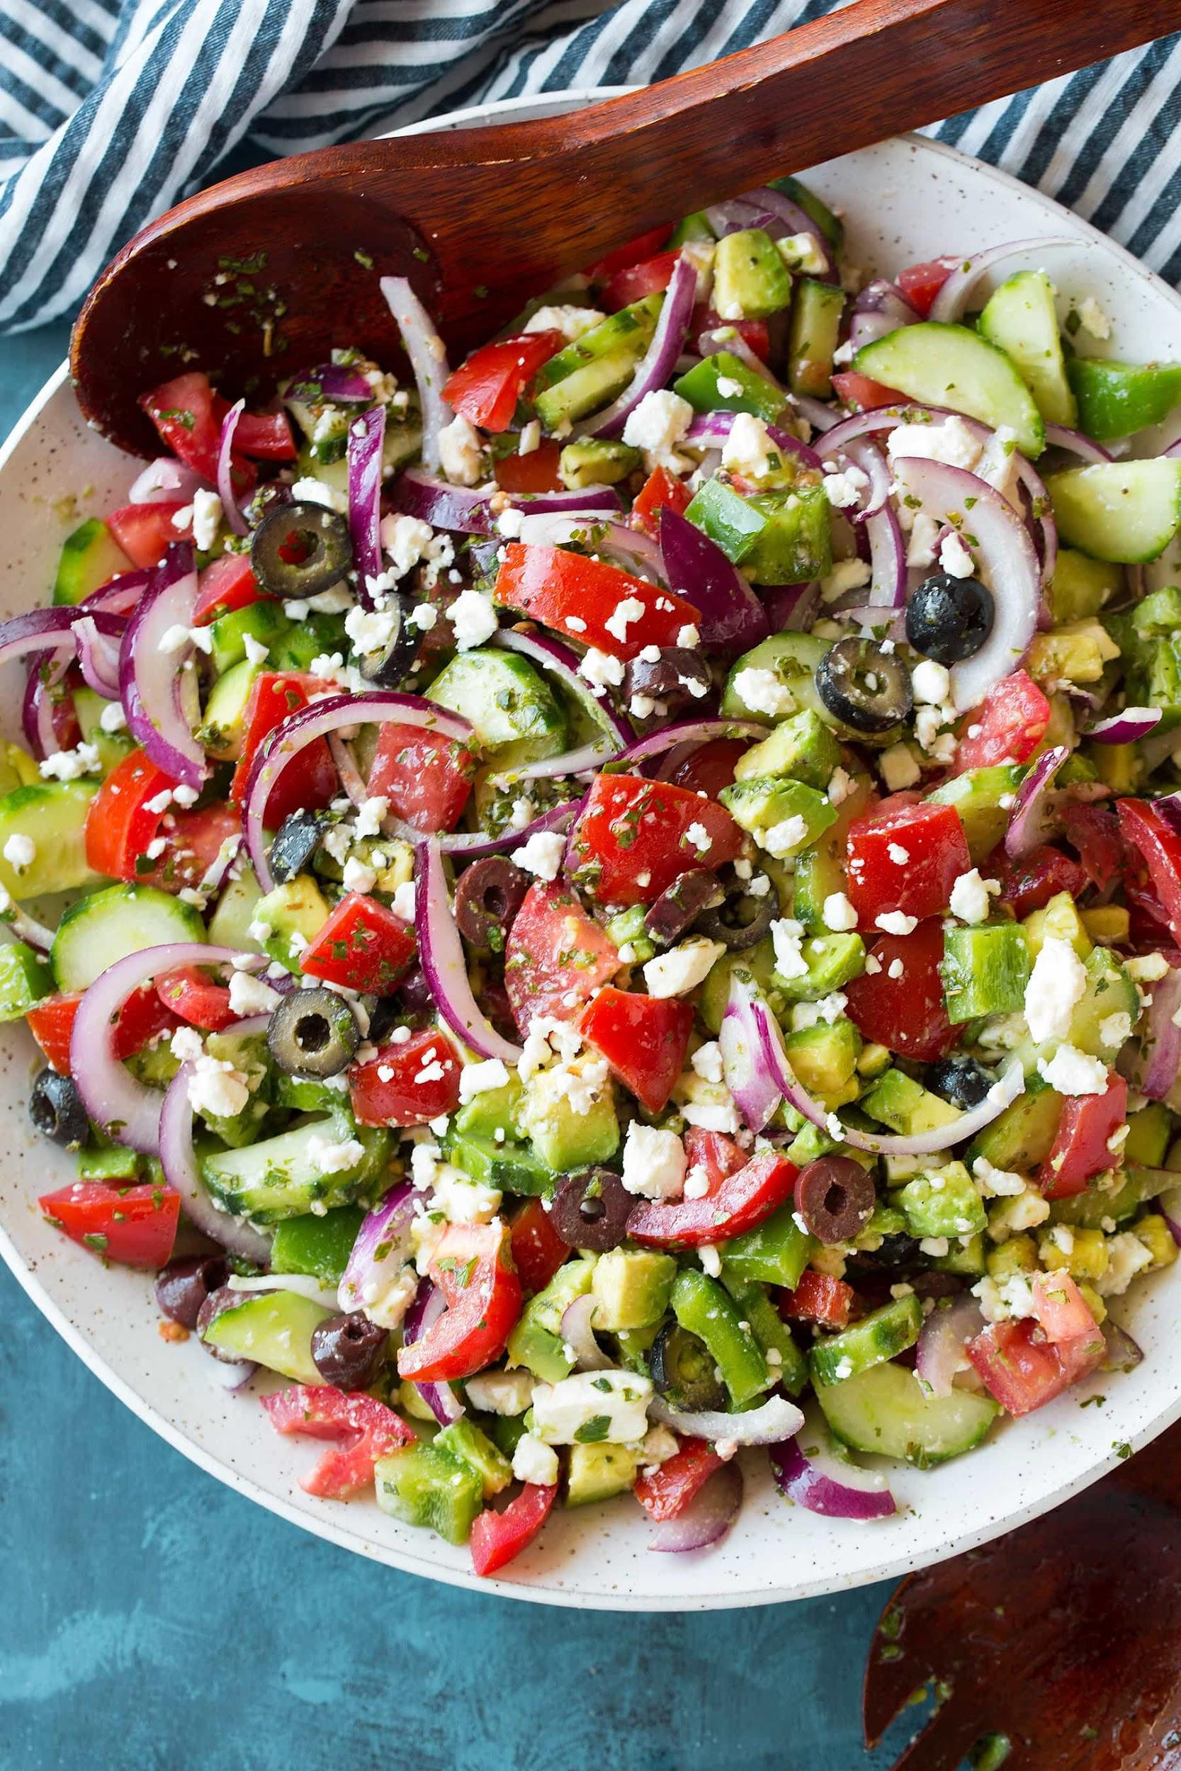
Greek Salad (ingredients)
4 medium-sized tomatoes, cut into wedges
1 cucumber , sliced into half moons
1 large green bell pepper, cored and thinly sliced
1 small red onion, peeled and thinly sliced
1 cup kalamata olives
3–4 tablespoons olive oil
2 tablespoons red wine vinegar
1 teaspoon dried oregano, plus extra for serving
sea salt
5 ounces feta cheese, thickly-sliced

Slide 9
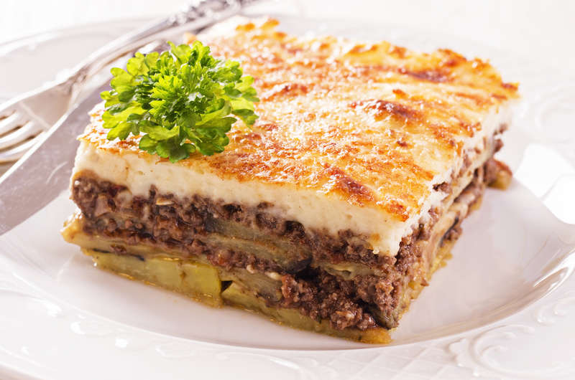
the legendary
“moussaka”
enjoy with a glass of dry
red wine

Slide 10
for the meat sauce
we need
Heat a large pan and add the olive oil.
Stir in the chopped onions and sauté, until softened and slightly colored.
Stir in the garlic, tomato puree and the mince breaking it up with a wooden spoon and sauté.
Pour in the red wine and wait to evaporate.
Add the tinned tomatoes, the sugar, a pinch of cinnamon, 1 bay leaf and a good pinch of salt and pepper.
Bring to the boil, turn the heat down and simmer with the lid on for about 30 minutes, until most of the juices have evaporated.
750g beef or lamb mince (26 ounces)
2 red onions (chopped)
2 cloves of garlic (chopped)
1 tin chopped tomatoes (400g/ 14 oz.)
2 tbsp tomato puree
1 teaspoon sugar
1 glass of red wine
sea salt and freshly ground black pepper
1 bay leaf and a pinch or stick of cinnamon
1/4 of a cup olive oil

Slide 11
Moussaka (instructions )
Begin by preparing the vegetables (aubergines, potatoes, zucchini). Peel the potatoes and remove the stalks from the aubergines and the zucchini. Cut them into slices, 1 cm thick. Season with salt and place in a colander for about half an hour.
Drizzle the vegetables with some olive oil and bake them for 20 minutes
Prepare the meat sauce and the béchamel sauce for the moussaka.
Assemble the moussaka. Butter the bottom and sides of the pan and layer the vegetables. Pour in the meat sauce and even out. Add a second layer of vegetables, top with the béchamel sauce and smooth out with a spatula.
Sprinkle with grated cheese and bake in preheated oven at 180-200C for about 60 minutes.

Slide 12
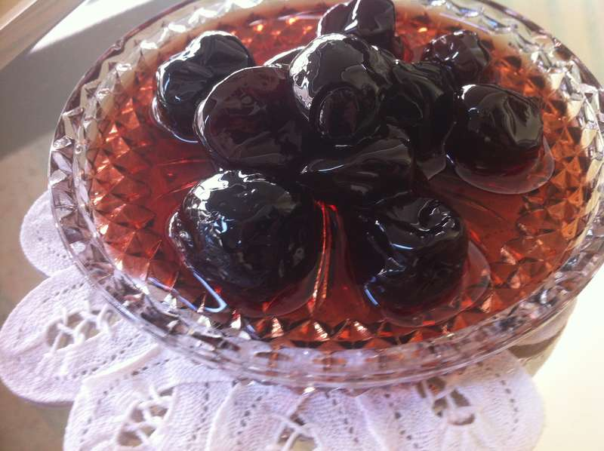
Desserts
The most famous desserts in Greece are the so mentioned spoon ones. There are too many of them! Usually our grandmothers make these desserts out of almost every fruit they can find!
Sour cherry spoon sweet is one of the most popular and it is served sometimes as a topping for dark chocolate Ice cream, try it and be amazed!

Slide 13
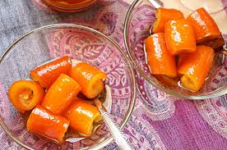
Orange peel spoon sweet

Slide 14
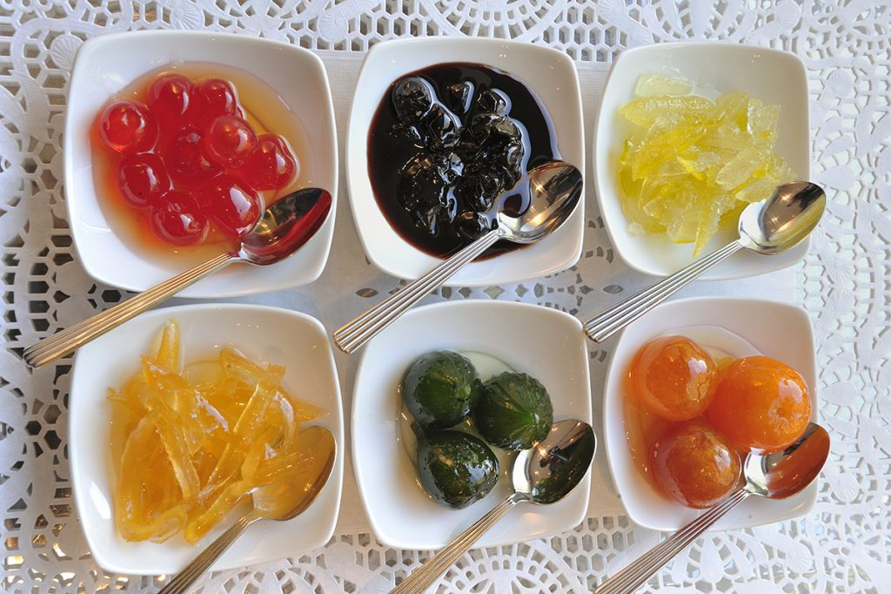
Spoon sweets out of every fruit you can imagine

Slide 15
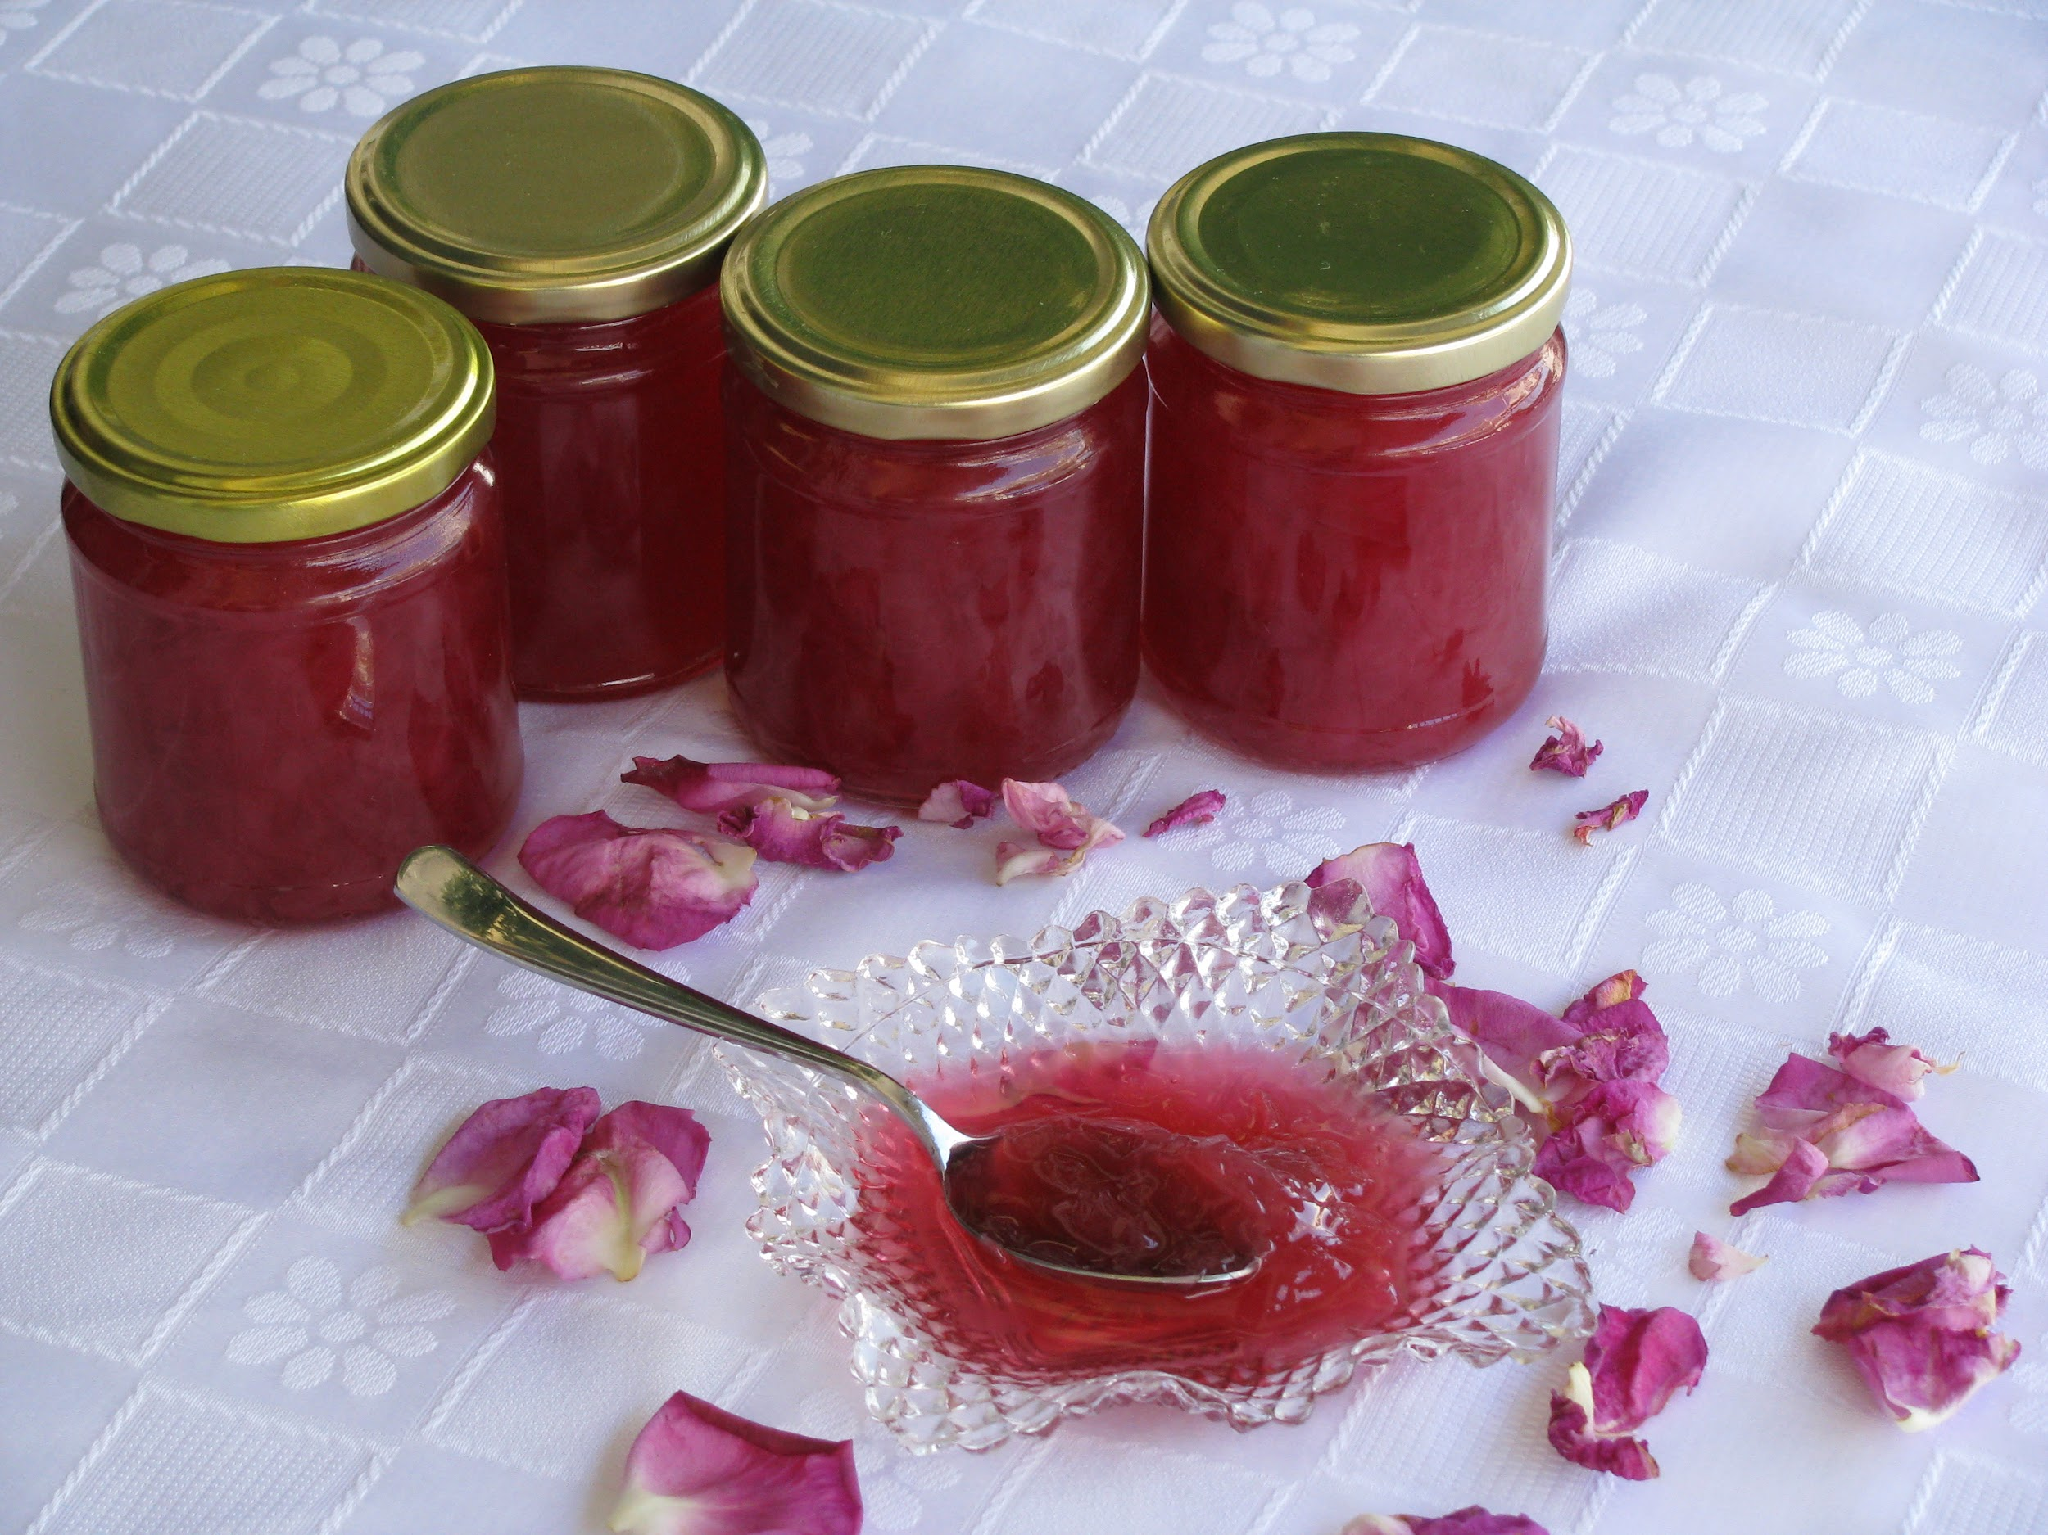
Spoon sweet out of a flower....Rose!

