Slide 2
Architecture and ecosystems

Slide 3
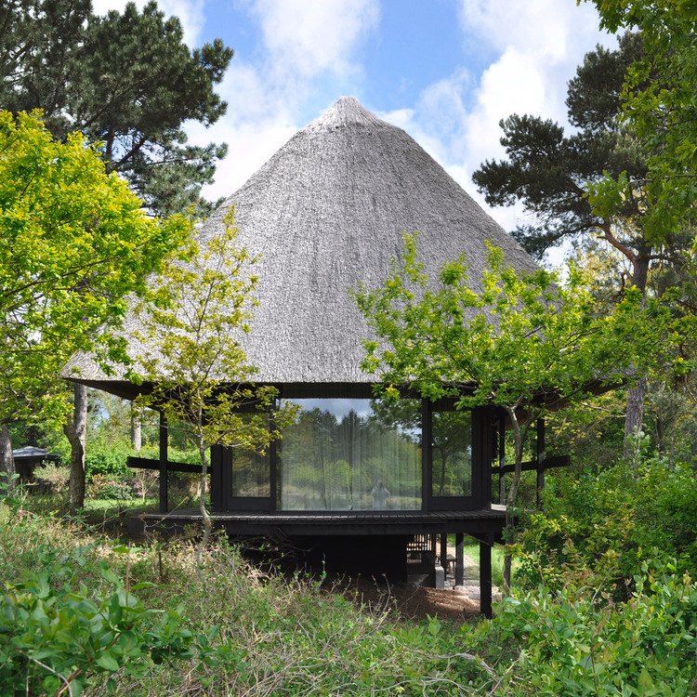
There are three types of architecture
Polite:Influenced by culture
Traditional:Following customs
Vernacular:Imposed by ecosystem and climate

Slide 4
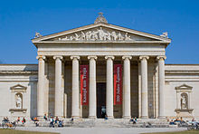
Classical architecture (spread around the world)

Slide 5
A typical example of polite architecture
Originated in ancient Greece (5th century BC)
Spread across the world in the 18th century AD
Some vernacular characteristics added: bay windows

Slide 6
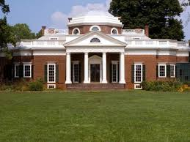
Neoclassical style (spread around the world

Slide 7
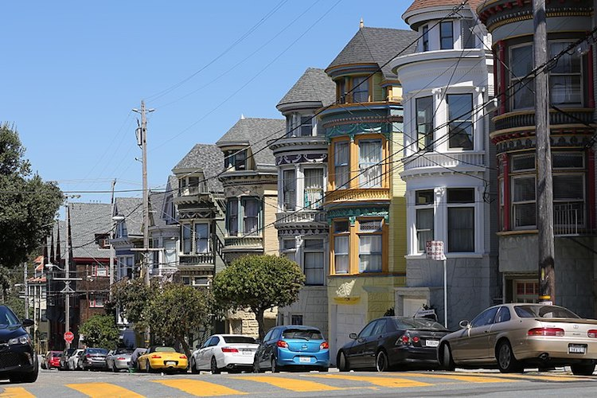
VICTORIAN AND EDWARDIAN HOUSES (SAN FRANCISCO, CALIFORNIA)

Slide 8
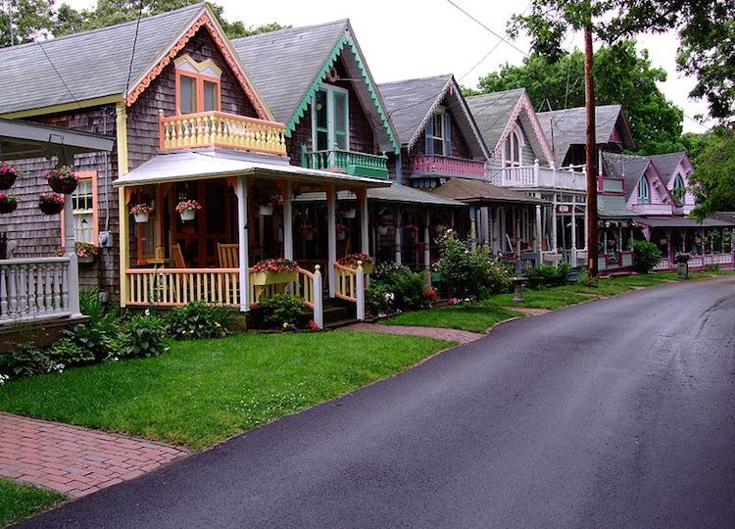
“GINGERBREAD” COTTAGES (MARTHA’S VINEYARD, USA)
look like they’re straight from a sugary-sweet storybook

Slide 9
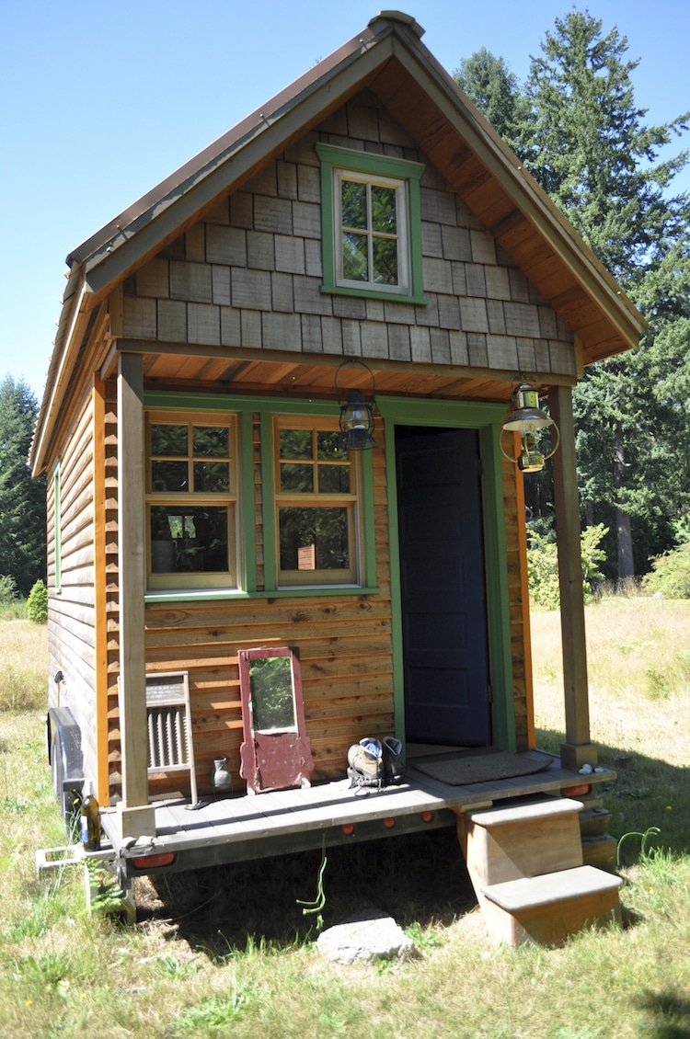
TINY HOUSES (PORTLAND, OREGON)
Downsizing:
embracing the tiny life philosophy and the freedom from financial worries

Slide 10
Differences due to the microclimate of the area:
cold climates:
high thermal mass
significant amounts of insulation
usually sealed in order to prevent heat loss
openings such as windows tend to be small or non-existent
warm climates:
lighter materials
cross-ventilation through openings

Slide 11
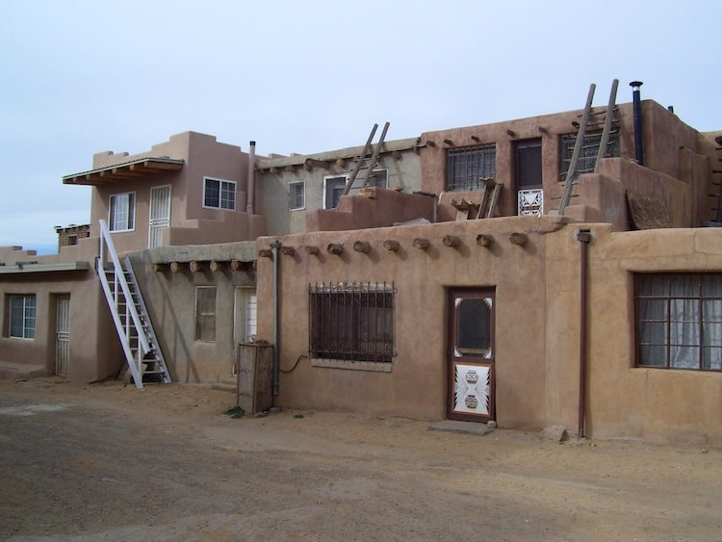
ADOBE BUILDINGS (ACOMA, NEW MEXICO)
2,000 years old
ladder-accessible homes
of adobe brick

Slide 12
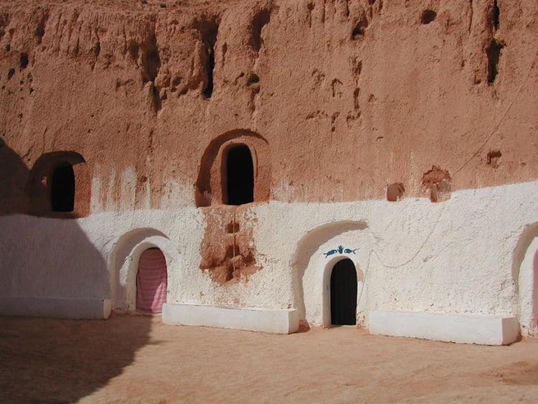
CAVE HOMES (MATMATA, TUNISIA)
ancient abodes that have been carved out of sandstone
provide protection from the North African sun and desert winds

Slide 13
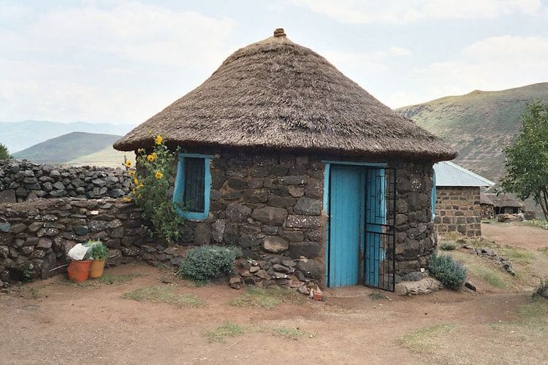
RONDAVELS/ROUND HOMES (LESOTHO, SOUTH AFRICA)
rounded, single-cell huts
like igloos, rondavels were traditionally used as temporary hunting lodgings

Slide 14
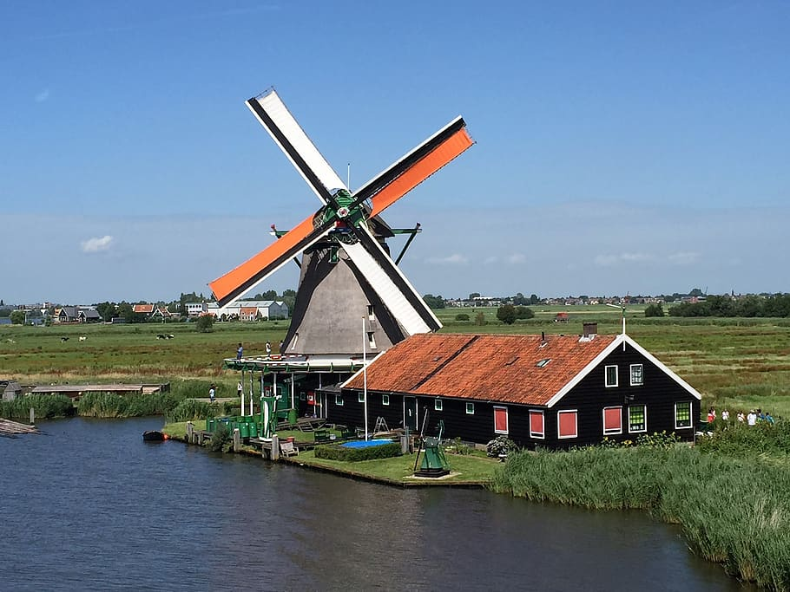
Windmills(Netherlands,Kinderdijk)
Converts wind power into rotational energy with blades and sails
Pumping water out back to the rivers

Slide 15
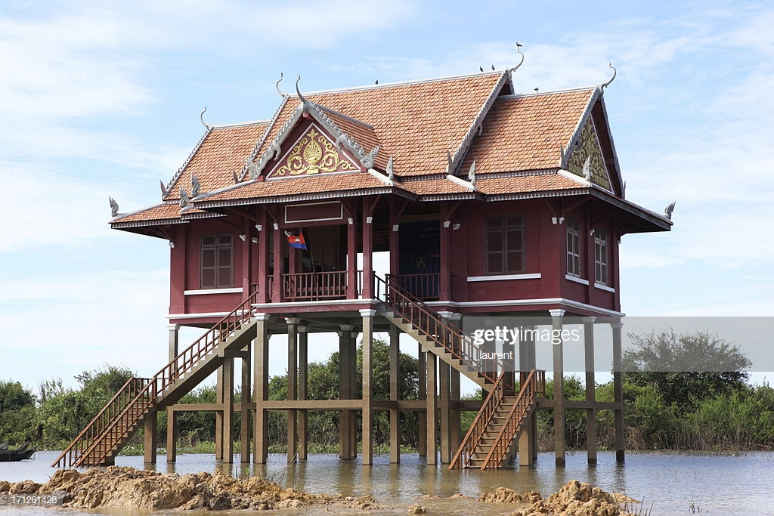
Stilt houses (cambodia Southeast Asia)
raised up on planks in order to protect its inhabitants and their possessions from flooding
from invading vermin—namely, snakes and insects
Food from the lake

Slide 16
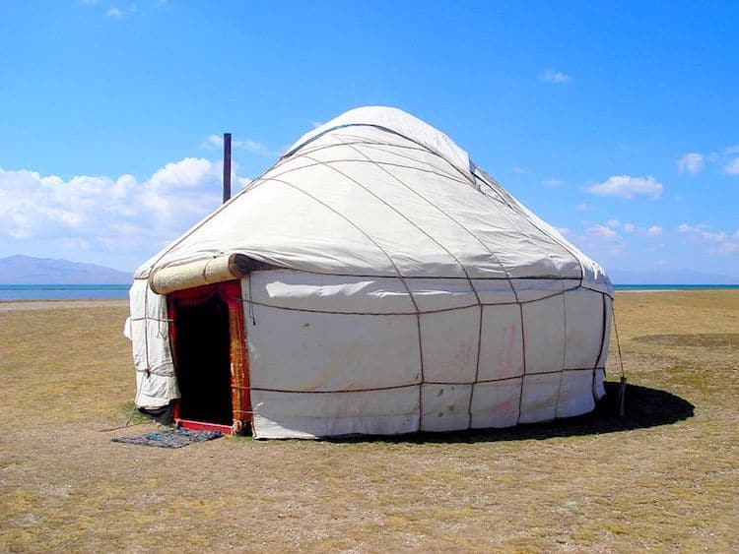
Yurts (Kyrgyzstan Central asia)
portable tents traditionally composed of animal skins—have been used by Central Asian nomads for centuries

Slide 17
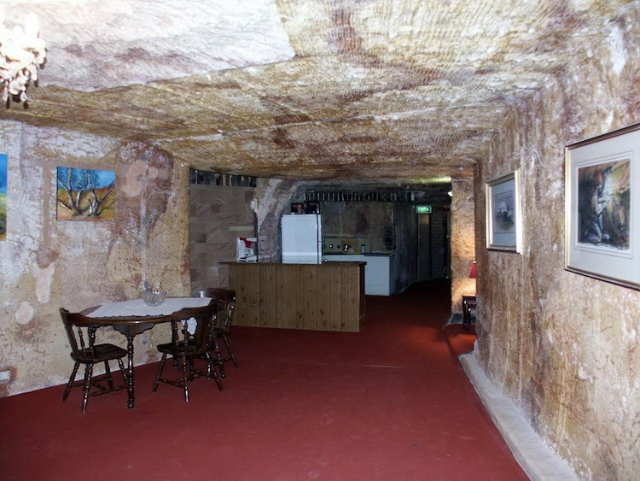
Dugouts underground shelters (Coober Pedy Australia)
underground homes
protection from heat and dust storms
half of the town’s residences, as well as a museum, a church, and even a hotel

Slide 18
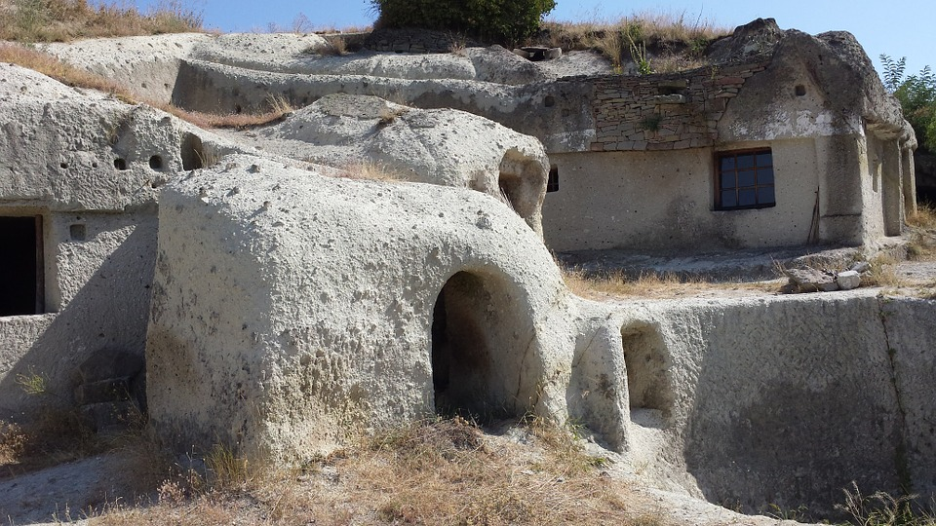
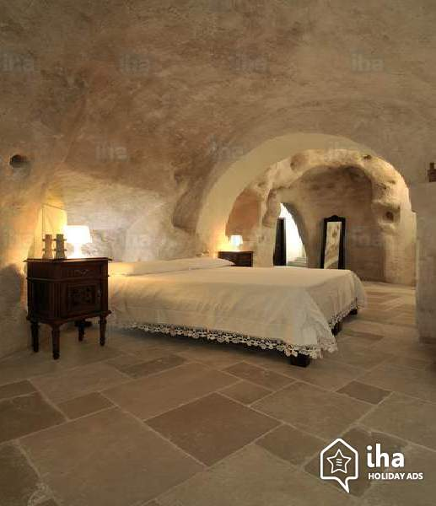
Cave homes in Matera

Slide 19
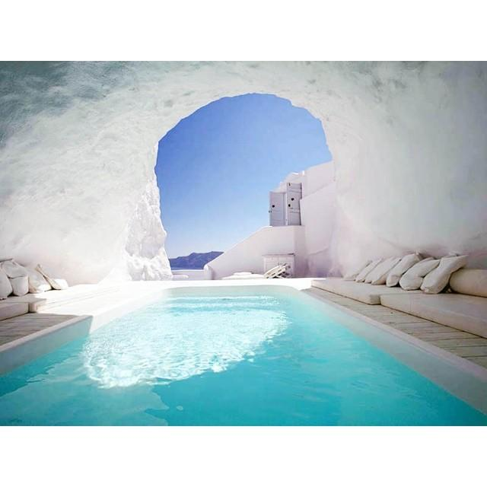
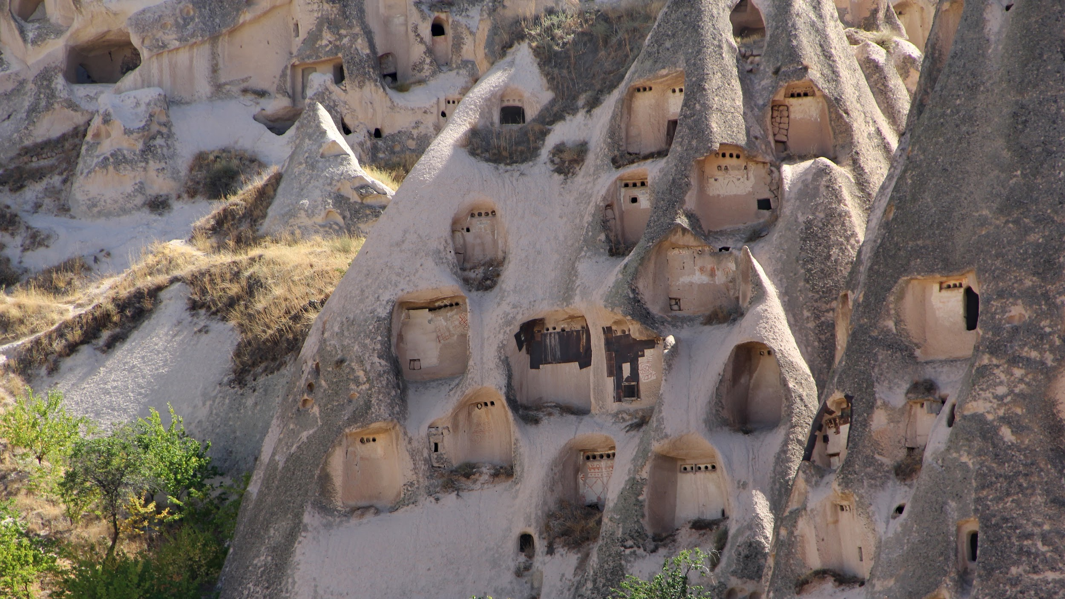
… in Greece and Turkey

Slide 20
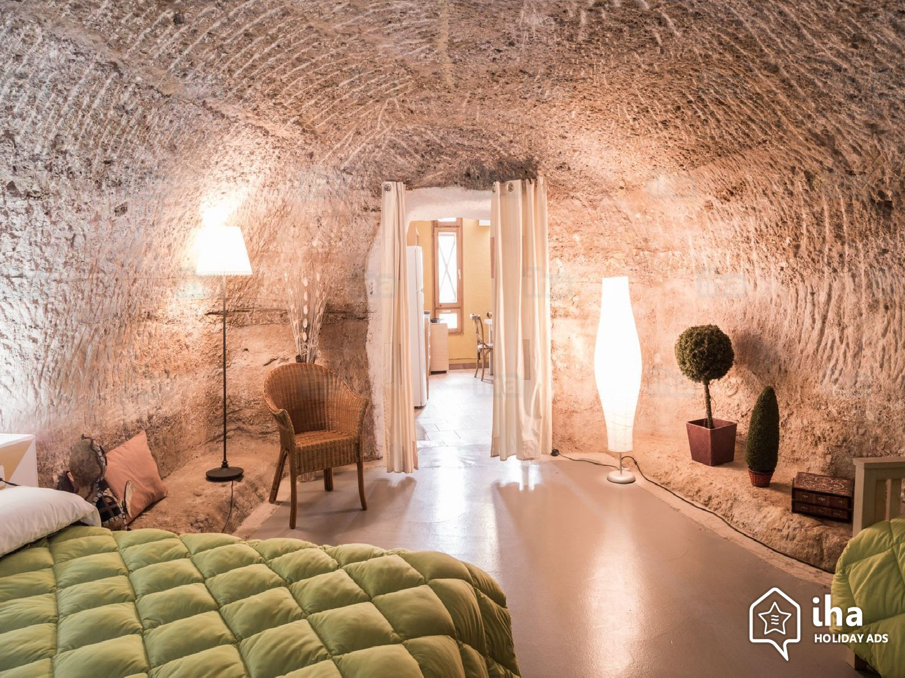
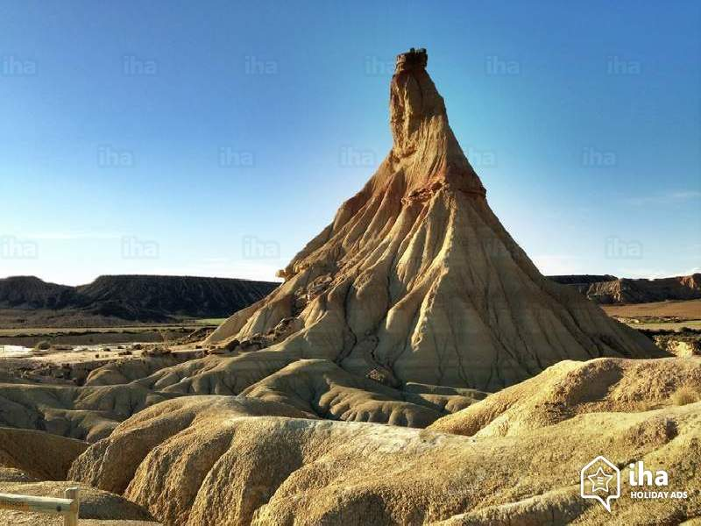
Cave dwellings and hotels in Spain

Slide 21
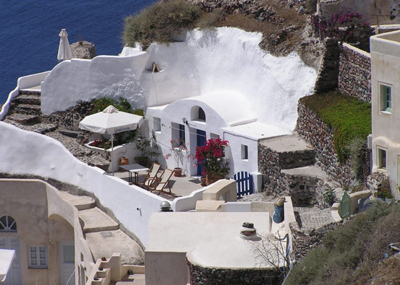
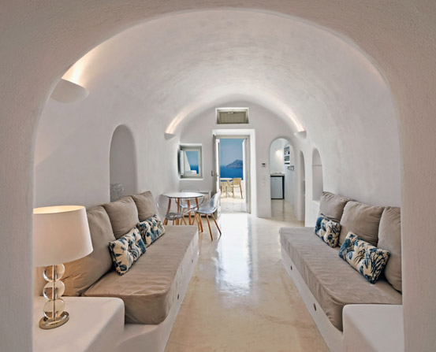
Dugouts in Santorini Greece

Slide 22
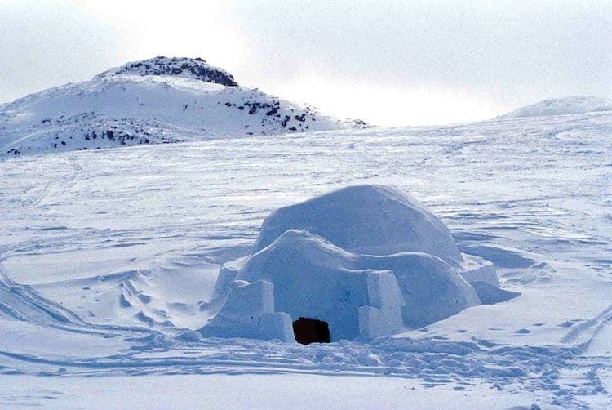
Igloos (Baffin island Canada)
Skillfully constructed out of insulating, compressed snow, the icy accommodations keep dwellers warm by blocking harsh winds and housing a small fire

