Slide 2
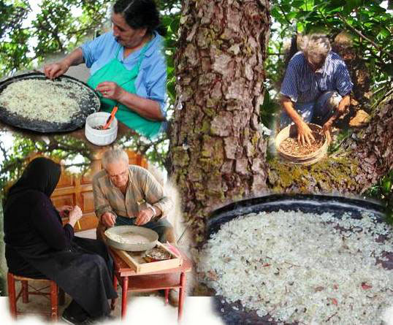
The mastic cultivation

Slide 3
The mastic cultivation: cultural heritage
The traditional know – how of mastic cultivation inscribed in the list of the intangible cultural heritage of Humanity by UNESCO in 2014

Slide 4
The Chios Mastic Museum
is located in the Mastichochoria of Southern Chios, the only place in the world where the mastic tree is cultivated and produces the mastíha resin. Traditional mastic cultivation continues to be alive today and is an element both of the inhabitants’ identity and of the locality’s history.

Slide 5
Skinos or mastic tree
pistacia lentiscus Chia shrub
grows in south Chios,
Gives an aromatic resin called mastic
Evergreen - αειθαλές
Height of 2-3 metres
Short trunk
Branches long, bending downwards
Develops fully after 40-50 years
Lives more than 100 years

Slide 6
The paradox of mastic
Skinos is a characteristic feature of the vegetation in Mediterranean
Only in the south of Chios
is cultivated systematically in order to produce mastic
Thanks to particular climate conditions

Slide 7
Cultivation
Starts in winter and completed in spring
Mastic resin is gathered in summer and early autumn
Whole families take part in this process
From October till the beginning of next spring, women clean the mastic resin

Slide 8
Mastic “tear”
Resin secreted by the tree
In order to heal the tree wounds caused by cuts

Slide 9
Know-how of cultivating mastic
τεχνογνωσία
Unique in the world
an ancient practice
It has gone down from generation to generation
Very important for the local society shaping:
Landscape
Settlements
Architecture
Social life

Slide 10
Mastic products
Natural mastic
Chewing gum
Mastic oil
Toothpaste
powder

Slide 11
Health benefits
A powerful antibacterial
Improves dental health
Full of antioxidants
Rejuvenate living cells

Slide 12
USES
Medicine
Pharmaceutics
Cooking
Beverage industry
Coatings industry
Perfumery
Cosmetics

Slide 13
Traditional cooking
Greek cooks use it in various baked goods, such as Tsoureki, the Greek Easter bread.
There is also a type of traditional spoon sweet that uses mastic
You can even put mastic in dishes such as Greek rice pudding

Slide 14
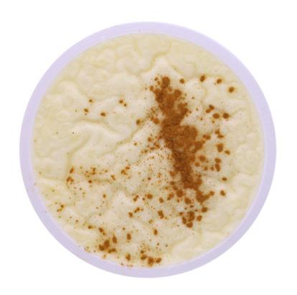
Recipe for the
mastic
pudding
Add 1 cup of water to a medium saucepan and bring it to a boil over medium heat. - Add rice and stir with a fork.
Simmer the rice with the lid on for 15 minutes.
Add the milk to the rice and water mixture and simmer for an additional 30 minutes over low heat, stirring the mixture with a fork a few times during the cooking process.
Mix flour with 4 tablespoons of water. - Add slowly to the rice mixture and stir vigorously with a fork.
Add about 1/2 teaspoon ground mastic with sugar
Stir in the sugar and simmer the mixture for an additional 15 minutes.
Remove the pan from the heat. - Stir in the vanilla extract.
Pour the pudding into individual custard cubs and sprinkle with cinnamon to garnish.
1 cup water plus 4 tablespoons
1/2 cup uncooked, medium grain rice
1 quart milk
1 1/2 tablespoons flour
1/2 cup sugar
1/2 teaspoon ground mastic
1/2 teaspoon vanilla extract
Cinnamon, to garnish

