Slide 2
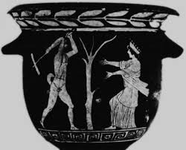
Erysichthon= the Earth tearer
A Myth for Sustainability

Slide 3
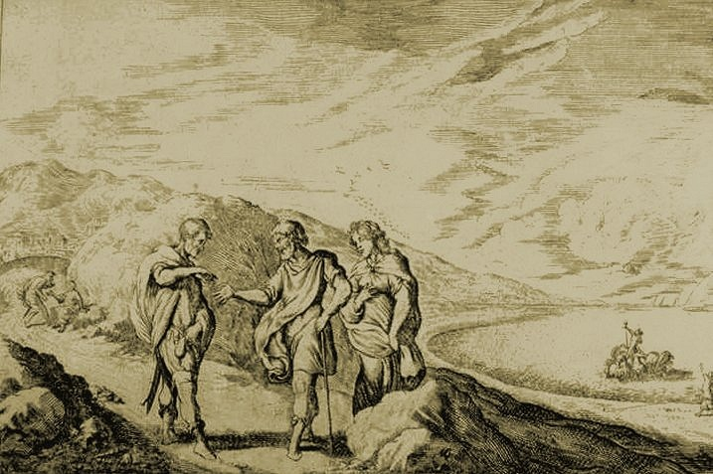
The hero was a super rich and super greedy king
who was looking for the perfect place to build his palace

Slide 4
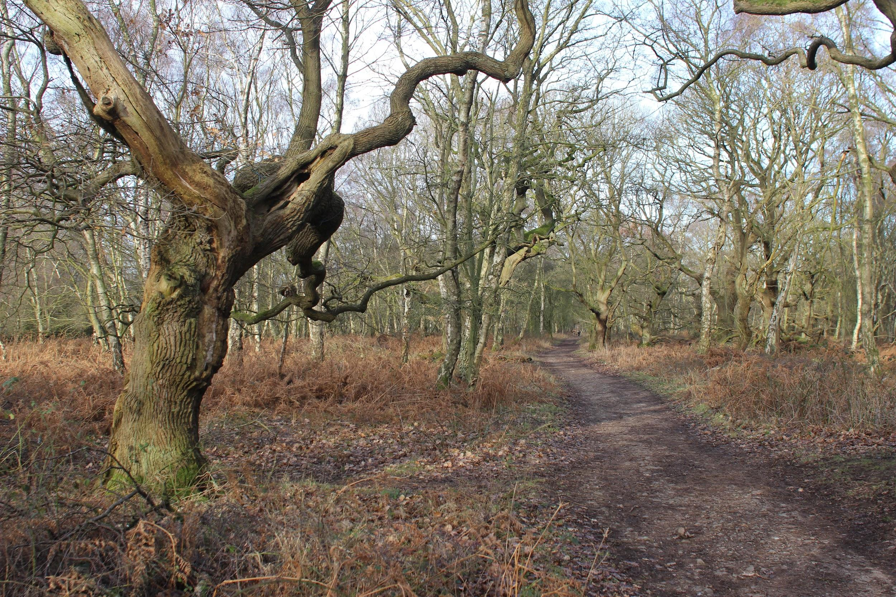
He found it near an oak tree forest
that belonged to goddess DEMETRA,
the protector of the Earth

Slide 5
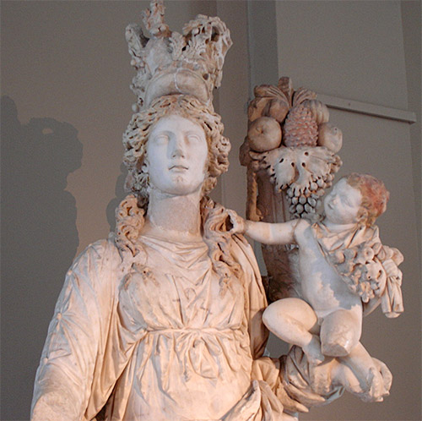
He had the forest cut down
to build his palace but the Goddess punished his GREED

Slide 6
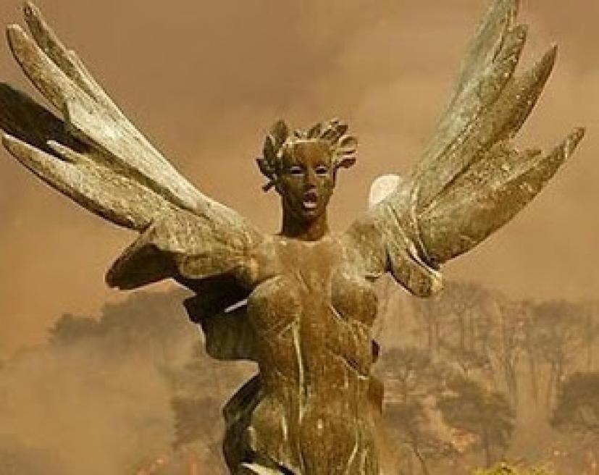
His punishment was eternal hunger
….insatiable greed; so it is believed that all men are greedy for wealth and power

Slide 7
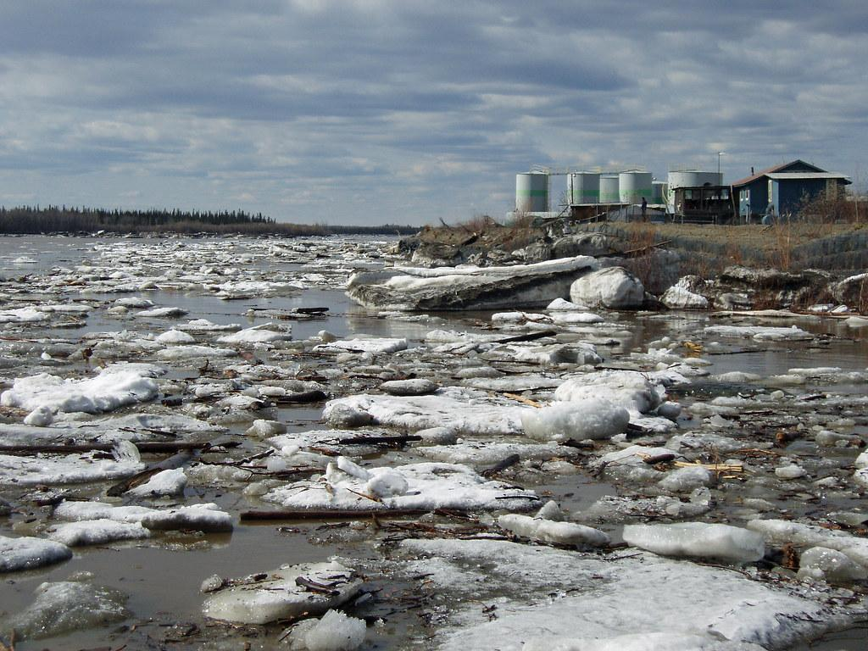
Eventually he ate everything on Earth,
even himself
… and became the symbol of environmental catastrophe

Slide 8
Earth is wounded
by overconsumption and violating the laws of nature,
that’s why we cry
for
sustainability

