Slide 2
Silk making
Silkworm farming in Greece

Slide 3
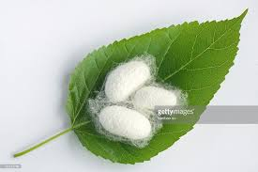
Silkworm cocoons

Slide 4
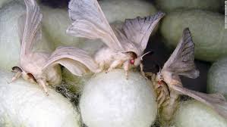
Busy weaving

Slide 5
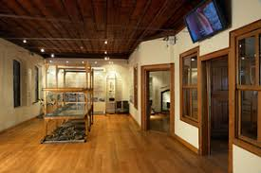
The Silk Museum in Soufli, Greece

Slide 6
Cotton farming in Greece
Greek cotton shares the same History with Greek olive oil
Greece holds the 10th place in cotton farming and production around the world

Slide 7
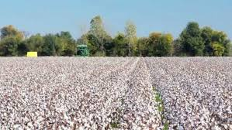
A supercrop

