Slide 2
Hellasdays
Holiday Plans
In Greece
Notes:
Welcome to our Travel Agency “Hellasdays”! We have created holiday plans in Greece especially for you, taking into account your desired holiday activities

Slide 3
REQUESTS
Toprak, Aurelio, Mohamed, Alba, Rayan, Bernaben, Jose A.
Carlos, Mohamed, Alba, Rayan, Soler, Jose, Jose A.,Toprak
Aurelio, Carlos, Mohamed, Alba, Soler, Jose
D. Alba, Mohamed
E. Rayan, Jose A., Mohamed
F. Pedro, Mohamed, Alba, Bernaben, Jose A., Jose
G. Aurelio, Carlos, Mohamed, Alba, Rayan, Jose A.
H. Pedro, Mohamed, Jose A.
Pedro, Mohamed
J. Jose A., Jose, Mohamed
K. Pedro, Rayan, Mohamed
L. Pedro, Mohamed
WORKSHOPS
Music/ Dance/ Instr.
Photography
Arts and Crafts
Language
History/ Traditions
Bike Riding
Scuba Diving
Marathon
Hiking
White water rafting
Farming/ Remedies
Other Sports
Notes:
Now, these are the 12 workshops we can organise for you to take in Greece. So, I am going to invite you here to look at our plans as you hear your names. Sorry, if we have got your names wrong...

Slide 4
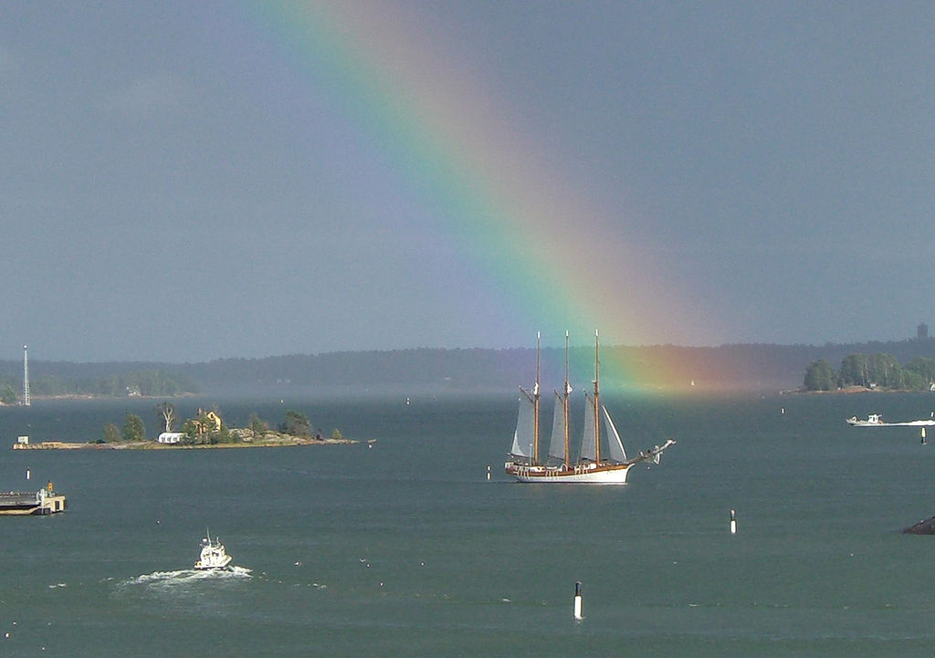
Sailing to
Greece
in teams of 8
Return fares
from southwestern Turkey: 150 euro per person
from southeastern Spain: 250 euro per person
Including skipper and meals
Notes:
Before we present you our proposals, let us start by recommending you an alternative and sustainable way of reaching Greece from your countries. You can hire a sailing boat for 8 passengers. If your group of friends is smaller, you can join others who travel this way. There are many...It will cost you only 150 (compared to 250 if you fly) from Turkey and only 250 (compared to 350 if you fly) from Spain. The skipper and the meals are included. It seems that this means of travel is not only sustainable but also interesting, I mean moneywise. So, who would like to sail? …….. Does anyone prefer flying?............. Or travelling by train?.....................

Slide 5
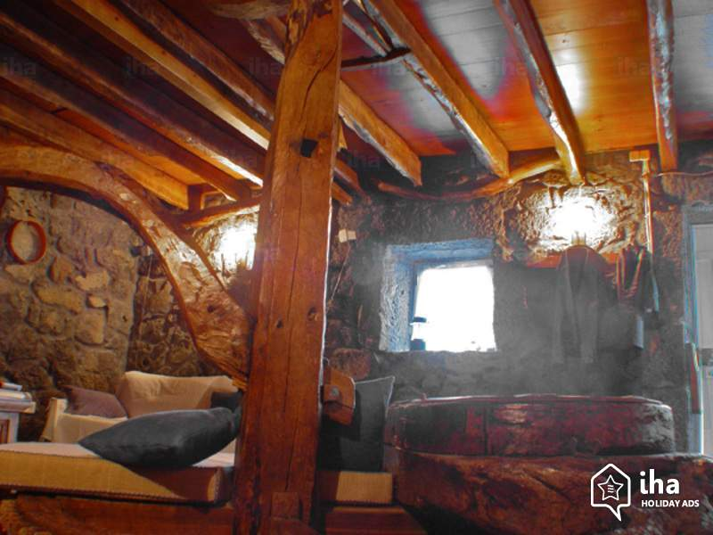
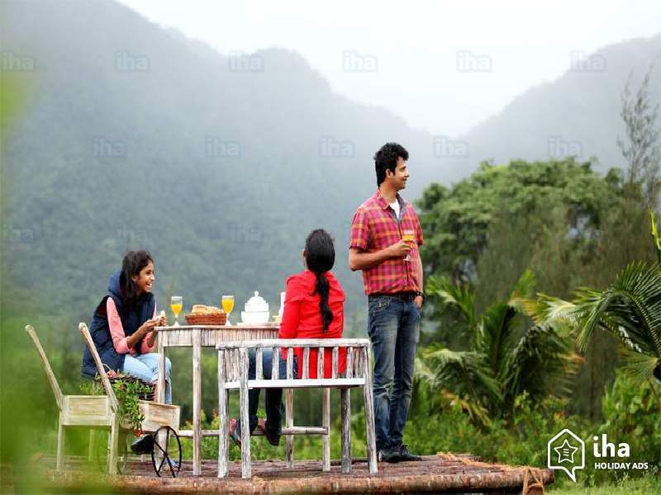
Accommodation
With host families
(all family types)
in urban or rural areas
Special prices!
Up to 25 euro/day
(self-catering)
Notes:
We would also like to recommend you being hosted with locals instead of staying at hotels. This way you will be able to experience Greece from within and contribute to the local economy by saving money! If you share a part of a family home with a friend and you cook yourselves or with the family, you may pay just 5 euro per night and if you help a rural family in the farm, you will make some income, too! So, who would like to be hosted?.......................
We can match you to suitable family types……………………. Does anyone prefer other types of accommodation? …………...

Slide 6
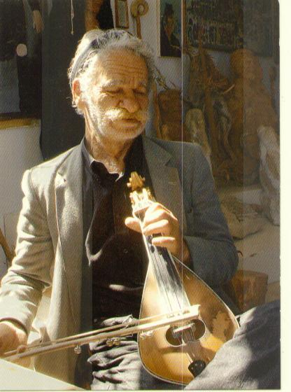
Music and Photography on Crete
Location: Crete
Instrument(Lyra)
Traditional Dancing
Ikariotikos
Zeimpekiko
Kalamatiano
Pentozali
Malevizioti
Sirtaki
Hasapiko
Photography
Samaria Gorge
Crete Aquarium( 5 euros)
Knossos
Chania
Fee per person: 83 euro/week
Notes:
Your choices have shown us that these are the most popular holiday activities among you so we recommend you the MUSIC and PHOTOGRAPHY workshop on Crete. It includes learning how to play the lyra, traditional dances and photography lessons on site at the most attractive sights of the island

Slide 7
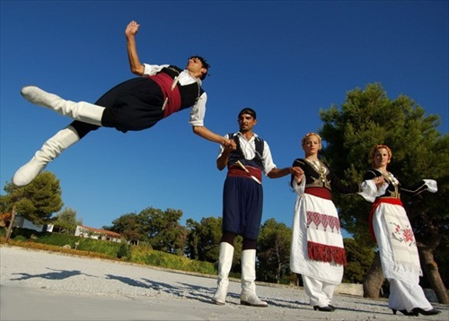
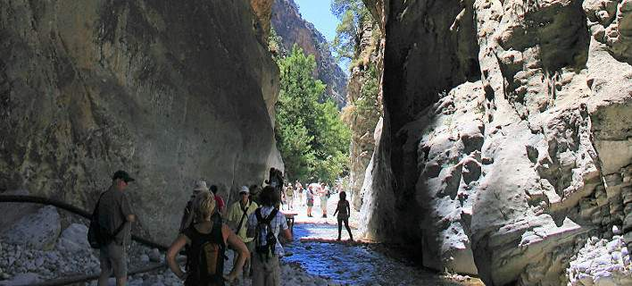
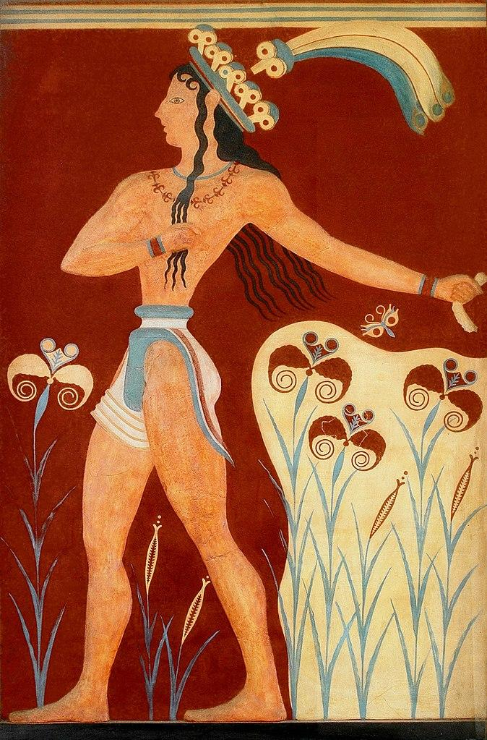
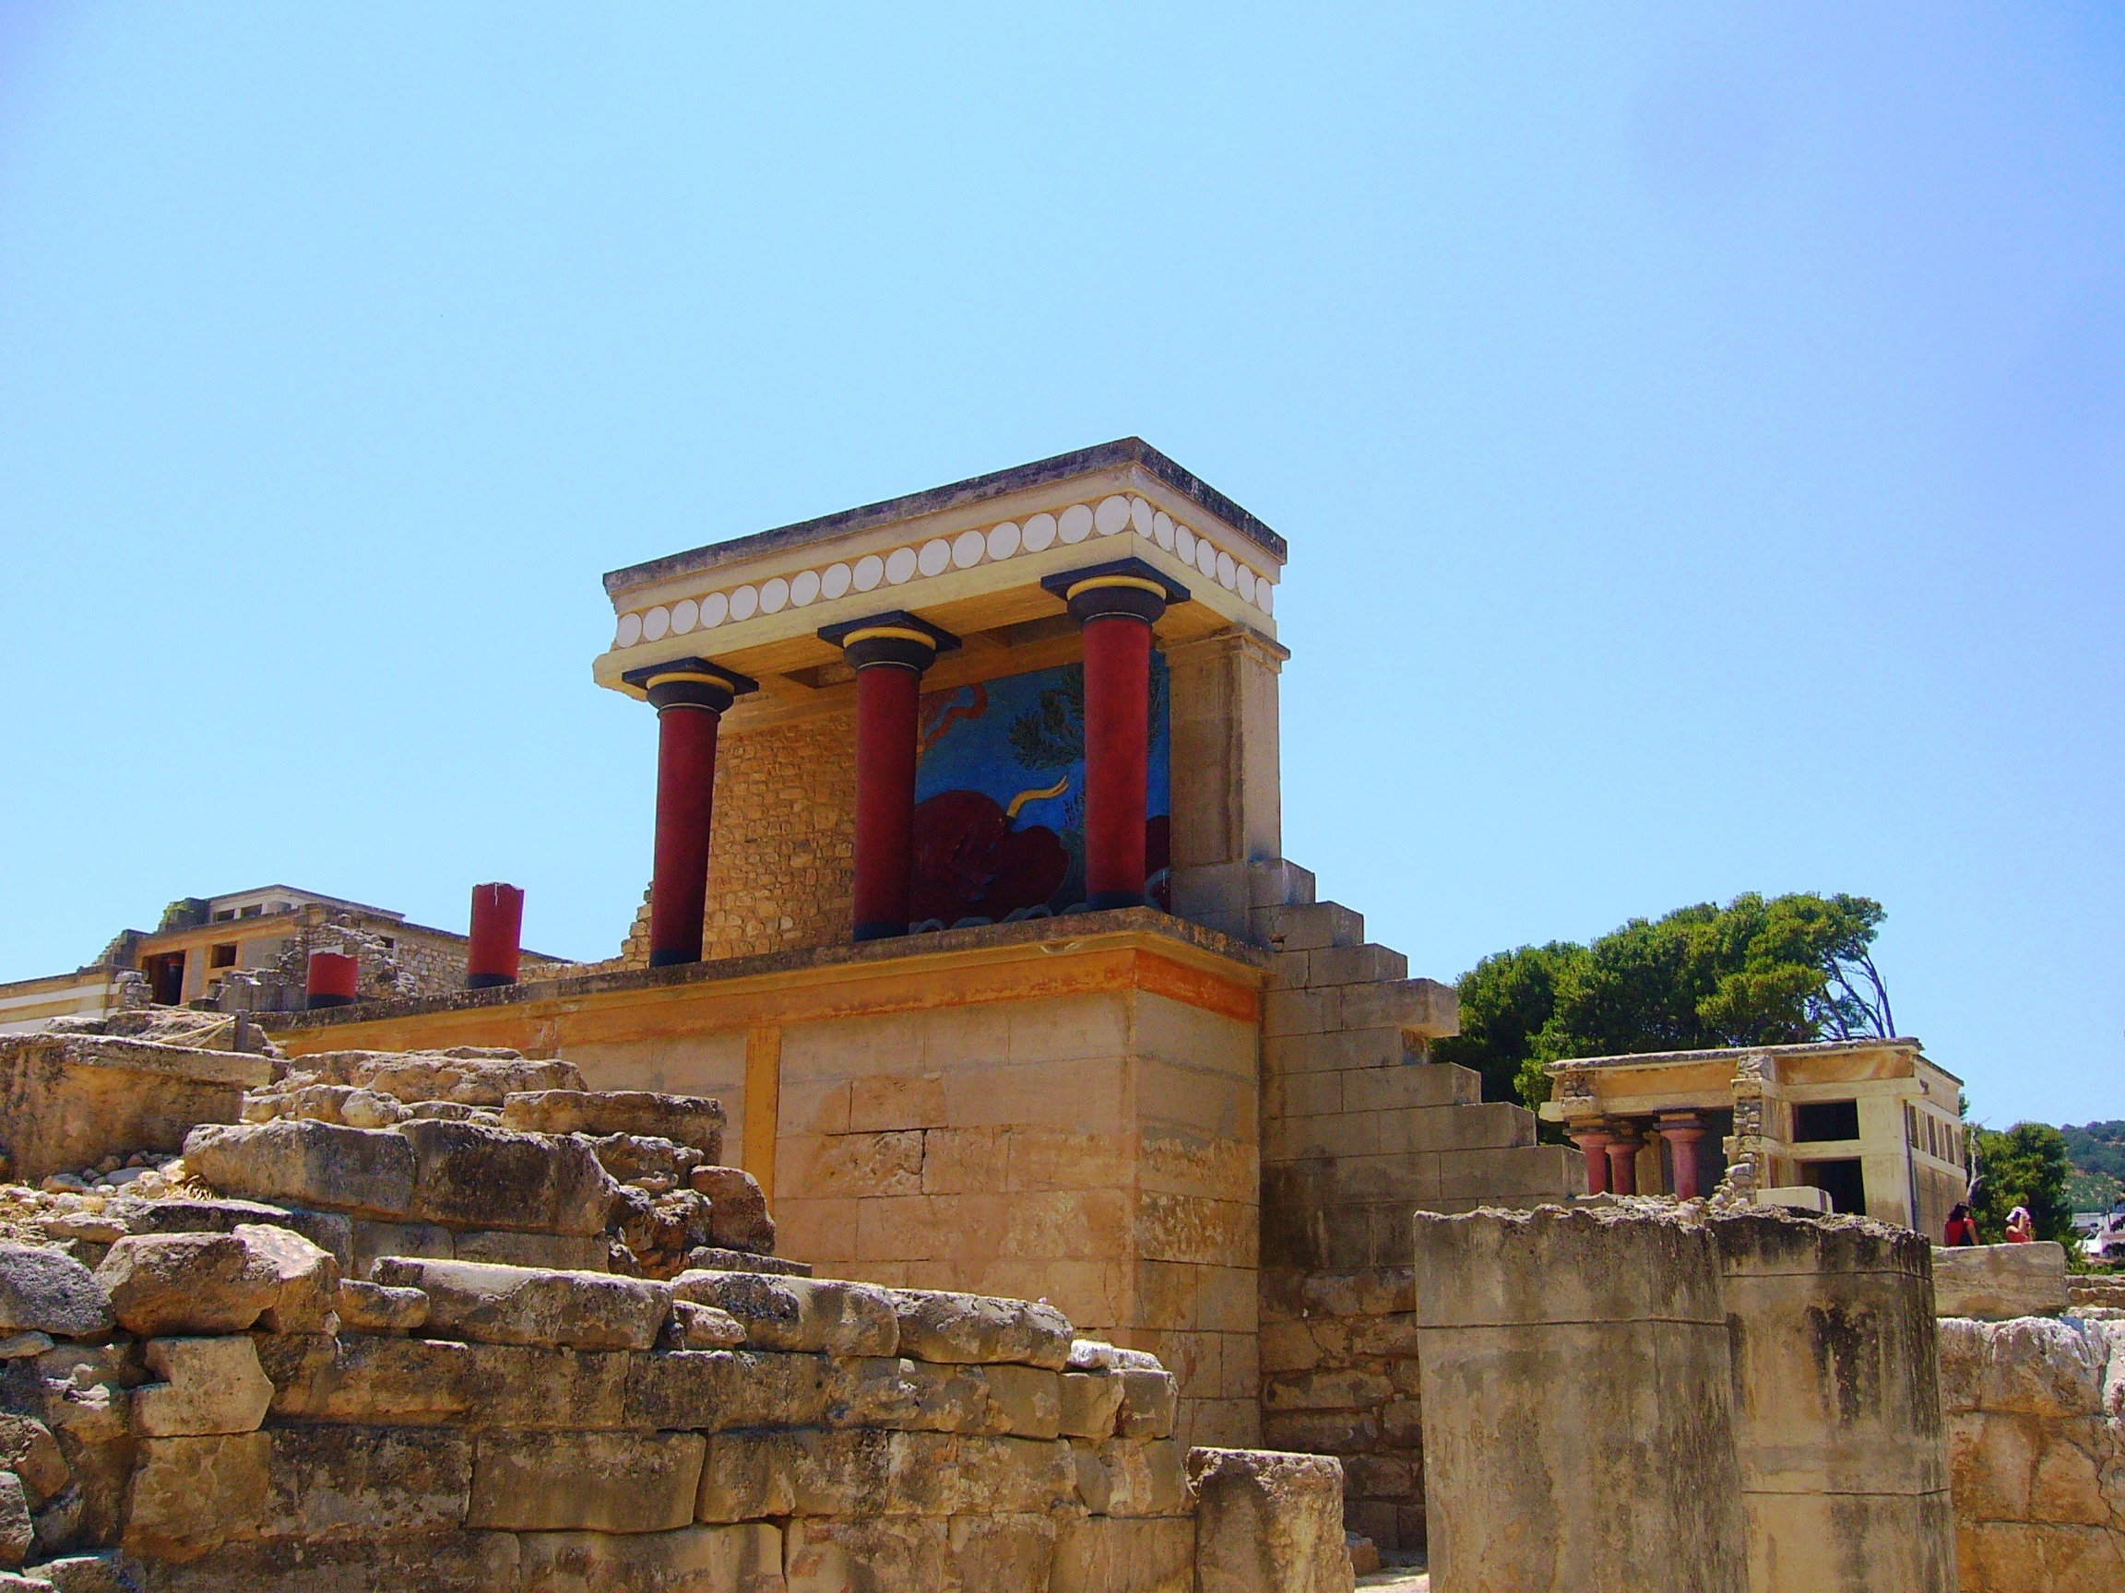
Notes:
The Samaria Gorge, the Palace of King Minos in Knossos, the Aquarium and others. It costs 83 euro per person per week for all three activities or just 30 for the lyra lessons, 30 for the dancing classes and 30 for the photography workshop.

Slide 8
Be creative as you learn!
Location: Athens
Arts n’ Crafts
Byzantine icon painting
or
Pottery
Experiential learning of Modern Greek
15-hour-language course
in a group of four
History/Cultures
Guided Visits to museums
Acropolis museum
Archaeological museum
Fee per person: 40 euro/week
Notes:
The next proposal is for those who opted for cultural tourism: traditional arts and crafts, learning Greek through experiences and guided visits to historical and cultural sights in Athens

Slide 9
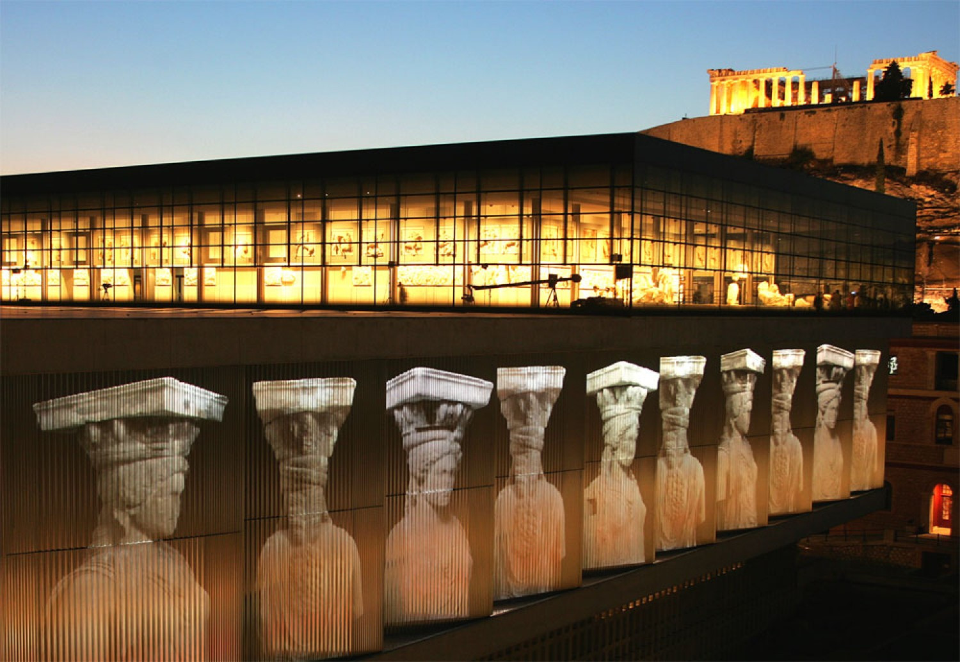
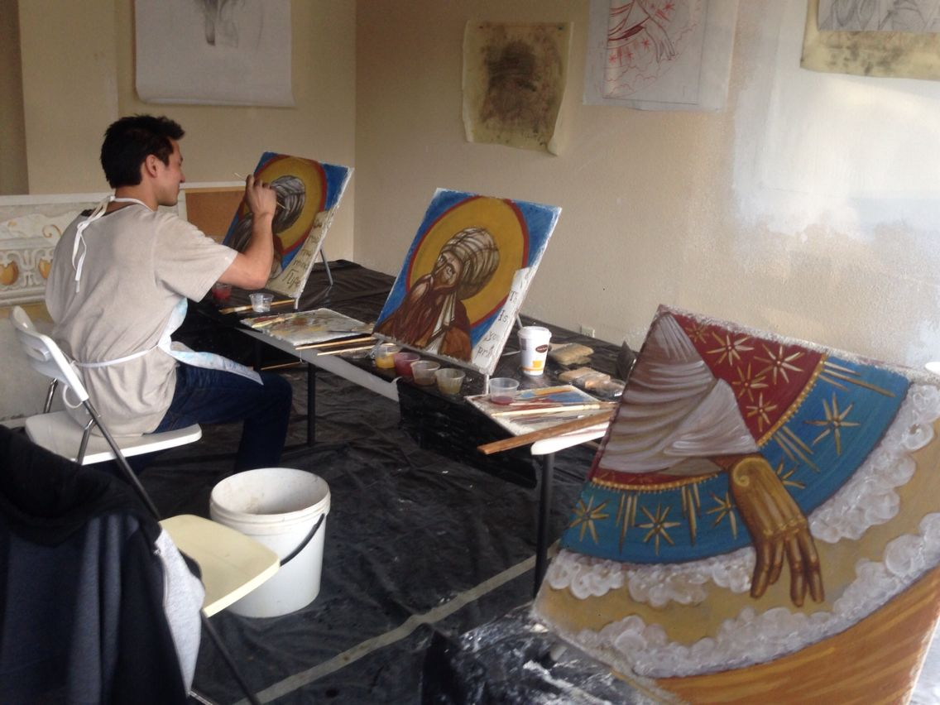
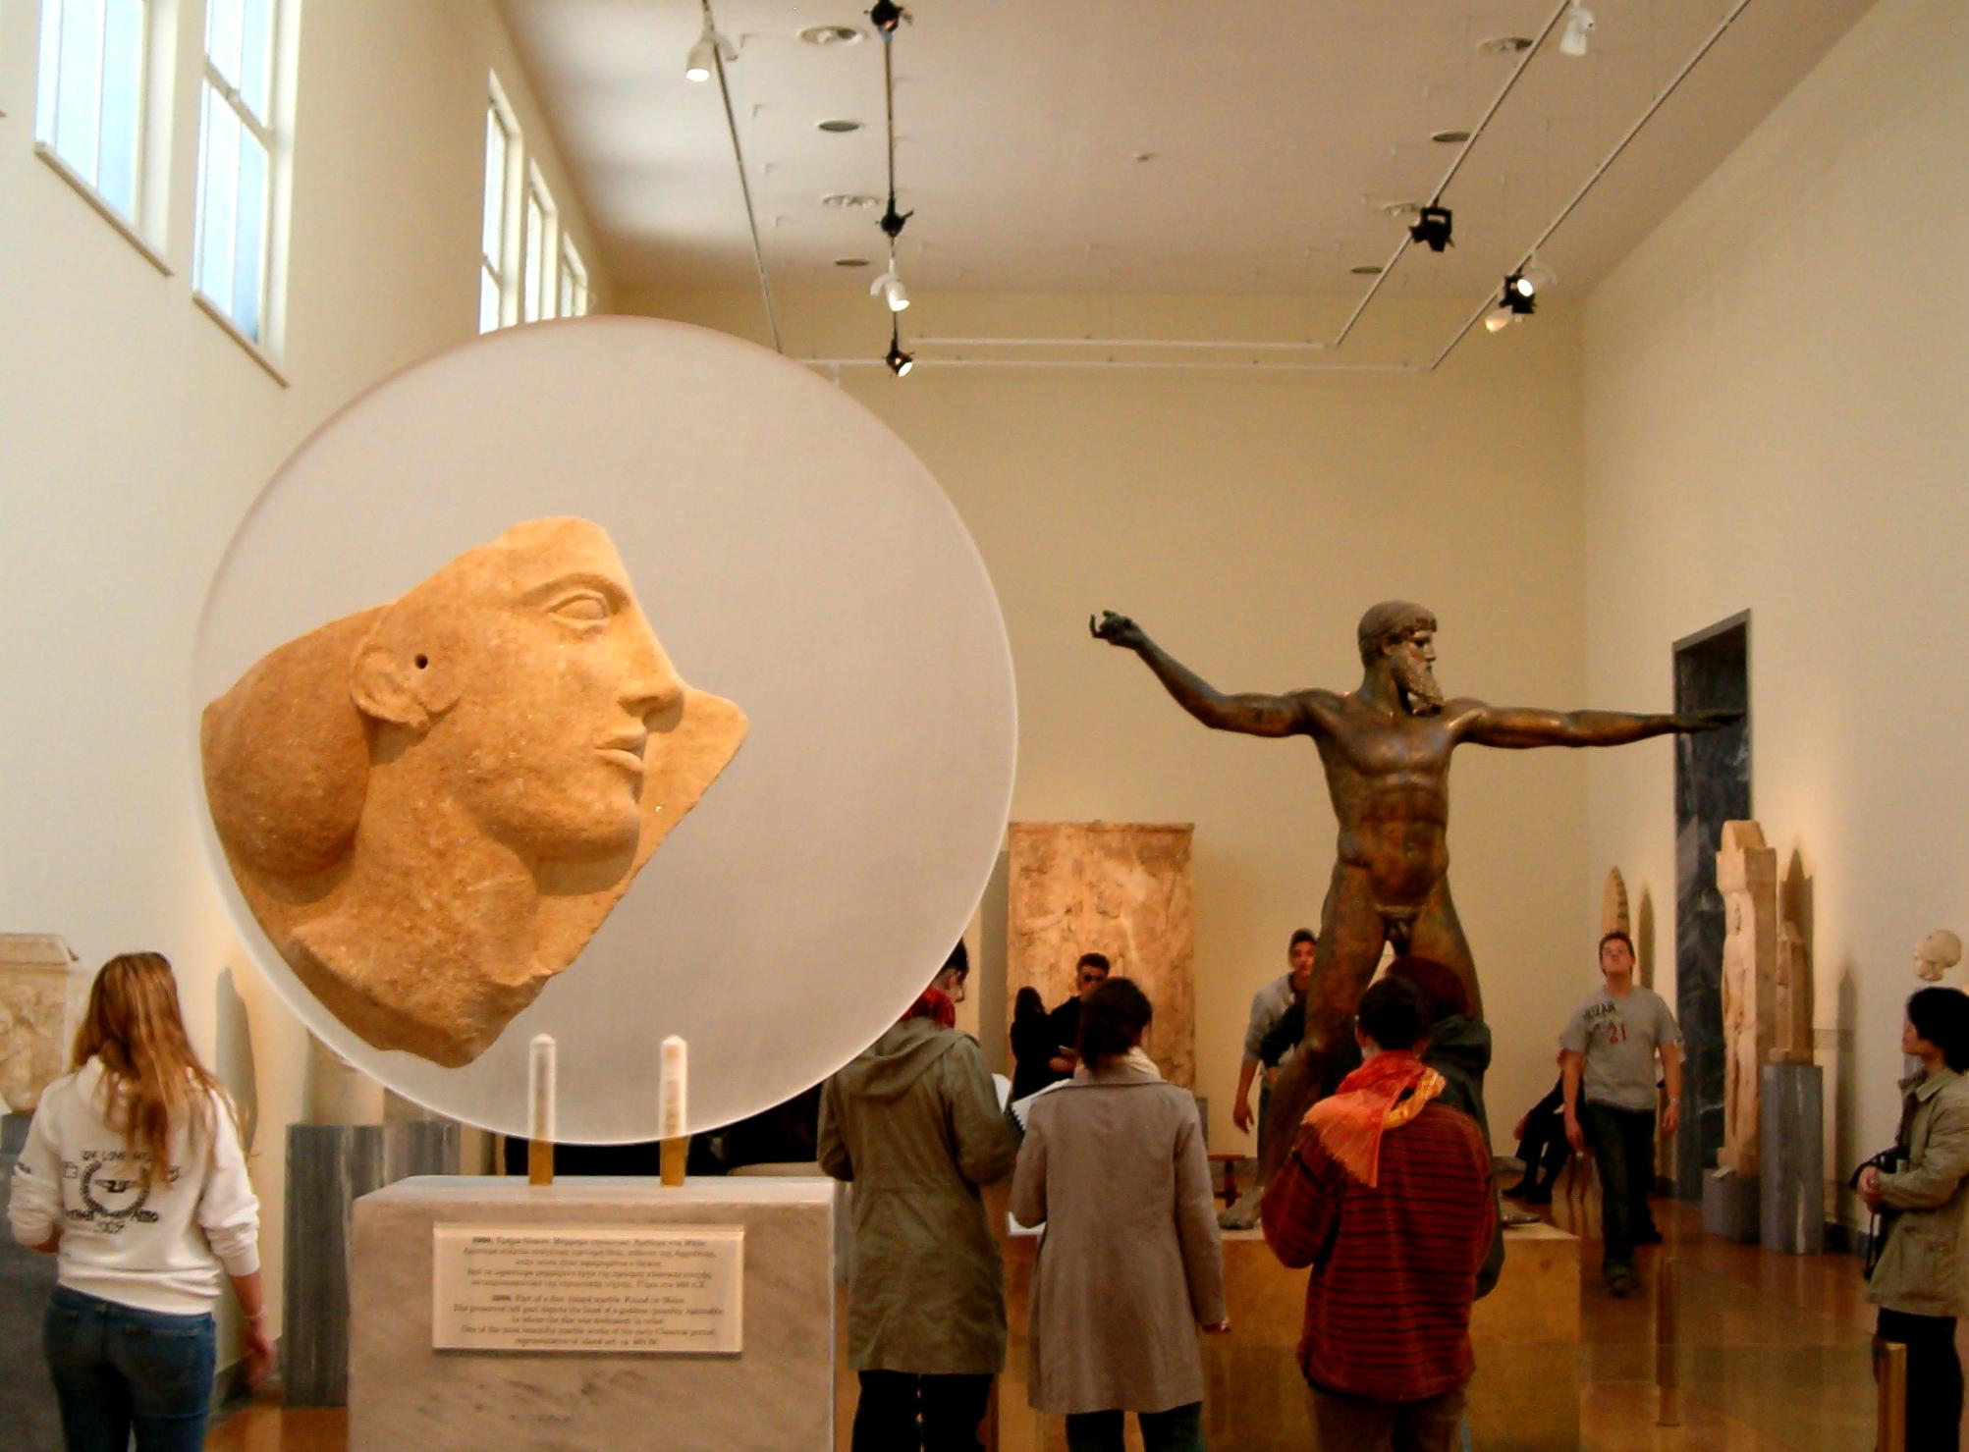
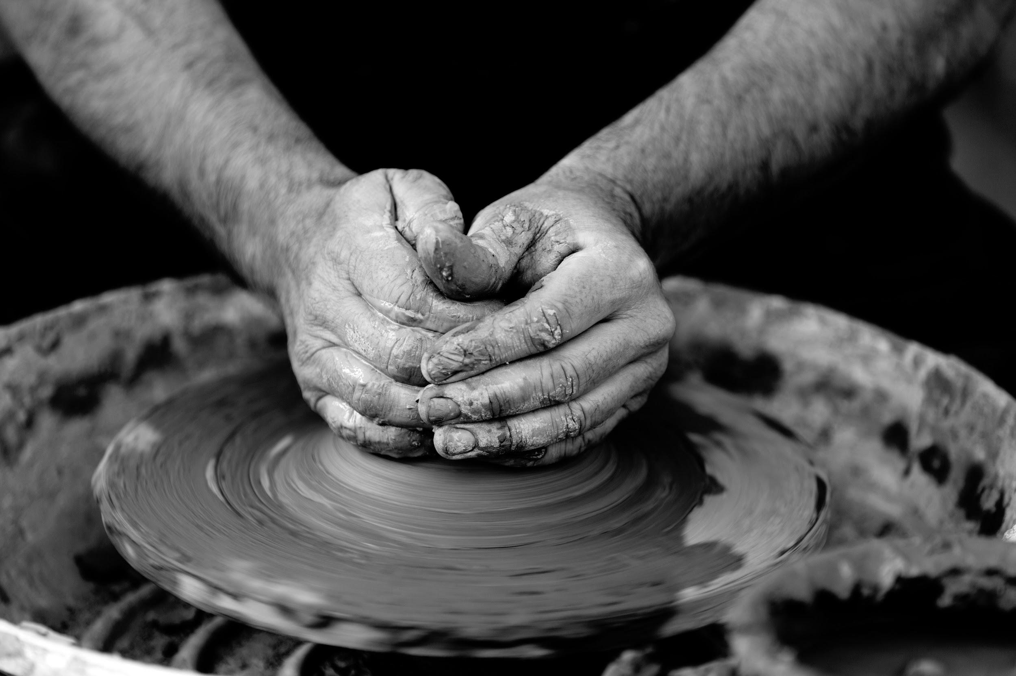
Notes:
It includes learning how to paint byzantine icons and fresco, making pottery and educational programmes in the Acropolis Museum and the Archeological Museum. The language course is lively and takes place in various places in the old city. At the end of the course, the whole class will perform at the Herodion Theatre under the Acropolis. The total cost of this plan is 40 euro per person for a week, all included.

Slide 10
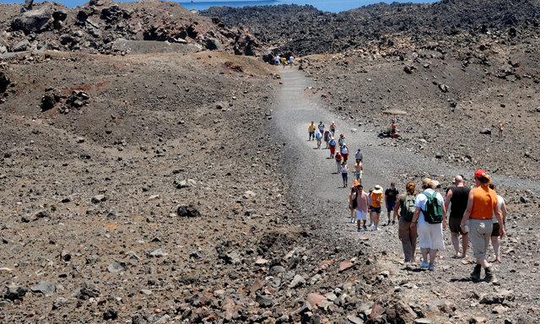
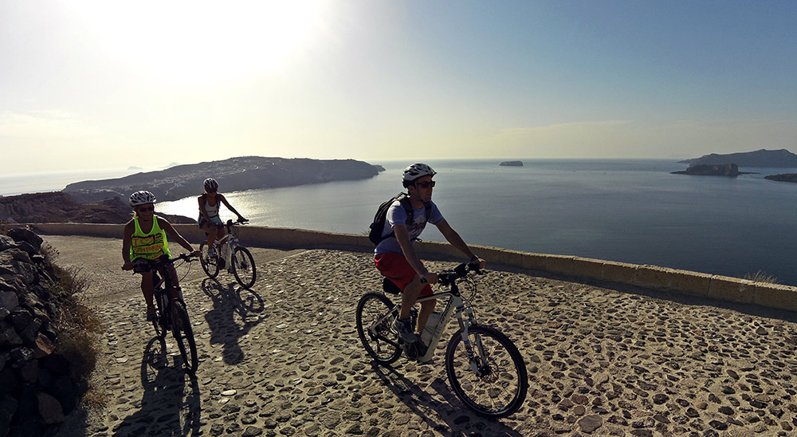
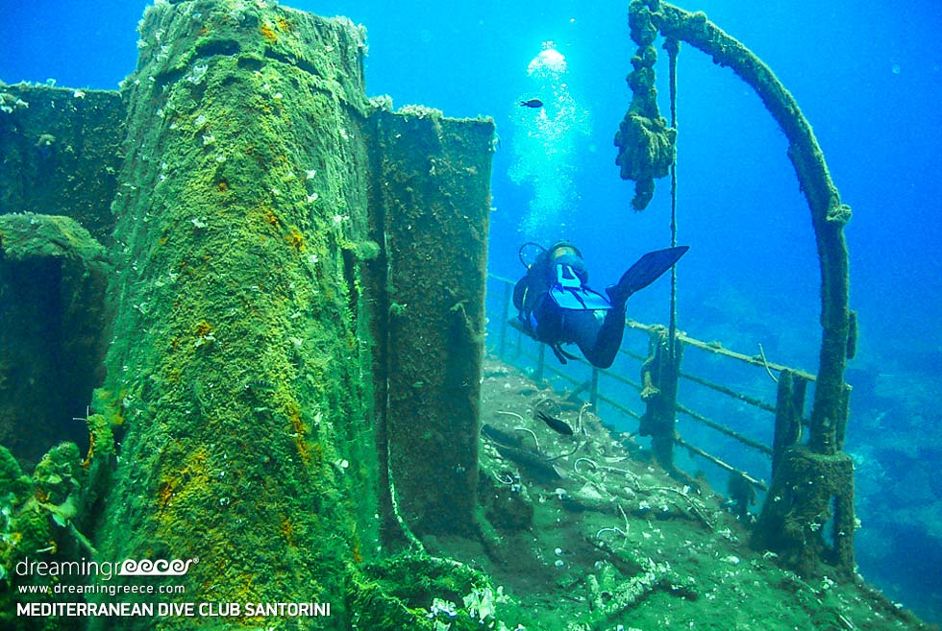
Take it easy!
LOCATION: SANTORINI
Bike riding
Scuba Diving
Hiking
Fee per person: 237 euro/week
Notes:
Our third plan is called “Take it easy” and it’s for those of you who opted for cool sports like bike riding, scuba diving and hiking. It costs 237 euro to do all three activities at least 3 times for a whole week on Santorini.
Alternatively, you can pay just 80 euro for daily bike riding, a 100 euro for daily scuba diving and 57 for daily hiking with a light meal included!

Slide 11
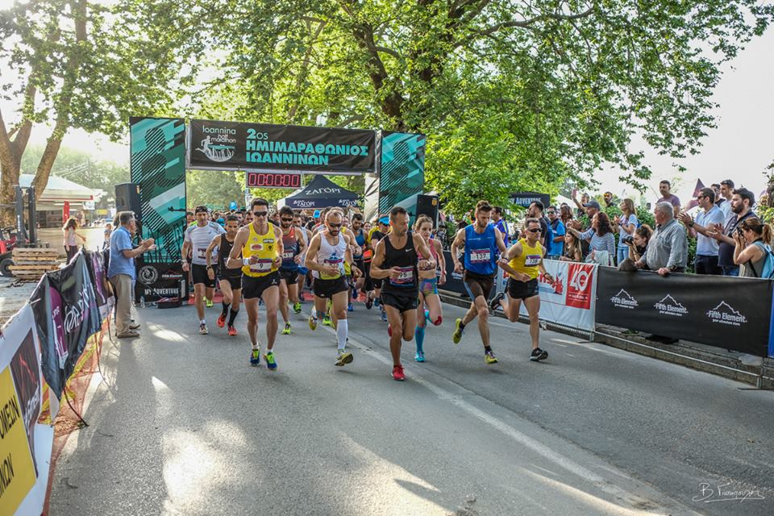
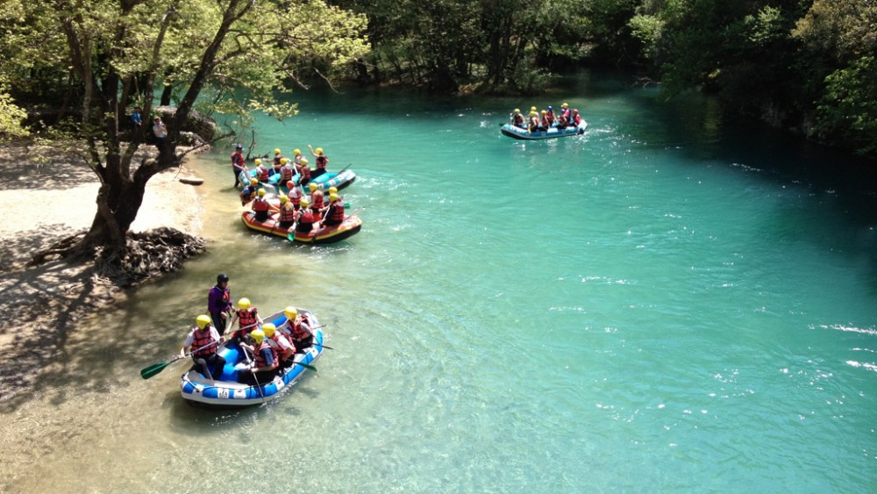
Group rhythm!
LOCATION: IOANNINA
Marathon
White water rafting
Other sports( football, martial arts e.t.c)
Fee per person: 65 euro/week
Notes:
This plan is for the more active! It includes training for and running a Marathon race in one of the coolest places in Greece, white-water rafting in a legendary river and a wide range of other sports of your choice.
The fee is only 65 euro a week per person and covers 7 training sessions.

Slide 12
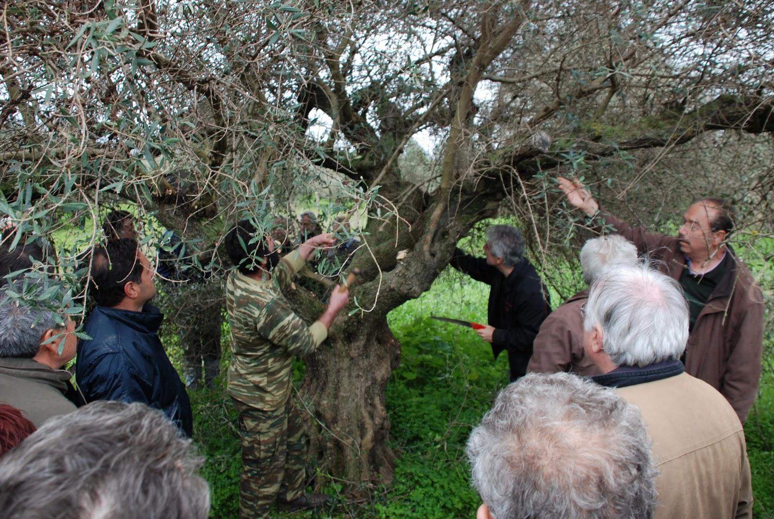
Learning from the Earth
LOCATION: CHIOS FREE
Mastic cultivation
Olive harvest and milling
Notes:
This is an agritourist plan involving staying with local families on beautiful Chios and helping them cultivate the mastic (medicinal chewing gum) which is a UNESCO cultural heritage example.
Alternatively, you can get involved in harvesting and milling olives for olive oil. Of course, this is free and available anytime!

Slide 13
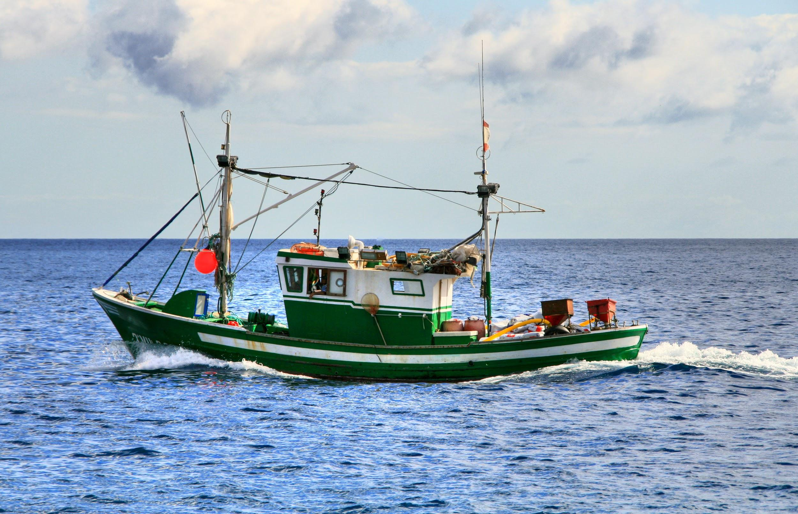
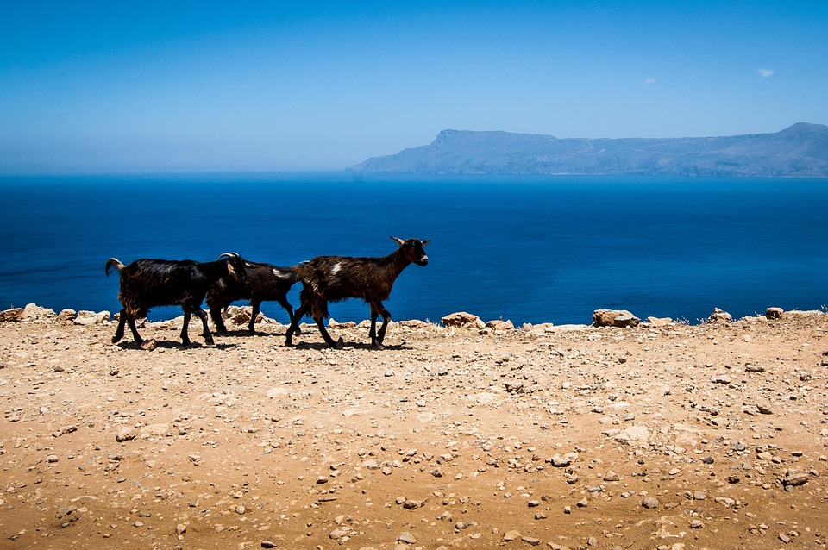
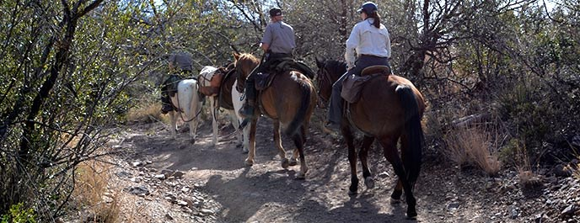
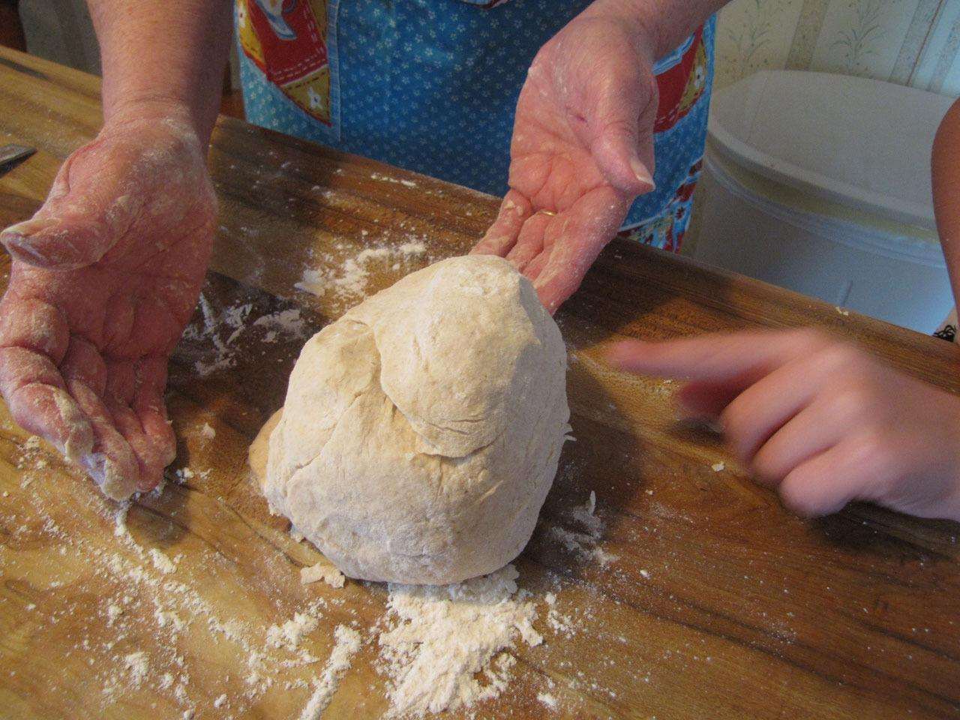
Experience Greece from within! (Messinia)
Staying with farmer families
Tending to the farm
Cooking/singing with granny
Horse Riding on Taygetos mountain
Fishing with grandpa
FREE!
Notes:
Our last proposal is also agri touristic. It includes farm staying, farm tending, cooking while learning how to sing, horse riding and fishing; all in Messinia. Of course, it’s free and never ending!
These were all of our proposals. If you are really interested in any of them, we can make arrangements later. Thank you very much!

