Slide 2
rituals and ceremonies

Slide 3
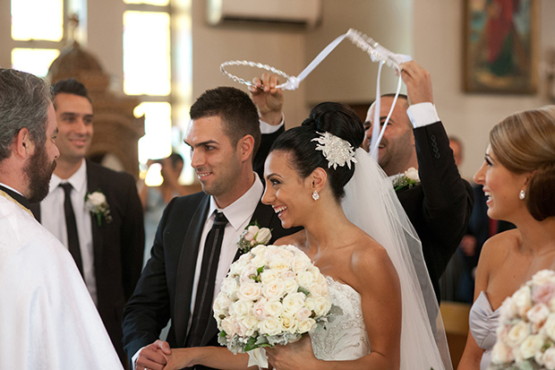
WEDDING CUSTOMS
IN GREECE
engagement: exchanging rings.
wedding bed: strewn with rose petals, coins and sugar-coated almonds (called koufeta) to bring fertility and prosperity to the couple.
dressing for the ceremony: wedding serenades and dancing
wedding procession: from groom’s house to church where groom present his bride with her bouquet.
wedding ceremony: couple enters the ceremony site, the ribbon is cut. They take three sips of wine and circle the altar three times while the guests throw rice or sugared almonds.

Slide 4
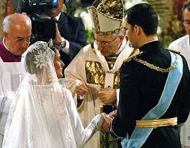
WEDDING CUSTOMS IN SPAIN
Engagement ring: women wear their ring on their left hand.
Traditional custom: bride and groom share 13 coins,the arras.Represent their commitment to sharing the goods they have and will have in their future together

Slide 5
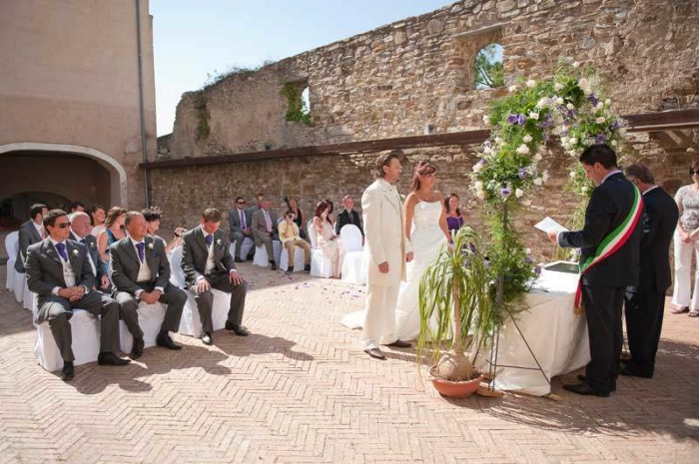
WEDDING CUSTOMS IN ITALY
On the way to church: Bride and groom receive challenges involving a fallen broom, a crying baby, or other household chores to test their skills before marriage
End of the wedding day: couple break a vase or glass and the number of pieces is supposed to represent the number of years that they would be happily married

Slide 6
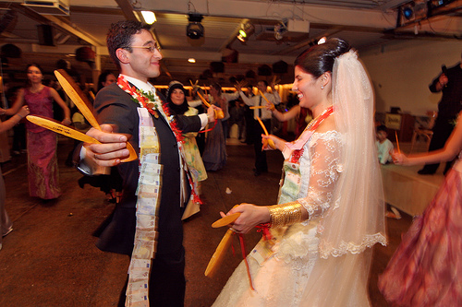
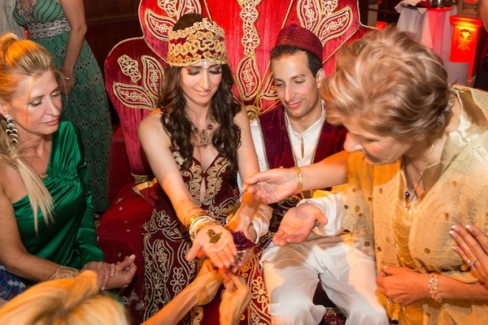
WEDDING CUSTOMS IN TURKEY
Day Of The Wedding: ceremony is called “Fetch the bride!” There is some sort of procession to go fetch the bride and bring her to the groom’s house in a celebration that seems like parade. At house, bride is greeted by her new mother-in-law and she is given a welcome gift.
Prepares for the entry:Bride and groom enter to a slow traditional song, single women hold candles and walk in-front of them. They then walk in a circle three times and are seated. An elder of the group commences the henna ceremony by placing henna onto the bride and grooms palms, however in order to open their closed fists the in laws have to resent a gold coin

Slide 7
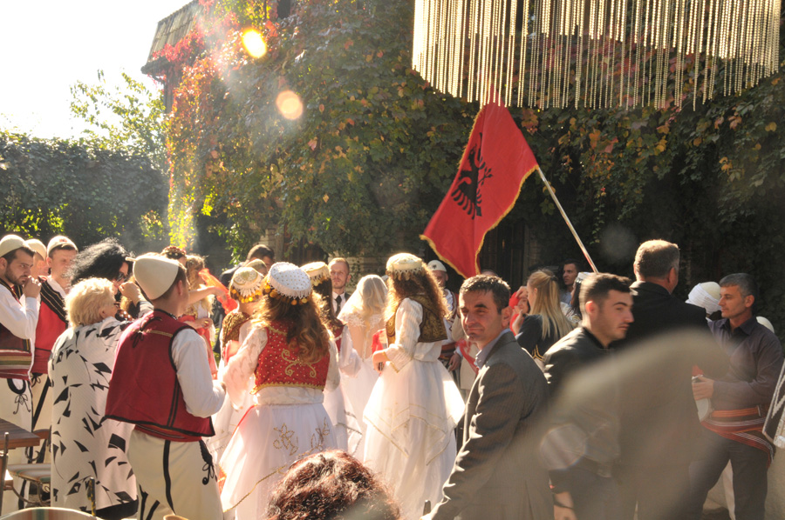
Wedding customs in Albania
Brides Cry:Bride leaving her family’s home en route to the new chapter in her life is a moving moment. Nacional Albania says that the bride and her family share tears of sadness (and joy) before meeting her groom.
Firing Guns For The Bride’s Arrival:Albanian Weddings fire shots when the bride arrives at the groom’s house. This is to signal the joy of the moment, and also because the wedding is seen as a kind of victory.
Traditional Dance And A Whole Lot Of Money:The wedding ceremony involves a traditional Albanian bride-groom dance and all the family and friends get involved.Guests make it rain on the bride and groom by throwing bank notes on them.

Slide 8
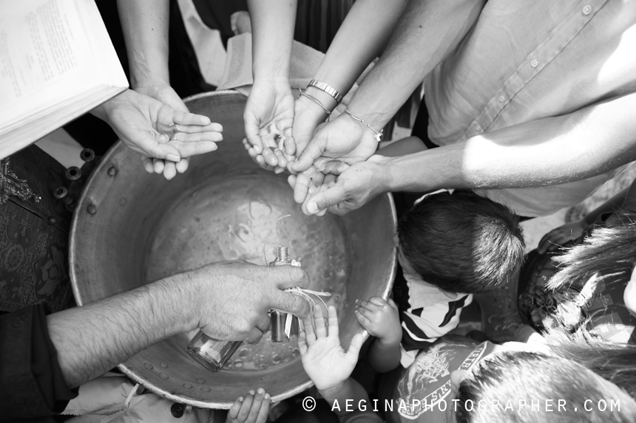
NAME GIVING COSTUMES

Slide 9
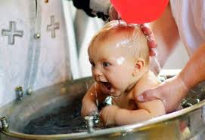
NAME GIVING CUSTOMS IN GREECE
,Choice of the name: parents give children a name of their choice as a first name and a name from grandparents as a middle name.
Christian baptism: parents, godparents and other relatives present the baby to the church, where the priest reads blessings and baptize the baby in a baptistery.

Slide 10
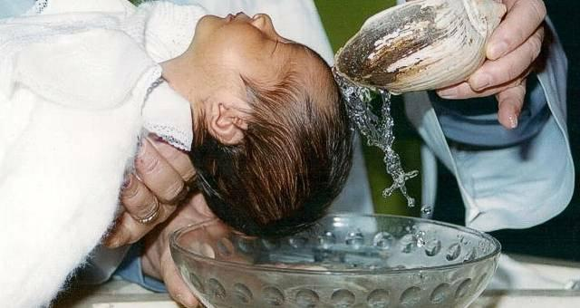
Name giving customs in spain
Currently in Spain: people bear a single or composite given name and two surnames
Traditionally, a person's first surname is the father's first surname while their second surname is the mother's first surname

Slide 11
Name giving in italy
A name day is a reason to celebrate and often is as important as a birthday for many Italians. The celebration can include , sparkling white wine known as Asti Spumante, and small gifts. Keep in mind that November 1 is La Festa d Ognissanti

