Slide 2
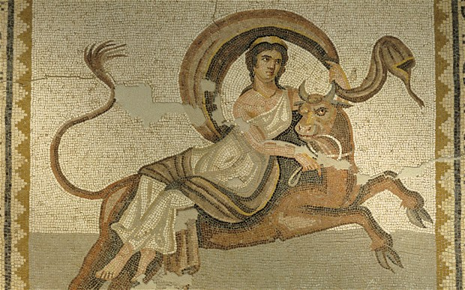
The Myth Of Europe And Its Variations
Notes:
bull is taurus in Greek
whose sign is Taurus? who was born between 21st April and 20th May?
ha-ha
the myth has some variations

Slide 3
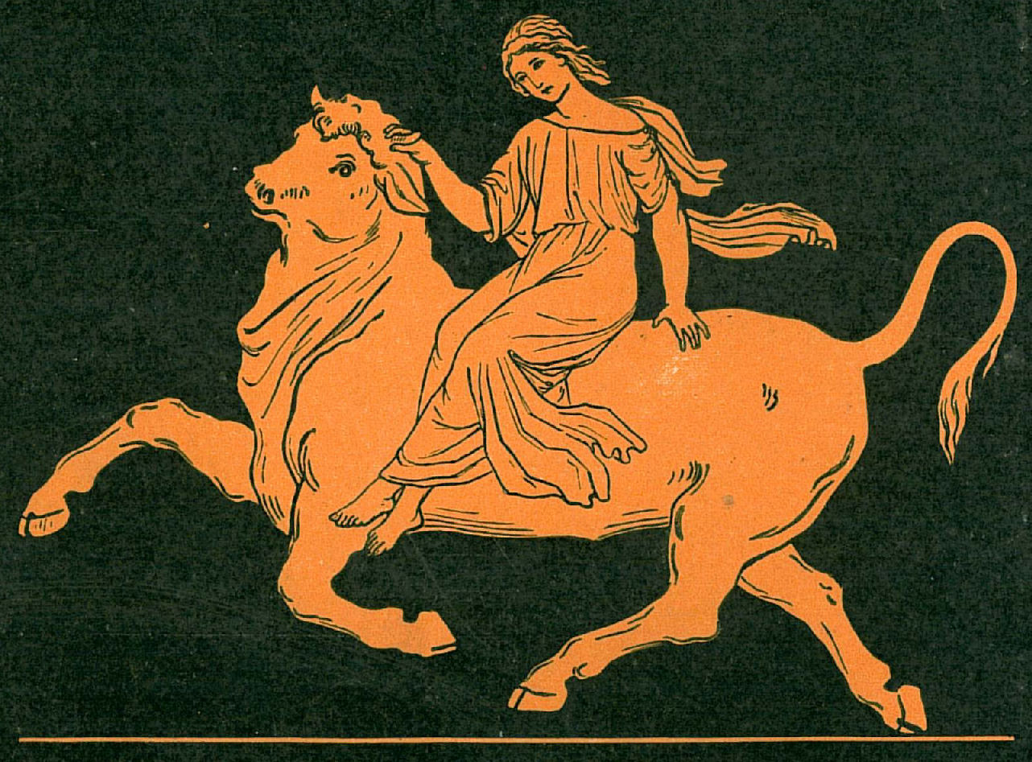
EUROPE
Notes:
We all live in Europe so it’s good to know the myth of Europe!

Slide 4
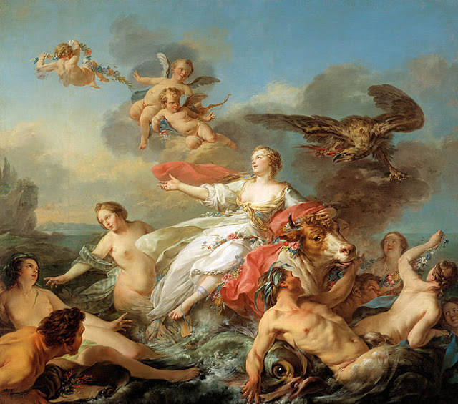
The myth of Europe is a fascinating myth of the Greek Mythology that inspired writers, historians, painters and politicians who gave her name to coins, to the continent and created several pieces of art depicting the love making of Zeus and Europe.

Slide 5
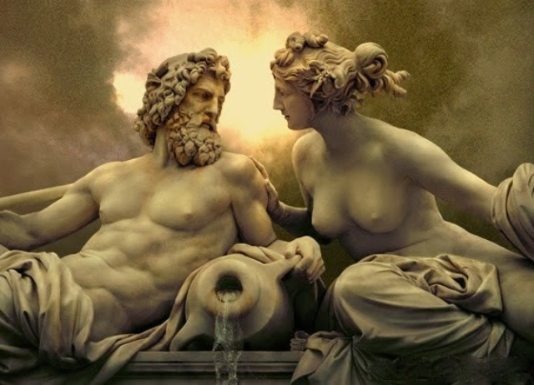
Europe And Zeus
Europe was a beautiful princess, who was kidnapped by Zeus, brought to Crete, and had three sons – Minos, Rhadamanthys, and Sarpedon, who all became judges of the Underworld. Zeus was the father of all the children of Europe but he asked her to marry Asterion, the king of stars. And she did.
Notes:
So the stars in the flag of Europe!

Slide 6
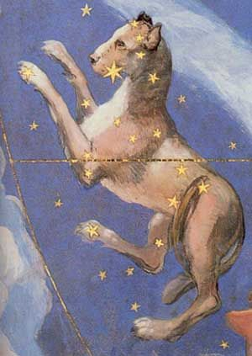
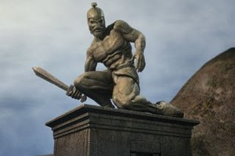
Zeus’ Gifts To Europe
Zeus’s love for Europe was so great that he gave her the finest presents: Talos, Laelaps, and a magic javelin. Talos was a man of bronze who was the guard of Crete; Laelaps was a hunting dog, and the javelin was magic since it could always hit the focused target. And that bull, that seduced Europe, was eventually turned into the constellation of Taurus.

Slide 7
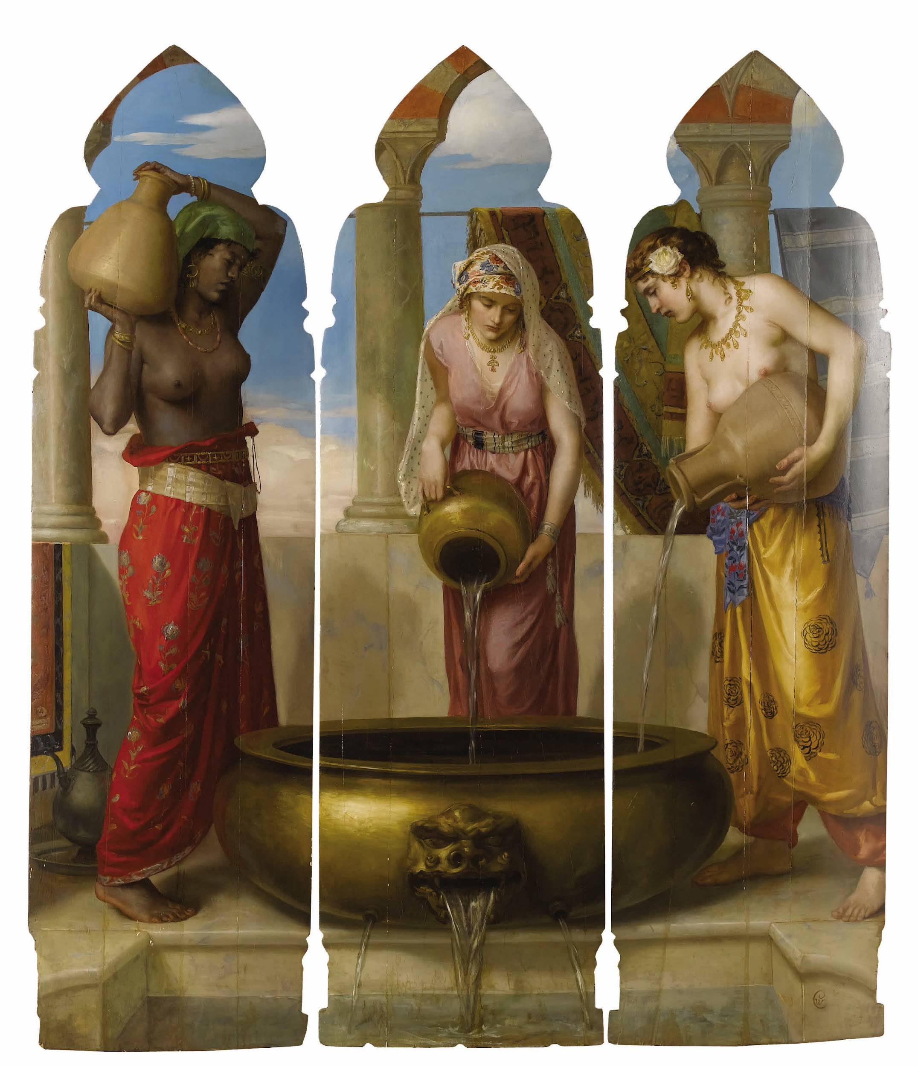
Starting off as a mortal woman in Greek Mythology, Europe became immortal after her name was given to the continent.
One legend says that Europe had a dream one night in which two women – actually two continents –were arguing. One of them, Asia, (on the right) believed that Europe belonged to Asia, since she was born there. The other woman is Africa. The one with no name -Europe – (in the middle) said Zeus would give the name to her.

