Slide 2
Traditional Entertainment
across our countries

Slide 3
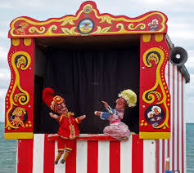
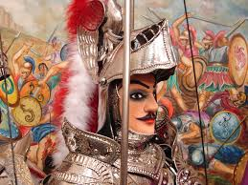
Puppet theatre
The Sicilian puppets - Italy
Kukla
oyunur -
Turkey

Slide 4
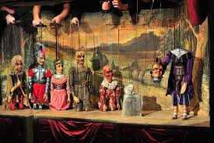
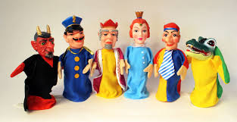
The first puppets in Prague - Czech Republic
Kasperle from GERMANY

Slide 5
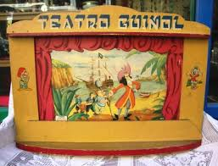
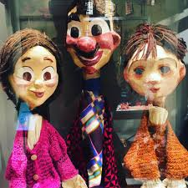
Spanish TEATRO GUIÑOL
Greek Puppets

Slide 6
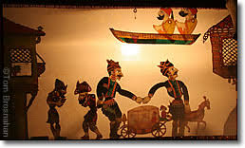
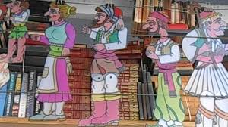
Shadow Theatre: Turkish and Greek Karagioz (is)

Slide 7
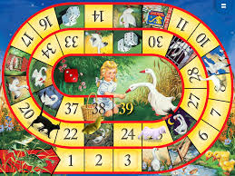
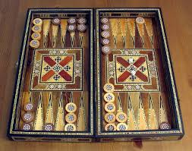
Board Games across our countries
Italian and Spanish OCA
Greek and Turkish TAVLI or TAVLA

Slide 8
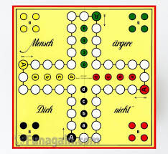
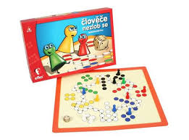
German and Czech board games

Slide 9
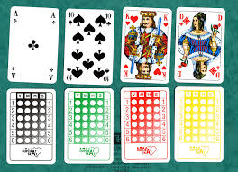
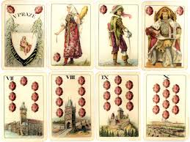
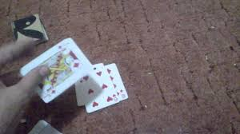
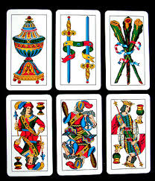
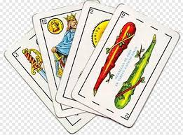
Card Games
German Skat
Czech Hussite
Spanish
Chinchón
Briscola Xeri
Italy Greece Pişti from Turkey

Slide 10
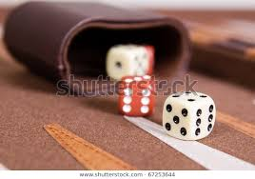
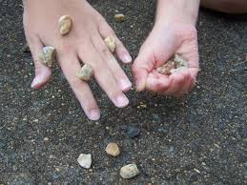
Other common games across our countries
Dice games
5, 7 or 9 stones

Slide 11
Rhymes and clapping
ITALY
Batti le mani!
GREECE
Palamakia
TURKEY
Çat Pat
GERMANY
Bei Müllers hat’s gebrannt
The CZECH REPUBLIC
Vařila myšička kašičku
SPAIN
Hacer palmas

Slide 12
Mimes
Greek Pantomima
Italian gioco dei mimi
Turkish Pandomim
Spanish Pantomima
Czech pantomima
German Pantomime

Slide 13
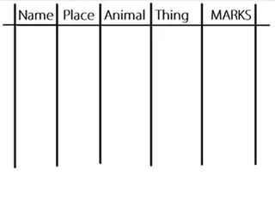
Name, place, animal, thing
IT: Nomi, città, cose
TR:İsim,Şehir,hayvan
GR:Prosopo,Zoo,Pragma
DE: Stadt, Land, Fluss
SP: Arriba el lápiz
CZ: Jméno, Město, Zvíře, Věc

Slide 14
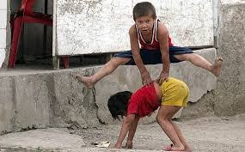
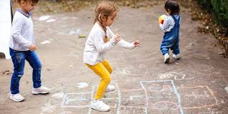
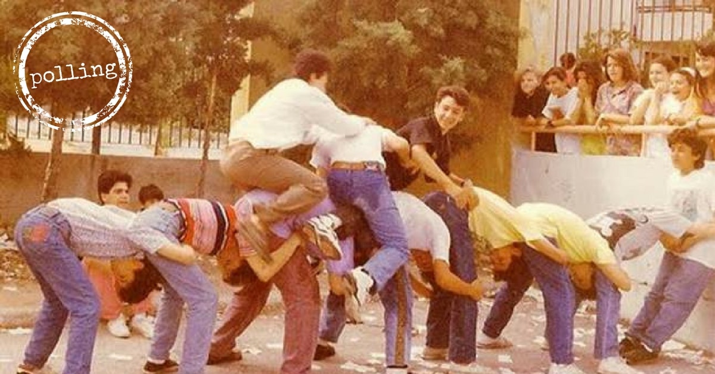
STREET GAMES
IT :La cavallina
ES: El burro
GR:Long Donkey
DE: Himmel und Hölle
CZ: Panák
TR: SekSek

Slide 15
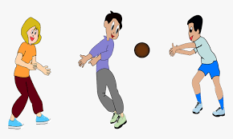
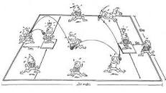
BALL GAMES
Turkey: Yakan Top
Italy: Palla avvelenata
Greece: Apples
CZ: Vybíjená
Germany: Brennball
Italy: Palla prigioniera Spain: El mate

Slide 16
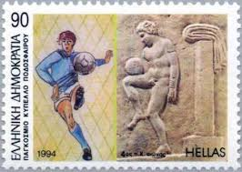
Always football everywhere!
(DE) Fußball
(TR) futbol
(CZ) fotbal
(ES) fútbol
(IT) calcio
(GR) podo sphero

Slide 17
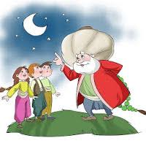
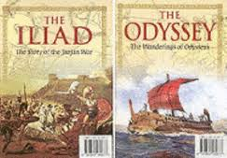
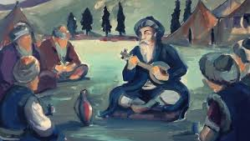
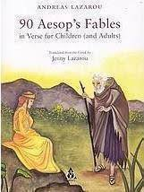
Literature (STORY-TELLING)
TURKISH/ GREEK:
Nasreddin Hoca
Turkey: Dede kotu
Greece and Turkey:
Greece:
Aesop’s fables

Slide 18
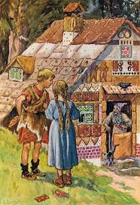
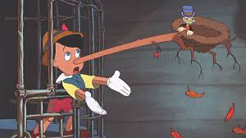
Stories… (continued)
(DE): Hänsel und Gretel
(IT): PINOCCHIO

Slide 19
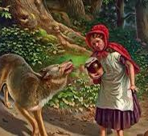
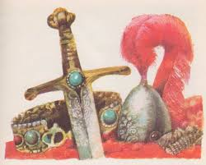
More stories...
Caperucita Roja
from Spain
Czech “Prince Bayaya”

Slide 20
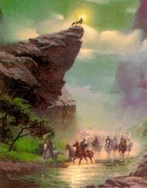
Myths and Legends across our countries
I monacelli
Ergenekon Efsenesi

Slide 21
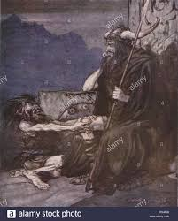
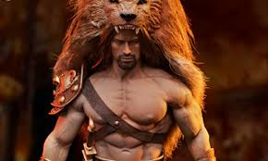
Hercules
Alberich

Slide 22
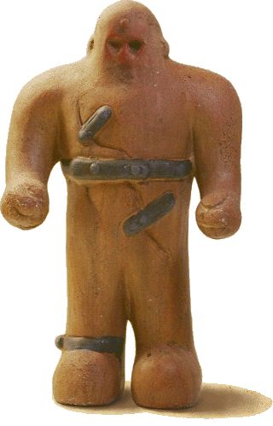
The Golem Of Prague
The Iron Man
There is no fire like fire
Libuše And The Foundation Of Prague

Slide 23
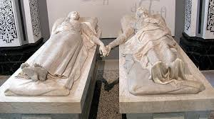
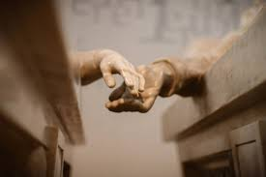
FROM SPAIN: Los amantes de Teruel

Slide 24
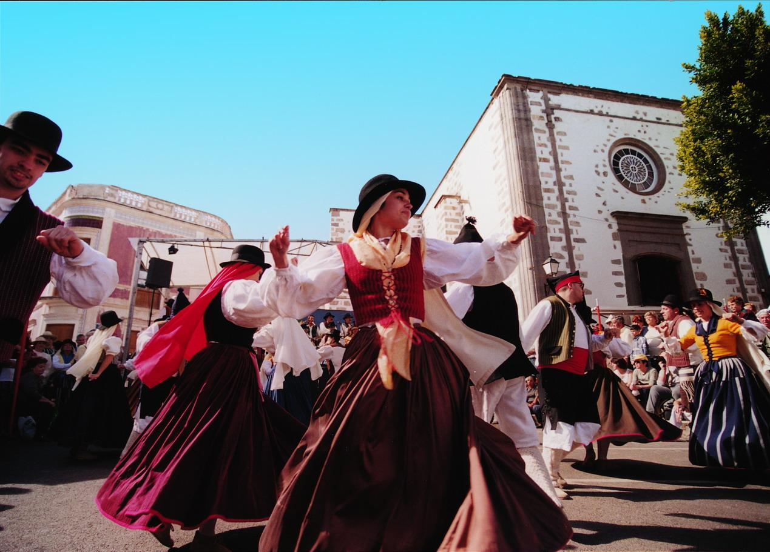
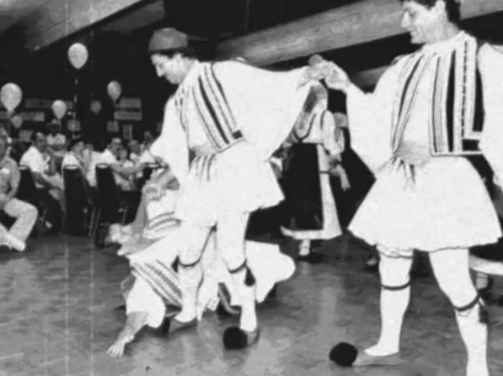
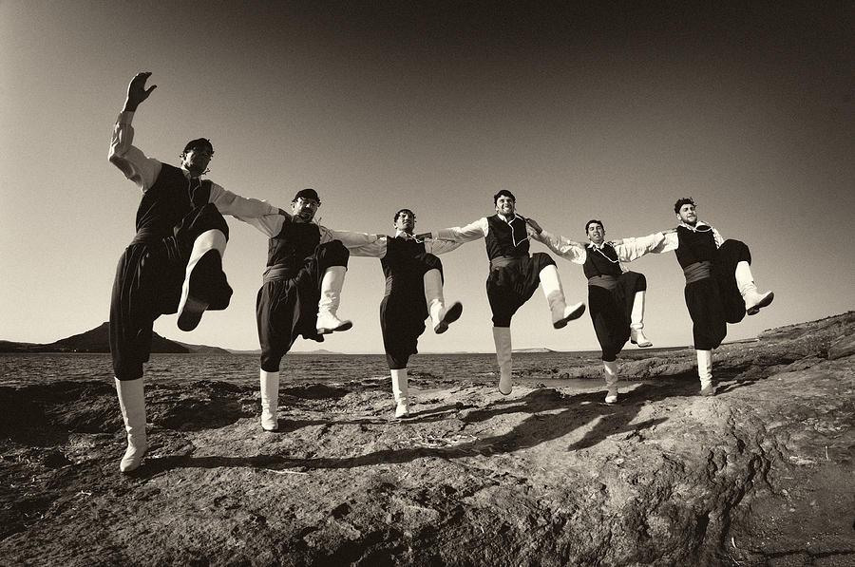
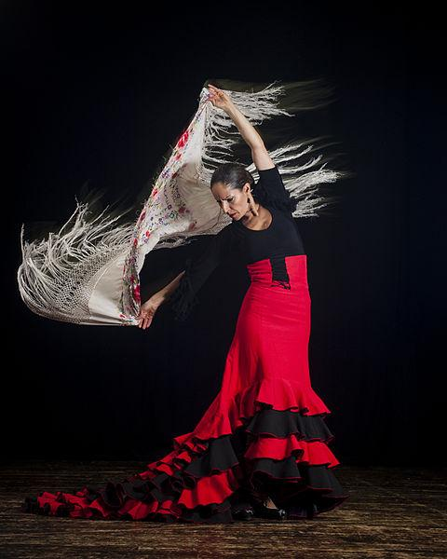
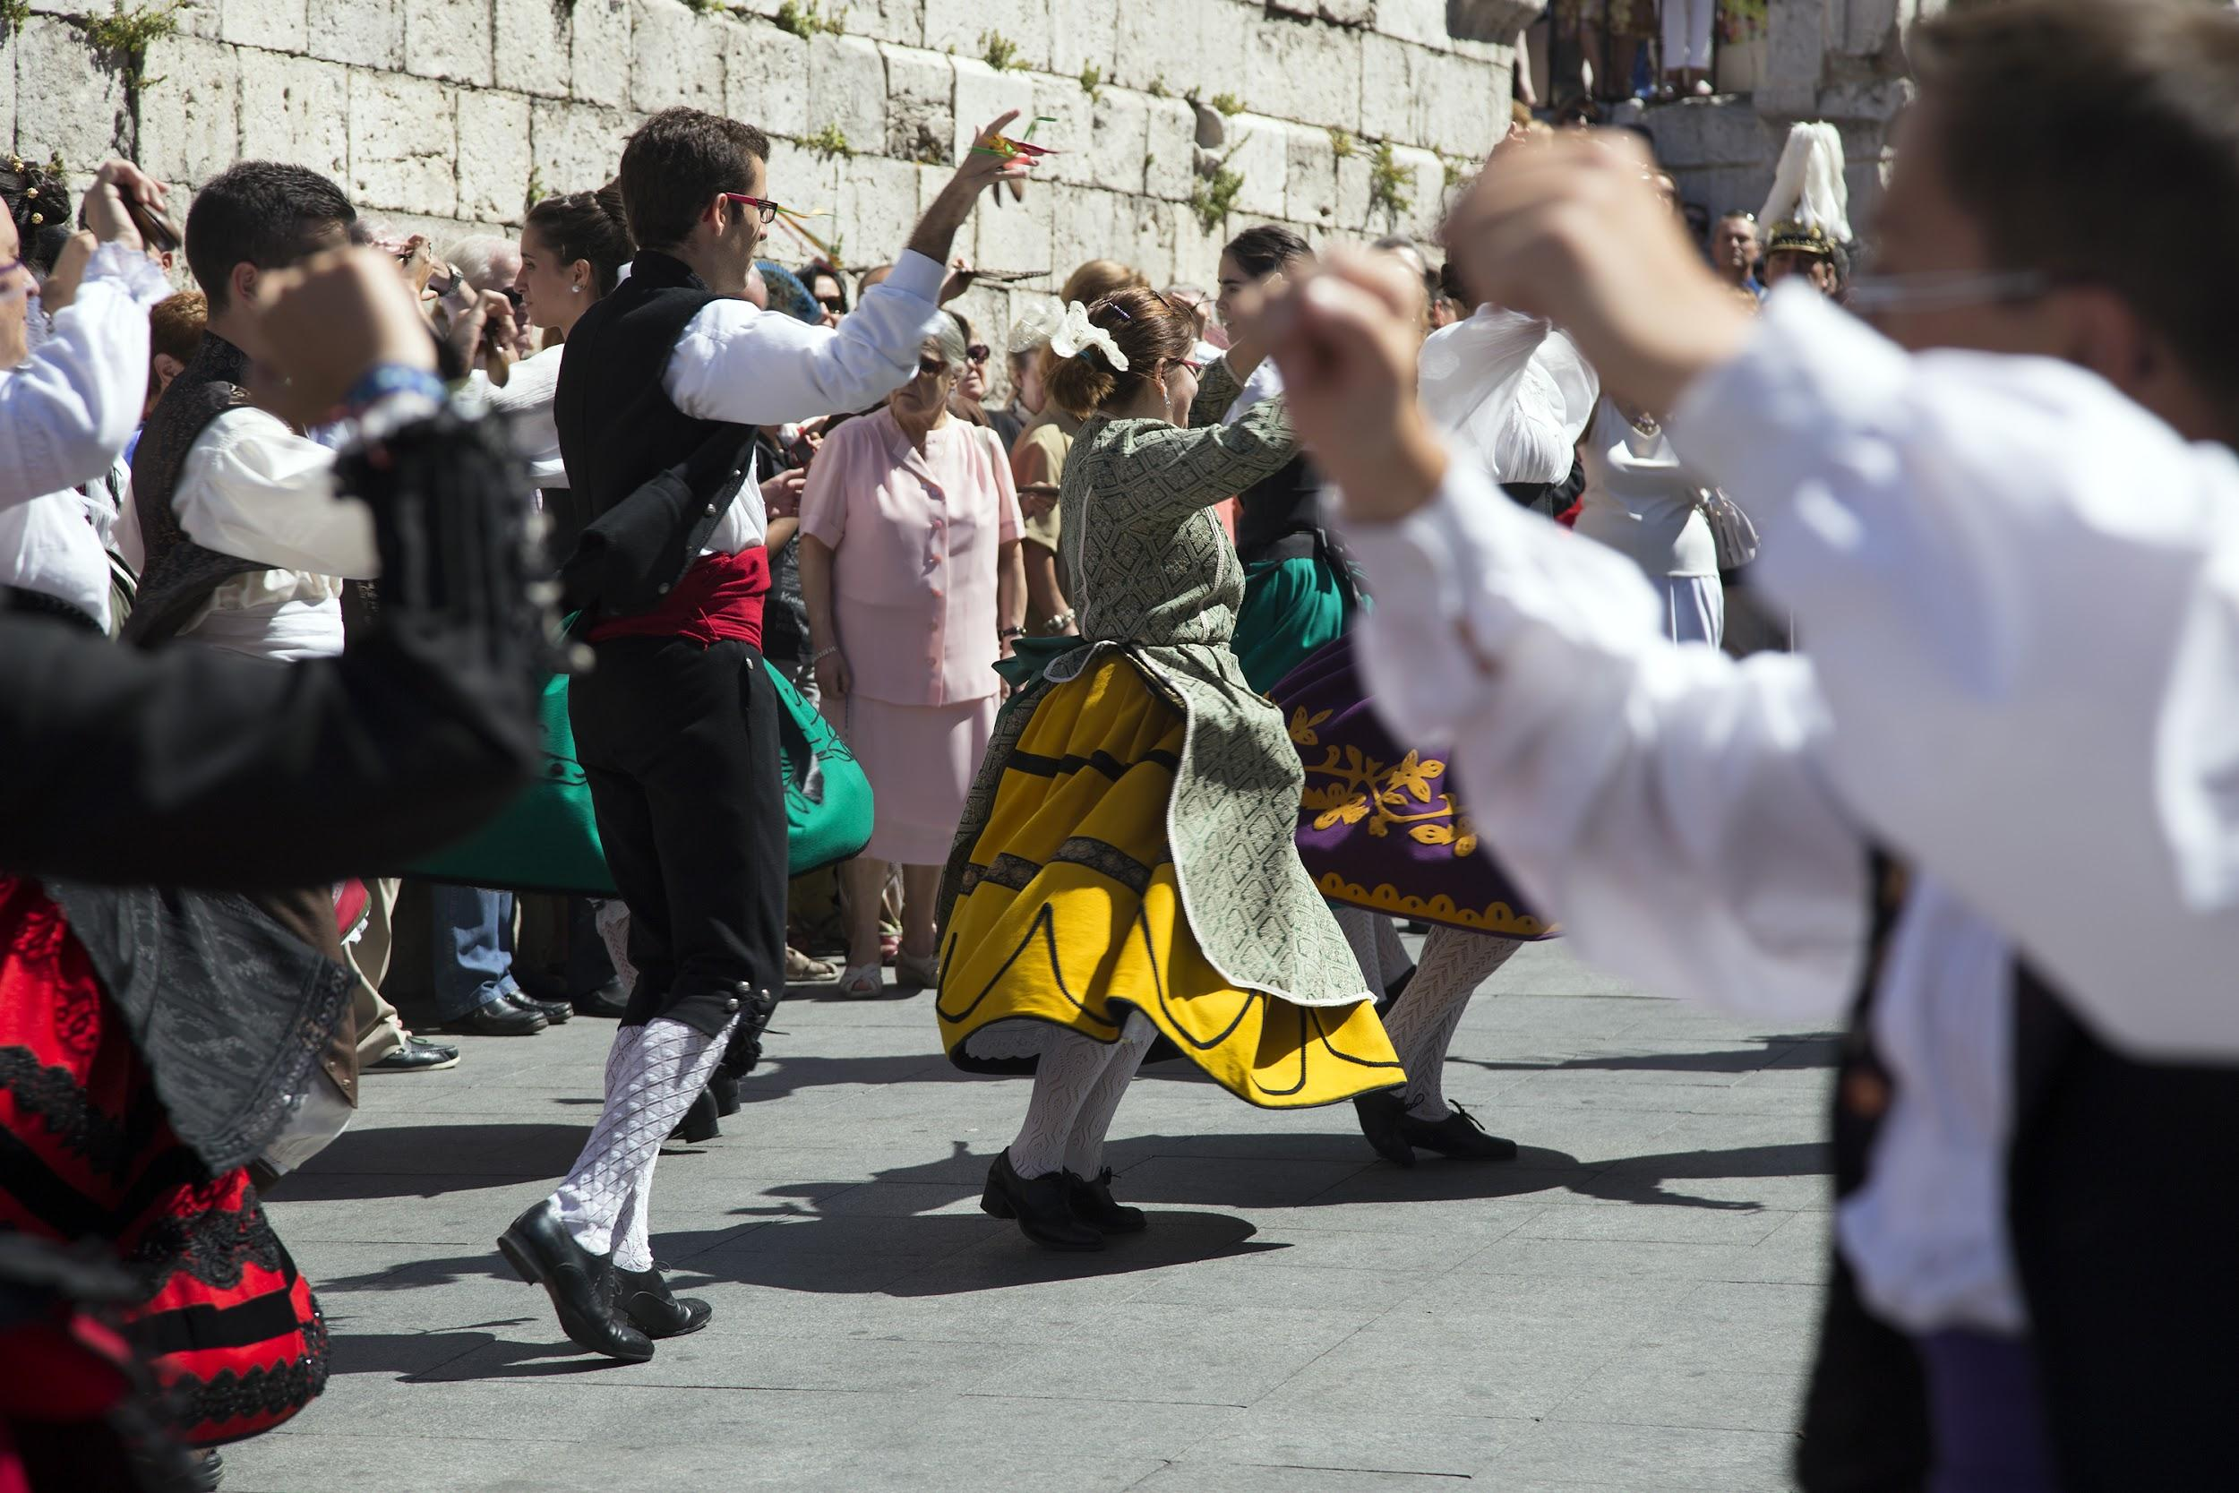
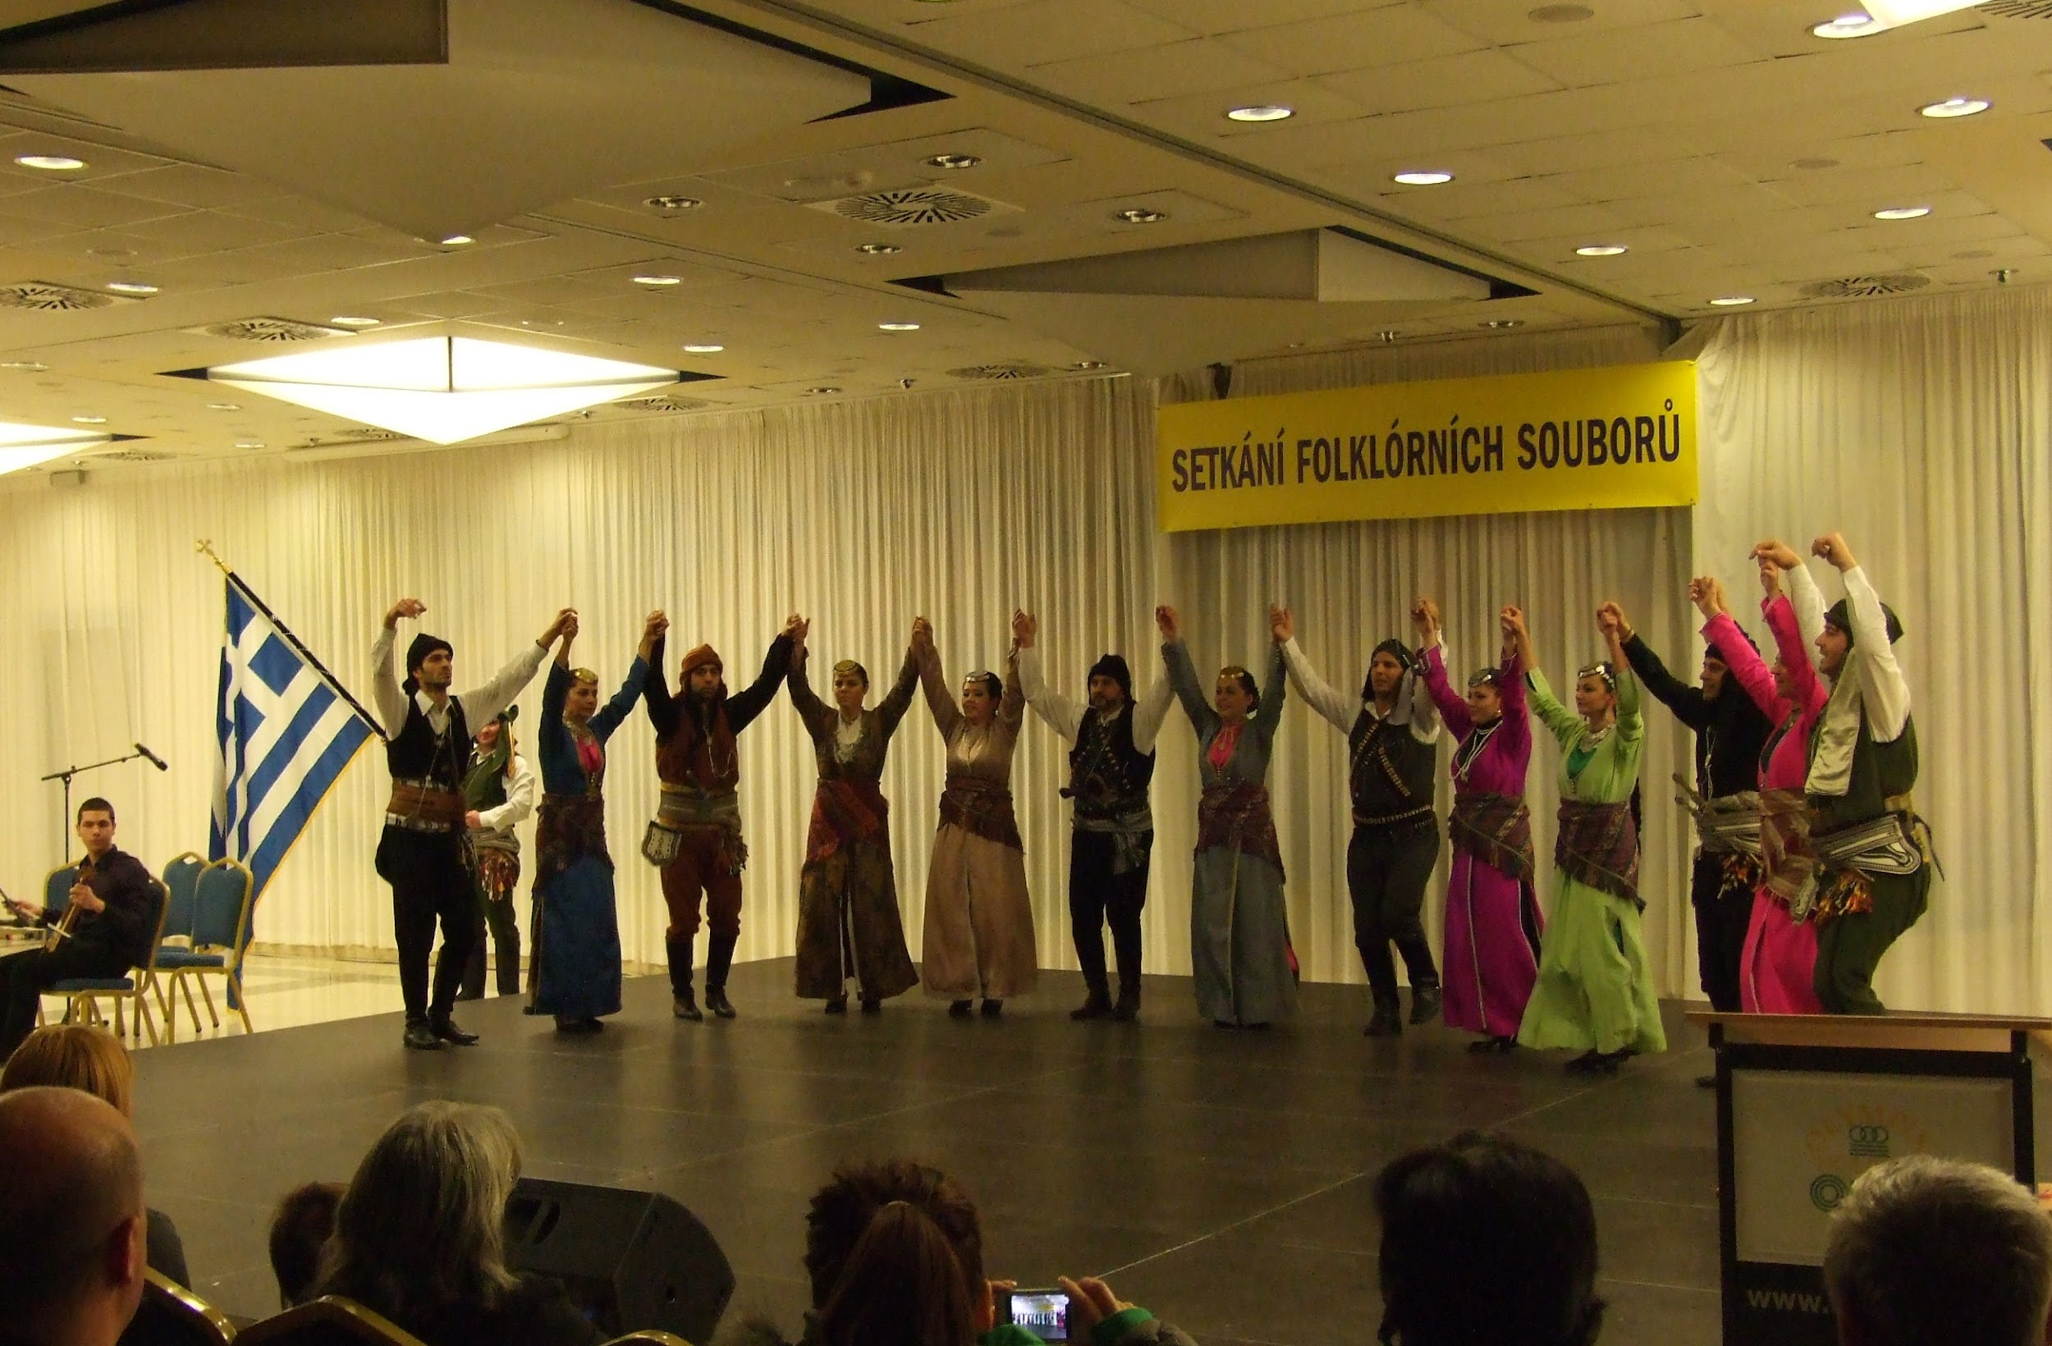
Dances
SPAIN: flamenco, jota, isa canaria...
jot
GREECE: Tsamikos, Pentozalis, Pontiakos,

Slide 25
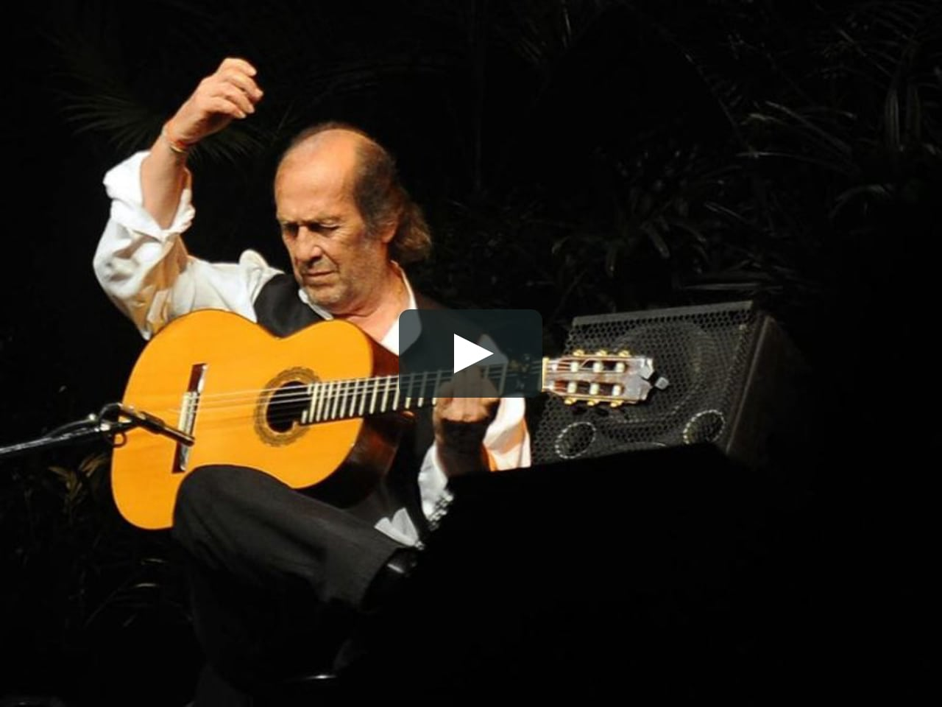
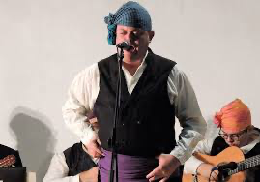
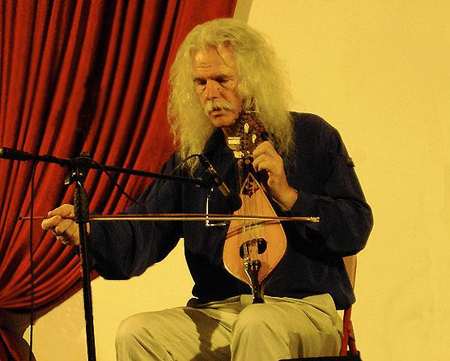
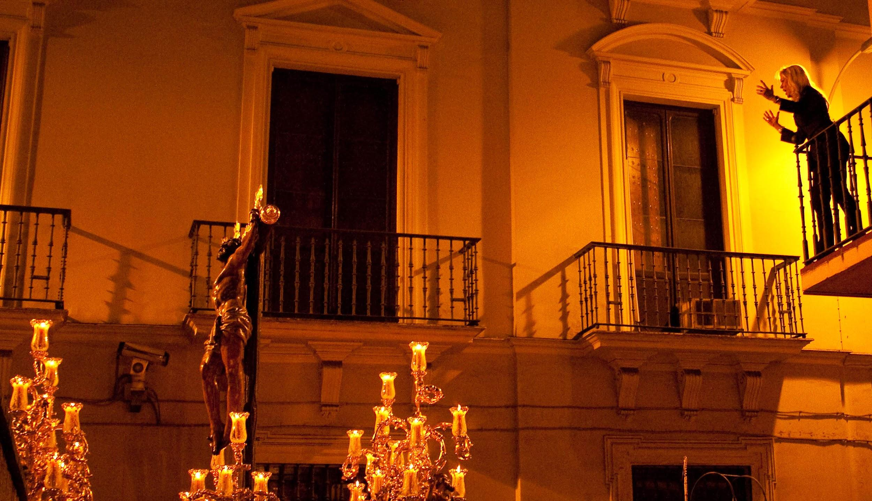
Music
SPAIN: fandango, saeta, jota…
GREECE: songs with the lyre and the bouzouki

Slide 26
Arts and Crafts
SPAIN: Dalí Gaudí
Greece: Chalepas and Theofilos

