Slide 2
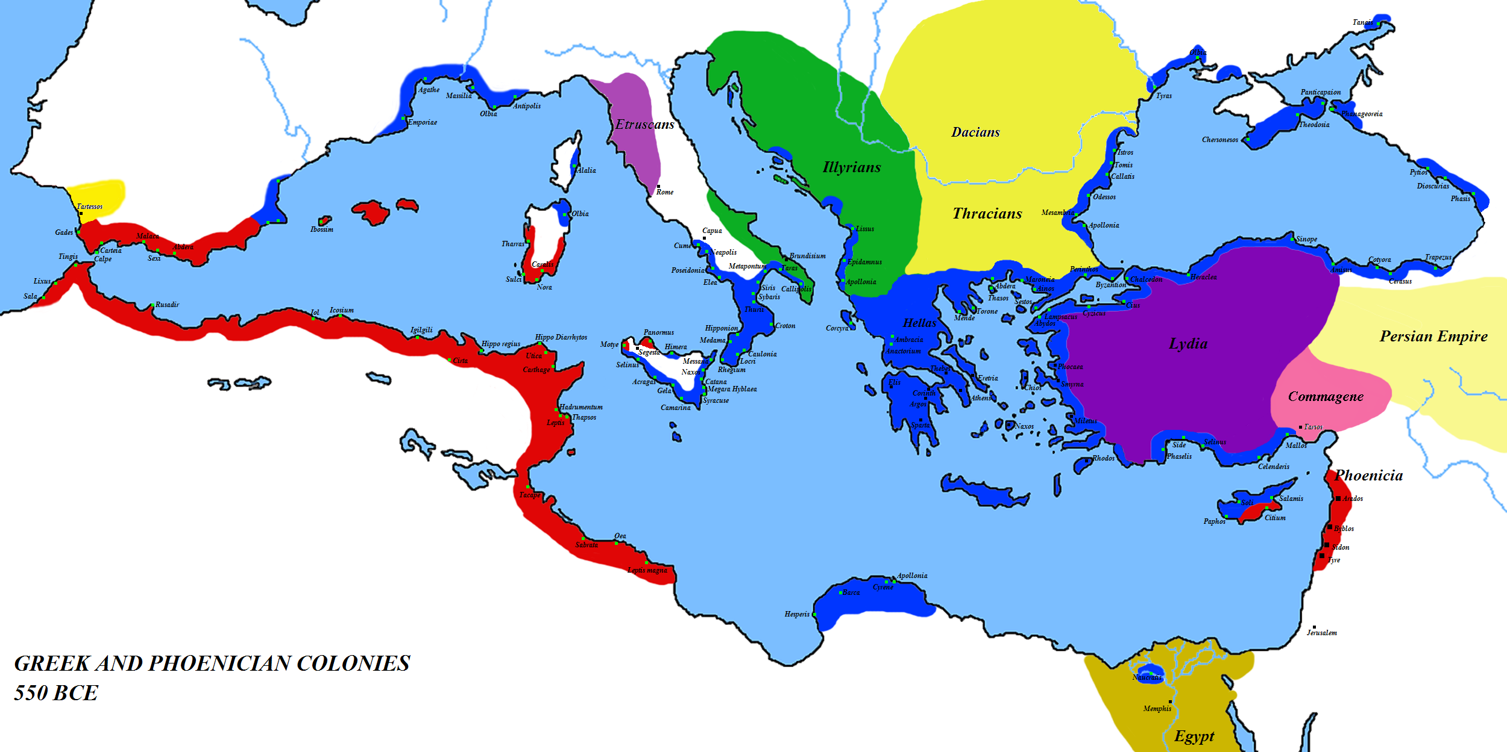
Greeks Μigrating
from ancient times to the modern day
“Migration Matters”

Slide 3
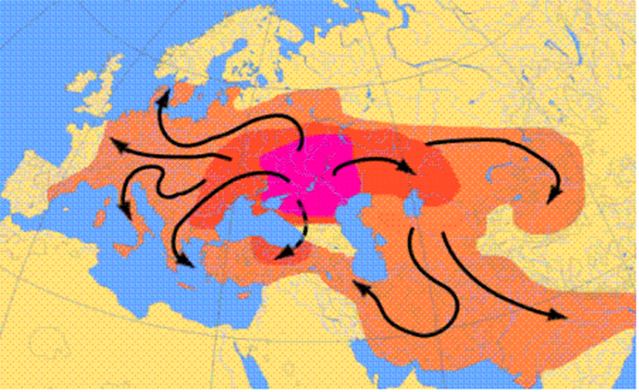
Great movements of peoples
Ancient times
Back in 2000 and 3000 bc when the great movements of people started, the Greeks settled where it is modern Greece.

Slide 4
INDEX
Ancient Times
First Greek Colonisation (Asia Minor) 11th century
Second Greek Colonisation (Mediterranean and the Black Sea)
Modern Era
Greek communities in Europe (18th-19th centuries)
First Massive Exodus of Greeks
(1800-1930)
Second Massive Exodus of Greeks
(1950-1970)
2009-nowadays (economic crisis, brain drain)

Slide 5
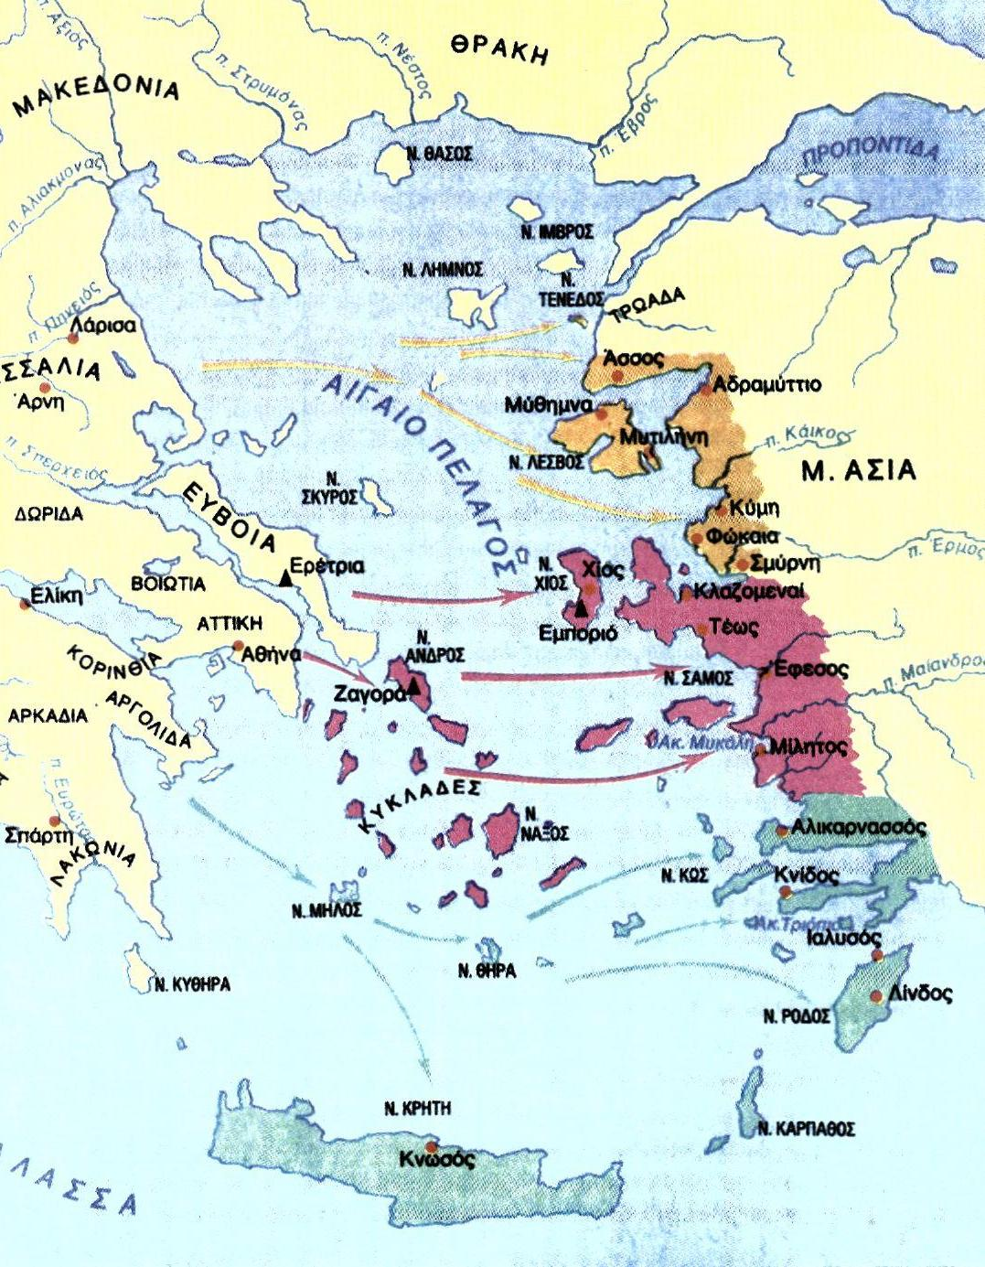
First Greek
Colonisation
1100 - 800 BC
Ancient times
First Greek
Colonization
1100 - 800 BC
From the 11th century BC the Greeks migrated to the coast of Αsia Minor, the other side of Aegean sea . There, they got to know the civilisation of the East.

Slide 6
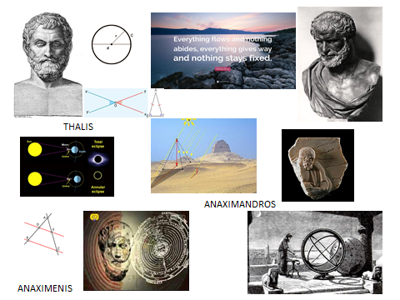
Ancient times
There the population developed both economically and culturally and the greek towns flourished and became centres of the Greek Civilisation.
Some of the most famous Greek Philosophers lived there (Herakletus etc.).
HERAKLETUS

Slide 7
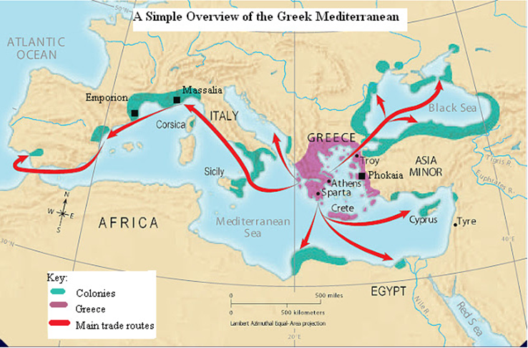
Second Greek Colonisation, 800 - 500 BC
Ancient times
This time they organised the civilisation in a very methodical way and they spread across the Βlack Sea and all over the Mediterranean Sea
( Spain - in Emporion (Empúries,
south France- in Massalia,
and in south Italy and Sicily - a lot of colonies) ).

Slide 8
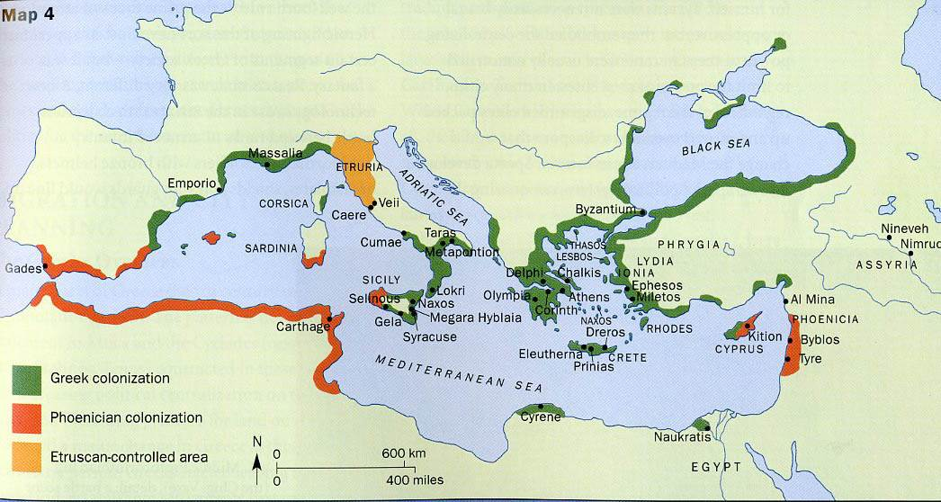
Greeks around Mediterranean Sea
(about 500 BC)
Ancient times

Slide 9
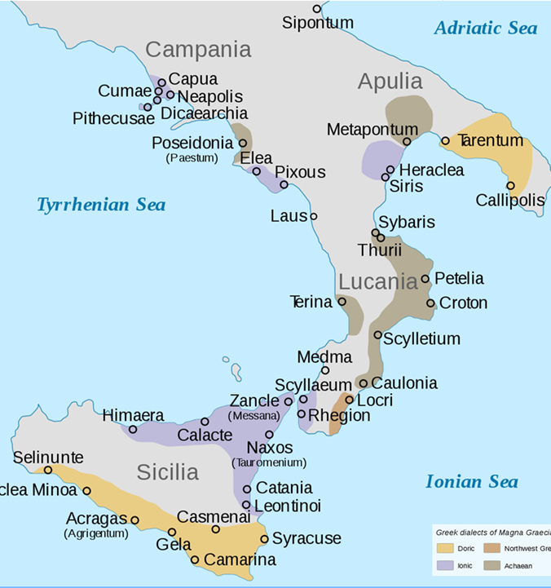
Magna
Graecia
Ancient times
In South Italy and Sicily, the Greeks were so many, that the area was called Magna Graecia. The greeks settled even in Milazzo!
Τhe most ancient Greek colony in Sicily is Imera.

Slide 10
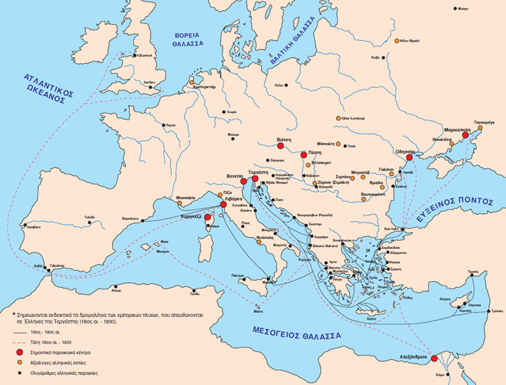
Greek communities in Europe
Greece under Turkish Occupation
18th-19th
In the 18th century, Greece was under Turkish Occupation.
During that time the oppressed greeks migrated all over Europe, they developed commerce and succeeded both economically and culturally. Through commerce with the Europeans, Greeks of the diaspora were influenced by the Enlightenment and helped in the revolution of the Greeks against the Ottoman Empire.

Slide 11
Immigration of Greeks in Recent Times

Slide 12
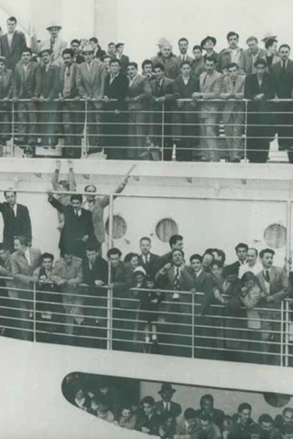
Recent times
First Massive Exodus
Second Massive Exodus
Nowadays

Slide 13
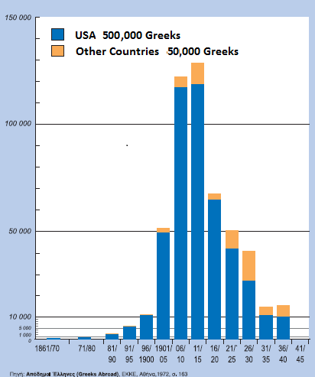
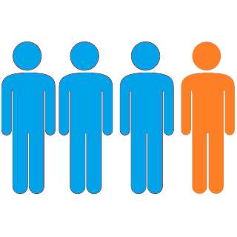
First Massive Exodus
Of Greeks
1880-1930
Recent times
Greek population about 4,000,000
Emigrants 550,000
1 out of 7 emigrated

Slide 14
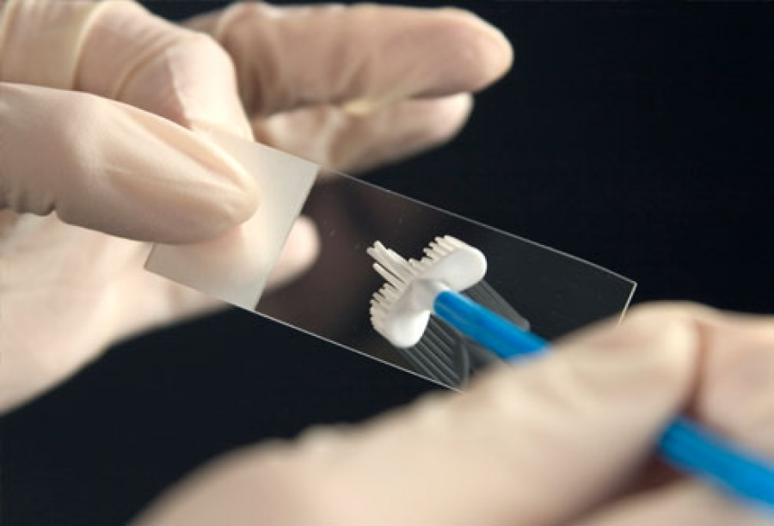
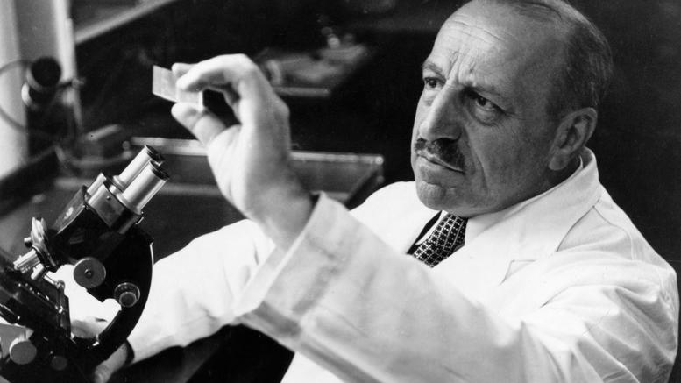
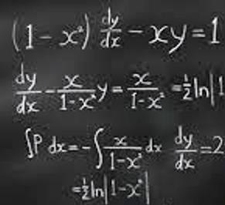
Karatheodori Konstantin
Mathematician
Science
Papanikolaou Georgios
Doctor & Biologist
Notes:
Science

Slide 15
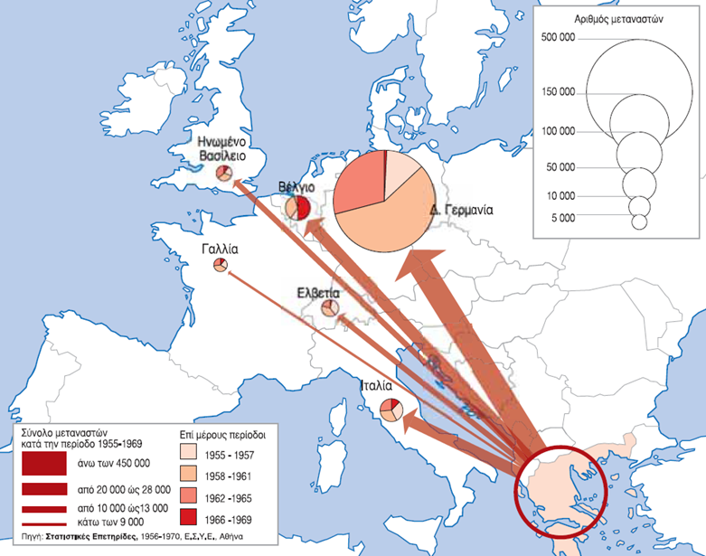
Greek Immigrants 1955-1969 (Europe)
In Europe, they immigrated mainly in Germany, Belgium, North Italy and other countries, where there was need for labor.
Recent times

Slide 16
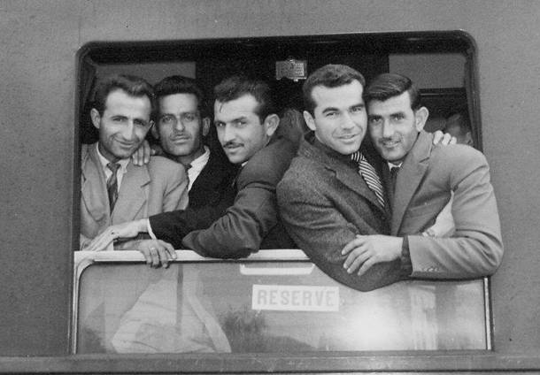
Second Massive Exodus of Greeks (1955-1969)
Recent times
Greeks travelling to Germany by train.

Slide 17
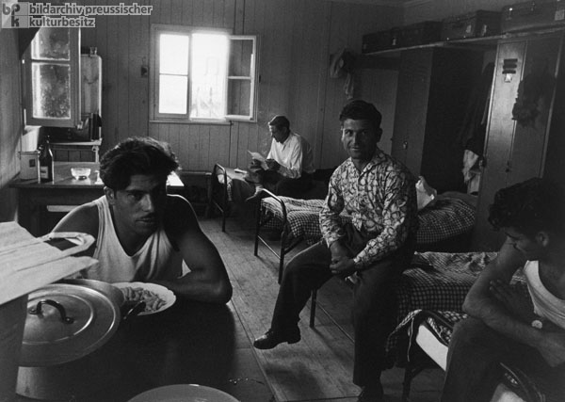
Living Conditions
Recent times
Notes:
Ισως αυτή η φωτογραφια επειδη ειναι πιο καθαρή

Slide 18
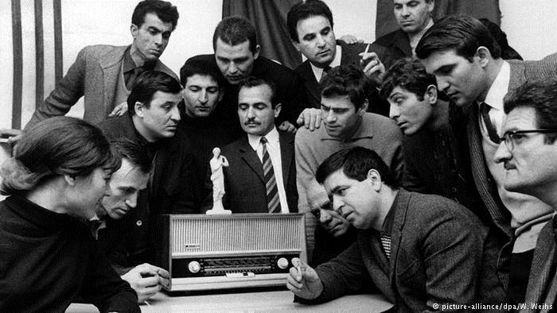
Greeks Succeeding Abroad
Recent times

Slide 19
Nowadays
Exodus of Educated Professionals 2009-present

Slide 20
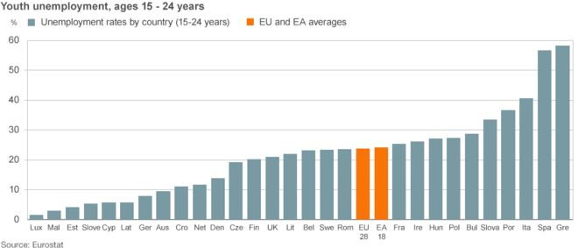
In 2009 Greece became the centre
of the recent big worldwide financial crisis
Recent times
Unemployment rate that reached 25%.
It is even bigger in young ages.

Slide 21
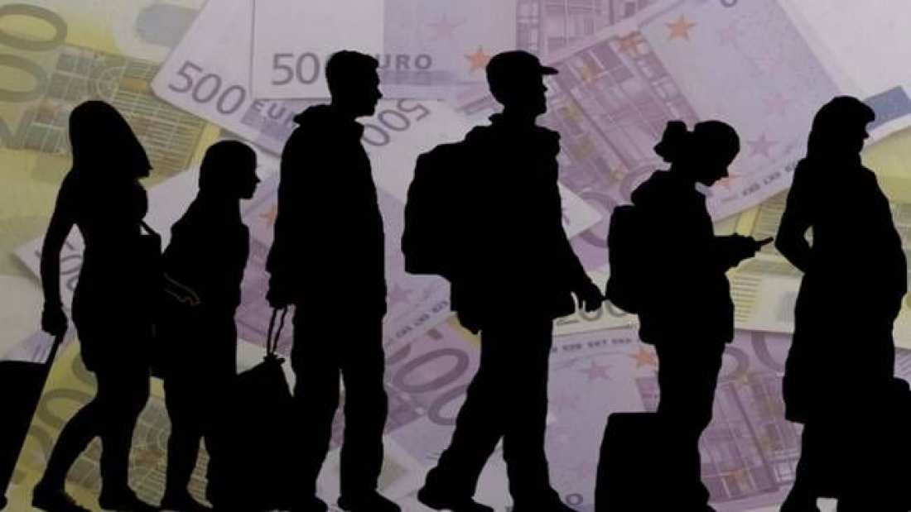
For these reasons nearly 500,000 Greeks have immigrated since 2009 in Germany, UK, the United Arab Emirates etc.
Their main motive is to find work and opportunities
Recent times

Slide 22
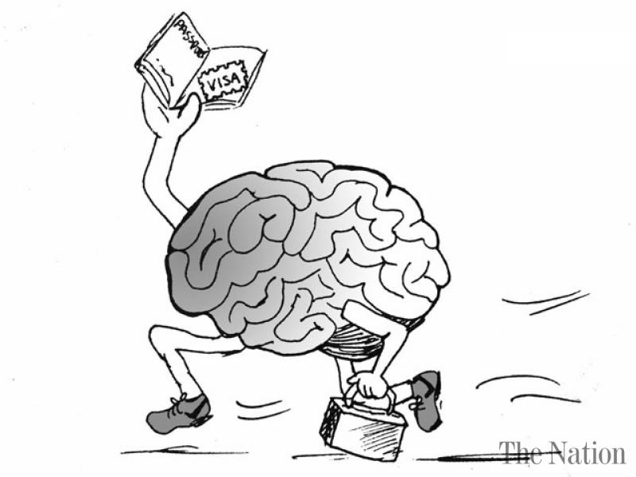
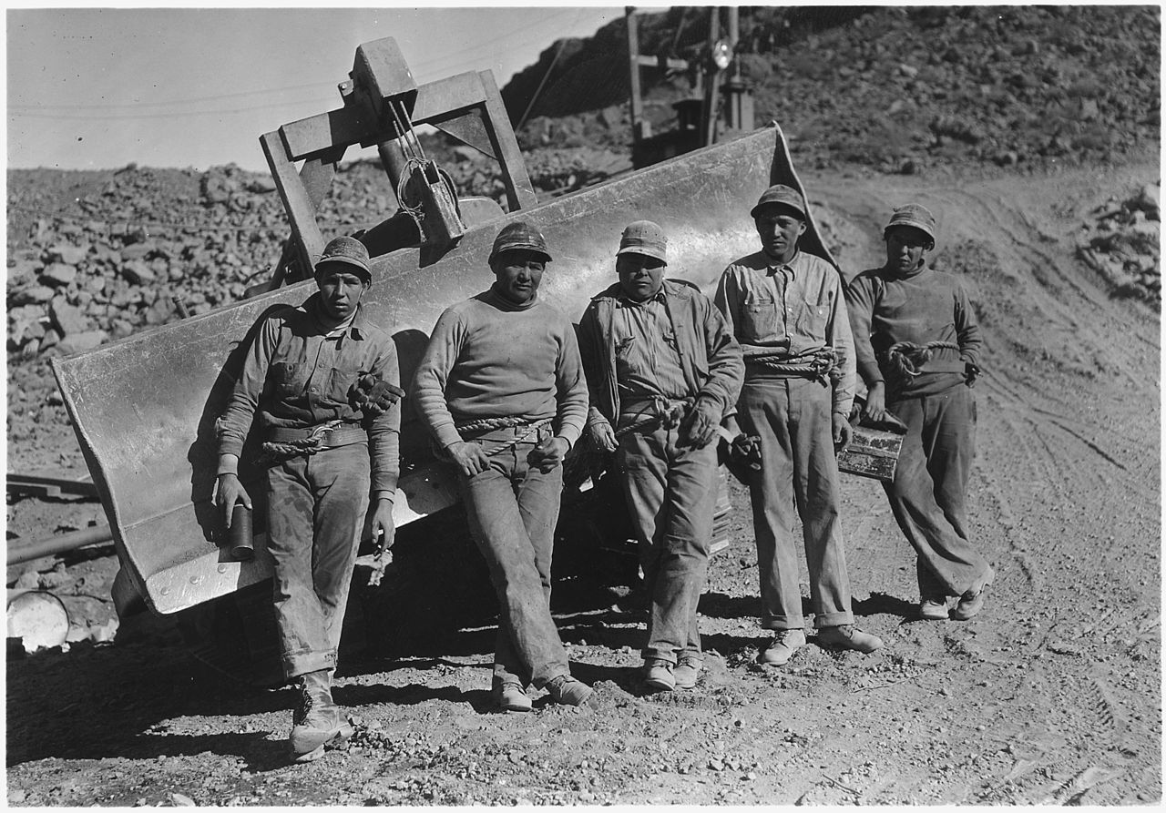
Recent times
In 20th century:
Unskilled workers
farmers
In 21st century:
Educated professionals
Young graduates

Slide 23
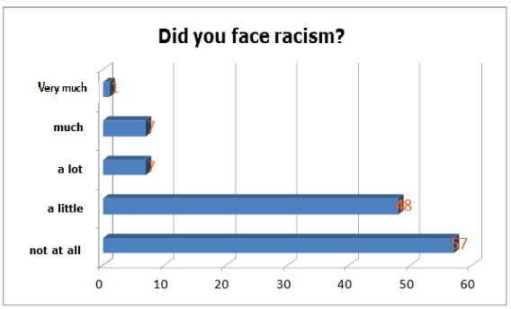
Recent times
Notes:
Οι περισσότεροι δεν αντιμετώπισαν ρατσισμό. Ίσως γιατί είναι υψηλής ειδίκευσης.

Slide 24
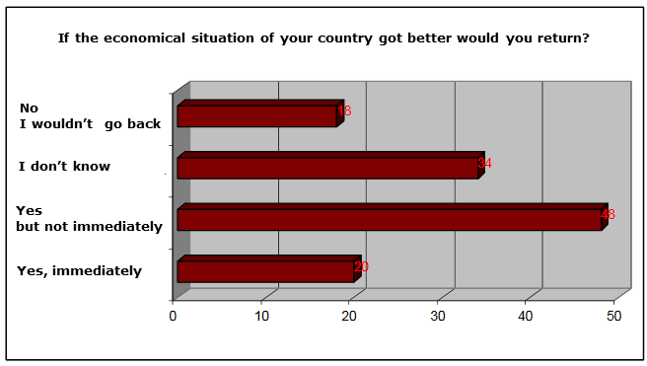
Recent times
Notes:
Γι αυτό οι περισσότεροι θα γύριζαν πίσω αν οι συνθήκες βελτιώνονταν
Αν βελτιώνονταν οι συνθήκες στις χώρες μεταναστών μήπως θα μπορούσε να λυθεί το σημερινό πρόβλημα της μετανάστευσης;

