Slide 1


Slide 2
The Entrepreneurial potential of natural traditional Remedies

Slide 3
the Human Body and Nature
Hippocrates (460-337 B.C.) stressed the therapeutic power of Nature
The Human Body is an open thermodynamic system
It receives energy from the Earth and the Heavenly bodies
In fact, our body is made of cells which rely on energy from:
the Earth’s Flora
the Fauna
the air
the Sun
Ο ΚΥΤΤΑΡΙΚΟΣ ΜΕΤΑΒΟΛΙΣΜΟΣ ΕΧΕΙ ΩΣ ΠΗΓΗ ΤΡΟΦΟΔΟΣΙΑΣ ΤΗ ΧΛΩΡΙΔΑ ΚΑΙ ΤΗΝ ΠΑΝΙΔΑ ΤΗΣ ΓΗΣ,ΤΟΝ ΑΕΡΑ ΚΑΙ ΤΟΝ ΗΛΙΟ

Slide 4
the Human Body and the Environment
The Human Body interacts with the Environment
However, there can be a deficiency in some elements which
can be made up for with the use of concentrates of natural elements
Herbal teas
Herbal extracts
Tinctures
Sirups

Slide 5
Sustainable traditional remedies - objectives
In order to help sustain TR, medical experts must provide
Scientific documentation of health benefits
Medically prescribed dosages and applications
The state must ensure their
Proper management and supply
Production cost: no higher than 20% of price
Certification
Publicity (Education, Health and Entrepreneurship)

Slide 6
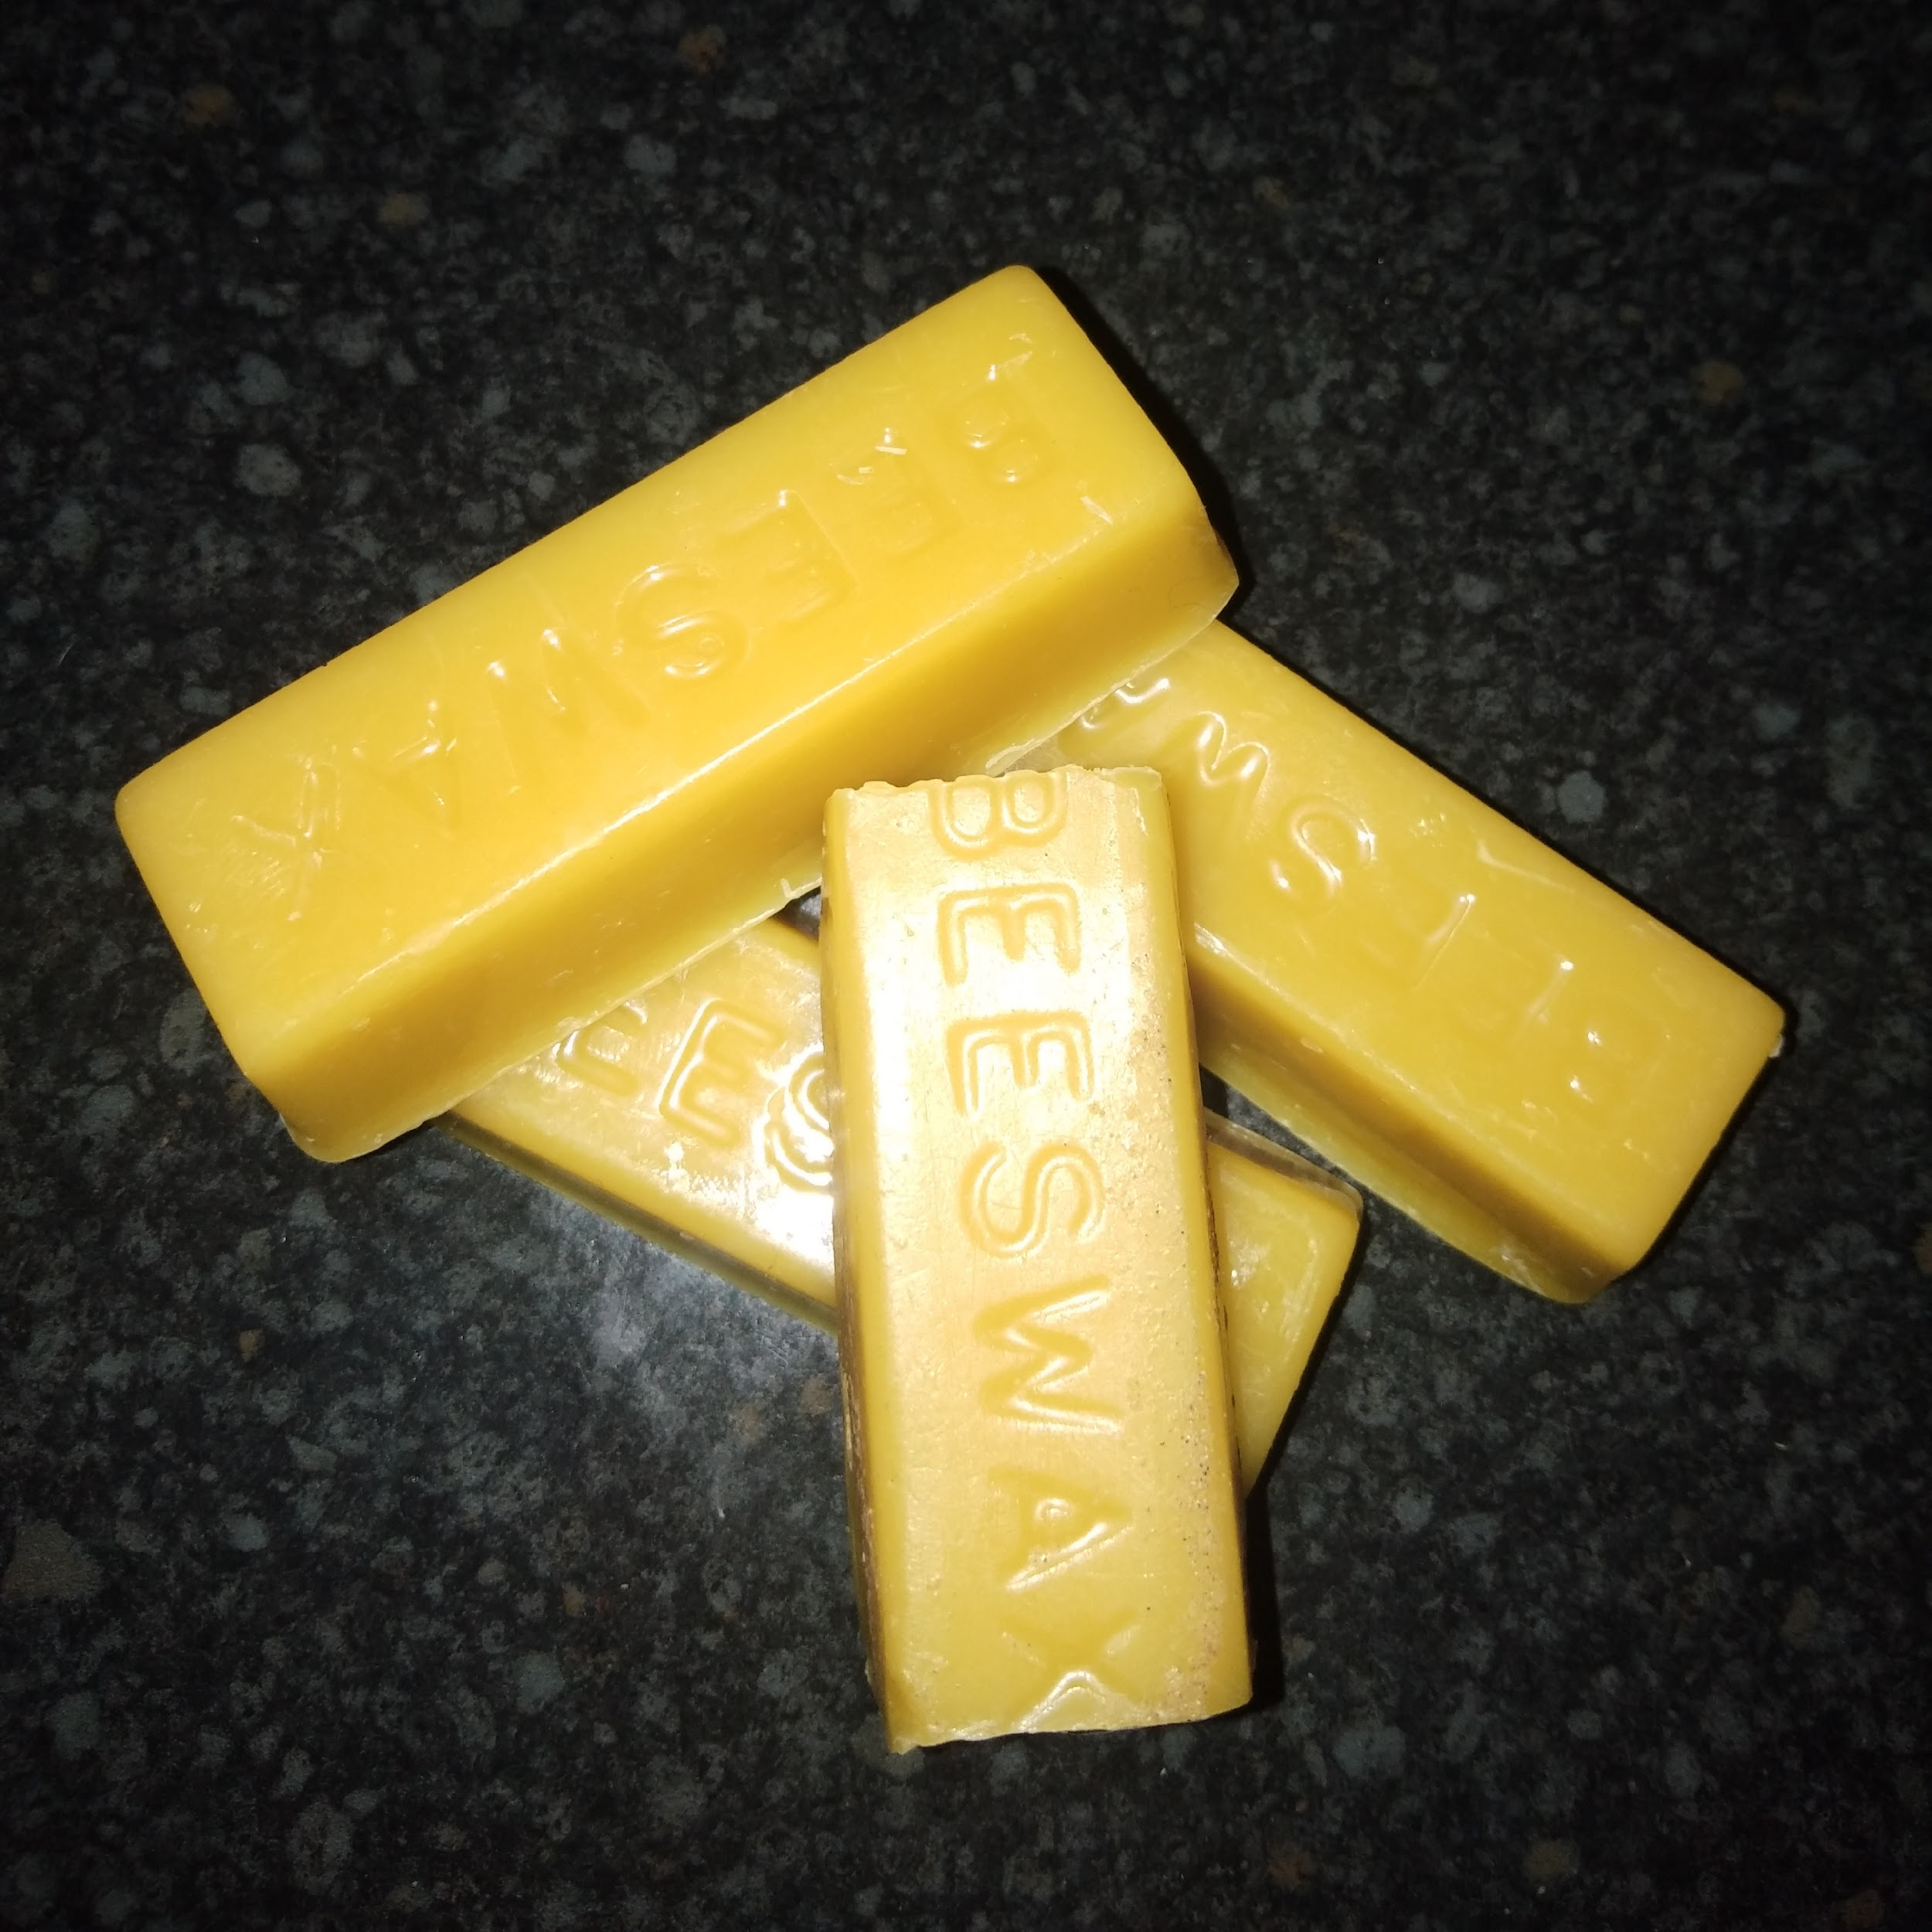
Here’s an example of how to start up at home
Homemade Beeswax Ointment

Slide 7
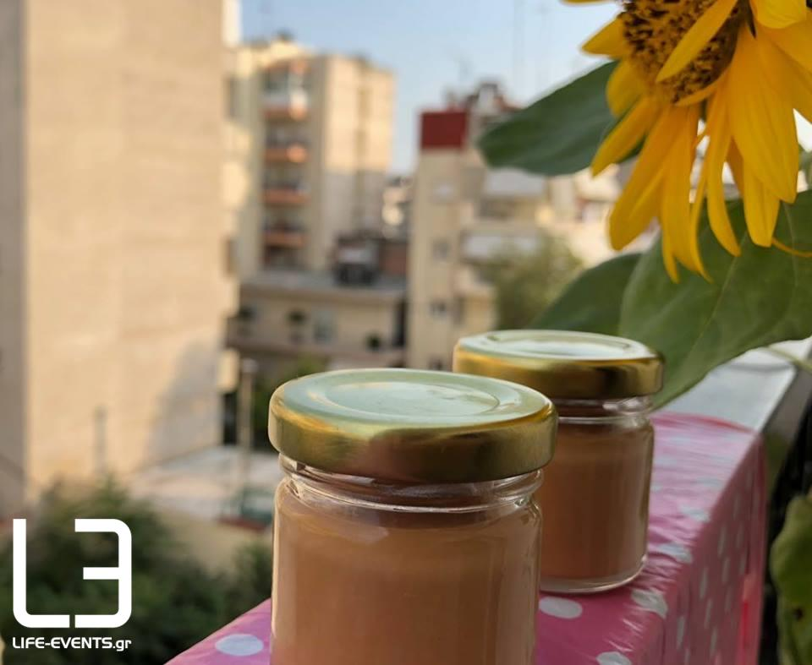
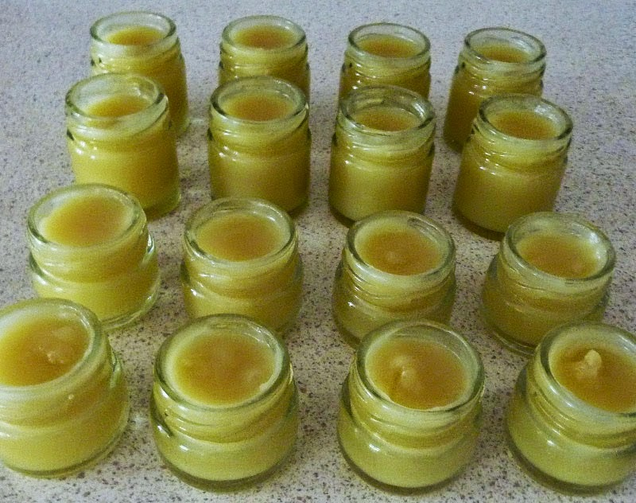
Recipe for beeswax ointment
Ingredients:
1 tablespoon of beeswax
5 tablespoons of olive oil

Slide 8
Making the wax spread:

Slide 9
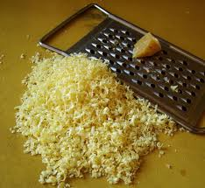
Grate the beeswax.
2) Melt it in a heat-proof bowl (using the bain marie method), add the olive oil
and mix until they merge.

Slide 10
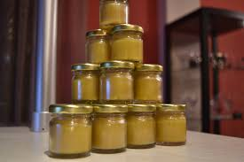
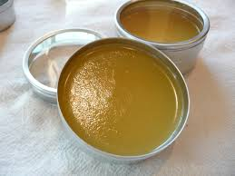
Remove the mix from the heat and put it in a clean container.
Let it cool and wait until it’s thick so it’s ready to use.

Slide 11
The Benefits:
To the Skin
Smoothes dry skin
Treats dark circles under the eyes
anti-age , anti-wrinkle
To the hair
Conditions dry hair
Natural strong Hair-styling

Slide 12
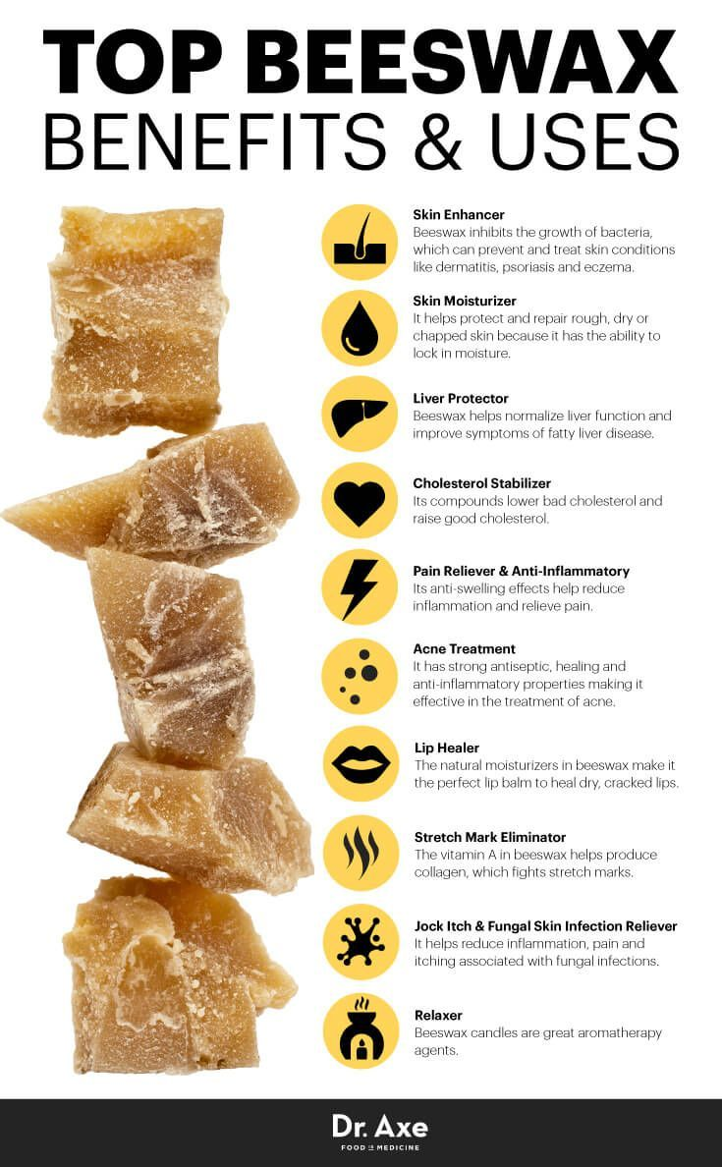
Products
Face cream
Eye cream
Lip balm
Hair styling
Hand cream
Moisturizing
for any dry part of your face or hands

