Slide 2
Rare traditions
from Greece

Slide 3
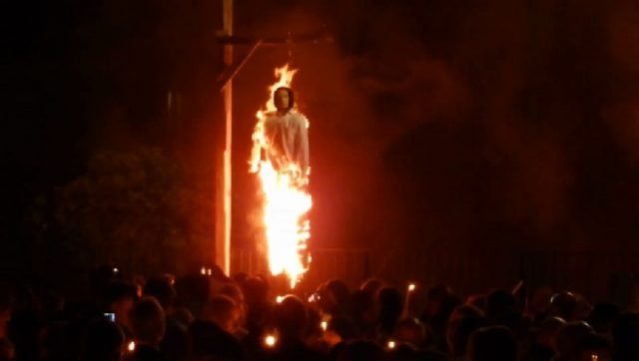
Judas burning
The burning of Judas is an Easter-time ritual which originated in European Christian communities, where an effigy of Judas Iscariot is burned.

Slide 4
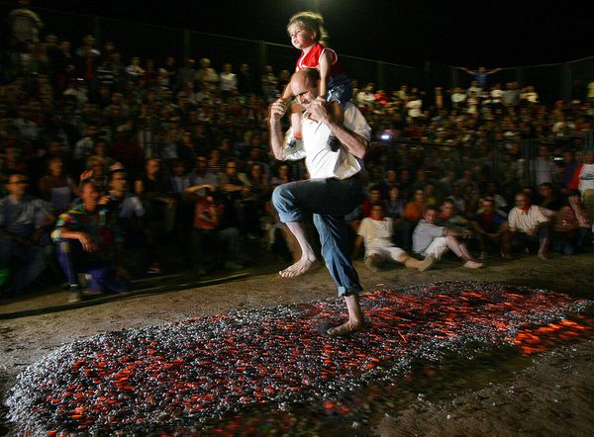
Walking over hot coals
Dating back to Pagan times, Anastenaria is a traditional ritual
of fire-walking
celebrated
in Northern Greece.
Performed from May 21st to 23rd
to celebrate the name days of Saint Constantine and Saint Helen.

Slide 5
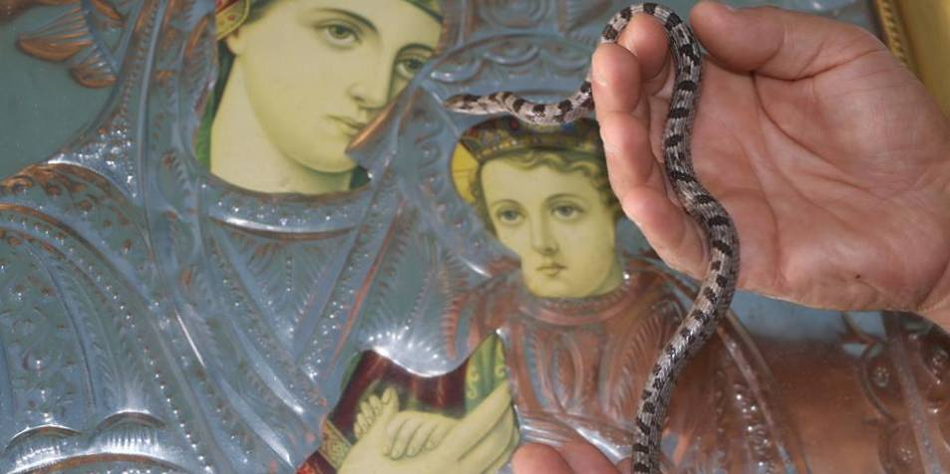
they appear each year on the island of Kefalonia, days before the Feast of the Dormition of the Theotokos, on August 15th
The small snakes -which are friendly to people - have a characteristic soft skin and the shape of a cross adorning their backs
The snakes of Virgin Mary
Notes:
And now a miracle Greeks believe in….

Slide 6
Diving for the Cross
January 6th is the Epiphany, the day Jesus was baptized in the River Jordan by John the Baptist
the Holy Cross is tossed into the icy waters of the sea and retrieved by the best diver!

Slide 7
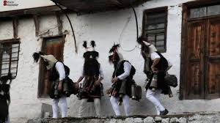
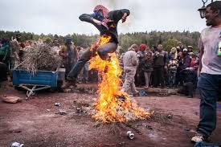
Dionysus worship
On the day of the Epiphany, January 6, in eastern Thrace, Paganism meets the Orthodox.
Black capes, animal skins, masks and bells ‘compose’ the overwhelming custom that has its roots in ancient Greece.

Slide 8
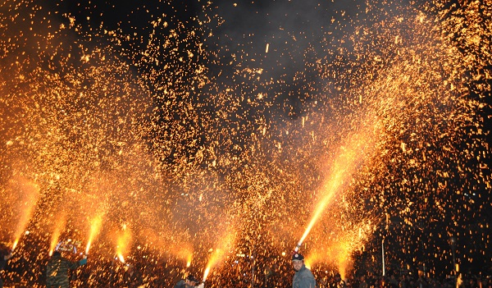
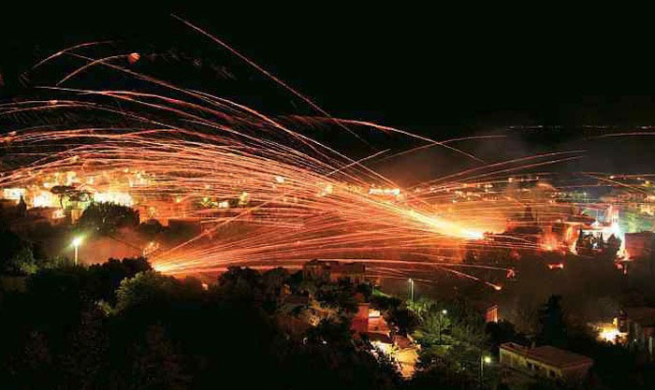
Fireworks war
The ‘Fireworks war’ is a custom that takes place every Easter at midnight.
Two churches throw thousands of improvised fireworks on the night of the Holy Saturday aimed at the bell of the other church creating a unique spectacle.

