Slide 2
Herbs and plants with cultural significance
from Greece - and beyond

Slide 3
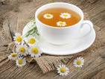
Chamomile Tea
A concentrate of nutrients
Slows down the digestive organs -
(stomach and bowel)
relieving from pain at digestion
is also a mild laxative
with anti-inflammatory and bactericidal properties
from the Greek χαμαίμηλον (chamaimēlon)
meaning "earth-apple"

Slide 4
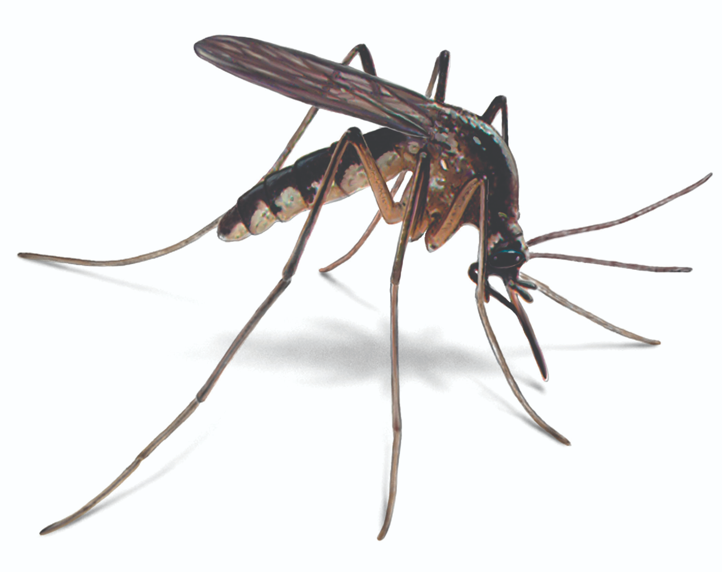
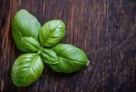
Basil and its benefits
Basil is native to tropical regions from central Africa to Southeast Asia.
Tastes and smells sweet
Repels mosquitoes naturally
Basil is used in religious rituals to
to spray holy water bless the all over
our bodies and homes

Slide 5
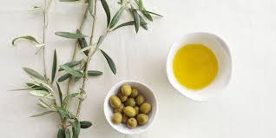
Olive
found in the Mediterranean Basin from Portugal to the Levant,
the Arabian Peninsula,
southern Asia as far east as China,
the Canary Islands and Réunion.
cultivated in many other places:
Argentina, Saudi Arabia, Java, Norfolk Island, California, and Bermuda

Slide 6
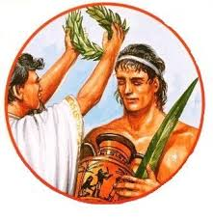
Olives in ancient Greece
The ancient Greeks smeared olive oil on their bodies and hair as a matter of grooming and good health.
Olive oil was used to anoint kings and athletes in ancient Greece. It was burnt in the sacred lamps of temples and was the "eternal flame" of the original Olympic games. Victors in these games were crowned with its leaves.

Slide 7
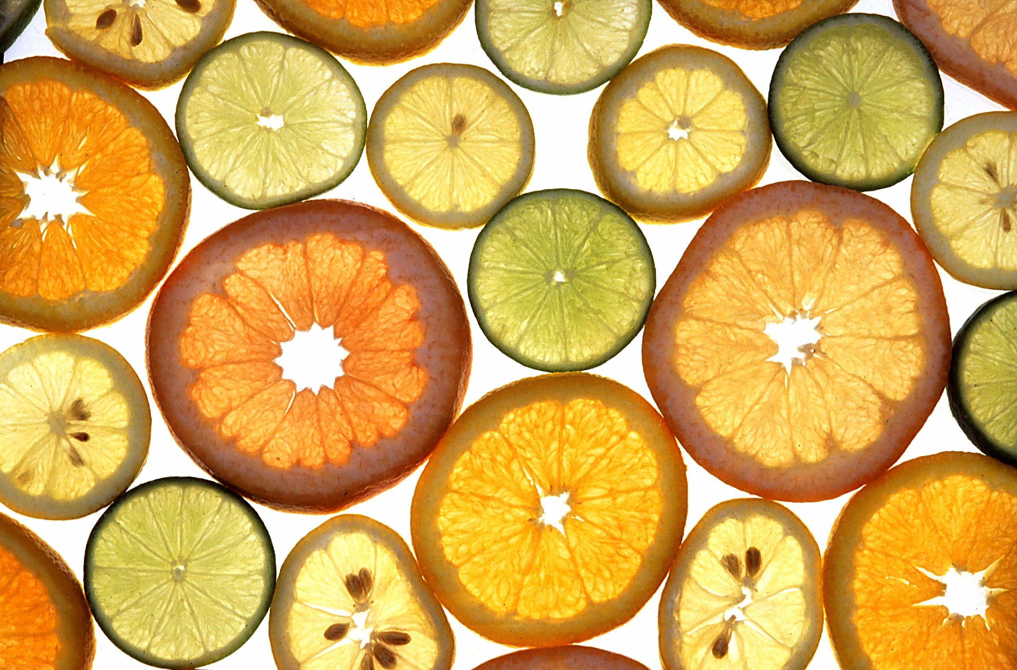
Citrus fruit
oranges
lemons
tangerines
bergamot oranges
kumquats

Slide 8
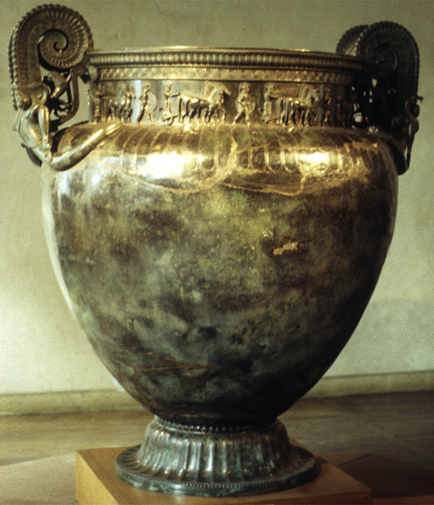
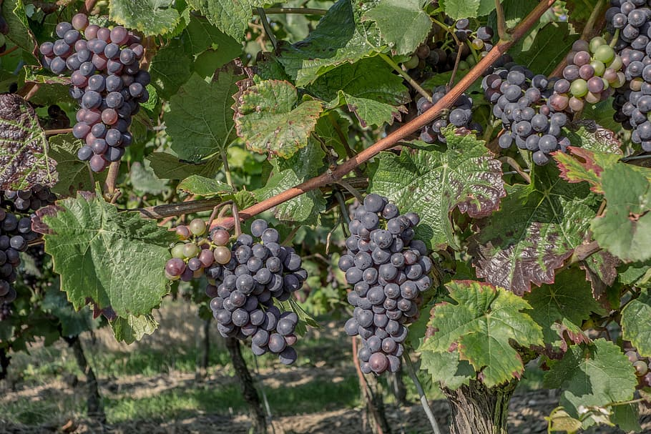
Drink and rejoice!

Slide 9
Pythagora’s cup

Slide 10
Health, nutrition, aroma and pastry!
vitamin C
helps absorb iron
prevents scurvy
prevents cancer and cardiovascular diseases.
citric acid
major food and drink preservative
Aroma
principle ingredient of soaps and detergents
Pastry
orange cake: great Christmas treat
Tsitsibira: citrus beer
kumquat liqueur

Slide 11
Citrus etymology and mythology
citrus= hesperioidea
Hesperia (Greek): the West
‘espera”: evening
portokalia (Greek): oranges
probably from Portugal
Hera had an orchard in Hesperia, known as the Garden of Hesperides, since it was under the care of these mythical figures
The fruits grown there were the famous “golden apples”— oranges, granting immortality to the ones savouring them.
Yet, this very orchard and its fruit brought about the widely-known Trojan War

Slide 12
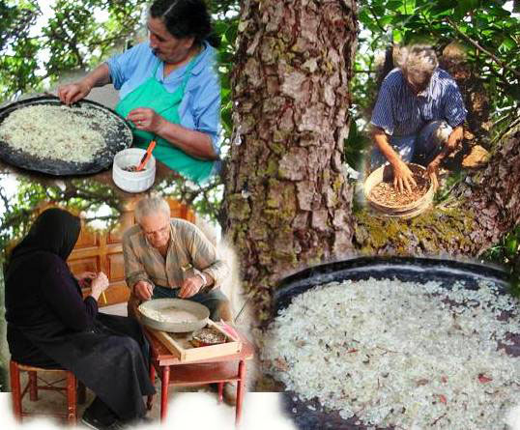
The mastic cultivation

Slide 13
The mastic cultivation: cultural heritage
The traditional know – how of mastic cultivation is included in the list of the intangible cultural heritage of Humanity by UNESCO in 2014

Slide 14
The Chios Mastic Museum
Mastichochoria of Southern Chios, where the mastic tree is cultivated and produces the mastíha resin.
Traditional mastic cultivation continues to be alive today and is an element both of the inhabitants’ identity and of the locality’s history.

Slide 15
Skinos or mastic tree
pistacia lentiscus Chia shrub
grows in south Chios,
Gives an aromatic resin called mastic
Evergreen - αειθαλές
Height of 2-3 metres
Short trunk
Branches long, bending downwards
Develops fully after 40-50 years
Lives more than 100 years

Slide 16
The ecosystem of mastic
Skinos is a characteristic feature of the vegetation in Mediterranean
Ιn the south of Chios
cultivated systematically in order to produce mastic
thanks to the particular climate conditions

Slide 17
Cultivation
Starts in winter and completed in spring
Mastic resin is gathered in summer and early autumn
Whole families take part in this process
From October till the beginning of next spring, women clean the mastic resin

Slide 18
Mastic “tear”
Resin secreted by the tree
In order to heal the tree wounds caused by cuts

Slide 19
Know-how of cultivating mastic
an ancient practice
has gone down from generation to generation
very important for the local society shaping:
Landscape
Settlements
Architecture
Social life

Slide 20
Mastic products
Natural mastic
Chewing gum
Mastic oil
Toothpaste
Cooking Powder

Slide 21
Health benefits
A powerful antibacterial
Improves dental health
Full of antioxidants
Rejuvenate cells

Slide 22
USES
Medicine
Pharmaceutics
Cooking
Beverage industry
Coatings industry
Perfumery
Cosmetics

Slide 23
Traditional cooking
Greek cooks use it in various baked goods, such as Tsoureki, the Greek Easter bread.
There is also a type of traditional spoon sweet that uses mastic
You can even put mastic in dishes such as Greek rice pudding
and, of course, the liquor!

