Slide 1
Greek ways of entertainment

Slide 2
Sport has always been
a favourite pastime

Slide 3
Ancient Greeks did sport to
learn
get fit
satisfy their spirit

Slide 4
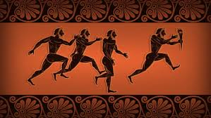
Ancient Greeks were really into
martial arts
2. track and field
3. discus, javelin
4. long jump
5. chariot racing
6. football

Slide 5
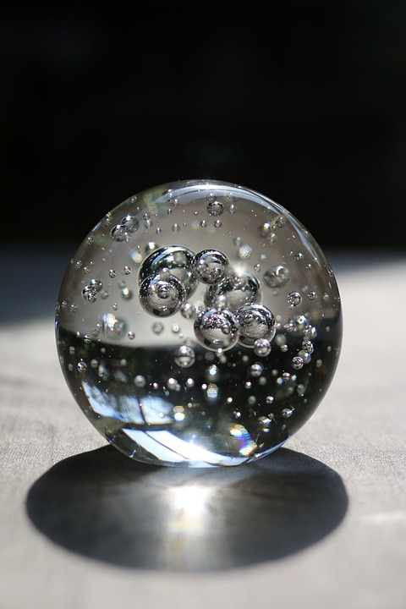
Celestial Sphere
Throwing the ball to the heavens and catching it before it landed

Slide 6
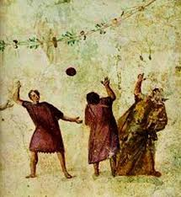
Aporaxis=
Bounce and basket sphere
The ancestors of basketball

Slide 7
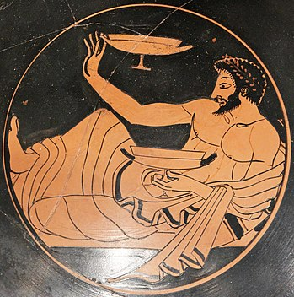
kotavos
Sprinkling the last wine drops from the glass to a target (vessel or discus)

Slide 8
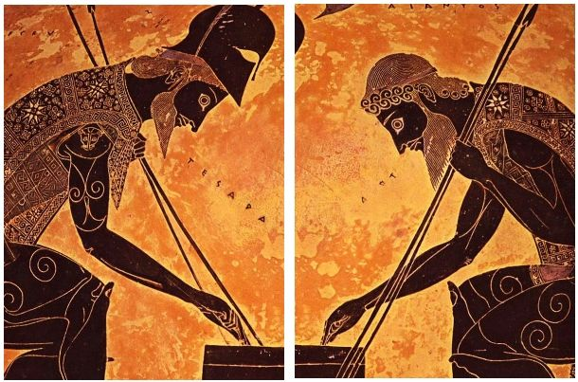
Board Games
Latrunculi strategic game (you must make your opponent unable to move his pawn)
Terni lapilli (tic tac toe)
Cubicles (dice)

Slide 9
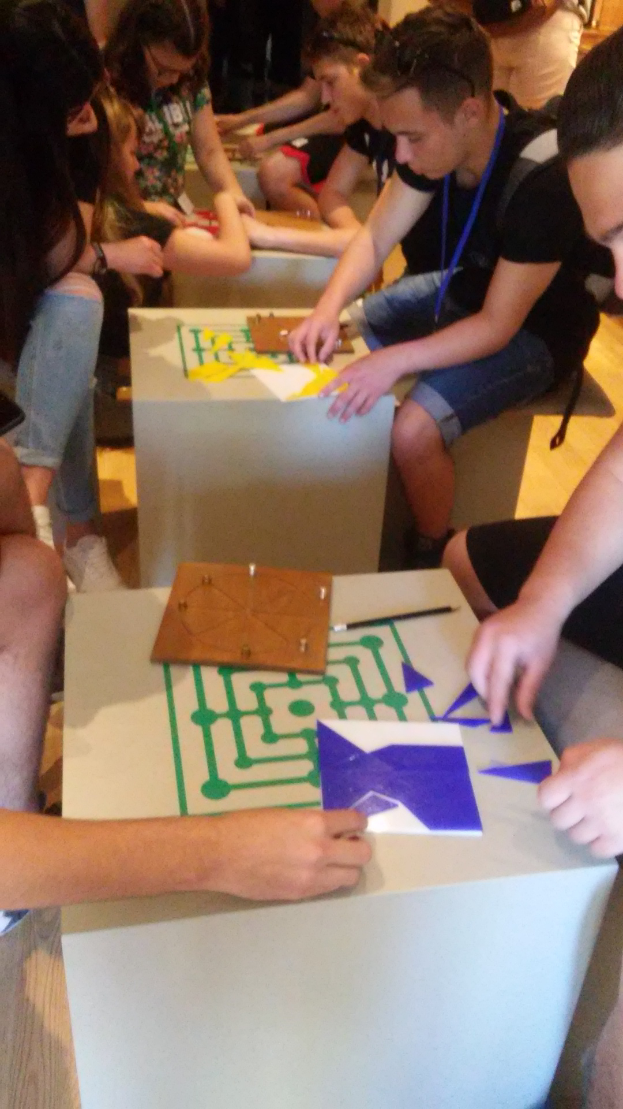
Tabla lusoria and
the first puzzle
(Ostomachion
of Archimedes)

Slide 10
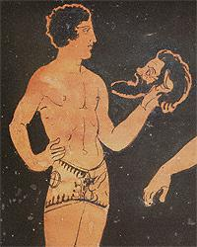
Theater
Ancient Greeks are famous for the tragedy (Aischylos, Sophocles, Euripides),
and the comedy (Aristophanes)
Drama was a means of political debate and psychotherapy
Rich people paid poor people tickets to watch theater

Slide 11
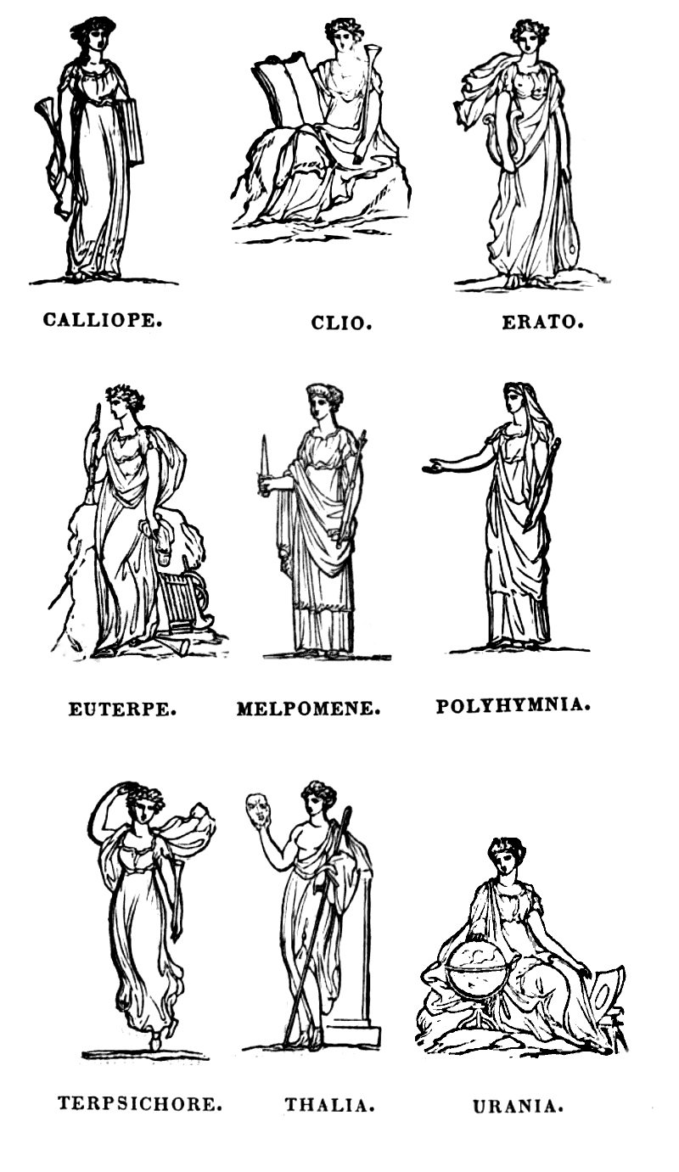
POETRY and MUSIC
The 9 Muses inspired artists who recited poetry with music
Hymn to Muse Calliope and Apollo

Slide 12
Mythology
The Olympian Gods and demigods (eg. Hercules)
The poems of Homer (Iliad,Odyssey)
The fairy-tales of Aesop

Slide 13
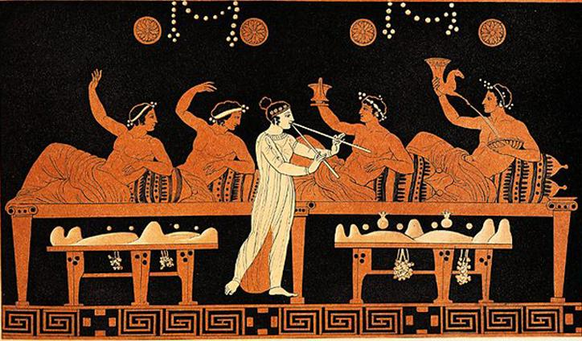
Feasts
Feasts were given mostly to honor gods by
Eating and Drinking
Singing
Dancing

Slide 14
Symposium
part of a banquet that took place after the meal,
when drinking for pleasure was accompanied by
music
dancing
recitals
philosophical conversation.
(drinking together)

Slide 15
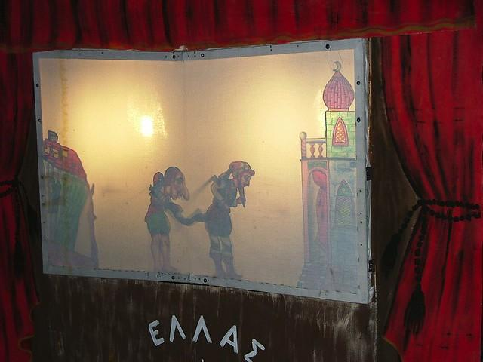
During the European Renaissance and Enlightenment
Greece was under the Ottoman occupation for 4 centuries (1453-1821)

Slide 16
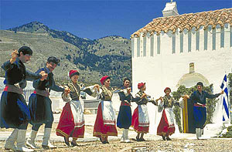
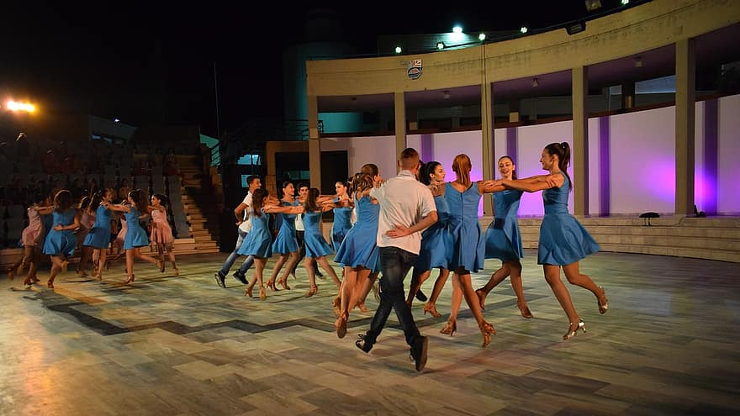
Traditional and pop dances

