Slide 2
TRADITIONAL REMEDIES FROM GREECE

Slide 3
PHYSIOTHERAPY
Physical therapy (PT), or physiotherapy
mechanical force(biomechanics)
movements (kinesiology)
manual therapy (massage)
exercise therapy (work-out)
electrotherapy

Slide 4
the benefits of PT
cures injuries
promotes mobility and function
improves a patient's quality of life
cures instead of alleviating symptoms

Slide 5
Stages
examination
diagnosis
prognosis
physical intervention
patient education

Slide 6
OSTEOTHERAPY
manual therapy
restores mobility and proper mechanics
aims at joints, muscles, the nervous system and fascia
An osteopath is like a human mechanic
Osteopaths test the whole body
by using palpation (their hands)

Slide 7
Homeopathy
homeopathy /ˌhəʊmɪˈɒpəθi,hɒmɪˈɒpəθi/
a system of complementary medicine in which ailments are treated by minute doses of natural substances that in larger amounts would produce symptoms of the ailment

Slide 8
the origins
Hippocrates (400 B.C.):
small dose of mandrake root to treat mania
Paracelsus (16th c.): "similia similibus curantur"
Hahnemann(18th c.): "what makes a man ill also cures him"
HOLISTIC VIEW:
diseases have spiritual, as well as physical causes

Slide 9
it is ideal for...
allergies
upper respiratory tract infections
childhood diarrhoea
hay fever
influenza
insomnia
rheumatic disease
sinusitis
vertigo

Slide 10
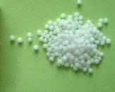
Homeopathic pills
an inert substance - basis
(often sugars, typically lactose)
upon which a drop of
liquid homeopathic
preparation is placed and
allowed to evaporate

Slide 11
ingredients
minerals and trace elements
chemical elements
plant extracts
in very high dilution (x6 or x12)

Slide 12
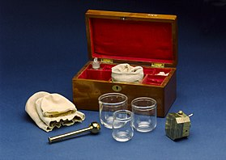
cupping therapy
Originated in ancient Egypt
Practised in ancient Greece,
the Sahara
Iran
Israel
Finland!
Ideal for:
back, neck or shoulder pain
lung infection
respiratory problems

Slide 13
categories
types according to technique:
dry
wet
massage
flash cupping therapy
types according to method:
fire
manual suction
electrical suction
special types: aquatic

