Slide 2
Weddings in Greece

Slide 3
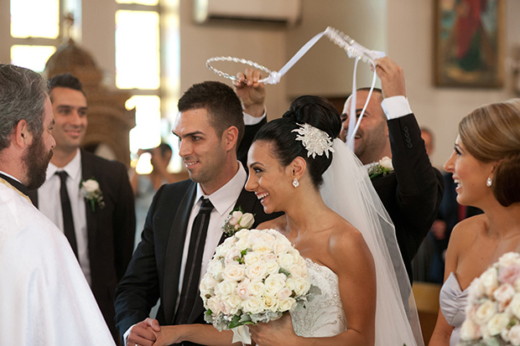
WEDDING CUSTOMS
IN GREECE
wedding bed: strewn with rose petals to bring fertility to the couple
dressing the bride: wedding serenades and dancing
Shaving the groom: bachelor party
wedding procession: from groom’s house to church
wedding ceremony: couple take three sips of wine and circle the altar three times while the guests throw rice or sugared almonds over them

Slide 4
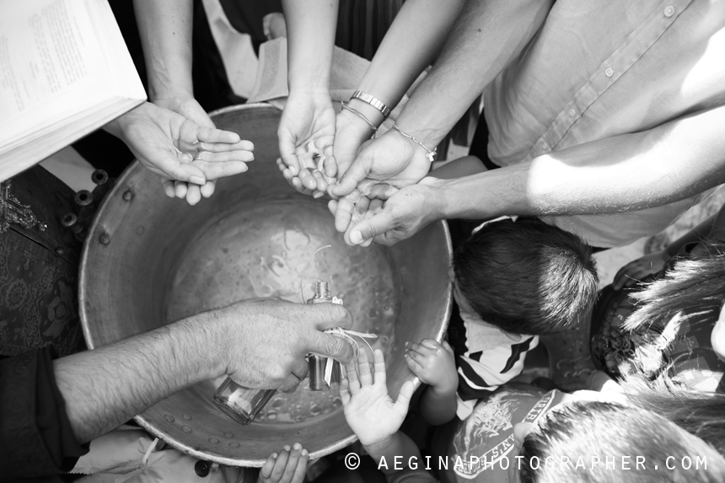
NAME GIVING COSTUMES

Slide 5
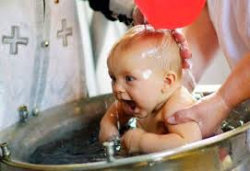
NAME GIVING CUSTOMS IN GREECE
,Choice of the name from the grandparents’
Christian baptism: parents, godparents and other relatives present the baby to the church
the priest reads blessings and baptizes the baby by sinking it in a baptistery

Slide 6
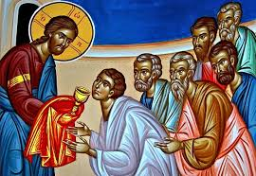
The Holy Communion
The Flesh and Blood
of Christ

Slide 7
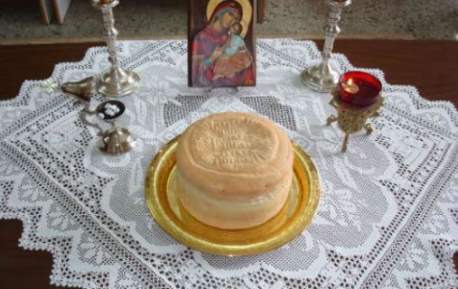
Orthodox Christian Holy Communion:
Hot, sweet red wine and homemade bread with sourdough and prayer

Slide 8
Incense
For Prayer

