Slide 2
Philosophy
From Greece
Notes:
Now we will present you some philosophical beliefs about life, death, Man and God.

Slide 3
About Life
Every
Everything flows
(ta panta ree)
HERACLETUS from Ephesus
Notes:
Similar to the saying: A rolling stone catches no weed

Slide 4
Pan metron ariston
Everything in Moderation
Hippocrates, father of Medicine
(also known for Holistic Medicine and Homeopathy)
Notes:
Today we can link this to
Balanced diet

Slide 5
About Death
Who knows whether
what we call Life is Death or whether
what we call Death is Life? Euripides, tragic poet and playwright

Slide 6
Epicurus
Why fear death
since it’s not here
as long as we live
and when it comes
we are not there,
anyway?

Slide 7
Man is sacred for Man
(the Stoics)
About Man
Notes:
The basis of Humanism

Slide 8
About Fate
About Fate
Know thyself
Oracle in Delphi
Notes:
And now some beliefs about God. The Greeks believed in Faith.
All civilisations believe in Fate, Destiny. In Greece it was so that Faith in fate was combined with faith in self-awareness, to know yourself. This motto was written at the Oracle of Delphi. The Oracle gave omens that people should explain themselves.

Slide 9
The Sophists
Cynicism scepticism
Agnosticism
Notes:
The Sophists believed in Sophia = Wisdom
They were Atheists - sceptical about the religion of the 12 Gods
They were also cynical, ironic of Gods
This is Prometheus, the mythical hero who stole the Light from the Gods to give it to men.

Slide 10
Socrates
New Demons
No one is born evil
Slaves are equal to citizens
Reason
I only know that I know nothing
Notes:
He was said to have delivered wisdom from Heaven to Earth
He influenced the 18th century Enlightenment
He had faith in innate goodness and in Reason which is the basis of Enlightenment

Slide 11
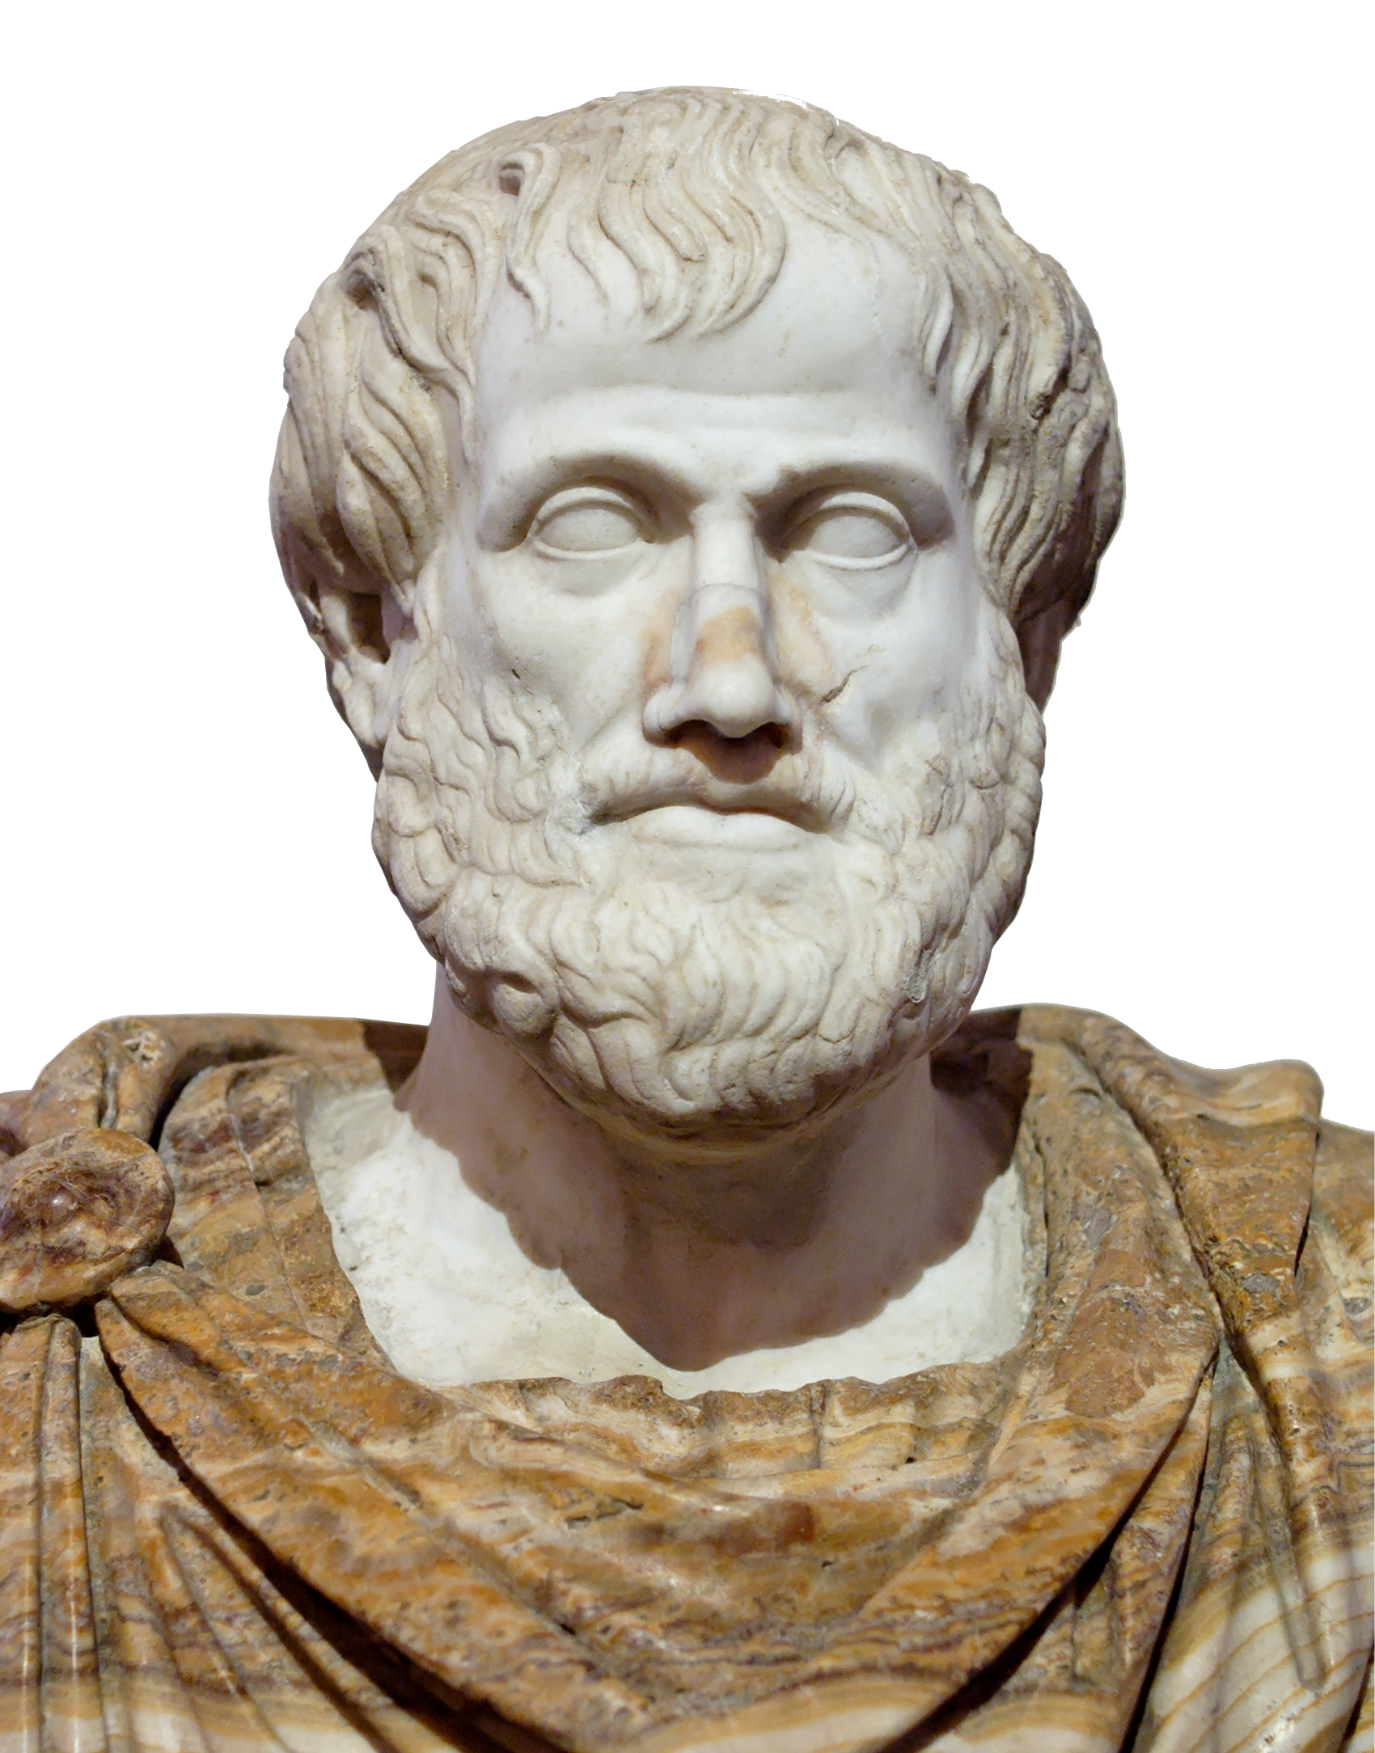
About God
Nature does
nothing in vain
Aristotle
Notes:
He saw God in Nature
There is a divine meaning in everything
He had faith in Purposefulness, so God is the Meaning of LIfe

Slide 12
PLATO
There is only ONE God who is the reason behind everything
The world of IDEAS vs the world of FORMS
Notes:
Father of Monotheism
Allegory of the Cave

