Slide 1
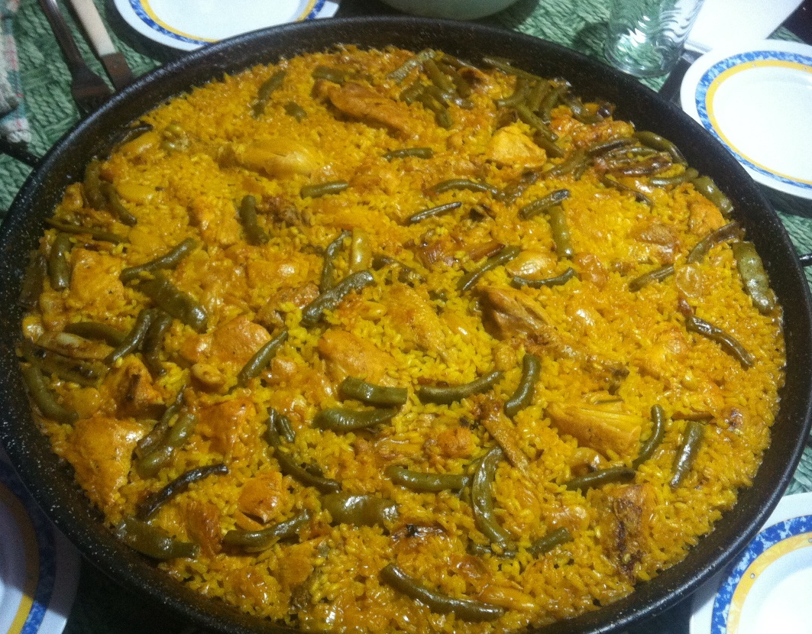
Valencian Paella
Berta Arribas Díaz

Slide 2
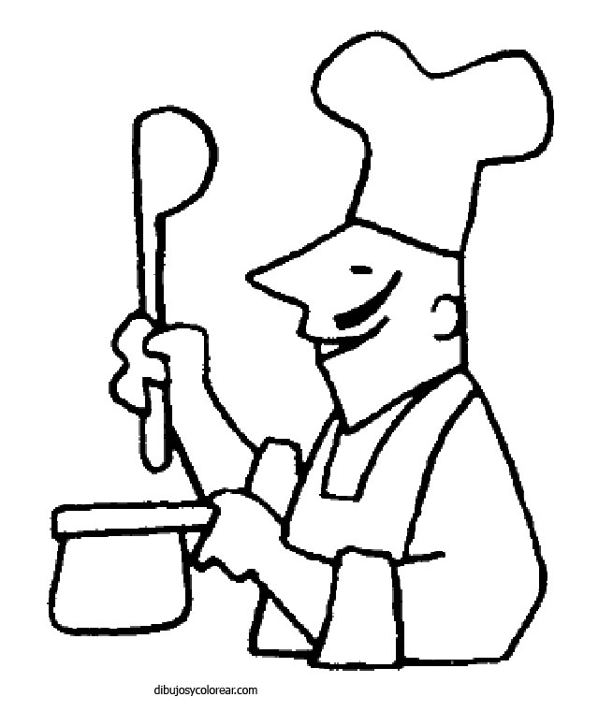
INGREDIENTS:
Rice
Green beans
Salt
Olive oil
Crushed tomato
Garrofón
Chicken
Rabbit
Sweet paprika
Saffron or food coloring

Slide 3
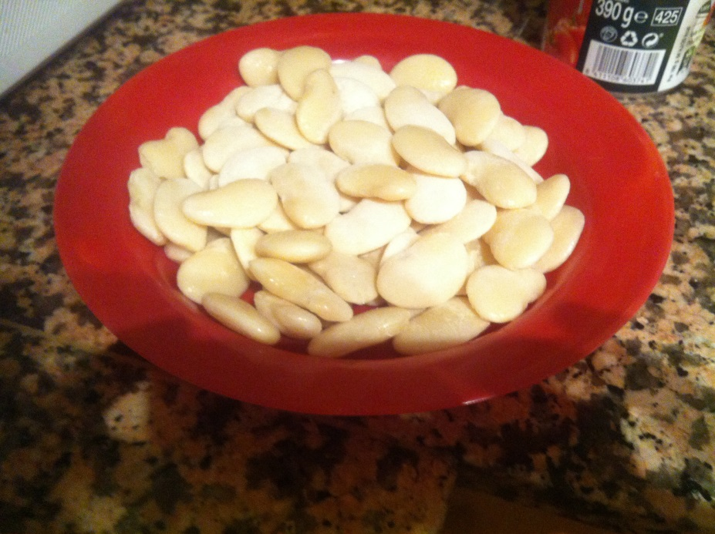
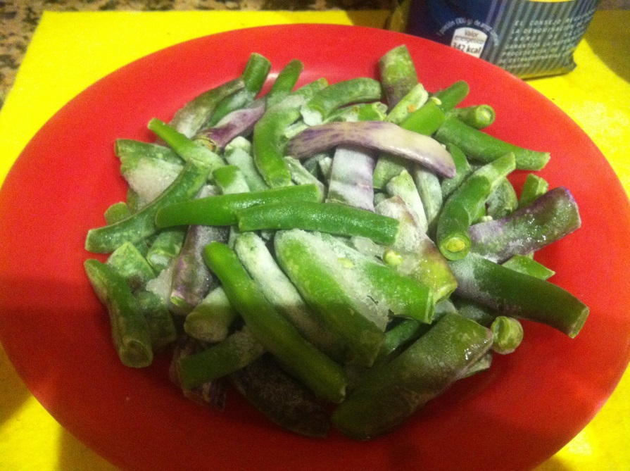
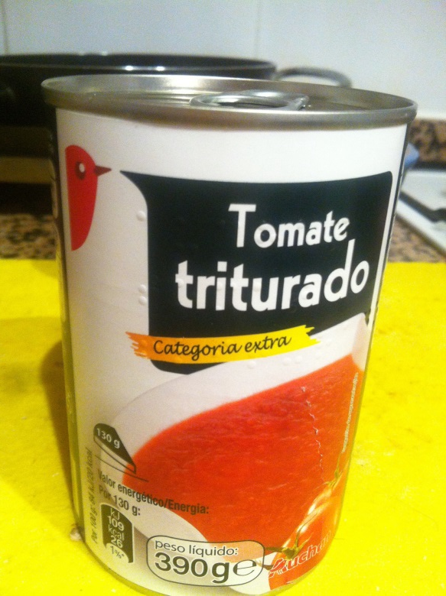
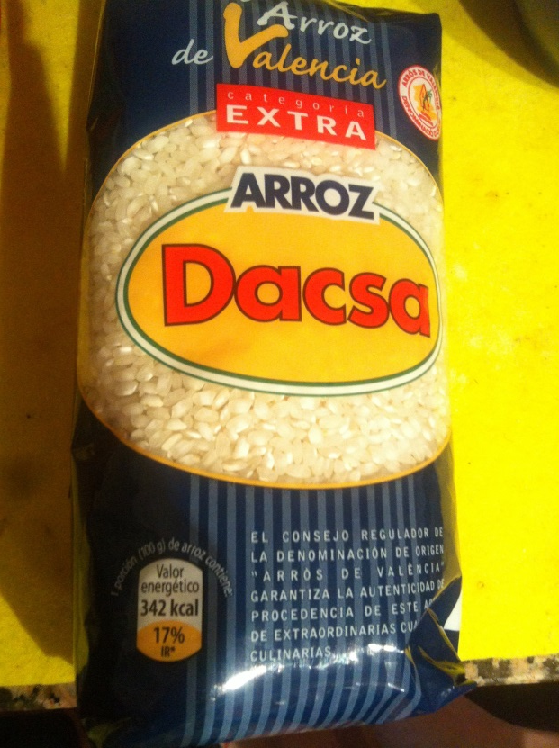
GARROFÓN
GREEN BEANS
CRUSHED TOMATO
RICE

Slide 4
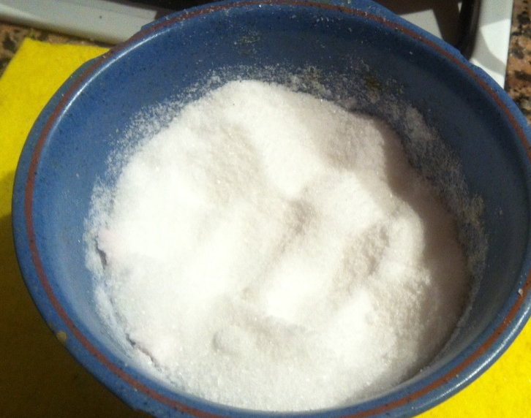
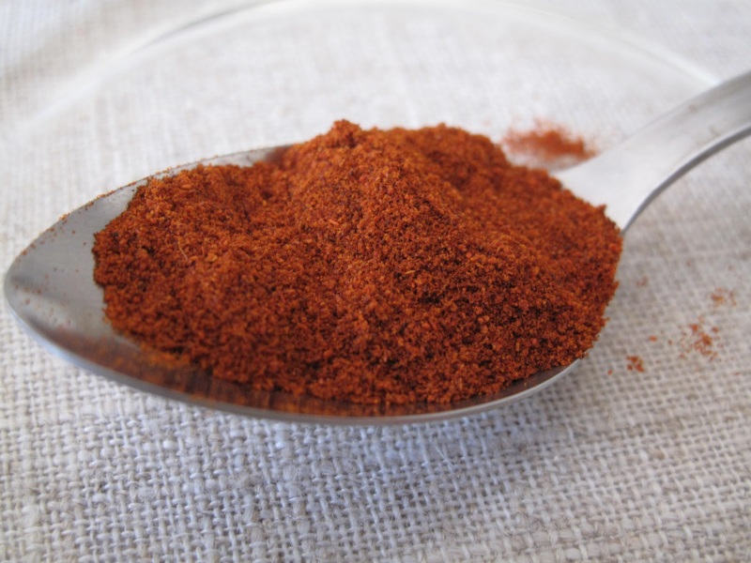
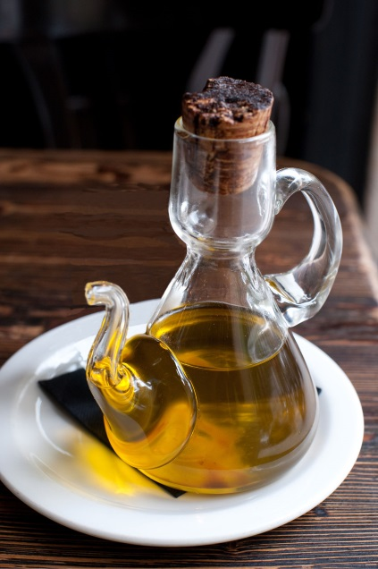
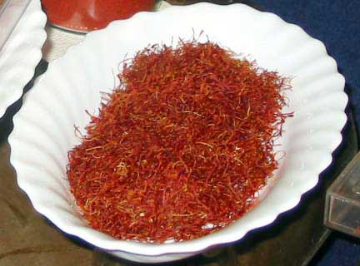
SALT
SWEET PAPRIKA
OLIVE OIL
SAFFRON

Slide 5
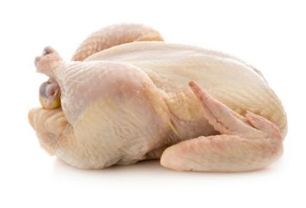
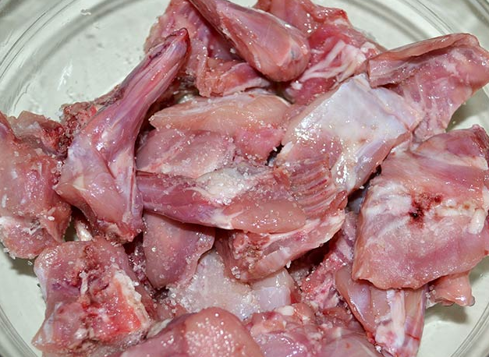
CHICKEN
RABBIT

Slide 6
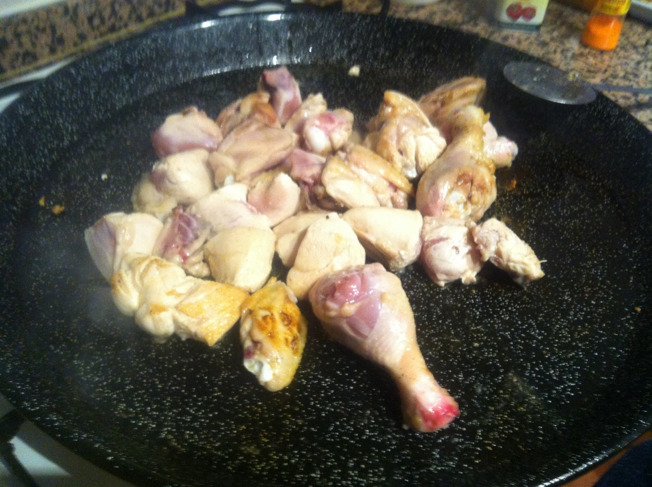
STEPS TO COOCK:
1. Pour in the oil paella and light the fire.
2. Put chicken and rabbit with salt to taste.

Slide 7
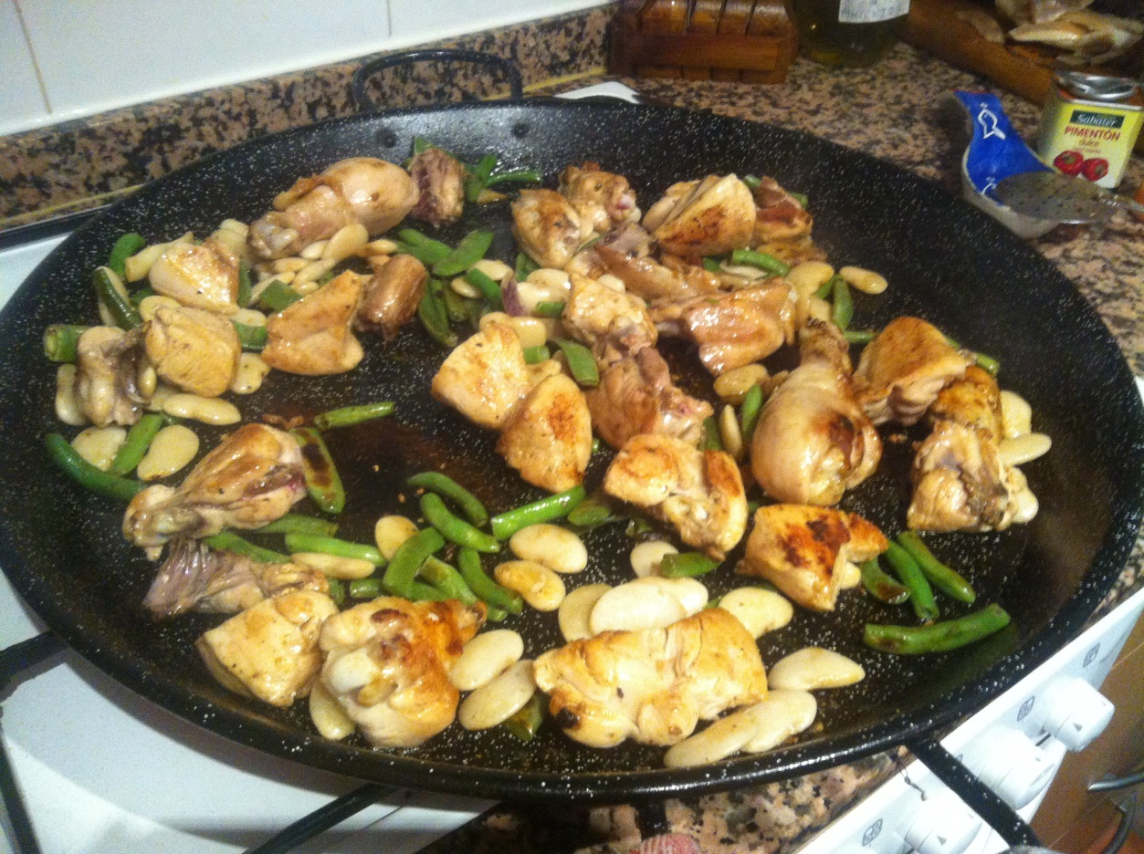
3. Let the meat brown.
4. Pour the garrofón and the green beans.

Slide 8
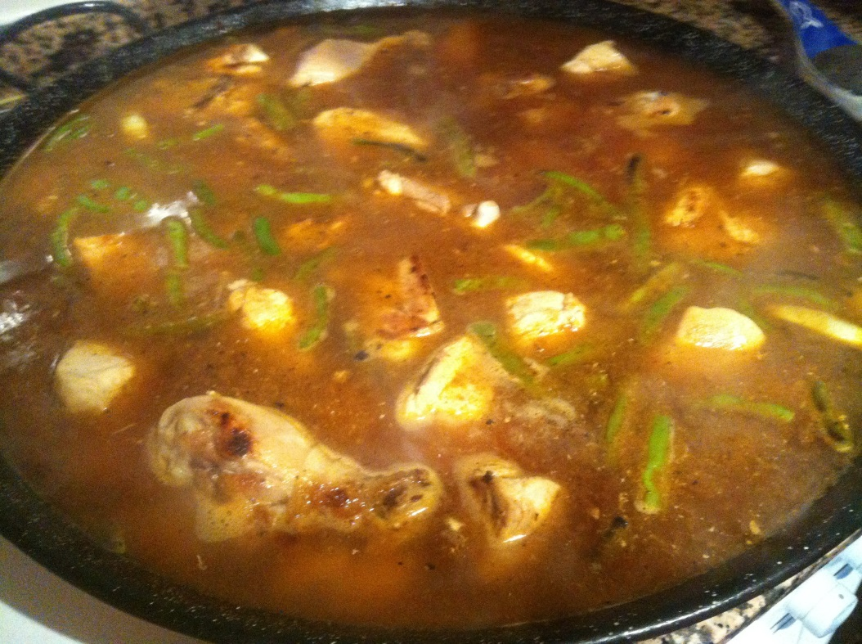
5. Add the crushed tomatoes and stir everything.
6. Add two teaspoons of paprika.
7. Add water (according to the paella)
8. When the water starts to boil, pour the saffron or food coloring.

Slide 9
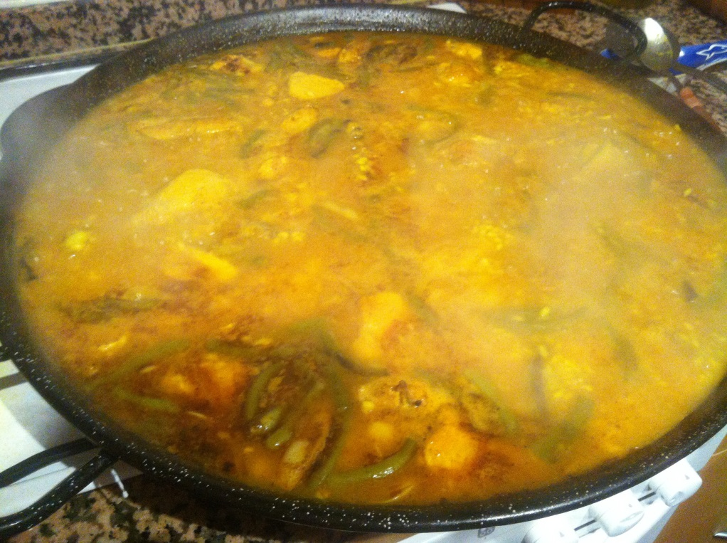
9. Pour the rice.
10. Wait until the rice is finished.
11. Test it to see if it needs more salt (according to the taste of each person)

Slide 10
12. Enjoy it!

