Slide 1


Self-motivation activity
Education team
Víctor Baños, Borja Cano, Mariano Sánchez, Maricarmen Mateo

Slide 2
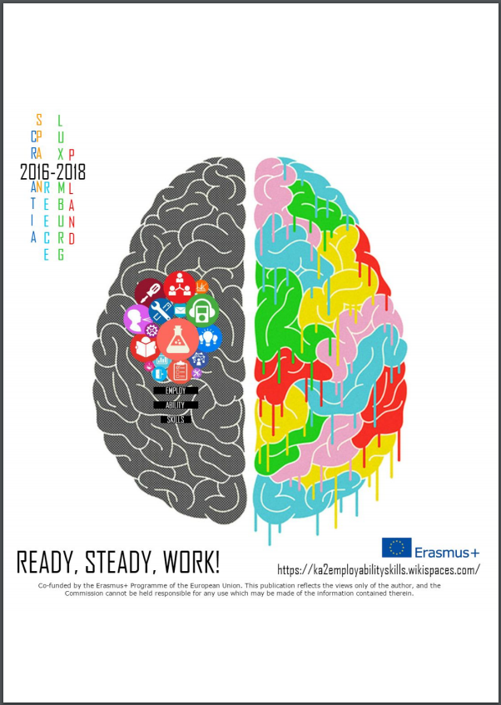

Slide 3
Excersice #1 bring face to face
Timing: 15 min.
Pupils: unlimited (even numbers if possible)
Location: Everywhere

Slide 4
Exercise #1 bring face to face
Goals:
  Getting relaxed before 2nd exercise.
  Turning stronger physically and mentally by tension and relaxation.
Action: In pairs, tension yours arms against your couple arms for 2 min.

Slide 5
Exercise #1 bring face to face
Goals:
  Getting relaxed before 2nd exercise.
  Turning stronger physically and mentally by tension and relaxation.
Action: After that you both feel relaxed, feel soft; like a plush toy. Now hug your friend, sharing your peace. Now, your are ready for the next exercise.

Slide 6
Exercise #2 MaxSelf-Motivation
Timing: 40 min.
Pupils: unlimited, sitting down in a circle.
Location: classroom

Slide 7
Exercise #2 MaxSelf-Motivation
Goals:
  Improving self-motivation
  Respect for others motto
  Knowing self-life-objectives
Action: Sitting down, close your eyes. Think about the good thing you have done last year. Things make you feel pride on you.

Slide 8
Exercise #2 MaxSelf-Motivation
Action: (with eyes close)
  Think about sentences you like. Sentences make you like you.
  Hug yourself very strong. Feel that feeling. Remember it.

Slide 9
Exercise #2 MaxSelf-Motivation
Action: By couples or trio:
  Talk about the things you have done last year that make you fell good.
  Talk about the things you would like to do this year. Feel the support of your mates.
  Talk about your strengths, as pillars to achieve your goal.

