Slide 1
Colors in art

Slide 2
Prehistoric art
It was found in the upper Paleolithic, it was the first art form.
The colors were obtained from nature.

Slide 3
Egyptian art
The painting technique consisted in mixing the pigments obtained by mineral compouns.

Slide 4
Greek art
Greek temples were decorated and painted.
The vase paintings in ancient Greece reached a high level of artistic quality. There were paintings with red figures and paintings with black figures.

Slide 5
Roman wall painting
The technique used was that of the fresco: the colors mixed with water, were applied on fresh plaster that drying fixed the pigment particles.

Slide 6
Gothic art
Frescoes continued to be used in Gothic art.
Architecture greatly increased the amount of coloured glass.

Slide 7
Medieval painting
The technique most used by artists like Duccio di Buoninsegna, was painting with tempera on panel with bright blue and bright colors (pink, yellow-gold).

Slide 8
Renaissance painting
In the Reinassance eggs began to be replaced by walnut or linseed oil as media. The use of oil and canvans supports permitted a wider variety of artworks. Italian Renaissance artists used natural chalks for drawing.

Slide 9
The impressionist revolution
Short brush strokes of pure pigment, primary colors (red, yellow and blue) in contrast to the complementary (green, purple and orange).

Slide 10
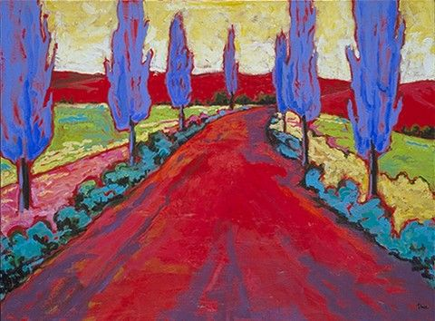
Fauvisme
The color is used in the most determinated and violent tones.

Slide 11
Neoplasticism
It is a painting that resembles a mathematical operation. Everything is based on the primary line, the plane and the primary colors.

Slide 12
Pop art
It is a type of art connected to meadia imagery: images coming from cinema, television, advertising, from magazines, from the urban landscape largely dominated by large billboards.
It portrays commonplace objects and people of everyday life.

Slide 13
Colours m@tter
ICS G. Perlasca – Bareggio, Italy
Gaia, Class 3B

