Slide 1
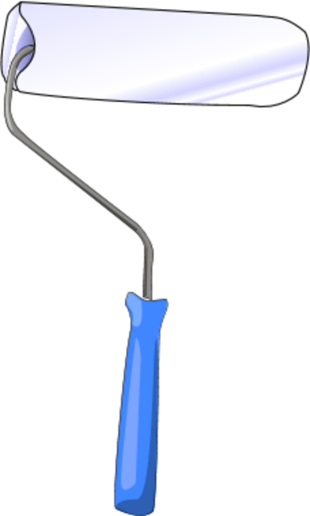
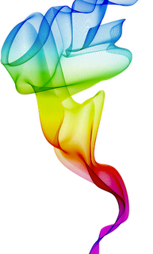
THE COLORS
Hello, I‘m Alessio and I’m happy like yellow flowers are;
Purple is smart
Green is the color of life
and light blue the colour of purity.
I say goodbye with a little bit of sadness, in gray!
I love colours and my favourite one is blue

Slide 2
I’m Marta. My favourite color is red because it makes me feel strong; the colors that I like the most are green, orange and blue. Green reminds me of nature and parks, orange reminds me of sun and summer, blue makes me feel sad because my dream is to live by the sea.
I’m Daniele. I like a lot of colours but my favourite is blue. I like blue because it is the colour of water. Water is very important to feed the planet.

Slide 3
I'm Ilenia and my favourite colour is light blue, it represents: the sky, the sea, the precious stones...you can get it with white and blue. I think that people who love light blue are calm and idealist and very close to their family. Light blue is a cold colour that gives me happiness, it's the title of a very famous song, too. It's a colour of heaven and of the turquoise, the preciuos gem stone. Light blue is the colour of the Italian Football National Team T-shirt. It's usually associated with boys.

Slide 4
I am Chiara and I’m 12 years old. My favourite color is red because it makes me happy.
I am Federico and I’m 12 years old, for me light blue is the best colour because it is happiness and good things.
My name is Noemi and I am 12 years old. My favorite colors is light blue because it gives me peace and harmony. I also like green and red.
All colors are beautiful and cheerful except for black I associate with sadness.

Slide 5
Hello I am Antonella and I am 12 years old.My favourite color is blue because it is everywhere and makes me dream when I close my eyes. However I like all colours.
Hi, my name is Irene. My favourite color is green because even in the bad days thinking about the green makes me happier. My second favourite color is light blue because it reminds me of the calm sea. My third favourite color is yellow: because it is a source of heat. Another color I like is blue because it reminds me of a sky with a cascade of stars. I also like red because it reminds me of the fire burning in the long winter evenings. I like brown because it is the colour of chestnuts. Black for me is the end of something that has no hope. I love colors !

Slide 6
Hello, my name is Martina, I am 12 years old. My favourite colour is blue. I love light blue but I hate pink, I like orange and I don't like green.
Hi, I'm Federica, I'm 12 years old, I live in Bareggio, near Milan. My favourite colour is orange because it reminds me of the summer. I like other colours too, like light blue and yellow. Usually who loves orange is optimistic, sincere and generous. I really like colours because they make me happy.

Slide 7
I am Nicoleta, my favourite color is white. I like it because it is the color of purity, it represents peace, wisdom and reminds me of the pearls.
I also like Orange because I think it is a symbol of inner harmony, artistic creativity, confidence in themselves and in others.
Hi, my name is Chiara, I am 12 years old. For me the colors represent emotions…
Red love, green hope, black death, pink passion, gray sadness, light blue peace and finally blue happiness.
But my favourite color is and always remains blue.

Slide 8
Colours m@tter

