Slide 1
Colours m@tter ICS Perlasca – Bareggio (Italy) Class 3A team

Slide 2
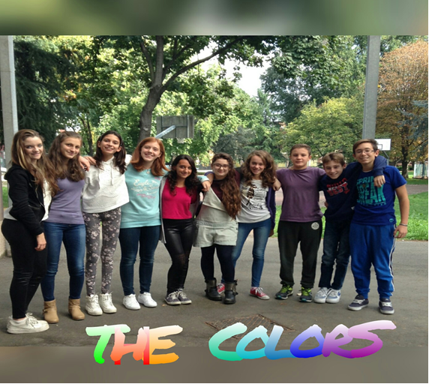

Slide 3
I am Morgana, my favourite color is yellow, because it is the color of sun, summer, fire... and HAPPINESS ! I love every thing that is yellow, especially the sun; in fact, in the summer I like lying in the sun and I relax. I think yellow is my colour, because I like to be happy and relaxed.
I am Camilla,
my favourite color is yellow because I love the sun. This color for me is the spring color, it is a color that gives me a positivity feeling, and I see myself in this.
(as soon as I was born my grandparents gave me a yellow dress and it is very important for me. )

Slide 4
Hi, my name is Giulia,
I am a sociable girl, I like staying with people and I like talking very much!!
My favourite color is yellow. This color reminds me of the summer, enjoyment and the friends that I met during my holidays. It is a bright colour like me!!
I have a pair of yellow shoes, too.. I like them!
My favourite color is light blue. This color is the colour of the sea and I love the sea!! And it reminds me of my swimming pool, often I invite my friends to have a bath in that.
I love the summer!

Slide 5
Hi, I'm Gaia.
My favourite colors are orange, green, blue and yellow. I like orange because it is similar to my hair!!! Blue and green because they are the colours of nature and they remind me of the sky and grass. I like nature because in it I feel free and I can play and have fun with my friends!!! I also like yellow because it reminds me of the summer and it is a very bright and vibrant color!!
Hello, my name is Marta
I’m a cheerful girl … as my favourite color: orange. It is my favourite color because it reminds me of a hot orange juice in summer and a sunset on the sea. It makes me feel happy ! ! !I love athletics, and orange is the track where I run. In winter my mum cooks a delicious soup with pumpkins and I love it.

Slide 6
I am Samuele,
My favourite color is orange because when I see something orange
I think of happiness and fun…
Hi, my name is Riccardo.
I’m 13 years old. I'm very nice and friendly. My favourite color is orange. I hate brown.

Slide 7
Hello, I’m Melissa…
I am a joyful and cheerful girl; my favourite color is red and all its shades because it reminds me of the summer and the sun shining! In the summer, I eat the fruits of all colors, especially red like the peach… I love them because they are rich in fiber and very good!
Hi, I’m Gabriele.
My favourite color since I was little is red. I like it because it makes me feel fine and happy. I am always hot, even in winter, so I am always “red”.

Slide 8
I am Aurora, my favourite color is blue. This color reminds me of the sea and the sky. It gives me joy and happiness. Another color that I like is green because it gives me a sense of hope. Yellow reminds me of the summer, the sun and the hot. I also like red because makes me think of friendship and love.
Hi, my name is Greta and I'm 13 years old.
My favourite color is light blue since I was little because it relaxes me and it reminds me of the sea and the sky.
This color represents me because I am very quiet and a bit shy.

