Slide 1
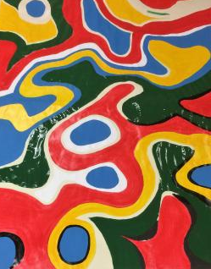
A8 – A kind of project…
Notes:
Create an outline to get ready:
Introduce the era (Use a mix of media and text)
Organize your artifacts to outline what life was like during the era you are presenting
Think about using a storyboard to outline your images and ideas
Make sure you prepare a clear and well rounded presentation of all aspects of the era (People, jobs, food, transportation, etc. What else should you include so the audience feels like they have visited your era?)

Slide 2
So different.. Working together

Slide 3
Once upon a time…
Someone asked us what ODD means…
And we asked some from Special Needs Pupils to answer the question…
And they started to try finding some explanations.

Slide 4
ODD is ?
Trying to find the meaning of odd…

Slide 5
Include an iconic picture from the era.

Slide 6
Meanwhile…
A group of some very good drawing pupils started to draw and paint something really ODD!!

Slide 7
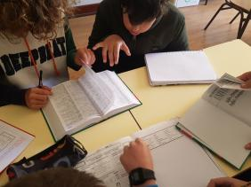
After…
Some English students translated into English the hard work of the Special needs Kids

Slide 8
Drawing

Slide 9
Painting

Slide 10
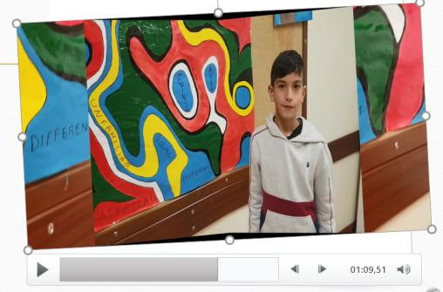
The Final Work…
To show how great it was and how all worked together, the specialists at computers did the shoots and this production to show you how all of us can work to a great combined work.

Slide 11
The End !!
That’s all Folks

