Slide 1
Spyros Louis
The first Marathon winner

Slide 2
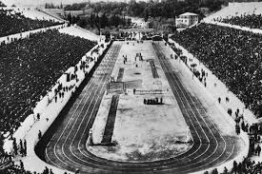
Olympic games 1896 - Marathon
The first Olympic games of contemporary times took place in Athens
14 countries participated
Organized by the French educator and historian Pierre de Coupertin

Slide 3
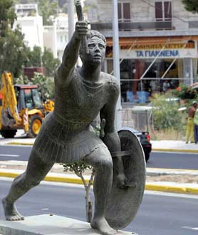
Men’s marathon game
New game
Organized to honer Pheidippides who died to announce the Greek victory against Persia
Length about 40Km

Slide 4
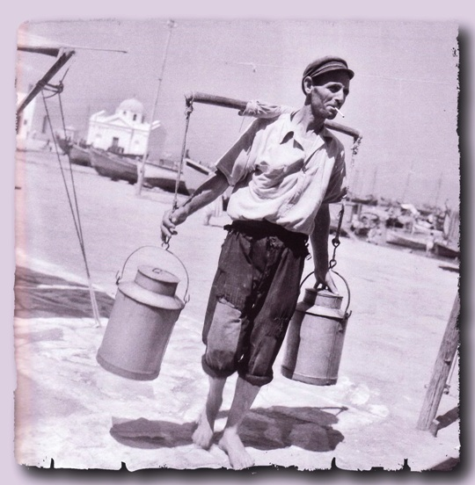
Spyros Louis
Louis was born in the town Marousi, near Athens, on 12 January 1873 into a poor family.
Louis’ father sold water in Athens, at the time lacking a central water supply, and his son helped him by transporting it.

Slide 5
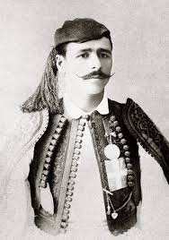
Engagement with Eleni
Louis was in love with a woman named Eleni, but her parents were against their wedding because he was poor.
If he managed to do something great, then maybe they will let him marry her.

Slide 6
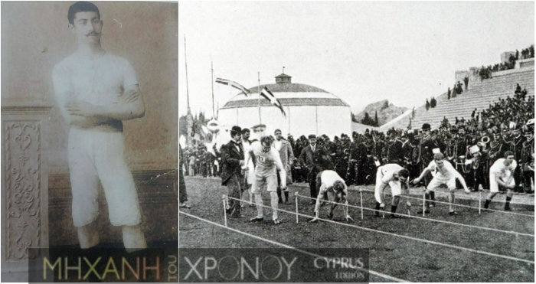
Preliminary games
Louis was in the army at the time of the Olympics
His commander believed in his strength and encouraged him to participate
He was the last to pass the preliminary games

Slide 7
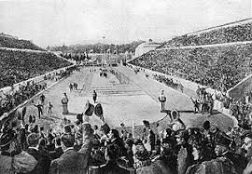
The race
Because of his job he was used to long runs
The professional runners never run over 5km
When the first in the race fell down, he was 2km behind him
He saved powers and managed to finish first

Slide 8
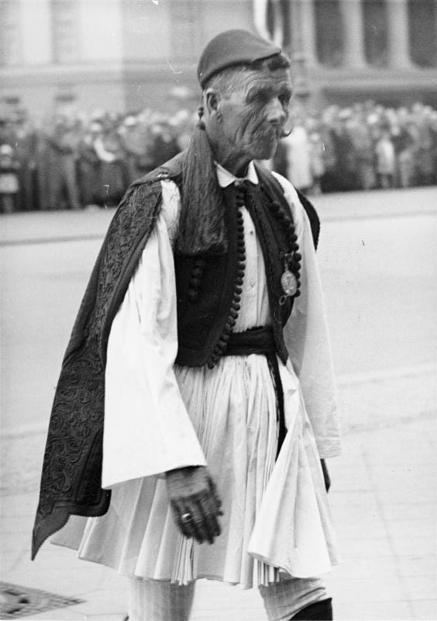
The end
Louis won a cup, a metal and Eleni
People were happy that a Greek won the first marathon race
People were also jealous. When he later became a policeman, he was accused of fraud and went to prison. He was finally proven innocent
He travelled, as an honor, to the Olympic games in Berlin in 1936.

Slide 9
The end!

