Slide 1
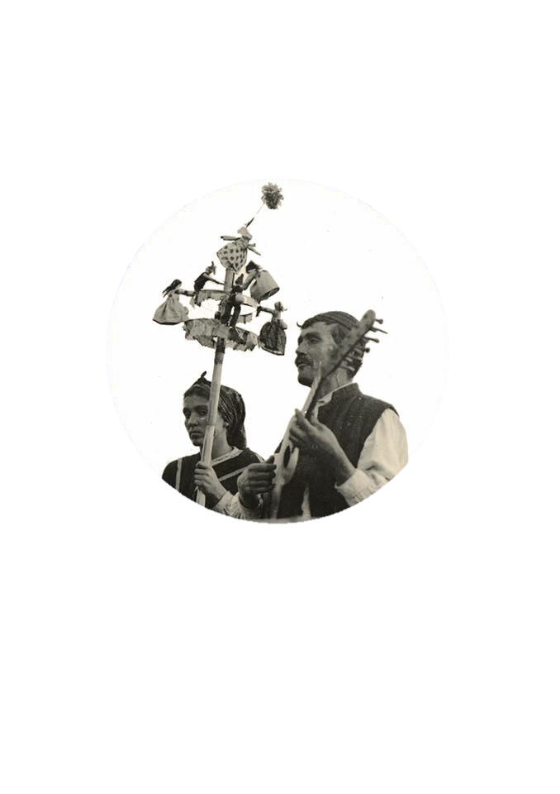


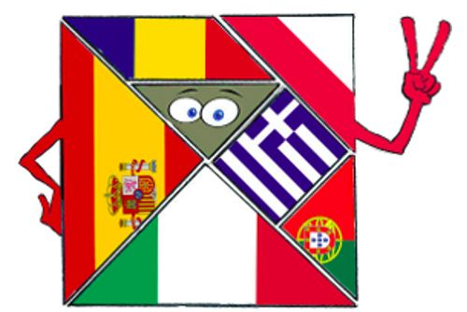

O Feiticeiro da Calheta
The wizard of calheta

Slide 2
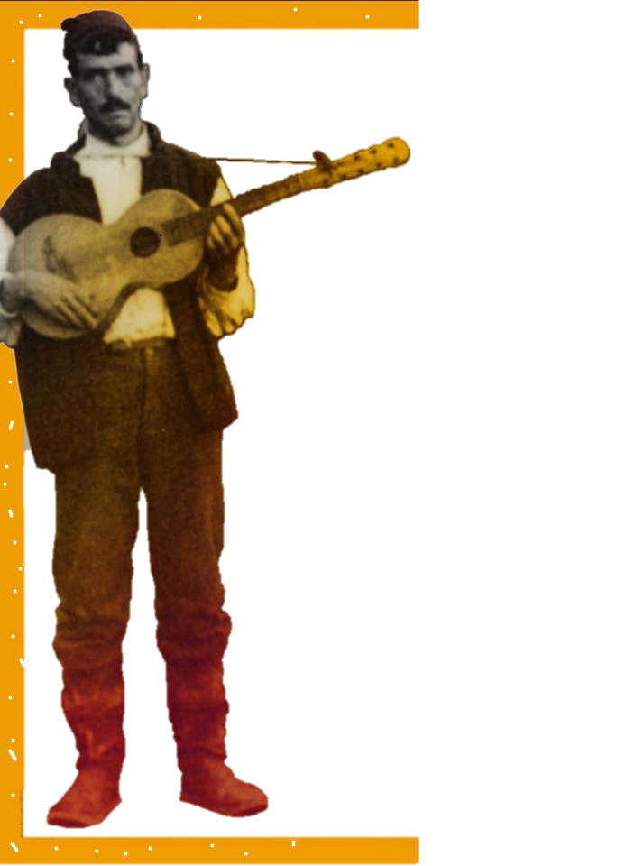
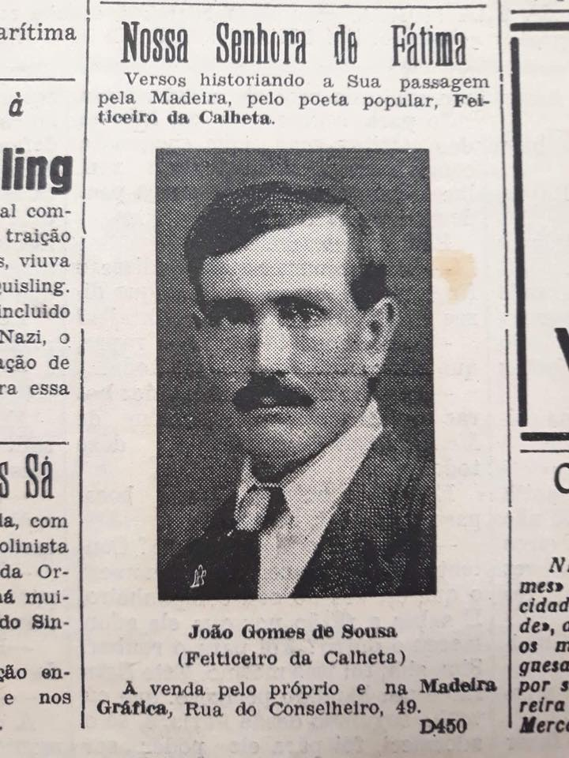
Notes:
João Gomes de Sousa was born in Calheta, on the West part of Madeira, in 1895 and died in 1974.

Slide 3
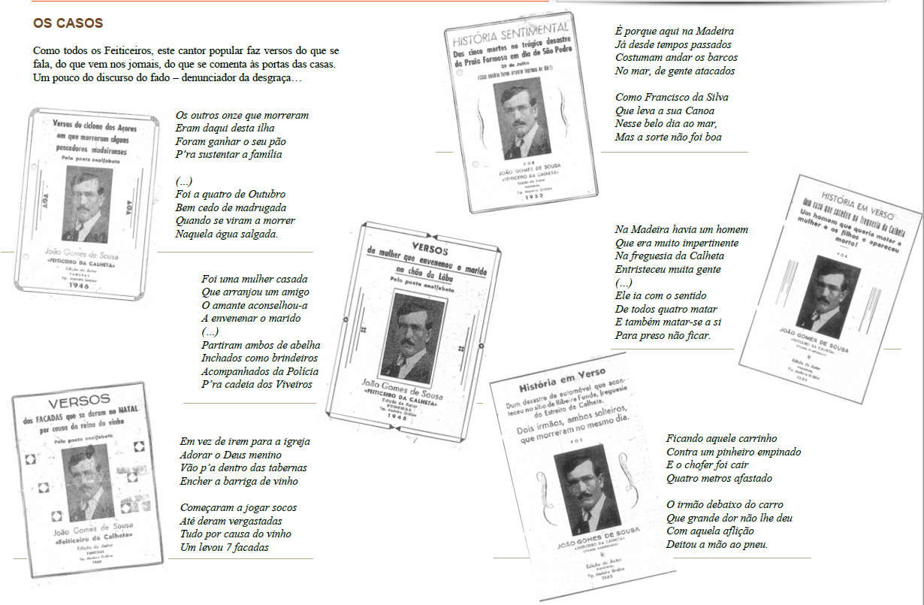
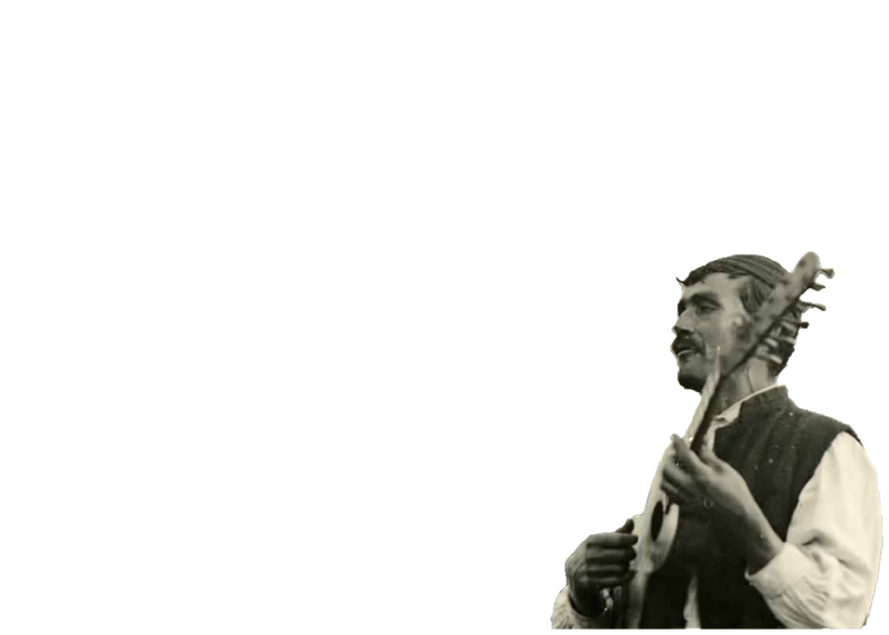
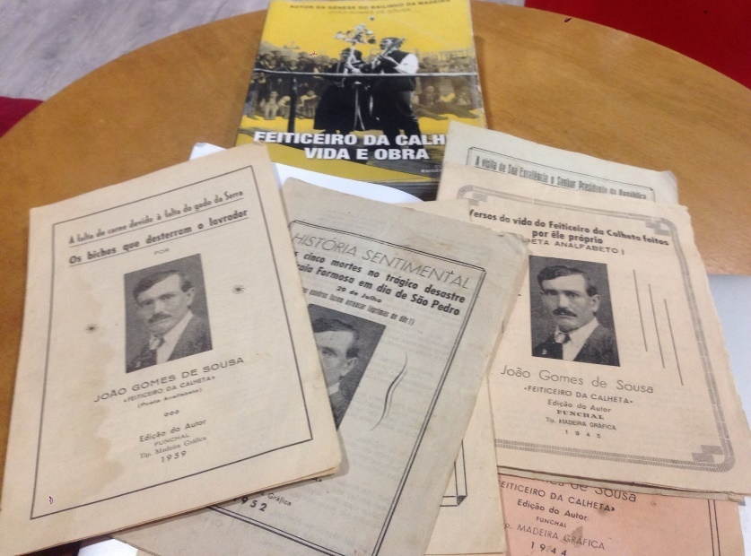
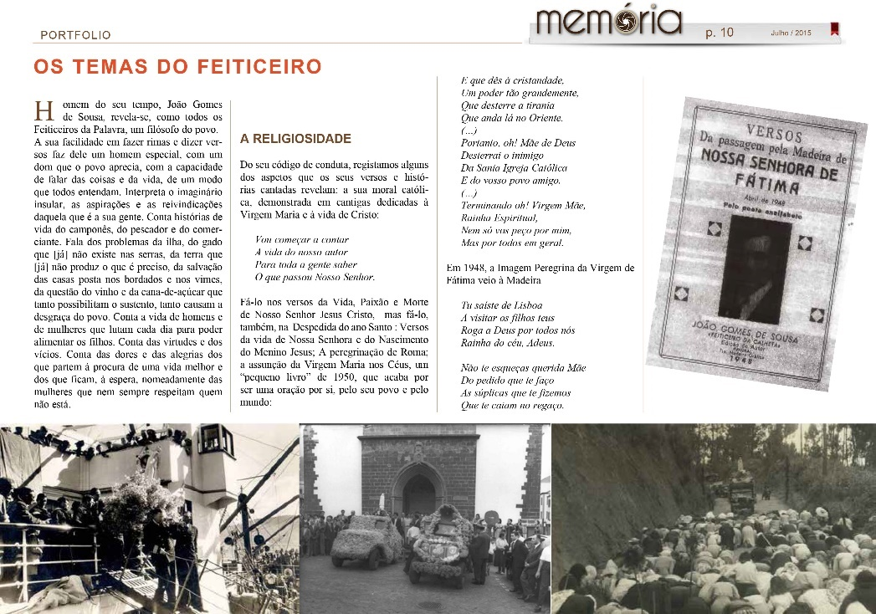
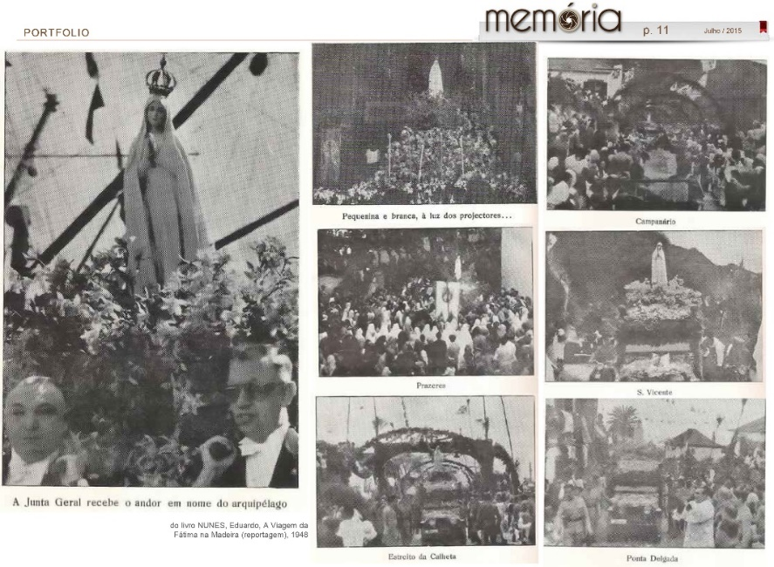
Notes:
He was poor and illiterate but revealed a great ability to create verses and rhymes, telling stories and events of his time, which were printed in pamphlets.

Slide 4

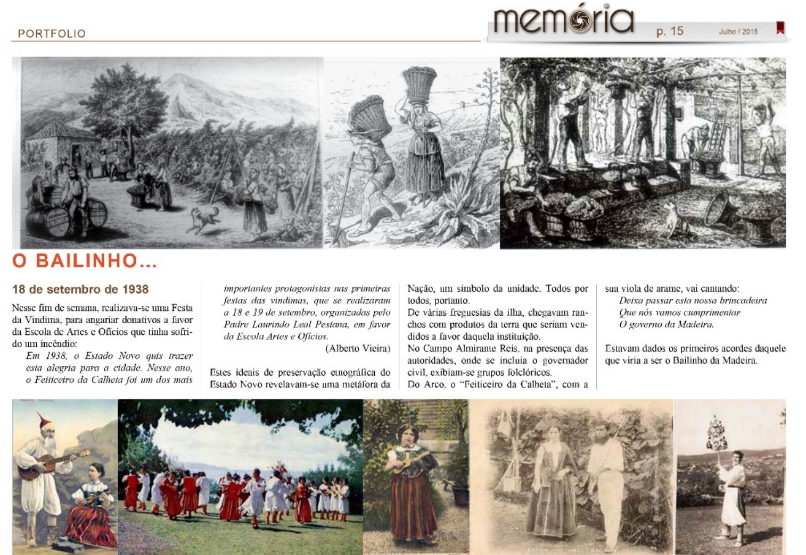

Notes:
The Madeiran poet João Gomes de Sousa is a popular figure, known as the Wizard of Calheta. He was the author of the “Bailinho da Madeira”, one of the best-well known Portuguese folklore song in the world.

Slide 5
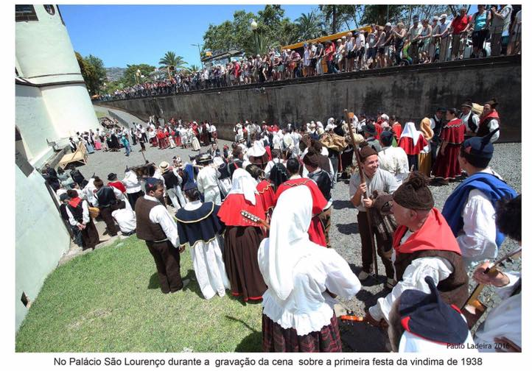


Notes:
He was also known as one of the promoters of the first Wine Harvest Festival in 1938, singing and playing his famous verses to portray Madeira, its people and the island's natural heritage.

Slide 6
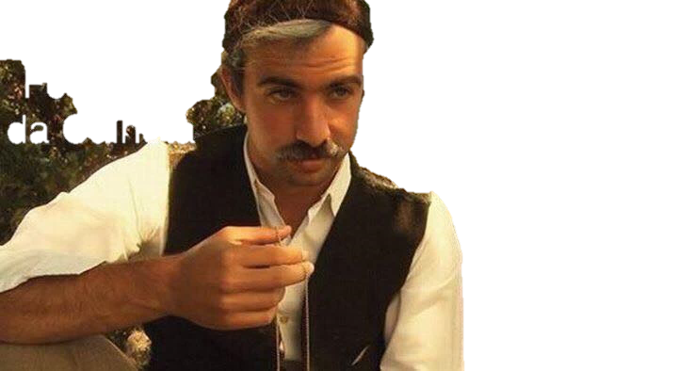
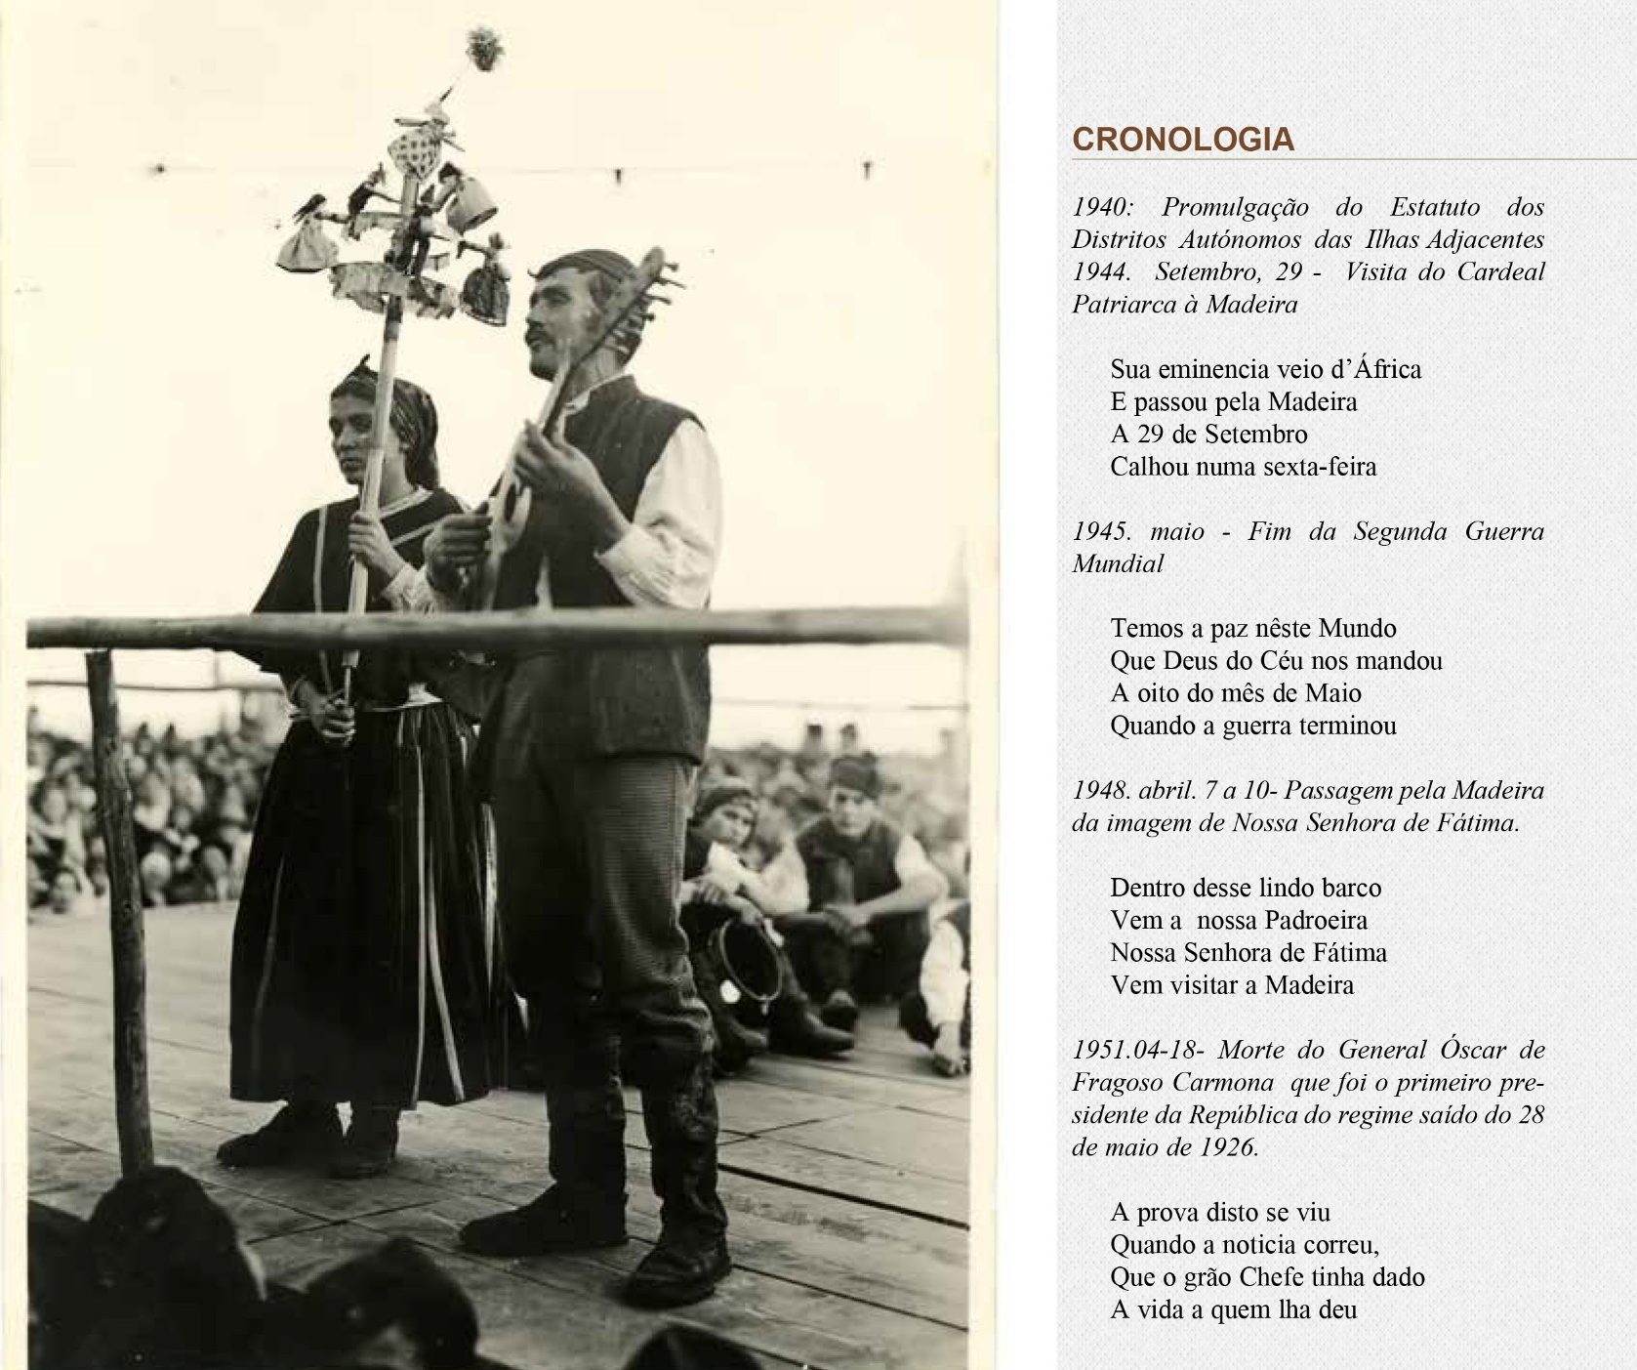
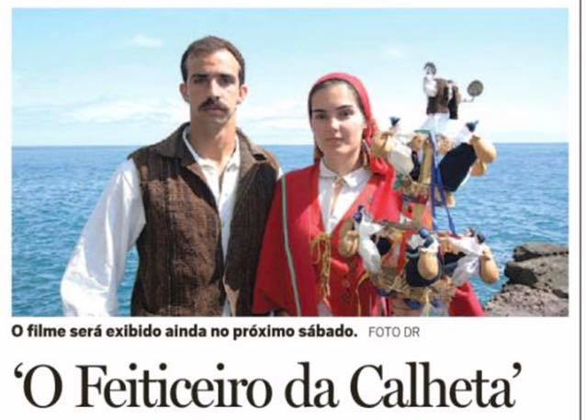
Notes:
The Wizard of Calheta became one of the greatest names in Cord poetry and Madeiran folklore music, because he had the ability to write and sing his poems in such a way that enchanted people.

Slide 7


Notes:
His well-known work was gathered, in 2015, in a book, Feiticeiro da Calheta: life and work, João Gomes de Sousa.
Last year a film about the life and work of this Madeiran poet was presented to public with great success.
And now we will show you the trailer of the film O Feiticeiro da Calheta.
Enjoy and thank you very much for your attention.

