Slide 1
Erasmus +
The odd one …in Literature

Slide 2
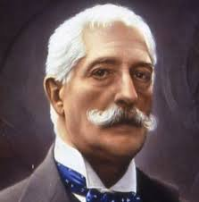
GIOVANNI VERGA’S NOVEL

Slide 3
Giovanni Verga, born in Catania in 1840, is a Sicilian novelist and short-story writer, most important of the Italian verismo (Realist). His reputation was slow to develop, but modern critics have assessed him as one of the greatest of all Italian novelists. One of his best known novella (short story) was Rosso Malpelo.

Slide 4
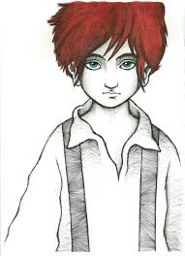
I’m Rosso Malpelo
Everybody calls me
Rosso Malpelo Because of my hair

Slide 5
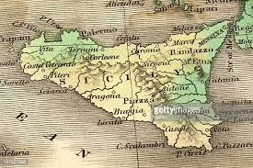
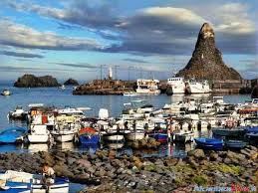
SICILY
ACITREZZA

Slide 6
THE MAIN CHARACTERS
His Mother
His Father = Mastro Misciu
His Sister
His Friend= Ranocchio ( FROG)

Slide 7
ROSSO MALPELO‘S anger
-DIVERSITY= -DIVERSITA’
-MARGINALIZATION -EMARGINAZIONE
-MISUNDERSTANDING -INCOMPRENSIONE
-EXCLUSION= -ESCLUSIONE

Slide 8
The Plot
Rosso Malpelo is a short story by Giovanni Verga, the title 'Rosso Malpelo' is Sicilian for 'Evil Hair', a nickname which combines Rosso (Red) with Malpelo (evil hair), as Sicilians believed people with red hair were malicious and had an evil disposition. The story, written in 1878 is set in Verga's native Sicily and reflects the social and economic conditions endured by the poor working classes in Southern Italy at the time.

Slide 9
Summary of the short story
Rosso Malpelo is a boy whose real name is ignored by almost all , even the mother has almost forgotten. Neglected and mistreated by everyone including his mother and his sister .the hair grows initially as all the boys of his age but then he is convinced of being unpleasant and surly with everyone.
Things fall when Mastro Misciu named Beast, his father, dies and Malpelo actually begins to behave badly with everyone and to behave violent against everyone even going to beat his old donkey. His loneliness made only of hard work in a sand mine, however, is not destined to last because a boy named Ranocchio arrives at the quarry, he is very frail and inexperienced. Between the two it is born a strange tie it is a temporary consolation, Ranocchio after a short time gets sick of tubercolosis and dies. Now Rosso Malpelo is definitely alone without anyone taking care of him the boy agrees to perform the most unpleasant and risky tasks to the point that one day he walks into the mine, but is never seen again. His name becomes a legend amongst the miners.
MORAL
The importance of friendship to fight prejudice

