Slide 1
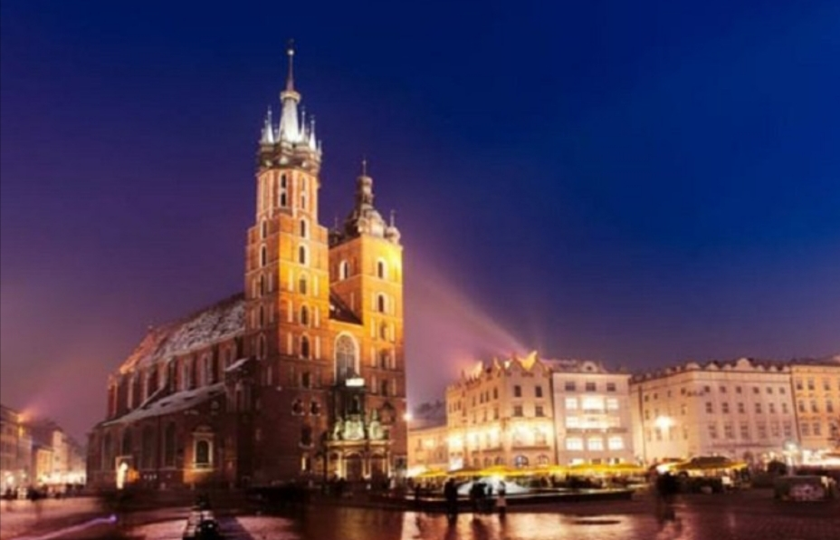
Our trip to Poland
Good morning, this year we, Marco and Beatrice, should have left for Poland precisely near Krakow but because of emergency Covid-19. We expected an environment different from ours featured of a cold climate and with food different from the usual one. We expected a school organized differently. We thought we would find a city with few monuments but then, watching photos on the internet, discovered that it is not so. In fact there are many monuments such as the old town, the concentration camp of Auschwitz and Wawel Royal Castle.

Slide 2
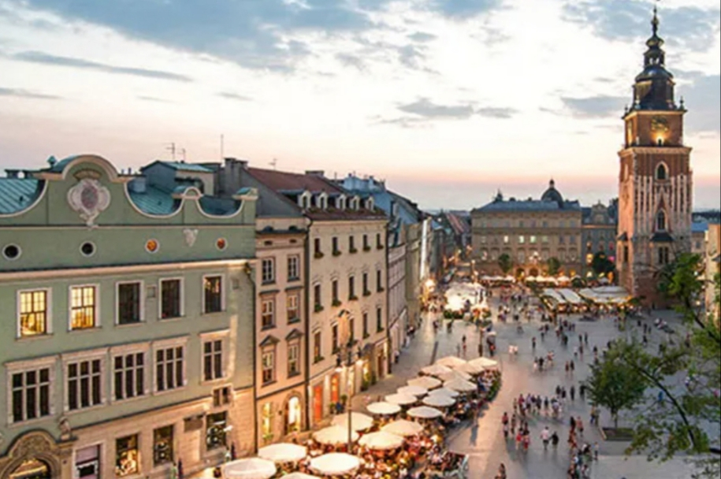
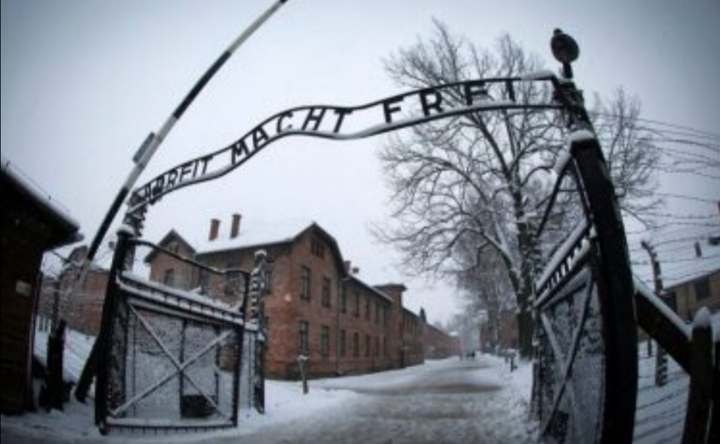
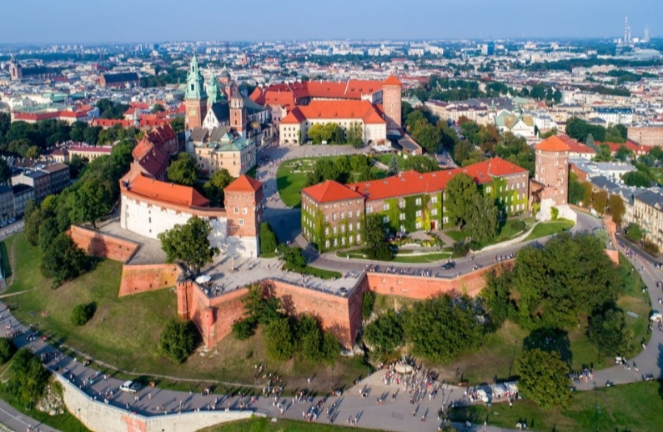
The old town
The concentration camp of Auschwitz
Wawel castle

