Slide 1
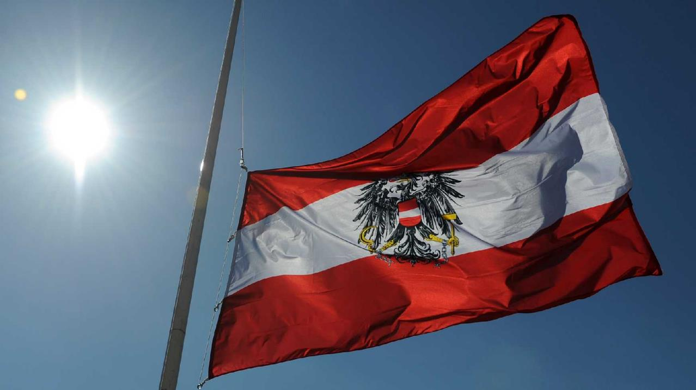
Austria
BG/BRG Kufstein Amaury, Yara, Nazli, Hannah, Annalena, Victoria, Rebecca

Slide 2
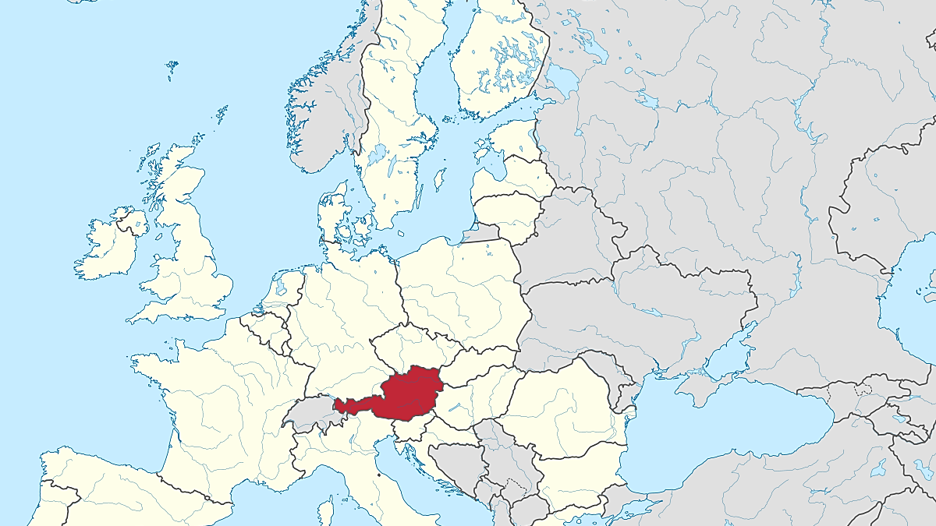
General Information
Capital city: Vienna (1,8 million)
9 federal states
8,8 million inhabitants
well-known for: Alps, Food, traditional costumes, dialect

Slide 3
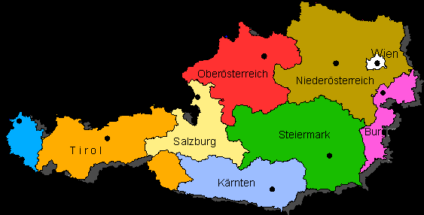

Slide 4
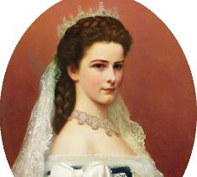
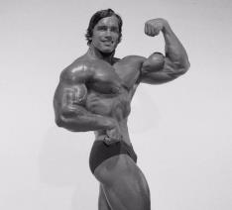
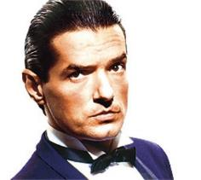
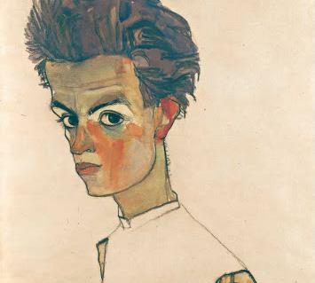
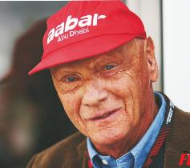
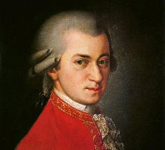
Famous Austrians
Wolfgang A. Mozart
Niki Lauda
Falco
Arnold Schwarzenegger
Kaiserin Sissi
Egon Schiele

Slide 5
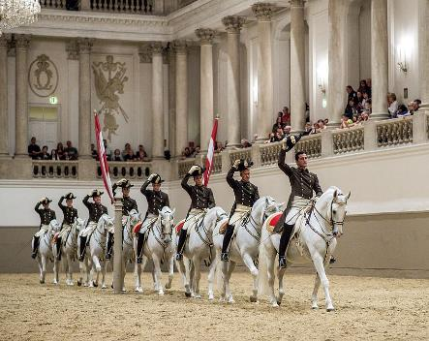
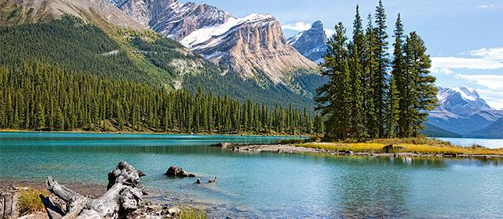
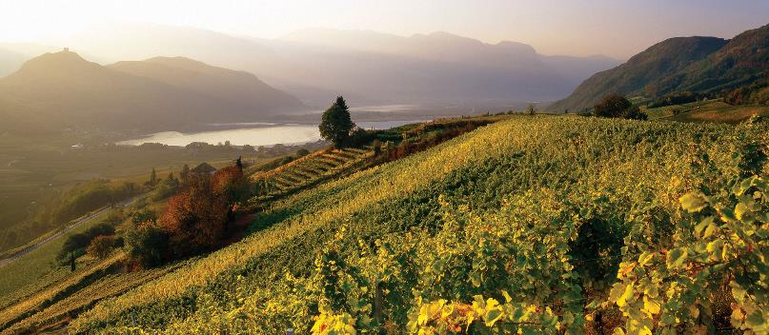
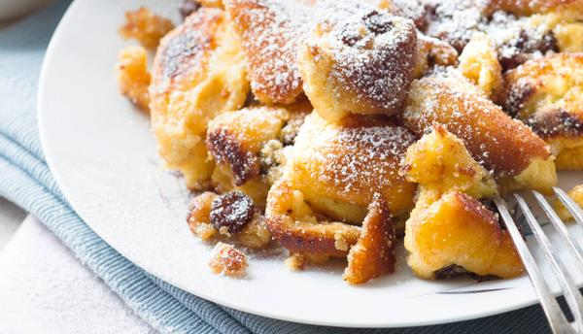

Slide 6
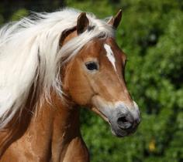
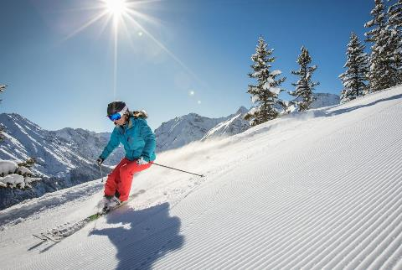
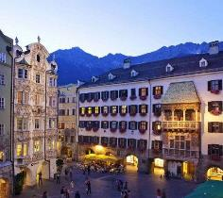
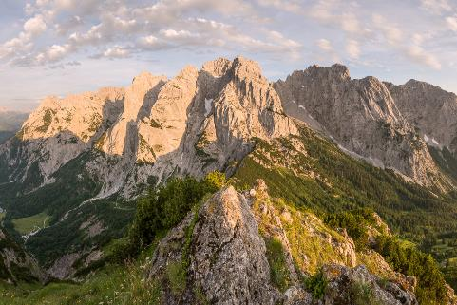
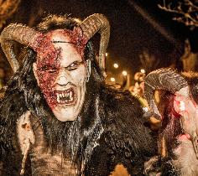
Tyrol
Capital city: Innsbruck
Haflinger horses
Skiing (famous race: Streif)
Mountains
Tradition: „Perchtnlauf“

Slide 7
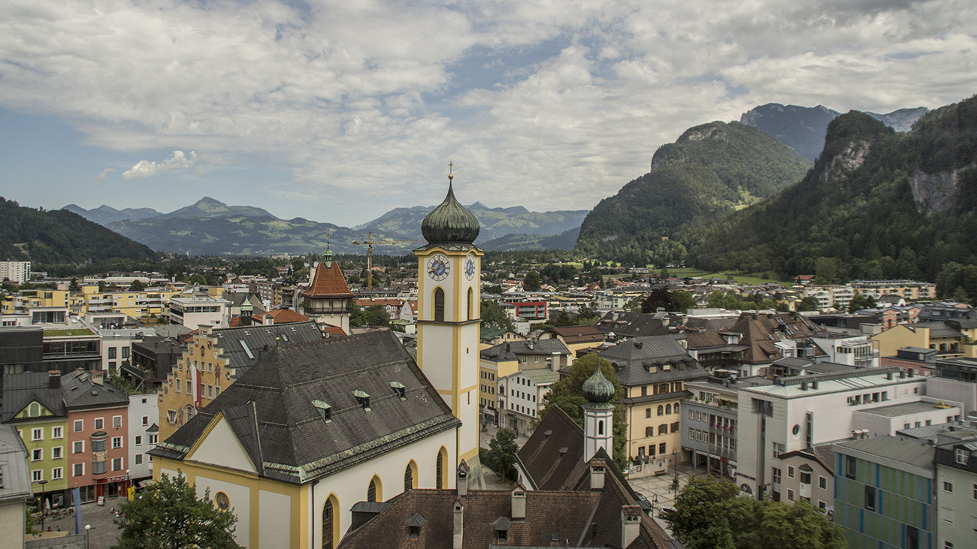
Kufstein

Slide 8
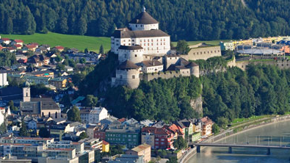
A small town with 19.223 inhabitants
Old castle from the 13th century in the city center
Much cultural diversity
Festivals, charity balls and street markets

Slide 9
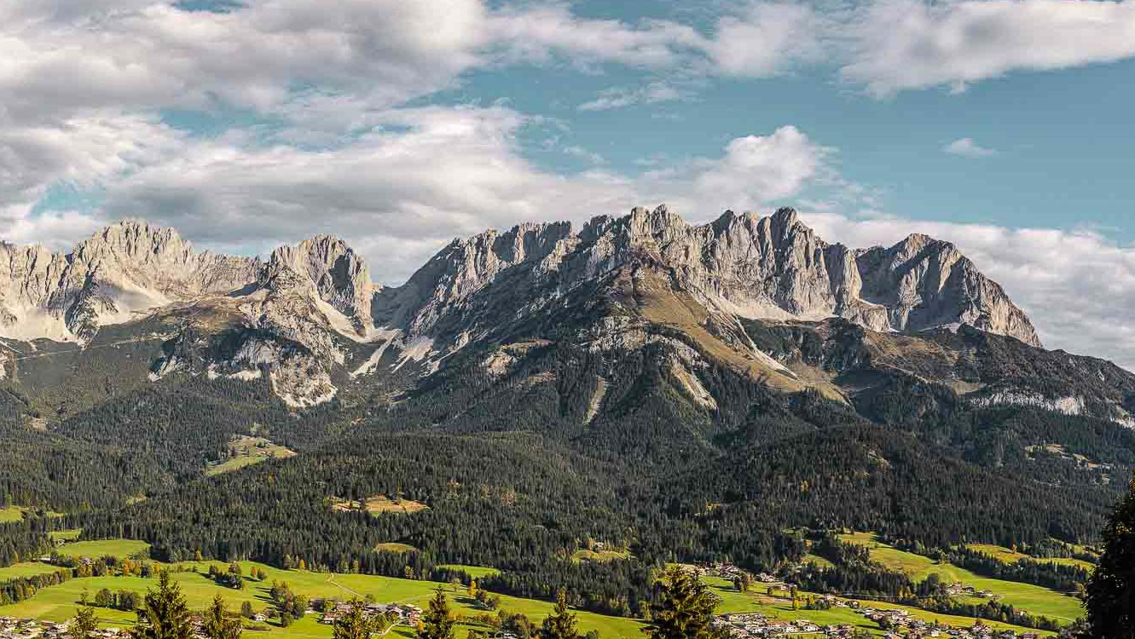
City located near the border to Germany
The most beautiful mountains of Austria

Slide 11
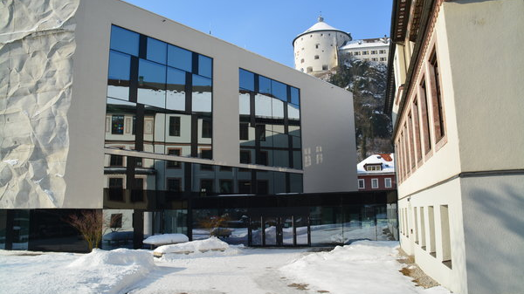
Our School
BG/BRG Kufstein

Slide 12
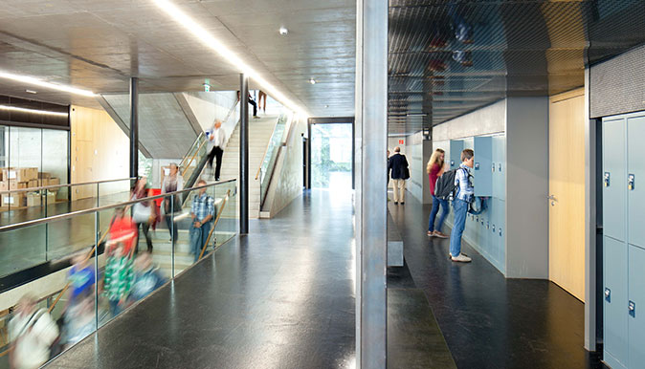
Founded in 1907
750 students (2/3 are girls)
languages: German, English, French, Italian, Latin and Spanish

Slide 13
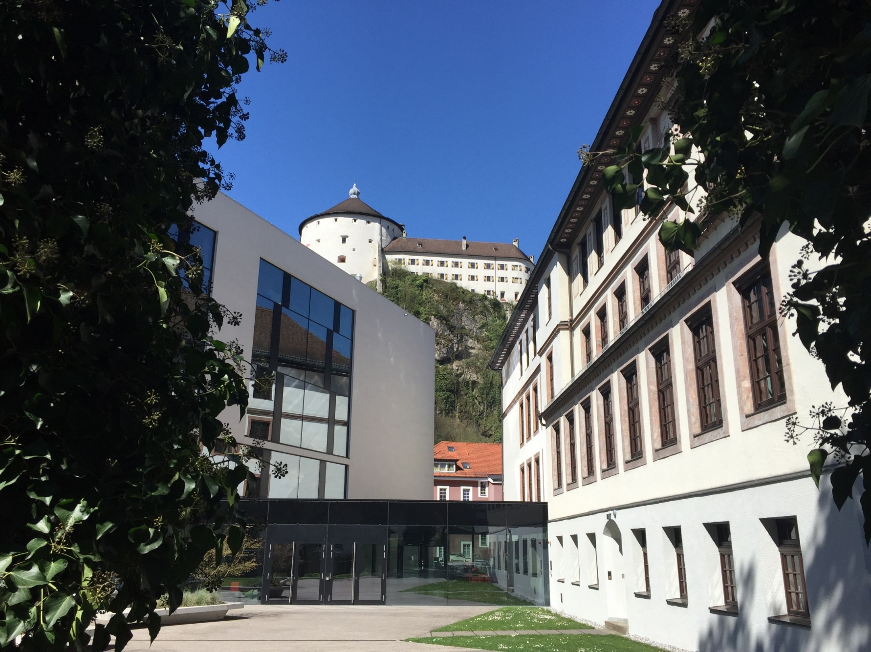
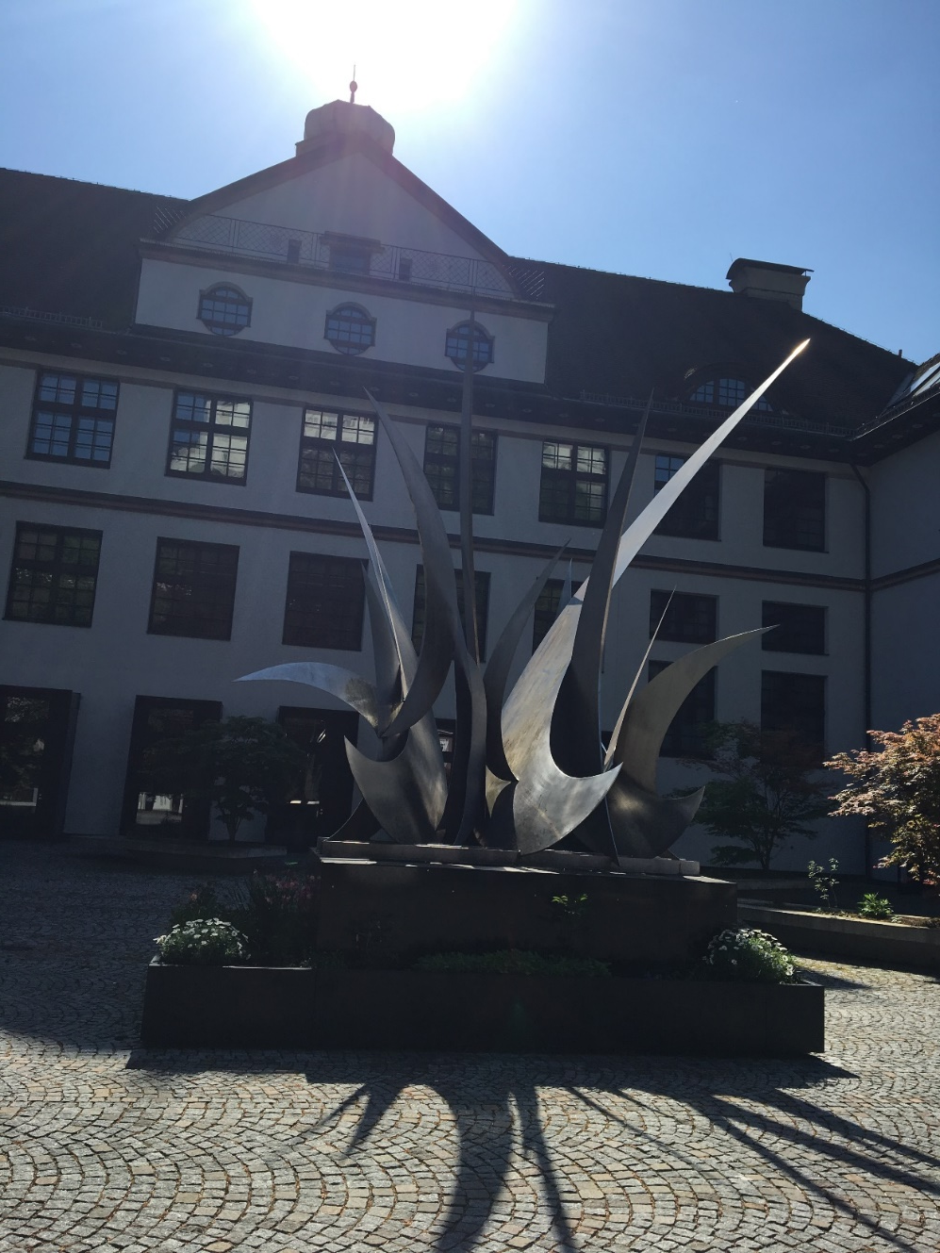

Slide 14
