Slide 1
Buxtehude
Our hometown

Slide 2
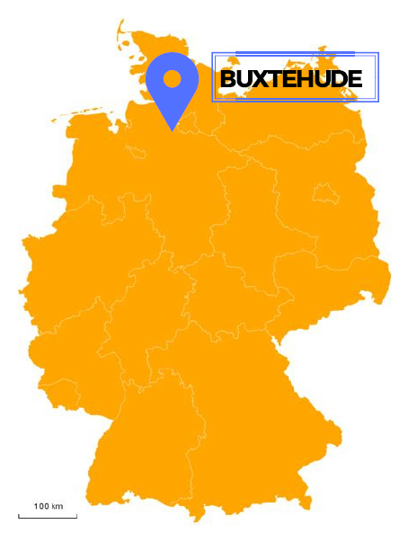
General facts
Population: 40.000 people
Near Hamburg
Known as a „fairytale city“
(„Hase & Igel“)

Slide 3
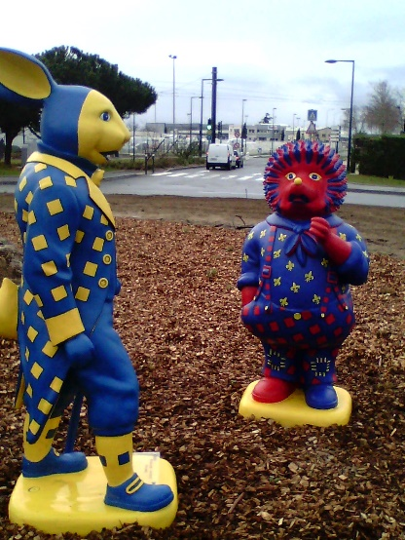
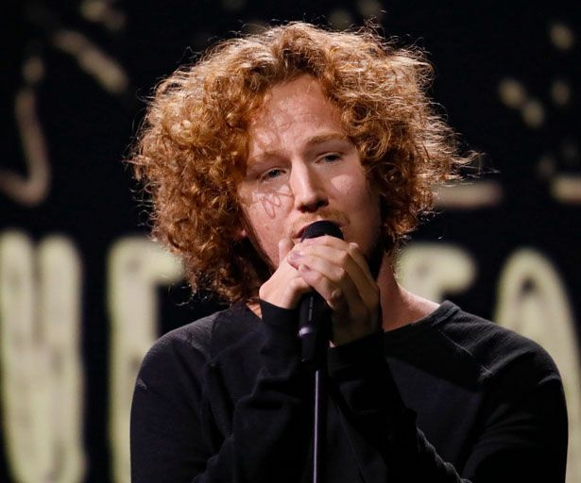
Specialities
Buxtehuder Bulle
Hanseatic town
Twin town of Blagnac
Michael Schulte

Slide 4
A short guided city tour

Slide 5
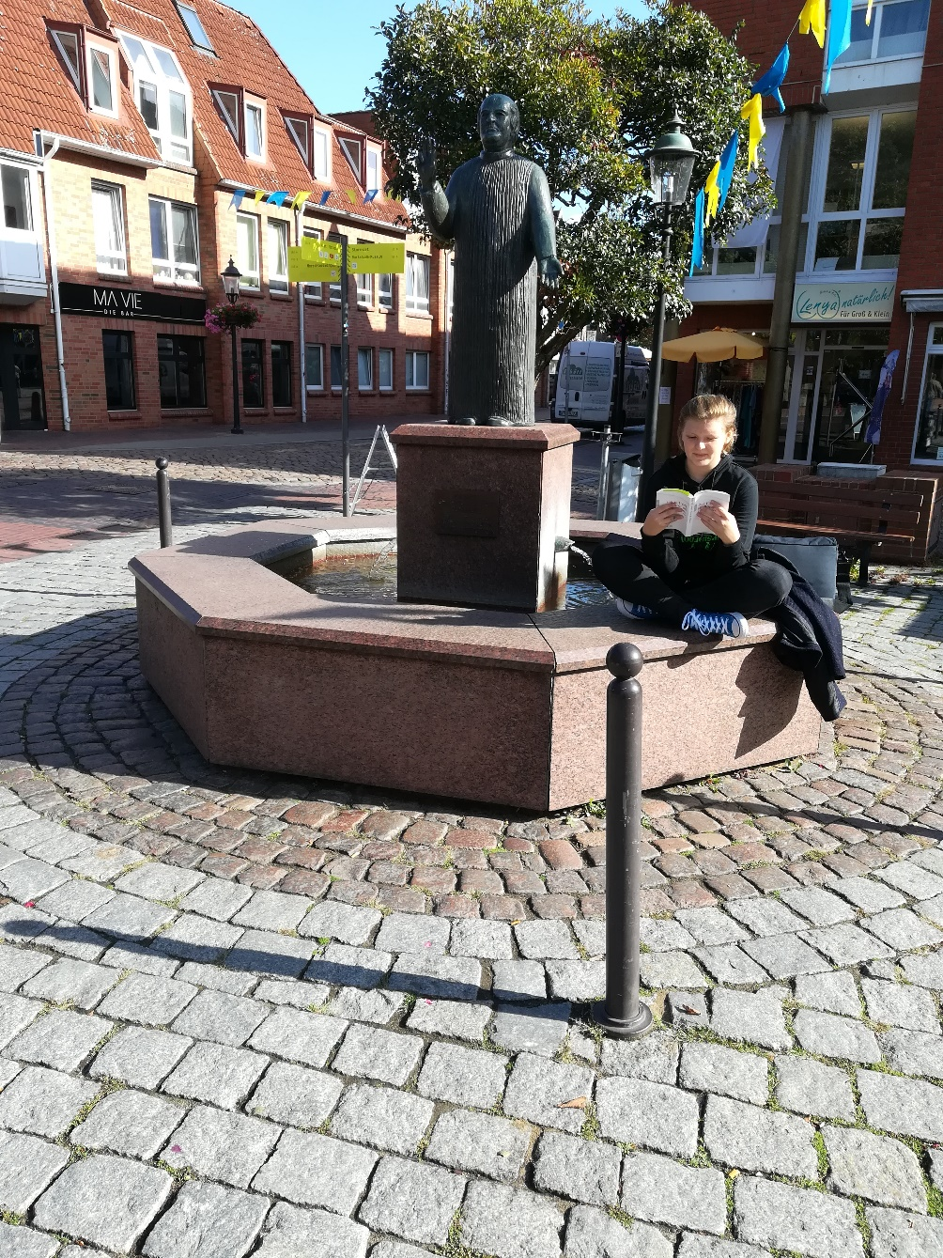
Halepaghen-Brunnen / Halepaghen-well

Slide 6
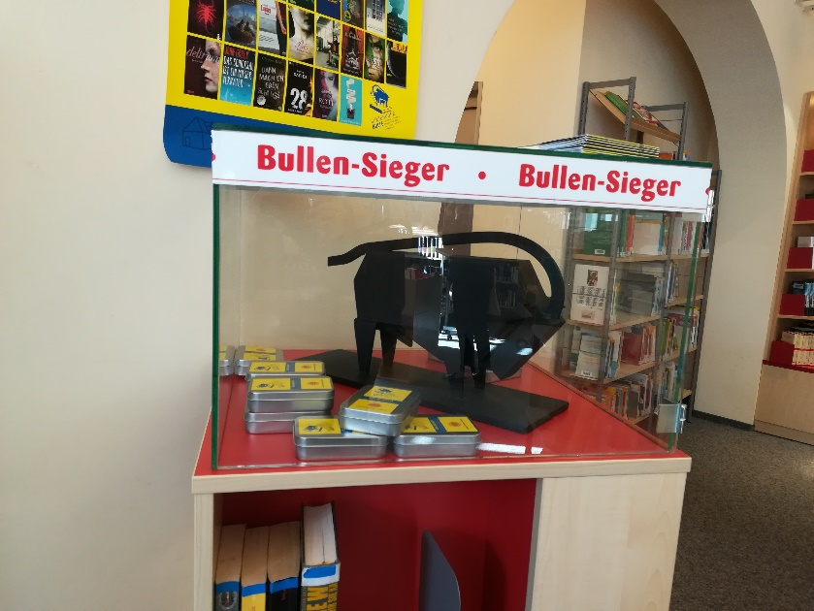
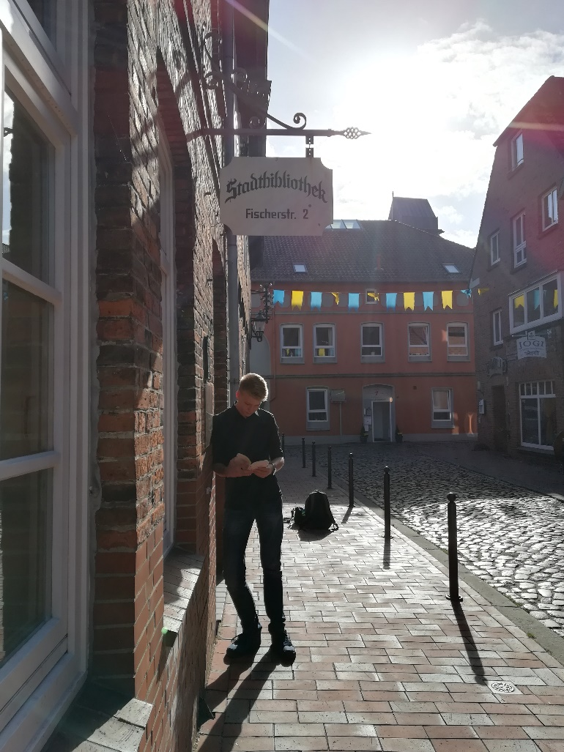
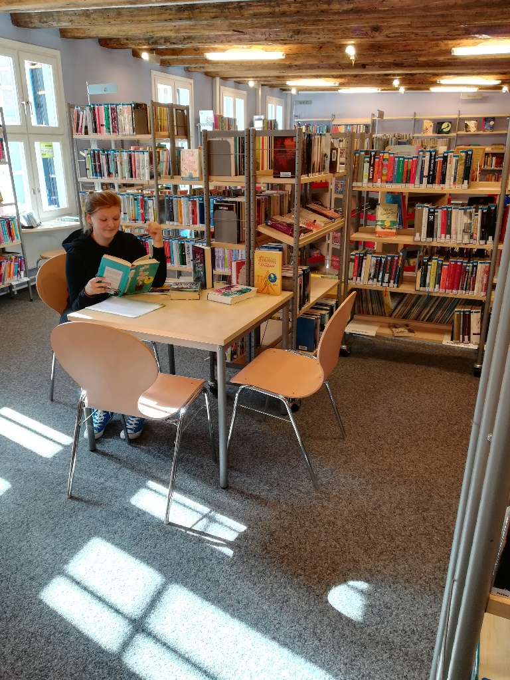
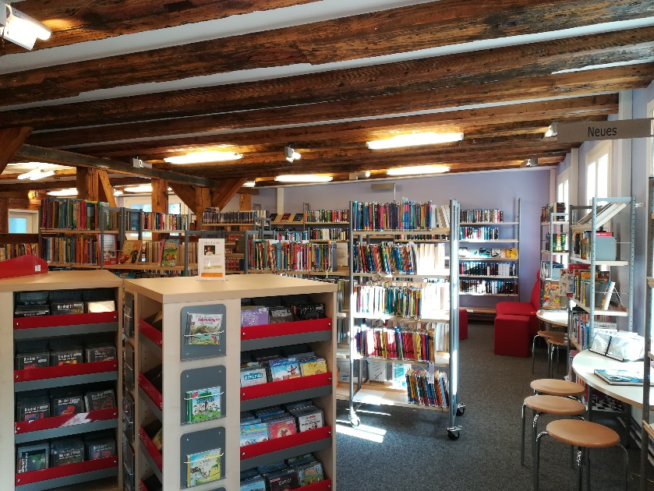
Library

Slide 7
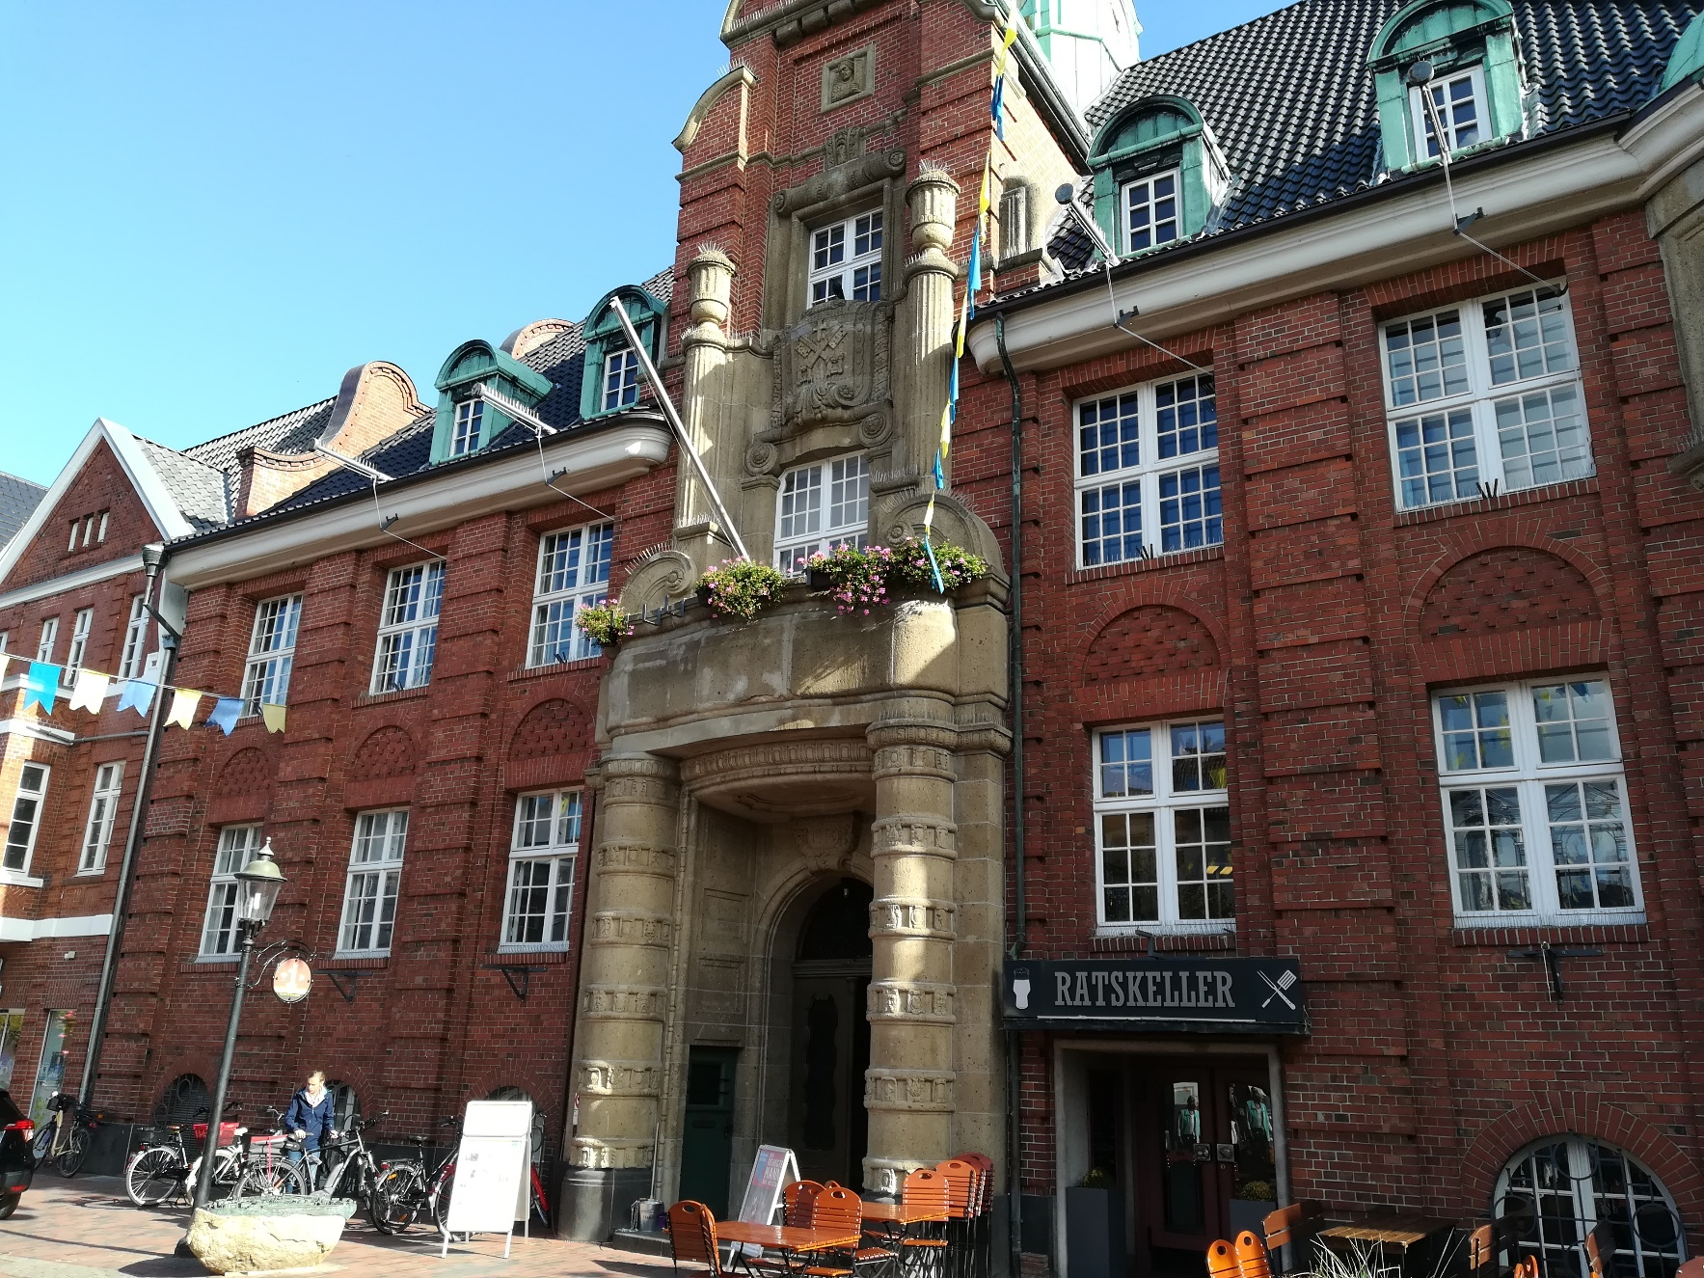
Old townhall

Slide 8
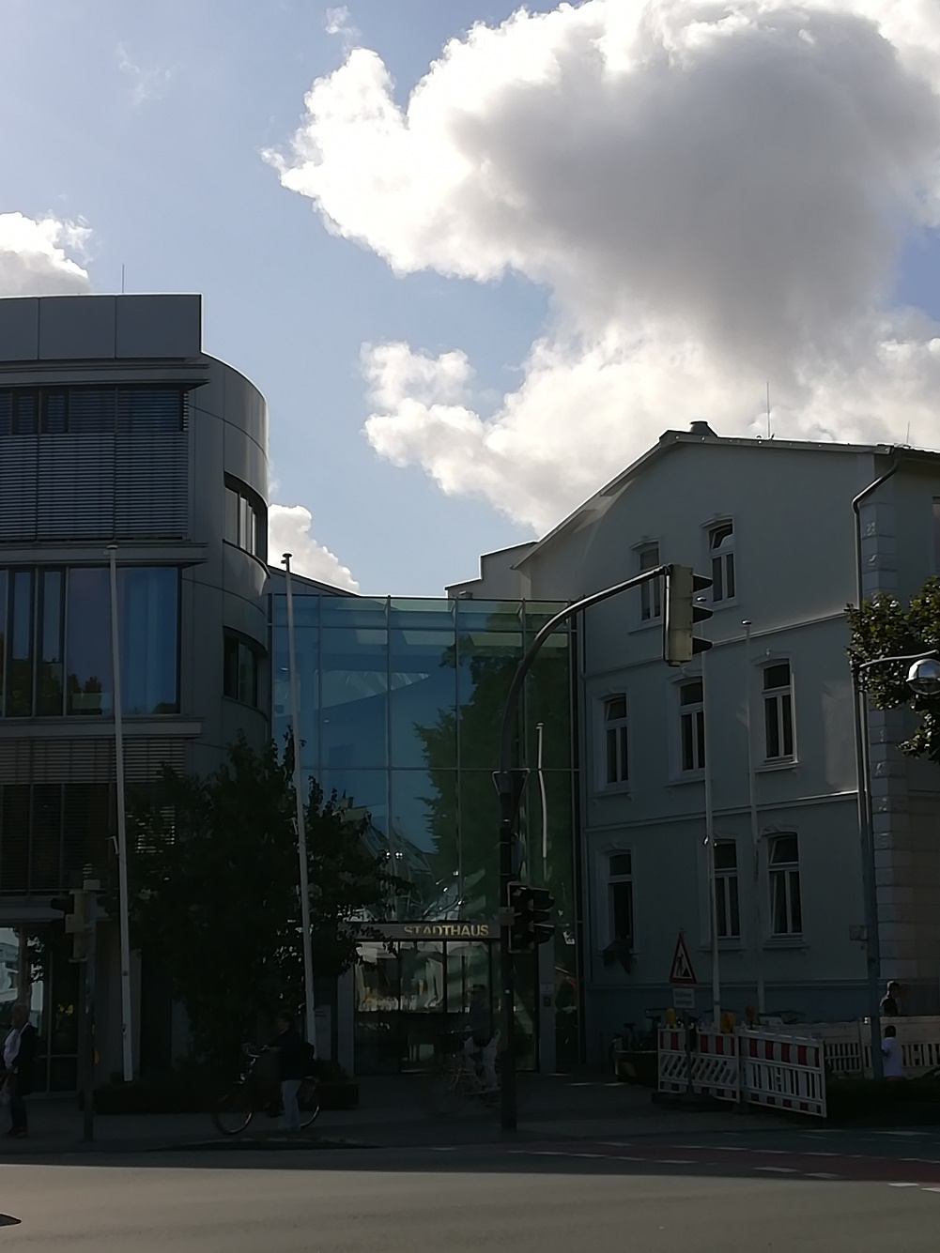
New townhall

Slide 9
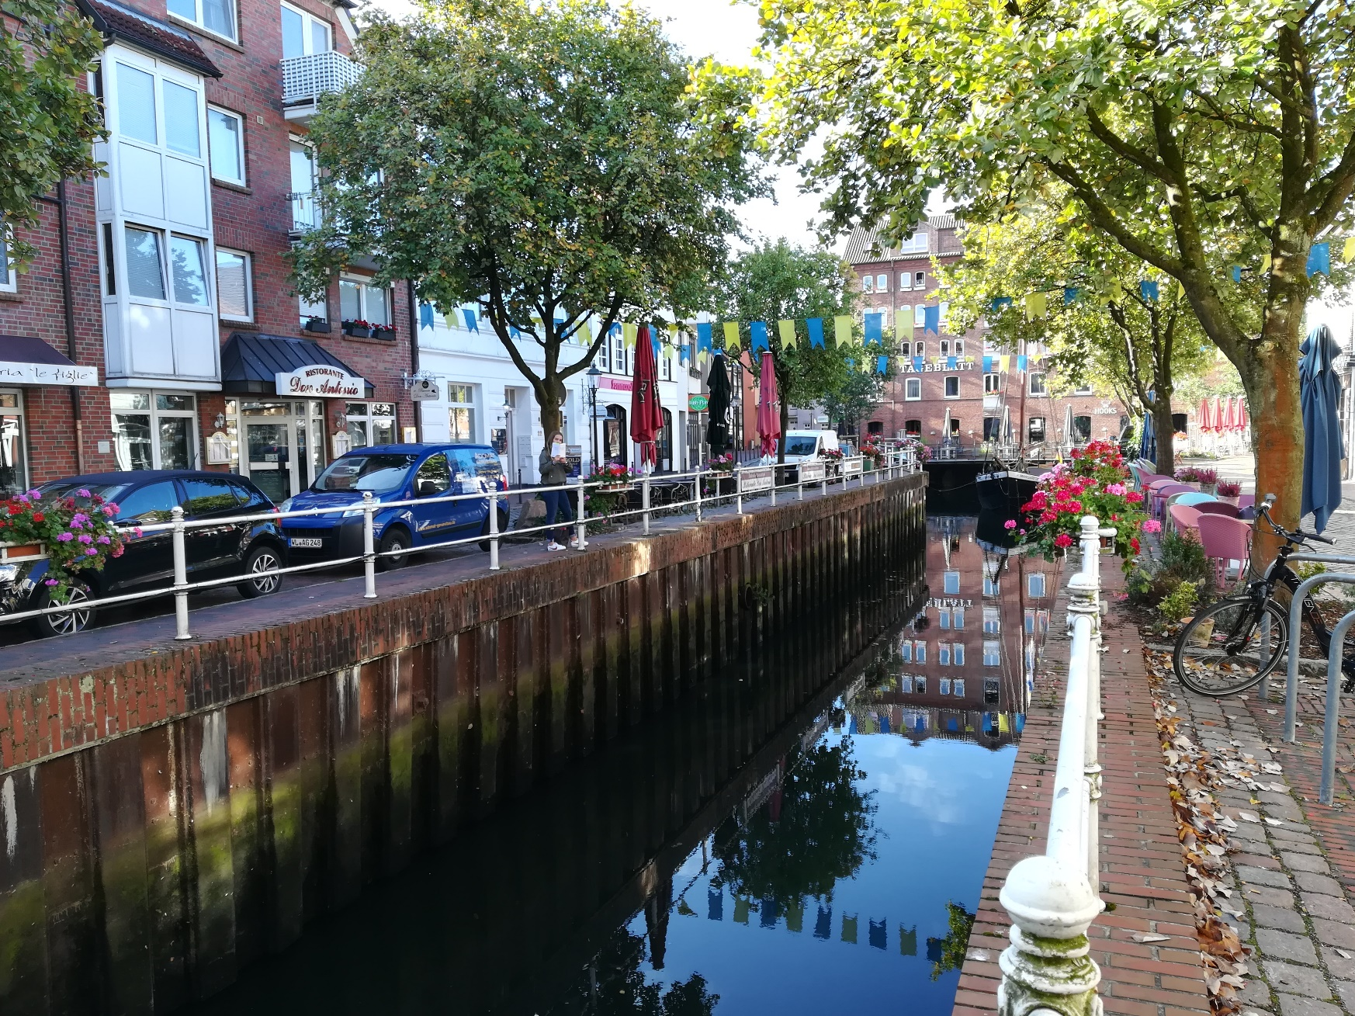
Fleth

Slide 10
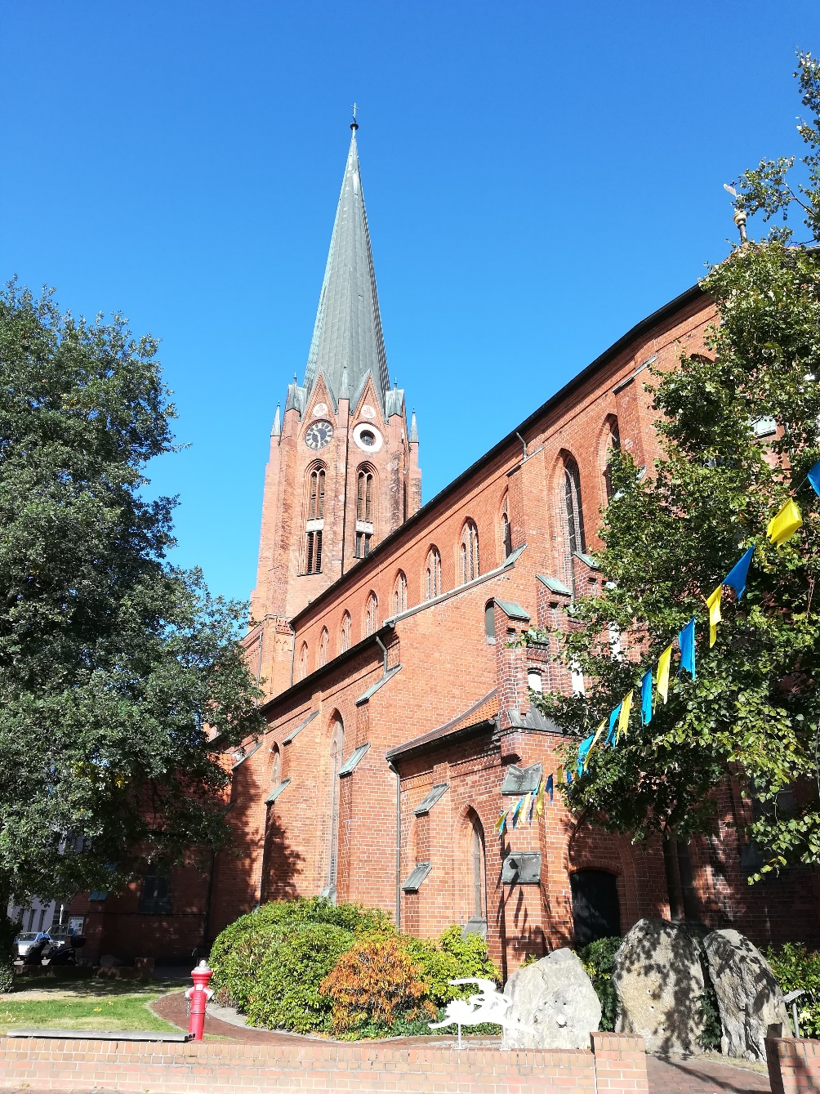
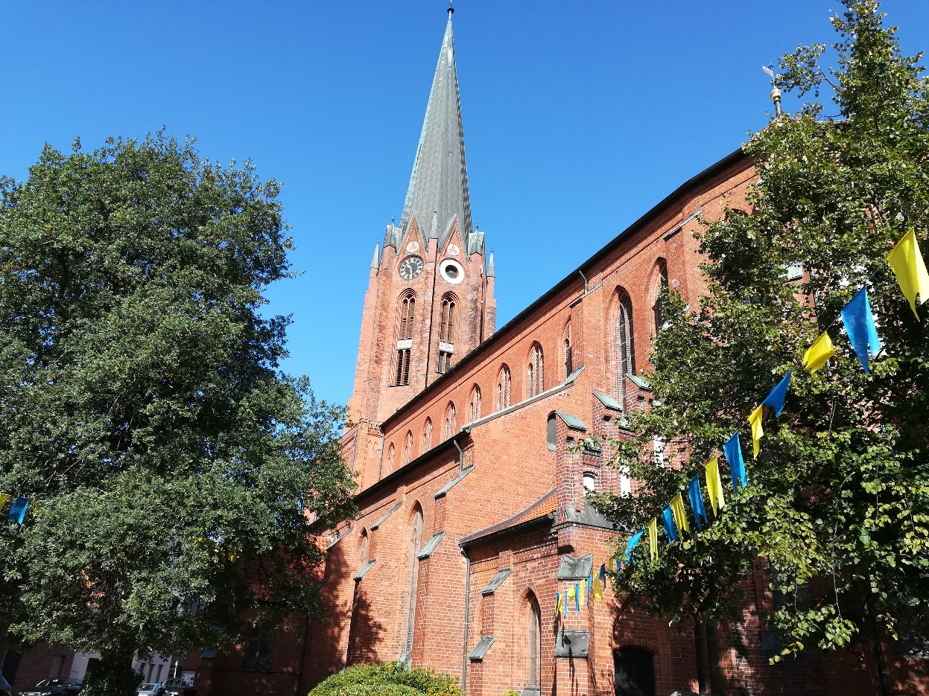
St.-Petri-Church

Slide 11
We are happy to work with you the next days!

