Slide 1
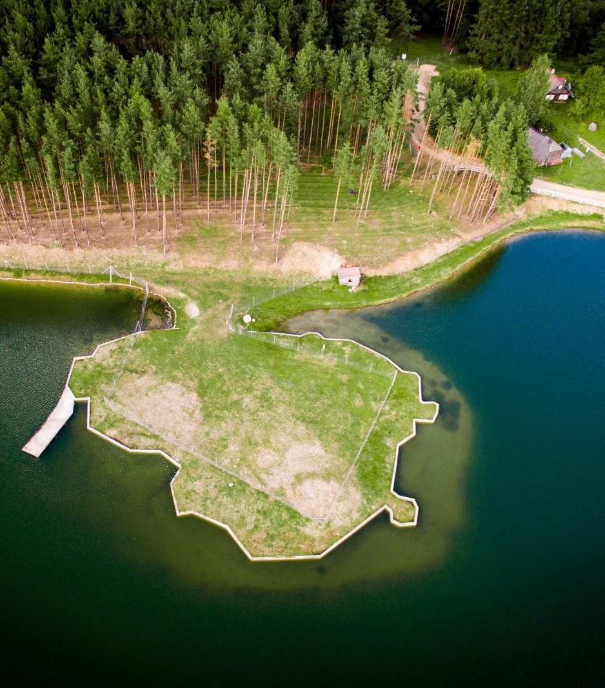
OUR COUNTRY LITHUANIA
Jonava Senamiestis gymnasium
Presentation by Vaiva, Rugilė, Rūta, Austėja K.

Slide 2
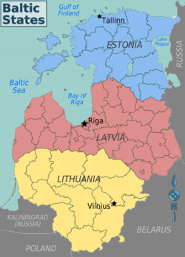
Republic of Lithuania
(Lithuanian: Lietuvos Respublika) is a country in the Baltic region of northern/ eastern Europe. Since its independence, Lithuania has been referred to as one of the Baltic states.

Slide 3
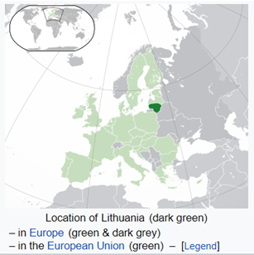
History
Lithuania is a member of the European Union, the Council of Europe, eurozone, Schengen Agreement, NATO.
Independence restored | 11 March 1990
Admitted to the United Nations | 17 September 1991
Admitted to NATO | 29 March 2004
Joined the European Union | 1 May 2004

Slide 4
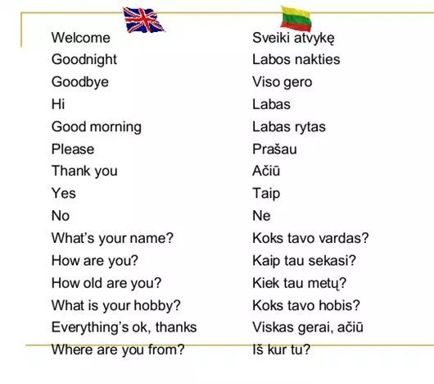
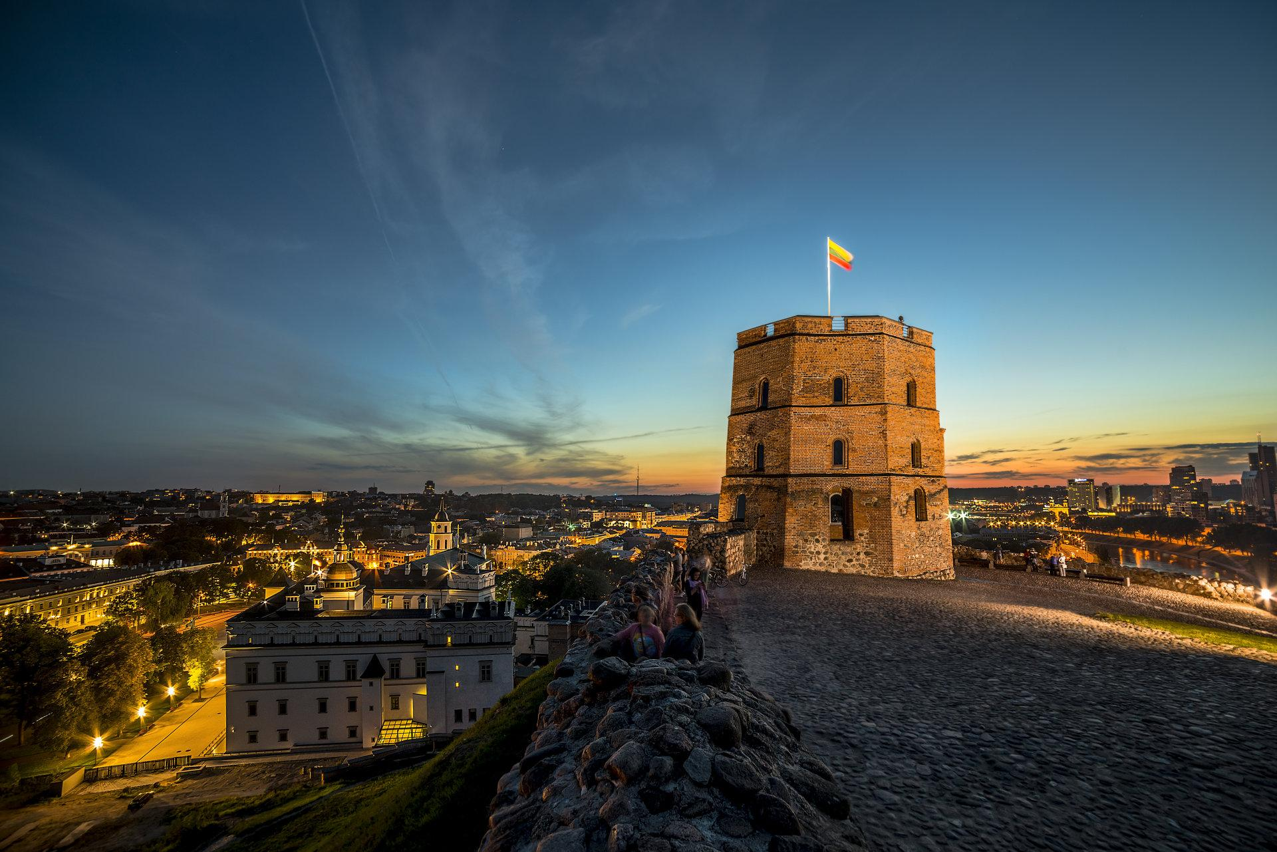
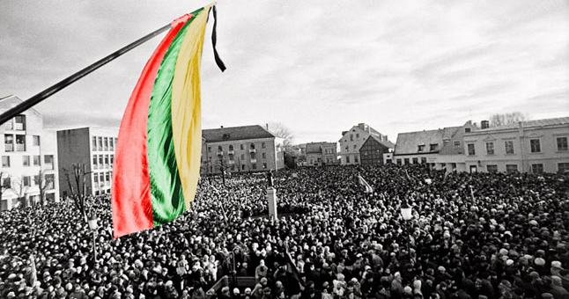
Facts
Lithuania has an estimated population of 2.7 million people as of 2018 and Vilnius is its capital and largest city.
The official language – Lithuanian. It’s
one of the oldest languages in the world.

Slide 5
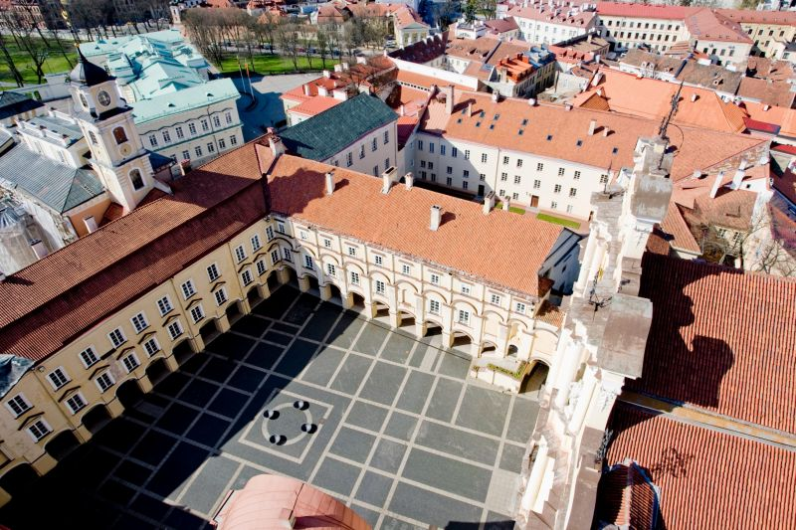
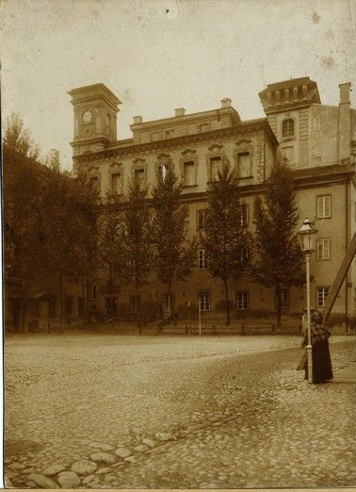
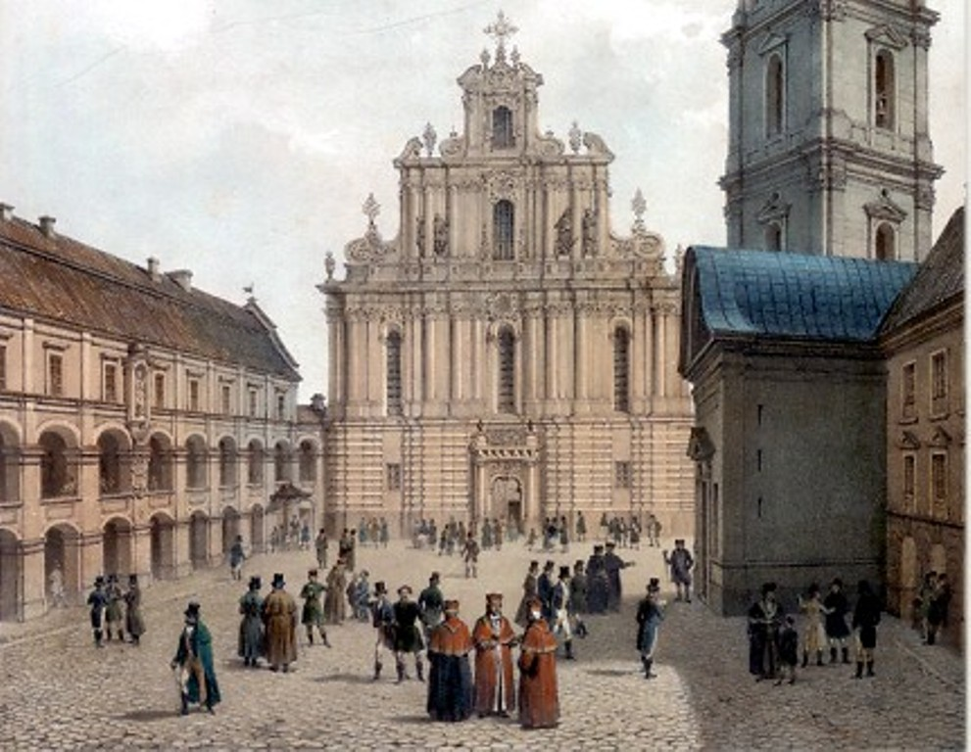
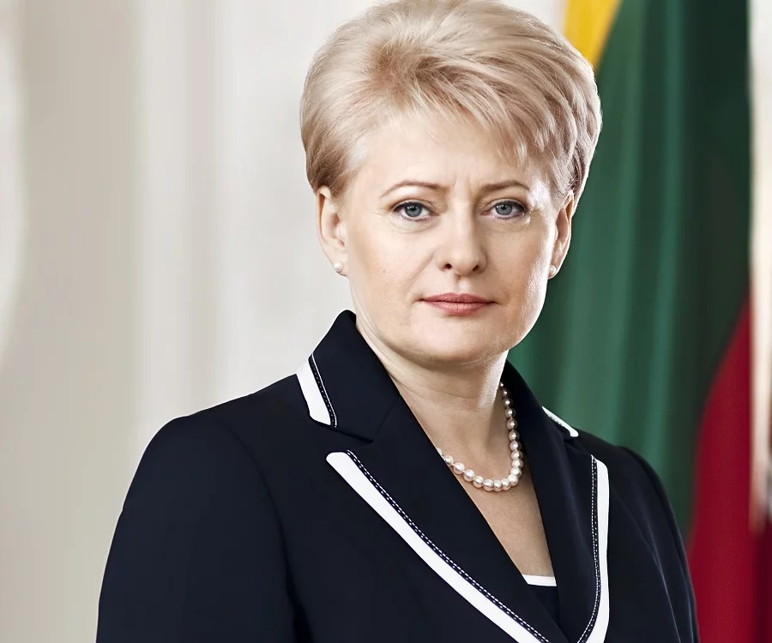
Vilnius university is the oldest university in Eastern Europe.
The Lithuanian head of state is the president, directly elected for a five-year term and serving a maximum of two terms.
At this moment the president is Dalia Grybauskaitė.

Slide 6
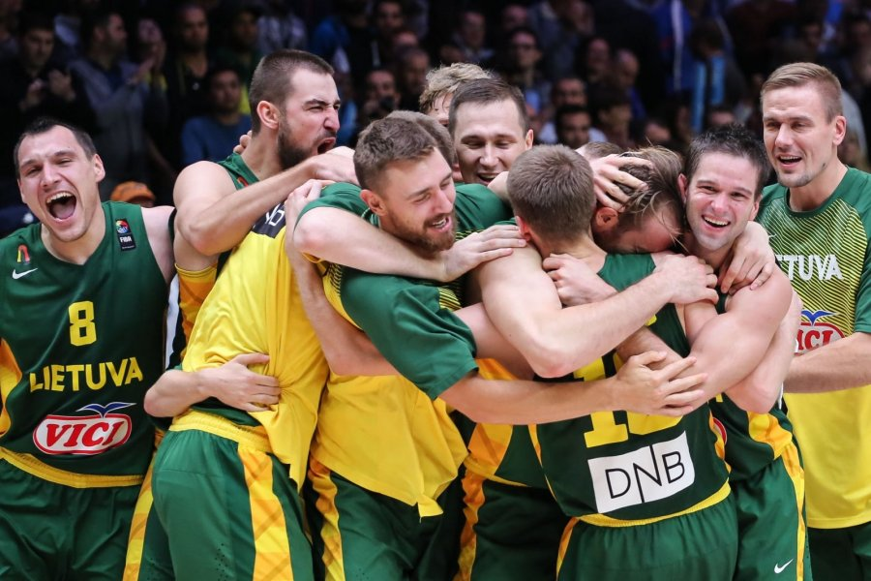
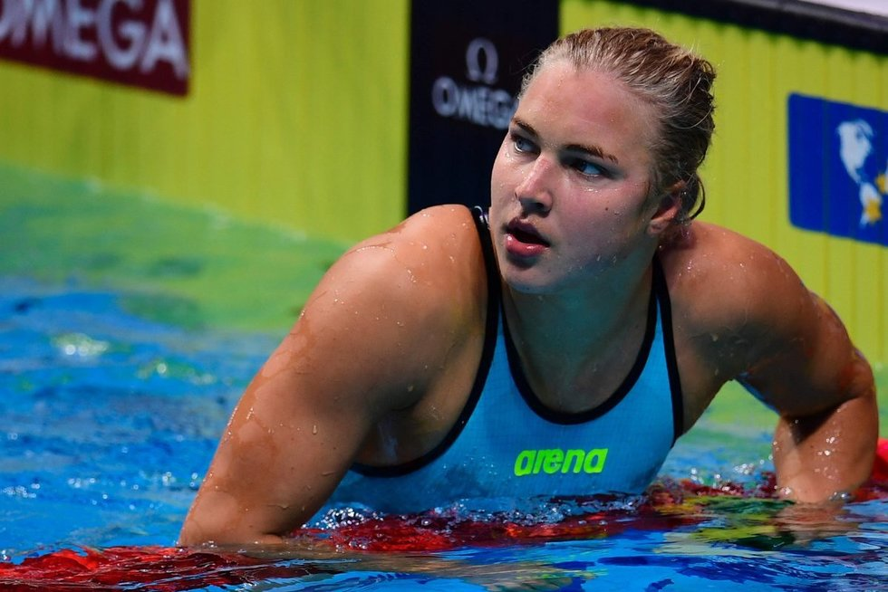
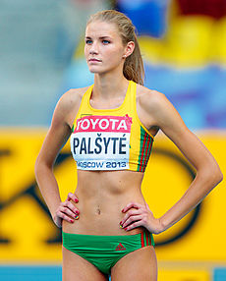
Sports
The most popular sport of Lithuania is basketball. The national Lithuania basketball team has had significant success in international basketball events.
Our legendary youngest gold medal winner in swimming is Rūta Meiltutytė (she was 16 at the time, now she‘s 21 years old).
Airinė Palšytė is a high jumper. She won a gold medal at the 2017 European Athletics Indoor Championships.

Slide 7
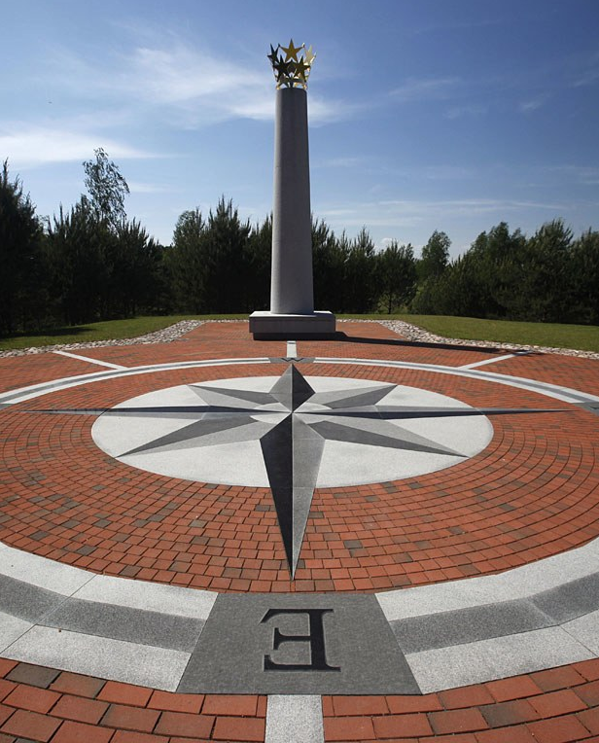
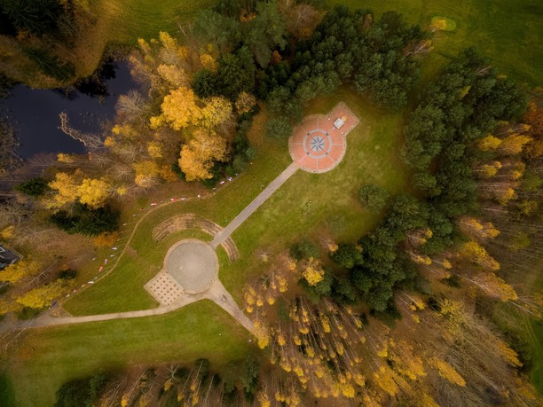
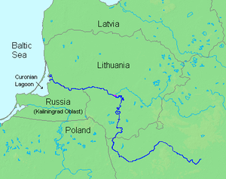
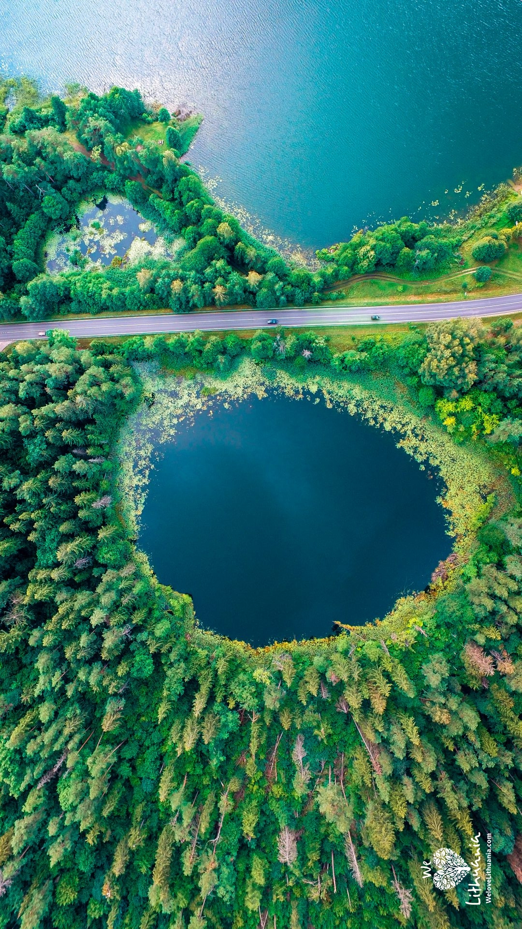
Geography
The Geographic Centre of Europe (The European park) is in Lithuania.
Lithuania is a particularly watery region with more than 3,000 lakes, mostly in northeastern Lithuania.
The longest river is Nemunas.

Slide 8
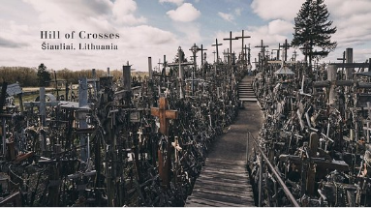
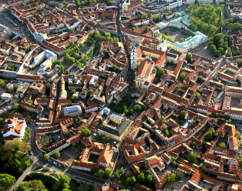
Places to visit
1. Hill of crosses. You’ll never find a place with this many crosses anywhere else in the world, it’s definitely a sight to see.
2. The old town of Vilnius. It’s one of the largest surviving medieval old towns in Northern Europe.

Slide 9
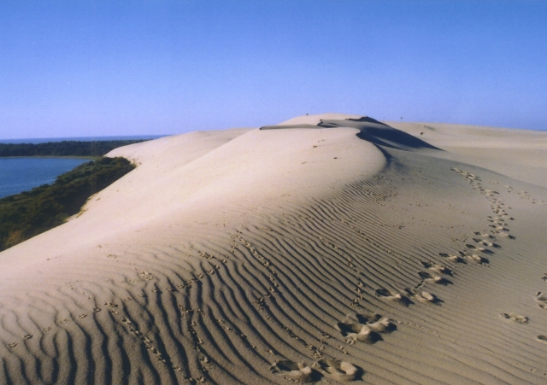
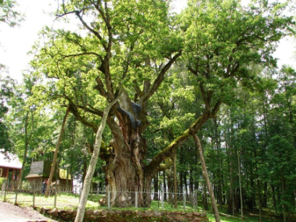
3. The Curonian Spit. The view is spectacular: majestic sand dunes rising up to 67 metres and, literally, emerging from the blue depths of the sea.
4. The Stelmužė oak tree. It’s one of the oldest oak trees in Europe.

Slide 10
Quick recap
The capital
The president
National sport
Tourism
spot
Dalia Grybauskaitė
Vilnius
Basketball
The hill of crosses

