Slide 1
Made by
Lisavencu Tatiana-Ionela
Teacher
Mioara Paraschiv

Slide 2
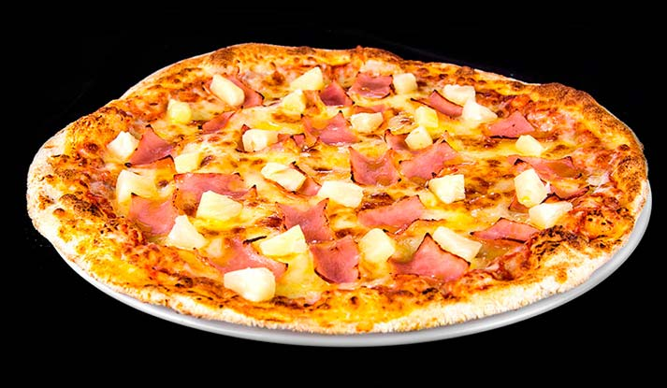
Taste:8/10 Looks:9/10 What you get for the price:9/10 Overall score:8.6/10

Slide 3
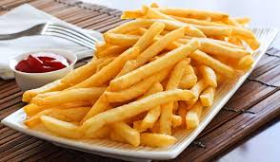
Taste:8/10 Looks:10/10 What you get for the price:10/10 Overall score:9.3/10

Slide 4
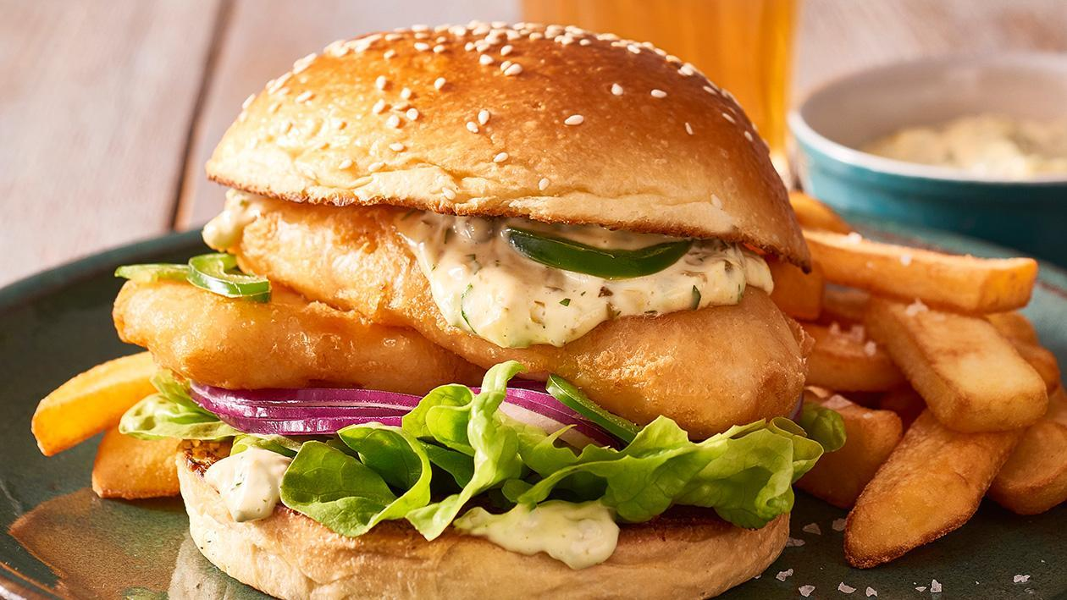
Taste:9/10 Looks:10/10 What you get for the price:9/10 Overall score:9.3/10

Slide 5
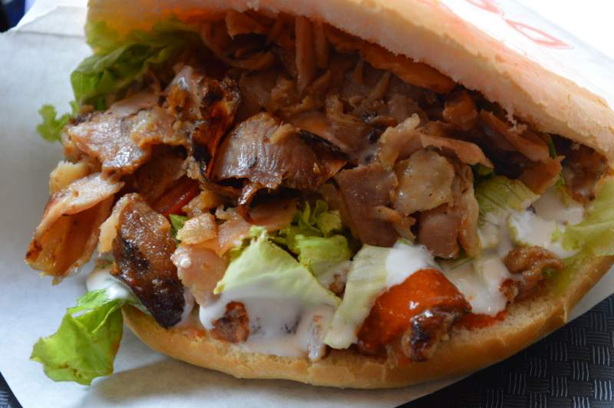
Taste:10/10 Looks:10/10 What you get for the price:10/10 Overall score:10/10

