Slide 1
JONAVA
MADE BY GUOste kaleininkaite, vilte mataraite, austeja juskauskaite, vilte mataraite

Slide 2
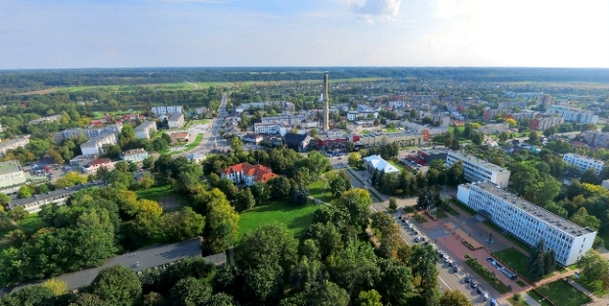
WHAT IS JONAVA?
Jonava is considered to be one of the most modern cities in Kaunas County, Lithuania.
The population is 27 thousand people. The town is divided into 17 districts. Tere are 12 schools. Mayor of Jonava is Eugenijus Sabutis, who belongs to Lithuanian Social Democratic party.

Slide 3
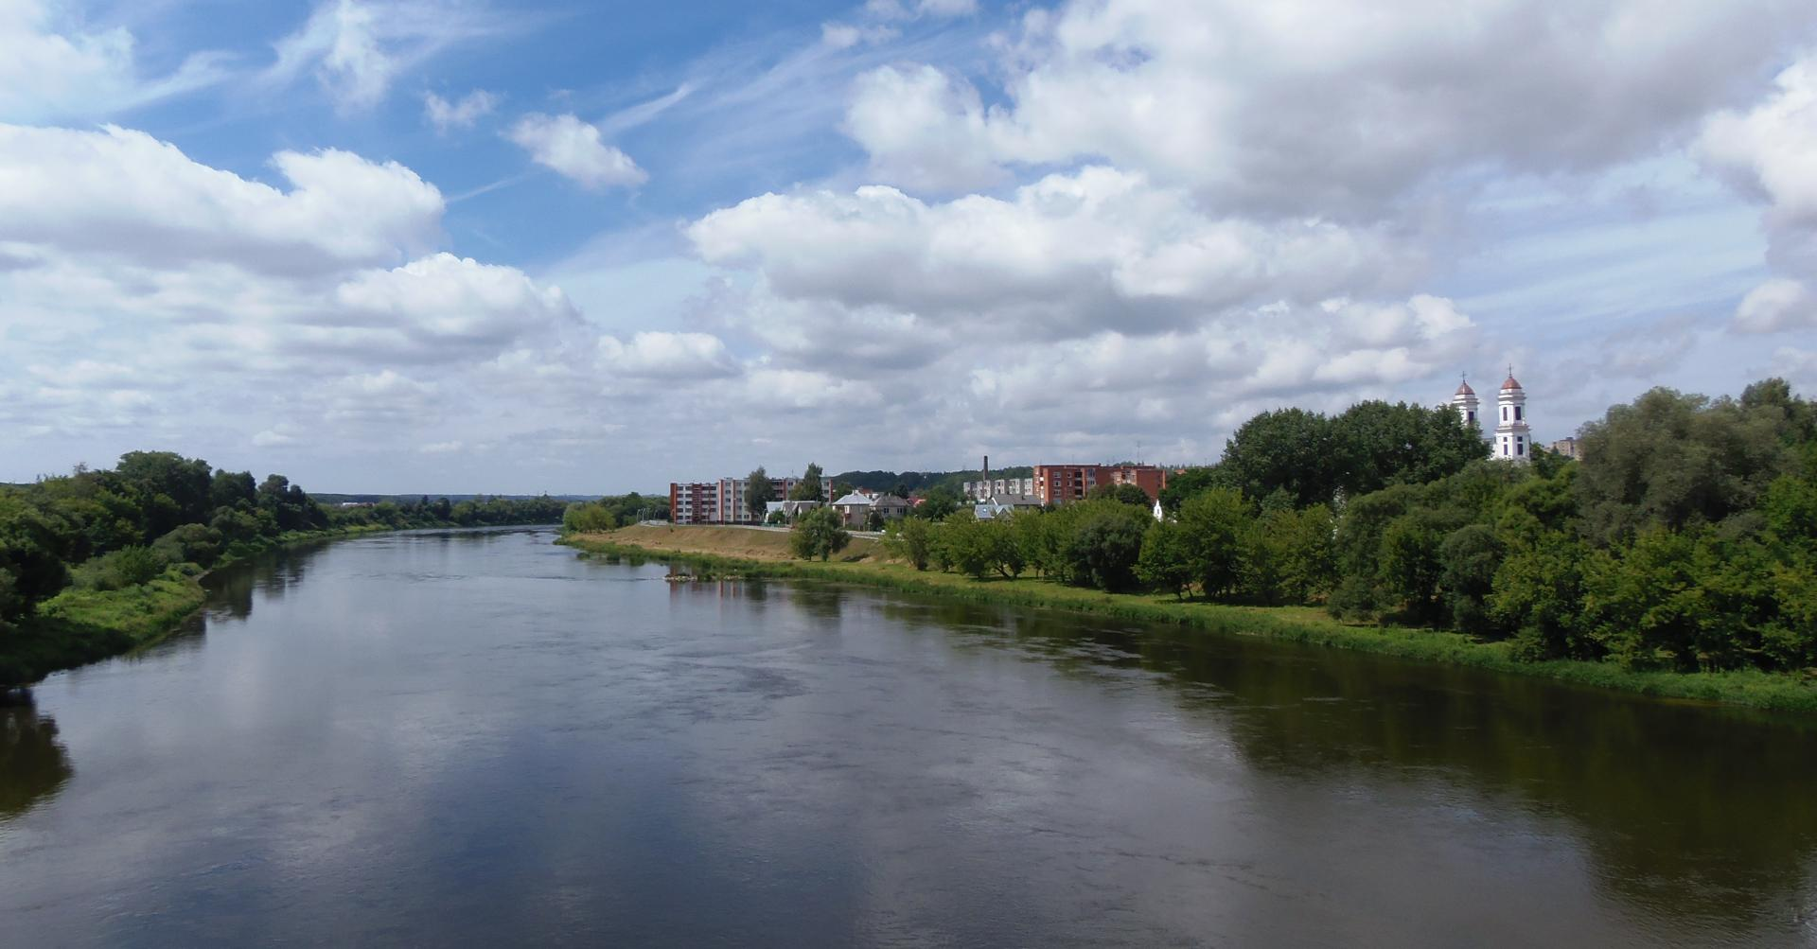
WHY IS IT NAMED JONAVA?
A long time ago on the left Neris shore there was a tavern. In that tavern lived Jonas and Jonienė. It attracted shoppers and craftsmen and often they would say ,, Let‘s stop by Jonus“. Legend says, that‘s how the name Jonava came to be.
However the truth is that Dominykas Kosakovskis,who is the founder of Jonava, named the city after his son Jonas.

Slide 4
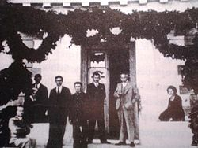
BACK TO THE PAST
A lot of things happened in Jonava during the 1800s:
A horse post office and railway station were built, which had a big impact in town expansion.
A ferry was operating through Neris .
A fire devastated Jonava but town reconstruction plan had been prepared.
Over 3000 people lived in Jonava. Most of them engaged in trade.
The first mills were built ( on the Varnute river).

Slide 5
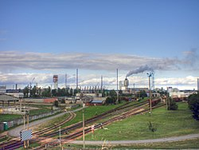
BACK TO THE PAST
The 1900s were also an important time for our city.
In 1912 a match factory was built, however it was later decided to change the match factory into a furniture firm, which even later became Jonava furniture factory.
Sadly, after WWII Jonava lost a lot of buildings and inhabitants.
,,Azotas“ (now ,,Achema“) construction began and in 1965 first lithuanian ammonia was made. This factory is very important to our city.

Slide 6
THE CURRENT SITUATION
Many cultural events and celebrations are organized in Jonava. The most popular ones are: St.Johns feast with pagan traditions, spruce uplift ceremony, town festival and Homo Ludens-International Contemporary Art festival. Various holidays are organized by the culture centre. There are about 20 groups performing modern and traditional art.

Slide 7
THE CURRENT SITUATION
We have a regional museum, where there are several exhibition halls, art, history and ethnography departments.
Like all people in Lithuania, the residents of Jonava are quite religious. The majority of our inhabitants are Catholics and we have 4 churches, the most popular ones are St. Jacob's Church and St. Ann`s church.
The residents of Jonava, are quite active in sports activities, therefore we have two football, one volleyball and one basketball club.

Slide 8
THE CURRENT SITUATION
There are 26w orking youth organizations, such as Jonava youth centre, Jonava district municipality student self-government, Jonava St. Jacob Parish Catholic Youth Center "Vartai" and others.
Active people in Jonava can find any field of activity according to their needs and interests.

Slide 9
WELL KNOWN PEOPLE
PETRAS VAICIUNAS
(WELL KNOWN POET,DRAMA WRITER)
JERONIMAS RALYS
(DOCTOR, TRANSLATOR,JOURNALIST)

Slide 10
WELL KNOWN PEOPLE
VACLOVAS MICHNEVICIUS
(ARCHITECT)
ABRAOMAS KULVIETIS
(DOCTOR OF LAW, HAD AN ACTIVE ROLE IN LITHUANIAN CULTURE)

