Slide 1
ETWINNING FAST FOOD RATING

Slide 2
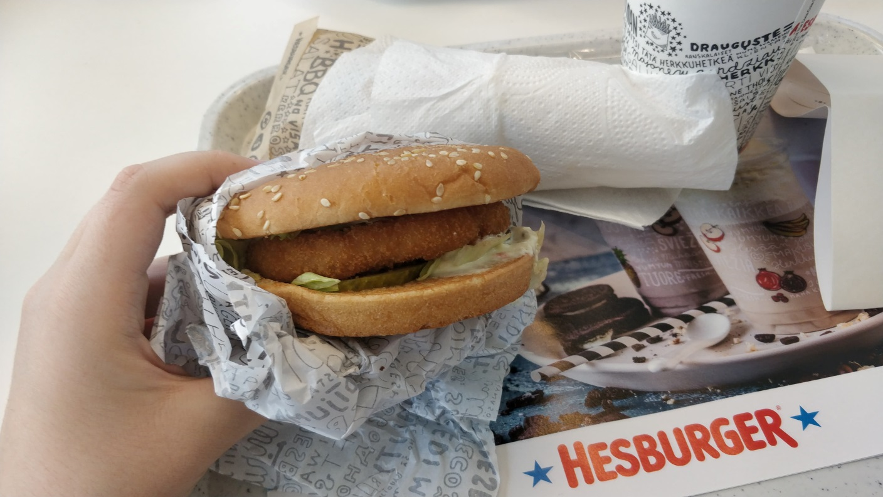
BURGER
Looks:7
Taste:10
For price: 8
Average: 8,34

Slide 3
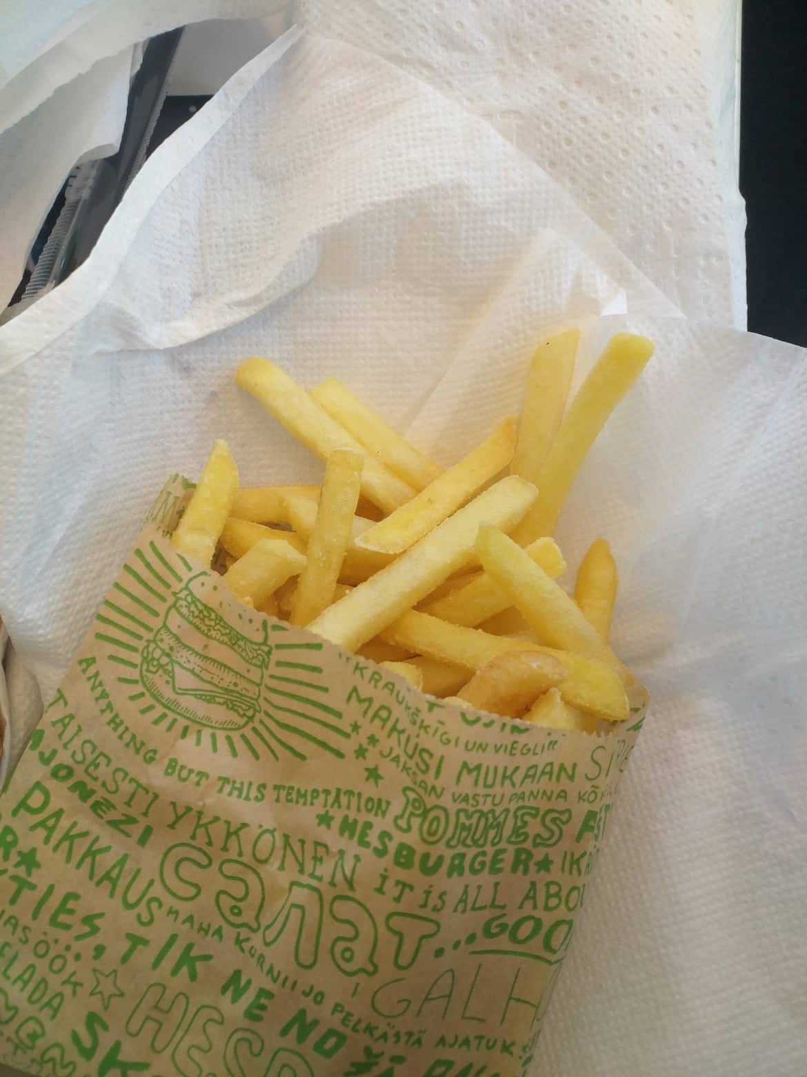
FRENCH FRIES
Looks: 7
Taste: 9
For price: 8
Average: 8

Slide 4
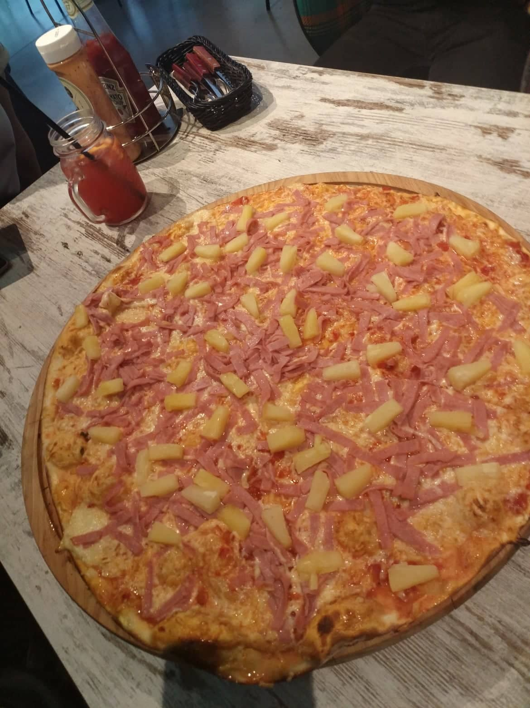
HAWAIIAN PIZZA
Looks: 7
Taste: 9
For price: 8
Average: 8

Slide 5
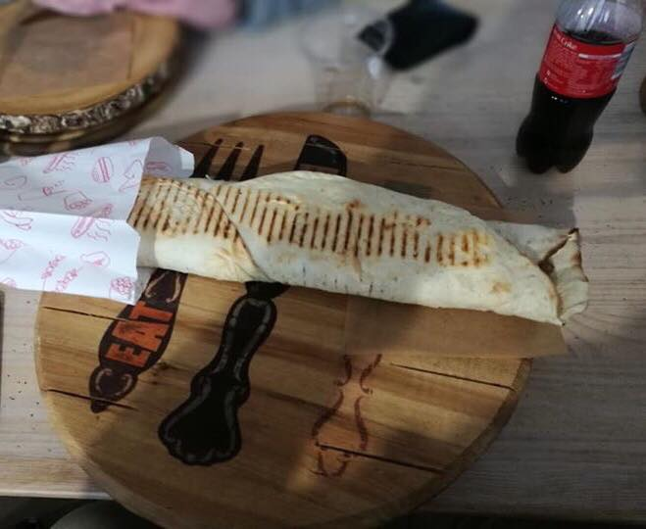
KEBAB
Looks: 9
Taste: 8
For price: 8
Average: 8,34

