Slide 1
our school
Jonavos Senamiestis gymnasium, 2a form

Slide 2
Content
Introduction
History
Resent times
Interesting facts

Slide 3
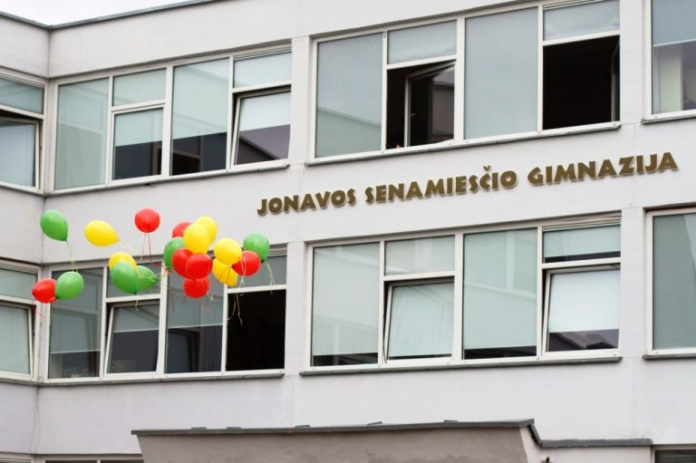
Introduction
Our school is named Jonavos Senamiestis gymnasium. It is located in Jonava, near the old town of Jonava. It is one of seven schools in this town, which has 559 students.
Since the founding of the school, there has been a strong tradition of teaching chemistry and mathematics.

Slide 4
History
Jonavos fourth high school started working 1974 September 15
In 1995 September 1 the school was named Jonavos Senamiestis gymnasium
From 1974 the school had released 4416 graduate students
The school regularly hosts various annual festivals. The most mentioned are: the first christening, the centennial, the Techno Art Days, ,,Terra incognita”, sports and dance festivals, preventive actions, ecological talks.

Slide 5
Resent times
Jonavos Senamiestis gymnasium is a full-time, self-study general education school in Jonava, which provides basic, secondary and supplementary education programs.
To this day in our school work 49 teachers
5 experts
33 methodologists
13 senior teachers

Slide 6
Events
This school year we had many events and celebrations, here are some of the few:
This year 36 students were competing in International Virtual English Competition ,,Best in English“
On October 25th in our school had held it’s 4th dr. Bronislovo Lubio chemistry contest. Where we were visited by 72 students from other schools across Lithuania.
On November 27th and 28th school had it’s 19th technology and art days. Students competed in dance, installation, fashion and music categories.
And we are still hoping that it is not the end.

Slide 7
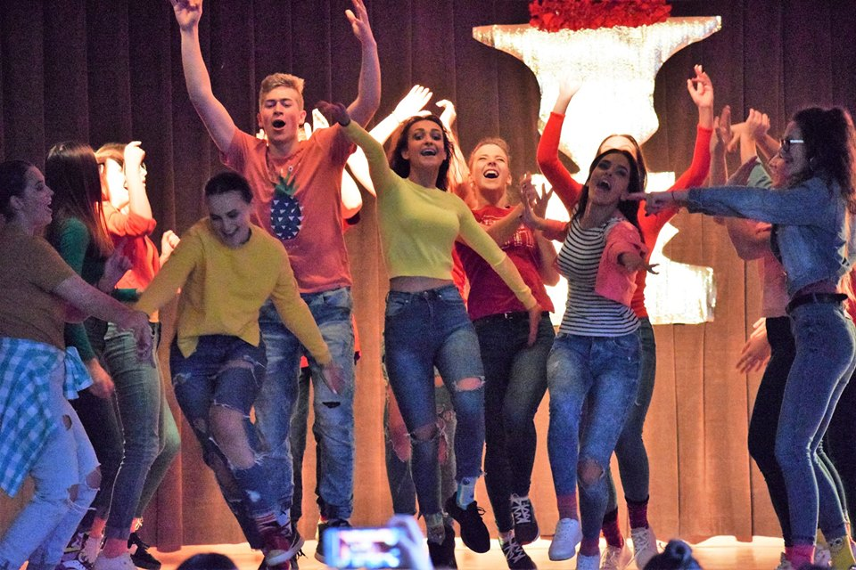

Slide 8
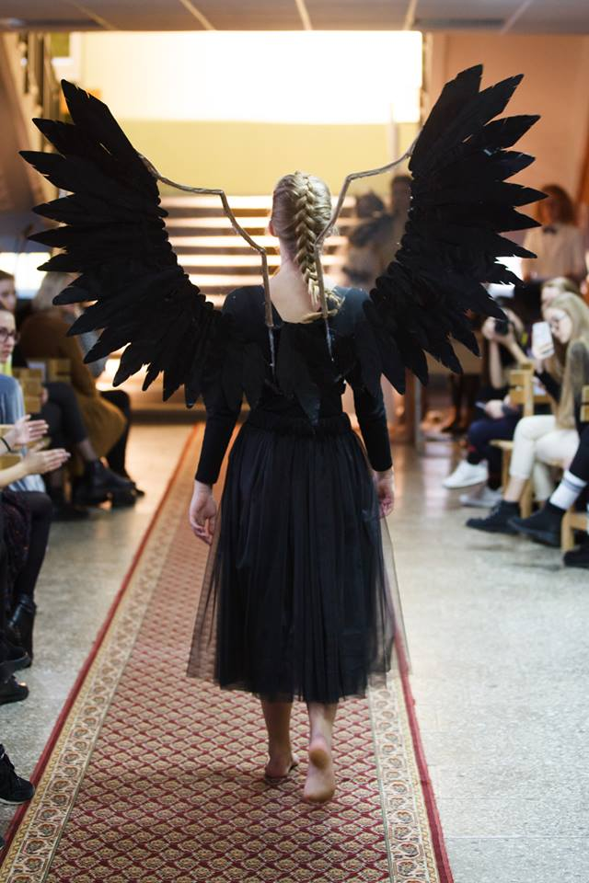

Slide 9
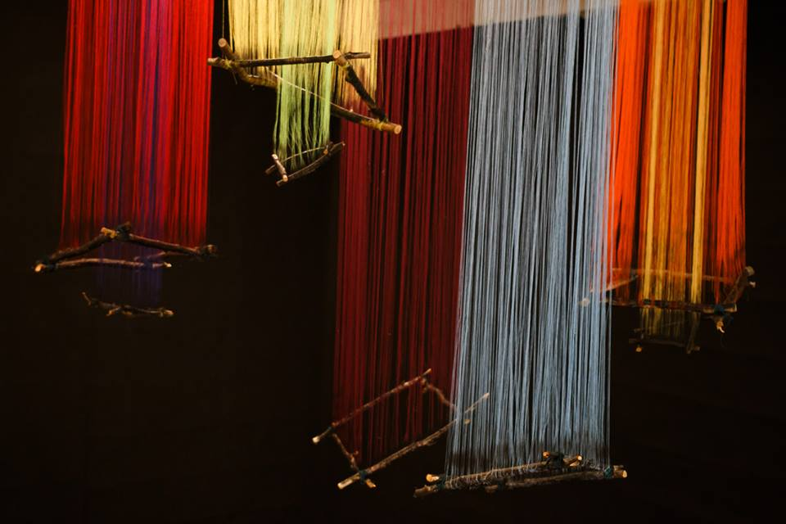

Slide 10
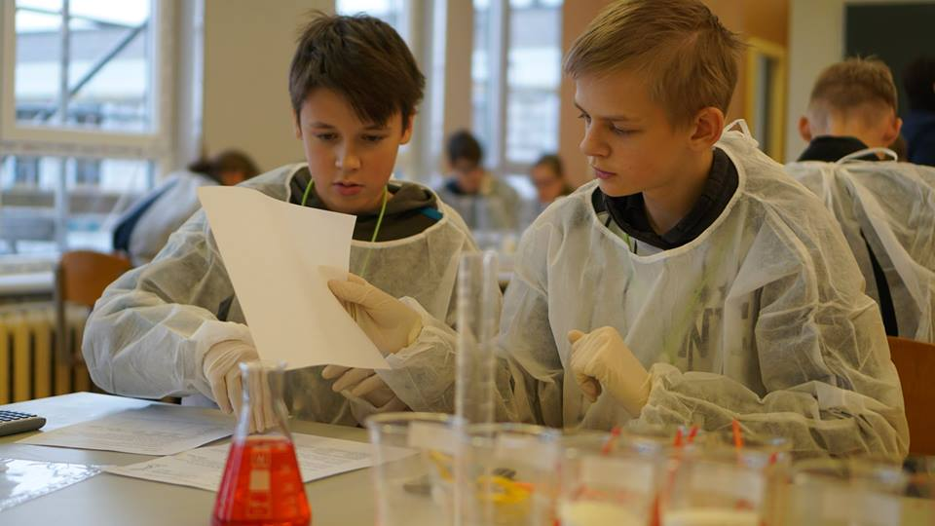

Slide 11
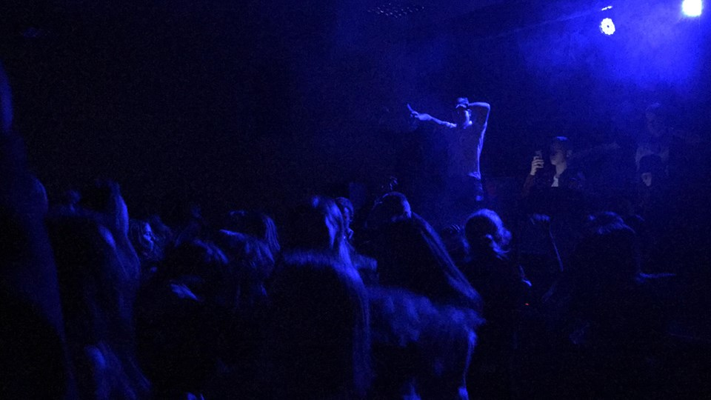

Slide 12
Interesting facts
Vytenis Buzas (born in Jonava) - Lithuanian aircraft engineer, developer of the first Lithuanian satellite "LituanicaSAT-1", head of the space mission, studied in this school.
Mindaugas Sinkevičius - Minister of Economy of Lithuania, former Mayor of Jonava graduated with honors Jonavos Senamiestis gymnasium.
Aloyzas Cibarauskas – aviator, President of the Lithuanian Aerobatics Federation also graduated Jonavos Senamiestis gymnasium.

