Slide 1
Consumerism
Prepared by Julija Darvidaitė, Guostė Kalininkaitė, Viltė Mataraitė , Ugnė Valantaitė

Slide 2
What is consumerism ?
continual expansion of one’s wants and needs for goods and service.
https://www.youtube.com/watch?v=D9gcGjCF60o
Consumerism is often confused with capitalism but the latter is an economic system, while the former is a pervasive cultural attitude.
Notes:
Idk siulau paziureti ta filmuka ir nuspresti ar jis reikalingas ar ne

Slide 3
Q&A
What types of consumerism do you know ?
What are consumerism pros and cons ?
Where do you think consumerism is the biggest problem ?
Notes:
Type of consumerism: Shopping consumerism, Fast food consumerism, Technology consumerism
Pros: Consumerism stimulates economic growth, It also boosts creativity and innovation, Cost reductions are encouraged because of consumerism, It weeds out the poor performers naturally, Consumerism encourages freelancing, entrepreneurialism, and self-employment, It creates safer goods for consumers, Consumers are given more choices in this society.
Cons: The economy takes precedence over the environment, It changes the moral fabric of society, Consumerism encourages debt, It leads to health problems, Consumerism does not provide fulfillment, It can be used as a political tool, Consumerism conflicts with various spiritual beliefs, The poor are always left behind by consumerism.
Placiau: https://vittana.org/15-consumerism-pros-and-cons

Slide 4
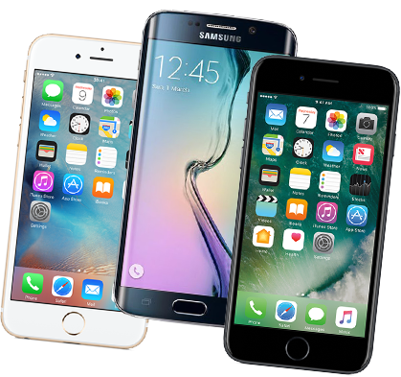
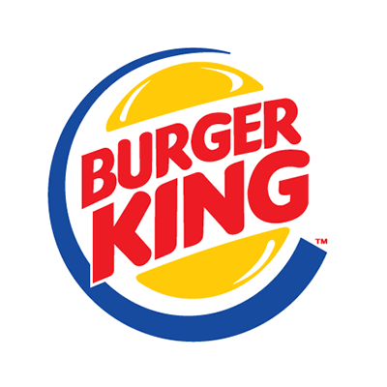
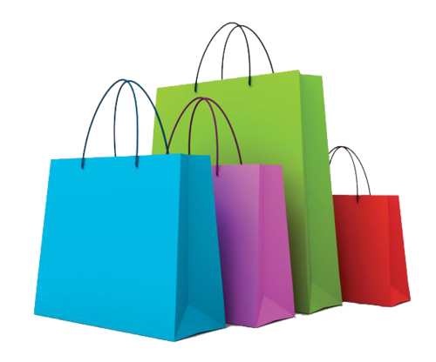
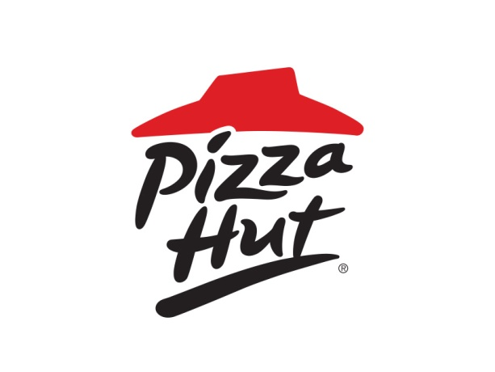
Types of consumerism
Shopping consumerism
Fast food consumerism
Technology consumerism

Slide 5
Pros and cons
Pros:
Consumerism stimulates economic growth
It also boosts creativity and innovation
Cost reductions are encouraged because of consumerism
It weeds out the poor performers naturally
Consumerism encourages freelancing, entrepreneurialism, and self-employment
It creates safer goods for consumers
Consumers are given more choices in this society.
Notes:
Placiau: https://vittana.org/15-consumerism-pros-and-cons

Slide 6
Pros and cons
Cons:
The economy takes precedence over the environment
It changes the moral fabric of society
Consumerism encourages debt
It leads to health problems
Consumerism does not provide fulfillment
It can be used as a political tool
Consumerism conflicts with various spiritual beliefs
The poor are always left behind by consumerism
Notes:
Placiau: https://vittana.org/15-consumerism-pros-and-cons

Slide 8
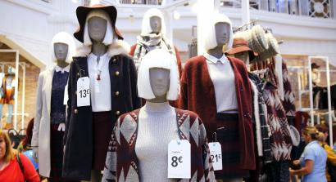
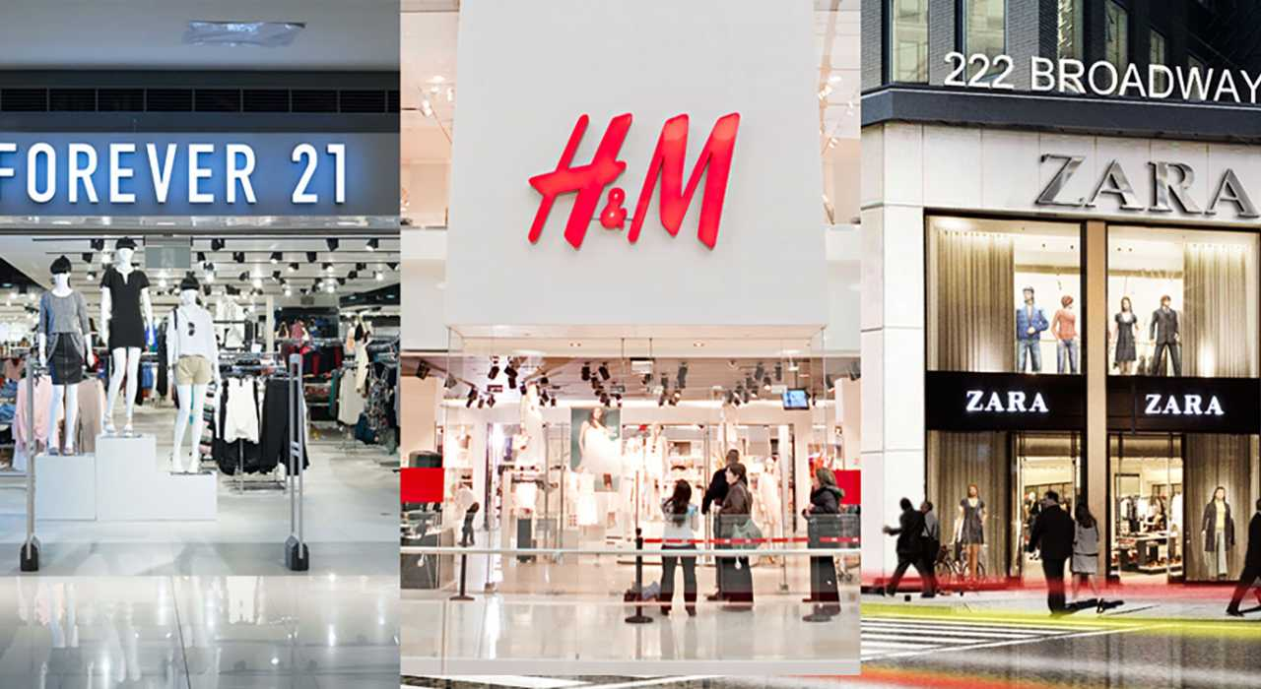
Fast Fashion
What is Fast Fashion?
Fast fashion can be defined as cheap, trendy clothing, that samples ideas from the catwalk or celebrity culture and turns them into garments in high street stores at breakneck speed.

Slide 9
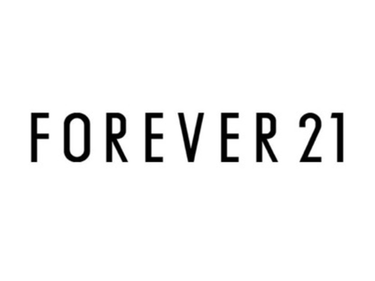
Fast fashion brands
Bershka
Forever 21
H&M
NewYorker
Pull & Bear
Zara
Topshop
United Colors of Benetton
Mango
Fashion Nova
Notes:
FUN FACT: H&M is the oldest of Fast Fashion retailers

Slide 10
What’s the impact of Fast Fashion?
Fashion industry the second largest polluter of clean water globally after agriculture.
Polyester is one of the most popular fabrics.
Huge amount of textile is wasted
Fast Fashion makes us feel dissatisfaction
Animal welfare is put at risk
Notes:
1.Fast Fashion’s negative impact includes its use of cheap, toxic textile dyes – with the fashion industry the second largest polluter of clean water globally after agriculture. That’s why Greenpeace has been pressuring brands to remove dangerous chemicals from their supply chains through its Detox The Catwalk campaign.
2.Polyester is one of the most popular fabrics. It’s derived from fossil fuels, contributing to global warming, and can shed microfibres that add to the increasing levels of plastic in our oceans when it’s put through a wash.
3. The speed at which garments are produced also means that more and more clothes are disposed of by consumers, creating a huge amount of textile waste. In the UK alone, 235 million pieces of clothing were thought to have been sent to landfill in spring 2017.
4. Fast Fashion makes us believe we need to shop more and more to stay on top of trends, creating a constant sense of need and ultimate disatisfaction.
5. Animals are also impacted by Fast Fashion, as the toxic dyes that are released in waterways and microfibres that can be ingested by ocean life. When animal products such as leather and fur are used, animal welfare is put at risk.
PILNAI: https://goodonyou.eco/what-is-fast-fashion/

Slide 11
Q&A
Is Fast Fashion Going Green?
Is Fast Fashion in decline?
What can we do?
Notes:
As an increasing number of consumers call out the true cost of the fashion industry, and especially Fast Fashion, we‘ve seen a growing number of retailers introduce sustainable and ethical fashion initiatives such as in-store recycling schemes. These schemes, allow customers to drop off unwanted items in “bins” in the brands’ stores. But it’s been highlighted that only 0.1% of all clothing collected by charities and take-back programs is recycled into new textile fibre.
Millennials, the drivers of the future economy may have not be catching the Fast Fashion bug. Some have argued that this generation has “grown too clever for mindless consumerism, forcing producers to become more ethical, more inclusive, and more liberal”. There is also a growing interest towards moving to a more circular model of textile production, reusing materials wherever and whenever possible.
Buying Less is the first, and here’s how you can fall back in love with the clothes you already own and prioritize quality fashion over Fast Fashion. Choose Well is the second step, choosing an eco-friendly fabric is complex as there are pros and cons to all fibre types, but hopefully we have several material guides to help you, such as denim, linen, cotton and more. Finally we should Make it Last and wear our clothes until they are worn out
More: https://goodonyou.eco/what-is-fast-fashion/

Slide 12
Dialogue
Student A
Student B
Time: 4-5 minutes
Topic: men’s and women’s clothes consumption
Situation: there are two opinions in your class about men’s and women’s clothes consumption. One side is saying that women use and need a lot more clothes than men and others are saying that men and women use approximately the same amount of clothes.
Task:
Start the conversation and talk about the on-going situation;
Pick a side you’re on;
Talk about your experience in clothes consumption;
Share your ideas on why the consumption is different/the same;
Talk about other stereotypes that you often hear about your gender.
Time: 4-5 minutes
Topic: men’s and women’s clothes consumption
Situation: there are two opinions in your class about men’s and women’s clothes consumption. One side is saying that women use and need a lot more clothes than men and others are saying that men and women use approximately the same amount of clothes.
Task:
Pick a side you’re on;
Talk about your experience in clothes consumption;
Share your ideas on why the consumption is different/the same;
Talk about other stereotypes that you often hear about your gender;
Try to find the clash points and summarize the dialogue.

