Slide 1
Hotel departments
Created by: Natalie AngeLOVEa

Slide 2
As an outsider when you look at a hotel, the operation appears to be pretty simple, selling of rooms and food and beverage services etc. But, actually, the hotel is a highly complex operation where several departments function, coordinate and interact for a smooth day to day operations.
In order to run the Hotel as a functional unit, there are several departments in a hotel which work and coordinate together and the major departments of the hotel are:

Slide 3
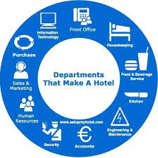
1. Front Office Department
2. Housekeeping Department
3. Food and Beverage Service Department
4. Kitchen or Food Production Department
5. Engineering and Maintenance Department
6. Accounts and Credits Department
7. Security Department
8. Human Resources (HR) Department
9. Sales and Marketing Department
10. Purchase Department
11. Information Technology (IT)

Slide 4
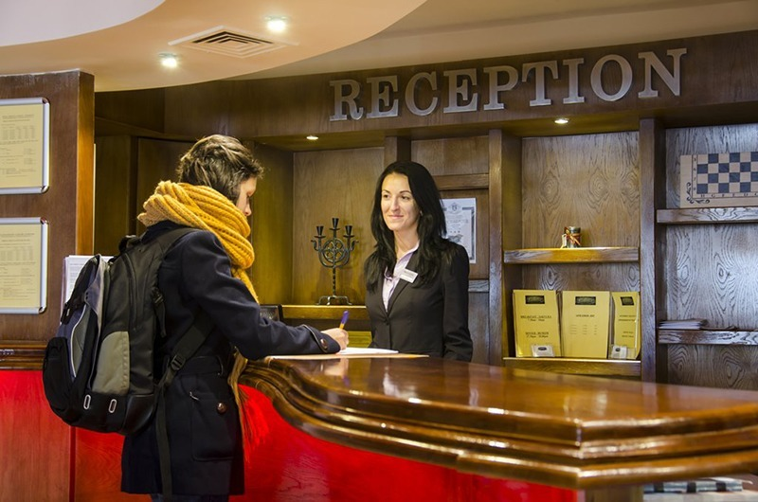
1. Front Office Department:
This department performs various functions like reservation, reception, registration, room assignment, and settlement of bills of a resident guest and the front office department is considered as the nerve centre of a hotel.
The front-office staff welcome the guests, carry their luggage, help them register, give them their room keys and mail, answer questions about the activities in the hotel and surrounding area, and finally check them out. In fact, the only direct contact most guests have with hotel employees, other than in the restaurants, is with members of the front-office staff.

Slide 5
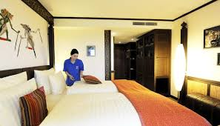
2. Housekeeping Department:
The housekeeping department is responsible for the cleanliness, maintenance, and aesthetic upkeep of rooms, public areas, back areas, and surroundings in a hotel and for the immaculate care and upkeep of all guest rooms and public spaces at all times.
The staff members who excel in the Housekeeping Departments have an eye for detail and a commitment to the training, development and motivation of a diverse group of talented employees. It is the service and cleanliness that really make an impact on our guests and determine whether they will return and also recommend the hotel to others.

Slide 6
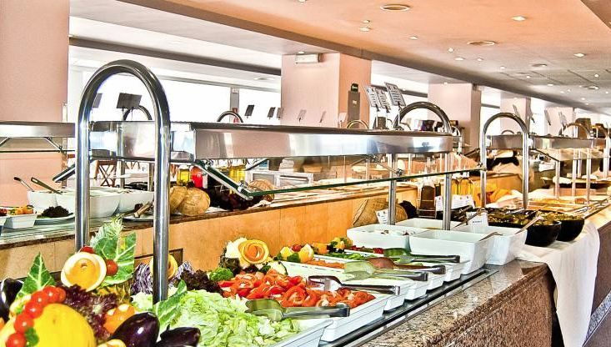
3. Food and Beverage Service Department:
This department looks after the service of food and drinks to guests. The Food which is made in the Kitchen and Drinks prepared in the Bar to the Customers (Guest) at the Food & Beverage premises.

Slide 7
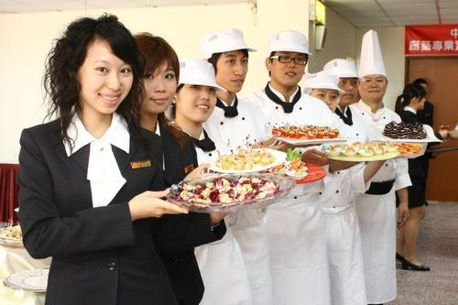
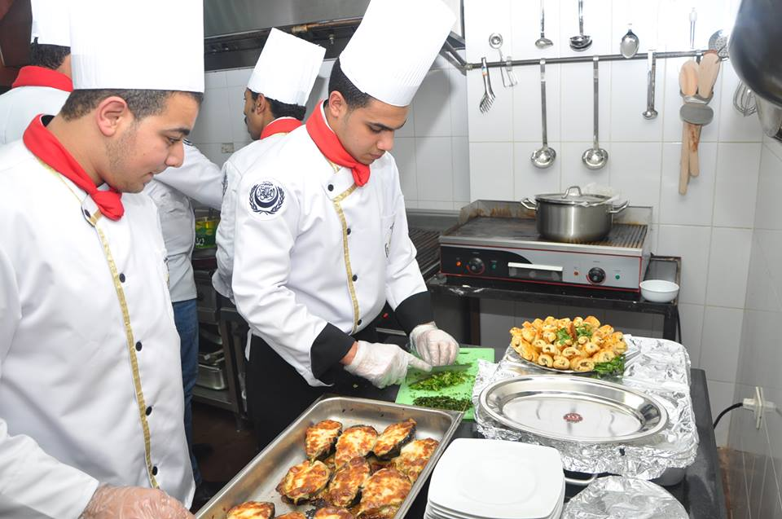
4. Kitchen or Food Production Department:
All the food and beverages that are served to the hotel guest is prepared in the kitchen. Culinary preparation, as an art and science in the modern kitchen, required more than just a knowledge of food being prepared and the methods of preparation.
It is through a knowledge of basic skills, terminology, and rules of the kitchen that a final goal, preparation and service of quality is achieved in the hotel kitchen.

Slide 8
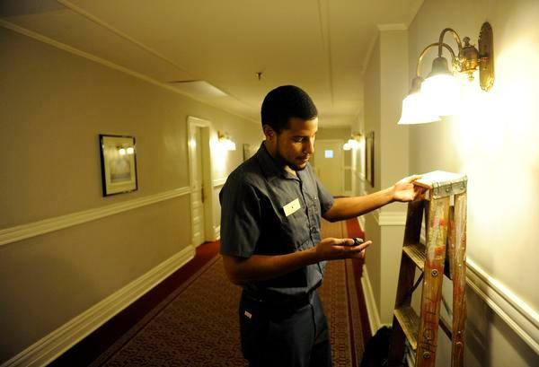
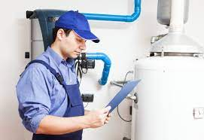
5. Engineering and Maintenance Department:
The engineering department is responsible for repairing and maintaining the plant and machinery, water treatment and distribution, boilers and water heating, sewage treatment, external and common area lighting, fountains and water features etc. Also, It looks after the maintenance of all the equipment, furniture and fixture installed in a hotel.

Slide 9
6. Accounts and Credits Department:
This department maintains all the financial transactions. Accounting departments typically handle a variety of important tasks. Such tasks often include invoicing customers, accounts receivable monitoring and collections, account reconciliations, payables processing, consolidation of multiple entities under common ownership, budgeting, periodic financial reporting as well as financial analysis. Also common are setting up adequate internal controls for all business processes (to prevent theft/misappropriation of assets), handling external audits and dealing with banks in order to obtain financing. Taxes are sometimes handled by accounting departments in house, but this work is often contracted to outside tax accountants.

Slide 10
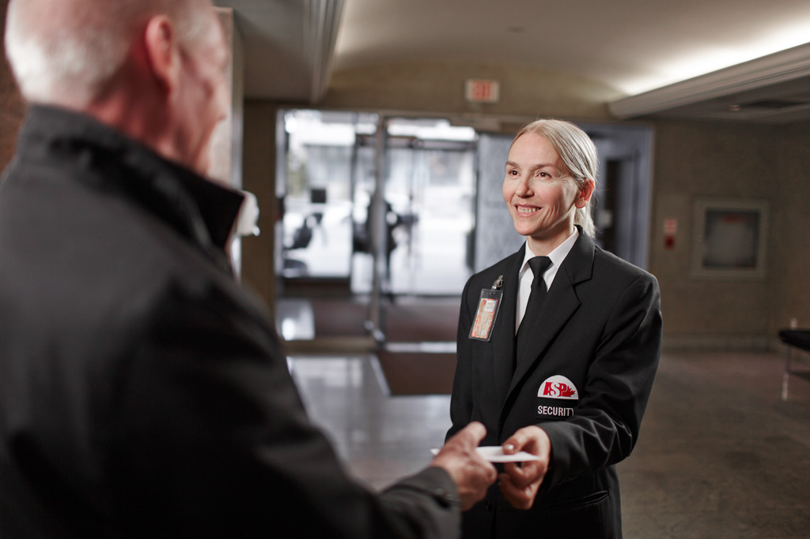
7. Security Department:
The security department of a hotel is responsible for the overall security of the hotel building, in-house guests, visitors, day users, and employees of the hotel, and also their belongings.

Slide 11
8. H R department:
Human Resource department is responsible for the acquisition, utilisation, training, and development of the human resources of the hotel.
The role of the HR department also has to do with the administration of an impartial and internal justice system which will promote transparency and openness in organisational communication. The Human resources department also serves as a progressive voice in a common system and strives to ensure competitiveness in the conditions of service for staff.

Slide 12
9. Sales and Marketing Department:
The major role of the sales and marketing department is to bring in business and also to increase the sales of the hotel’s products and services is the major task of the department.

Slide 13
10. Purchase Department:
The purchase department is responsible for procuring the inventories of all the departments of a hotel.

Slide 14
11. Information Technology (IT) / Systems
The Information Technology department is responsible for the day-to-day support of all IT systems, business systems, office systems, computer networks, and telephony systems throughout the hotel/resort.
Additionally responsible for Information Technology issues, products, and services at the property. Provides user training and support of all property/site systems, network enhancements, hardware and software support etc.

Slide 15
Thank you for attention!

