Slide 1
VOCATIONAL SCHOOL OF TOURISM "ALEXANDER PASKALEV"Haskovo, region Haskovo
EDUCATIONAL PRACTICEONHOTEL TECHNOLOGY EN- 10 class
specialty: Hotel management
Individual practical assignment:1
By topic:Human Resources
-Merlin Mustafa

Slide 2

The human resources management system covers all activities that must be carried out within its framework, the links between them, their interaction with the environment and the way it operates in order to achieve the goals of the organization.

Slide 3

Human resource management covers activities that can be considered as elements and as a series of processes between which there are complex causal links.

Slide 4
The elements in the human resources management system are all activities that must be carried out within its framework: analysis and design of positions, human resources planning, selection, training and evaluation of staff, remuneration, ensuring safe and healthy conditions of labor, improvement of labor relations.

Slide 5

Job analysis is the first step in the overall system. It includes a systematic study of the content, responsibilities and interrelationships of positions and the requirements for their performers. In general, the analysis of the positions is a determination of the requirements, the responsibilities of the positions to be occupied and the relations between themselves and their managers. Job analysis is necessitated by the need for information on the number and qualifications of future staff.

Slide 6
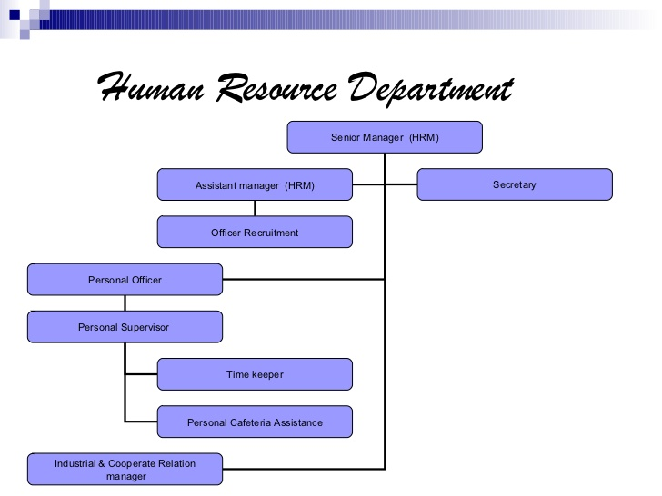

Slide 7


Slide 8


Slide 9

Thank you for your attention!

