Slide 1
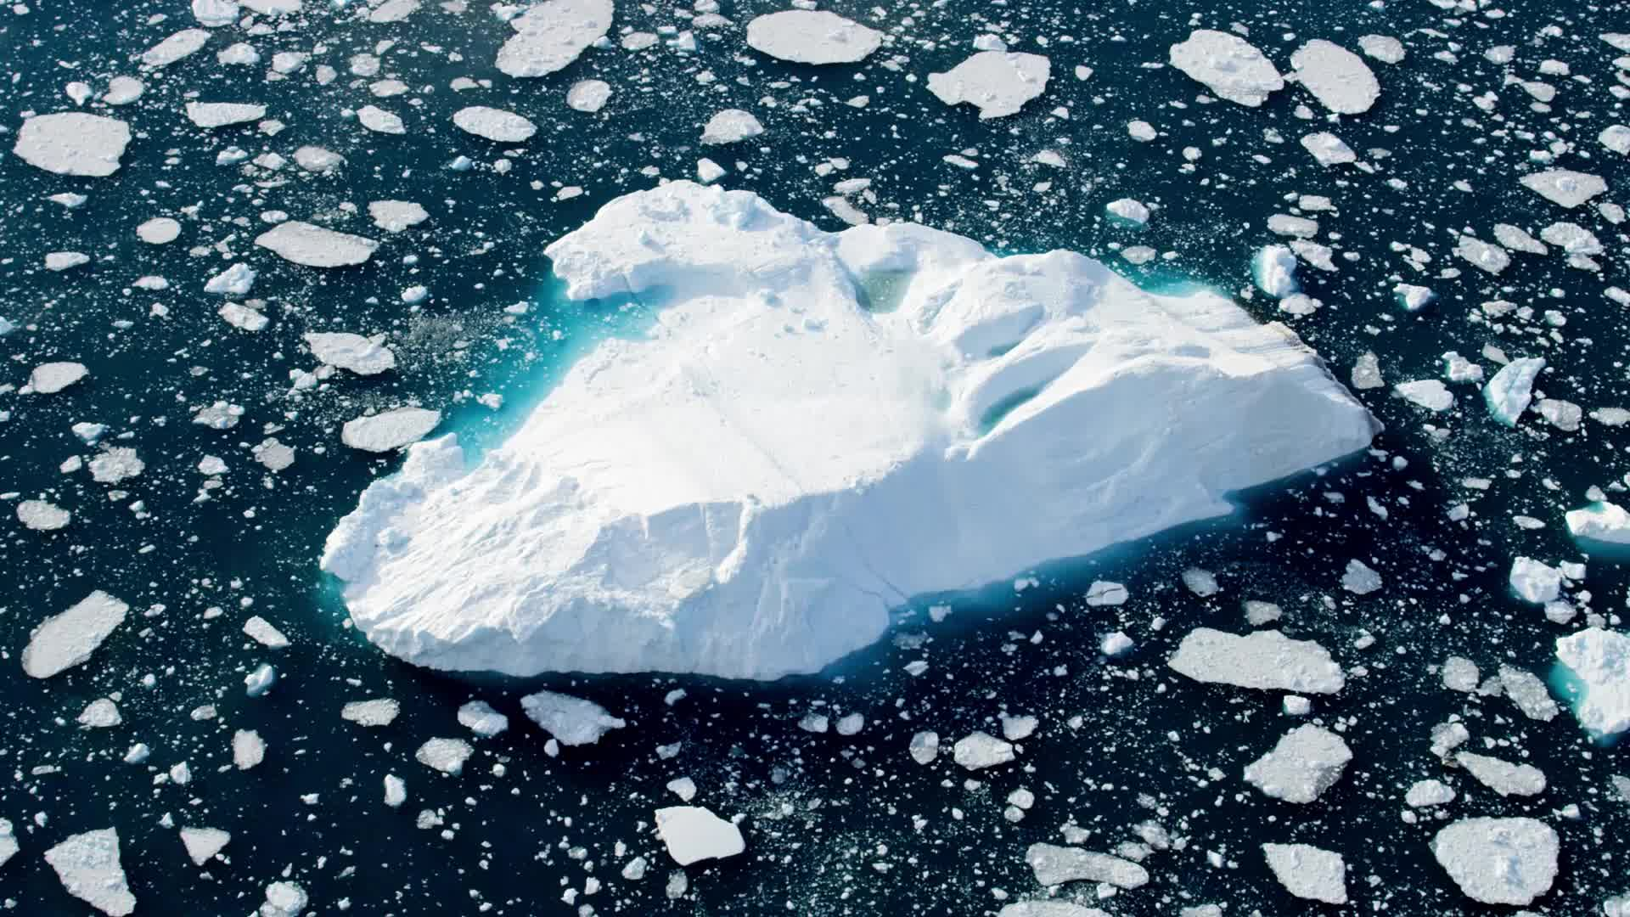

Hotel Marketing and sales
Станислав 10б

Slide 2
What is hotel sales and marketing?
A Sales and marketing manager in the hotel industry is responsible for maximizing a hotel’s revenues by developing programmes to increase occupancy and make profitable use of its accommodation, meeting and leisure facilities.
The manager must maintain awareness of the factors that influence the hotel industry and gain a deep understanding of the needs and attitudes of a hotel’s customers.
A manager will be responsible for coordinating marketing and promotional activities to meet customer needs, working closely with other hotel staff to ensure customers are satisfied with the facilities and their time there.
The Sales and marketing team has a substantial influence on the profitability of the business.
He or she have to define roles that reflect the strengths of your products and assign responsibilities for achieving the sales performance required by the company.
When your marketing strategy builds on the roles taken on by the members of your team, they can set achievable targets and take responsibility for meeting their objectives.

Slide 3
How do you promote hotel sales?
Let people take virtual tours of your hotel.
Use fresh, interesting, content to answer travellers' questions.
Keep your website updated with local events.
Have conversations with followers on social media.
Link with local businesses to create lucrative partnerships.

Slide 4
What are the 5 concepts of marketing?
There are 5 marketing concepts that organizations adopt and execute. These are; (1) production concept, (2) product concept, (3) selling concept, (4) marketing concept, and (5) societal marketing concept.

Slide 5
Which marketing concept is best?
Here are five marketing concepts that organizations adopt and execute.
Production Concept.
Product Concept.
Selling Concept.
Marketing Concept.
Societal Marketing Concept.

Slide 6
What is the work of sales marketing?
The Sales and Marketing Manager's responsibilities include generating unique sales plans, creating engaging advertisements, emails, and promotional literature, developing pricing strategies, and meeting marketing and sales human resource objectives.

Slide 7
What is difference between marketing and selling?
In simple words, selling transforms the goods into money, but marketing is the method of serving and satisfying customer needs. The marketing process includes the planning of a product's and service's price, promotion and distribution.

Slide 8
What are the benefits of marketing?
Sales. When you employ good marketing tactics, you will make more sales.
Reputation. Your business reputation is very important. ...
Audience. ...
You earn trust. ...
Knowing what works. ...
Learning the marketplace.

Slide 9
What are the 5 Ps of marketing?
If you pursued a traditional marketing degree in the past 10 or 20 years, you were probably taught about the 5 Ps: product, price, place, promotion, and people. At the time, they were the key pieces of any marketing puzzle.

Slide 10
What are the 3 C's in marketing?
The 3 Cs are: Company, Customers and Competitors - the three semi-fixed environmental factors in your market. As the 4 Ps and 3 Cs all need to be considered in relation to each other, it doesn't really matter in what order you define them.

Slide 11
What skills are needed for sales and marketing?
Occupation specific skills: customer service, selling, negotiating and influencing, analysis and decision-making, and management skills. Areas of knowledge: the business environment, product knowledge, and financial awareness.

