Slide 1
Gymnázium a Střední odborná škola dr. Václava Šmejkala, Ústí nad Labem, příspěvková organizace
Stavbařů 5 Ústí nad Labem - Severní Terasa 400 11
Odloučené pracoviště
Stará 99

Slide 2
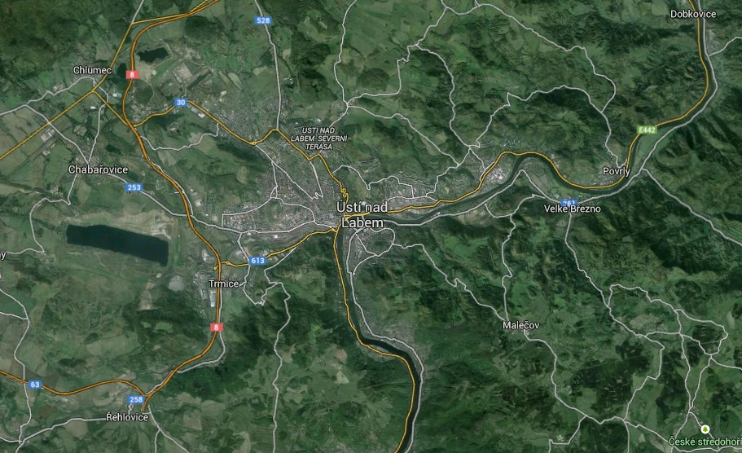
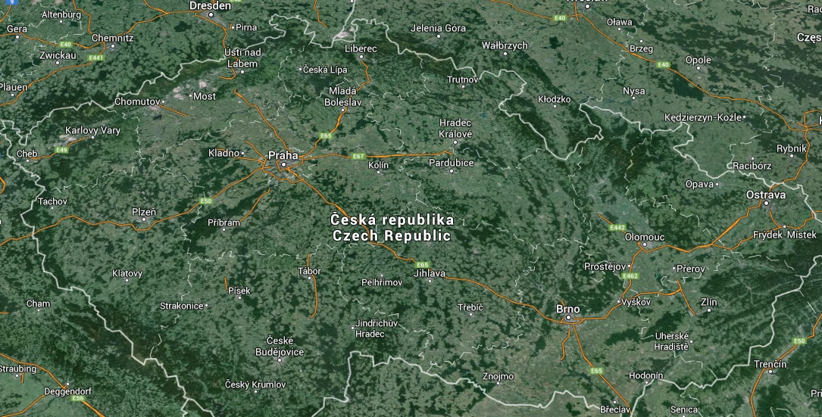
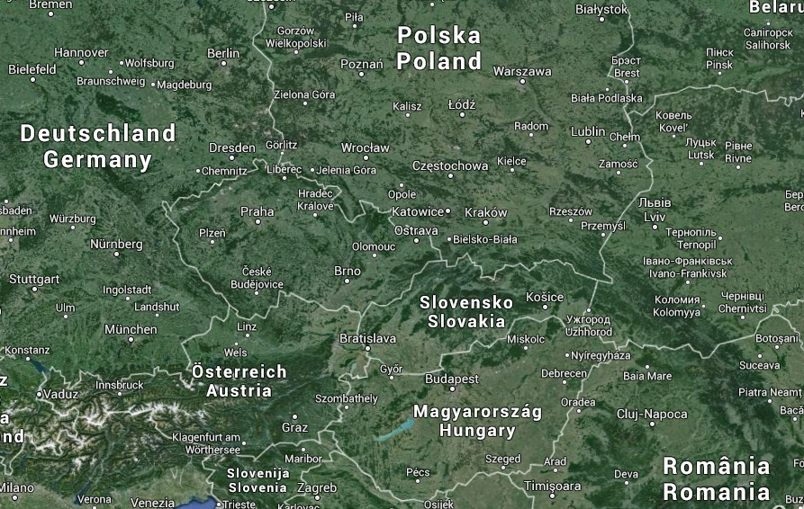
Ústí nad Labem

Slide 3
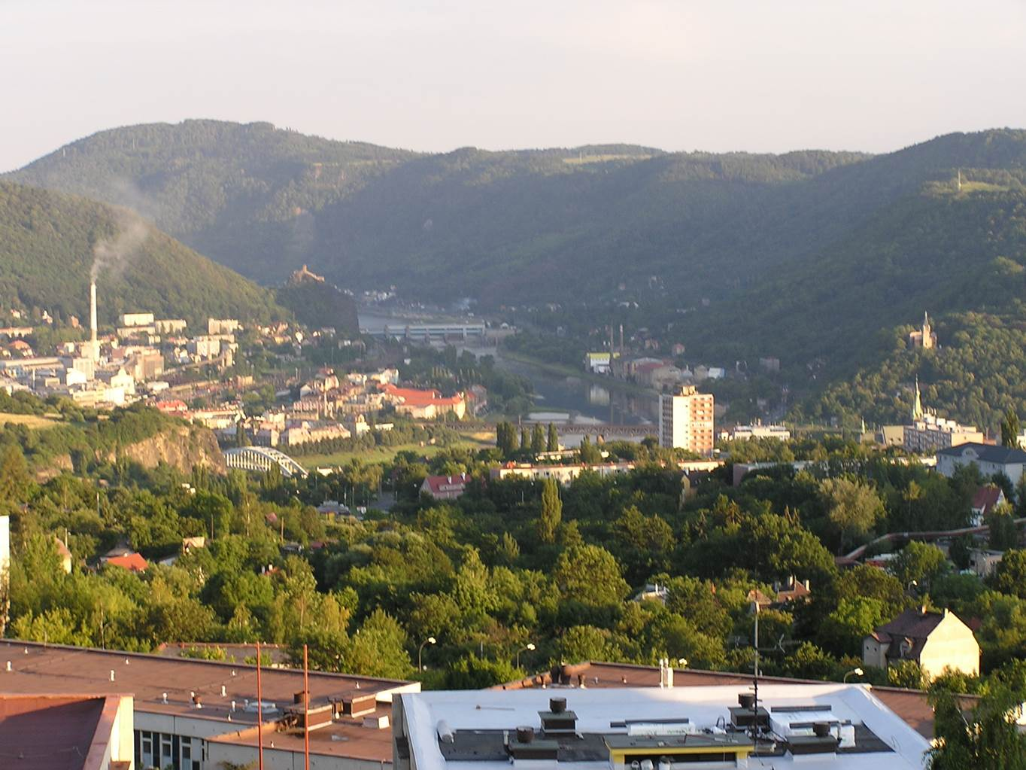
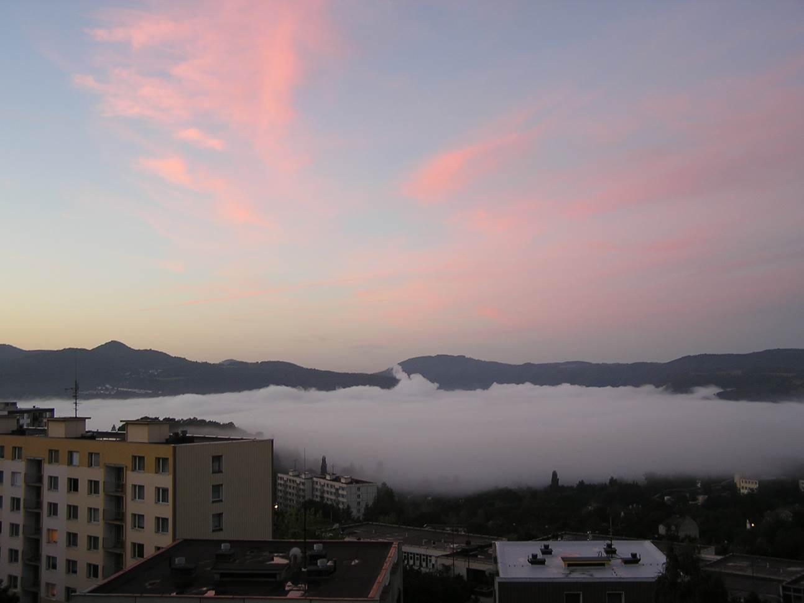
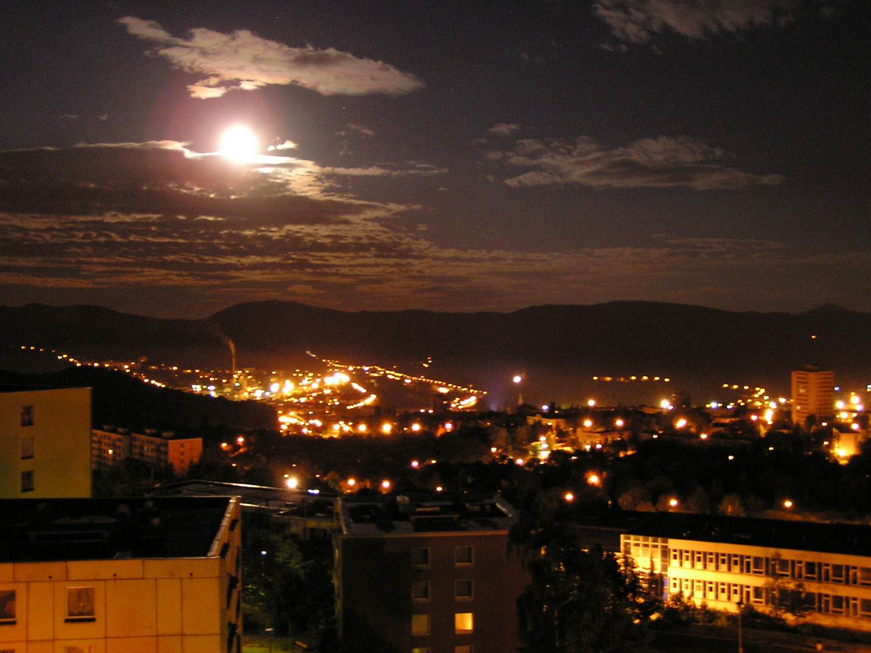
Ústí nad Labem

Slide 4
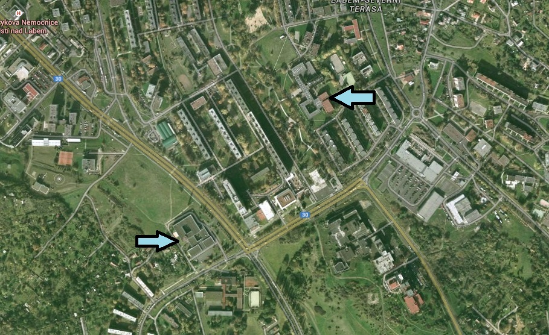
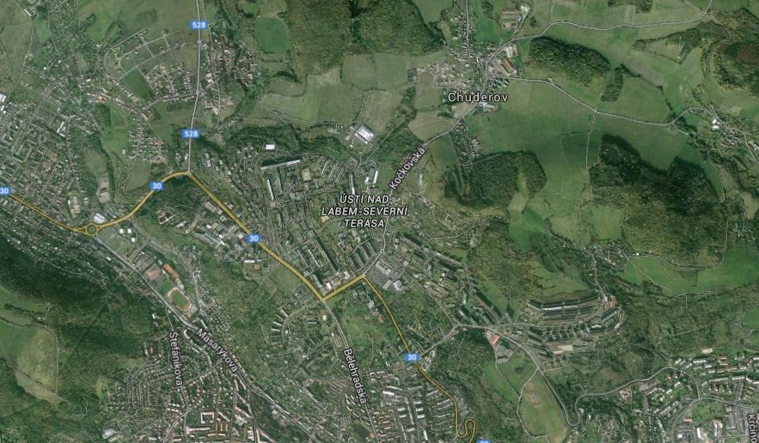
Gymnázium a Střední odborná škola dr. Václava Šmejkala

Slide 5
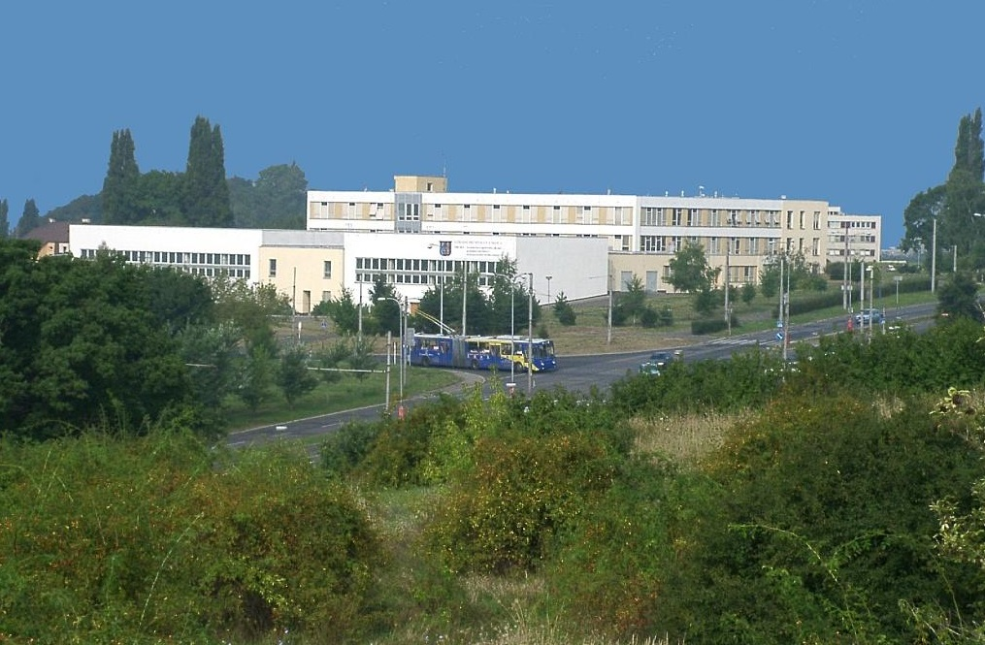
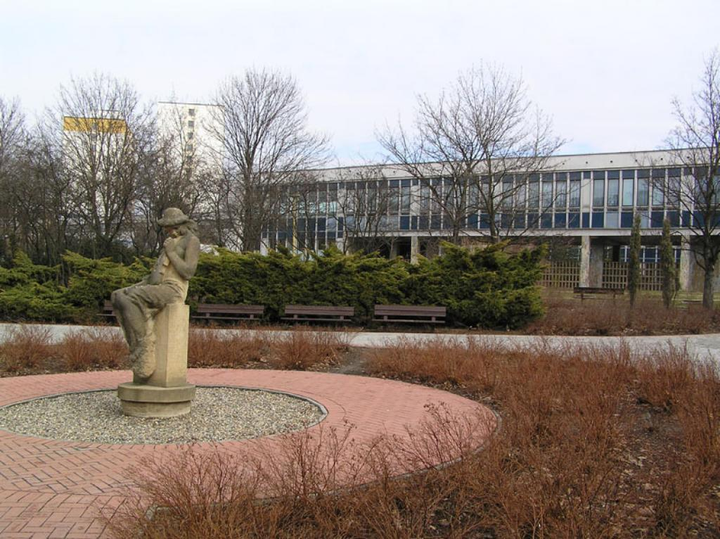
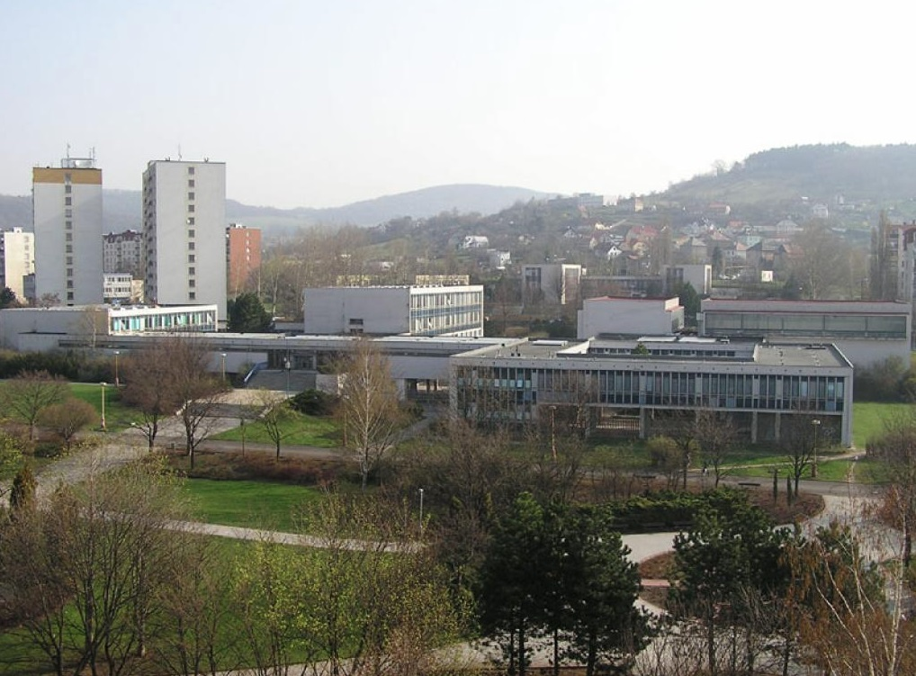
Gymnázium a Střední odborná škola dr. Václava Šmejkala

Slide 6
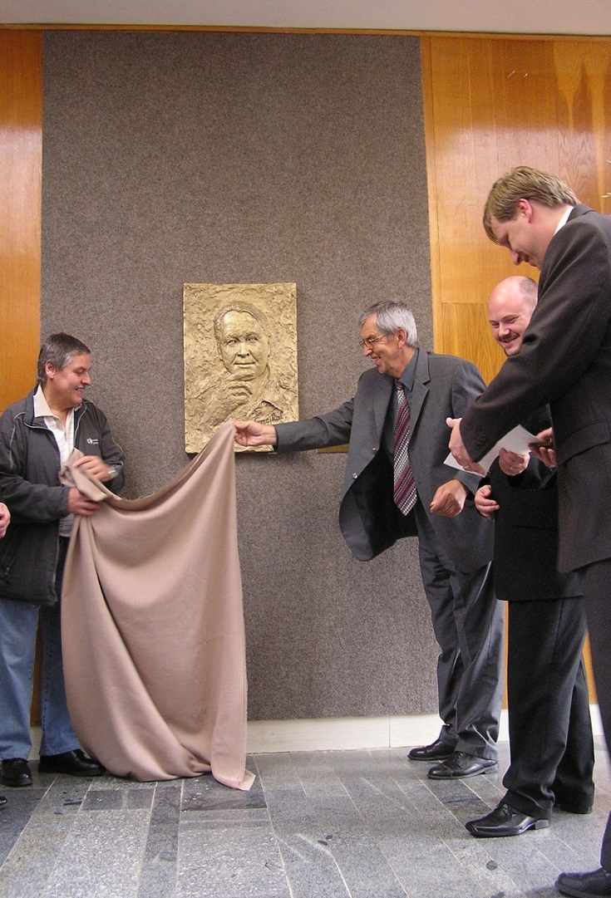
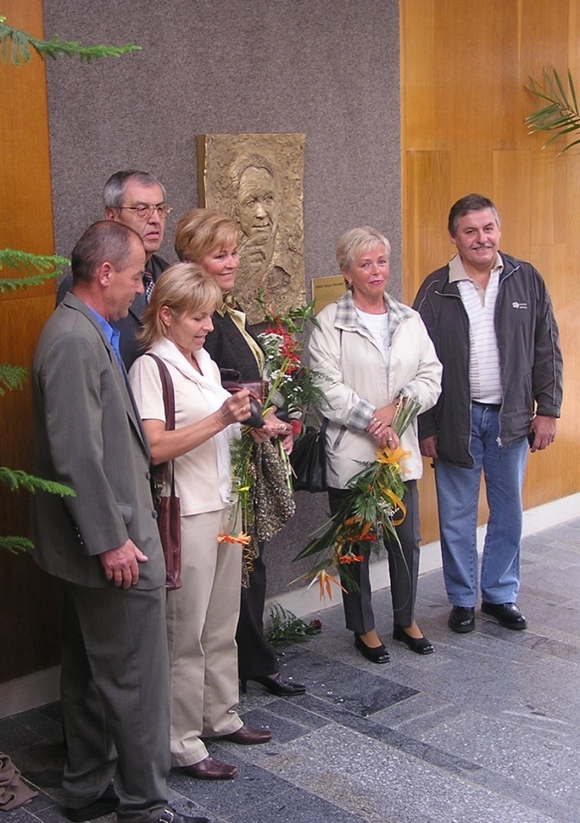
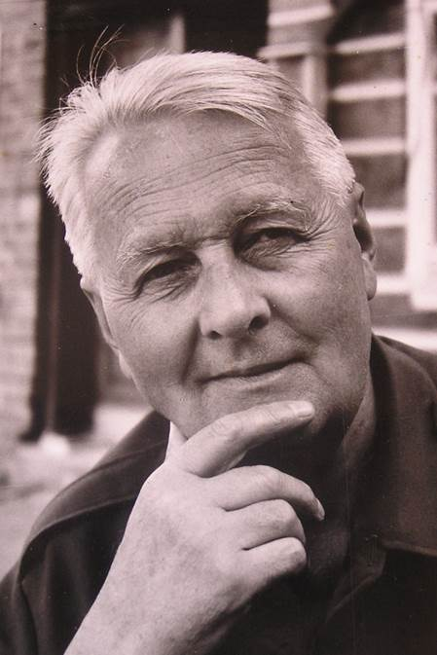
Škola je pojmenována po dr. Václavu Šmejkalovi
Notes:
Animated picture collection: center picture grow and return
(Intermediate)
Tip: For the effects on this slide, it is recommended to use pictures with a “portrait” (vertical) orientation. For best results, use this slide in combination with the previous slide in this PowerPoint file. This slide is the third slide in the picture collection sequence.
To reproduce the picture effects on this slide, do the following:
On the Home tab, in the Slides group, click Layout, and then click Blank.
On the Insert tab, in the Images group, click Picture. In the Insert Picture dialog box, select a picture, and then click Insert.
Select the picture. Under Picture Tools, on the Format tab, in the bottom right corner of the Size group, click the Size and Position dialog box launcher. In the Format Picture dialog box, resize or crop the picture as needed so that the height is set to 3.5” and the width is set to 2.35”.
To crop the picture, click Crop in the left pane, and in the Crop pane, under Crop position, enter values into the Height, Width, Left, and Top boxes.
To resize the picture, click Size in the left pane, and in the Size pane, under Size and rotate, enter values into the Height and Width boxes.
Also in the Format Picture dialog box, click Line Color in the left pane. In the Line Color pane, select Solid line, click the button next to Color, and then under Theme Colors click Black, Text 1, Lighter 25% (fourth row, second option from the left).
Also in the Format Picture dialog box, click Line Style in the left pane, and then in the Line Style pane, in the Width box, enter 8 pt.
Also in the Format Picture dialog box, click Shadow in the left pane. In the Shadow pane, click the button next to Presets, and then under Perspective, click Perspective Diagonal Upper Right (first row, second option from the left).
Also in the Format Picture dialog box, click 3-D Format in the left pane, and then do the following in the 3-D Format tab:
Under Bevel, click the button next to Top, and then under Bevel click Relaxed Inset (first row, second option from the left). Next to Top, in the Width box, enter 8 pt, and in the Height box, enter 6 pt.
Under Depth, click the button next to Color, and then under Theme Colors click Black, Text 1, Lighter 25% (fourth row, second option from the left). In the Depth box, enter 12 pt.
Under Surface, click the button next to Material, and then under Standard click Warm Matte (second option from the left).
On the Home tab, in the Drawing group, click Arrange, point to Align, and then do the following:
Click Align to Slide.
Click Align Center.
On the Home tab, in the Clipboard group, click the arrow to the right of Copy, and then click Duplicate. Drag the duplicate picture to the right on the slide.
Right-click the duplicate picture, and click Change Picture. In the Insert Picture dialog box, select a picture and click Insert.
Select the first picture. On the Home tab, in the Clipboard group, click the arrow to the right of Copy, and then click Duplicate. Drag the duplicate picture to the left on the slide.
Right-click the duplicate picture, and click Change Picture. In the Insert Picture dialog box, select a picture and click Insert.
Select the picture on the left side of the slide. On the Home tab, in the bottom right corner of the Drawing group, click the Format Picture dialog box launcher. In the Format Picture dialog box, click 3-D Rotation in the left pane. In the 3-D Rotation pane, click the button next to Presets, and then under Perspective, click Perspective Heroic Extreme Right (third row, third option from the left).
Also in the Format Picture dialog box, resize or crop the picture as needed so that the height is set to 3.8” and the width is set to 2.53”.
To crop the picture, click Crop in the left pane, and in the Crop pane, under Crop position, enter values into the Height, Width, Left, and Top boxes.
To resize the picture, click Size in the left pane, and in the Size pane, under Size and rotate, enter values into the Height and Width boxes.
Select the picture on the right side of the slide. On the Home tab, in the bottom right corner of the Drawing group, click the Format Picture dialog box launcher. In the Format Picture dialog box, click 3-D Rotation in the left pane. In the 3-D Rotation pane, click the button next to Presets, and then under Perspective, click Perspective Heroic Extreme Left (third row, second option from the left).
Also in the Format Picture dialog box, resize or crop the picture as needed so that height is set to 4.17” and the width is set to 2.78”.
To crop the picture, click Crop in the left pane, and in the Crop pane, under Crop position, enter values into the Height, Width, Left, and Top boxes.
To resize the picture, click Size in the left pane, and in the Size pane, under Size and rotate, enter values into the Height and Width boxes.
Select the picture in the middle of the slide. On the Home tab, in the bottom right corner of the Drawing group, click the Format Shape dialog box launcher. In the Format Picture dialog box, in the left pane, click Shadow. In the Shadow pane, click the button next to Presets, and then under No Shadow click No Shadow.
Select the picture in the middle of the slide. On the Home tab, in the Clipboard group, click the arrow to the right of Copy, and then click Duplicate.
Select the duplicate picture. On the Home tab, Drawing group, click Arrange, under Position Objects, point to Align, and then do the following:
Click Align to Slide.
Click Align Center.
Click Align Middle.
Under Picture Tools, on the Format tab, in the bottom right corner of the Size group, click the Size and Position dialog box launcher. In the Format Picture dialog box, on the Size tab, under Size and rotate, do the following:
In the Height box, enter 5.83”.
In the Width box, enter 3.91”.
Under Picture Tools, on the Format tab, in the Picture Styles group, click Picture Effects, point to 3-D Rotation, and then click No Rotation.
To reproduce the animation effects on this slide, do the following:
Right-click the slide background, and then click Grid and Guides. In the Grid and Guides dialog box, under Guide settings, select Display drawing guides on screen. (Note: One horizontal and one vertical guide will display on the slide at 0.00.)
On the Home tab, in the Editing group, click Select, and then click Selection Pane.
In the Selection and Visibility pane, select the original small picture behind the large duplicate picture in the center of the slide. On the Animations tab, in the Advanced Animation tab, click Add Animation, and then under Emphasis click Grow/Shrink.
Also on the Animations tab, in the Animation group, click the Effect Options dialog box launcher. In the Grow/Shrink dialog box, do the following:
On the Effect tab, under Settings, in the Size list, in the Custom box, enter 165%, and then press ENTER.
Also under Settings, select Auto-reverse.
On the Timing tab, in the Start list, select With Previous.
Also on the Timing tab, in the Duration list, select 1.00 seconds (Fast).
On the Animations tab, in the Advanced Animation group, click Add Animation, and then under Motion Paths click Lines.
Also on the Animations tab, in the Animation group, click the Effect Options dialog box launcher. In the Down dialog box, do the following:
On the Effect tab, under Settings, in the Smooth start box enter 0, and in the Smooth end box enter 0.
Also under Settings, select Auto-reverse.
On the Timing tab, in the Start list, select With Previous.
Also on the Timing tab, in the Duration list, select 1.00 seconds (Fast).
On the slide, select the down motion path. Point to the endpoint (red arrow) of the selected down motion path until the cursor becomes a two-headed arrow. Drag the endpoint to the intersection of the horizontal and vertical drawing guides at the center of the slide.
Select the large duplicate picture in the front center of the slide. On the Animations tab, in the Advanced Animation group, click Add Animation, and then under Entrance click Appear.
Also on the Animations tab, in the Timing group, do the following:
In the Start list, select With Previous.
In the Delay box, enter 1.00 second.
In the Selection and Visibility pane, select the original small picture behind the large duplicate picture in the center of the slide. On the Animations tab, in the Advanced Animation group, click Add Animation, and then under Exit click Disappear.
Also on the Animations tab, in the Timing group, do the following:
In the Start list, select With Previous.
In the Delay box, enter 1.00 second.
Select the large duplicate picture in the front center of the slide. On the Animations tab, in the Advanced Animation group, click Add Animation, and then under Emphasis click Grow/Shrink.
Also on the Animations tab, in the Animation group, click the Effect Options dialog box launcher. In the Grow/Shrink dialog box, do the following:
On the Effect tab, under in the Size list, in the Custom box, enter 60%, and then press ENTER.
On the Timing tab, in the Start list, select On Click.
Also on the Timing tab, in the Duration list, select 1.00 seconds (Fast).
On the Animations tab, in the Advanced Animation group, click Add Animation, and then under Motion Paths click Lines.
Also on the Animations tab, in the Animation group, click the Effect Options dialog box launcher. In the Down dialog box, do the following:
On the Effect tab, under Settings, in the Smooth start box enter 0, and in the Smooth end box enter 0.
On the Timing tab, in the Start list, select With Previous.
Also on the Timing tab, in the Duration list, select 1.00 seconds (Fast).
On the slide, select the sixth animation effect (down motion path). Point to the endpoint (red arrow) of the selected up motion path until the cursor becomes a two-headed arrow. Drag the endpoint to the same position as the starting point (green arrow) for the first motion path.
Select the large duplicate picture in the front center of the slide. On the Animations tab, in the Advanced Animation group, click Add Animation, and then under Exit click Disappear.
Also on the Animations tab, in the Timing group, in the Start list, select After Previous.
In the Selection and Visibility pane, select the small original picture in the center of the slide. On Animations tab, in the Advanced Animation group, click Add Animation, and then under Entrance click Appear.
Also on the Animations tab, in the Timing group, in the Start list, select After Previous.
To reproduce the background effects on this slide, do the following:
Right-click the slide background area, and then click Format Background. In the Format Background dialog box, click Fill in the left pane, select Gradient fill in the Fill pane, and then do the following:
In the Type list, select Linear.
Click the button next to Direction, and then click Linear Down (first row, second option from the left).
Under Gradient stops, click Add gradient stops or Remove gradient stops until four stops appear in the drop-down list.
Also under Gradient stops, customize the gradient stops as follows:
Select the first stop in the slider, and then do the following:
In the Position box, enter 0%.
Click the button next to Color, and then under Theme Colors click Black, Text 1, Lighter 5% (sixth row, second option from the left).
Select the next stop in the slider, and then do the following:
In the Position box, enter 24%.
Click the button next to Color, click More Colors, and then in the Colors dialog box, on the Custom tab, enter values for Red: 125, Green: 121, and Blue: 107.
Select the next stop in the slider, and then do the following:
In the Position box, enter 35%.
Click the button next to Color, click More Colors, and then in the Colors dialog box, on the Custom tab, enter values for Red: 125, Green: 121, Blue: 107.
Select the last stop in the slider, and then do the following:
In the Position box, enter 90%.
Click the button next to Color, and then under Theme Colors click Black, Text 1, Lighter 5% (sixth row, second option from the left).

Slide 7
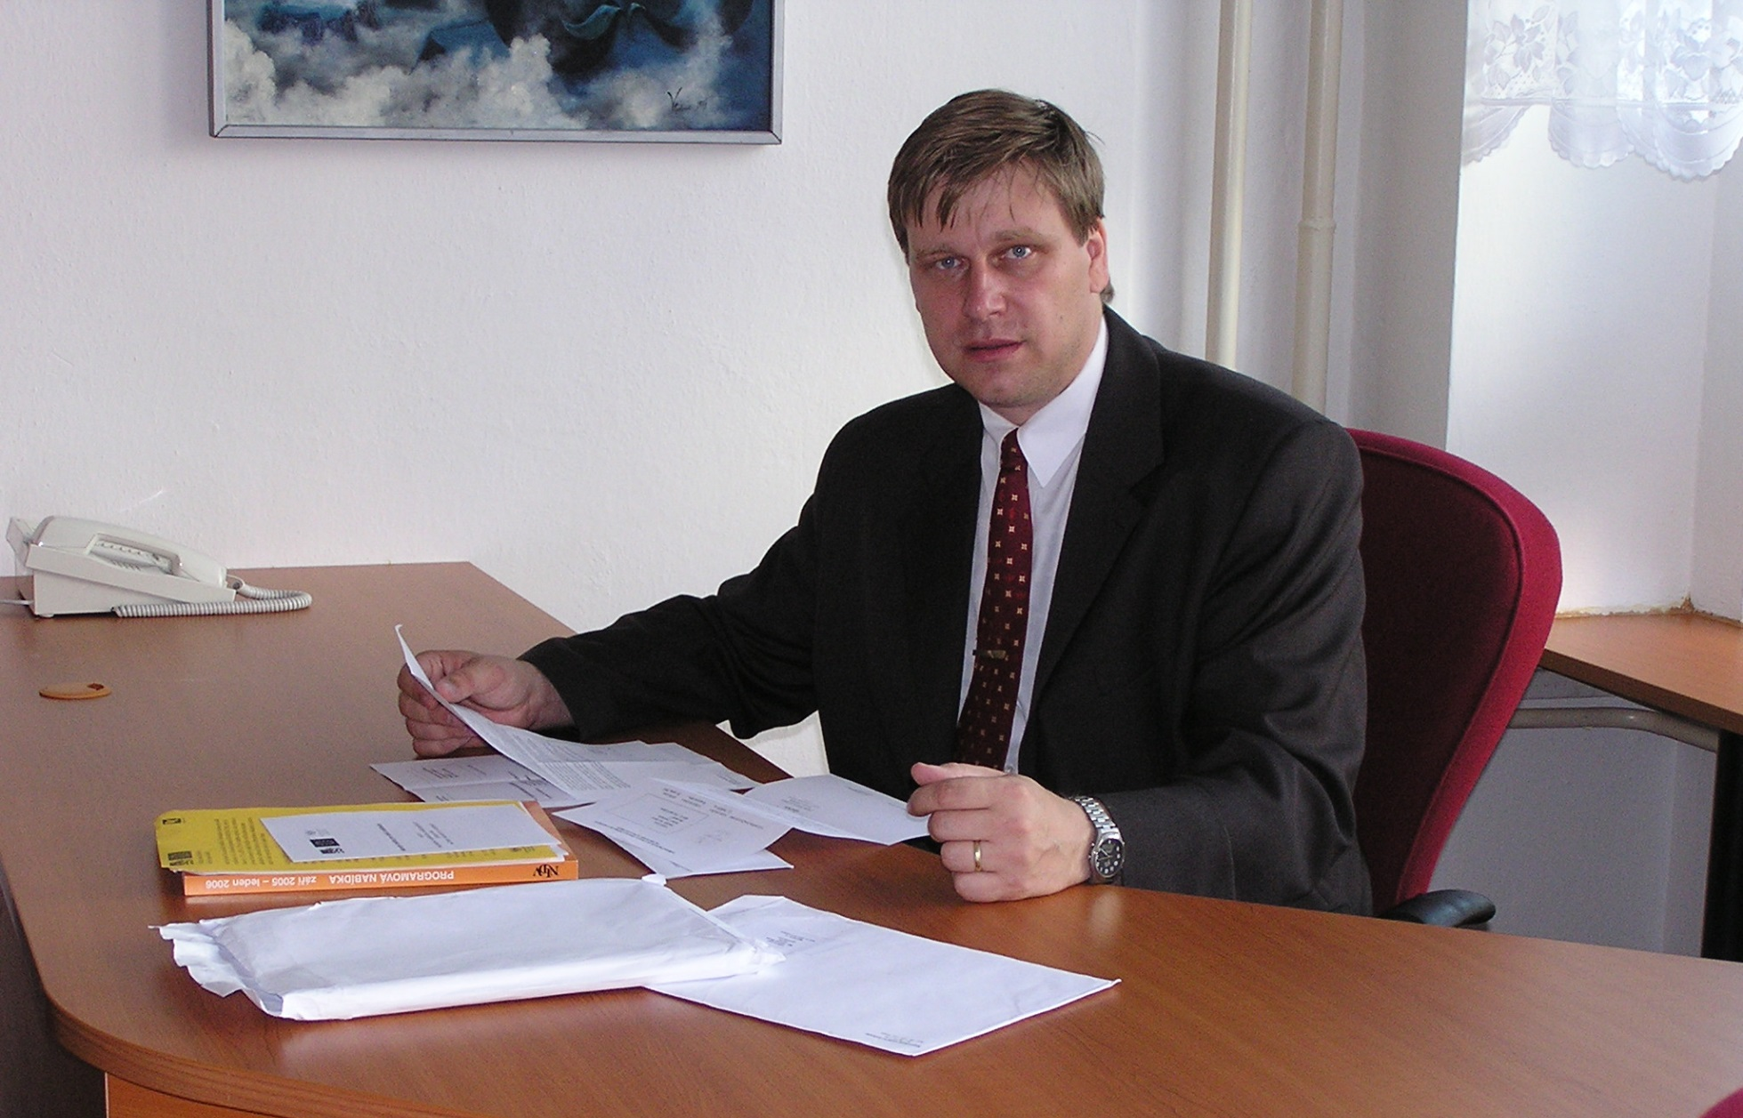
Mgr. Ing. Michal Šidák - ředitel školy

Slide 8
Obory vzdělání
Osmileté studium (12 - 18 let)
79 - 41 - K / 81 - gymnázium
Čtyřleté studium (15 – 18 let)
79 - 41 - K / 41 - gymnázium
78 - 42 - M / 05 - přírodovědné lyceum
28 - 44 - M / 01 - aplikovaná chemie
68 - 43 - M / 01 - veřejnosprávní činnost
75 - 41 - M / 01 - sociální činnost

Slide 9
Gymnázium
Absolvent je připraven pro studium na vysokých školách všech směrů.
Díky vzdělanostnímu základu může také nalézt uplatnění na trhu práce.
Notes:
Pictures in 3-D flip book
(Intermediate)
To reproduce the picture effects on this slide, do the following:
On the Home tab, in the Slides group, click Layout, and then click Blank.
Also on the Home tab, in the Drawing group, click Shapes, and then under Rectangles click Rectangle (first option from the left).
On the slide, drag to draw a rectangle.
Select the rectangle. Under Drawing Tools, on the Format tab, in the Size group, enter 3.71” in the Height box and 2.57” in the Width box.
Also under Drawing Tools, on the Format tab, in the Shape Styles group, click Shape Outline, and then click No Outline.
On the Home tab, in the Clipboard group, click the arrow to the right of Copy, and then click Duplicate.
Select the first rectangle. Under Drawing Tools, on the Format tab, in the Shape Styles group, click Shape Fill, and then click Picture. In the Insert Picture dialog box, select a picture and then click Insert.
Also under Drawing Tools, on the Format tab, in the Shape Styles group, click Shape Effects, point to 3-D Rotation, and then click 3-D Rotation Options. In the Format Shape dialog box, click 3-D Rotation in the left pane, and in the 3-D Rotation pane do the following:
Click the button next to Presets, and then under Perspective click Perspective Contrasting Right.
In the X box, enter 342.5°.
In the Y box, enter 57.2°.
In the Z box, enter 11°.
In the Perspective box, enter 25°.
Select the second rectangle. Under Drawing Tools, on the Format tab, in the Shape Styles group, click Shape Fill, and then click Picture. In the Insert Picture dialog box, select another picture and then click Insert.
Also under Drawing Tools, on the Format tab, in the Shape Styles group, click Shape Effects, point to 3-D Rotation, and then click 3-D Rotation Options. In the Format Shape dialog box, click 3-D Rotation in the left pane, and in the 3-D Rotation pane do the following:
In the Presets list, under Perspective, click Perspective Contrasting Right.
In the X box, enter 300.6°.
In the Y box, enter 68.7°.
In the Z box, enter 329°.
In the Perspective box, enter 0°.
Position the two rectangles so that the bottom left corners touch.
On the Home tab, in the Drawing group, click Shapes, and then under Rectangles click Rectangle.
On the slide, drag to draw a rectangle.
Select the rectangle. Under Drawing Tools, on the Format tab, in the Size group, enter 2.5” into the Height box and 3.25” into the Width box.
Also under Drawing Tools, on the Format tab, in the Shape Styles group, click Shape Outline, and then click No Outline.
On the Home tab, in the Clipboard group, click the arrow to the right of Copy, and then click Duplicate.
Select the third rectangle. Under Drawing Tools, on the Format tab, in the Shape Styles group, click Shape Fill, and then click Picture. In the Insert Picture dialog box, select a picture and then click Insert.
Also under Drawing Tools, on the Format tab, in the Shape Styles group, click Shape Effects, point to 3-D Rotation, and then click 3-D Rotation Options. In the Format Picture dialog box, click 3-D Rotation in the left pane, and in the 3-D Rotation pane do the following:
Click the button next to Presets, and then under Perspective click Perspective Contrasting Right.
In the X box, enter 303.1°.
In the Y box, enter 313°.
In the Z box, enter 78°.
In the Perspective box, enter 100°.
Select the fourth rectangle. Under Drawing Tools, on the Format tab, in the Shape Styles group, click Shape Fill, and then click Picture. In the Insert Picture dialog box, select a picture and then click Insert.
Also under Drawing Tools, on the Format tab, in the Shape Styles group, click Shape Effects, point to 3-D Rotation, and then click 3-D Rotation Options. In the Format Picture dialog box, click 3-D Rotation in the left pane, and in the 3-D Rotation pane do the following:
Click the button next to Presets, and then under Perspective click Perspective Contrasting Right.
In the X box, enter 310.3°.
In the Y box, enter 330°.
In the Z box, enter 63°.
In the Perspective box, enter 90°.
Also in the Format Picture dialog box, click Shadow in the left pane, and in the Shadow pane, do the following:
Click the button next to Color, and then under Theme Colors click Black, Text 1.
In the Transparency box, enter 47%.
In the Size box, enter 102%.
In the Blur box, enter 16 pt.
In the Angle box, enter 160°.
In the Distance box, enter 4 pt.
Position the third and fourth rectangles so that the left corners touch the bottom left corners of the first and second rectangles.
To reproduce the background effects on this slide, do the following:
Right-click the slide background area, and then click Format Background. In the Format Background dialog box, click Fill in the left pane, select Gradient fill in the Fill pane, and then do the following:
In the Type list, select Linear.
Click the button next to Direction, and then click Linear Down (first row, second option from the left).
Under Gradient stops, click Add gradient stops or Remove gradient stops until four stops appear in the slider.
Also under Gradient stops, customize the gradient stops as follows:
Select the first stop in the slider, and then do the following:
In the Position box, enter 0%.
Click the button next to Color, and then under Theme Colors click White, Background 1, Darker 15% (third row, first option from the left).
Select the next stop in the slider, and then do the following:
In the Stop position box, enter 56%.
Click the button next to Color, and then under Theme Colors click White, Background 1, Darker 5% (second row, first option from the left).
Select the next stop in the slider, and then do the following:
In the Stop position box, enter 57%.
Click the button next to Color, click More Colors, and then in the Colors dialog box, on the Custom tab, enter values for Red: 169, Green: 169, Blue: 169.
Select the last stop in the slider, and then do the following:
In the Stop position box, enter 100%.
Click the button next to Color, click More Colors, and then in the Colors dialog box, on the Custom tab, enter values for Red: 211, Green: 211, Blue: 211.

Slide 10
Přírodovědné lyceum
Absolvent je připraven
ke studiu na VŠ a VOŠ zejména technologického a přírodovědného charakteru. Získal potřebné kompetence pro uplatnění na trhu práce.
Notes:
Pictures in 3-D flip book
(Intermediate)
To reproduce the picture effects on this slide, do the following:
On the Home tab, in the Slides group, click Layout, and then click Blank.
Also on the Home tab, in the Drawing group, click Shapes, and then under Rectangles click Rectangle (first option from the left).
On the slide, drag to draw a rectangle.
Select the rectangle. Under Drawing Tools, on the Format tab, in the Size group, enter 3.71” in the Height box and 2.57” in the Width box.
Also under Drawing Tools, on the Format tab, in the Shape Styles group, click Shape Outline, and then click No Outline.
On the Home tab, in the Clipboard group, click the arrow to the right of Copy, and then click Duplicate.
Select the first rectangle. Under Drawing Tools, on the Format tab, in the Shape Styles group, click Shape Fill, and then click Picture. In the Insert Picture dialog box, select a picture and then click Insert.
Also under Drawing Tools, on the Format tab, in the Shape Styles group, click Shape Effects, point to 3-D Rotation, and then click 3-D Rotation Options. In the Format Shape dialog box, click 3-D Rotation in the left pane, and in the 3-D Rotation pane do the following:
Click the button next to Presets, and then under Perspective click Perspective Contrasting Right.
In the X box, enter 342.5°.
In the Y box, enter 57.2°.
In the Z box, enter 11°.
In the Perspective box, enter 25°.
Select the second rectangle. Under Drawing Tools, on the Format tab, in the Shape Styles group, click Shape Fill, and then click Picture. In the Insert Picture dialog box, select another picture and then click Insert.
Also under Drawing Tools, on the Format tab, in the Shape Styles group, click Shape Effects, point to 3-D Rotation, and then click 3-D Rotation Options. In the Format Shape dialog box, click 3-D Rotation in the left pane, and in the 3-D Rotation pane do the following:
In the Presets list, under Perspective, click Perspective Contrasting Right.
In the X box, enter 300.6°.
In the Y box, enter 68.7°.
In the Z box, enter 329°.
In the Perspective box, enter 0°.
Position the two rectangles so that the bottom left corners touch.
On the Home tab, in the Drawing group, click Shapes, and then under Rectangles click Rectangle.
On the slide, drag to draw a rectangle.
Select the rectangle. Under Drawing Tools, on the Format tab, in the Size group, enter 2.5” into the Height box and 3.25” into the Width box.
Also under Drawing Tools, on the Format tab, in the Shape Styles group, click Shape Outline, and then click No Outline.
On the Home tab, in the Clipboard group, click the arrow to the right of Copy, and then click Duplicate.
Select the third rectangle. Under Drawing Tools, on the Format tab, in the Shape Styles group, click Shape Fill, and then click Picture. In the Insert Picture dialog box, select a picture and then click Insert.
Also under Drawing Tools, on the Format tab, in the Shape Styles group, click Shape Effects, point to 3-D Rotation, and then click 3-D Rotation Options. In the Format Picture dialog box, click 3-D Rotation in the left pane, and in the 3-D Rotation pane do the following:
Click the button next to Presets, and then under Perspective click Perspective Contrasting Right.
In the X box, enter 303.1°.
In the Y box, enter 313°.
In the Z box, enter 78°.
In the Perspective box, enter 100°.
Select the fourth rectangle. Under Drawing Tools, on the Format tab, in the Shape Styles group, click Shape Fill, and then click Picture. In the Insert Picture dialog box, select a picture and then click Insert.
Also under Drawing Tools, on the Format tab, in the Shape Styles group, click Shape Effects, point to 3-D Rotation, and then click 3-D Rotation Options. In the Format Picture dialog box, click 3-D Rotation in the left pane, and in the 3-D Rotation pane do the following:
Click the button next to Presets, and then under Perspective click Perspective Contrasting Right.
In the X box, enter 310.3°.
In the Y box, enter 330°.
In the Z box, enter 63°.
In the Perspective box, enter 90°.
Also in the Format Picture dialog box, click Shadow in the left pane, and in the Shadow pane, do the following:
Click the button next to Color, and then under Theme Colors click Black, Text 1.
In the Transparency box, enter 47%.
In the Size box, enter 102%.
In the Blur box, enter 16 pt.
In the Angle box, enter 160°.
In the Distance box, enter 4 pt.
Position the third and fourth rectangles so that the left corners touch the bottom left corners of the first and second rectangles.
To reproduce the background effects on this slide, do the following:
Right-click the slide background area, and then click Format Background. In the Format Background dialog box, click Fill in the left pane, select Gradient fill in the Fill pane, and then do the following:
In the Type list, select Linear.
Click the button next to Direction, and then click Linear Down (first row, second option from the left).
Under Gradient stops, click Add gradient stops or Remove gradient stops until four stops appear in the slider.
Also under Gradient stops, customize the gradient stops as follows:
Select the first stop in the slider, and then do the following:
In the Position box, enter 0%.
Click the button next to Color, and then under Theme Colors click White, Background 1, Darker 15% (third row, first option from the left).
Select the next stop in the slider, and then do the following:
In the Stop position box, enter 56%.
Click the button next to Color, and then under Theme Colors click White, Background 1, Darker 5% (second row, first option from the left).
Select the next stop in the slider, and then do the following:
In the Stop position box, enter 57%.
Click the button next to Color, click More Colors, and then in the Colors dialog box, on the Custom tab, enter values for Red: 169, Green: 169, Blue: 169.
Select the last stop in the slider, and then do the following:
In the Stop position box, enter 100%.
Click the button next to Color, click More Colors, and then in the Colors dialog box, on the Custom tab, enter values for Red: 211, Green: 211, Blue: 211.

Slide 11
Aplikovaná chemie
Absolvent je připraven ke studiu na VOŠ a VŠ zaměřených především na chemii, farmacii, životní prostředí nebo přírodní vědy.
Uplatní se při výkonu povolání:
chemický technik
kontrolor jakosti
technolog
manažer provozu
Notes:
Pictures in 3-D flip book
(Intermediate)
To reproduce the picture effects on this slide, do the following:
On the Home tab, in the Slides group, click Layout, and then click Blank.
Also on the Home tab, in the Drawing group, click Shapes, and then under Rectangles click Rectangle (first option from the left).
On the slide, drag to draw a rectangle.
Select the rectangle. Under Drawing Tools, on the Format tab, in the Size group, enter 3.71” in the Height box and 2.57” in the Width box.
Also under Drawing Tools, on the Format tab, in the Shape Styles group, click Shape Outline, and then click No Outline.
On the Home tab, in the Clipboard group, click the arrow to the right of Copy, and then click Duplicate.
Select the first rectangle. Under Drawing Tools, on the Format tab, in the Shape Styles group, click Shape Fill, and then click Picture. In the Insert Picture dialog box, select a picture and then click Insert.
Also under Drawing Tools, on the Format tab, in the Shape Styles group, click Shape Effects, point to 3-D Rotation, and then click 3-D Rotation Options. In the Format Shape dialog box, click 3-D Rotation in the left pane, and in the 3-D Rotation pane do the following:
Click the button next to Presets, and then under Perspective click Perspective Contrasting Right.
In the X box, enter 342.5°.
In the Y box, enter 57.2°.
In the Z box, enter 11°.
In the Perspective box, enter 25°.
Select the second rectangle. Under Drawing Tools, on the Format tab, in the Shape Styles group, click Shape Fill, and then click Picture. In the Insert Picture dialog box, select another picture and then click Insert.
Also under Drawing Tools, on the Format tab, in the Shape Styles group, click Shape Effects, point to 3-D Rotation, and then click 3-D Rotation Options. In the Format Shape dialog box, click 3-D Rotation in the left pane, and in the 3-D Rotation pane do the following:
In the Presets list, under Perspective, click Perspective Contrasting Right.
In the X box, enter 300.6°.
In the Y box, enter 68.7°.
In the Z box, enter 329°.
In the Perspective box, enter 0°.
Position the two rectangles so that the bottom left corners touch.
On the Home tab, in the Drawing group, click Shapes, and then under Rectangles click Rectangle.
On the slide, drag to draw a rectangle.
Select the rectangle. Under Drawing Tools, on the Format tab, in the Size group, enter 2.5” into the Height box and 3.25” into the Width box.
Also under Drawing Tools, on the Format tab, in the Shape Styles group, click Shape Outline, and then click No Outline.
On the Home tab, in the Clipboard group, click the arrow to the right of Copy, and then click Duplicate.
Select the third rectangle. Under Drawing Tools, on the Format tab, in the Shape Styles group, click Shape Fill, and then click Picture. In the Insert Picture dialog box, select a picture and then click Insert.
Also under Drawing Tools, on the Format tab, in the Shape Styles group, click Shape Effects, point to 3-D Rotation, and then click 3-D Rotation Options. In the Format Picture dialog box, click 3-D Rotation in the left pane, and in the 3-D Rotation pane do the following:
Click the button next to Presets, and then under Perspective click Perspective Contrasting Right.
In the X box, enter 303.1°.
In the Y box, enter 313°.
In the Z box, enter 78°.
In the Perspective box, enter 100°.
Select the fourth rectangle. Under Drawing Tools, on the Format tab, in the Shape Styles group, click Shape Fill, and then click Picture. In the Insert Picture dialog box, select a picture and then click Insert.
Also under Drawing Tools, on the Format tab, in the Shape Styles group, click Shape Effects, point to 3-D Rotation, and then click 3-D Rotation Options. In the Format Picture dialog box, click 3-D Rotation in the left pane, and in the 3-D Rotation pane do the following:
Click the button next to Presets, and then under Perspective click Perspective Contrasting Right.
In the X box, enter 310.3°.
In the Y box, enter 330°.
In the Z box, enter 63°.
In the Perspective box, enter 90°.
Also in the Format Picture dialog box, click Shadow in the left pane, and in the Shadow pane, do the following:
Click the button next to Color, and then under Theme Colors click Black, Text 1.
In the Transparency box, enter 47%.
In the Size box, enter 102%.
In the Blur box, enter 16 pt.
In the Angle box, enter 160°.
In the Distance box, enter 4 pt.
Position the third and fourth rectangles so that the left corners touch the bottom left corners of the first and second rectangles.
To reproduce the background effects on this slide, do the following:
Right-click the slide background area, and then click Format Background. In the Format Background dialog box, click Fill in the left pane, select Gradient fill in the Fill pane, and then do the following:
In the Type list, select Linear.
Click the button next to Direction, and then click Linear Down (first row, second option from the left).
Under Gradient stops, click Add gradient stops or Remove gradient stops until four stops appear in the slider.
Also under Gradient stops, customize the gradient stops as follows:
Select the first stop in the slider, and then do the following:
In the Position box, enter 0%.
Click the button next to Color, and then under Theme Colors click White, Background 1, Darker 15% (third row, first option from the left).
Select the next stop in the slider, and then do the following:
In the Stop position box, enter 56%.
Click the button next to Color, and then under Theme Colors click White, Background 1, Darker 5% (second row, first option from the left).
Select the next stop in the slider, and then do the following:
In the Stop position box, enter 57%.
Click the button next to Color, click More Colors, and then in the Colors dialog box, on the Custom tab, enter values for Red: 169, Green: 169, Blue: 169.
Select the last stop in the slider, and then do the following:
In the Stop position box, enter 100%.
Click the button next to Color, click More Colors, and then in the Colors dialog box, on the Custom tab, enter values for Red: 211, Green: 211, Blue: 211.

Slide 12
Veřejnosprávní činnost
Absolvent disponuje kompetencemi pro činnost zaměstnance státní správy, samosprávy, na obecních i krajských úřadech.
V rámci dalšího vzdělávání může studovat na VOŠ i na VŠ veřejnosprávního, ekonomického směru.
Notes:
Pictures in 3-D flip book
(Intermediate)
To reproduce the picture effects on this slide, do the following:
On the Home tab, in the Slides group, click Layout, and then click Blank.
Also on the Home tab, in the Drawing group, click Shapes, and then under Rectangles click Rectangle (first option from the left).
On the slide, drag to draw a rectangle.
Select the rectangle. Under Drawing Tools, on the Format tab, in the Size group, enter 3.71” in the Height box and 2.57” in the Width box.
Also under Drawing Tools, on the Format tab, in the Shape Styles group, click Shape Outline, and then click No Outline.
On the Home tab, in the Clipboard group, click the arrow to the right of Copy, and then click Duplicate.
Select the first rectangle. Under Drawing Tools, on the Format tab, in the Shape Styles group, click Shape Fill, and then click Picture. In the Insert Picture dialog box, select a picture and then click Insert.
Also under Drawing Tools, on the Format tab, in the Shape Styles group, click Shape Effects, point to 3-D Rotation, and then click 3-D Rotation Options. In the Format Shape dialog box, click 3-D Rotation in the left pane, and in the 3-D Rotation pane do the following:
Click the button next to Presets, and then under Perspective click Perspective Contrasting Right.
In the X box, enter 342.5°.
In the Y box, enter 57.2°.
In the Z box, enter 11°.
In the Perspective box, enter 25°.
Select the second rectangle. Under Drawing Tools, on the Format tab, in the Shape Styles group, click Shape Fill, and then click Picture. In the Insert Picture dialog box, select another picture and then click Insert.
Also under Drawing Tools, on the Format tab, in the Shape Styles group, click Shape Effects, point to 3-D Rotation, and then click 3-D Rotation Options. In the Format Shape dialog box, click 3-D Rotation in the left pane, and in the 3-D Rotation pane do the following:
In the Presets list, under Perspective, click Perspective Contrasting Right.
In the X box, enter 300.6°.
In the Y box, enter 68.7°.
In the Z box, enter 329°.
In the Perspective box, enter 0°.
Position the two rectangles so that the bottom left corners touch.
On the Home tab, in the Drawing group, click Shapes, and then under Rectangles click Rectangle.
On the slide, drag to draw a rectangle.
Select the rectangle. Under Drawing Tools, on the Format tab, in the Size group, enter 2.5” into the Height box and 3.25” into the Width box.
Also under Drawing Tools, on the Format tab, in the Shape Styles group, click Shape Outline, and then click No Outline.
On the Home tab, in the Clipboard group, click the arrow to the right of Copy, and then click Duplicate.
Select the third rectangle. Under Drawing Tools, on the Format tab, in the Shape Styles group, click Shape Fill, and then click Picture. In the Insert Picture dialog box, select a picture and then click Insert.
Also under Drawing Tools, on the Format tab, in the Shape Styles group, click Shape Effects, point to 3-D Rotation, and then click 3-D Rotation Options. In the Format Picture dialog box, click 3-D Rotation in the left pane, and in the 3-D Rotation pane do the following:
Click the button next to Presets, and then under Perspective click Perspective Contrasting Right.
In the X box, enter 303.1°.
In the Y box, enter 313°.
In the Z box, enter 78°.
In the Perspective box, enter 100°.
Select the fourth rectangle. Under Drawing Tools, on the Format tab, in the Shape Styles group, click Shape Fill, and then click Picture. In the Insert Picture dialog box, select a picture and then click Insert.
Also under Drawing Tools, on the Format tab, in the Shape Styles group, click Shape Effects, point to 3-D Rotation, and then click 3-D Rotation Options. In the Format Picture dialog box, click 3-D Rotation in the left pane, and in the 3-D Rotation pane do the following:
Click the button next to Presets, and then under Perspective click Perspective Contrasting Right.
In the X box, enter 310.3°.
In the Y box, enter 330°.
In the Z box, enter 63°.
In the Perspective box, enter 90°.
Also in the Format Picture dialog box, click Shadow in the left pane, and in the Shadow pane, do the following:
Click the button next to Color, and then under Theme Colors click Black, Text 1.
In the Transparency box, enter 47%.
In the Size box, enter 102%.
In the Blur box, enter 16 pt.
In the Angle box, enter 160°.
In the Distance box, enter 4 pt.
Position the third and fourth rectangles so that the left corners touch the bottom left corners of the first and second rectangles.
To reproduce the background effects on this slide, do the following:
Right-click the slide background area, and then click Format Background. In the Format Background dialog box, click Fill in the left pane, select Gradient fill in the Fill pane, and then do the following:
In the Type list, select Linear.
Click the button next to Direction, and then click Linear Down (first row, second option from the left).
Under Gradient stops, click Add gradient stops or Remove gradient stops until four stops appear in the slider.
Also under Gradient stops, customize the gradient stops as follows:
Select the first stop in the slider, and then do the following:
In the Position box, enter 0%.
Click the button next to Color, and then under Theme Colors click White, Background 1, Darker 15% (third row, first option from the left).
Select the next stop in the slider, and then do the following:
In the Stop position box, enter 56%.
Click the button next to Color, and then under Theme Colors click White, Background 1, Darker 5% (second row, first option from the left).
Select the next stop in the slider, and then do the following:
In the Stop position box, enter 57%.
Click the button next to Color, click More Colors, and then in the Colors dialog box, on the Custom tab, enter values for Red: 169, Green: 169, Blue: 169.
Select the last stop in the slider, and then do the following:
In the Stop position box, enter 100%.
Click the button next to Color, click More Colors, and then in the Colors dialog box, on the Custom tab, enter values for Red: 211, Green: 211, Blue: 211.

Slide 13
Sociální činnost
Absolvent může dále
studovat VŠ obory sociální
práce, speciální pedagogika,
psychologie. V praxi se
uplatní jako pracovník
sociálních služeb při
poskytování sociální pomoci
dětem i dospělým.
Notes:
Pictures in 3-D flip book
(Intermediate)
To reproduce the picture effects on this slide, do the following:
On the Home tab, in the Slides group, click Layout, and then click Blank.
Also on the Home tab, in the Drawing group, click Shapes, and then under Rectangles click Rectangle (first option from the left).
On the slide, drag to draw a rectangle.
Select the rectangle. Under Drawing Tools, on the Format tab, in the Size group, enter 3.71” in the Height box and 2.57” in the Width box.
Also under Drawing Tools, on the Format tab, in the Shape Styles group, click Shape Outline, and then click No Outline.
On the Home tab, in the Clipboard group, click the arrow to the right of Copy, and then click Duplicate.
Select the first rectangle. Under Drawing Tools, on the Format tab, in the Shape Styles group, click Shape Fill, and then click Picture. In the Insert Picture dialog box, select a picture and then click Insert.
Also under Drawing Tools, on the Format tab, in the Shape Styles group, click Shape Effects, point to 3-D Rotation, and then click 3-D Rotation Options. In the Format Shape dialog box, click 3-D Rotation in the left pane, and in the 3-D Rotation pane do the following:
Click the button next to Presets, and then under Perspective click Perspective Contrasting Right.
In the X box, enter 342.5°.
In the Y box, enter 57.2°.
In the Z box, enter 11°.
In the Perspective box, enter 25°.
Select the second rectangle. Under Drawing Tools, on the Format tab, in the Shape Styles group, click Shape Fill, and then click Picture. In the Insert Picture dialog box, select another picture and then click Insert.
Also under Drawing Tools, on the Format tab, in the Shape Styles group, click Shape Effects, point to 3-D Rotation, and then click 3-D Rotation Options. In the Format Shape dialog box, click 3-D Rotation in the left pane, and in the 3-D Rotation pane do the following:
In the Presets list, under Perspective, click Perspective Contrasting Right.
In the X box, enter 300.6°.
In the Y box, enter 68.7°.
In the Z box, enter 329°.
In the Perspective box, enter 0°.
Position the two rectangles so that the bottom left corners touch.
On the Home tab, in the Drawing group, click Shapes, and then under Rectangles click Rectangle.
On the slide, drag to draw a rectangle.
Select the rectangle. Under Drawing Tools, on the Format tab, in the Size group, enter 2.5” into the Height box and 3.25” into the Width box.
Also under Drawing Tools, on the Format tab, in the Shape Styles group, click Shape Outline, and then click No Outline.
On the Home tab, in the Clipboard group, click the arrow to the right of Copy, and then click Duplicate.
Select the third rectangle. Under Drawing Tools, on the Format tab, in the Shape Styles group, click Shape Fill, and then click Picture. In the Insert Picture dialog box, select a picture and then click Insert.
Also under Drawing Tools, on the Format tab, in the Shape Styles group, click Shape Effects, point to 3-D Rotation, and then click 3-D Rotation Options. In the Format Picture dialog box, click 3-D Rotation in the left pane, and in the 3-D Rotation pane do the following:
Click the button next to Presets, and then under Perspective click Perspective Contrasting Right.
In the X box, enter 303.1°.
In the Y box, enter 313°.
In the Z box, enter 78°.
In the Perspective box, enter 100°.
Select the fourth rectangle. Under Drawing Tools, on the Format tab, in the Shape Styles group, click Shape Fill, and then click Picture. In the Insert Picture dialog box, select a picture and then click Insert.
Also under Drawing Tools, on the Format tab, in the Shape Styles group, click Shape Effects, point to 3-D Rotation, and then click 3-D Rotation Options. In the Format Picture dialog box, click 3-D Rotation in the left pane, and in the 3-D Rotation pane do the following:
Click the button next to Presets, and then under Perspective click Perspective Contrasting Right.
In the X box, enter 310.3°.
In the Y box, enter 330°.
In the Z box, enter 63°.
In the Perspective box, enter 90°.
Also in the Format Picture dialog box, click Shadow in the left pane, and in the Shadow pane, do the following:
Click the button next to Color, and then under Theme Colors click Black, Text 1.
In the Transparency box, enter 47%.
In the Size box, enter 102%.
In the Blur box, enter 16 pt.
In the Angle box, enter 160°.
In the Distance box, enter 4 pt.
Position the third and fourth rectangles so that the left corners touch the bottom left corners of the first and second rectangles.
To reproduce the background effects on this slide, do the following:
Right-click the slide background area, and then click Format Background. In the Format Background dialog box, click Fill in the left pane, select Gradient fill in the Fill pane, and then do the following:
In the Type list, select Linear.
Click the button next to Direction, and then click Linear Down (first row, second option from the left).
Under Gradient stops, click Add gradient stops or Remove gradient stops until four stops appear in the slider.
Also under Gradient stops, customize the gradient stops as follows:
Select the first stop in the slider, and then do the following:
In the Position box, enter 0%.
Click the button next to Color, and then under Theme Colors click White, Background 1, Darker 15% (third row, first option from the left).
Select the next stop in the slider, and then do the following:
In the Stop position box, enter 56%.
Click the button next to Color, and then under Theme Colors click White, Background 1, Darker 5% (second row, first option from the left).
Select the next stop in the slider, and then do the following:
In the Stop position box, enter 57%.
Click the button next to Color, click More Colors, and then in the Colors dialog box, on the Custom tab, enter values for Red: 169, Green: 169, Blue: 169.
Select the last stop in the slider, and then do the following:
In the Stop position box, enter 100%.
Click the button next to Color, click More Colors, and then in the Colors dialog box, on the Custom tab, enter values for Red: 211, Green: 211, Blue: 211.

Slide 14
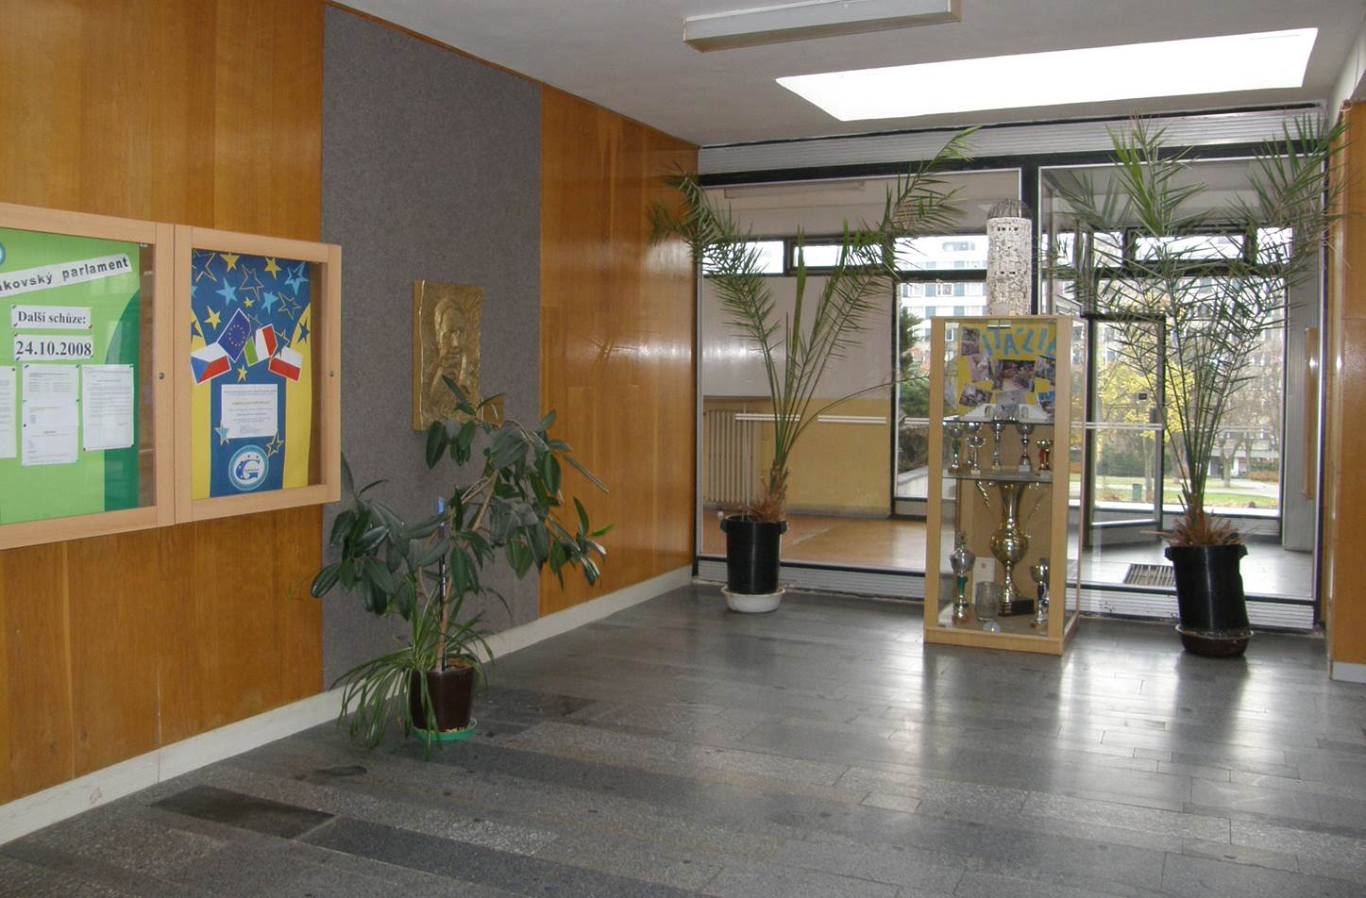
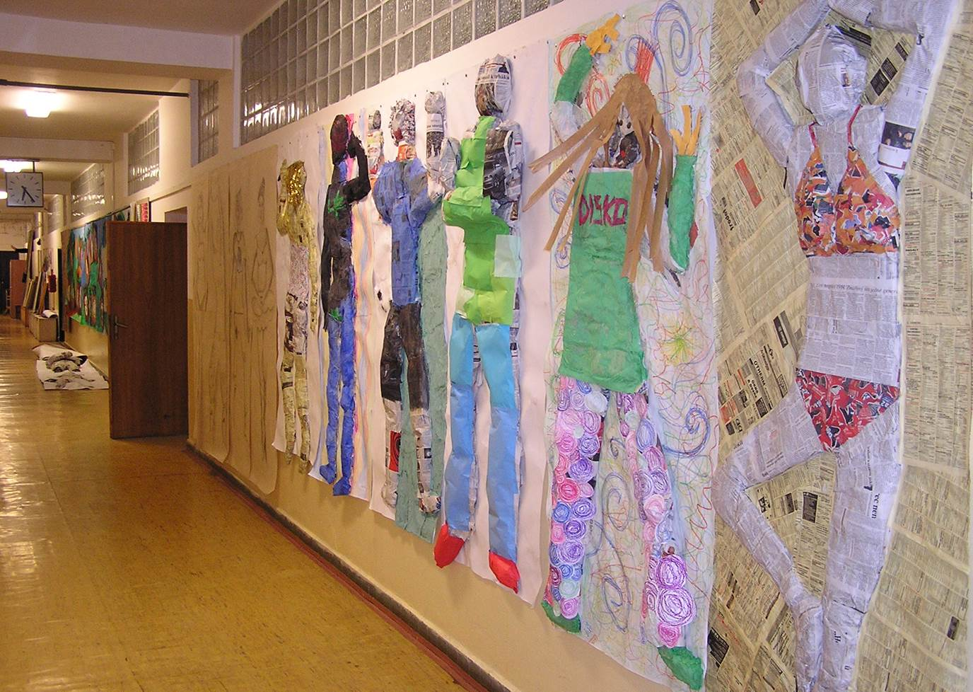
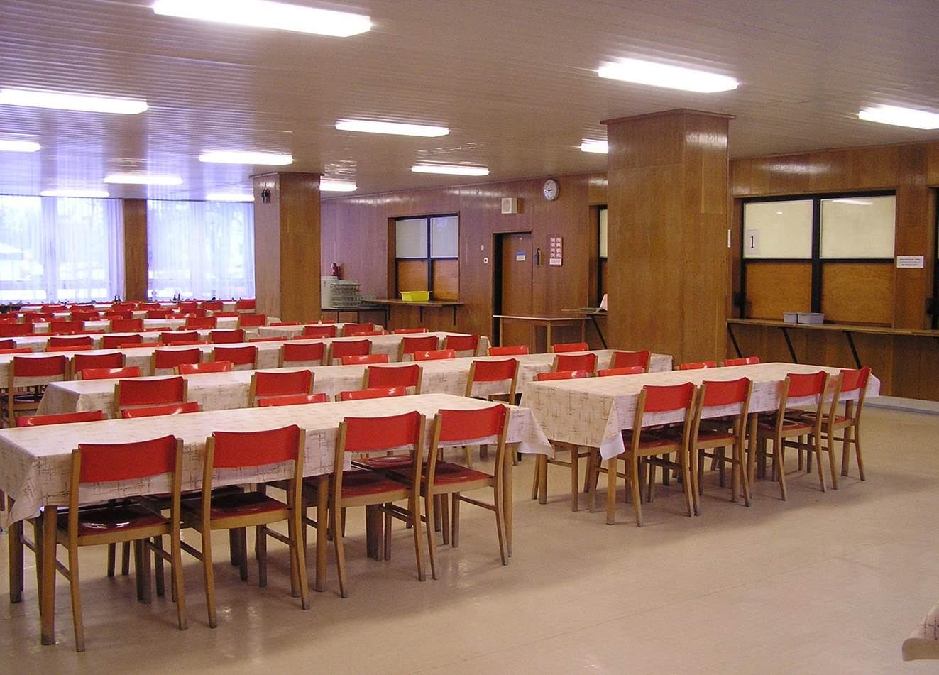
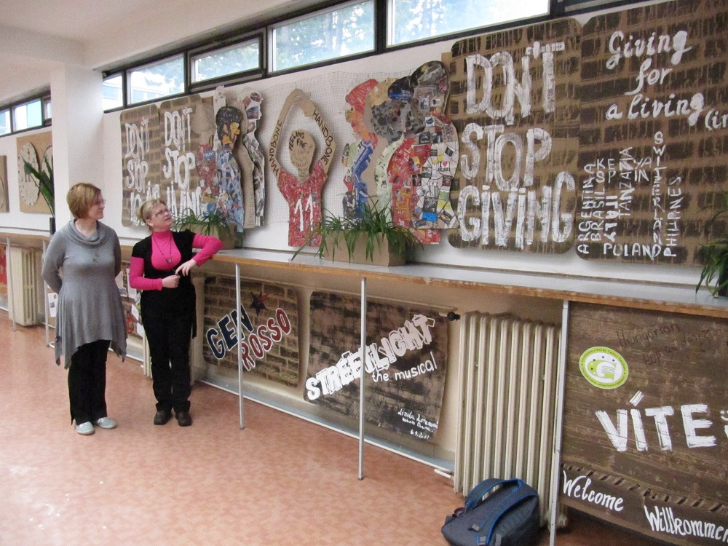
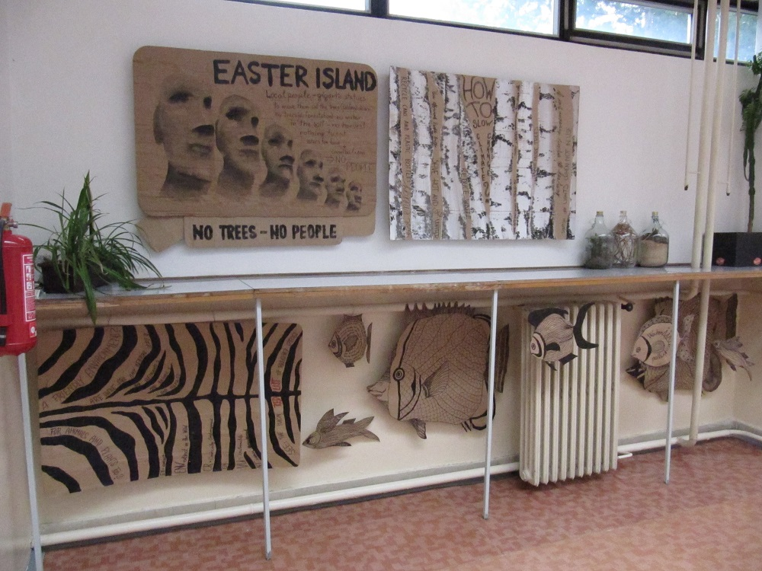
Společné prostory školy

Slide 15
Speciálně vybavené odborné učebny
fyzika
dějepis
biologie
chemie
ICT
chemické laboratoře
cizí jazyky
zeměpis
knihovna
hudební výchova
výtvarná výchova
multimediální učebna

Slide 16
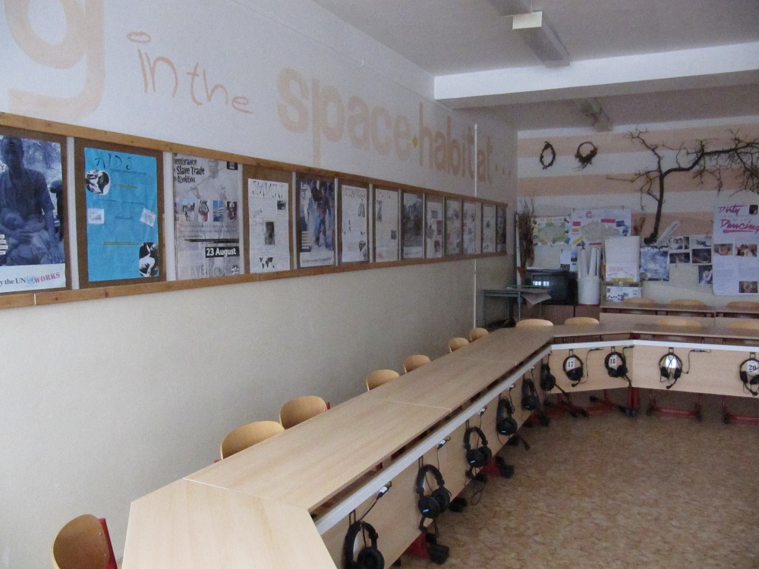
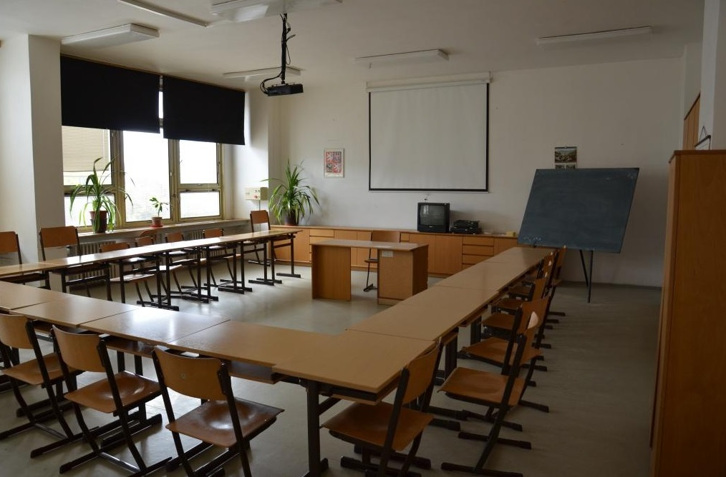
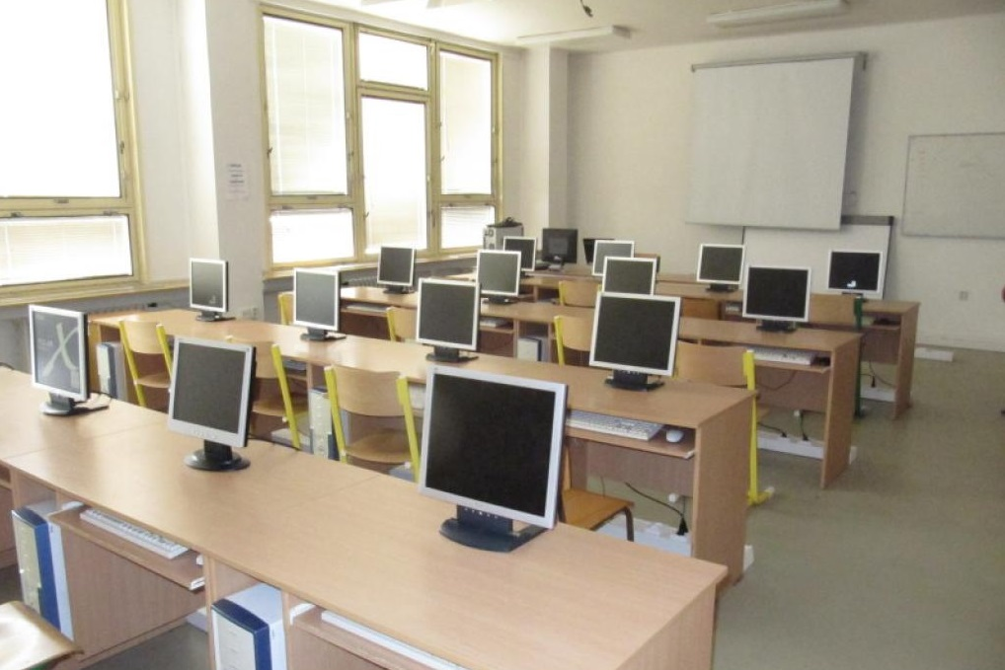
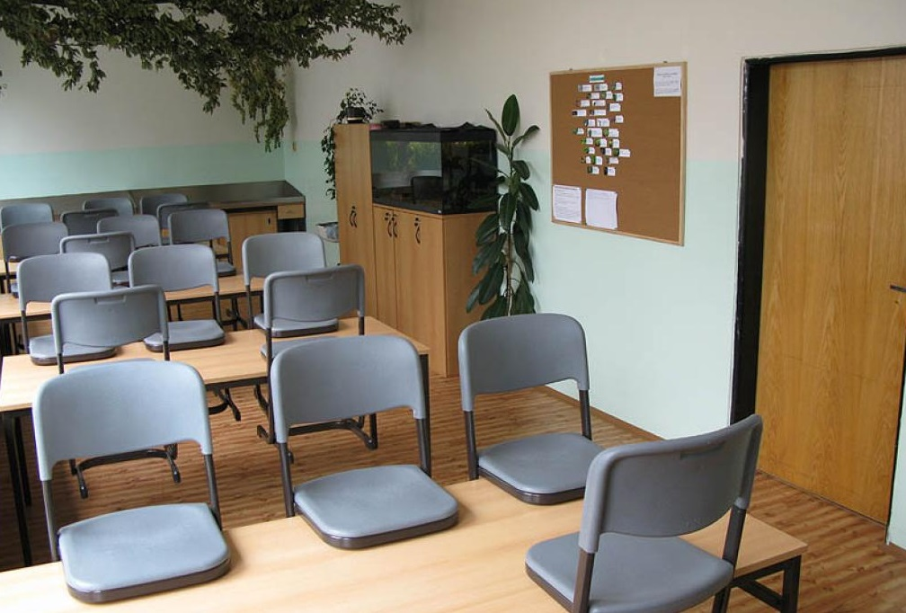
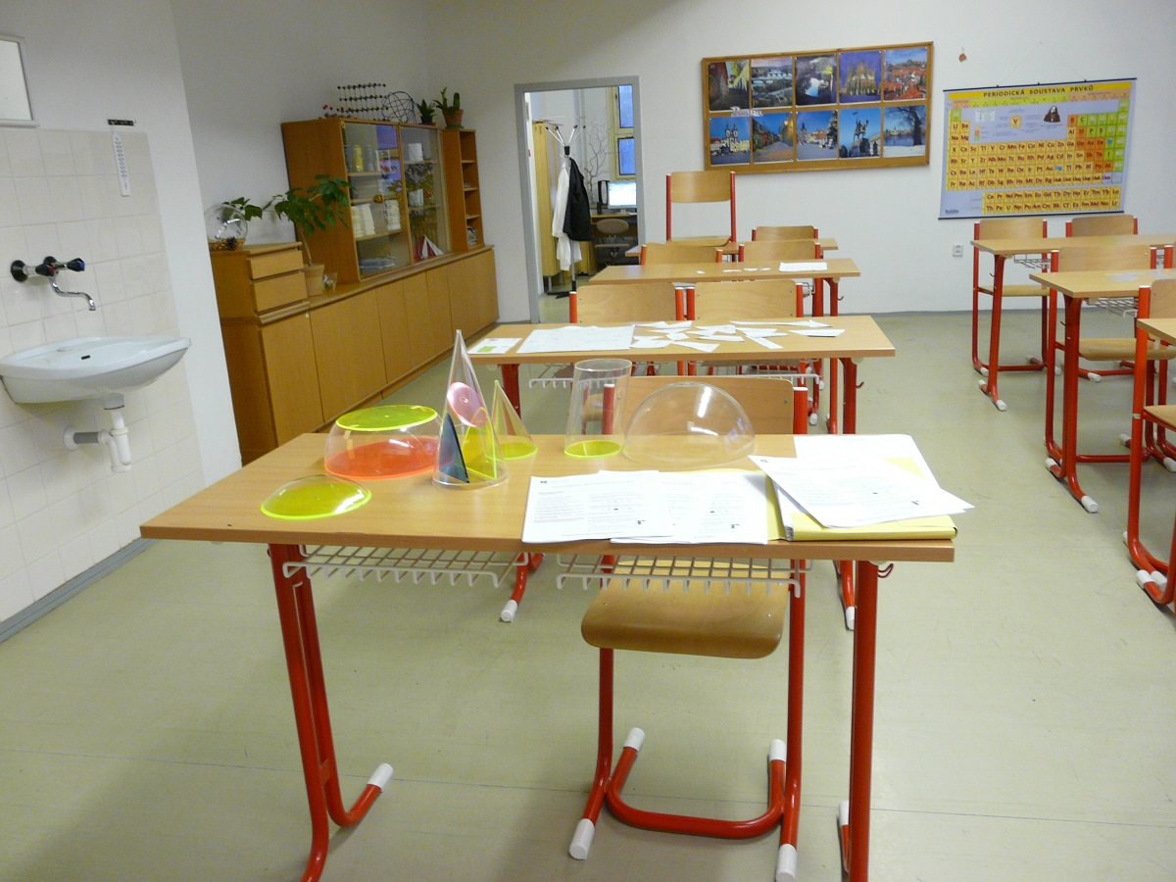

Slide 17
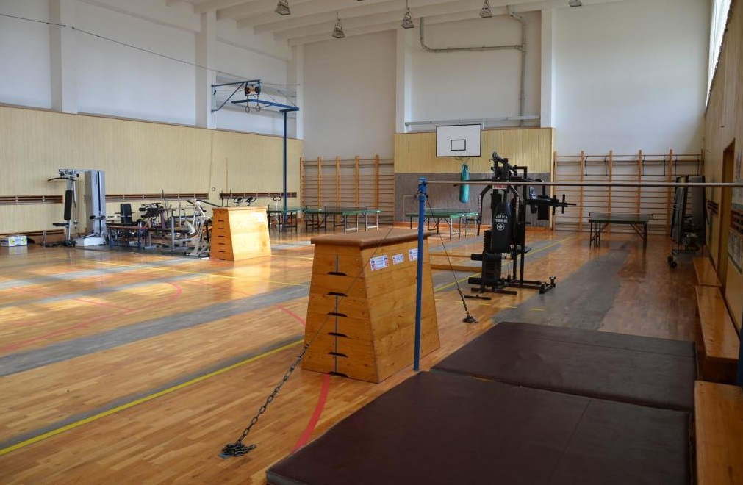
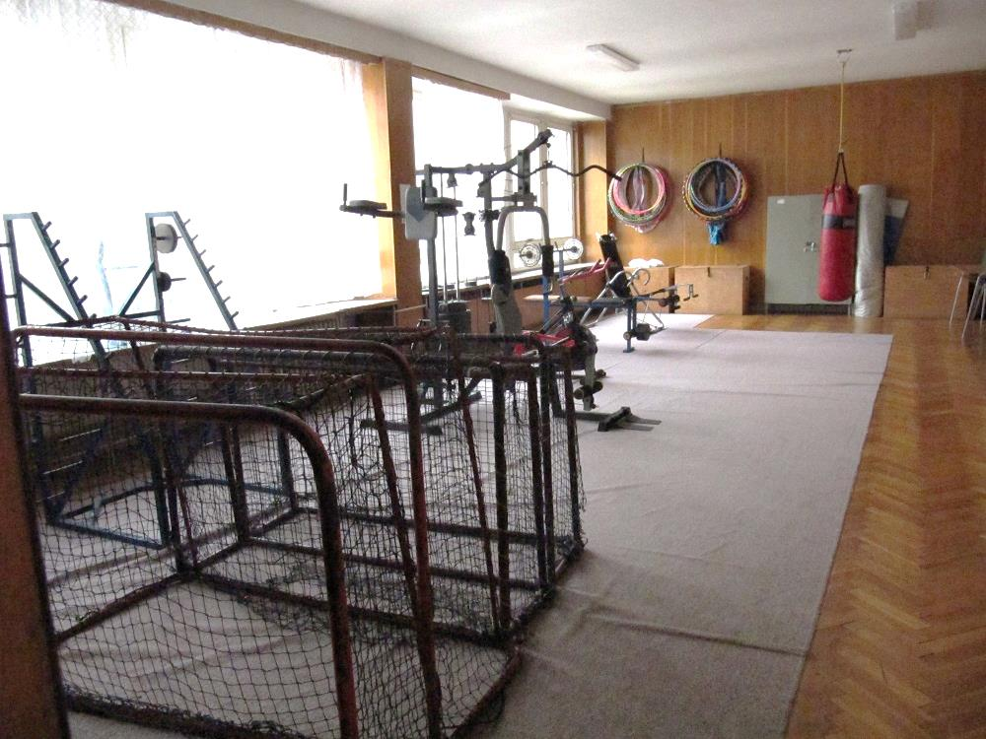
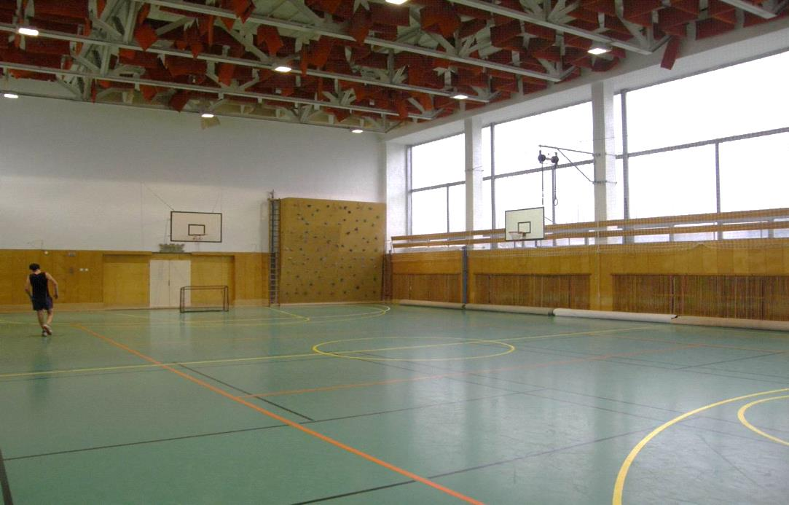
Prostory pro výuku tělesné výchovy
tělocvična/sportovní hala, posilovna

Slide 18
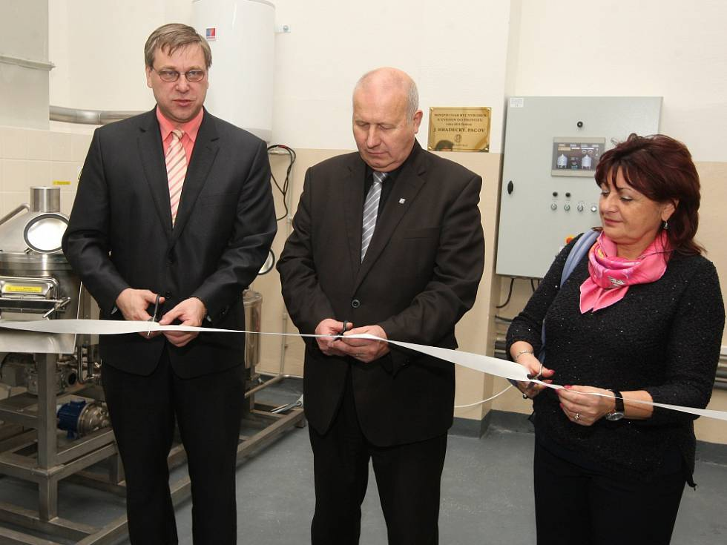
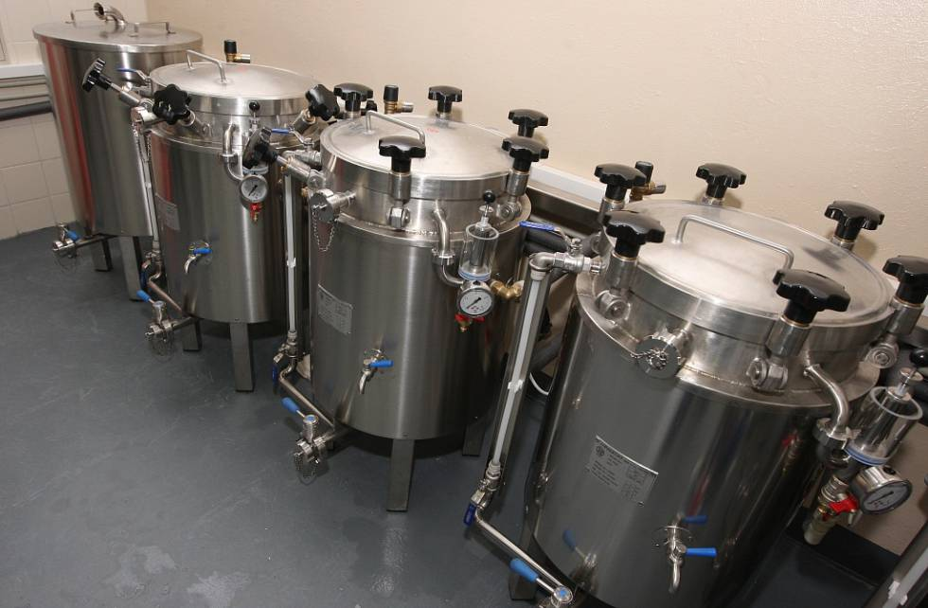
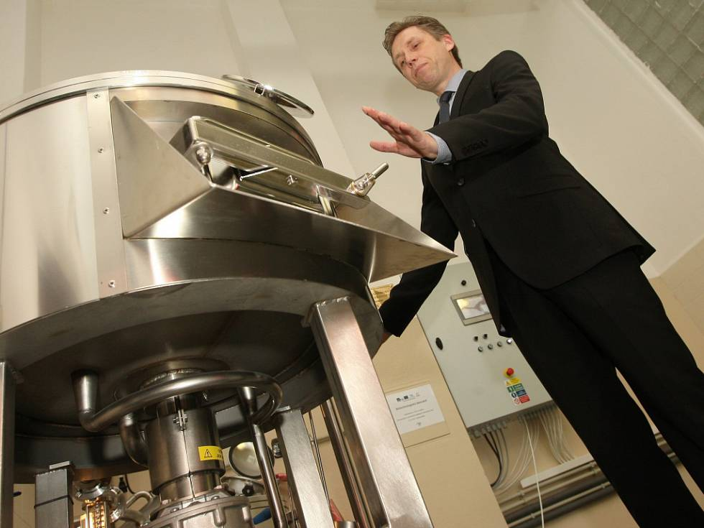
Biotechnologická laboratoř – Školní minipivovar

Slide 19
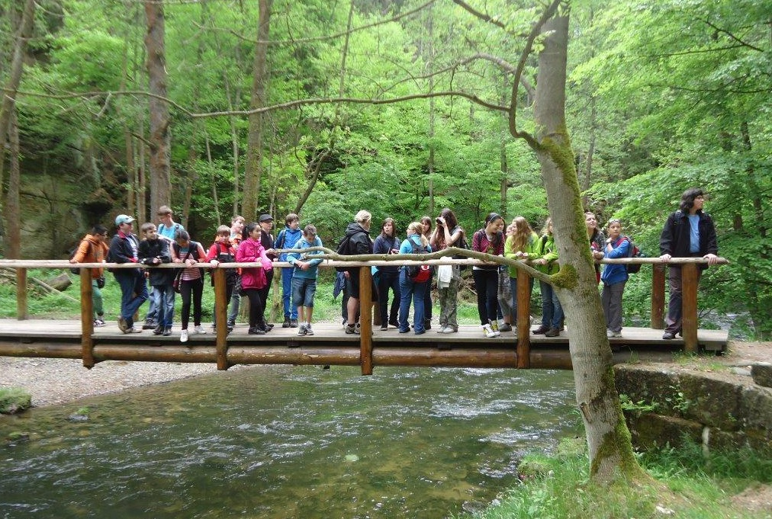
Sportovní kurzy
turistický, vodácký, cyklistický, lyžařský

Slide 20
Specifické akce školy (pravidelné)
studentské dobrovolnické akce,
hudebně-dramatický sbor, muzikály,
maturitní plesy,
taneční pro mentálně postižené,
besídky/akademie (vánoční akademie),
zahraniční exkurze,
tematické/projektové dny,
exkurze,
návštěvy kulturních akcí,
sportovní dny,
škola v přírodě/ozdravné pobyty, výlety.

Slide 21
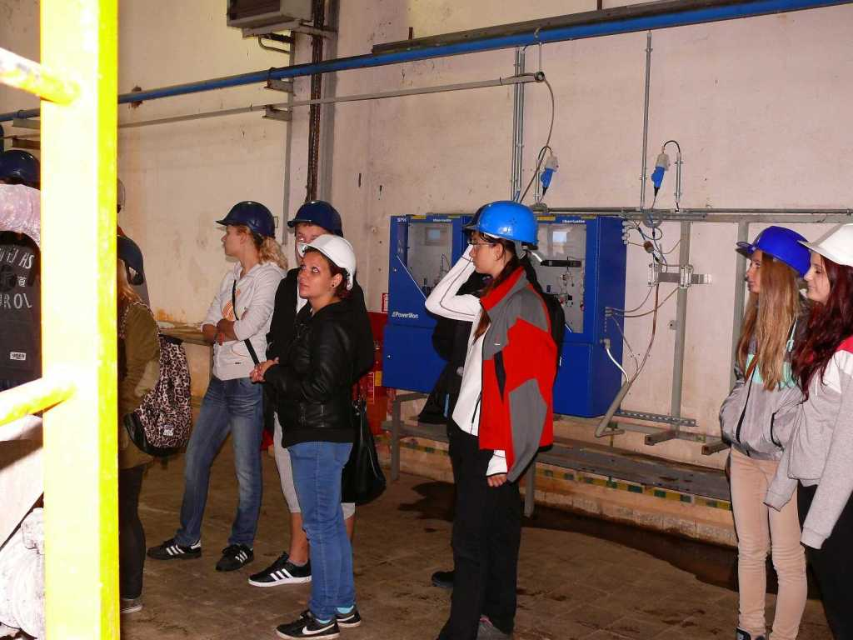
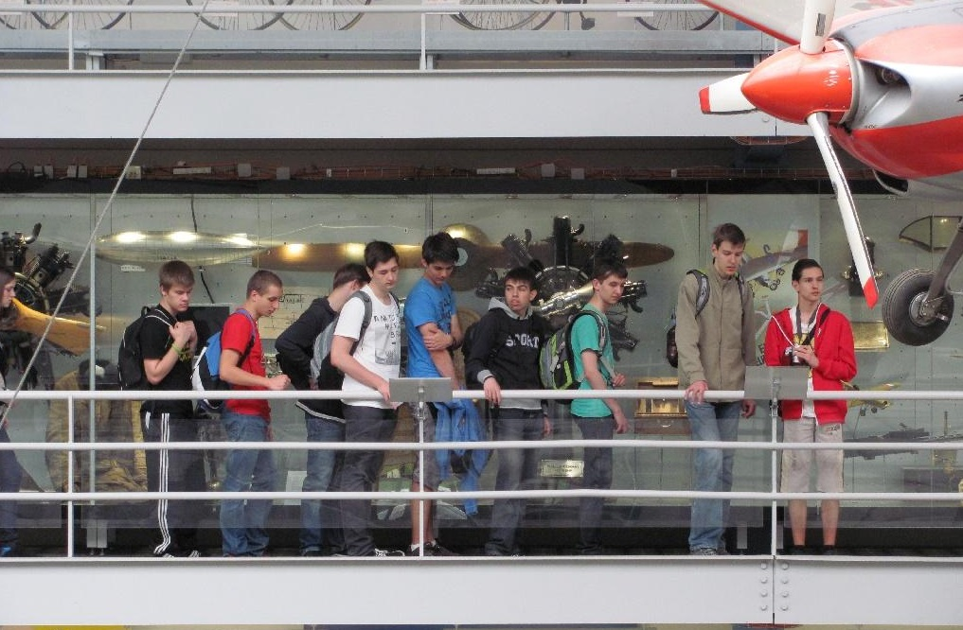
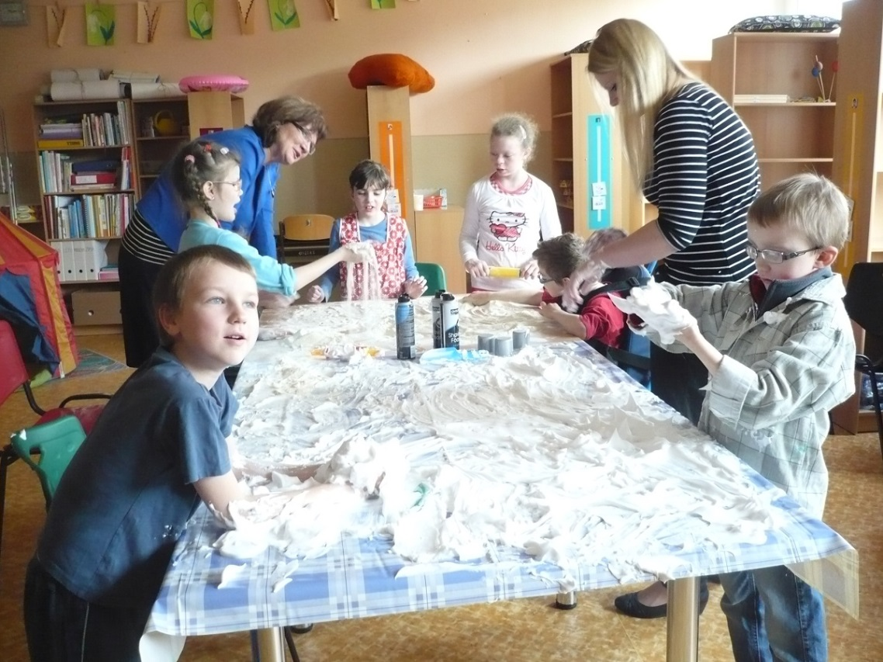

Slide 22
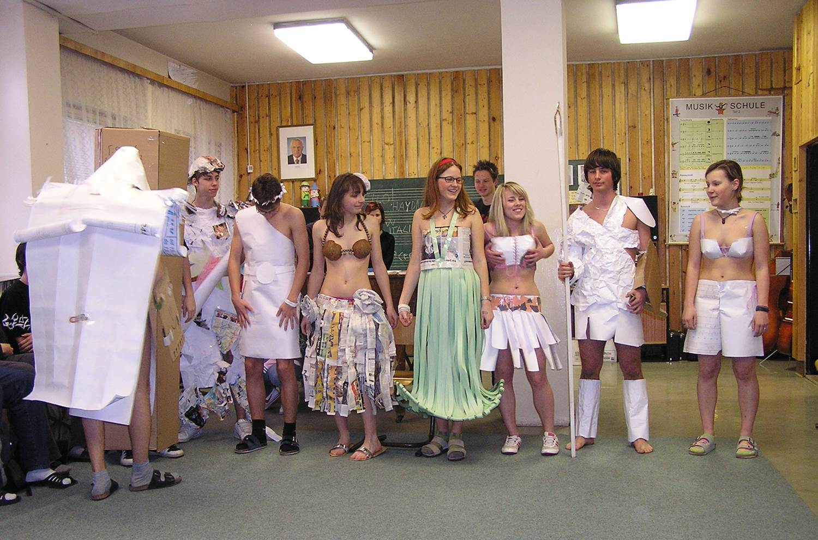
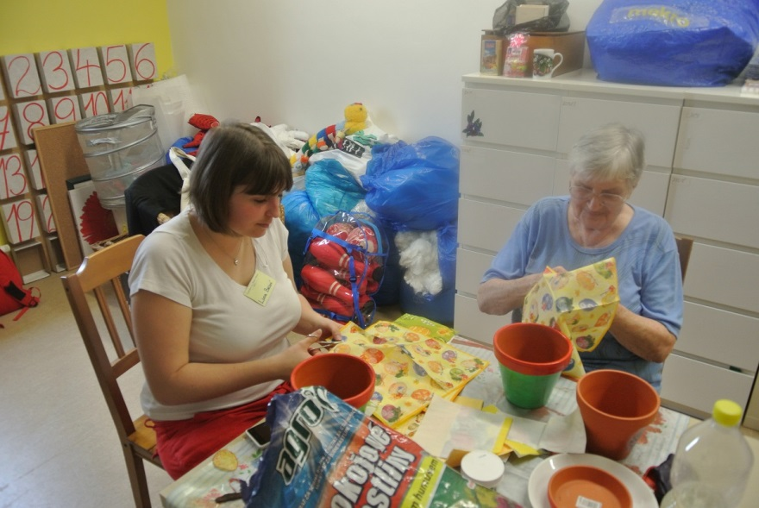
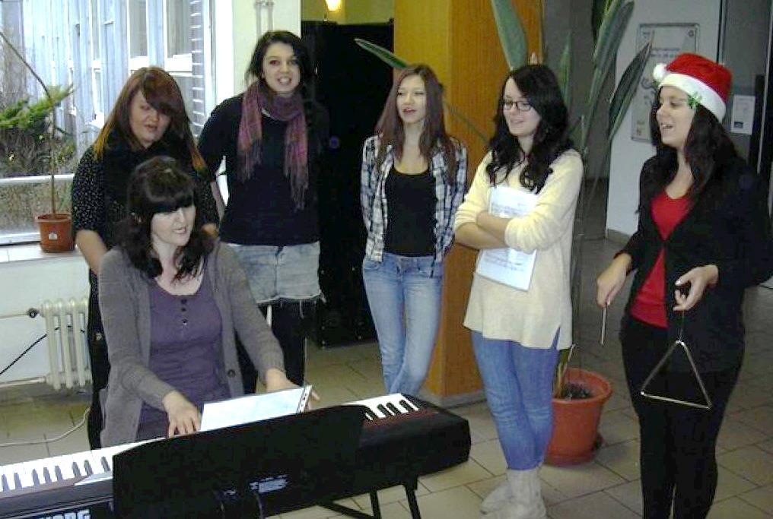
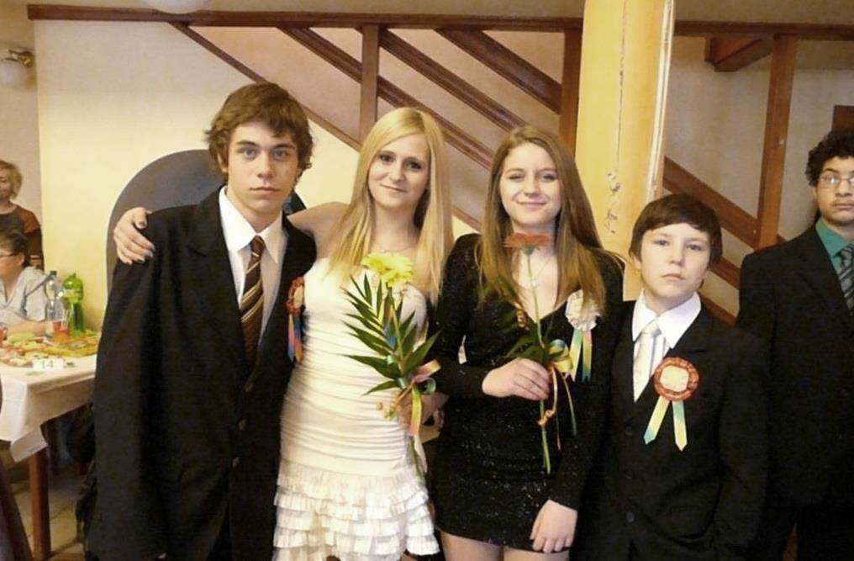
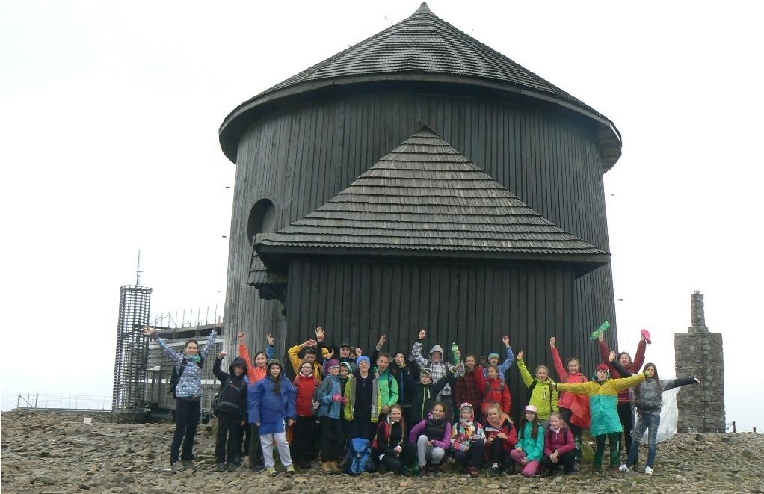

Slide 23
Mezinárodní spolupráce
partnerské školy,
studijní pobyt v zahraničí,
sportovní pobyt v zahraničí,
společné projekty se zahraničním subjektem,
výměnné pobyty.

Slide 24
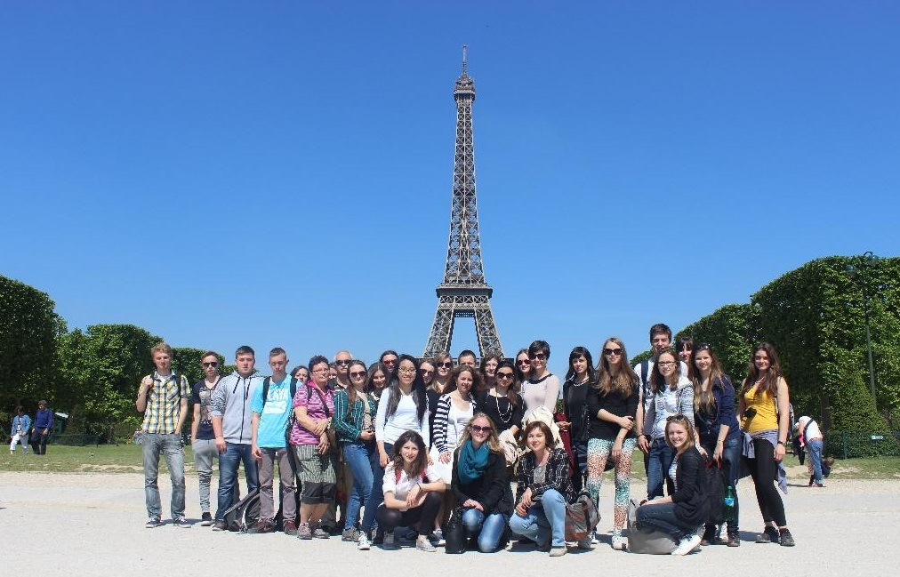
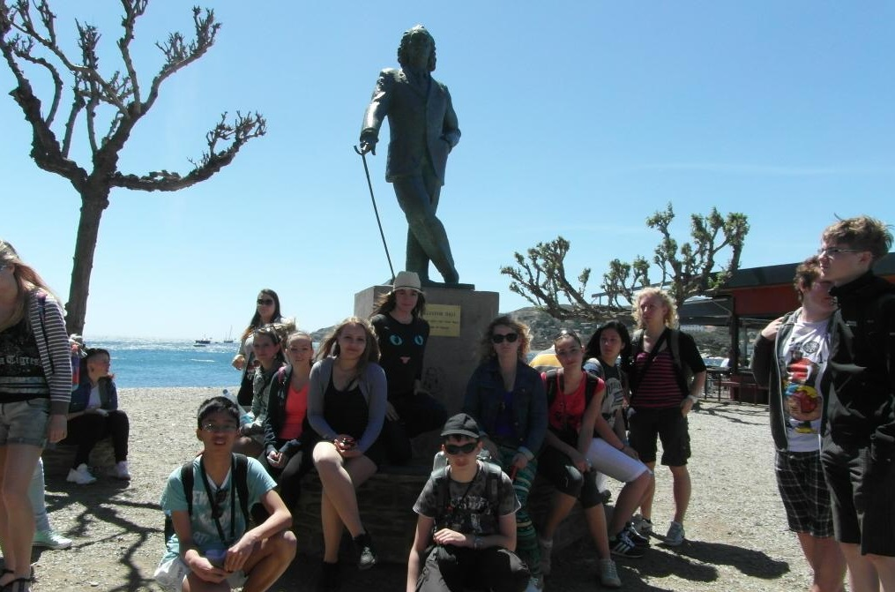
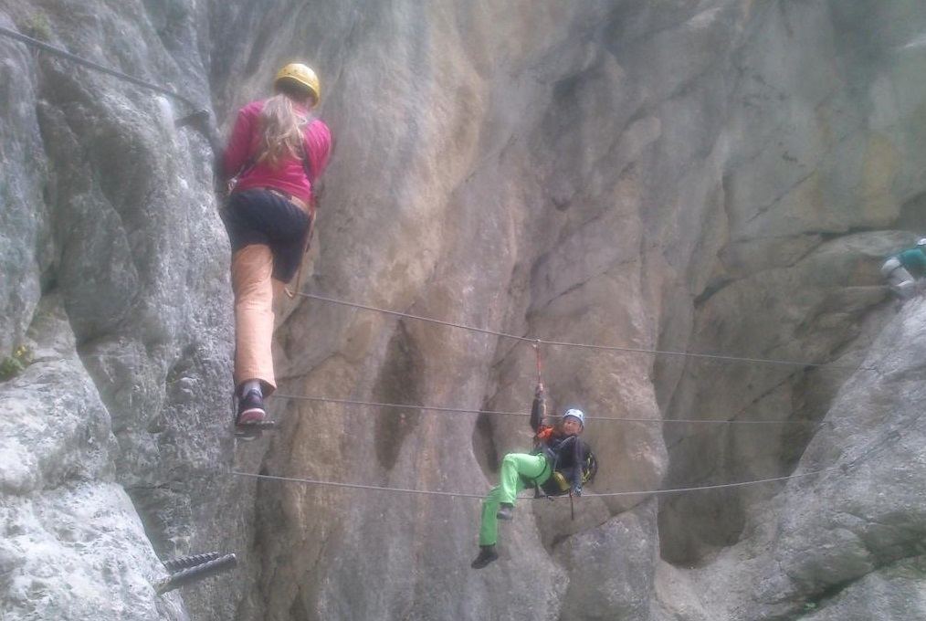
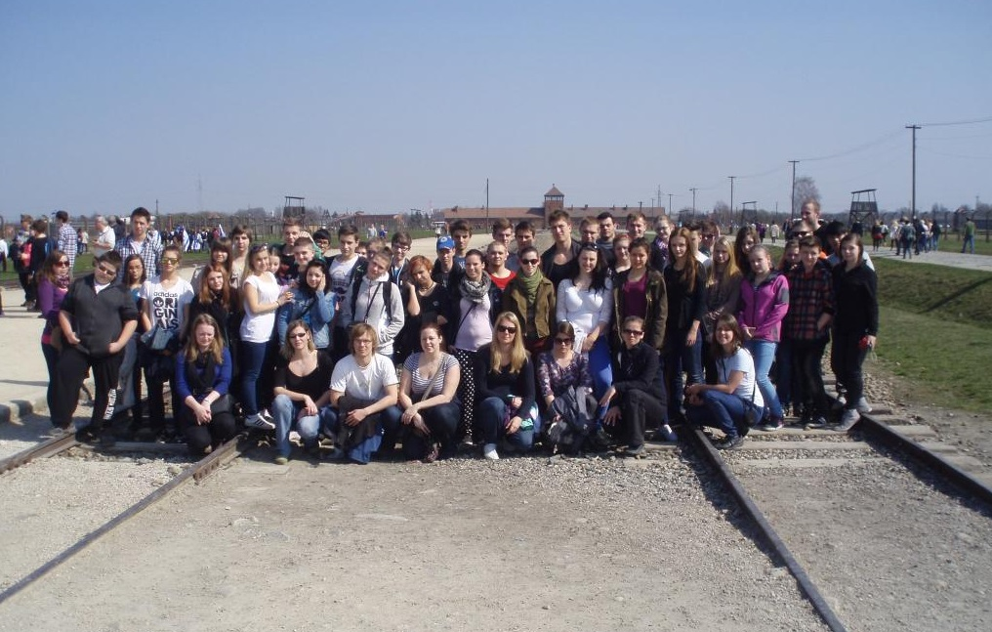

Slide 25
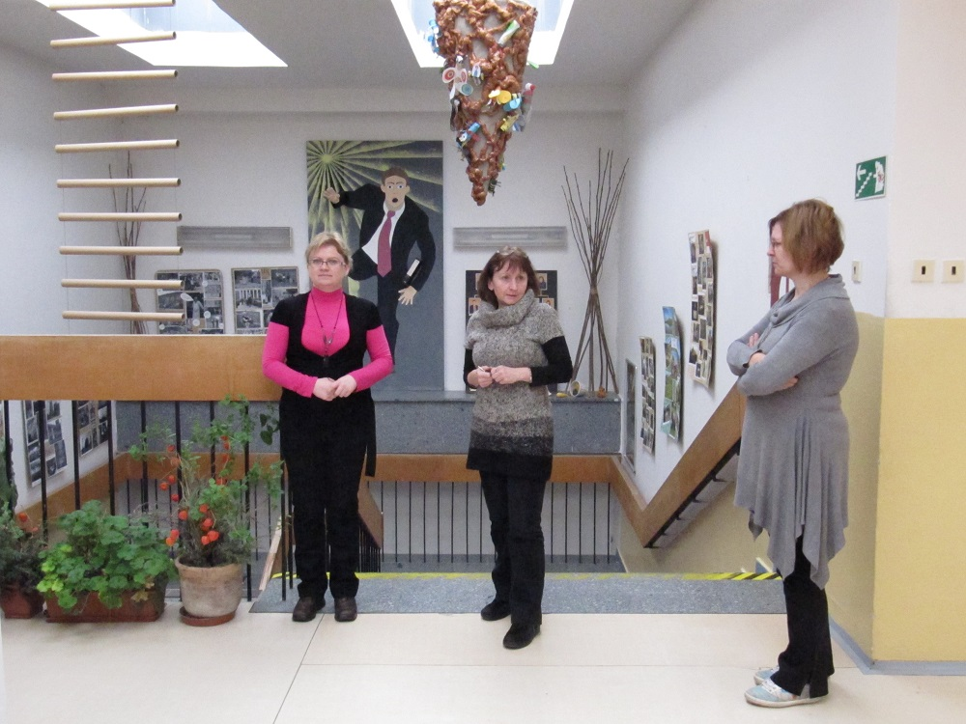
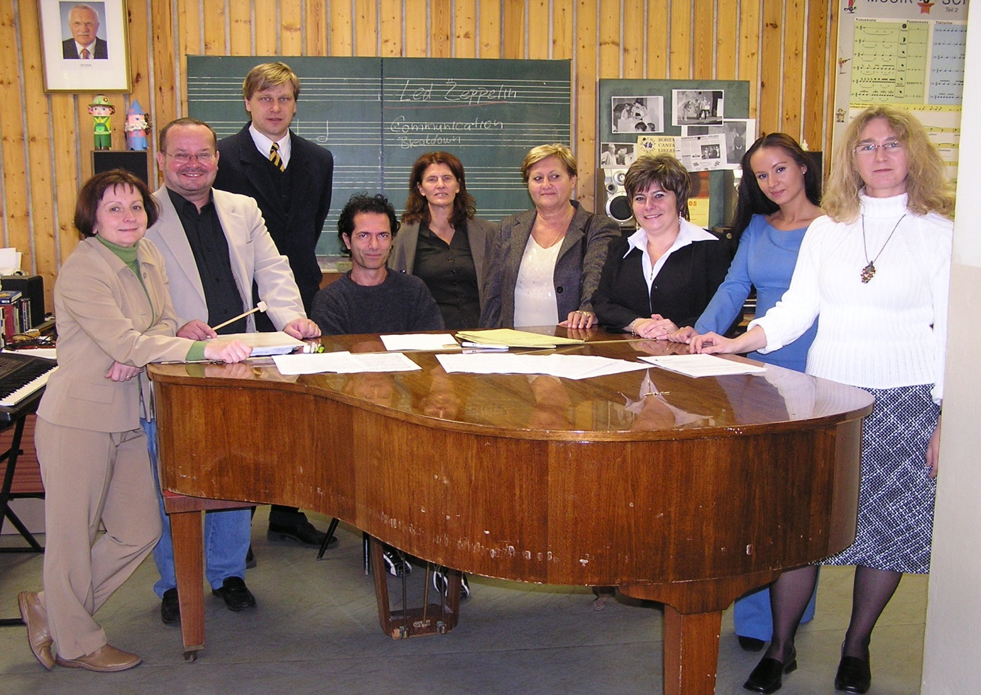
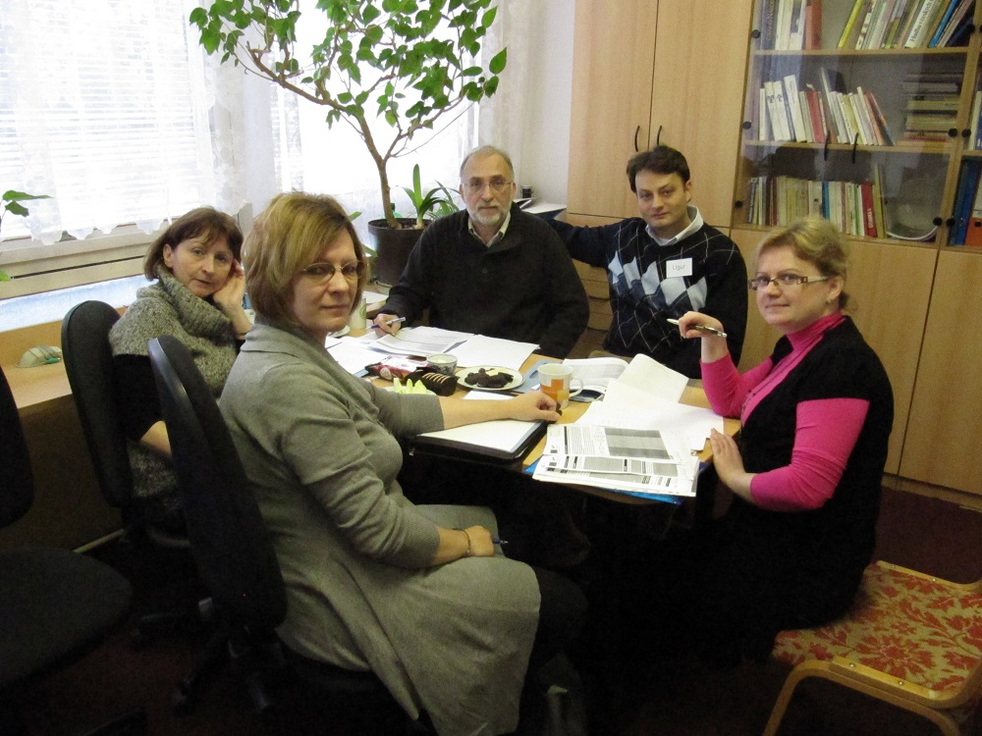
Projekt Comenius

Slide 26
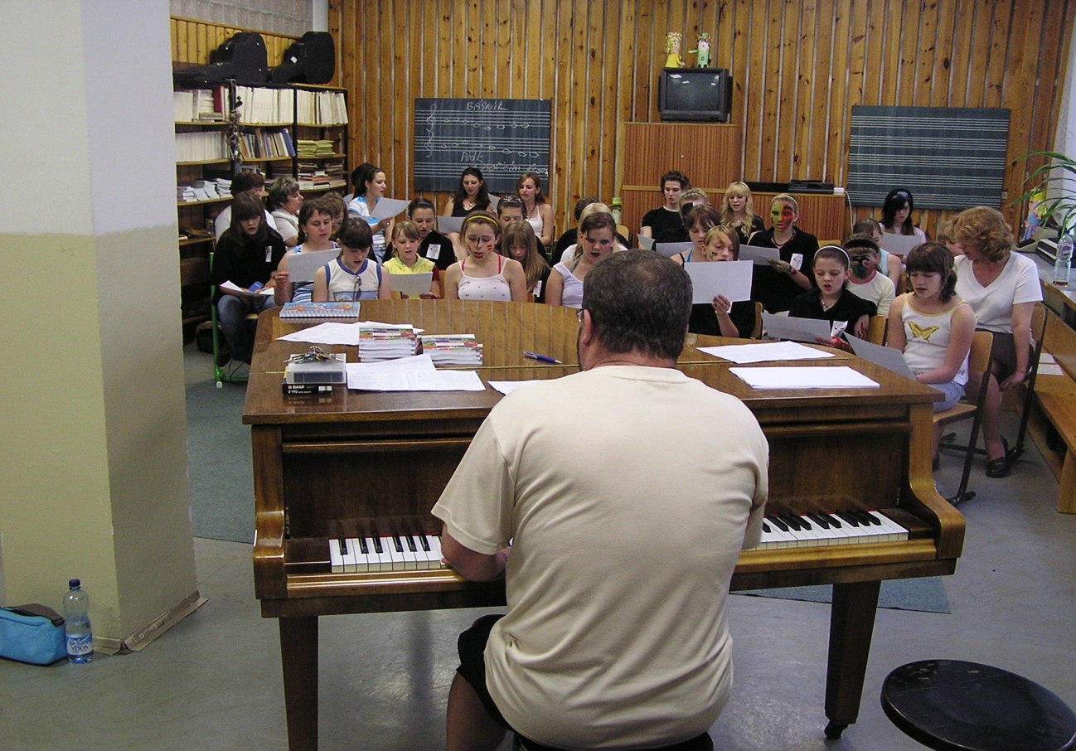
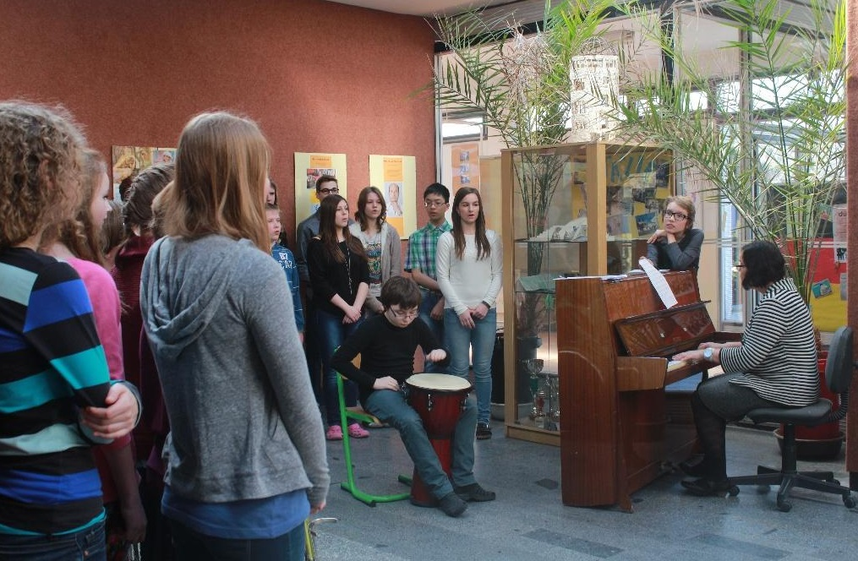
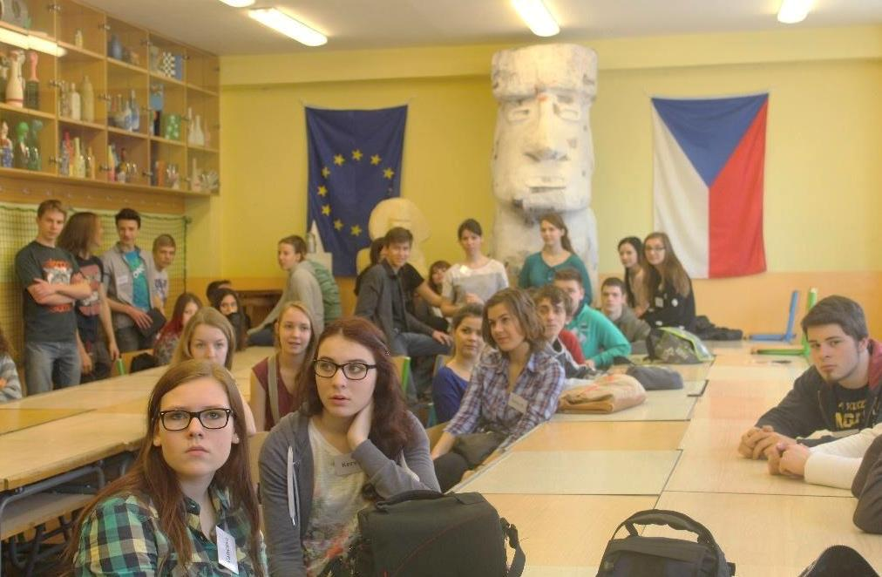

Slide 27
Děkujeme za pozornost.
Notes:
Animated 3-D cube with changing pictures
(Basic)
Tip: This example uses six pictures grouped in four sets of three, so that during the animation, various pictures appear on the cube.
To reproduce the effects on this slide, do the following:
On the Home tab, in the Slides group, click Layout, and then click Blank.
On the Insert tab, in the Illustrations group, click Picture. In the Insert Picture dialog box, select a picture, and then click Insert.
Select the picture. Under Picture Tools, on the Format tab, in the Size group, click the Size and Position dialog box launcher. In the Format Picture dialog box, resize or crop the image so that the height is set to 3.42” and the width is set to 3.42”.
To crop the picture, click Crop in the left pane, and in the Crop pane, under Crop position, enter values into the Height, Width, Left, and Top boxes.
To resize the picture, click Size in the left pane, and in the right pane, under Size and rotate, enter values into the Height and Width boxes.
Under Picture Tools , on the Format tab, in the Picture Styles group, in the bottom right corner click the Format Shape dialog box launcher. In the Format Picture dialog box, in the left pane, click 3-D Format, and then in the 3-D Format pane, under Bevel, in the Top section, do the following:
Click the button next to Top and then select Convex (second row, third from the left)
In the Width box, enter 6 pt.
In the Height box, enter 6 pt.
Also in the Format Shape dialog box, in the left pane, click Line Color, and then in the Line Color pane, do the following:
Click Solid line.
Click the button next to Color, and then click More Colors. In the Colors dialog box, on the Custom tab, enter Red: 8, Green: 18, Blue: 31.
Also in the Format Shape dialog box, in the left pane, click Line Style, and then in the Line Style pane, in Width box, enter 0.75 pt.
To reproduce two additional pictures and the cube, do the following:
Select the picture on the slide. On the Home tab, in the Clipboard group, click the arrow next to Copy, and then click Duplicate. Repeat this step again for a total of three pictures. Position the pictures on the slide so that each one is visible.
Select one of the duplicate pictures. Under Picture Tools, on the Format tab, in the Adjust group, click Change Picture. In the Insert Picture dialog box, select a picture, and then click Insert.
Select the picture. Under Picture Tools, on the Format tab, in the Size group, click the Size and Position dialog box launcher. In the Format Picture dialog box, resize or crop the image so that the height is set to 3.42” and the width is set to 3.42”.
To crop the picture, click Crop in the left pane, and in the Crop pane, under Crop position, enter values into the Height, Width, Left, and Top boxes.
To resize the picture, click Size in the left pane, and in the right pane, under Size and rotate, enter values into the Height and Width boxes.
Repeat steps 1 -3 to reproduce another picture.
Select the picture that will appear on the top of the cube. Under Picture Tools, on the Format tab, in the Picture Styles group, click Picture Effects, point to 3-D Rotation, and then under Parallel, click Off Axis 1 Top (second row, third option from the left).
Select the picture that will appear on the left side of the cube. Under Picture Tools, on the Format tab, in the Picture Styles group, click Picture Effects, point to 3-D Rotation, and then under Parallel, click Off Axis 1 Left (second row, first option from the left).
Select the picture that will appear on the right side of the cube. Under Picture Tools, on the Format tab, in the Picture Styles group, click Picture Effects, point to 3-D Rotation, and then under Parallel, click Off Axis 1 Right (second row, second option from the left).
Drag the pictures on the slide to create a cube. The edges of each picture may not line up exactly. To align the pictures as closely as possible, on the View tab, click Zoom. In the Zoom dialog box, click 400%, and then drag the pictures on the slide. Tip: To help more precisely place the pictures, select the picture that you want to move, then hold down the CTRL key and use the keyboard direction arrow keys.
Press and hold SHIFT and select all three pictures on the slide. On the Home tab, in the Drawing group, click Arrange, and then click Group.
On the Home tab, in the Editing group, click Select, and then click Selection Pane. Edit the name of the group in the Selection and Visibility pane, by double-clicking the group and then entering Cube Group.
To reproduce the shadow effects on this slide, do the following:
On the Home tab, in the Drawing group, click Shapes, and then under Rectangles click Rectangle (first option from the left). On the slide, drag to draw a rectangle.
Select the rectangle. Under Drawing Tools, on the Format tab, in the Size group, do the following:
In the Shape Height box, enter 3.42”.
In the Shape Width box, enter 3.42”.
On the Home tab, in the Drawing group, click the arrow next to Shape Fill, and then under Theme Colors click White, Text 1 (first row, second option from the left).
On the Home tab, in the Drawing group, click the arrow next to Shape Outline, and then click No Outline.
On the Home tab, in the bottom right corner of the Drawing group, click the Format Shape dialog box launcher. In the Format Shape dialog box, click 3-D Rotation in the left pane. In the 3-D Rotation pane, click the button next to Presets, and then under Parallel click Off Axis 1 Top (second row, third option from the left).
Also in the Format Shape dialog box, click Shadow in the left pane, and then do the following in the Shadow pane:
Click the button next to Presets, and then under Perspective click Below (first row, third option from the left).
In the Transparency box, enter 72%.
In the Size box, enter 110%.
In the Blur box, enter 41 pt.
In the Angle box, enter 115°.
In the Distance box, enter 111 pt.
On the Home tab, in the Drawing group, click Arrange, and then click Send to Back.
Drag the rectangle under the cube so that it looks like the cube is floating.
On the Home tab, in the Editing group, click Select, and then click Selection Pane. In the Selection and Visibility pane, press and hold CTRL and select both Cube Group and the rectangle. On the Home tab, in the Drawing group, click Arrange, and then do the following:
Click Group.
Point to Align, and then click Align to Slide.
Point to Align, and then click Align Center.
Point to Align, and then click Align Middle.
To reproduce the animation effects on this slide, do the following:
Select the cube. On the Home tab, in the Drawing group, Clipboard group, click the arrow next to Copy, and then click Duplicate.
Click one of the pictures in the new group of pictures and under Picture Tools, on the Format tab, in the group, click Change Picture. In the Insert Picture dialog box, select another picture and click Insert. If necessary resize the picture – under Picture Tools, on the Format tab, in the Size group, click the Size and Position dialog box launcher. In the Format Picture dialog box, resize or crop the image so that the height is set to 3.42” and the width is set to 3.42”.
To crop the picture, click Crop in the left pane, and in the Crop pane, under Crop position, enter values into the Height, Width, Left, and Top boxes.
To resize the picture, click Size in the left pane, and in the right pane, under Size and rotate, enter values into the Height and Width boxes.
Right-click another picture in the new group of pictures and repeat step 2. Note: If necessary, reposition the new pictures so they form a cube.
Select the second cube. On the Animations tab, in the Animations group gallery of animation effects, under Entrance, click Fade.
In the Animation Pane, click the arrow next to the animation, and then click Timing. In the Fade dialog box, on the Timing tab, in the Delay box, enter 0.5 seconds, and then click OK.
Select both cubes. On the Home tab, in the Drawing group, click the arrow below Arrange, and under Position Objects, point to Align, and do the following:
Select Align Center.
Select Align Middle.
Repeat steps 1 through 6 two more times to reproduce the third and fourth cube, which improves the animation effect.
To reproduce the background effects on this slide, do the following:
On the Design tab, in the Background group, click Background Styles, and then select Style 8 (second row, fourth from the left).
Note: If this action is taken in a PowerPoint presentation containing more than one slide, the background style will be applied to all of the slides.

